Slide 1
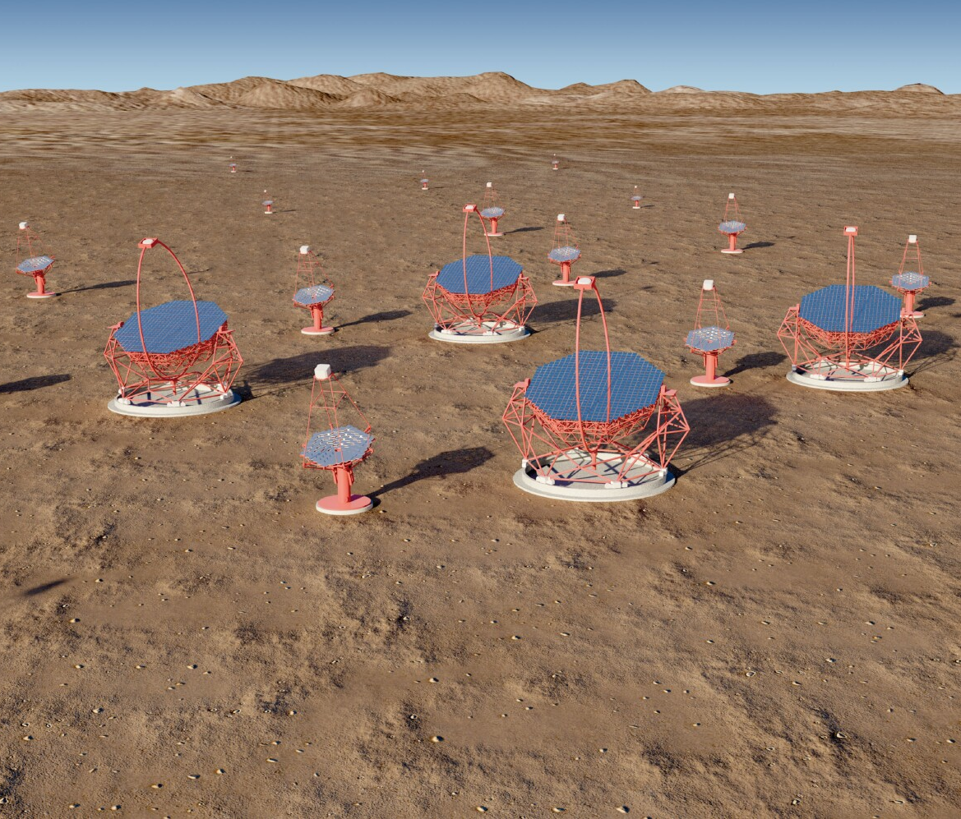
The Gamma-ray Cherenkov
Telescope for CTA
Introduction.
Cherenkov radiation from air showers.
The CTA concept.
Evolution of imaging atmospheric Cherenkov telescopes.
The SSTs and the development of the Gamma-ray Cherenkov Telescope.
Next steps for the GCT.
Summary.
Tim Greenshaw, Liverpool University
Notes:
The Cherenkov Telescope Array (CTA) is the next generation observatory for ground-based gamma-ray astronomy. Current instruments (HESS, MAGIC and VERITAS) have made huge progress in the observation of cosmic sources of photons in the ~ 50 GeV to ~ 50 TeV energy range using Imaging Atmospheric Cherenkov Telescopes (IACTs). CTA will extend the range of these observations at both low and high energies, will improve their sensitivity by a factor of about 10 and will increase the precision of photon energy and direction measurements. This talk presents briefly the designs of the 23 m, 12 m and 4 m diameter IACTs that CTA will use to achieve this performance, before discussing the impact the array will have on studies of Fundamental and Astroparticle Physics. Topics covered include: searches for Dark Matter (DM) and axion-like particles (ALPs); studies of possible violation of Lorentz invariance; and studies of the sources and acceleration mechanisms of high energy cosmic rays.
Remember the Ellis/White paper.
Include EBL studies.

Slide 2
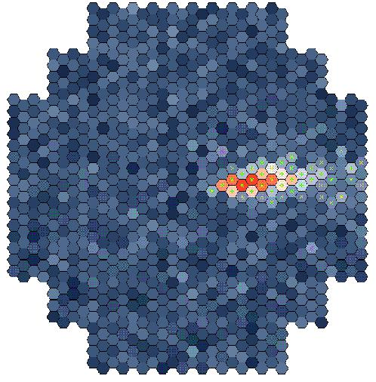
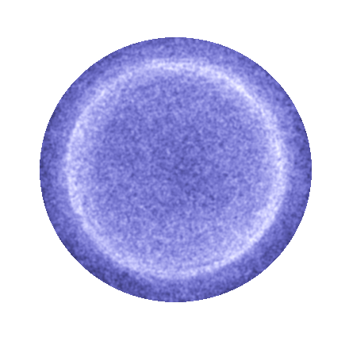
Detecting high energy γ rays
γ
e⁺
e⁻
VHE γ causes EM
shower with max.
at alt. ~ 10 km.
Cherenkov angle ~ 1°:
get ~ 10 ns light flash
on ground with radius ~ 120 m.
Detect with camera made of PMs.
cos θ = 1/n, light cone angle about 1° in air.
Primary γ ray
~ 10 km
×
~ 120 m
2

Slide 3
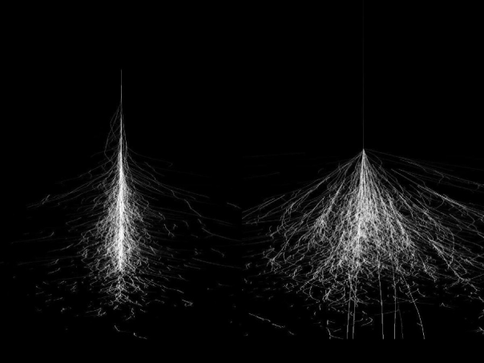
Detecting high energy γ rays
Cherenkov emission, attenuation in air, QE of photomultiplier lead to:
  About 1 p.e./m² in few ns for (frequent) 100 GeV γ-ray.
  About 10³ p.e./m² in few 10 to 100 ns for (infreq.) 10 TeV γ-ray.
Limitations:
  E < 100 GeV, Night Sky Background.
  E ~ 0.1...5 TeV, Cosmic Rays (need γ/h sep).
  E > 5 TeV, rate.
Array of telescopes with different sizes copes best with these different regions.
3

Slide 4
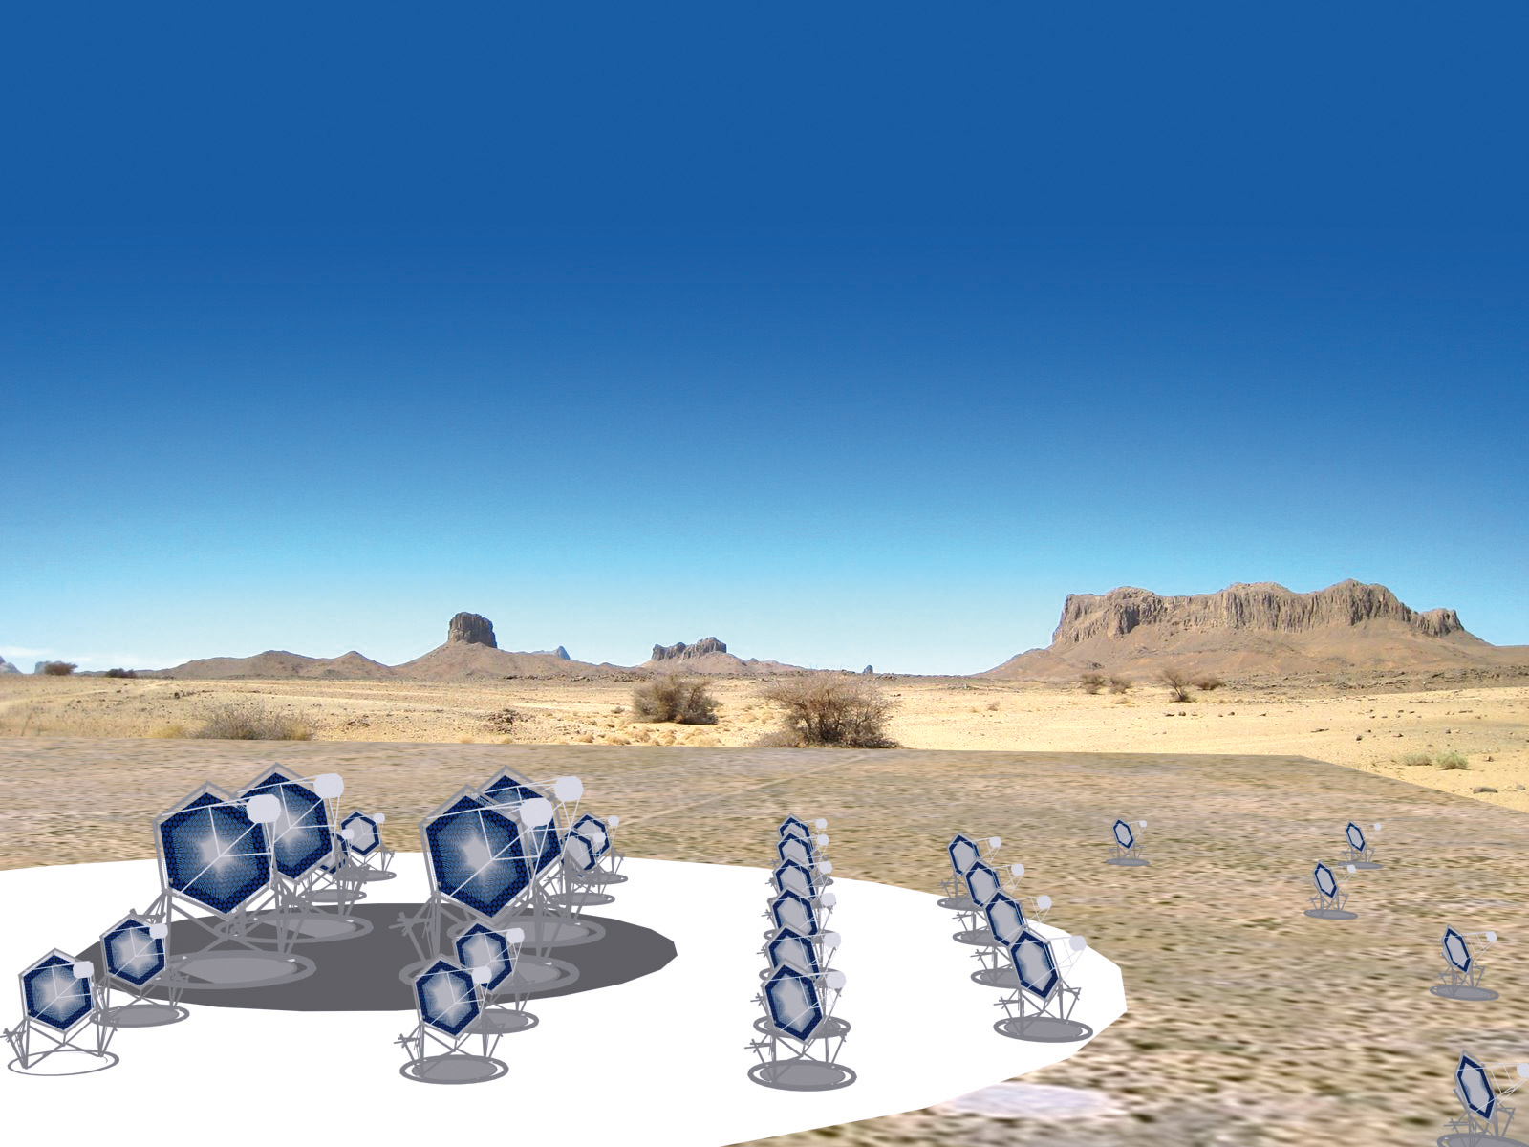
The Cherenkov Telescope Array concept
Low energy
Four 23 m telescopes
4.5º FoV
~2000 pixels
~ 0.1º
Medium energy
About twenty-five 12 m telescopes
8º FoV
~2000 pixels
~ 0.18º
High energy
About seventy 4 m telescopes
9º FoV
1000…2000 pixels
~ 0.17º…0.23º

Slide 5
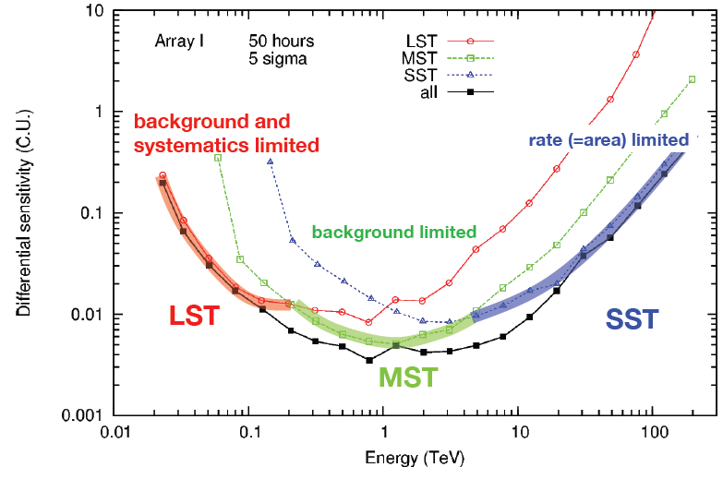
CTA sensitivity
Differential sensitivity (C.U.)
5

Slide 6
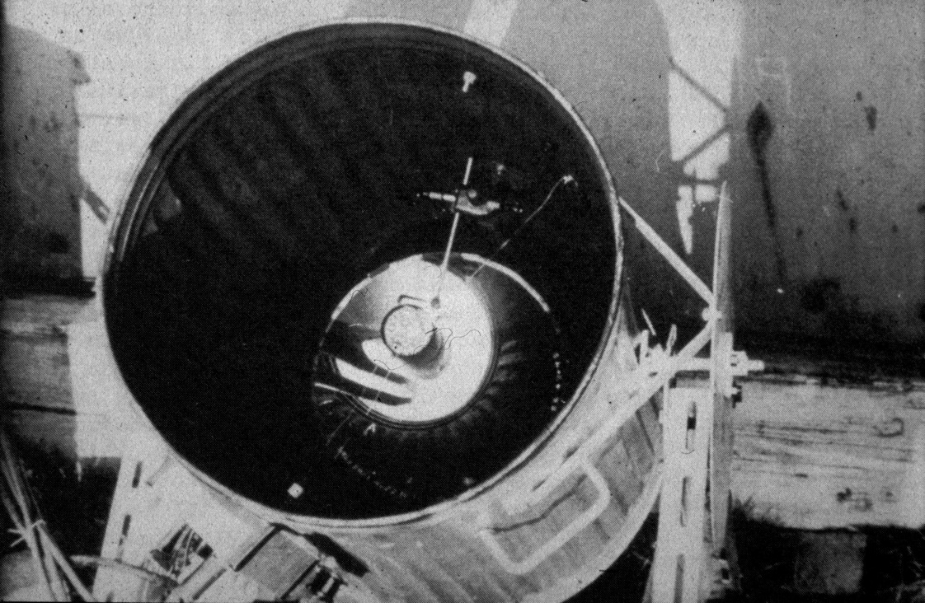
The first Atmospheric Cherenkov Telescope
Galbraith and Jelley, Harwell, 1953.
6

Slide 7
The first dual mirror ACT?
An early “dual mirror” gamma ray telescope, Porter and Jelley, Glencullen (Ireland), 1962.
Gun mount and searchlight mirrors from WWII.
7

Slide 8
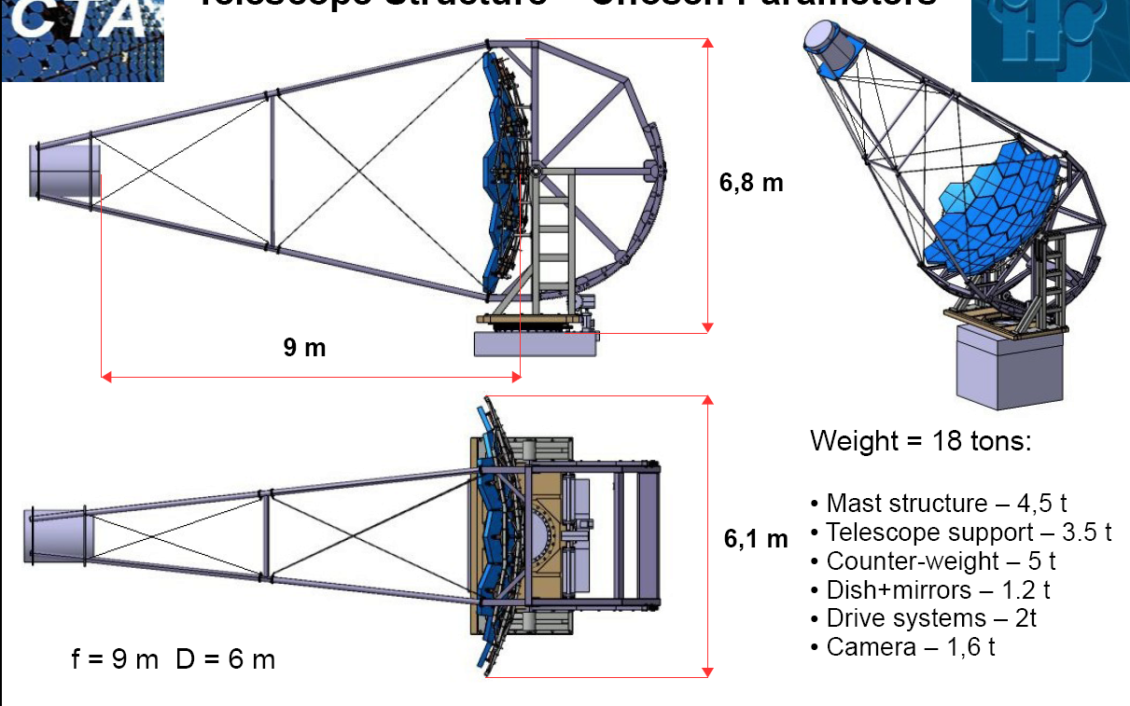
The SSTs – take one
Davies-Cotton 7 m telescope designed for CTA.
This is a viable solution for the SST.
But, the camera:
  Has a diameter of about 1.6 m.
  Weighs about 2 tonnes.
  Is expensive, in no small part because of the price of the PMTs.
The cost of the camera dominates that of the telescope.
Making it cheaper would allow the construction of more telescopes and hence improve CTA performance.
8

Slide 9
The SSTs – take two
Can we use cheaper sensors (e.g. SiPMs) in a compact camera?
Must have F ~ 2 m so ~ 6 × 6 mm² pixels commercially available match required angular resolution of ~ 0.2°.
Need reasonable area, D > 3 m, hence “fast” focal ratio (f = F/D small).
Primary aberrations:
  Spherical ~ 1/f³.
  Coma (1st order) ~ δ/f².
Require sophisticated optics to correct for aberrations at large field angles.
Look at two-mirror telescope designs, c.f. 9 m dual mirror telescope originally proposed by Vassiliev for AGIS.
9

Slide 10
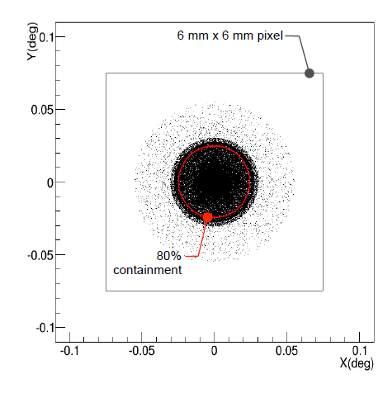
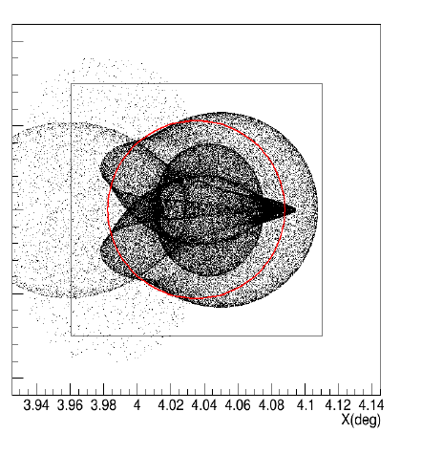
Gamma-ray Cherenkov Telescope optics
Design (Liverpool, Durham 2010):
Images of point source at infinity:
For field angles below about 5°, over 80% of the light from a point source at infinity (or at 10 km with refocusing) is contained in a 6 × 6 mm² pixel.
δ = 0°
δ = 4°
10

Slide 11
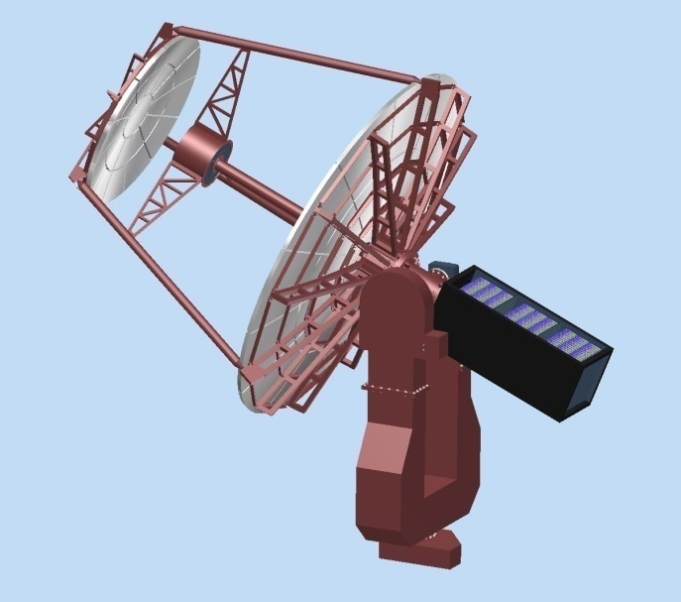
Mechanical design
Durham 2011.
Long fork.
Central tube supports camera.
Tripod supports secondary mirror
Electronics in counterweight.
Aluminium structure.
Paris, 2012.
Short fork.
Primary dish
support
separated from
secondary
support.
Camera
attached to
secondary.
Shaped
counterweight.
Steel structure,
aluminium mirrors.
11

Slide 12
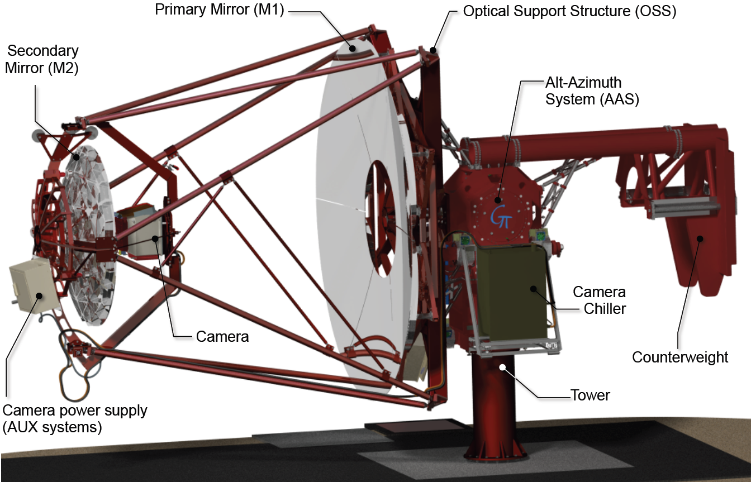
Mechanical design
Paris 2015.
Four masts to
support secondary.
Same motors on both axes.
Primary mirror rotation mechanism to facilitate mirror installation.
Camera removal mechanism.
12

Slide 13
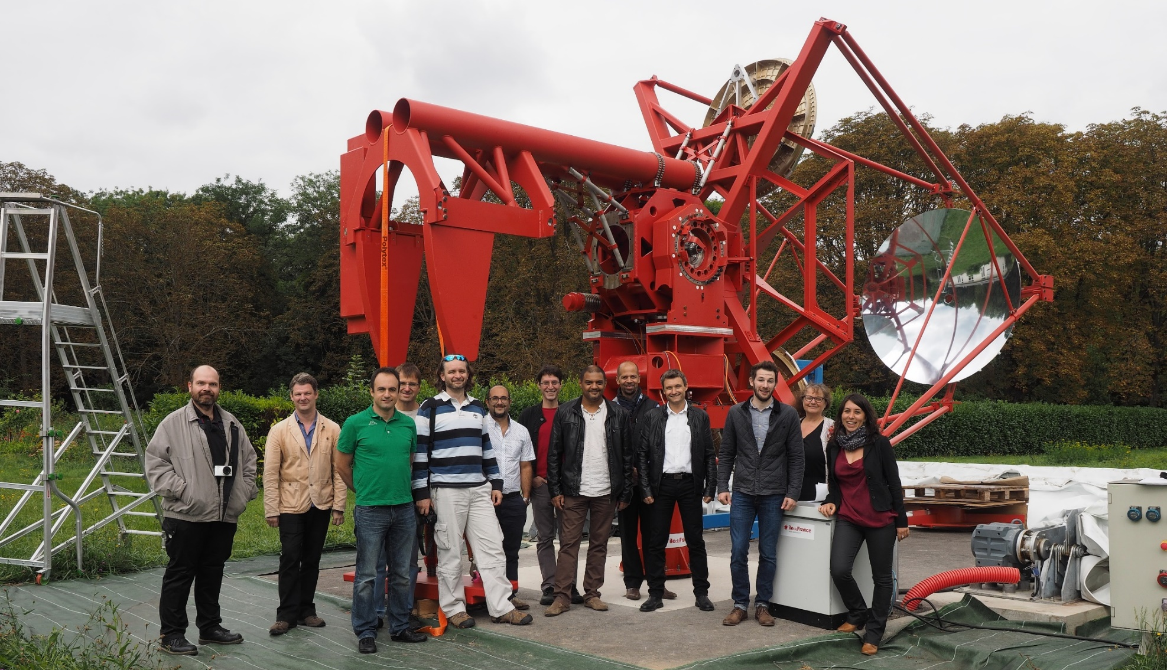
Mechanical structure
Prototype structure assembled in April, visited by ESO team in September.
13

Slide 14
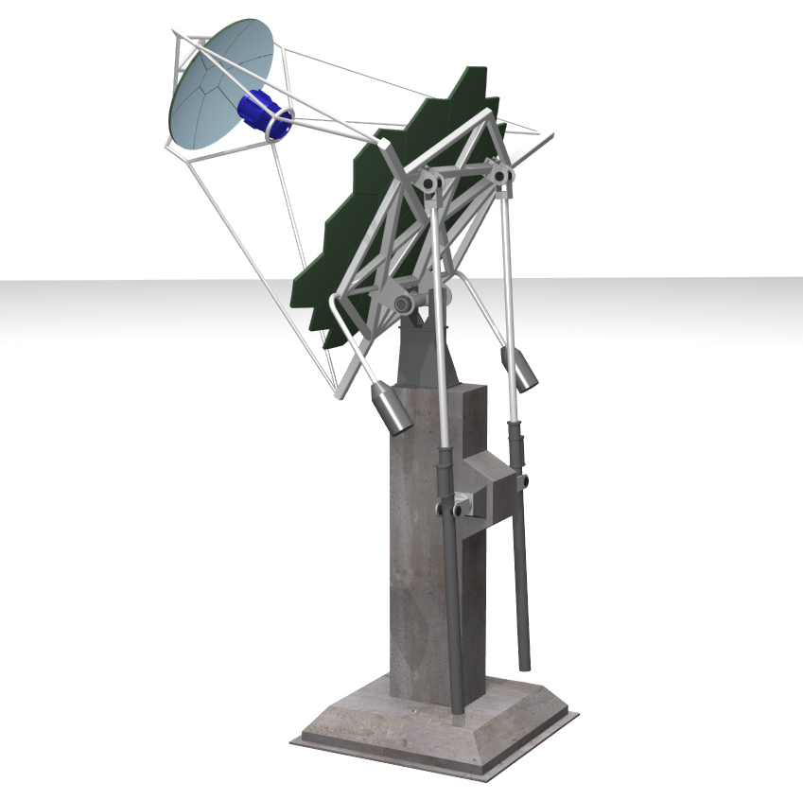
Dual Mirror – alternative Italian design
Primary mirror with sector panels
Secondary mirror
Camera
M1 dish
Mast structure
Elevation universal joint
(Cardan joint)
Counterweight
Worm drive
Concrete pedestal and foundation
14

Slide 15
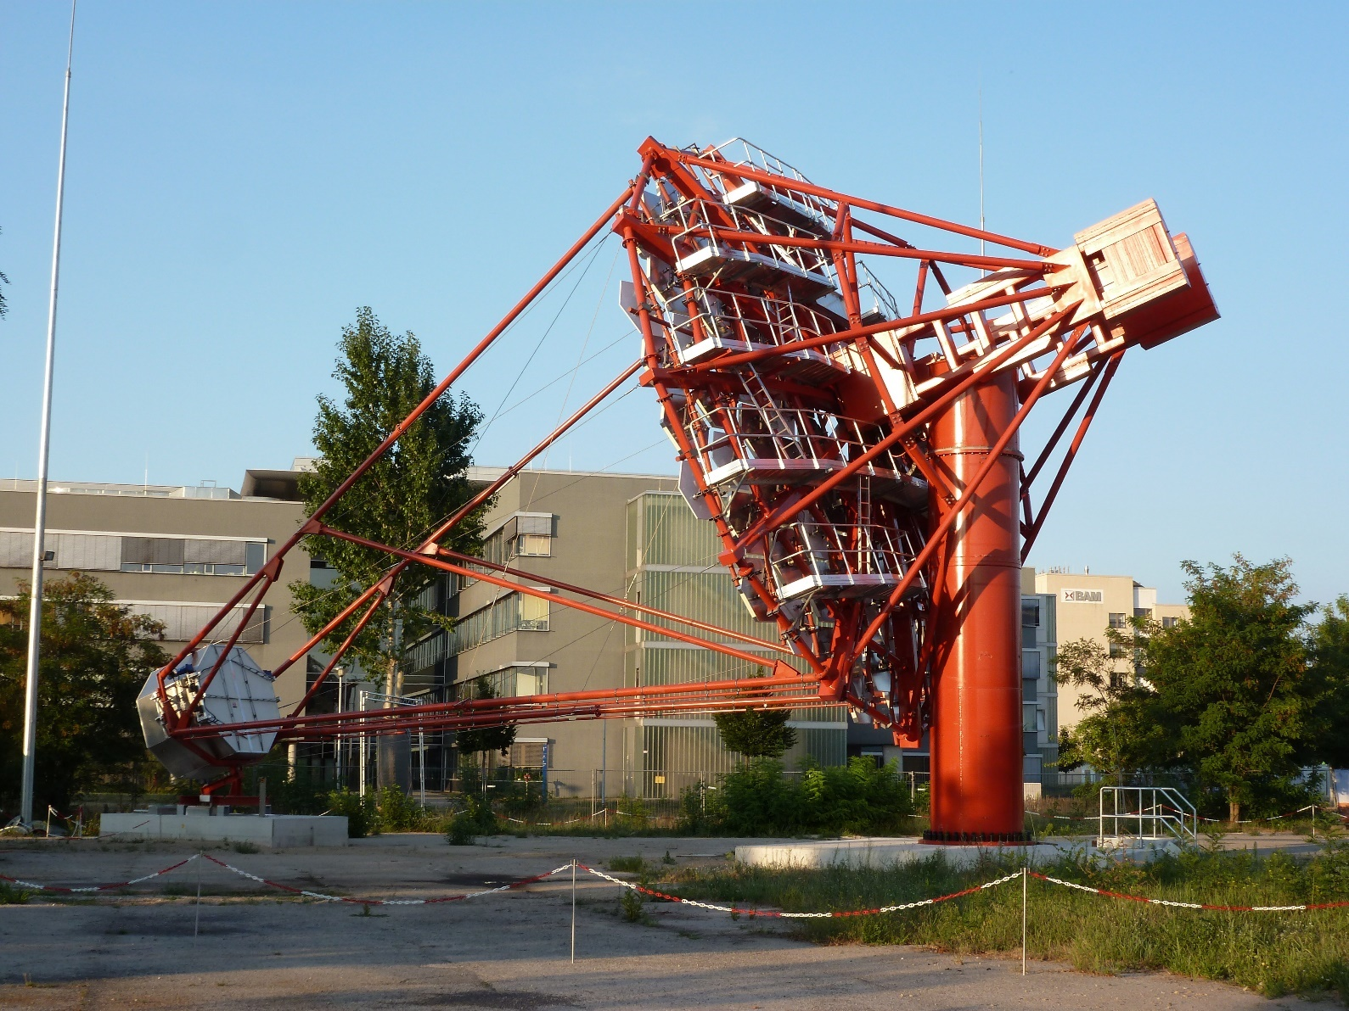
SST-1M prototype
Davies-Cotton optics.
Mirror 4 m diameter.
Focal length 5.6 m.
Mass ~ 9 t.
SiPM based camera.
Diameter ~ 1 m.
Mass ~ 200 kg.
15

Slide 16
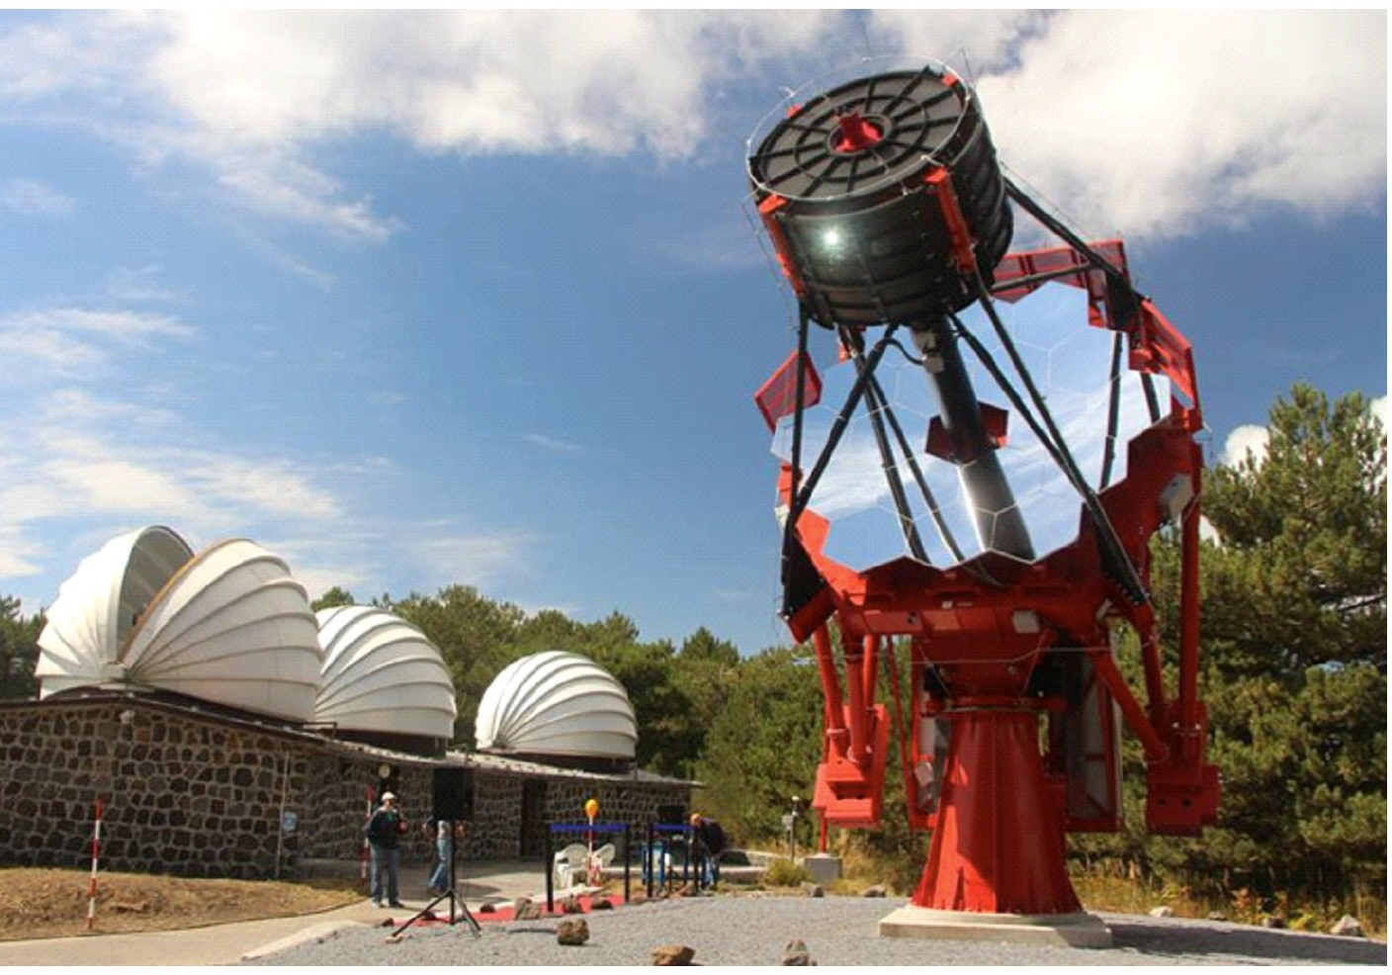
ASTRI prototype
Primary 4.3 m diameter.
Focal length 2.2 m.
Mass ~ 20 t.
Camera diameter
about 0.4 m.
Mass ~ 70 kg.
Note, astronomical telescopes are protected from the elements…
…but ACTs generally aren’t!
16

Slide 17
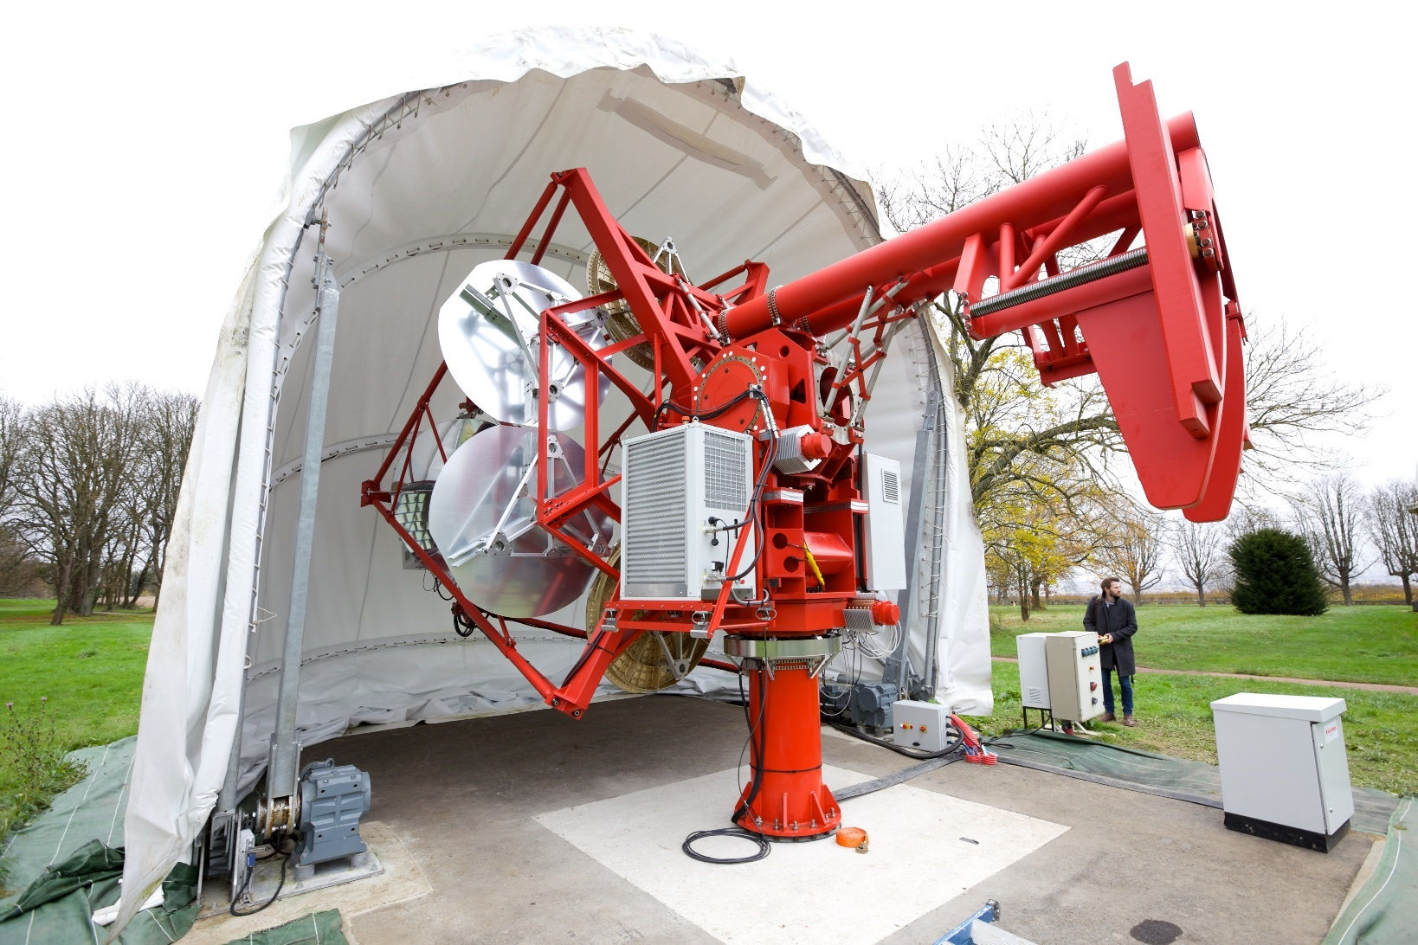
A shelter for the GCT
“Pram cover” shelter used to protect the GCT prototype in Paris.
Cost benefit on southern site, reduced frequency of mirror recoating.
17

Slide 18
Camera design
TARGET Module
16 x Preamps
Target Asic
FPGA
UDP Data
64 Pixel Module
16 x Preamps
Target Asic
16 x Preamps
Target Asic
16 x Preamp
TARGET ASIC
Trigger
Backplane Board
Buffering and Serialisation
Backplane
x 32
Amplification and shaping
Digitisation and Trigger
Camera Trigger
64 Pixel Module
Goal – produce low cost camera
with full-waveform readout
Data
DACQ Boards
Timing Board
Peripherals (calibration, lid, etc)
Clock, Timestamps
Safety Boards
Control
18

Slide 19
Camera
TARGET Module
16 x Preamps
Target Asic
FPGA
UDP Data
64 Pixel Module
16 x Preamps
Target Asic
16 x Preamps
Target Asic
16 x Preamp
TARGET ASIC
Trigger
Backplane Board
Backplane
x 32
Amplification and shaping
Trigger:
4 neighbouring pixels are summed, then discriminated.
64 Pixel Module
Data
6 mm
(0.17º) pixel
DACQ Boards
Timing Board
Safety Boards
Clock, Timestamps
Control
0.34º super pixel
19

Slide 20
Camera
TARGET Module
16 x Preamps
Target Asic
FPGA
UDP Data
64 Pixel Module
16 x Preamps
Target Asic
16 x Preamps
Target Asic
16 x Preamp
TARGET ASIC
Backplane Board
Backplane
x 32
Any 2 neighbouring super-pixels
64 Pixel Module
Data
DACQ Boards
Following camera trigger data read out to central location
Timing Board
Safety Boards
Clock, Timestamps
Control
20

Slide 21
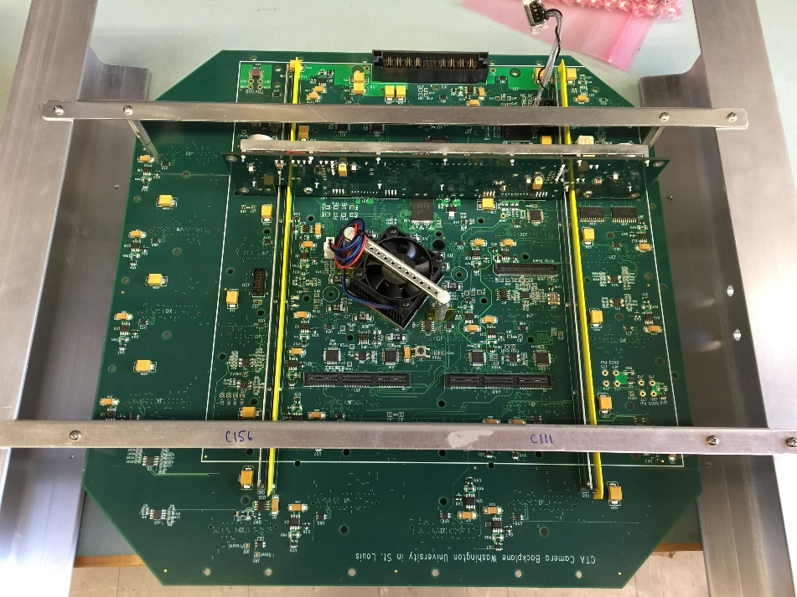
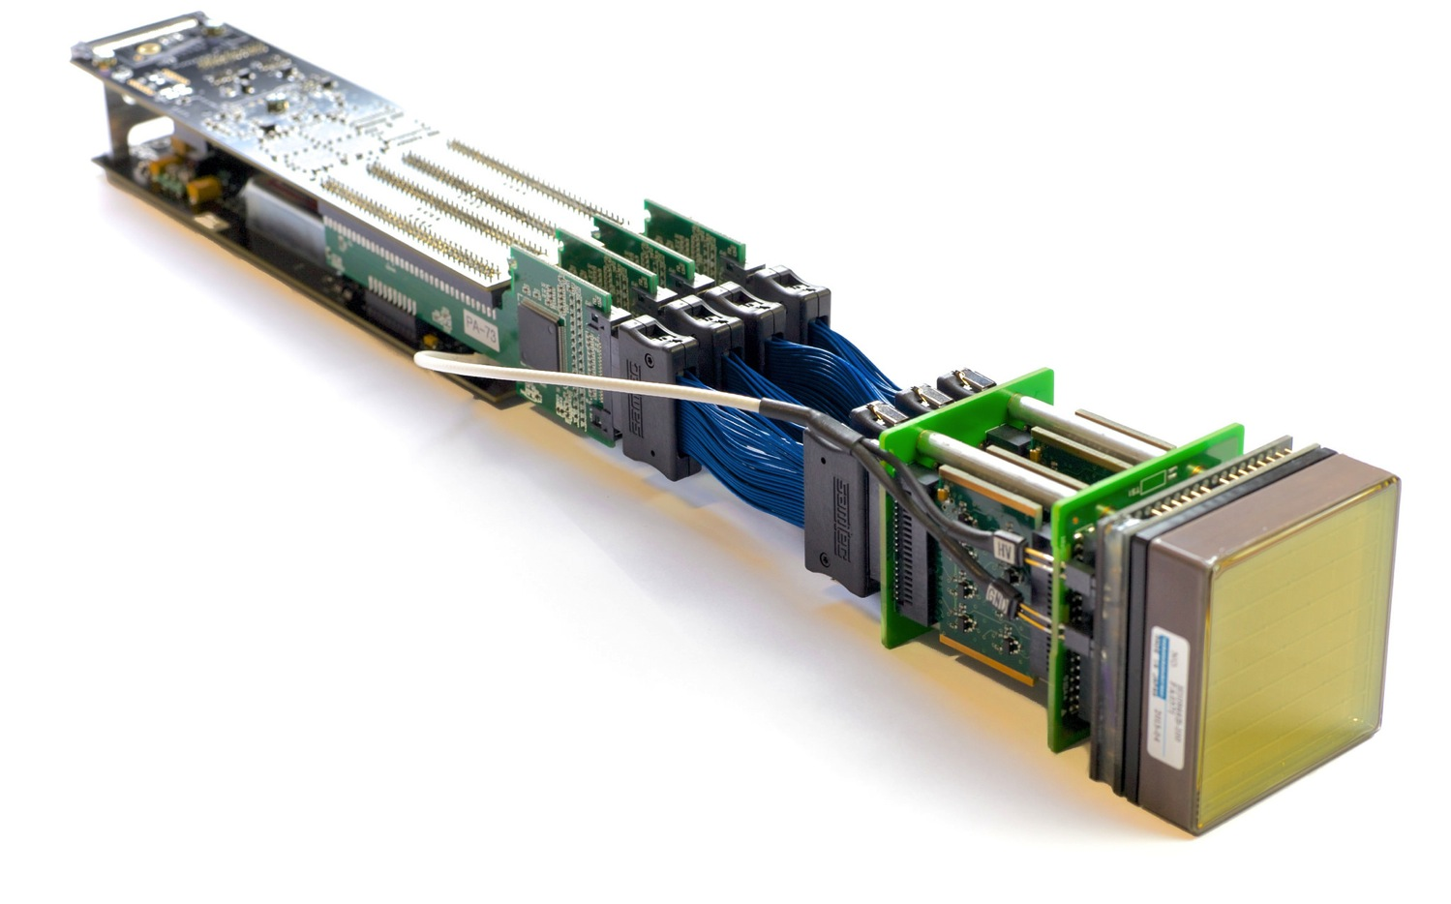
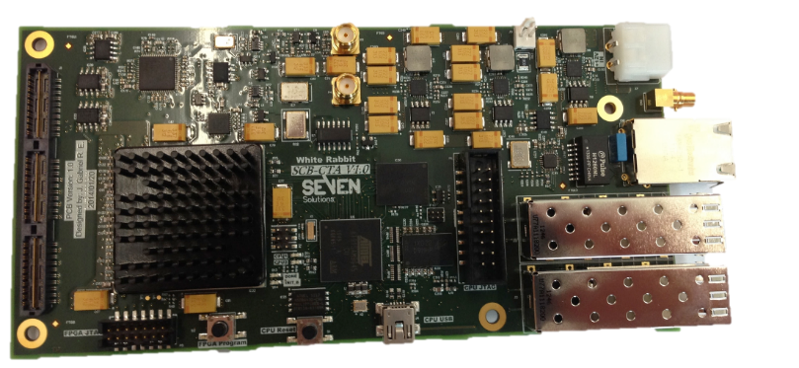
Development of the camera
Leicester 2012, start construction of camera with MAPMs – CHEC-M.
Electronics based around TARGET (Hawaii/SLAC and Erlangen).
DAQ using White Rabbit for timing (Amsterdam).
Backplane, common with SCT (Washington University).
Flashers (Durham) and Peripherals Board (Liverpool) complete camera.
21

Slide 22
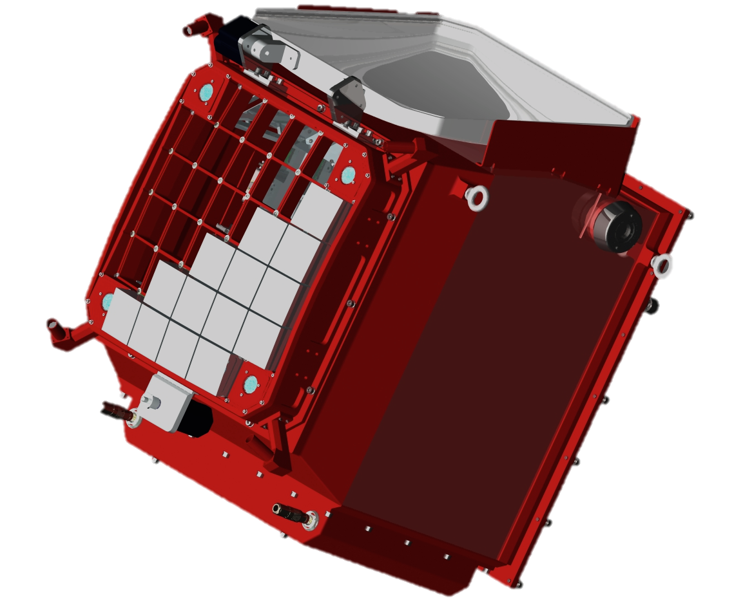
Development of the camera
Leicester 2015, CHEC-M complete.
Pointing LEDs
Lid
Lid motor
Photodetectors and front end electronics
Mounting eyelets
LED Flasher Units
Desiccator
Focal plane plate
Lid Locking Mechanism
Motor Bulk-head Connectors
Thermal Exchange Unit
Enclosure
22

Slide 23
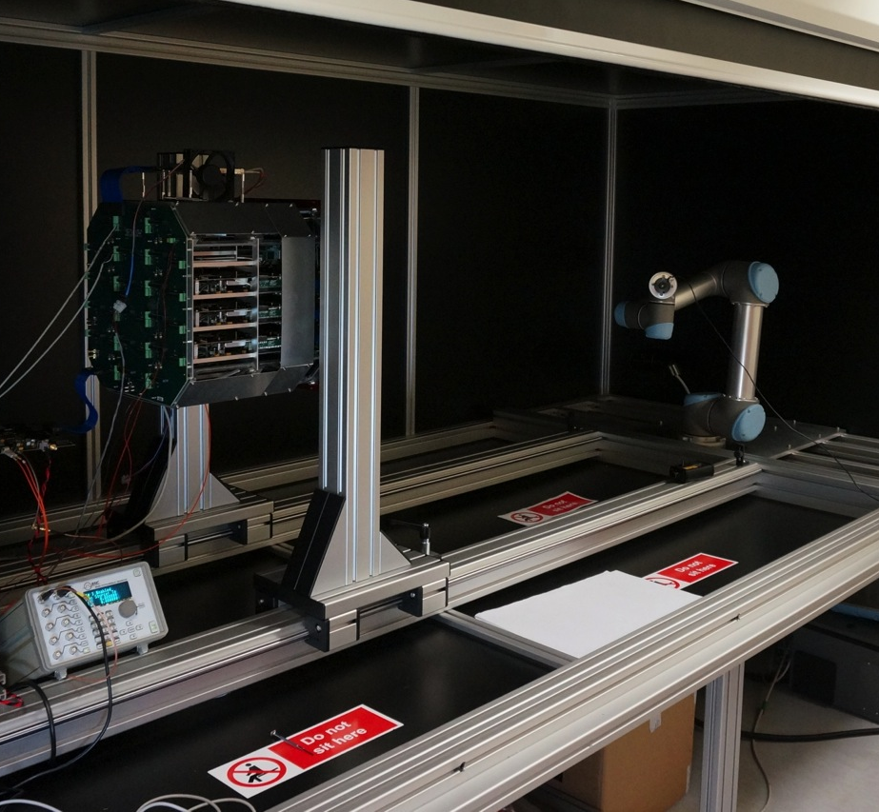
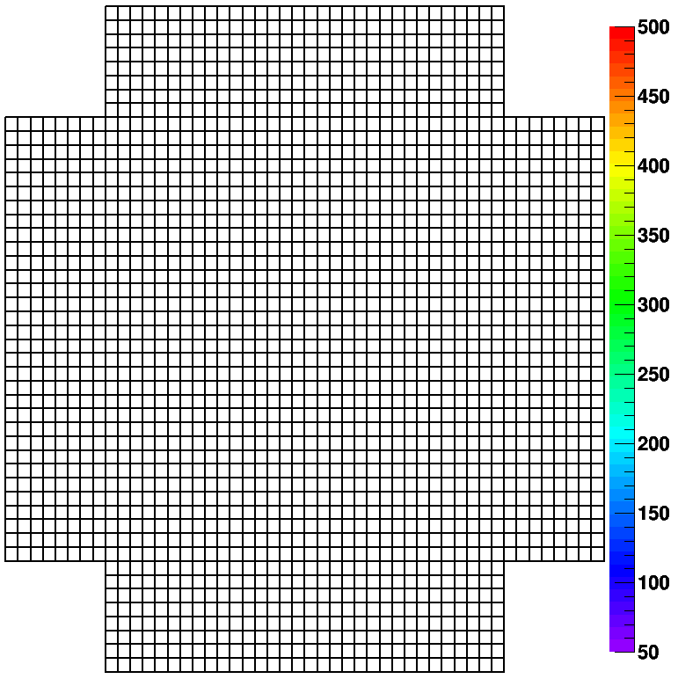
Camera tests
Camera in dark box with laser mounted on robot arm.
Lab. tests results (here with external trigger).
23

Slide 24
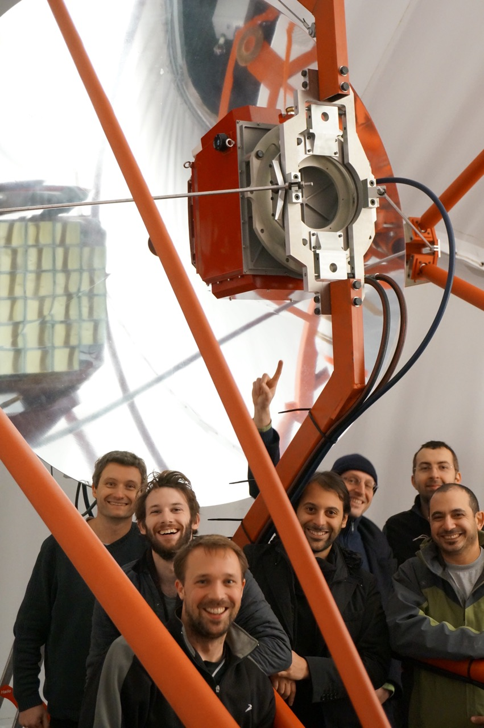
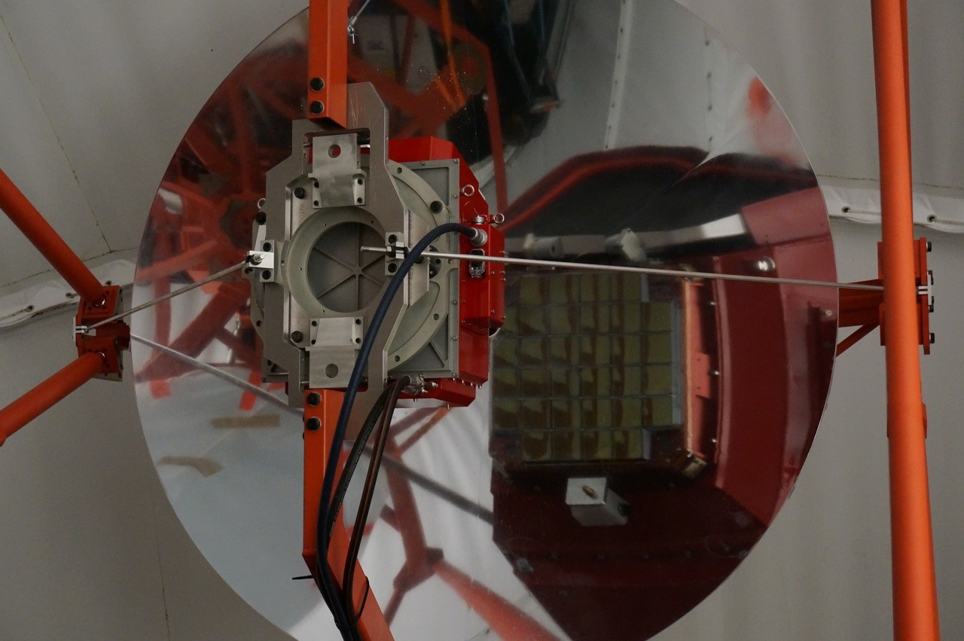
Completing the
GCT prototype
Camera shipped to Paris, arrived Friday 13th November.
Checked in lab and mounted on telescope on 20th November…

Slide 25
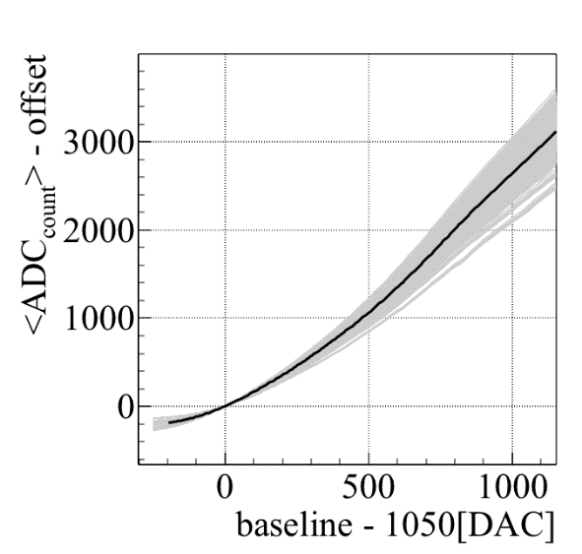
Verify camera operation on telescope
Check that
operation
safe, e.g.
TARGET
module
temperatures.
Check
electronics
performance,
e.g. transfer
functions.
Check that MAPMs functioning as expected – look for single photo-electron peak:
25

Slide 26
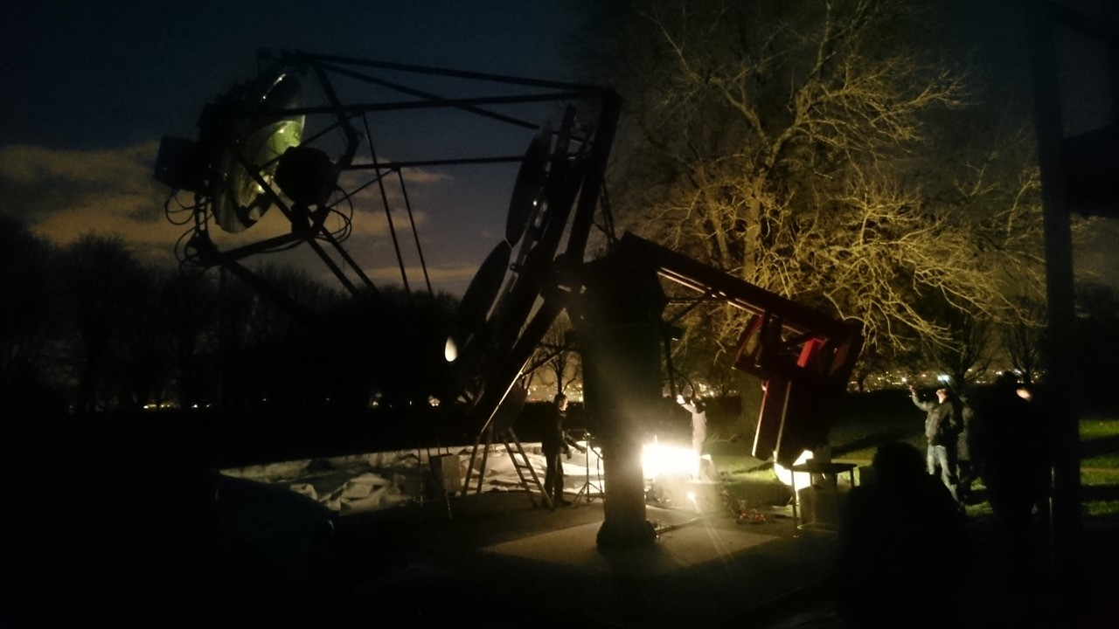
First tests of the GCT prototype on sky
Thursday 26th Nov, night sky background 20 to 100 times higher than CTA site…

Slide 27
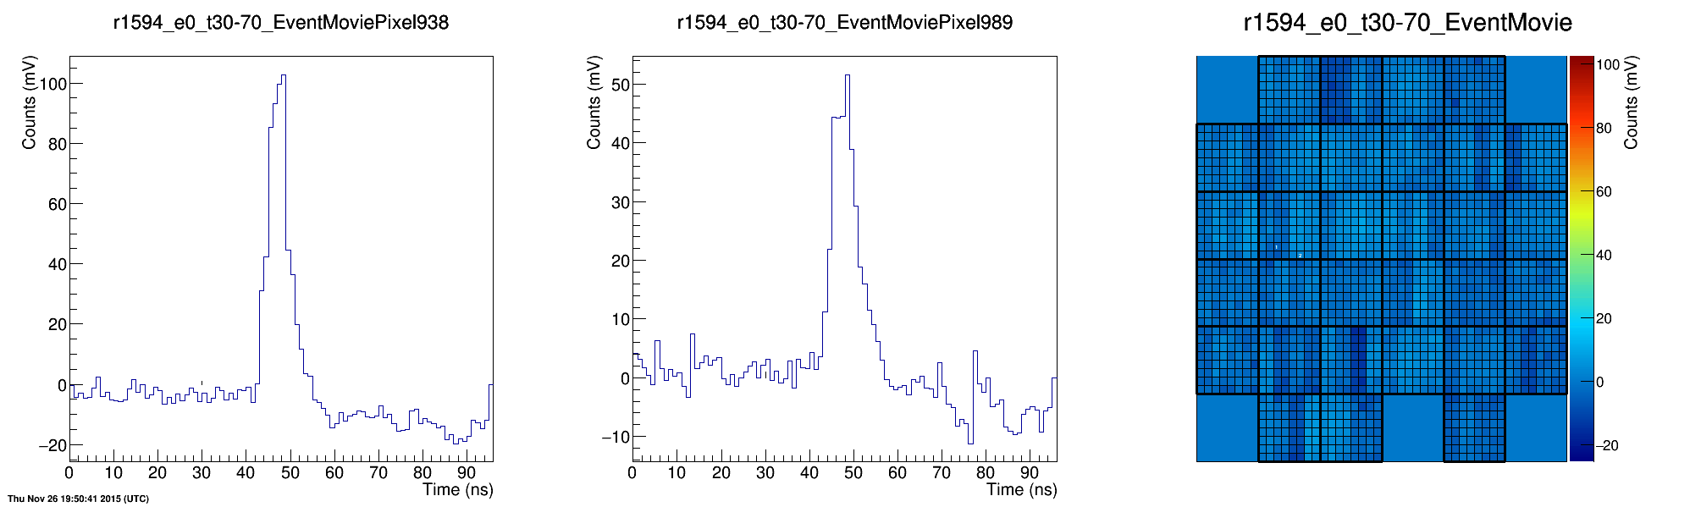
First tests of the GCT prototype on sky
…but successfully observed Cherenkov light from ~ 50 TeV showers.
27

Slide 28
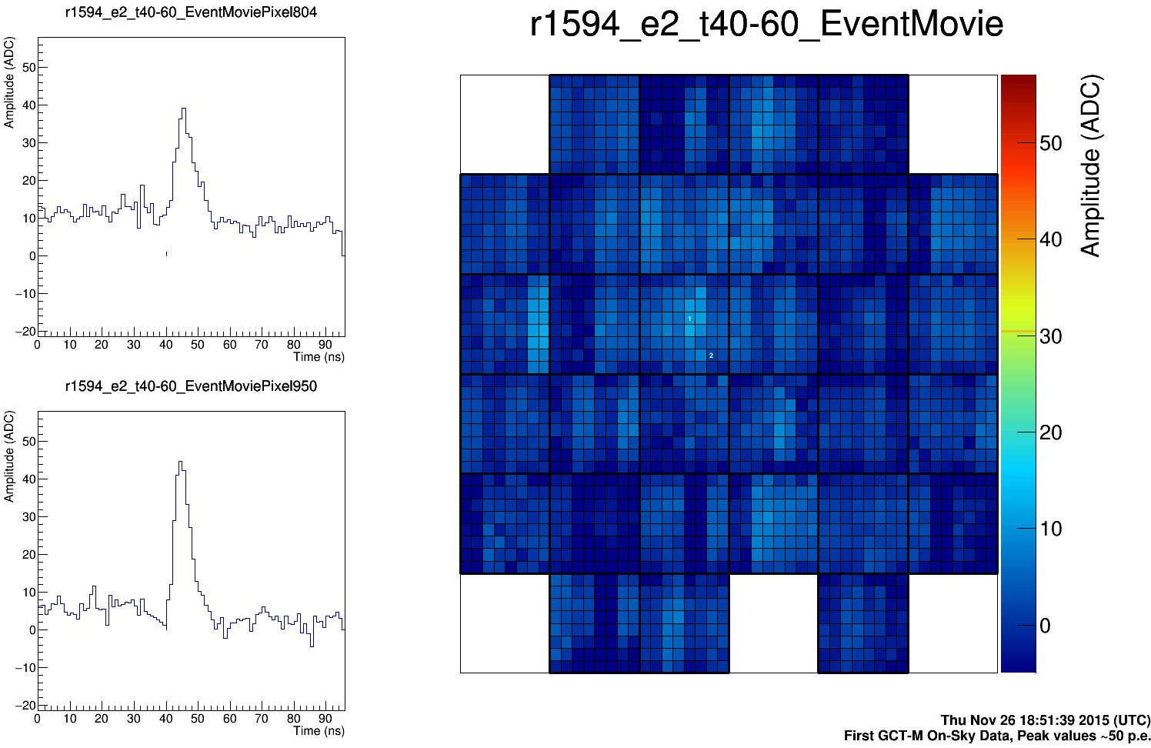
First tests of the GCT prototype on sky
Thursday 26th November.
28

Slide 29
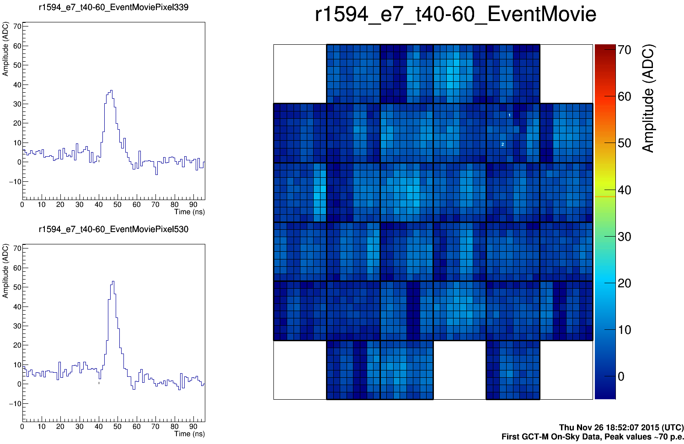
First tests of the GCT prototype on sky
Thursday 26th November.
29

Slide 30
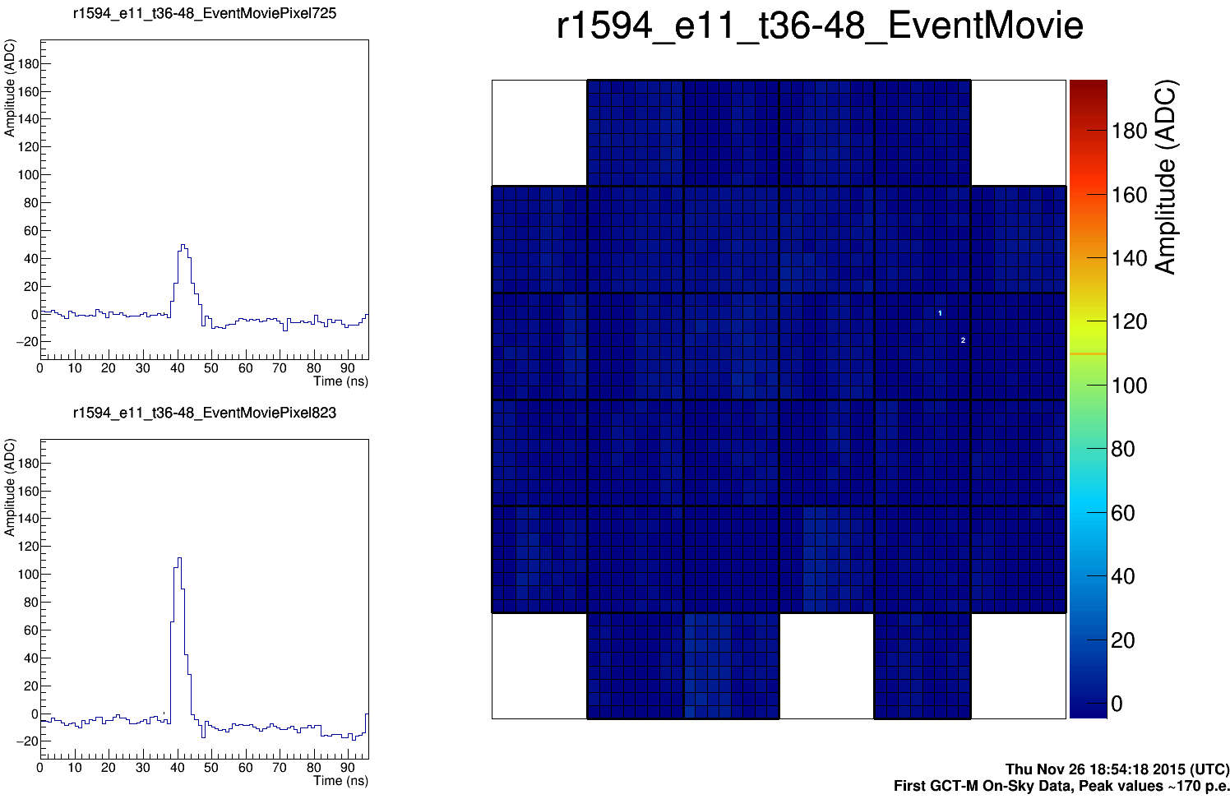
First tests of the GCT prototype on sky
Thursday 26th November.
30

Slide 31
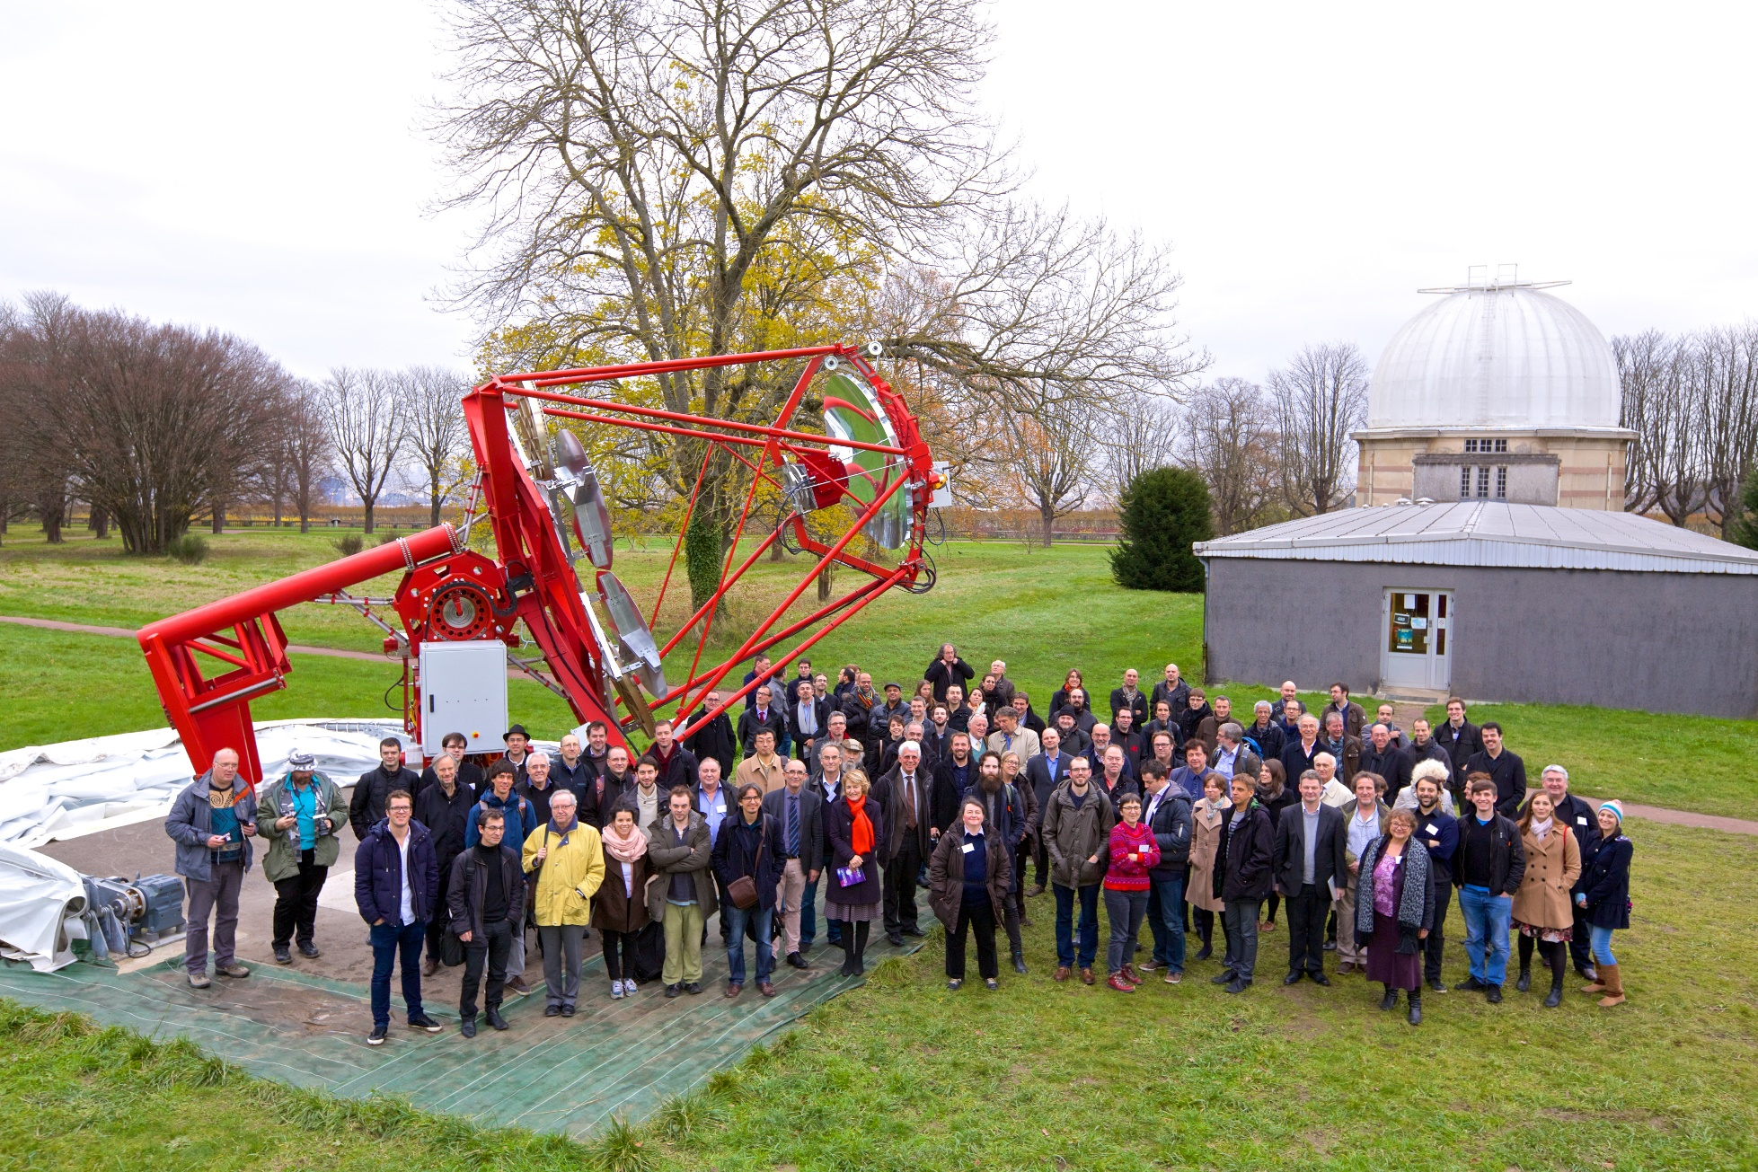
Inauguration of the telescope
Party on 1st Dec. 2015!

Slide 32

What have we learnt?
We need to work on mirrors and mirror production processes.
Can see by eye that two panels of the secondary are of poor quality (despite nominally all being same).
Try casting aluminium, machining, applying nickel layer, polishing, coating with aluminium and SiO₂.
Nickel layer improves surface quality, but also needed if mirror to be recoated, otherwise old Al coating cannot be stripped off.
Good quality control needed.
Casting should also reduce cost.
(Applies also to structural elements.)
Bad panel in GCT secondary.
32

Slide 33
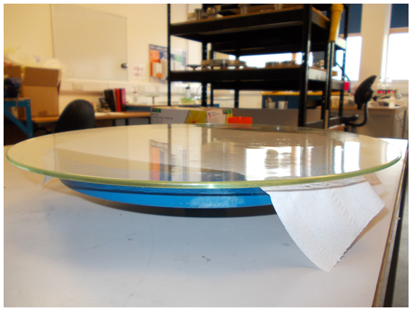
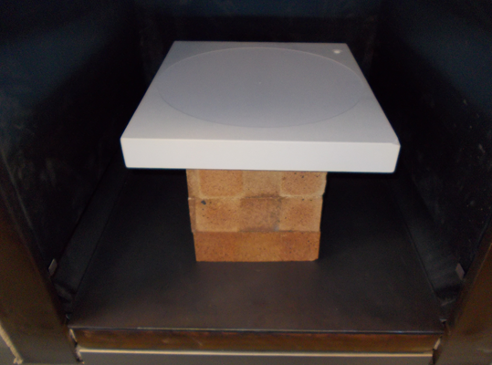
Glass mirror studies
Hot slump glass mirrors using concave mould.
Proof-of-principle studies.
Grind a ceramic mould with radius of curvature of 3 m.
Level mould in oven and slump
4 mm thick glass sheet, 35 cm diameter, using carefully controlled temperature cycle.
33

Slide 34
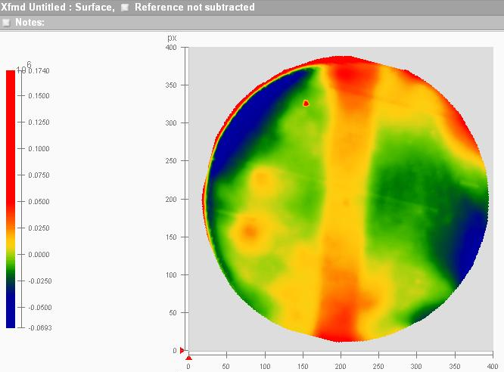
First glass mirror studies
Measure RoC of glass samples and of mould.
Mould shrinks slightly after baking.
Part 1, slumped simultaneously with mould baking, during power cut.
Part 2, smaller RoC than mould.
Glass follows shape of details of mould.
Next steps, larger samples, petal shapes, smaller RoC, coating…
34

Slide 35
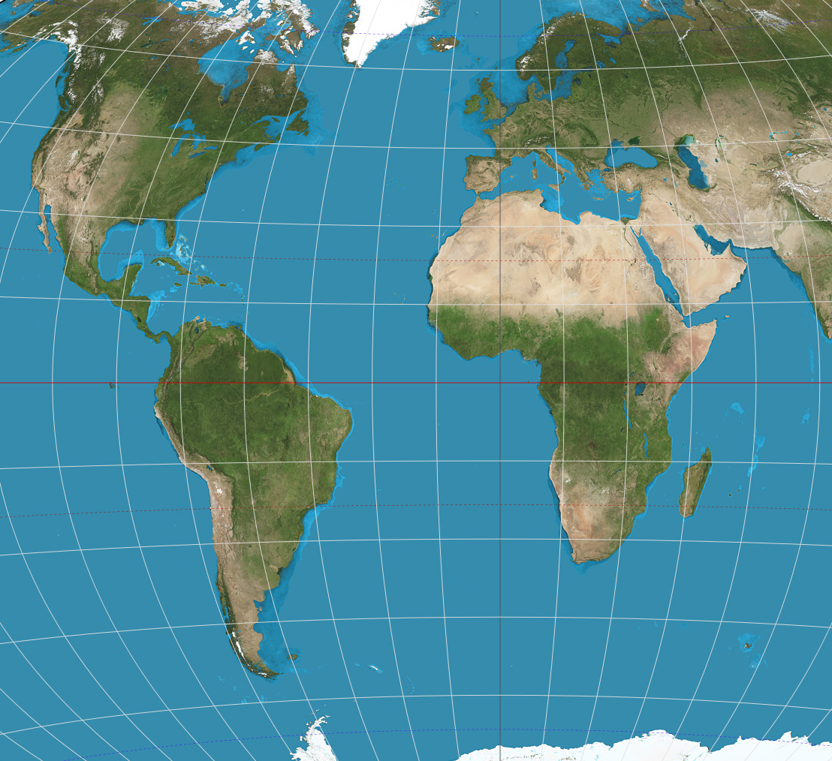
Next steps for the GCT
Complete commissioning and testing of GCT camera and structure.
Complete SiPM-based camera and test.
Design pre-production camera and telescope.
Produce three pre-production instruments and install on southern site from end 2017.
Produce further 32 telescope and deliver 35 systems to CTA Observatory.
La Palma, Spain
San Pedro Martir,
Mexico
Paranal, Chile
Aar, Namibia
35

Slide 36
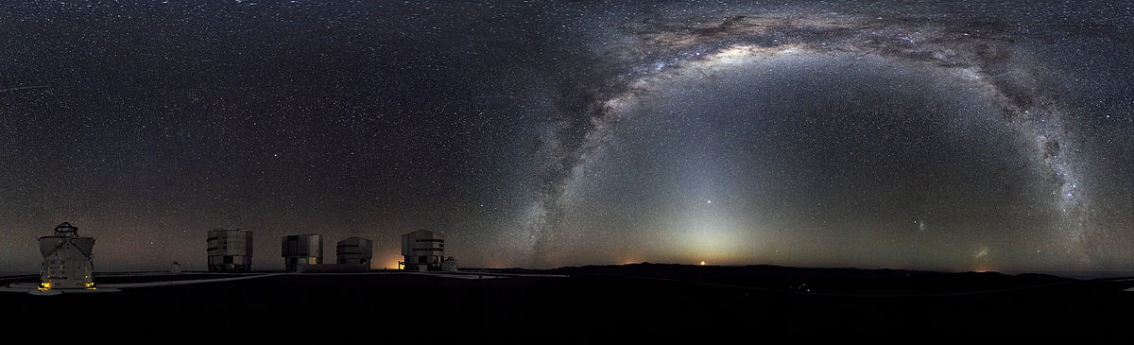
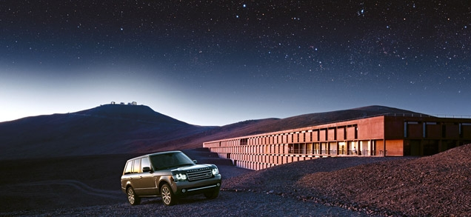
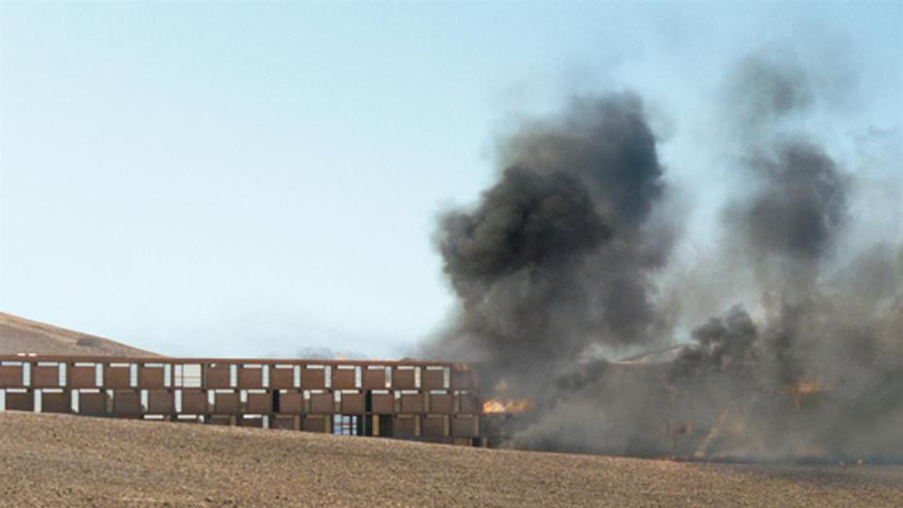
ESO Paranal site in Chile
36

Slide 37
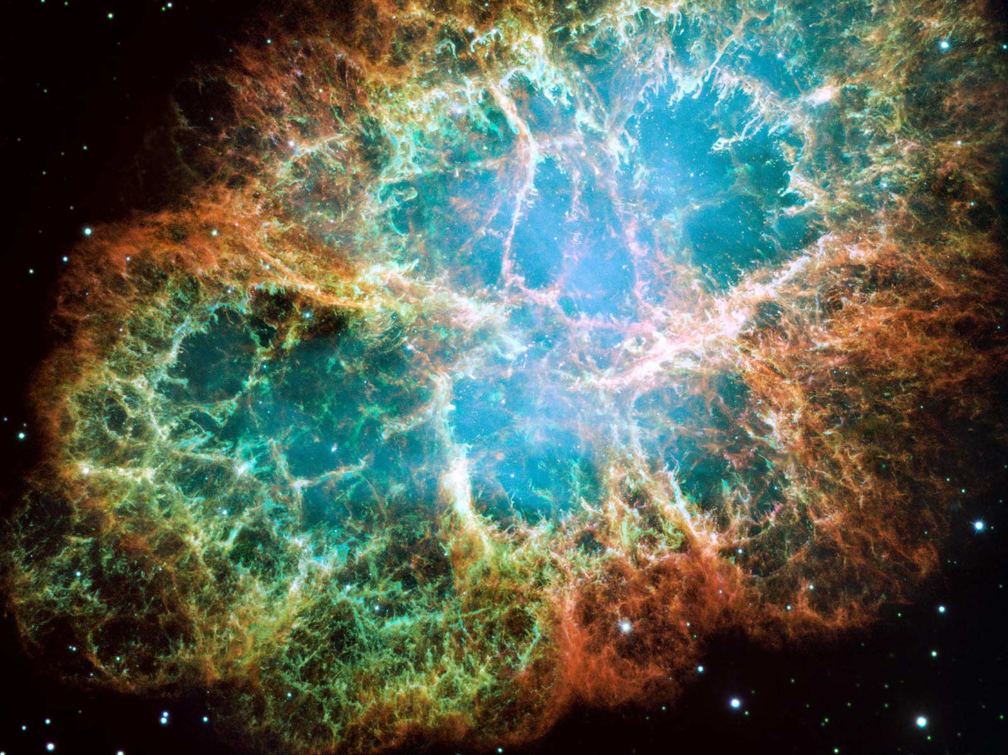
Summary
Progress with GCT good.
First of CTA’s prototypes to observe Cherenkov light images of air showers.
Comprehensive prototype telescope and camera test programme underway.
Design and review pre-production structure by end of 2016.
Test SiPM camera early in 2017.
Plan to install first telescopes on southern and northern sites in 2017.
37

