Slide 1
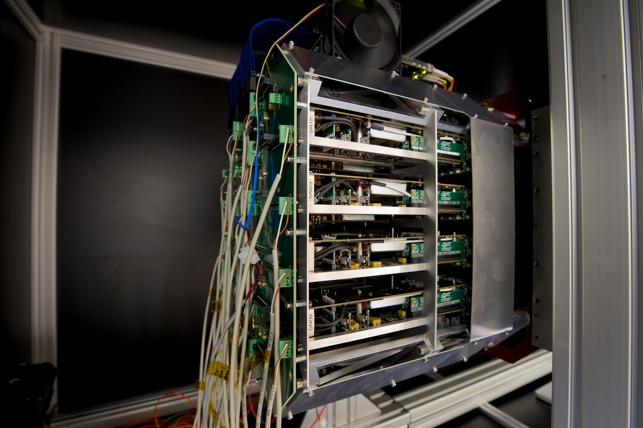
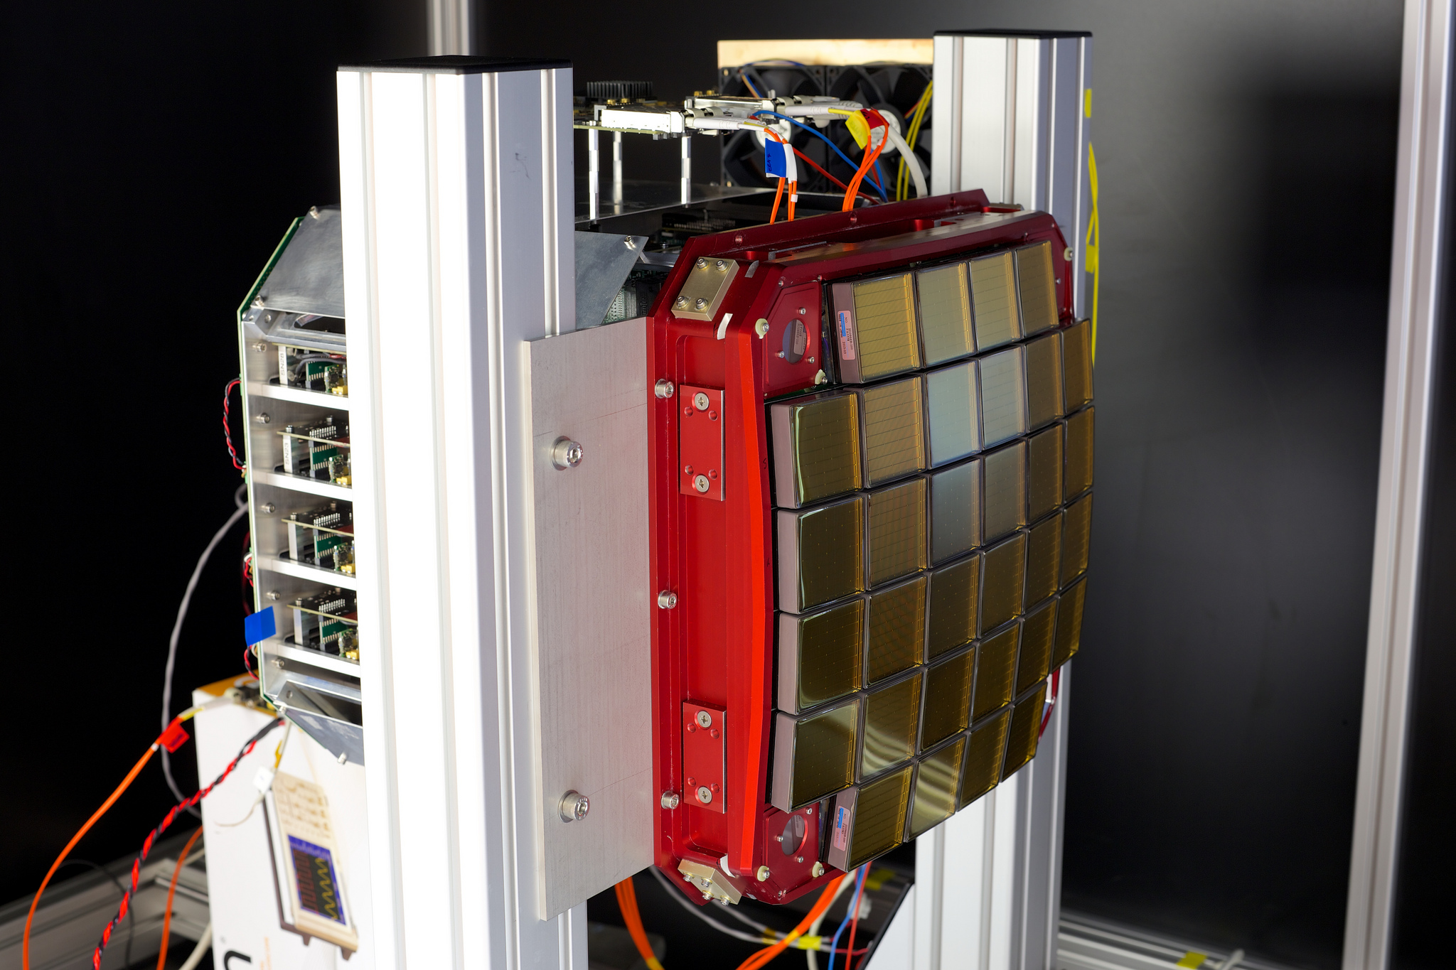
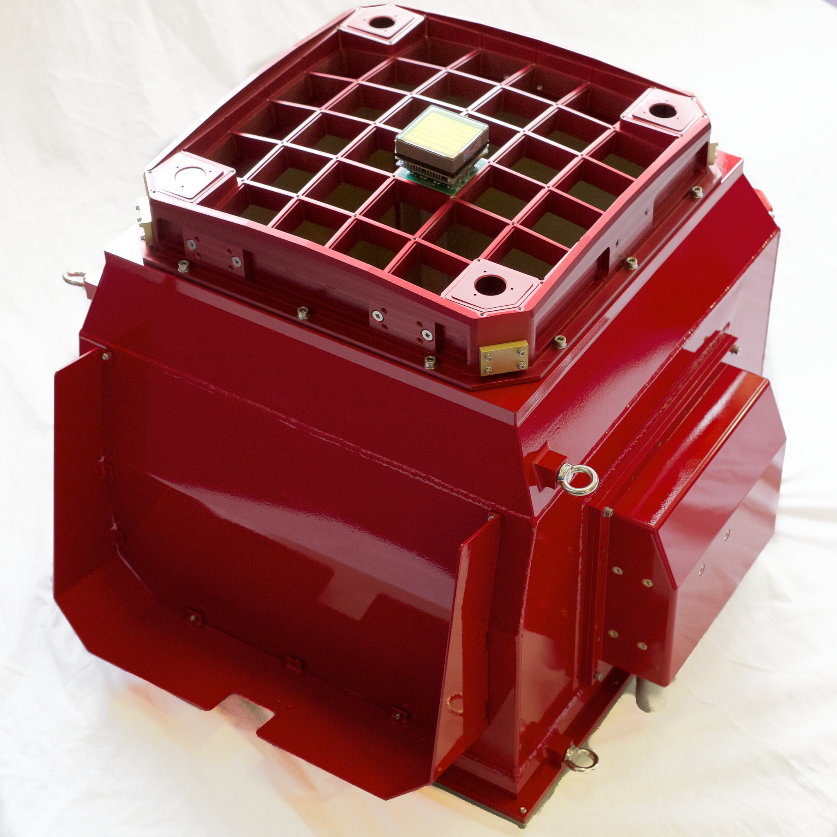














GCT Progress
May 2015

Slide 2
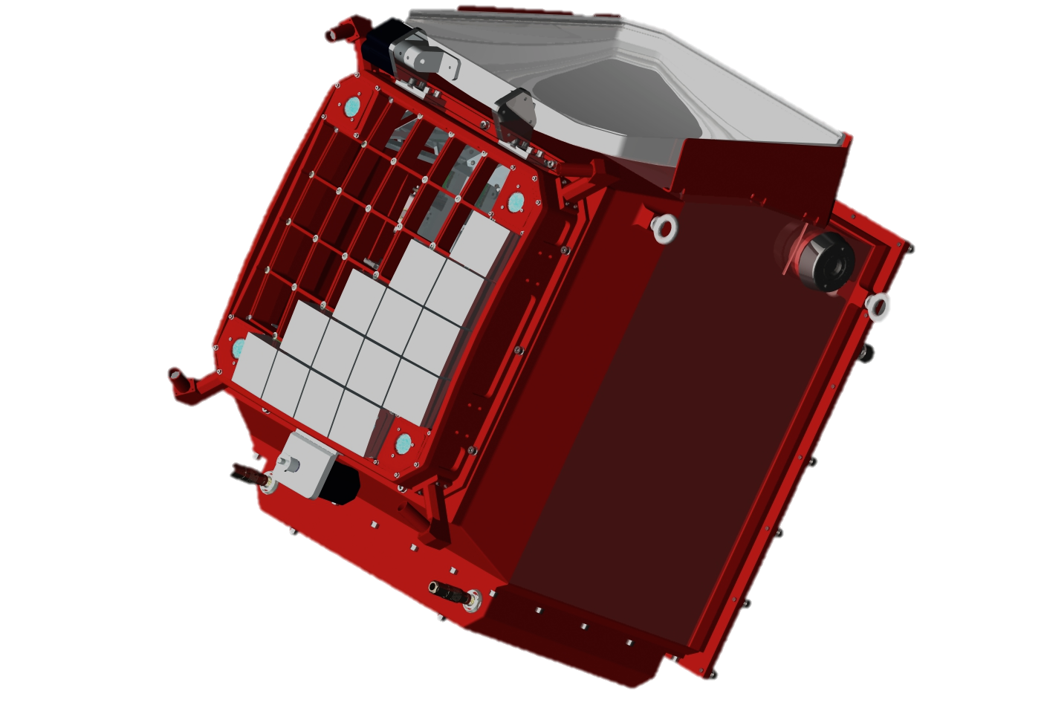
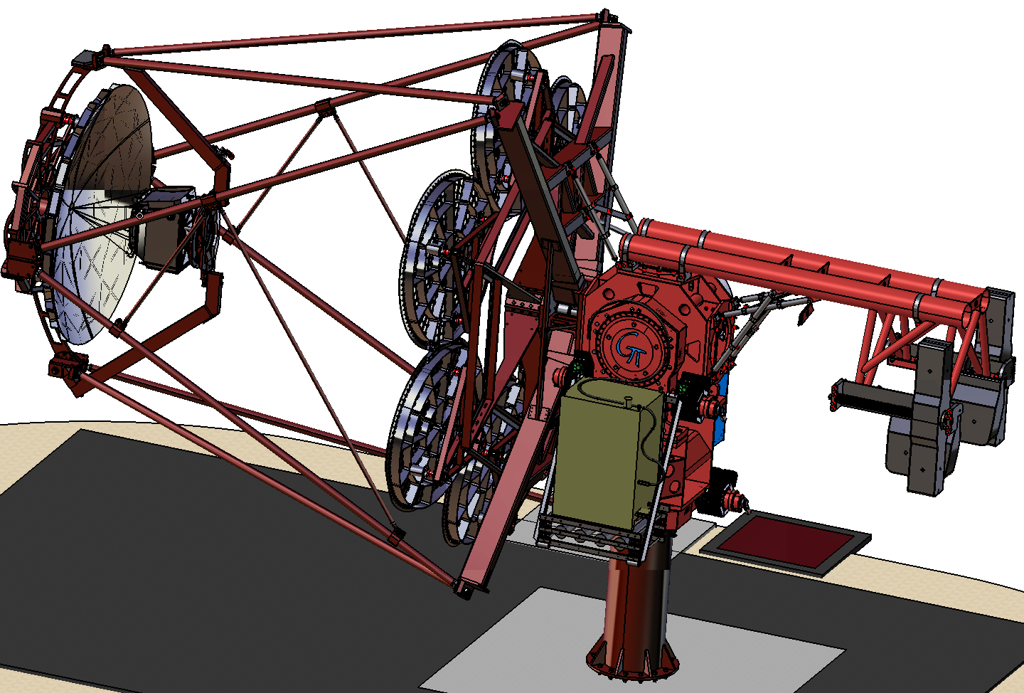
GCT: The Gamma Cherenkov Telescope
The UK-designed CHEC camera will equip the GCT
Optics and first mechanical design of telescope in UK
Prototype structure was
assembled in Meudon (Paris Observatory) in April.
Prototype mirrors will
be added in June.
Camera will be
tested on telescope in
September.

Slide 3
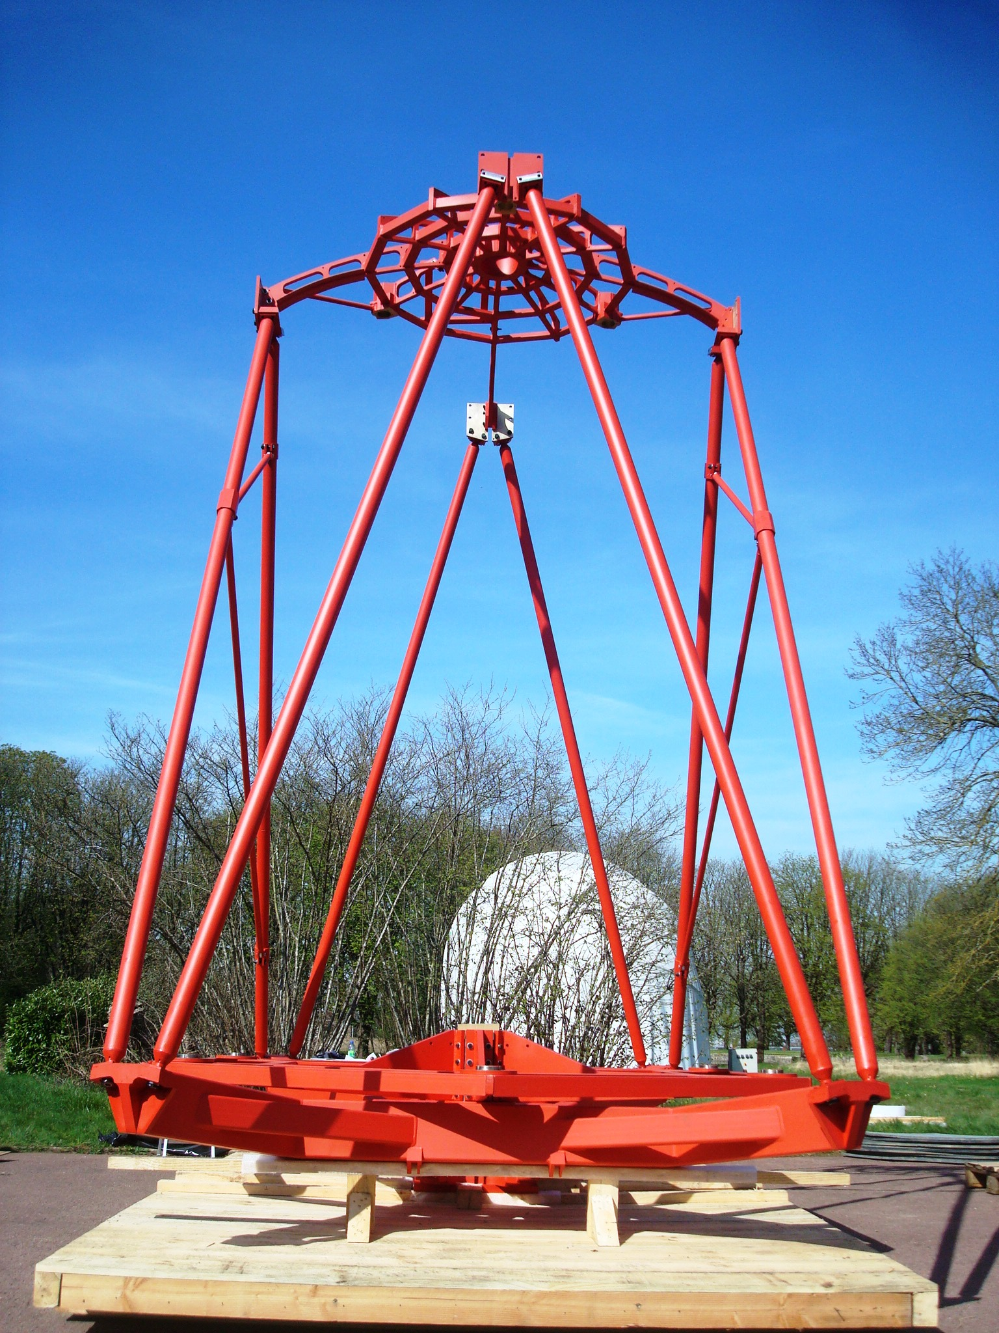
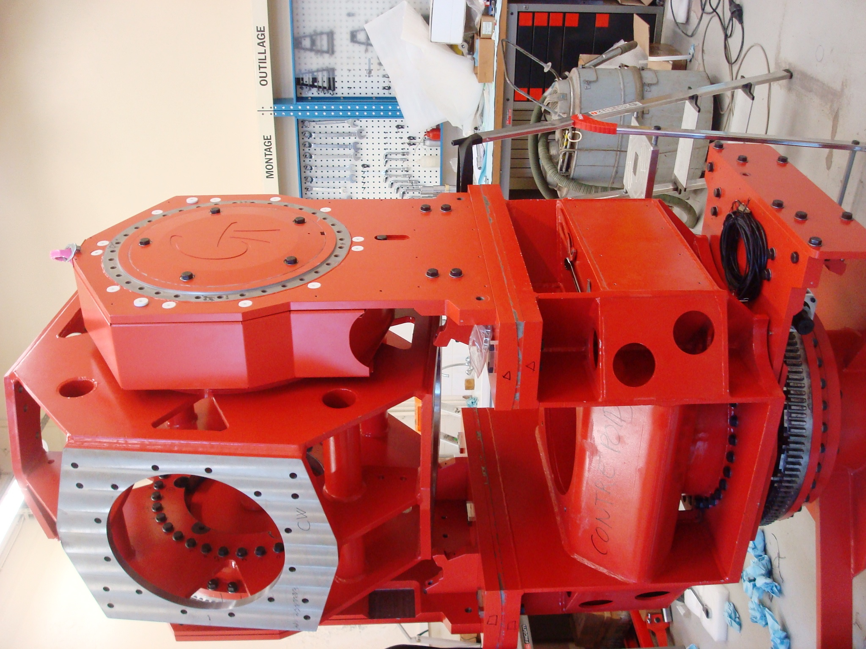
Prototype telescope
Optical Support Structure and Alt-Az system

Slide 4
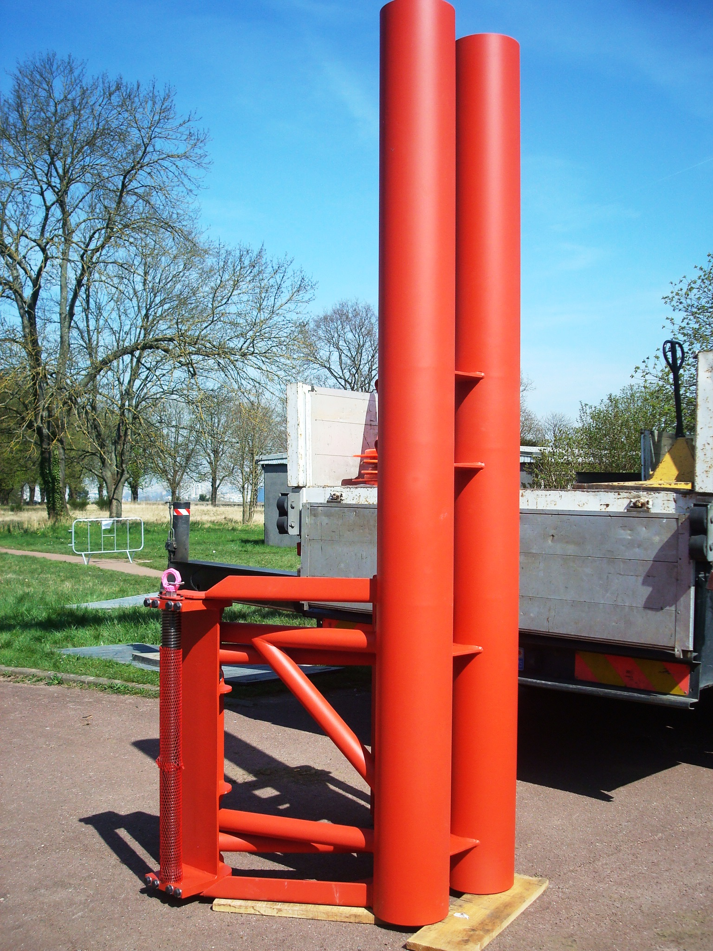
Prototype telescope
Counterweight, mounting of Alt-Az structure

Slide 5
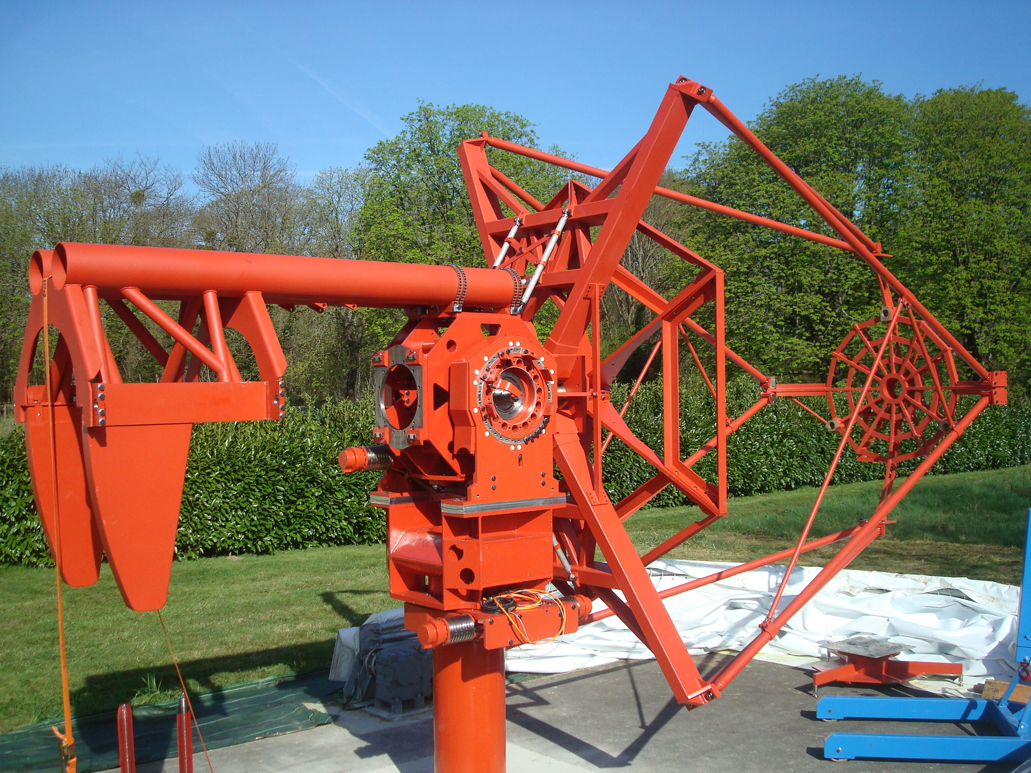
Prototype telescope
Assembly completed in two days

Slide 6
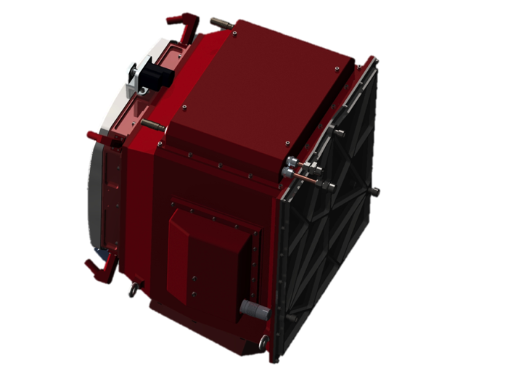

Camera Overview
Telescope Interface
Pointing LEDs
Lid motor
Lid
Photodetectors attached to trigger and digitisation electronics
Chiller send/return
Power and data connections
Mounting eyelets
LED Flasher Units
Desiccator
Focal plane plate
Lid Locking Mechanism
Motor Bulk-head Connectors
Thermal Exchange Unit
Enclosure

Slide 7
Electronics and Readout
TARGET Module
16 x Preamps
Target Asic
FPGA
64 Pixel Module
16 x Preamps
Target Asic
Data
16 x Preamps
Target Asic
Array/Clock Interface
16 x Preamp
TARGET ASIC
Trigger
Backend Electronics
Control, & Data
x 32
Any 2 neighbouring super-pixels
64 Pixel Module
Following camera trigger data read out to central location

Slide 8
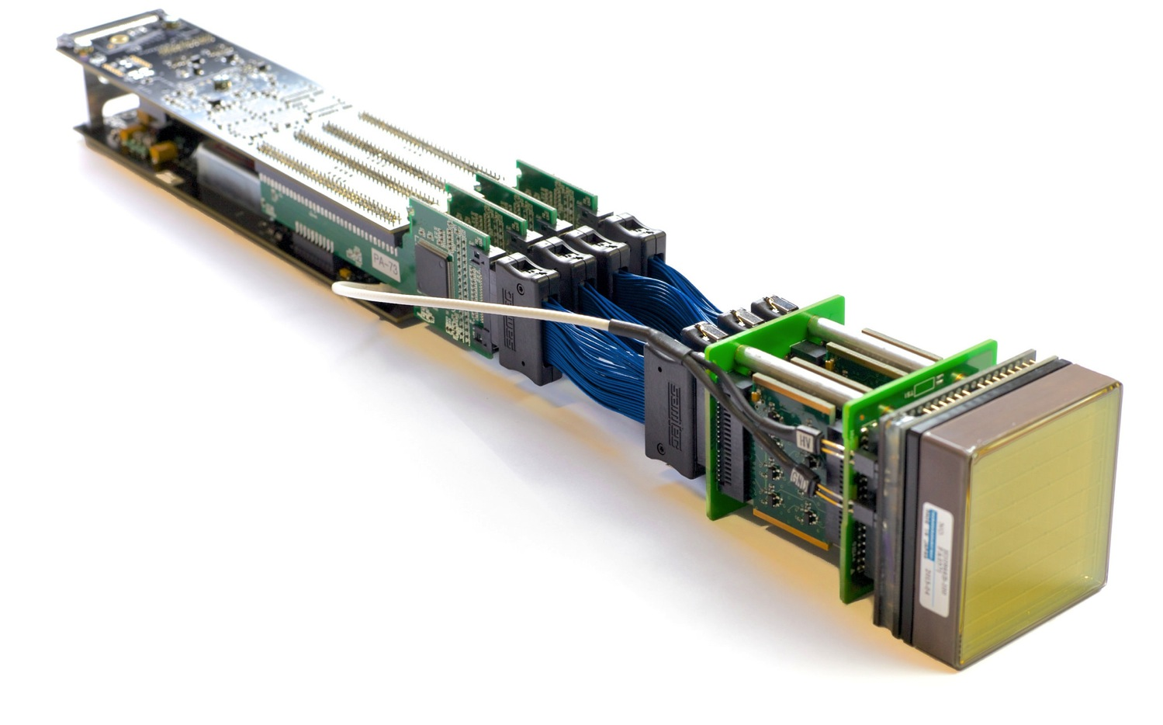
CHEC-M Camera Module
Backplane connector carrying raw data, trigger and sync signals and power
Xilinx Spartan 6 FPGA (under)
Coaxial ribbon cables for analogue signals and preamplifier power
Front-end buffer module – 4 x 16 channel preamplifiers
Mechanical standoff with retention for TARGET module to the backplane
PCB to interface with the focal plane plate
High Voltage supply
TARGET ASIC
16 channels digitisation and triggering
Individual amplifier circuit
High Voltage connection
to the MAPM
MAPM
(Hamamatsu H10966B)

Slide 9
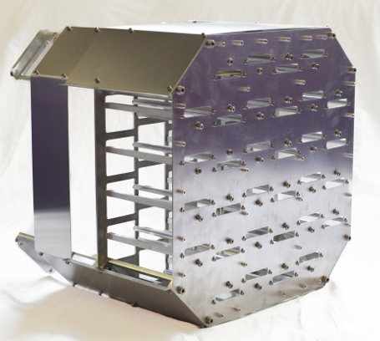
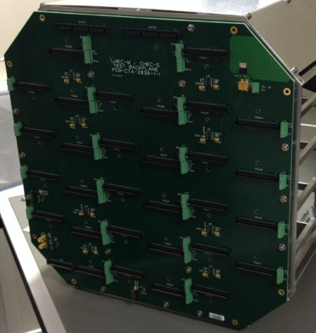
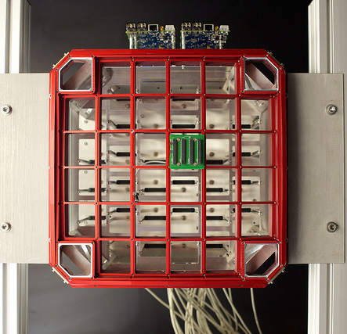
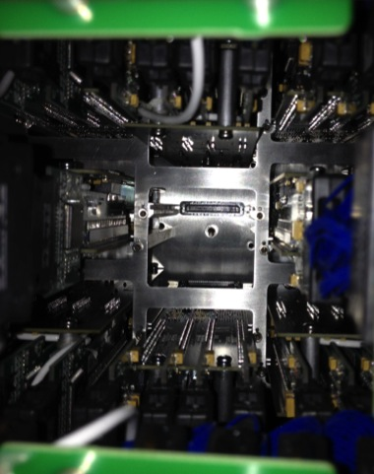
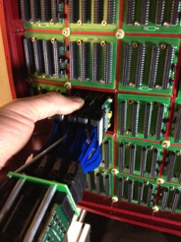
Assembly
Internal rack built
Focal plane attached
Backplane and DACQ boards attached
TARGET Modules inserted

Slide 10
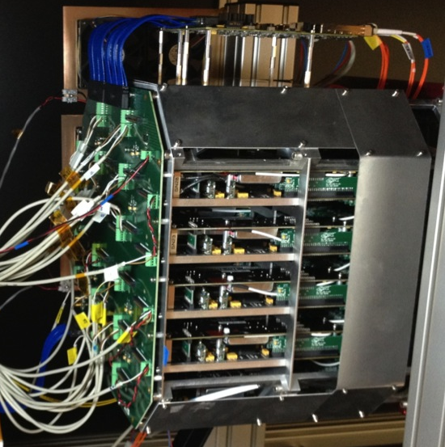
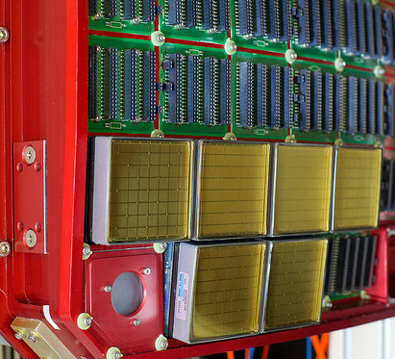
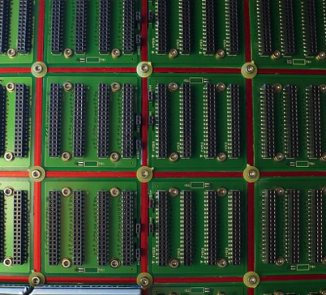
Assembly
Power and Monitoring PCB
TMs pulled in from rear with screw via tool inserted through backplane access hole
Pre-amps secured from front
MAPMs added
Enclosure added
Standoff
TARGET module Samtec connector
ASIC and Readout PCB
Backplane
Pre-amp retention washers
Tool
Threaded hole
Slot
Backplane Samtec connector

Slide 11
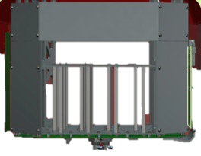

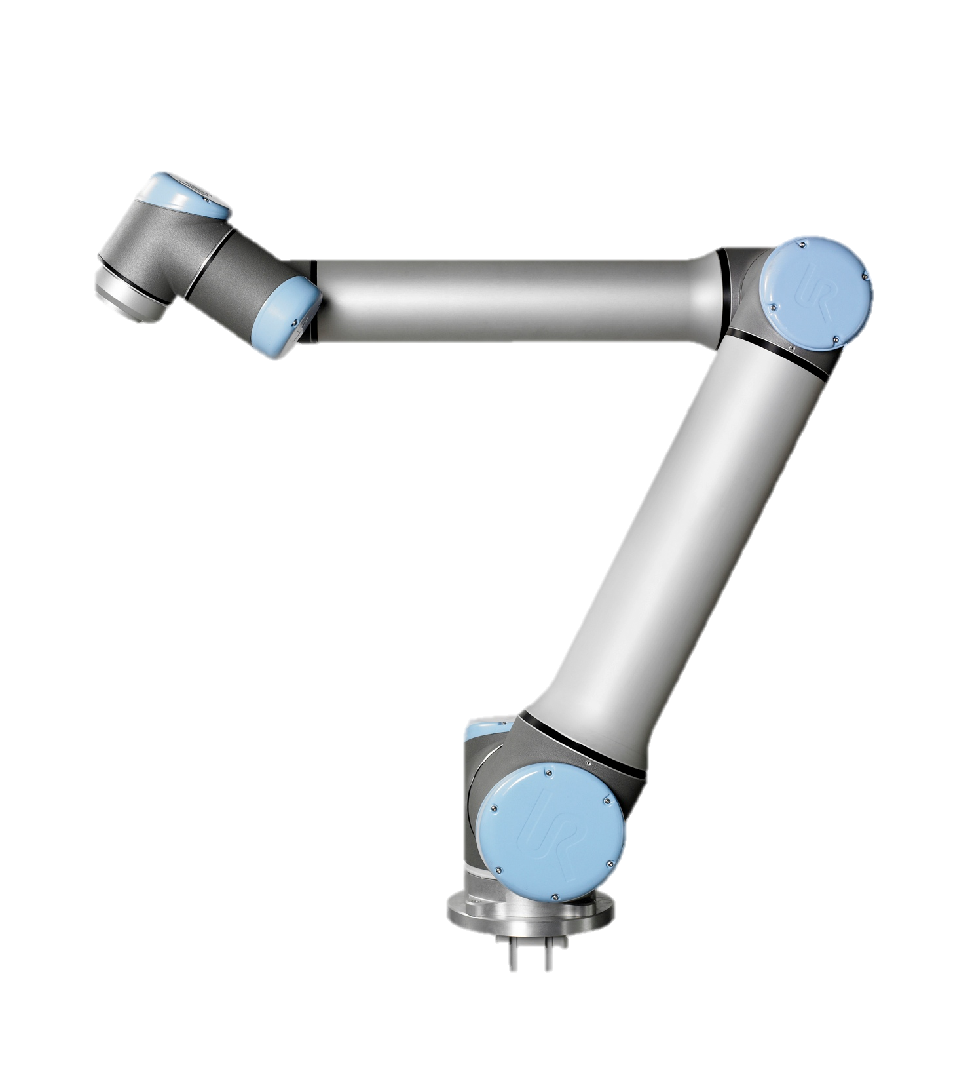
Commissioning Lab Setup
Initial setup for uniform illumination
Dark Box
Camera
Laser and diffuser
Robot Arm
Monitor SiPM
Tester board
Camera mounted on sliding rail
Raw Data & Control
Trigger
PC
Control
Pulse Generator
Control PC with TCP/IP control interface
SiPM Out
Tester board 12 V PSU
Laser 12 V PSU
Scope
Camera 12 V PSU
Proto. Backplane 5 V PSU

Slide 12
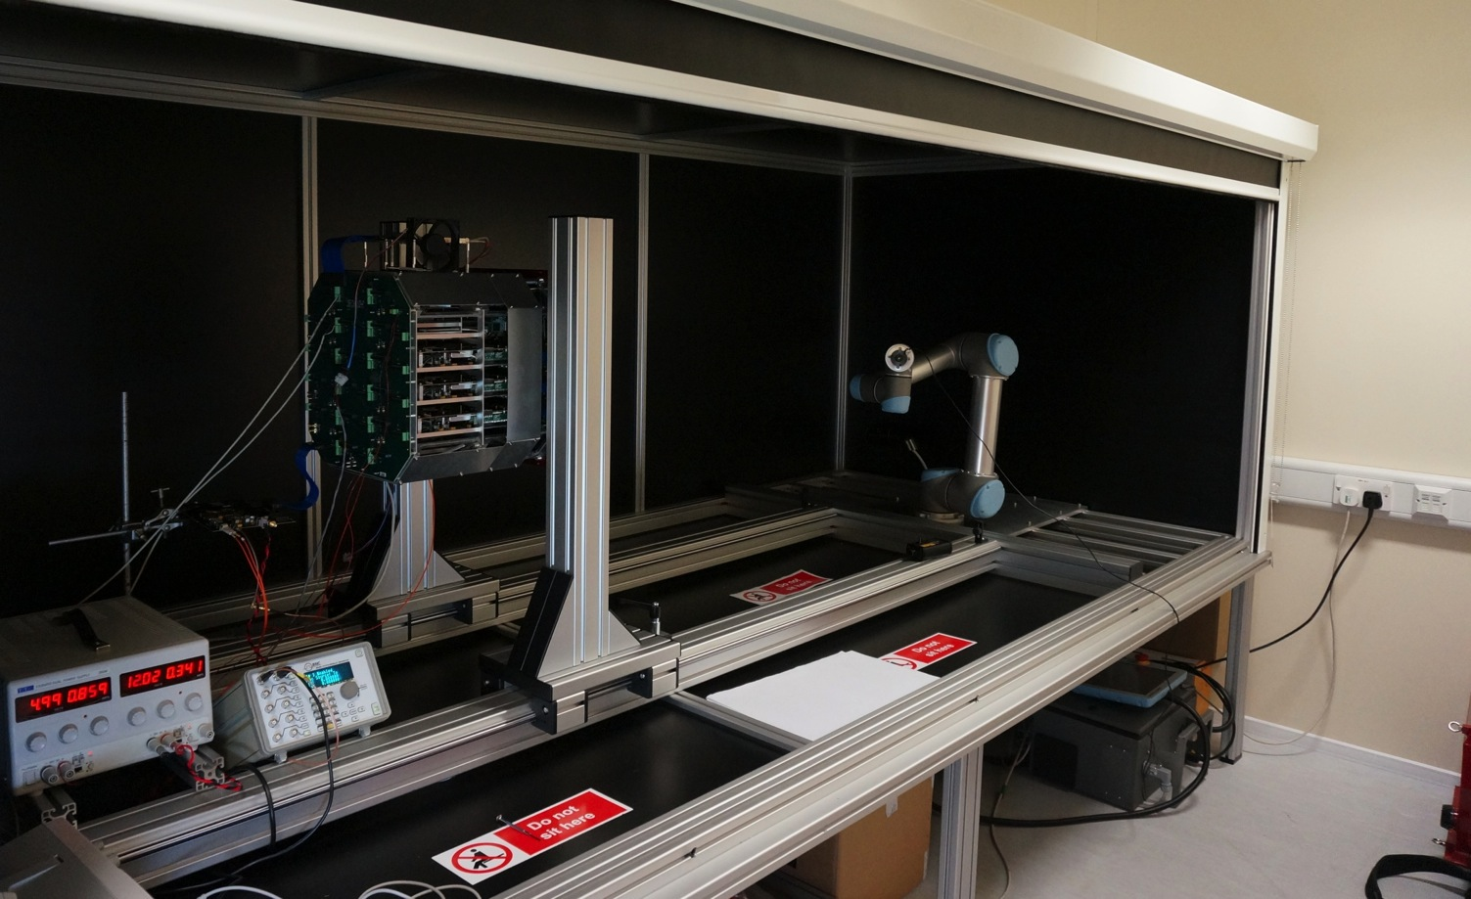
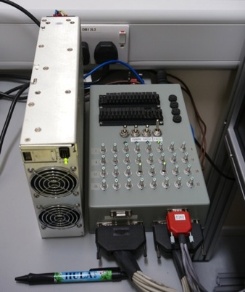
Commissioning Lab Setup
Light-tight enclosure (with roller blind)
Camera PSU and switch box

Slide 13
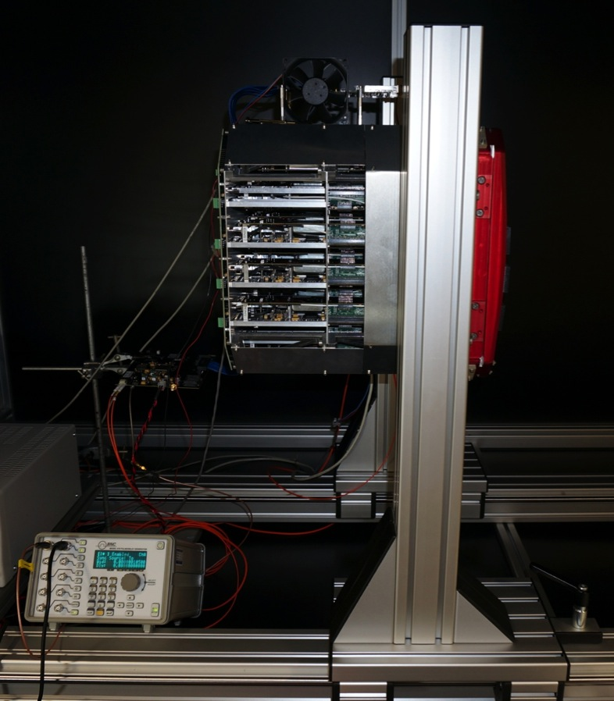
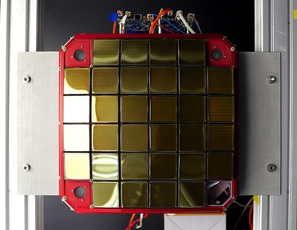
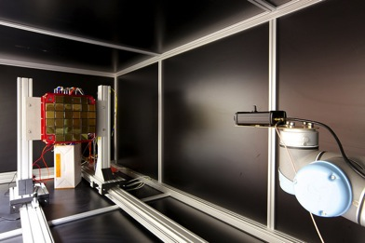
Commissioning Lab Setup
proto-Backplane
DACQ boards
Tester Board: FPGA board to generate CLK and Trigger signals for protoBackplane

Slide 14
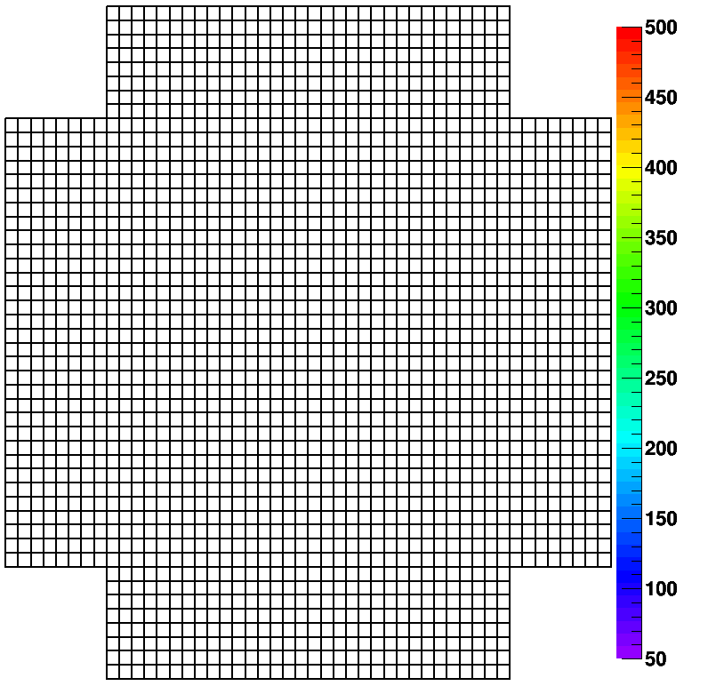
CHEC-M Commissioning Results
Laser flashes, externally triggered camera readout
  Full libCHEC software setup: camera server, controller “online”
  “offline” data analysis
  Use waveform sampling: per event, step through waveform around peak
  Fake air-shower images with mask

Slide 15
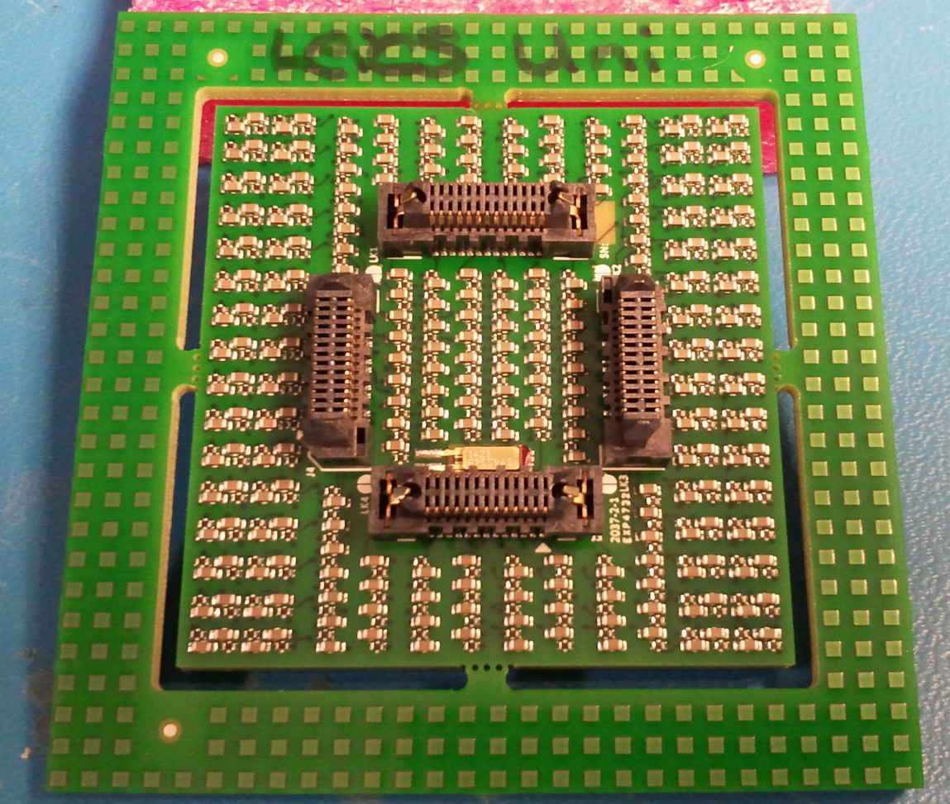
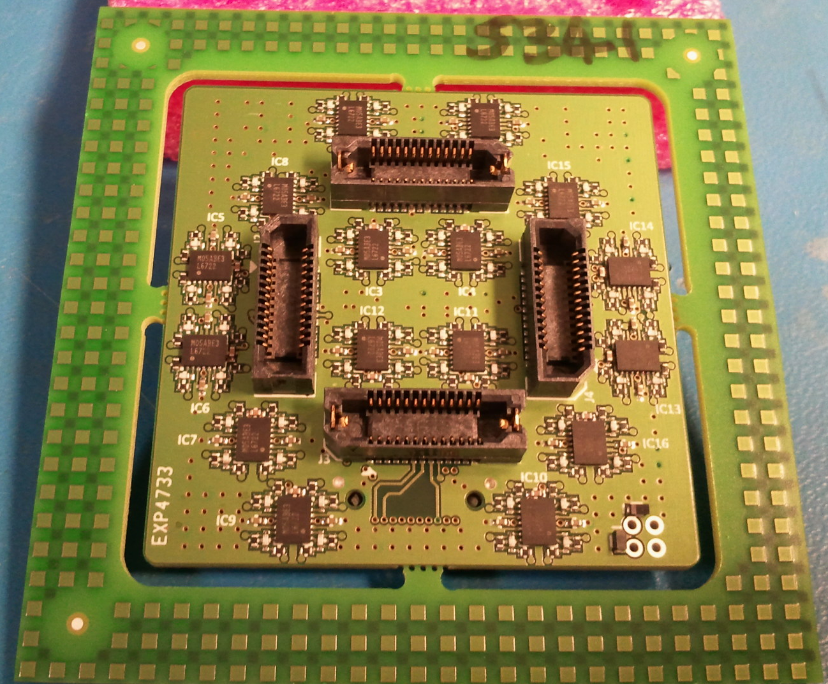
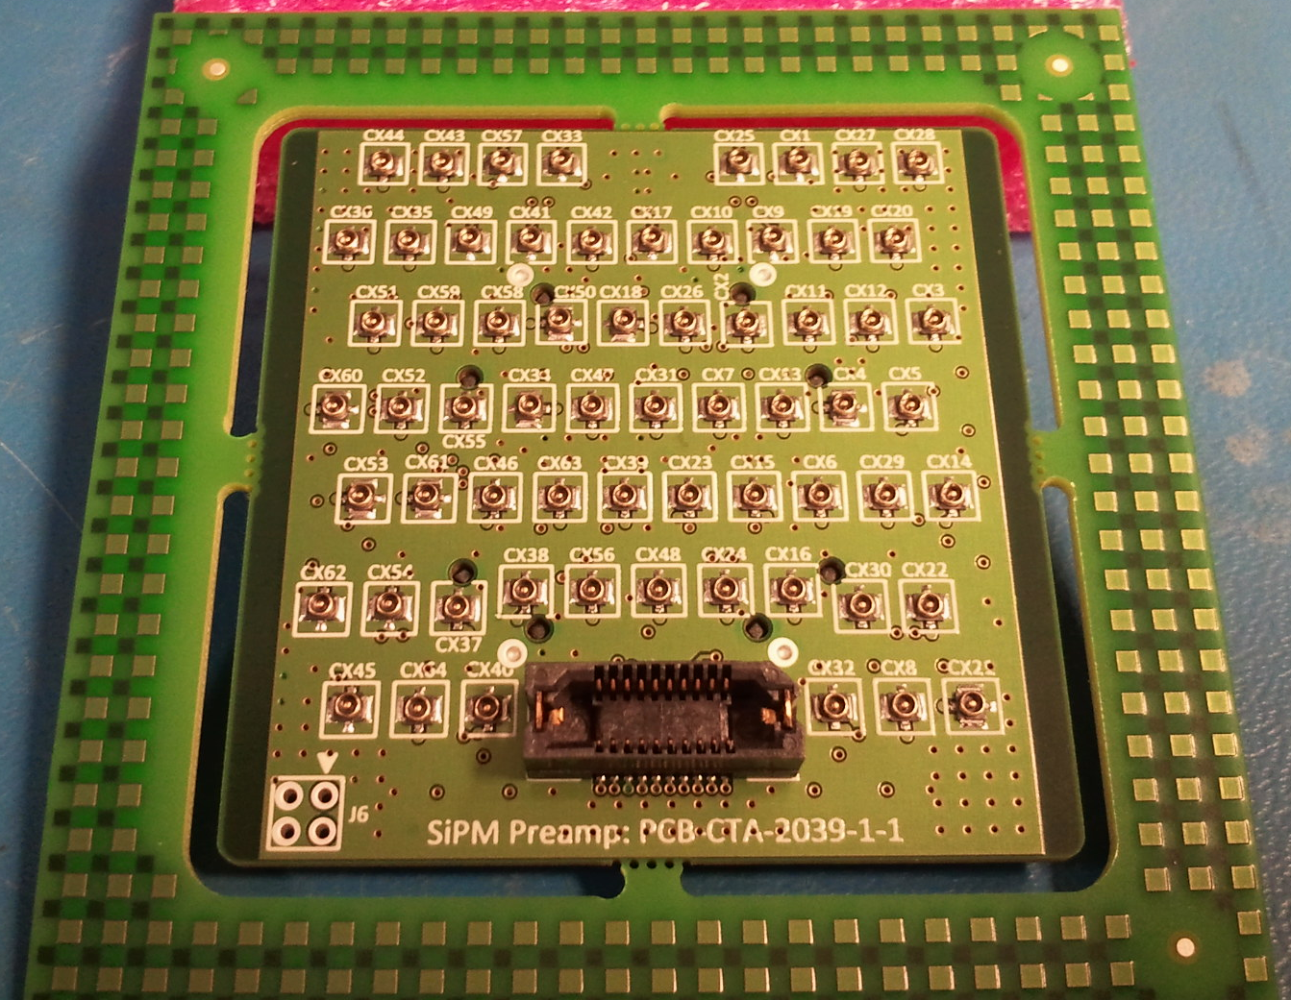
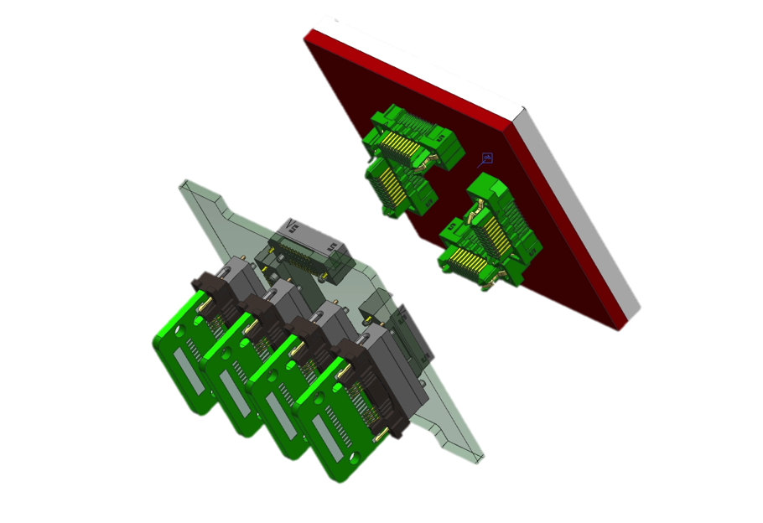
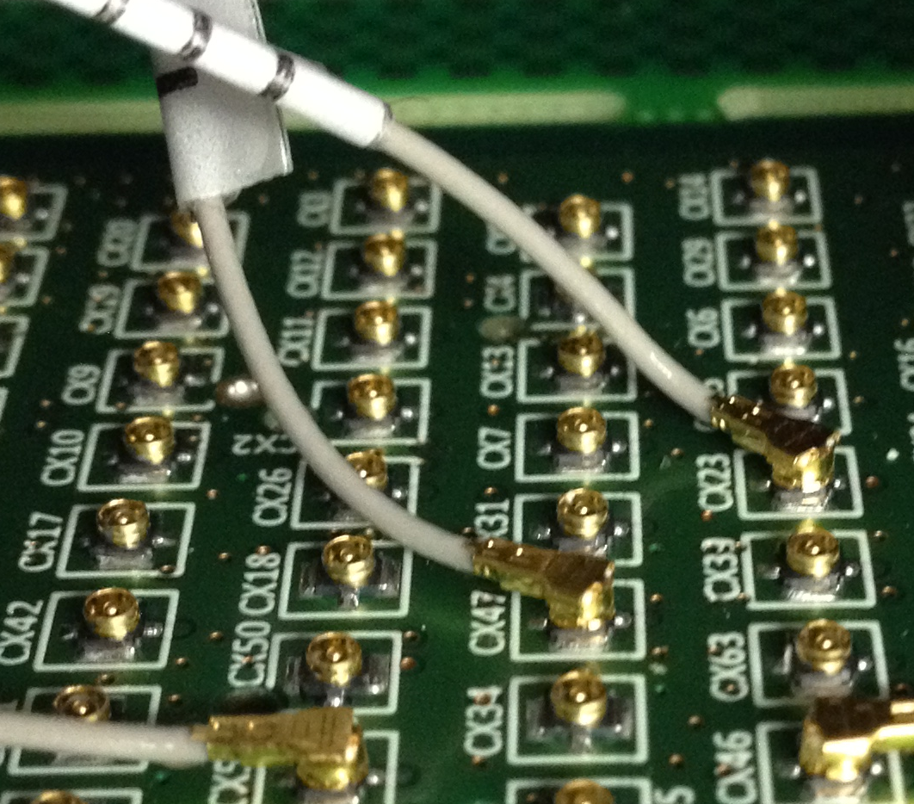
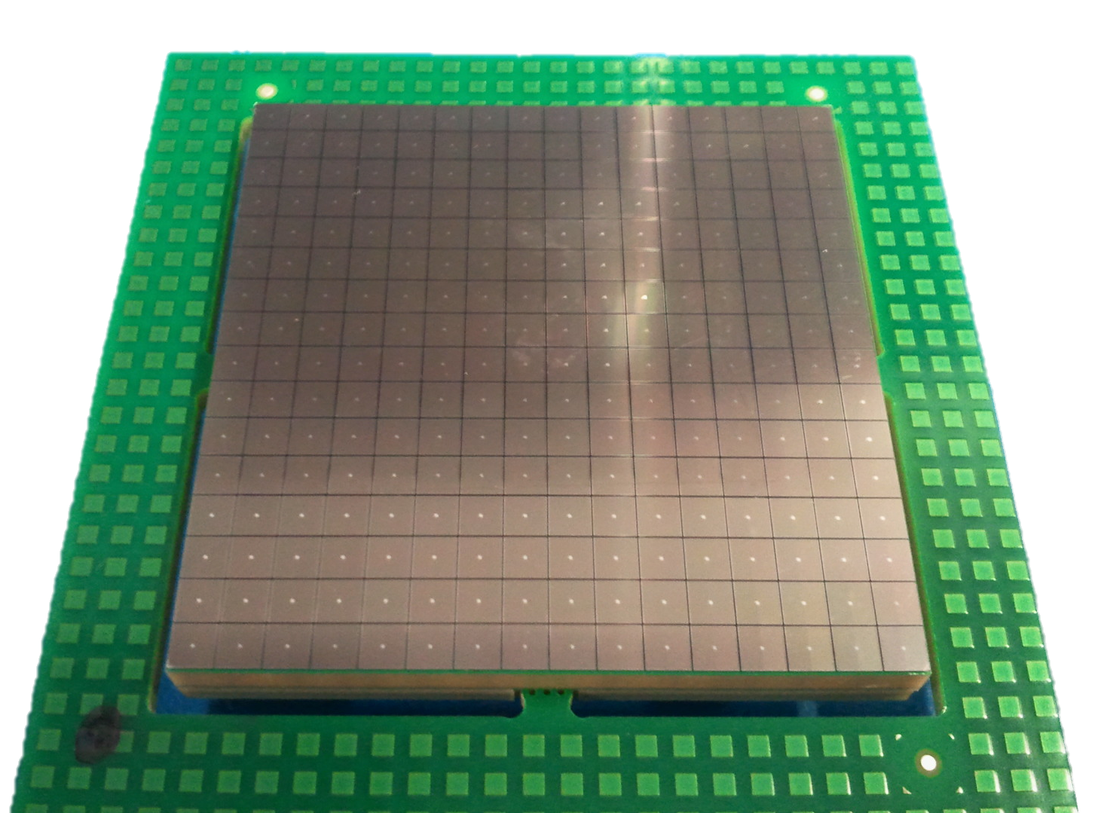
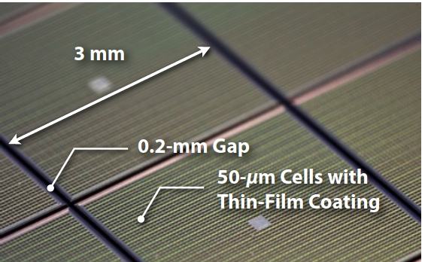
CHEC-S
Latching connectors
Op-amps
Latest news:
  TARGET-7 modules under test in Erlangen
  Front-end buffer and preamp now under test at Leicester with full SiPM tile attached to base
Bias circuits
Rear of SiPM base
Front of front-end buffer
Rear of front-end buffer
CHEC-S SiPM:
Hamamatsu S12642-1616PA-50
Micro coax cables
64 camera pixels
87% geometric fill factor
4 pixels combined to make 1 CHEC-S pixel
51.4 mm
93% geometric fill factor possible with 6 mm pixels and same gaps, tile reduces to 50 mm x 50 mm
51.4 mm
Depth of ~3.5 mm (including base PCB)
Through Silicon Via (TSV)

Slide 16
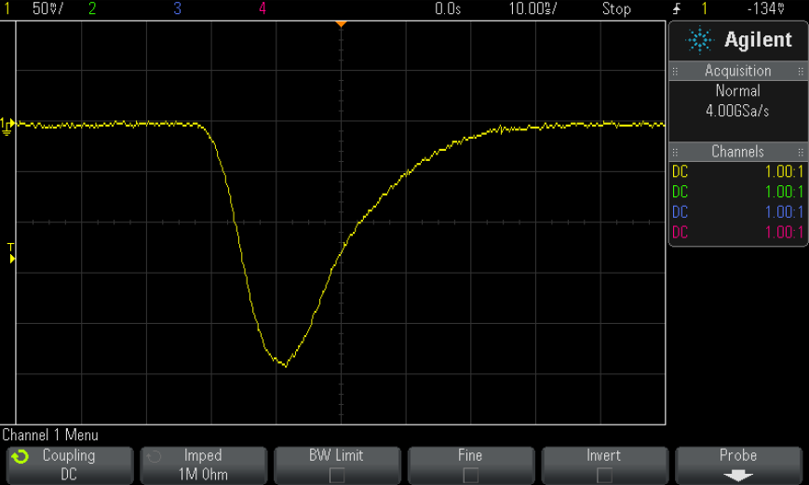
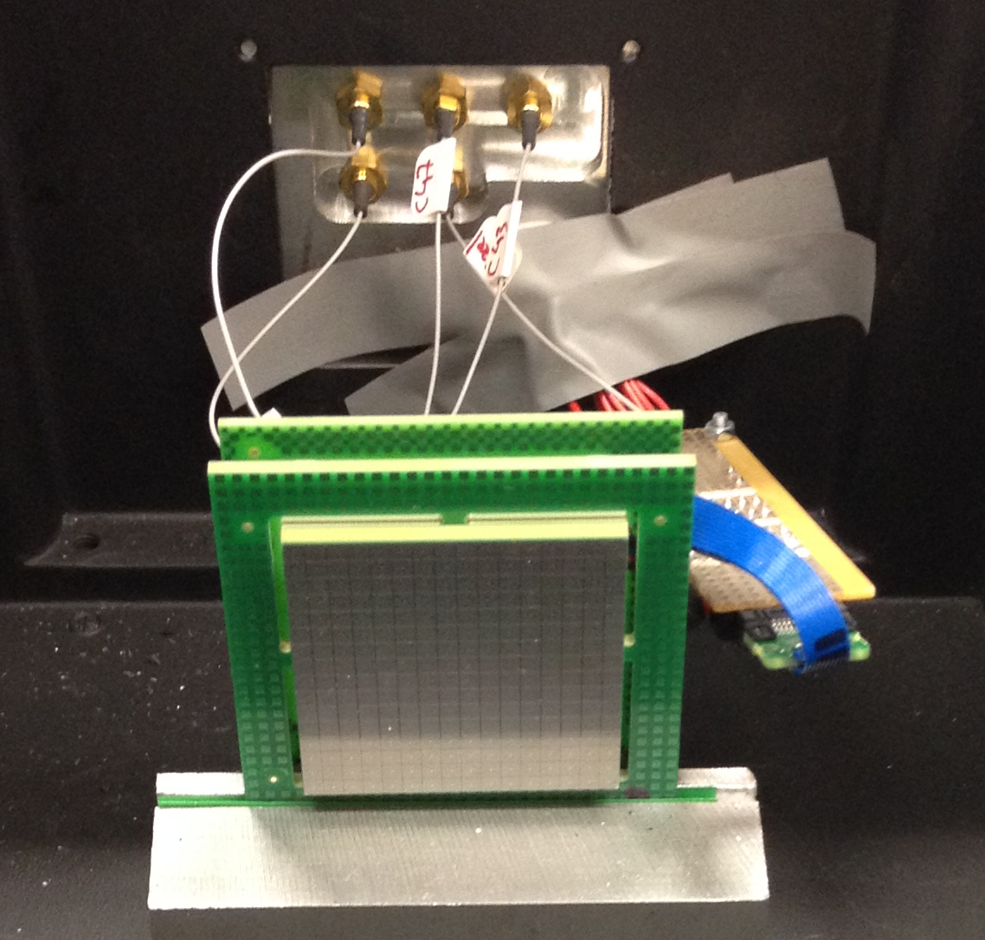
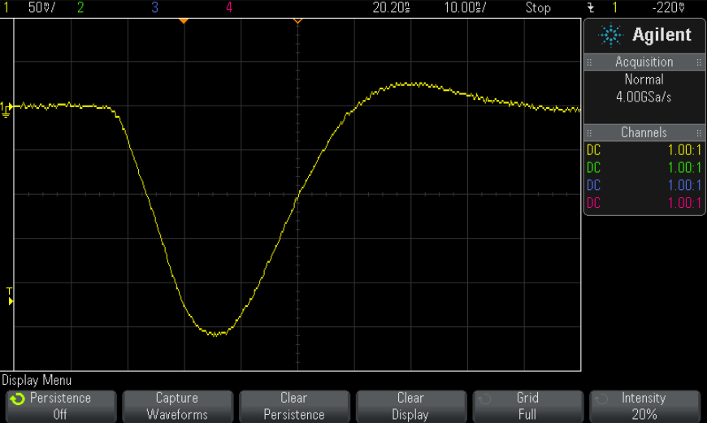
CHEC-S
Front end buffer tests
Only using mechanical samples thus far
Faster pulse rise time than previous devices
Preamp response with 1 pixel
SiPM tile, base and front-end buffer test in dark box
Preamp response with 4 pixels

Slide 17
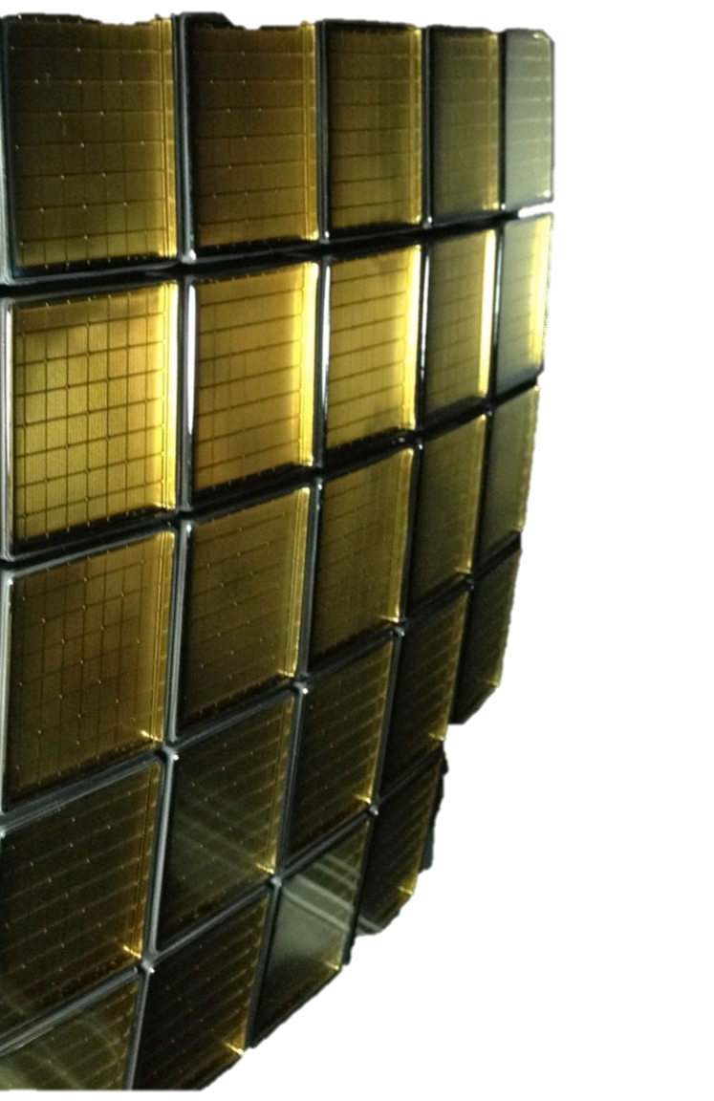
Summary
Prototype GCT assembled
Mirrors under construction
and test
  On telescope in July
CHEC-M commissioning in progress
Meudon field trials
  Later in 2015
CHEC-S progressing
  First batch of MPPCs delivered
  Second MPPC batch due end-May

