Slide 1
Fourier transforms
In this lecture we will:
Look at some more Fourier transforms.
See how Fourier transforms can be used to solve differential equations.
Do a useful integral.
A comprehension question for this lecture:
Calculate the Fourier transform of the function given by:
1

Slide 2
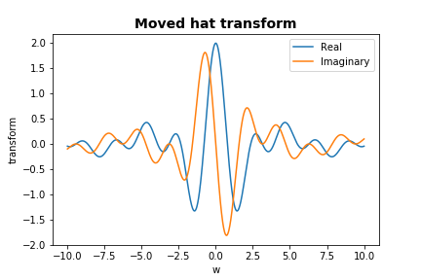
Fourier transforms – effect of shifting function
Shift hat from origin.
Is this function (the orange one!) even or odd?
Would you expect the transform to be purely real (“cosine”)…
…or purely imaginary (“sine”)?
Fourier transform of shifted hat:
2

Slide 3
Shifted hat transform
Fourier transform of hat is:
Fourier transform of hat shifted to right is:
Given this, what function would you expect the following transform to represent:
Hat shifted to left!
3

Slide 4
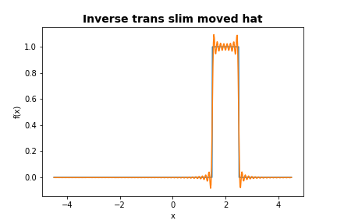
Slim hat
Yet another function.
Fourier transform:
4

Slide 5
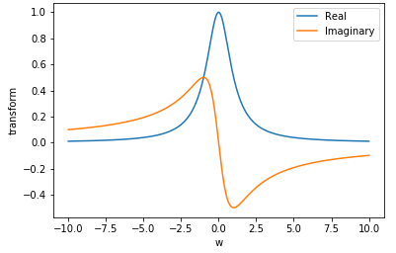
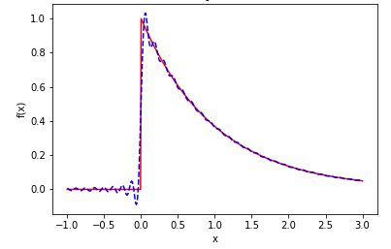
Transform of exponential
E.g. (a > 0):
Fourier transform is:
Have used:
Transform:
Recovered function:
5

Slide 6
Fourier transform of derivative
Differential equations and Fourier transforms
One of the useful properties of Fourier transforms derives from the following result (for functions such that ):
Applying this twice gives:
This can be used to solve some differential equations, for example:
Take the Fourier transform of both sides:
Then use inverse Fourier transform to determine y(x).
6

Slide 7
One more useful Fourier transform
Look at
Calculate the transform:
Using the result (see next slide):
We have:
In this case, the Fourier transform has the same functional form (exponential) as the function.
7

Slide 8
A useful integral
Define:
Then:
Think of this as an integral over the (x, y) plane and convert to polar coordinates:
We then have:
Using:
Hence:
This gives:
8

Slide 9
Fourier series and transforms in physics
The time development of many physical systems is described by partial differential equations (involving say position x and time t).
Often we know the initial configuration, e.g. as a function of x at time zero.
In the case of a periodic initial configuration, or one that is confined to a finite region of x, it is often useful to write this configuration as a Fourier series.
Each mode in the series typically has simple (but different) behaviour as a function of t.
Each mode can therefore be solved and its behaviour with t calculated.
The behaviour of the system can then be found by summing up the solutions for the individual modes.
Examples include heat diffusing along a metal bar or waves on strings.
A similar procedure can be used for non-periodic configurations and those not confined to a limited x range.
In these cases, Fourier transforms are used rather than Fourier series.
Examples include waves travelling through space and single pulses in electronic circuits.
9

