Slide 1
Fourier Series and Fourier Transforms
Example from problems class.
Find the first six terms in the Fourier series for the function with T = 4 defined by:
Compute the Fourier transform of the function:
Determine the Fourier transform of the function:
1

Slide 2
Fourier transform of f(x)
We have:
Break integral into parts
First part:
Second part:

Slide 3
Fourier transform of f(x)
Third part:
Fourth part:

Slide 4
Fourier transform of f(x)

Slide 5
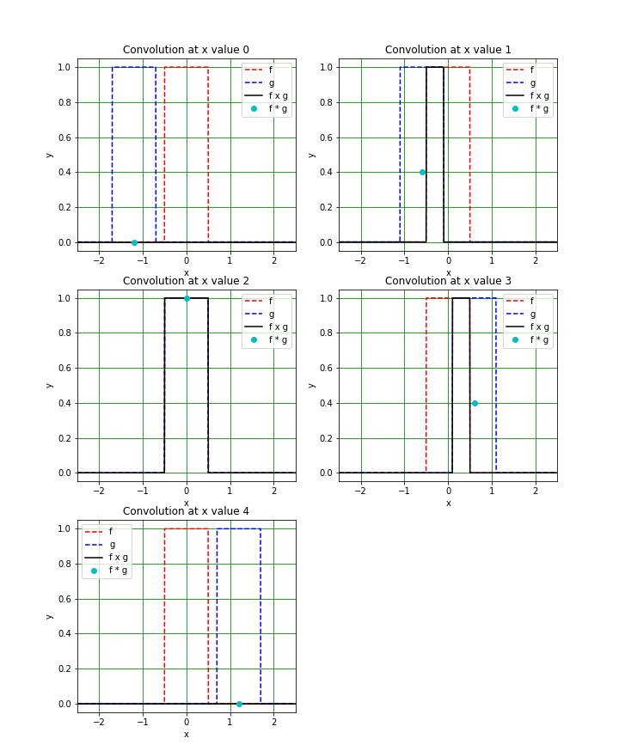
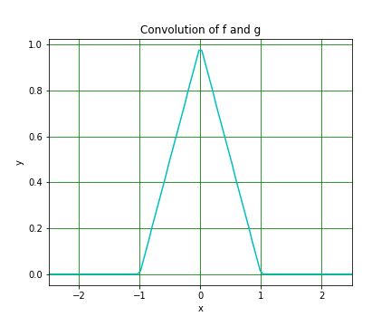
Convolution example
Remember what convolution is:
The value of at a given x is the overlapping area of f and g
(Here we have f = g.)
5

Slide 6
Convolution example – animation
6

Slide 7
Convolution example
If is the Fourier Transform of g then:
This gives us:
7

