Slide 1
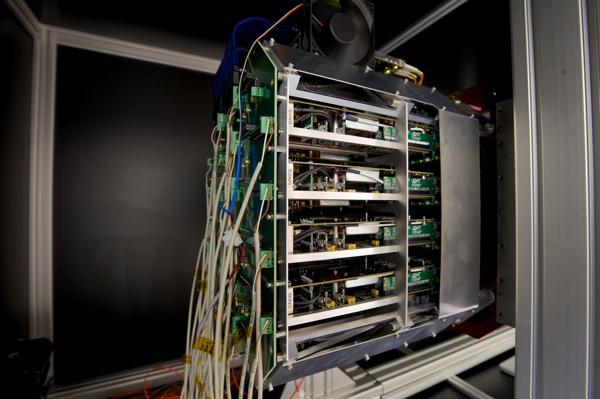
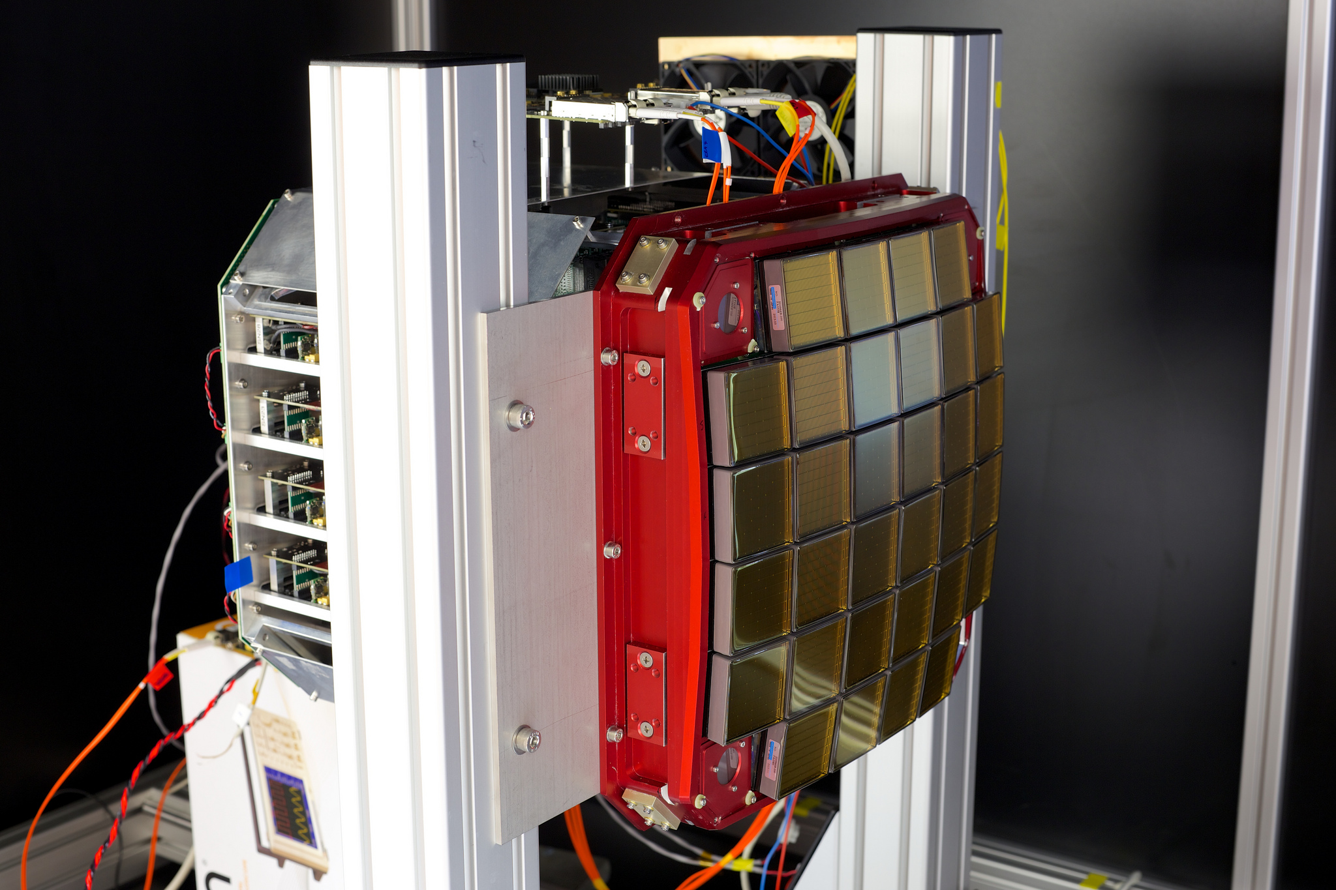
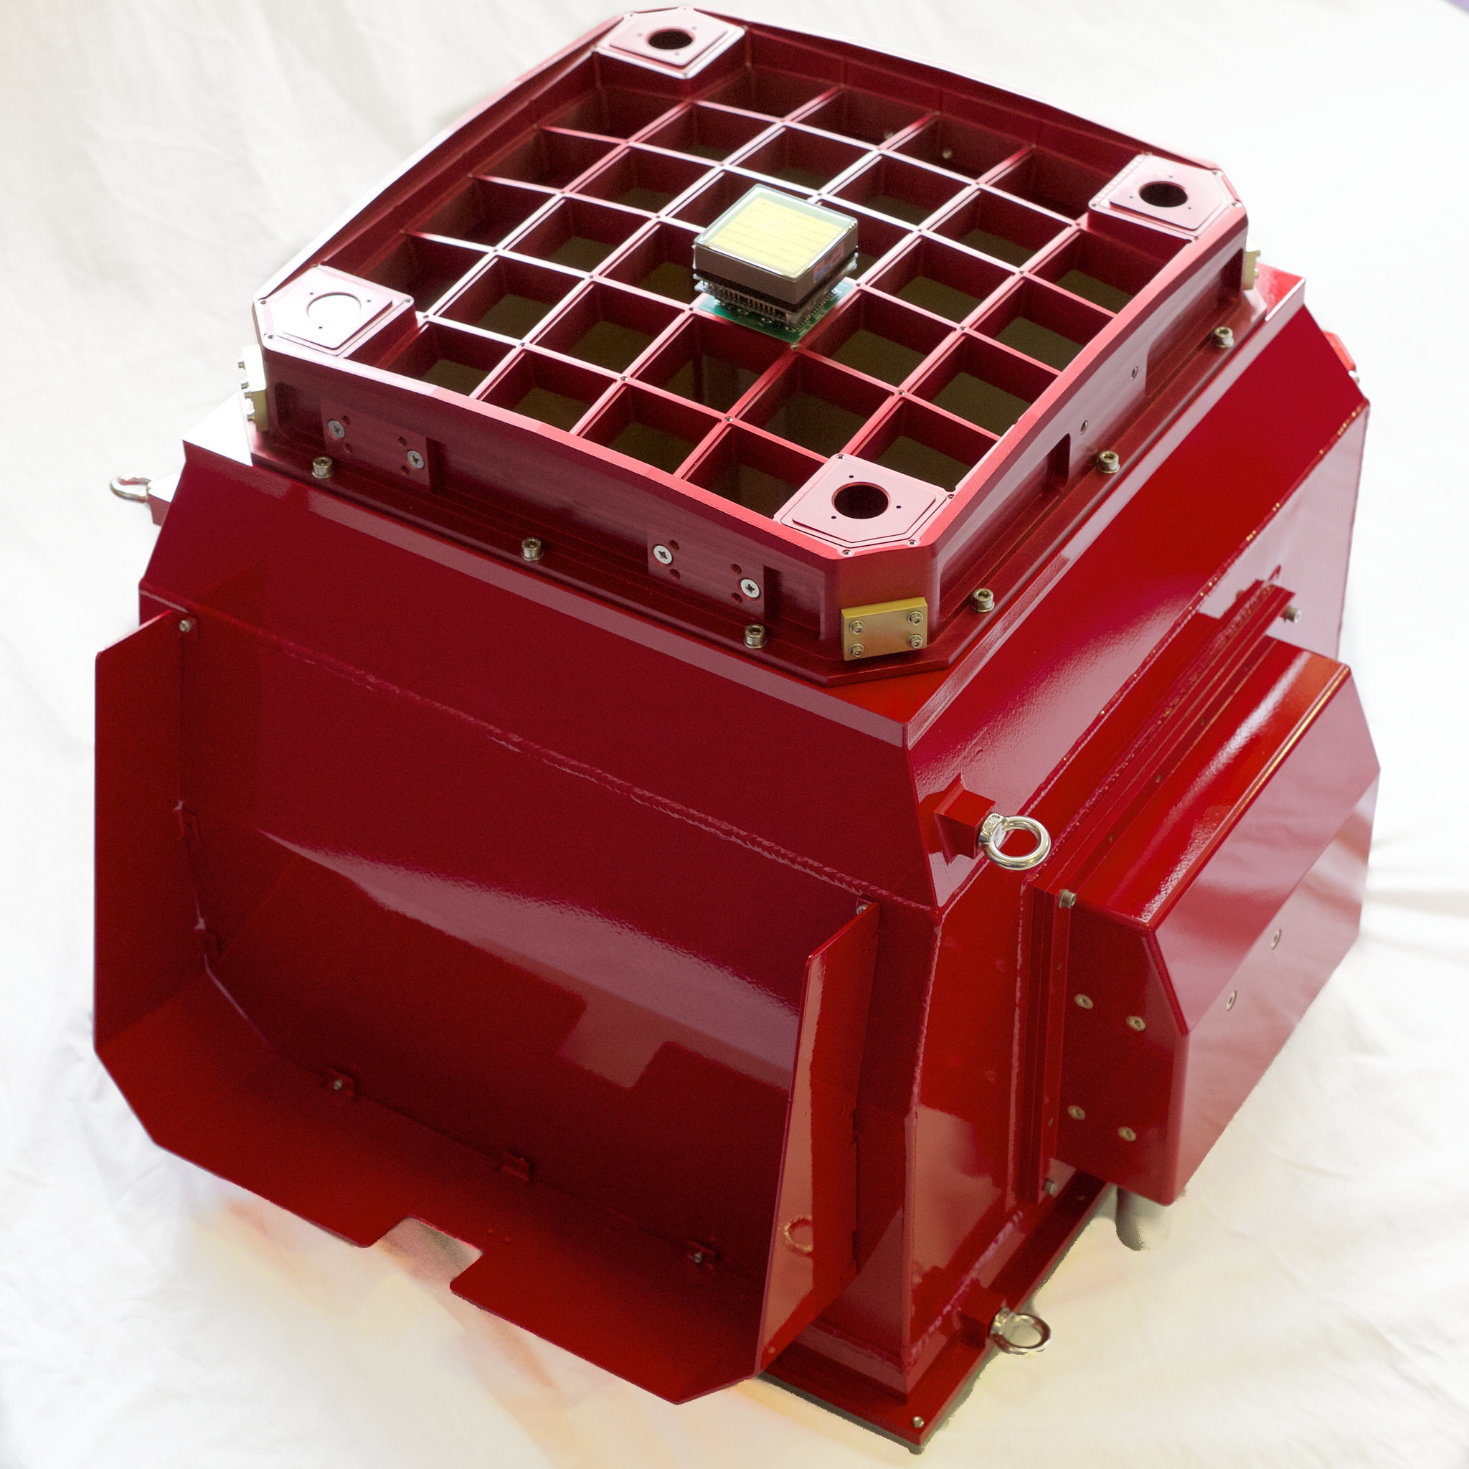














GCT Camera Progress
Jon Lapington, CTA Consortium Meeting,
Turku, May 2015
Notes:
STFC, Leicester, Oxford, Amsterdam, Wash U ST Louis, Adelaide
Liverpool, Durham, ?, SLAC, Santa Cruz, Hawaii

Slide 2
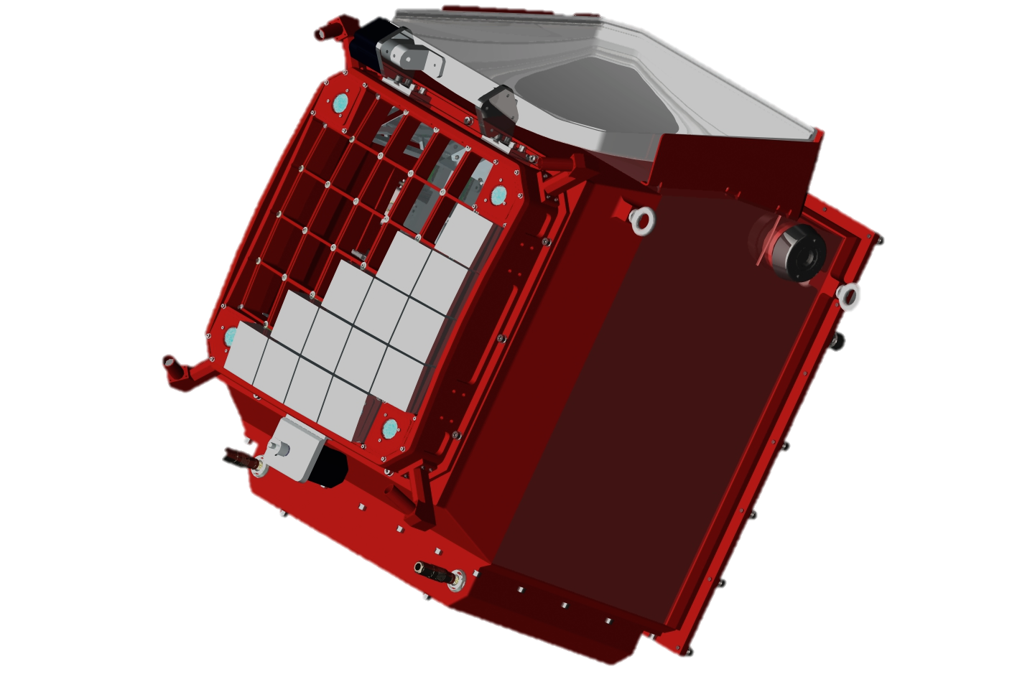
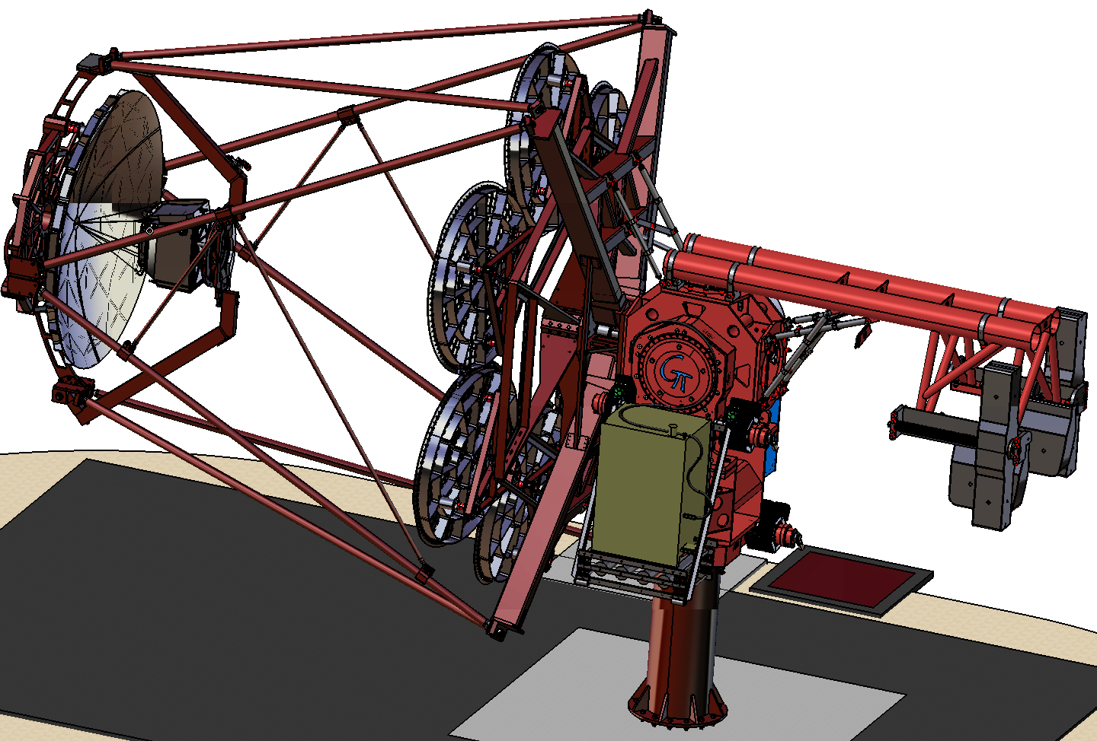
GCT: The Gamma Cherenkov Telescope
Talks at this meeting:
Monday SST
SST configuration 3: GCT
Tuesday SST
GCT structure and optics
GCT MC Studies
Control of GCT camera peripherals
GCT Camera Progress
GCT Camera Software
GCT Calibration
Thursday Plenary
SST-2M GCT progress report
CHEC progress report
Notes:
Monday: Tom Armstrong
Tuesday: Delphine Dumas, Tom Armstrong, Michael Daniel, me, Andrea de Franco, Anthony Brown
Thursday: Delphine Dumas, David Berge

Slide 3
GCT: The Gamma Cherenkov Telescope
Contents:
Camera team evolution
CHEC-M
Overview
Mechanics
Electronics
Commissioning
Auxiliary Systems
CHEC-S and beyond
SiPMs
Front-end electronics
Summary

Slide 4
Evolution of the camera team
UK collaboration
Leicester, Durham, Liverpool, Oxford, Liverpool John Moores (2015)
1st STFC funding 04/2012 – 03/2015, PI – Jim Hinton
March 2015: Jim, Rich, Akira → MPIK, Heidelberg
Proposed STFC funding 2015-2017, PI – Tim Greenshaw
Main camera development remains at Leicester
Jon Lapington – lead (since 1st April 2015)
Duncan Ross – mechanics
Julian Thornhill – electronics
Pippa Molyneux – commissioning
External team
Rich White, Akira Okumura, Arnim Balzer, Andrea De Franco, Jason Watson, Manuel Kraus, Tom Armstrong
Lab reorganization
CHEC-M, CHEC-S, GCT assembly & commissioning

Slide 5
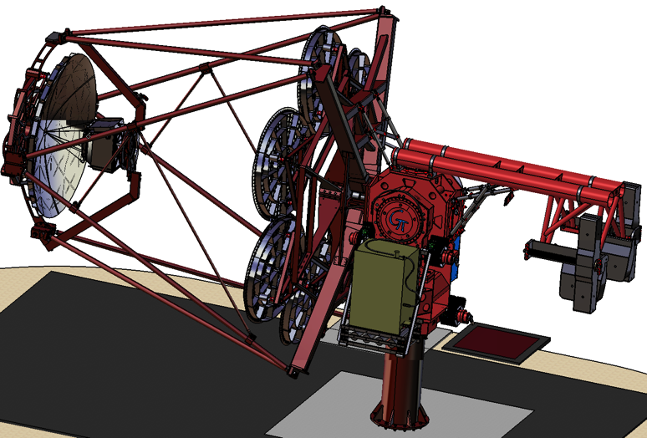
CHEC-M in context
First GCT camera prototype
Properties:
MAPMs
TARGET 5 ASICs
To be installed on GATE later this year
The next step is CHEC-S
Properties:
SiPMs
TARGET 7 ASICs
→ GCT pre-production camera
SiPMs (LCT5, etc.)
TARGET-C &TARGET-CCTV

Slide 6
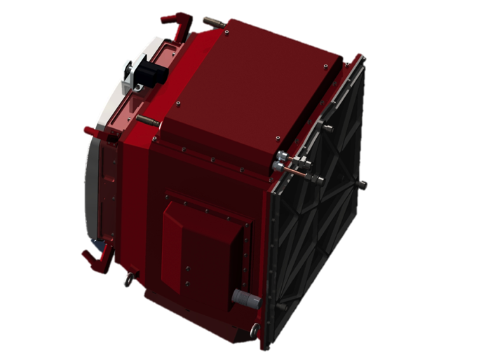

Overview
Telescope Interface
Pointing LEDs
Lid motor
Lid
Photodetectors attached to trigger and digitisation electronics
Chiller send/return
Power and data connections
Mounting eyelets
LED Flasher Units
Desiccator
Focal plane plate
Lid Locking Mechanism
Motor Bulk-head Connectors
Thermal Exchange Unit
Enclosure

Slide 7
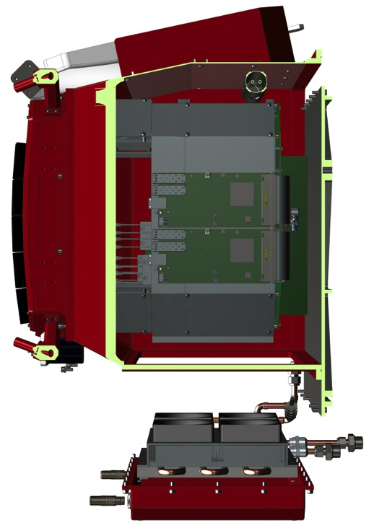
Overview
~0.5 m
Windshield
DACQ boards
SFP (fibre) connection points
Air-flow baffles
TARGET modules inserted into rack
Backplane
Send / return to backplane cooling block
Fans
Heat sink
Liquid-cooled block
Liquid send / return to chiller
Thermal Exchange Unit panel
Notes:
From right hand side

Slide 8
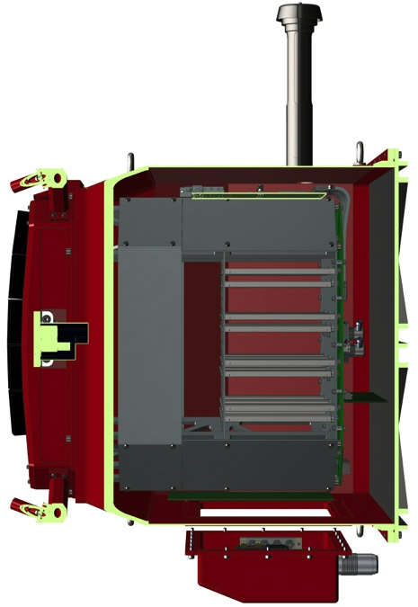
Overview
Desiccator
Pointing LEDs
Air-flow baffles
DACQ boards
DACQ-to-Backplane cables
Backplane
Backplate
Backplane cooling block
Rack
Lid Locking mechanism
Peripherals Board
Mouting eyelets
Cable inlet panel
Notes:
From underside

Slide 9
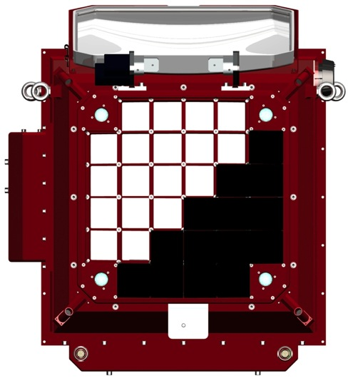
Overview
Lid motor
Lid
Mounting eyelets
Cable inlet panel
~0.5 m
~0.35 m
Photodetectors
LED Flasher Units
Connections to lid assembly
Notes:
From front

Slide 10
Electronics and Readout
TARGET Module
16 x Preamps
Target Asic
FPGA
64 Pixel Module
16 x Preamps
Target Asic
Data
16 x Preamps
Target Asic
Array/Clock Interface
16 x Preamp
TARGET ASIC
Trigger
Backend Electronics
Control, & Data
x 32
Any 2 neighbouring super-pixels
64 Pixel Module
Following camera trigger data read out to central location

Slide 11
CHEC Back-End Electronics
UDP TM Raw Data, Control / Monitoring
TCP DACQ (and → SPI) Control / Monitoring
SPI Control / Monitoring
TM 4-pix Analogue Sum Trigger Signals
Global Clock from DACQ
Camera Readout Trigger + Event #
Backplane
Photosensor, Preamp, TARGET Modules
DACQ Board 1
SFP 1.1
WR Switch
IP addresses 1 - 8
Event numbers time stamped and sent to PC
Photosensor, Preamp, TARGET Modules
SFP 1.2
IP addresses 8- 16
Camera Trigger and event number generation and distribution
Photosensor, Preamp, TARGET Modules
DACQ Board 2
SFP 2.1
IP addresses 16- 23
Photosensor, Preamp, TARGET Modules
SFP 2.2
IP addresses 24 32
Peripherals (LED Flashers, Lid, Fans, Sensors ++
Peripherals Board
PC with 4 NIC
Notes:
Update this if there is time
Trigger FPGA: 1760 pins, 256 mbit flash

Slide 12
Electronics and Readout
Focal Plane
Slow raw data signals read out over SPI to FPGA
Control and monitoring using SPI and several GPIO
Off-Camera
TARGET Module 1
Backplane
DACQ Board 1
Power and Monitoring PCB
ASIC and Readout PCB
Slow signal monitoring
TARGET Trigger ASIC
TARGET Digitisation ASIC
House -Keeping FPGA
SFP
TARGET Trigger ASIC
TARGET Digitisation ASIC
SFP
Photodetector Base PCB
Shaping and amplification
Connections from TARGET modules 1 – 16 input to DACQ1
64 Pixel Photodetector
Front-End Buffer
TARGET Trigger ASIC
TARGET Digitisation ASIC
FPGA
Fibre
Bias voltage trimming and pixel on/off
Trigger FPGA
Connections from TARGET modules 17 – 32 input to DACQ2
TARGET Trigger ASIC
TARGET Digitisation ASIC
DACQ Board 2
18-way Ethernet switch
64 channels
Flexible, shielded cables between buffer and TARGET module.
A single bias voltage is fed into all TARGET modules from outside the camera via the backplane and trimmed per SiPM tile
16 channels per ASIC
4 digital signals per ASIC, 16 per TARGET module
Full waveform digitisation
SFP
Interface to focal-plane plate
SFP
All TARGET I/O via copper connection
Timing Board
TARGET Module 32
SFP
Lid motor
Motor controllers
Peripherals Board
SPI
Lid lock motor
Limit switches
ALS
Pointing LED
LED Flasher
Pointing LED
LED Flasher
PWM speed control
Pointing LED
LED Flasher
Serial communications to set flasher pattern
Temperature and humidity
Pointing LED
LED Flasher
Sensors
Fans
Raw analogue data
Array-wide White Rabbit timing link input on 1 Gpbs fibre-optic link
Raw digitised data
1 PPS array-synchronous clock used to re-sync internal counters and sampling
1 Gbps UDP over Ethernet link (copper or fibre) for raw data, control and monitoring
62.5 MHz array-synchronous clock, multiplied to 125 MHz on the backplane
Discriminated analogue sum of 4-pixel digital trigger signals, 16 per TARGET module
Asynchronous TTL pulse from the backplane to trigger the LED flashers
Camera readout out and re-sync serial connection
Internal serial communications for control and monitoring
Notes:
Scheme for final GCT camera.
From sensor backwards, buffers, shielded cables, analogue functionality, 2 ASIC TM, Full BP and 2 DACQ boards with fibre to outside. Peripherals controls door, calib flashers and all housekeeping

Slide 13
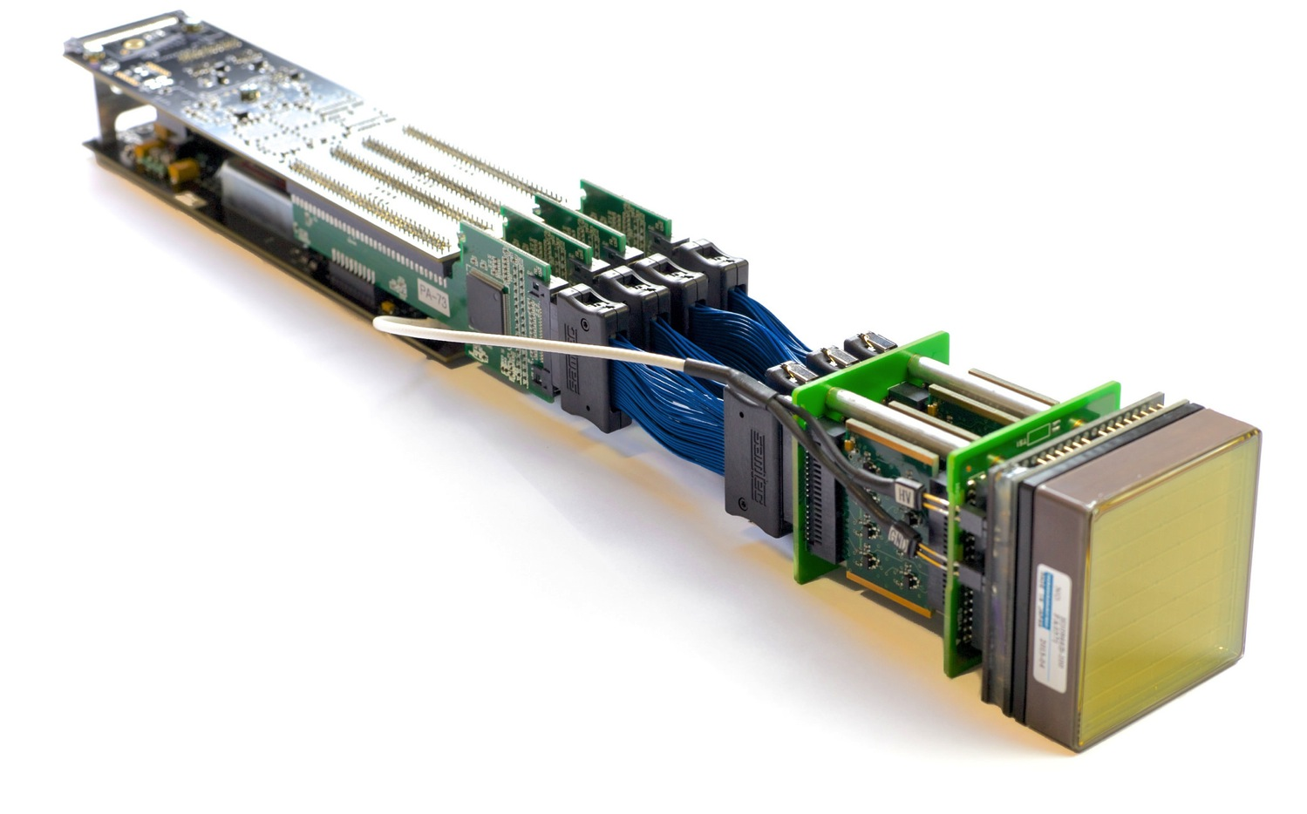
CHEC-M Camera Module
Backplane connector carrying raw data, trigger and sync signals and power
Xilinx Spartan 6 FPGA (under)
Coaxial ribbon cables for analogue signals and preamplifier power
Front-end buffer module – 4 x 16 channel preamplifiers
Mechanical standoff with retention for TARGET module to the backplane
PCB to interface with the focal plane plate
High Voltage supply
TARGET ASIC 16 channels digitisation and triggering
Individual amplifier circuit
High Voltage connection to the MAPM
MAPM
(Hamamatsu H10966B)

Slide 14
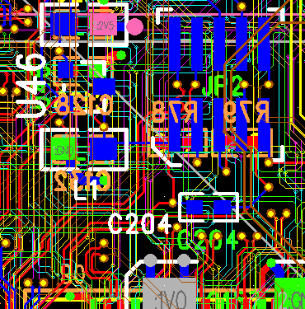
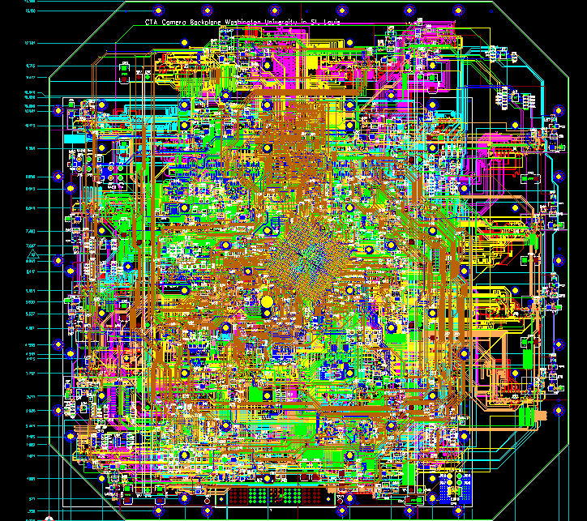
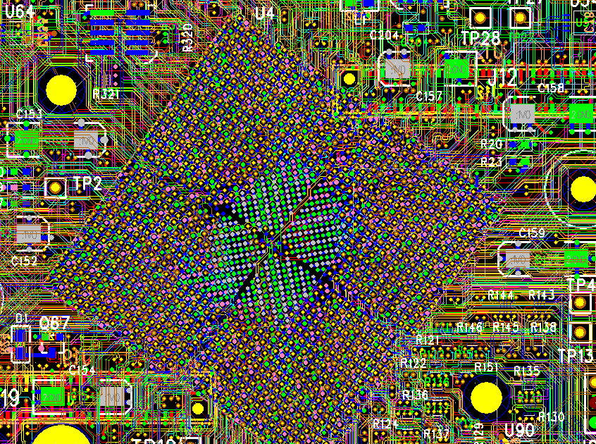
CHEC-M Backplane
Trigger FPGA
(XC6VLX550T )
Notes:
BP functionality:
Housekeeping FPGA
Trigger FPGA
Routes clock in, digital trigger out, serial comms in, digital raw data out
Trigger FPGA: 1760 pins, 256 mbit flash, >0.5M logic cells

Slide 15
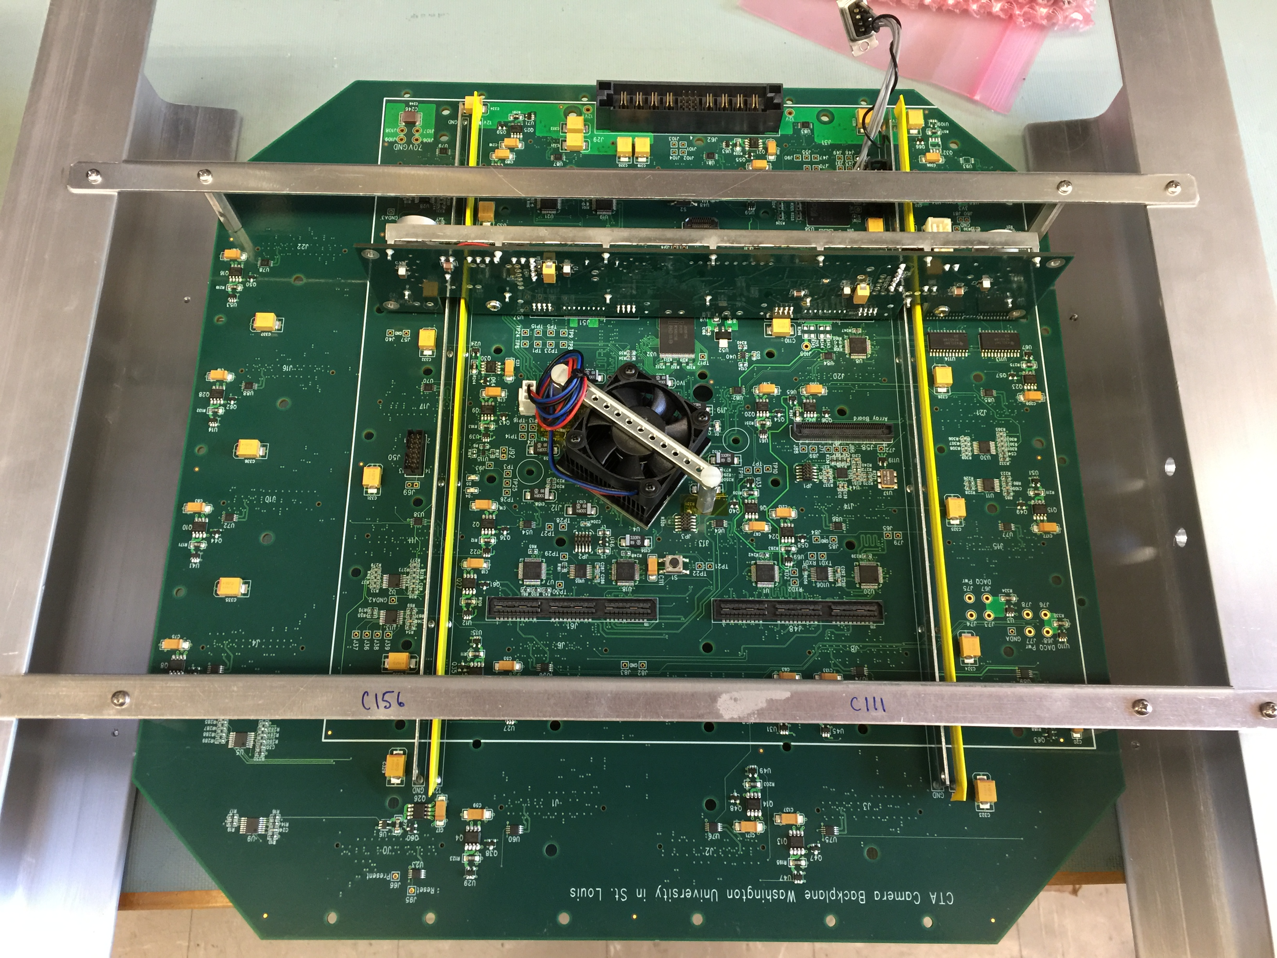
CHEC-M Backplane
Hardware complete – firmware under development
DACQ connections
Trigger FPGA
Housekeeping FPGA pads
Power Board connection

Slide 16
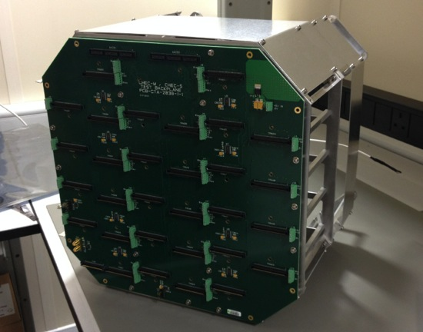
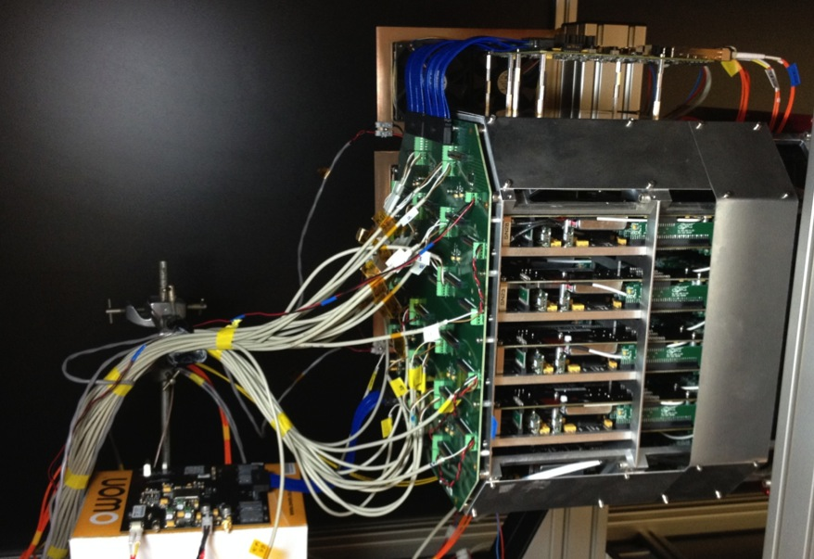
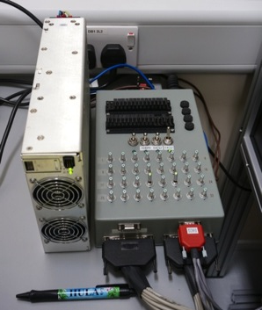
CHEC-M Backplane
Lab tests proceeding with a proto-Backplane
All tests apart from triggering possible
Connection to DACQs
Power to TARGET modules
Accommodates TARGET modules in identical way to real Backplane
Trigger and CLK input & fan-out
PSU and switch box
Notes:
Passive proto backplane plus tester board – no trigger functionality. TMs read out using tester board.

Slide 17
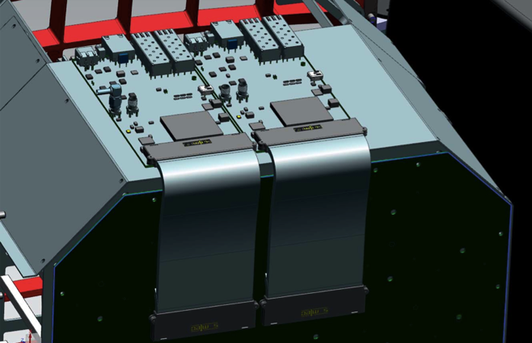
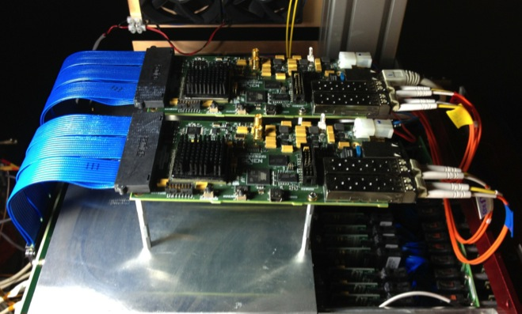
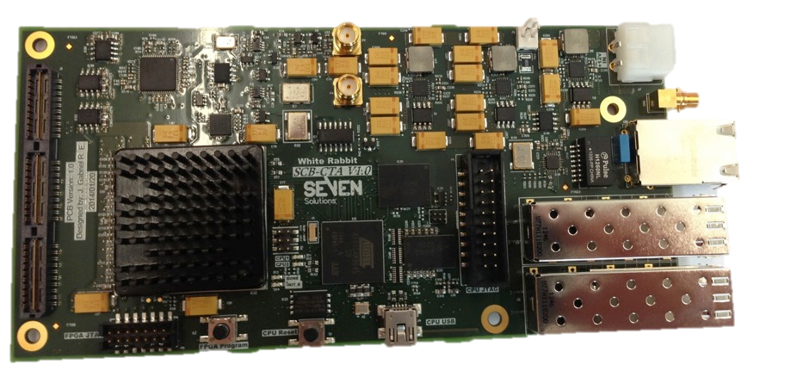
CHEC-M DACQ Boards
University of Amsterdam & Seven Solutions:
5 boards for manufactured, 2 iterations, both work, 2 for CHEC-M
2 boards provide:
36 port switch
4 x 1 Gb/s uplinks
Absolute time synchronisation (using White Rabbit)
Backplane connector
ARM μ-processor
Differential clock
+12 V
FPGA
RJ45 Debug
SFP
Notes:
Add advantages of full waveform readout
Expand this slide:
-- Waveform
-- Photosensors
-- TARGET

Slide 18
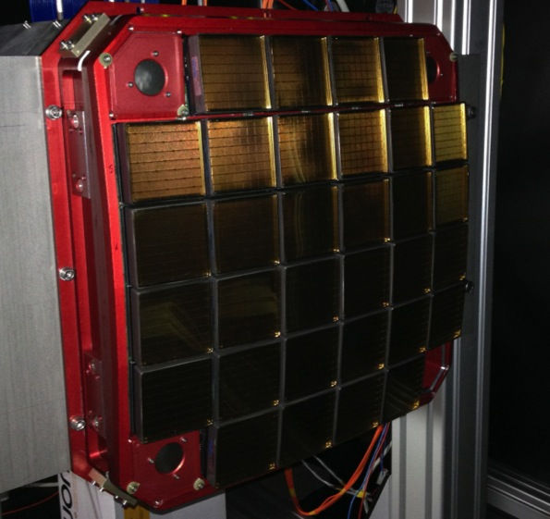
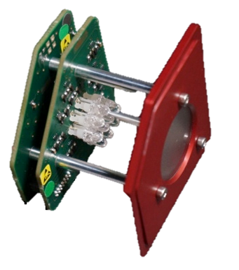
CHEC-M Calibration Units
Illumination of the focal plane via reflection from the secondary mirror
Installed in each corner of the camera
Performance:
Multi-LED provides ~1 - 1000 pe
Pulse width ~4 ns
M2
~0.5 m
To M1→
Camera focal plane
Diffused light from each corner of the camera
1” diameter diffuser
Notes:
Add advantages of full waveform readout
Expand this slide:
-- Waveform
-- Photosensors
-- TARGET

Slide 19
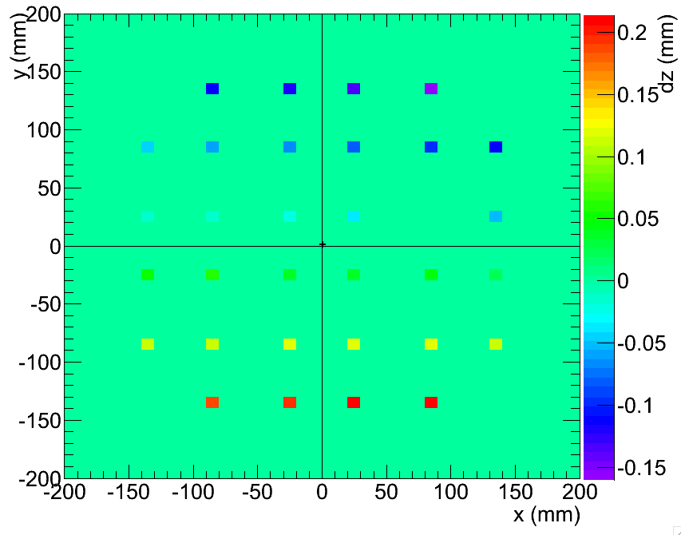
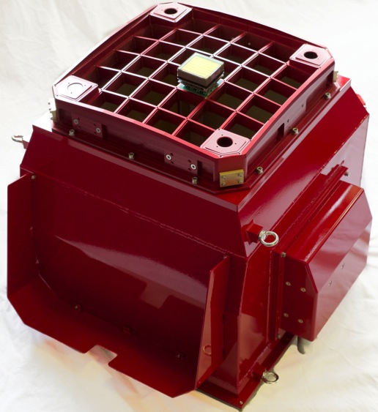
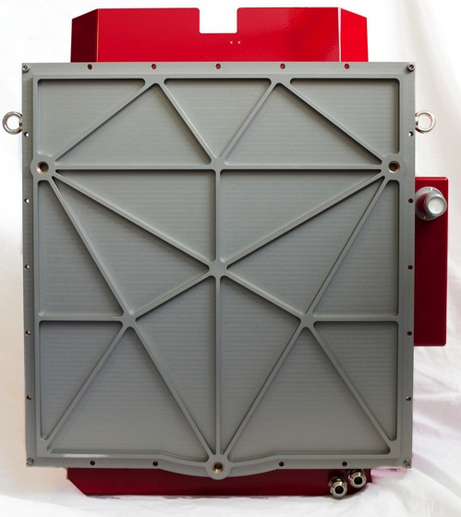
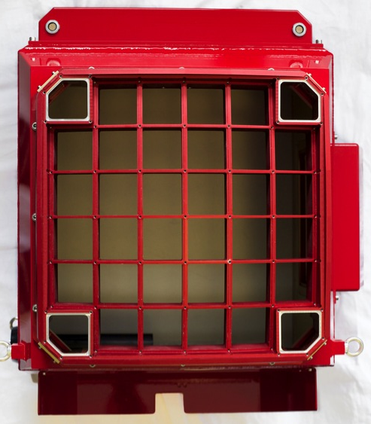
CHEC-M Mechanics
Machined and bent Aluminum
Defocus of 1 mm → PSF degradation of 10% (on axis)
Achieve ~0.35 mm spread between MAPM centres with no adjustment
Can be reduced to 0.035 mm
Notes:
Add advantages of full waveform readout
Expand this slide:
-- Waveform
-- Photosensors
-- TARGET

Slide 20
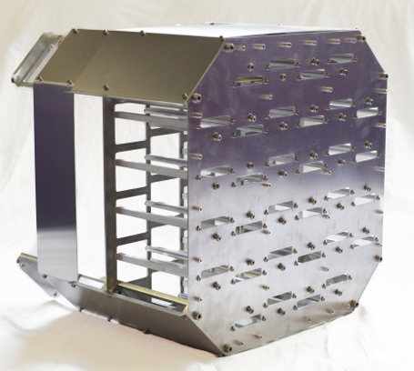
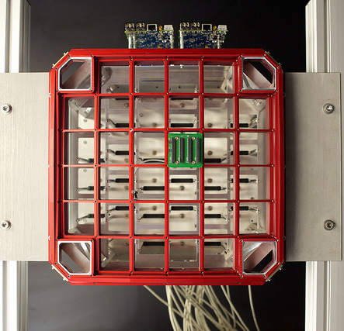
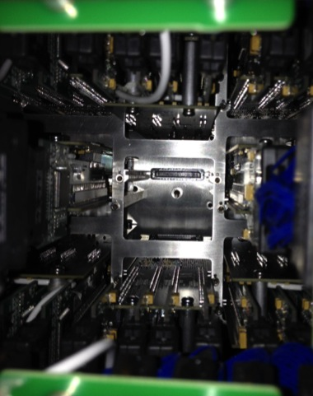
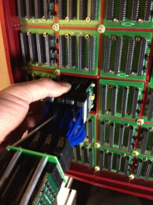
Assembly
Internal rack built
Focal plane attached
Backplane and DACQ boards attached
TMs inserted

Slide 21
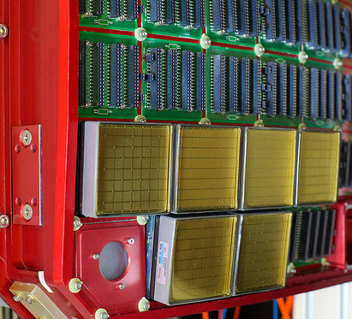
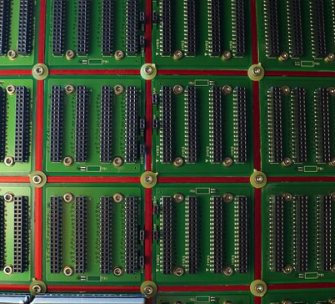
Assembly
Power and Monitoring PCB
TMs pulled in from rear
TARGET module inserted into slot in rack until screw mates with standoff
TARGET module pulled into place with screw via tool inserted through backplane access hole
TARGET module fully mated with backplane and secured in place
Pre-amps secured from front
MAPMs added
Enclosure added
Standoff
TARGET module Samtec connector
ASIC and Readout PCB
Backplane
Pre-amp retention washers
Tool
Threaded hole
Slot
Backplane Samtec connector

Slide 22
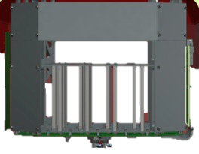

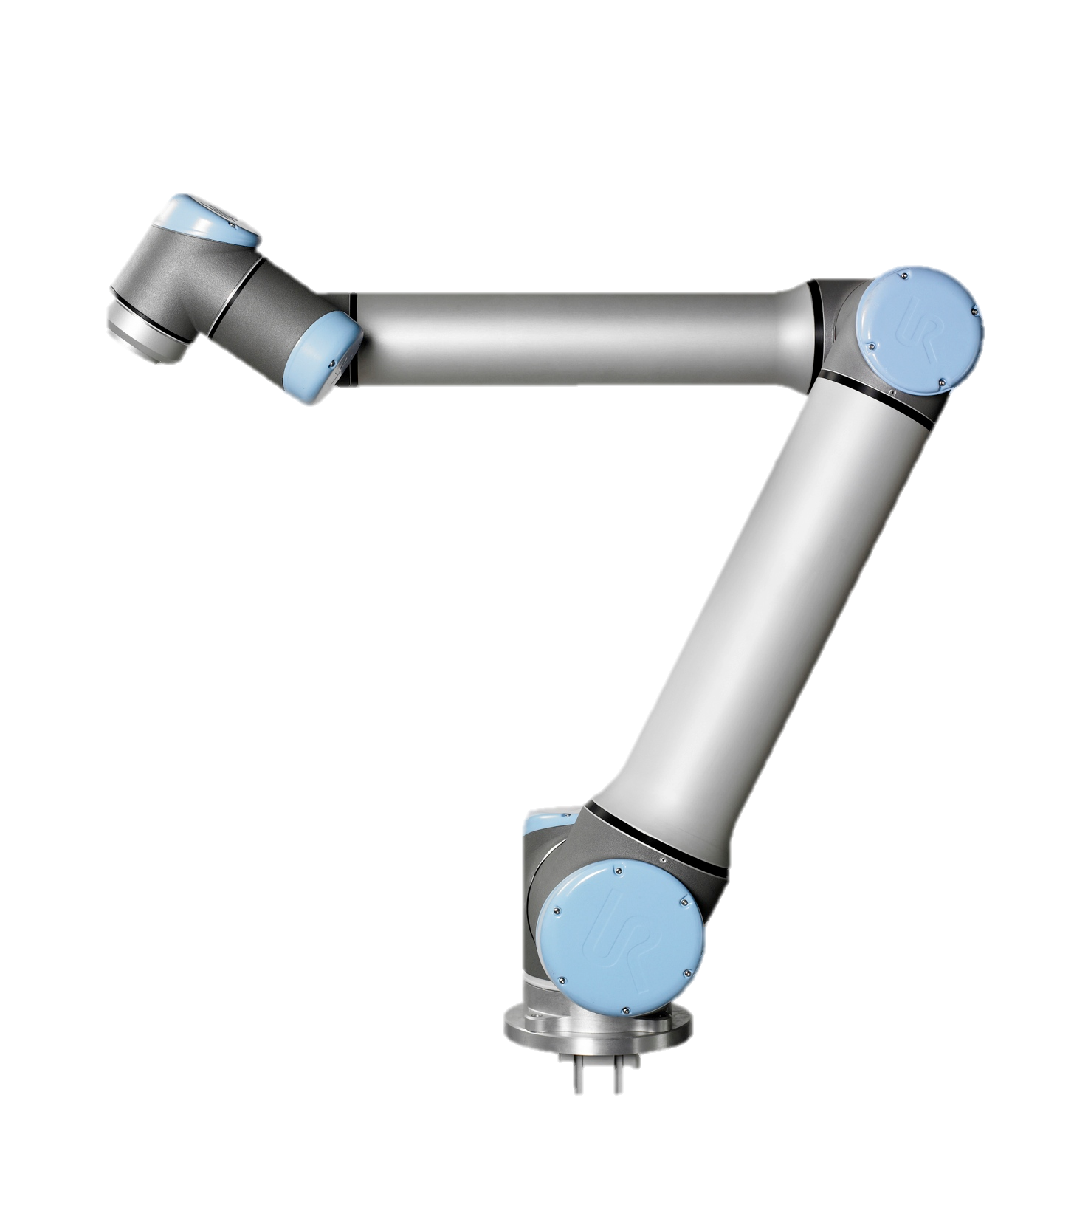
Commissioning Lab Setup
Initial setup for uniform illumination
Dark Box
Camera
Laser and diffuser
Robot Arm
Monitor SiPM
Tester board
Camera mounted on sliding rail
Raw Data & Control
Trigger
PC
Control
Pulse Generator
Control PC with TCP/IP control interface
SiPM Out
Tester board 12 V PSU
Laser 12 V PSU
Scope
Camera 12 V PSU
Proto. Backplane 5 V PSU

Slide 23
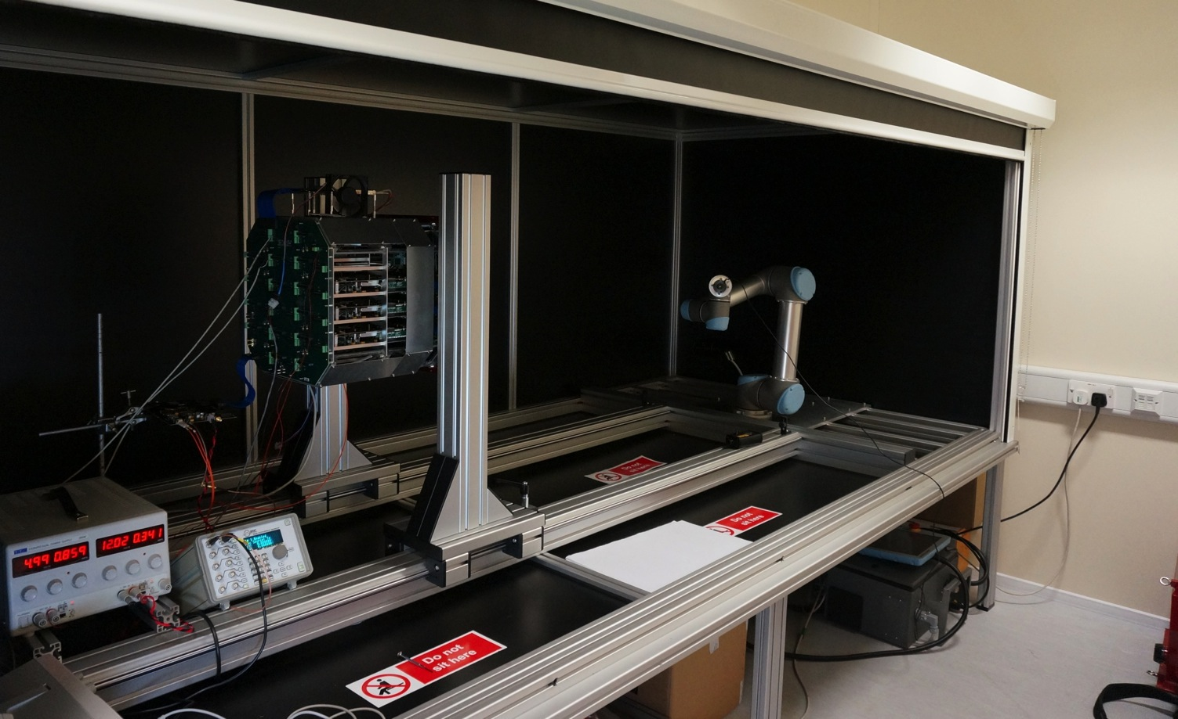

Commissioning Lab Setup
Light-tight enclosure (with roller blind)
Camera PSU and switch box
Notes:
Add advantages of full waveform readout
Expand this slide:
-- Waveform
-- Photosensors
-- TARGET

Slide 24
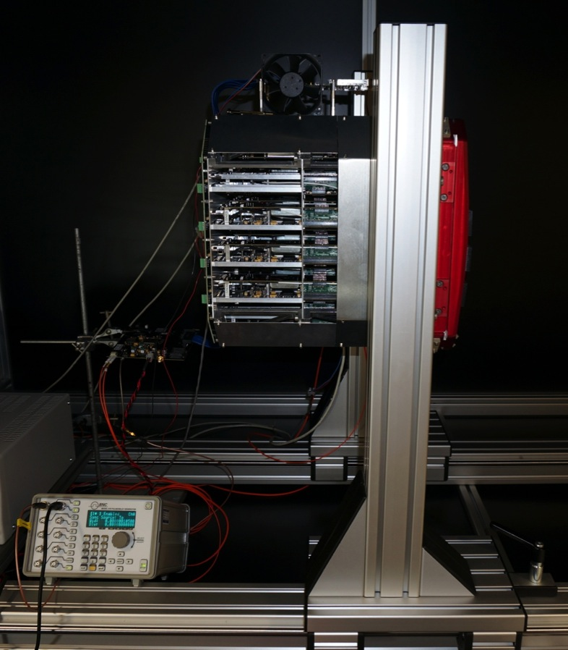
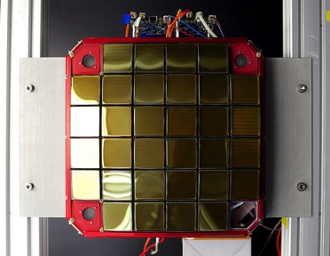
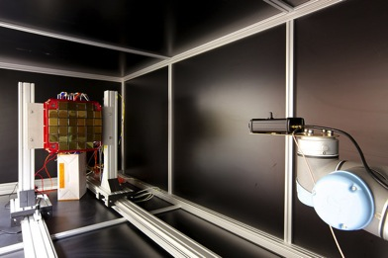
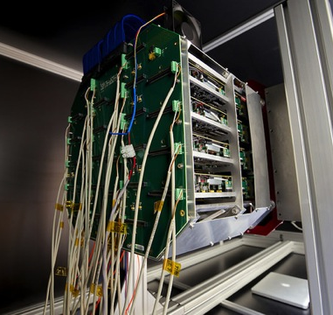
Commissioning Lab Setup
proto-Backplane
DACQ boards
Tester Board: FPGA board to generate CLK and Trigger signals for protoBackplane
Notes:
Add advantages of full waveform readout
Expand this slide:
-- Waveform
-- Photosensors
-- TARGET

Slide 25
Camera Readout
Raw data and slow control over 4 x 1 Gbps
Camera Server and Camera Controller software running as separate processes on 1 PC
Camera Server
Listens for raw data, builds events, writes to disk (binary format stored in fits files, with protobuf headers)
Receives run start / stop messages from Camera Controller
Camera Controller
Reads in camera config (protobufs)
Setups up the hardware (UDP raw socket to TM, zmq to DACQs)
Signals run start / stop to Camera Server and sends run header
Monitors camera (e.g. temperature) and writes to a fits file with time stamps
Offline
Analysis chain, uses same protobuf structure for headers / config as online
Assembles slow control and raw data based on timestamps
A lot of manpower has gone into this: libCHEC, see Andrea’s talk next…
Notes:
Protocol buffers: language-neutral, platform-neutral, extensible mechanism for serializing structured data – like XML, but smaller, faster, and simpler
Zeromq: code connection in any language, on any platform

Slide 26
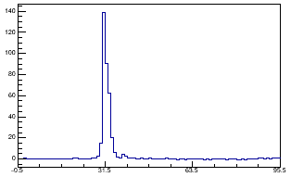
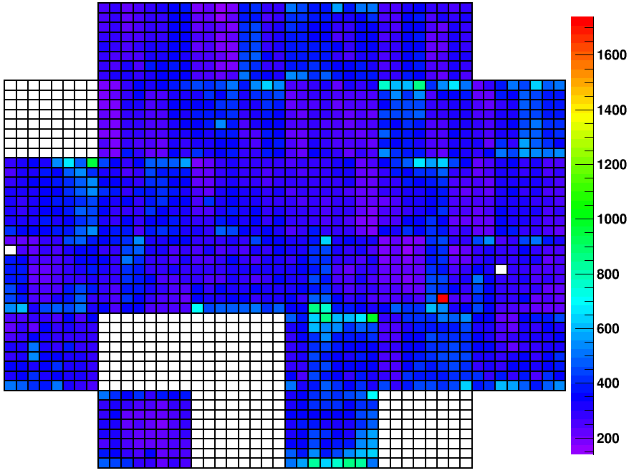
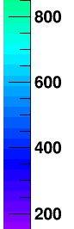
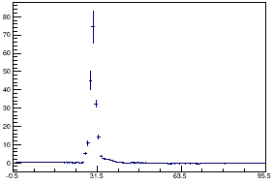
Commissioning Progress
Laser flashes, externally triggered camera readout
Single pixel (289)
Analysis chain and event-viewer under development
Pulse Area
Average over MAPM (module 8)
Pedestal subtracted, un-calibrated data
Notes:
Pedestal-subtracted
Non-calibrated
Difference between ASICs visible
Gain spread within MAPM visible

Slide 27
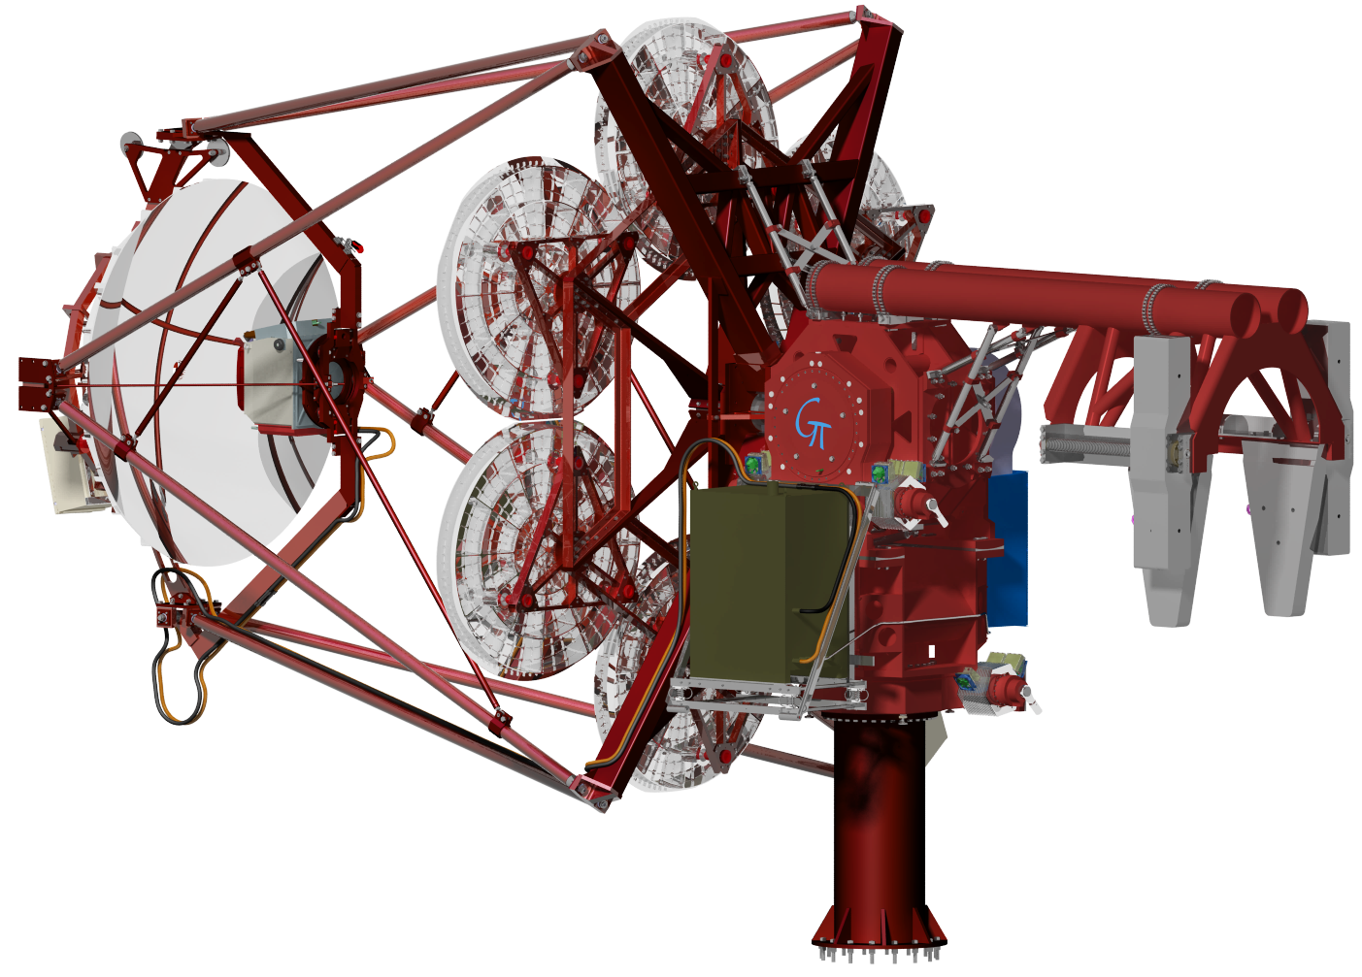
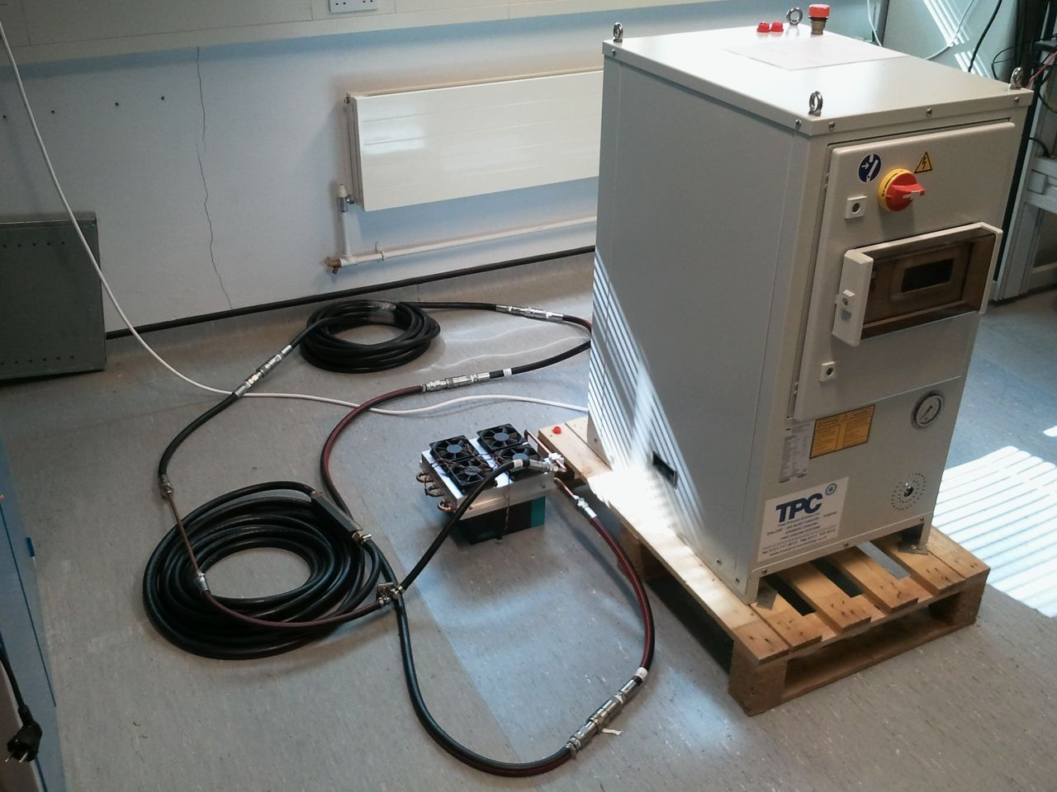
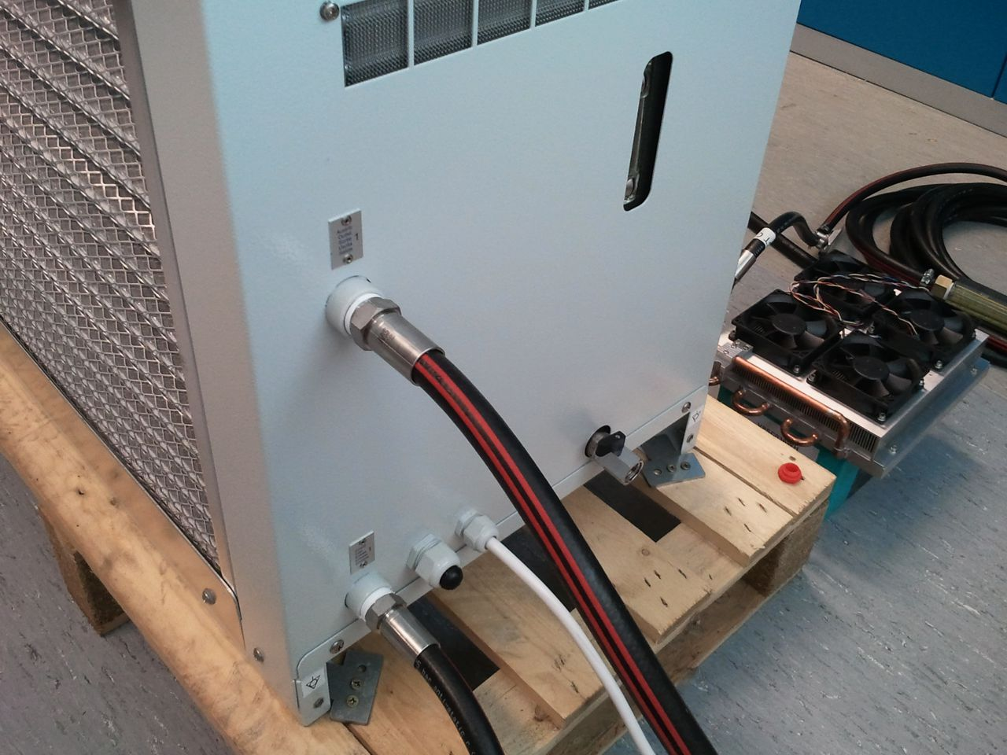
Auxiliary Systems
GATE
PSU
Located behind M2
Identical to the one being used in the lab
Chiller
Cooling loop now tested in Leicester
Camera Power Supply
Chiller
Pipes
Ethernet controllable
Dry / quick connections
Camera Thermal Exchange Unit

Slide 28
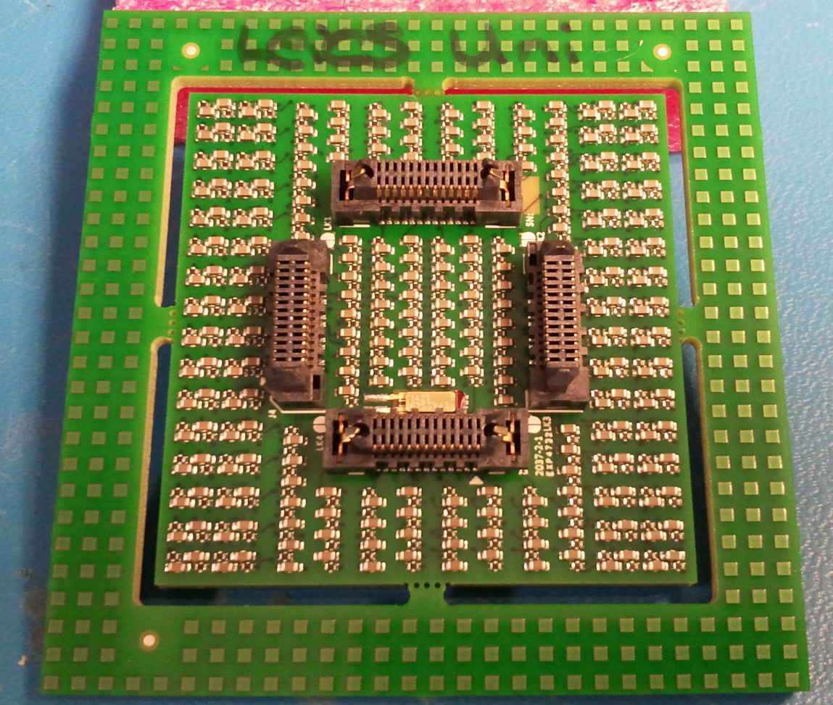
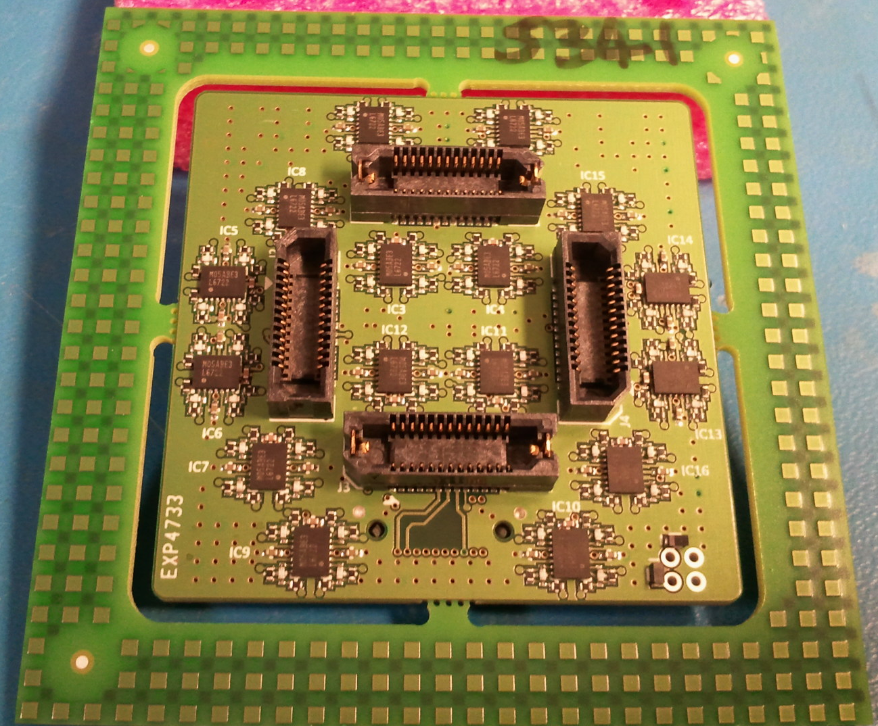
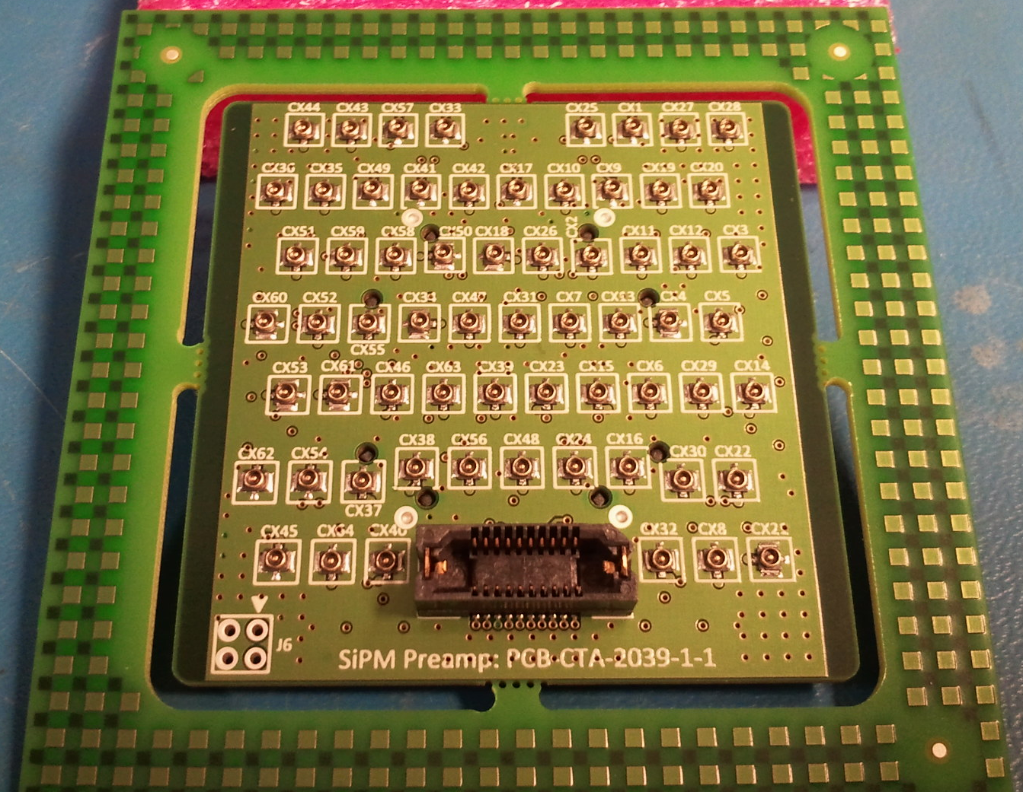




CHEC-S
Latching connectors
Op-amps
See previous meetings for overview
Latest news:
TARGET-7 modules under test at ECAP
Last part of SiPM tile delivery delayed
Front-end buffer and preamp now under test at Leicester with full SiPM tile attached to base
Bias circuits
Rear of SiPM base
Front of front-end buffer
Rear of front-end buffer
CHEC-S SiPM:
Hamamatsu S12642-1616PA-50
Micro coax cables
64 camera pixels
87% geometric fill factor
4 pixels combined to make 1 CHEC-S pixel
51.4 mm
93% geometric fill factor possible with 6 mm pixels and same gaps, tile reduces to 50 mm x 50 mm
51.4 mm
Depth of ~3.5 mm (including base PCB)
Through Silicon Via (TSV)

Slide 29



CHEC-S
Front end buffer tests
Only using mechanical samples thus far
Faster pulse rise time than previous devices
Ideal pulse requires more than p/z correction
Preamp response with 1 pixel
SiPM tile, base and front-end buffer test in dark box
Preamp response with 4 pixels

Slide 30


CHEC-S
SiPM – epoxy coating requested
Not supplied by Hamamatsu
Thin (paralene?) coating only
No waterproofing
Camera window required
Borofloat-33 glass
Not obtainable thin enough
Shinkolite plastic
Not obtainable thin enough
PMMA – Polycasa XT-UVT
Thermal forming or blow moulding
2mm thick→82% trans.
But high thermal expansion
Need flexible seals
Not obtainable thin enough

Slide 31
Beyond CHEC-S
Conventional front-end electronics options
CHEC-S discrete solution (integrated near sensor)
Existing TARGET7 daughterboard design
PACTA chip – ICC-UB
Multichannel ASIC front-end electronics
Initially developed for LST/MST
Designed for SiPMs (high capacitance)
Integrated additional functionality for SST
TARGET-C and TARGET-CCTV
Substrate noise → 2 separate ASICs required
Latest SiPMs?
Technology still improving
No imp. from Hamamatsu after LCT5
Other manufacturers still viable
Larger pixel size
Hamamatsu (LCT5), Excelitas, SensL – all still viable
50 - 57 mm?
6 - 7 mm
Final SiPM tile example
Example of what we could specify
200 μm gaps (50:50 dead:gap)
Gaps between tiles defined by tile tolerance (+_0.15 mm?)

Slide 32

Summary
CHEC-M commissioning in progress
Full testing limited by BP delay
..but delivery imminent
Meudon field trials
Later in 2015
CHEC-S progressing
First batch MPPCs delivered
..and will be attached to PCBs next
Second MPPC batch due end-May

