Slide 1
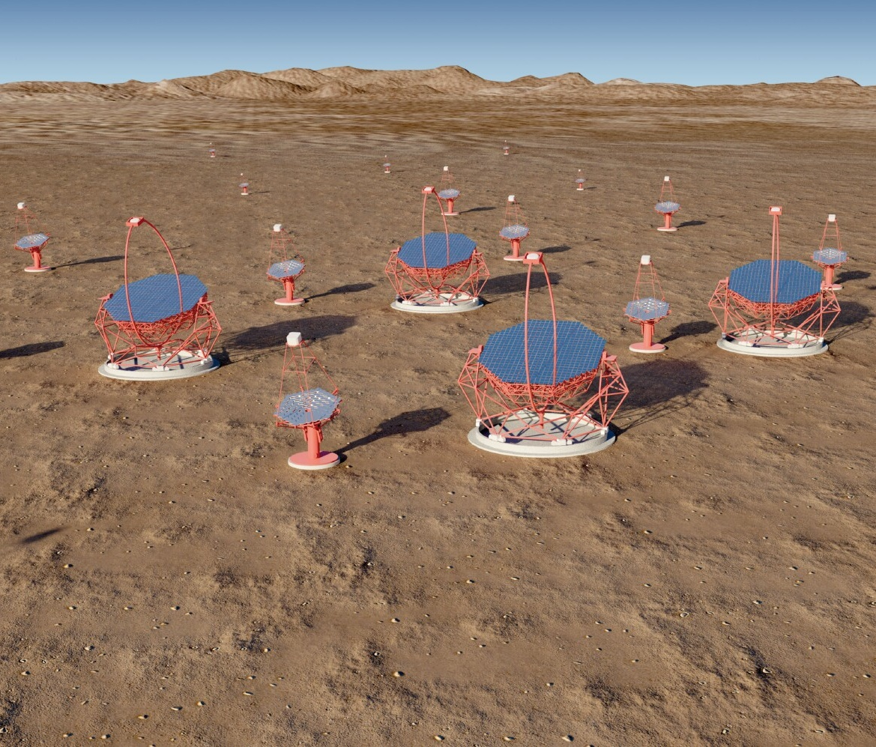
CTA
Overview of progress since July 2016 for:
CTA Observatory (CTAO) and Consortium (CTAC).
The Gamma-ray Cherenkov Telescope (GCT) and its Compact High-Energy Camera (CHEC).
Notes:
The Cherenkov Telescope Array (CTA) is the next generation observatory for ground-based gamma-ray astronomy. Current instruments (HESS, MAGIC and VERITAS) have made huge progress in the observation of cosmic sources of photons in the ~ 50 GeV to ~ 50 TeV energy range using Imaging Atmospheric Cherenkov Telescopes (IACTs). CTA will extend the range of these observations at both low and high energies, will improve their sensitivity by a factor of about 10 and will increase the precision of photon energy and direction measurements. This talk presents briefly the designs of the 23 m, 12 m and 4 m diameter IACTs that CTA will use to achieve this performance, before discussing the impact the array will have on studies of Fundamental and Astroparticle Physics. Topics covered include: searches for Dark Matter (DM) and axion-like particles (ALPs); studies of possible violation of Lorentz invariance; and studies of the sources and acceleration mechanisms of high energy cosmic rays.
Remember the Ellis/White paper.
Include EBL studies.

Slide 2
CTA developments
Site agreements:
For Northern Site (La Palma) signed.
For Southern Site (Paranal) finalised, needs final approval from Chilean government before signature.
Funding:
Initial Expressions of Interest resulted in offers totalling €279M (equipment and FTEs).
Expect “threshold” funding level (65% of total requirement of €400M) to be committed in 2017.
Then start construction of array.
Project Office now moved to Bologna, the new and final HQ of the CTA Observatory.
CTA Data Centre will be at DESY Zeuthen (near Berlin).
Major recruitment drive: 15…20 new positions at the Project Office, mainly engineering, management, IT.
New UK groups joined the CTA consortium:
LJMU (was associate member).
Armagh Observatory.
2

Slide 3
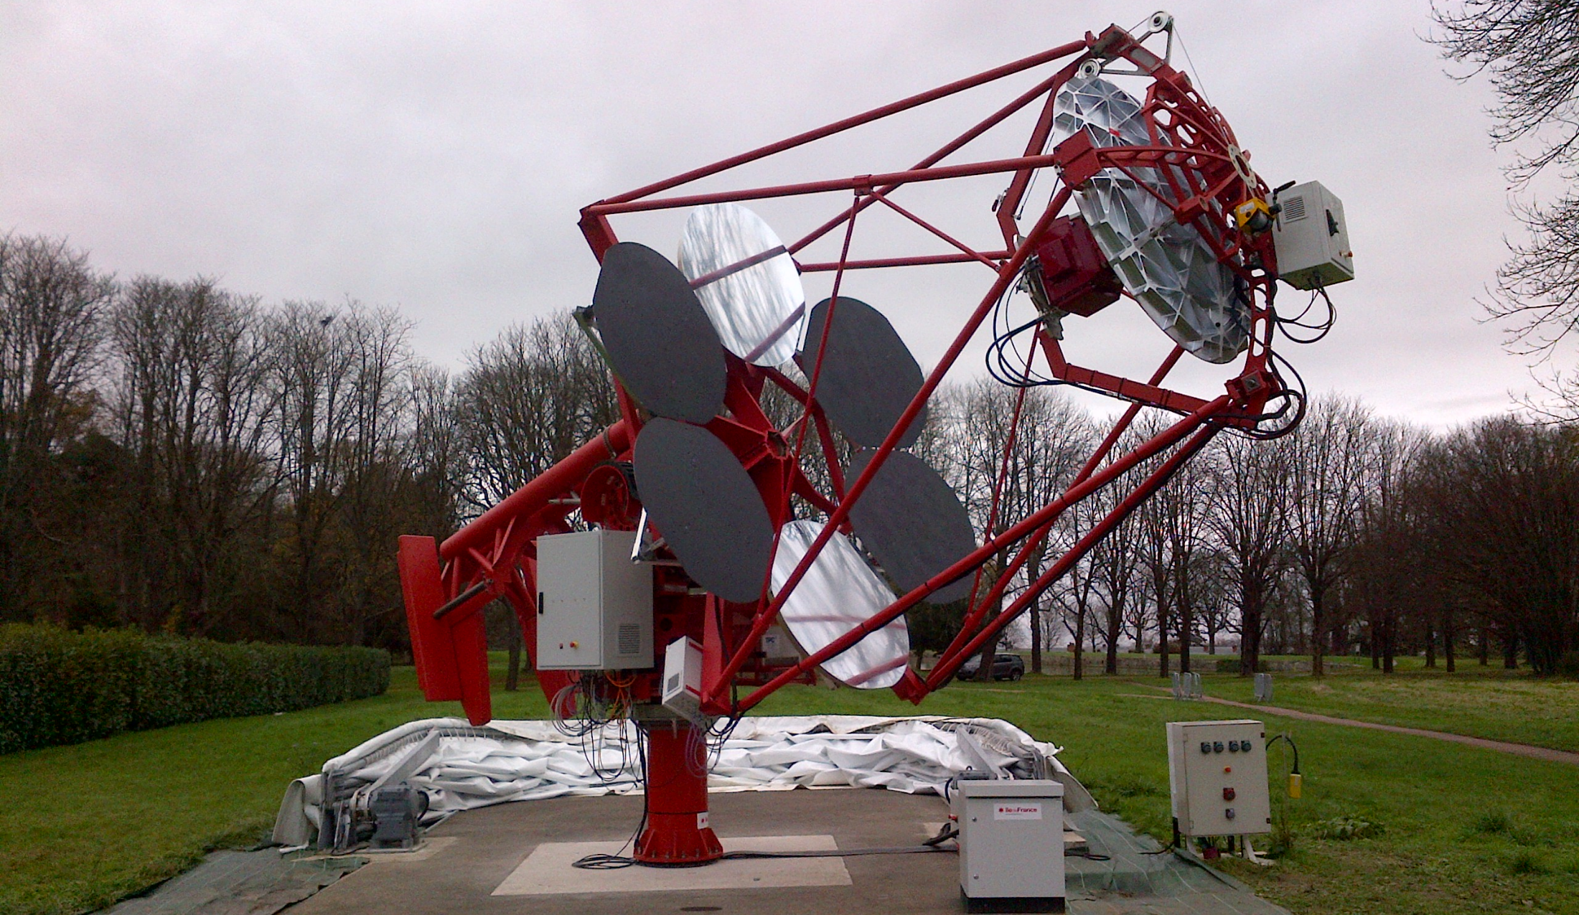
Status of GCT and CHEC
GCT prototype, Meudon, Paris
3

Slide 4
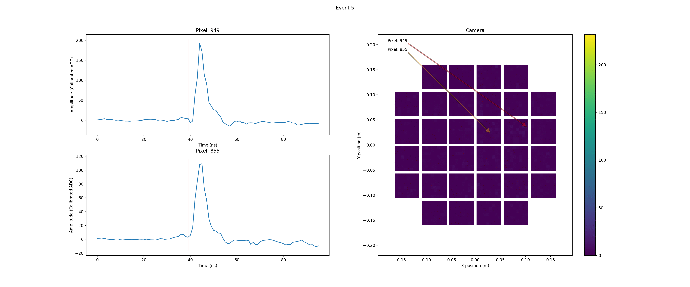
Test campaign 2017
Second round of tests of multi-anode photomultiplier version of CHEC, CHEC-M, on GCT in March 2017.
Includes camera control and calibration electronics and software that will be used on site on “pre-production” cameras.

Slide 5
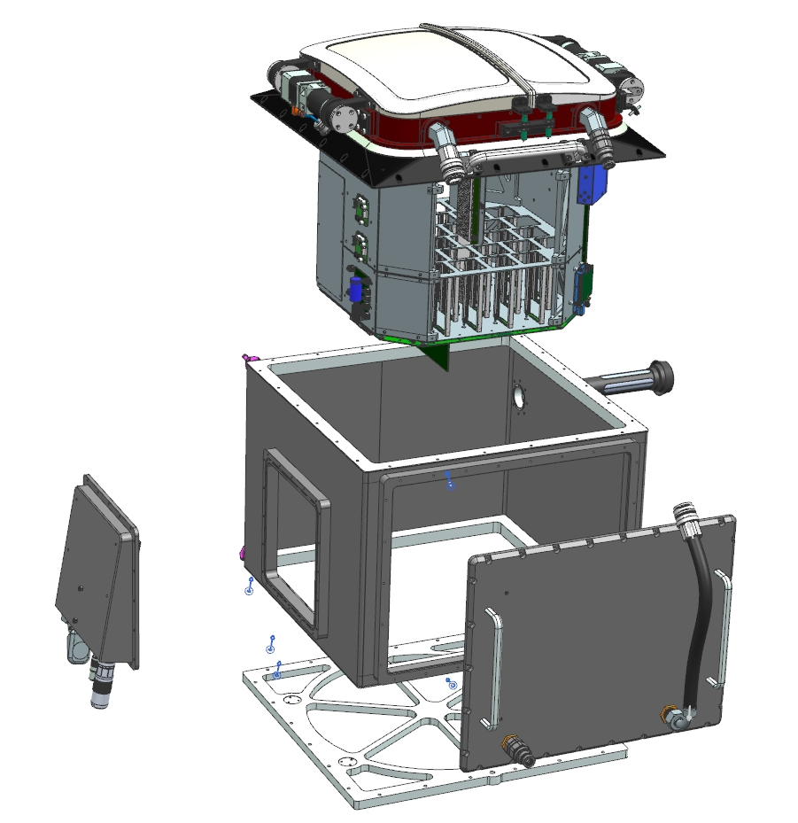
Status of CHEC-S
Pre-production and production cameras silicon photomultiplier based.
Add window to protect sensors.
Water cool sensor plane as well as camera body.
Dual aluminium doors with weather-sealed stepper motors and gearboxes.
Control electronics as tested in CHEC-M.
Improved TARGET readout chip and module, with reduced trigger noise.
Camera assembly simplified.
Focal Plane
Assembly
Rack
Assembly
Power/Comms
Assembly
Desiccator
Enclosure
Fan
Assembly
5

Slide 6
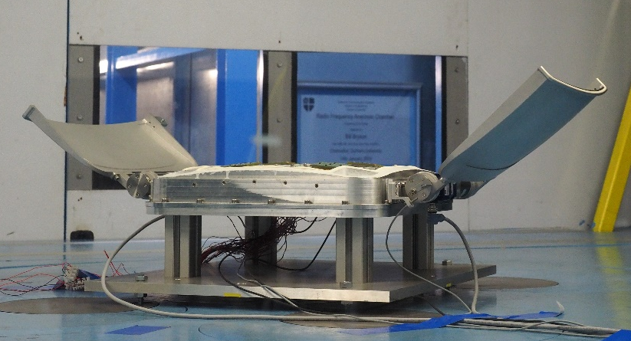
Status of CHEC-S
Trigger threshold meets requirements with new TARGET C and T5TEA chips.
Trigger dynamic range from below 3 mV to above 160 mV (with noise below 0.5 p.e. at 3..4 mV/p.e.).
Cooling of sensor plane functions well:
Doors tested in wind tunnel to above max. operational wind speed:

