Slide 1
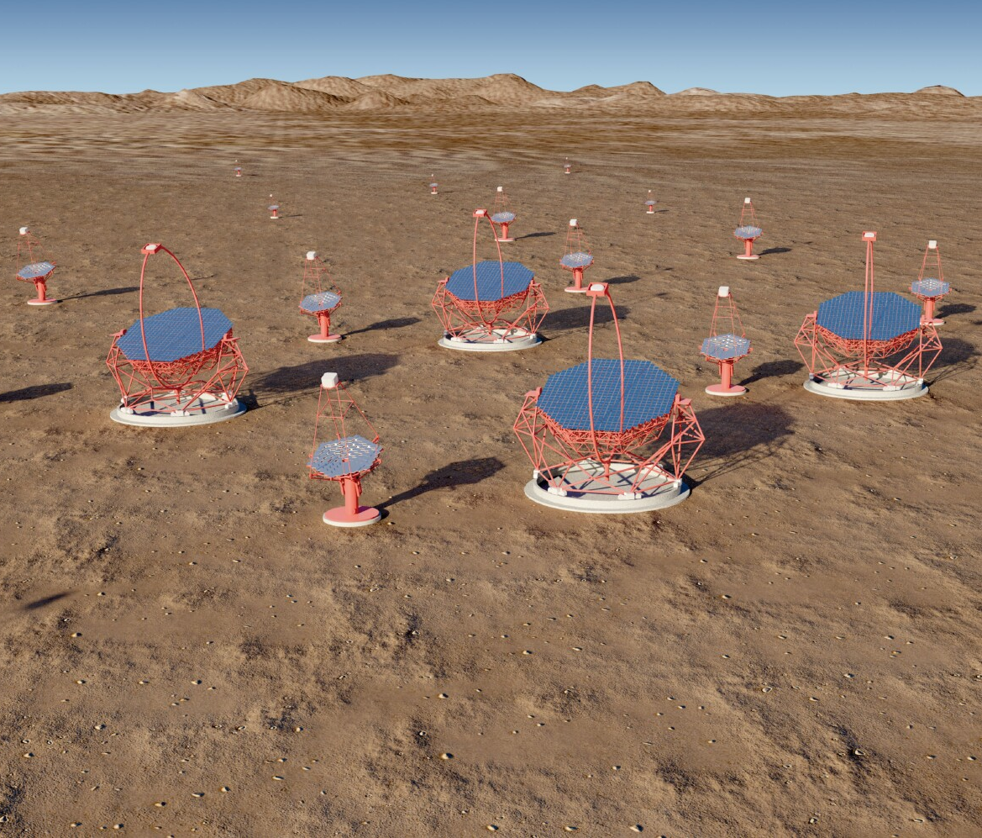
The Gamma-ray Cherenkov Telescope for CTA
Progress with GCT structure and design changes for pre-production.
Status of CHEC-M.
GCT tests: March in Paris.
CHEC-S status:
Sensors.
TARGET ASICs and modules.
Focal plane and mechanics.
Future plans.
Summary
Tim Greenshaw, Liverpool University
Notes:
The Cherenkov Telescope Array (CTA) is the next generation observatory for ground-based gamma-ray astronomy. Current instruments (HESS, MAGIC and VERITAS) have made huge progress in the observation of cosmic sources of photons in the ~ 50 GeV to ~ 50 TeV energy range using Imaging Atmospheric Cherenkov Telescopes (IACTs). CTA will extend the range of these observations at both low and high energies, will improve their sensitivity by a factor of about 10 and will increase the precision of photon energy and direction measurements. This talk presents briefly the designs of the 23 m, 12 m and 4 m diameter IACTs that CTA will use to achieve this performance, before discussing the impact the array will have on studies of Fundamental and Astroparticle Physics. Topics covered include: searches for Dark Matter (DM) and axion-like particles (ALPs); studies of possible violation of Lorentz invariance; and studies of the sources and acceleration mechanisms of high energy cosmic rays.
Remember the Ellis/White paper.
Include EBL studies.

Slide 2
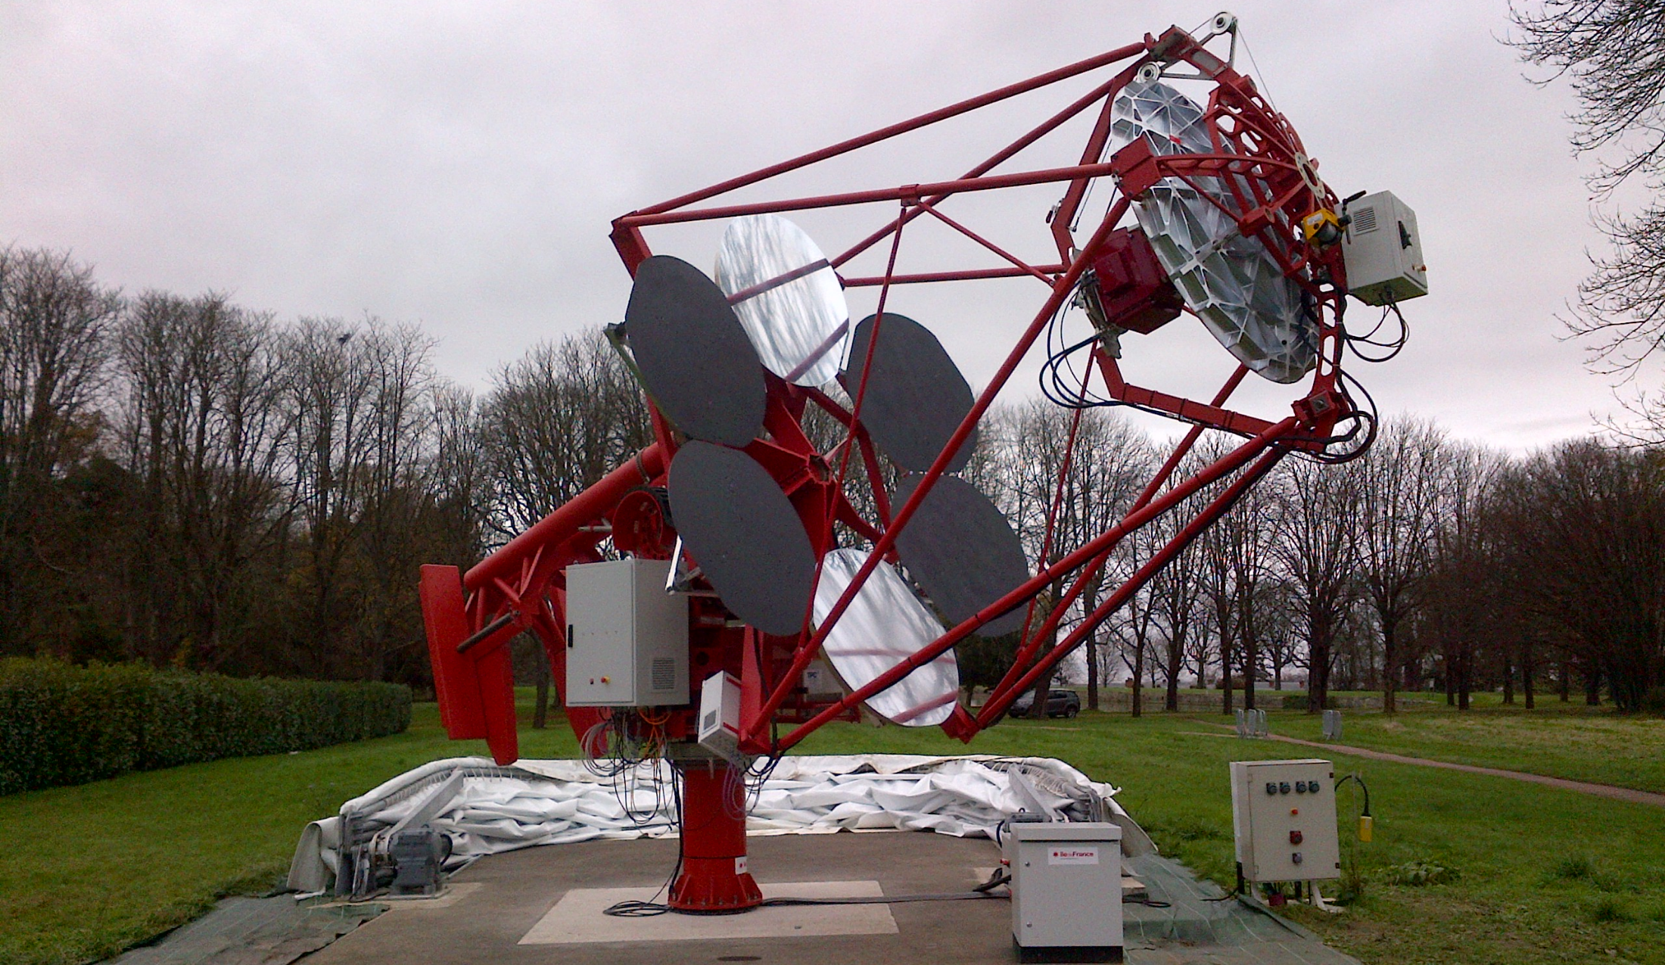
Status of GCT
GCT prototype, Meudon, Paris
2

Slide 3
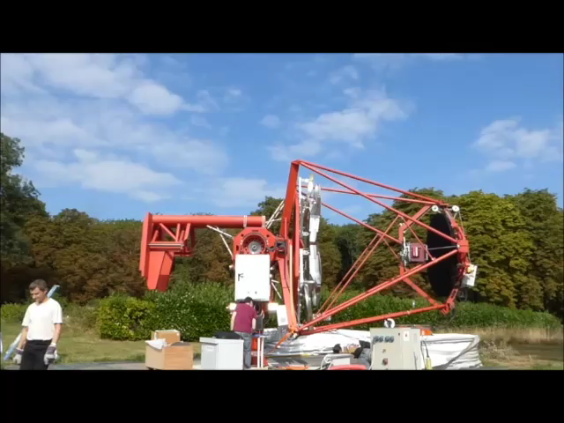
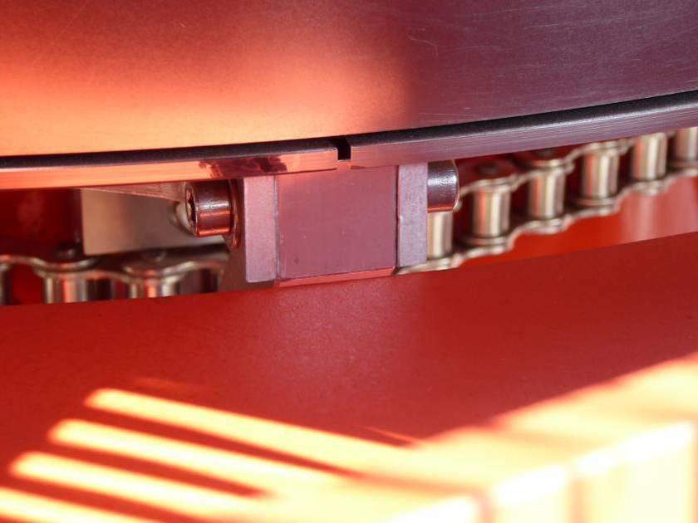
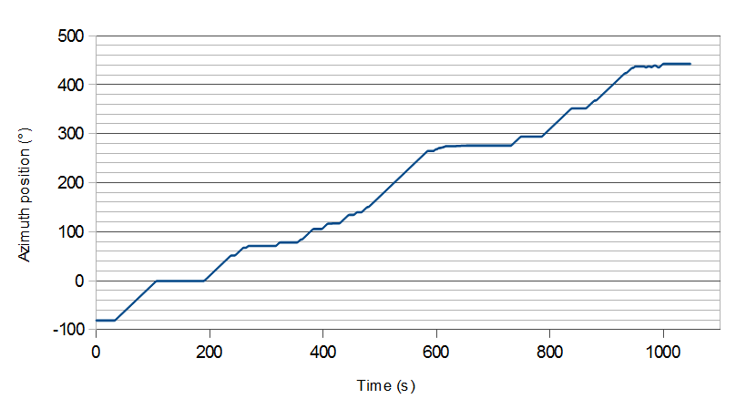
Status of GCT structure
Slewing studies:
Elevation rotation up to 90.6° (specification 91°), limited by:
Azimuth rotation -81° to 442° (range 523°, specification 510°), limited by end switches.
3

Slide 4
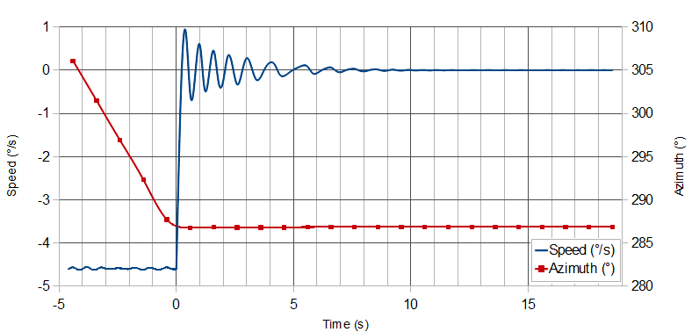
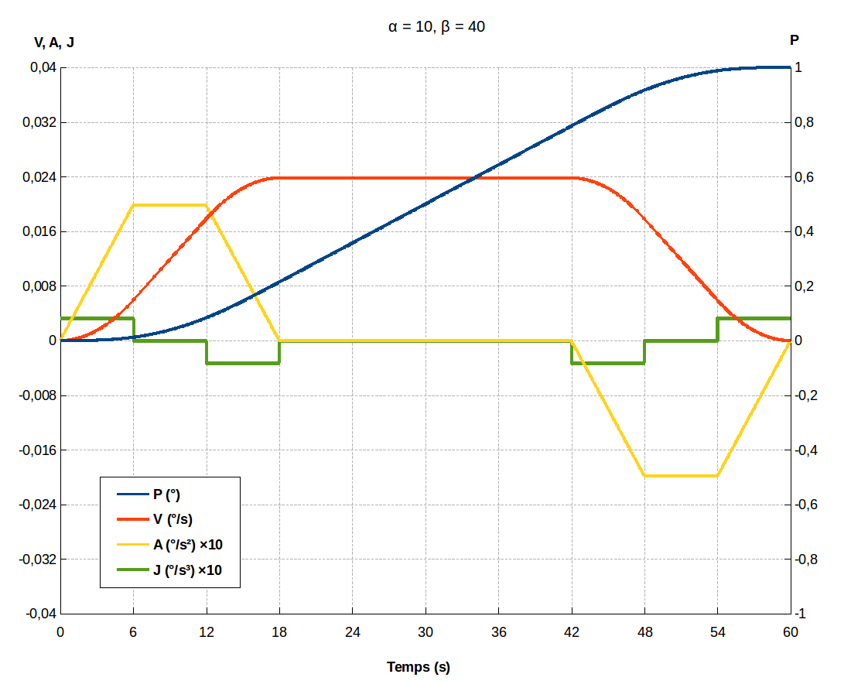
Status of GCT
Rotation speeds in azimuth and elevation meet CTA specs.
Example of position, speed, acceleration and jerk profile:
Emergency stop tested.
Example here, stop from maximum azimuth rotation speed:
Small amplitude oscillations of frequency ~ 1.5 Hz largely due to movement of counterweight.
4

Slide 5
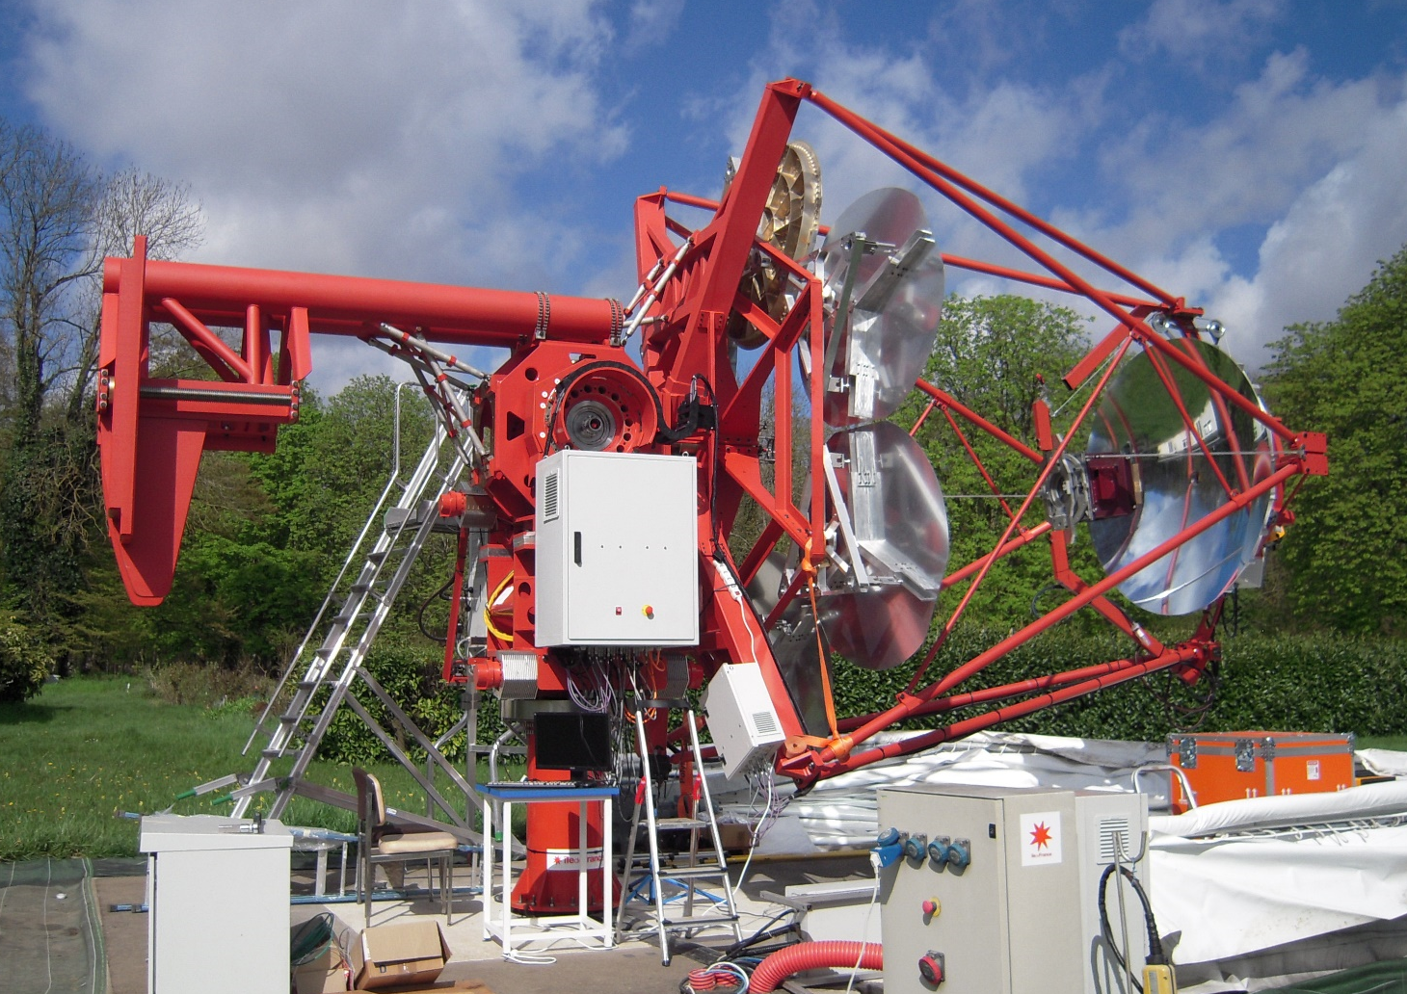
Design changes for pre-production
Telescope movement:
Extend elevation range to 91°.
Simplify exchange of motors.
Simplify mounting of fork.
Counterweight:
Reinforce beams.
Modify attachment mechanism (ensure can reach 91° in azimuth).
5

Slide 6
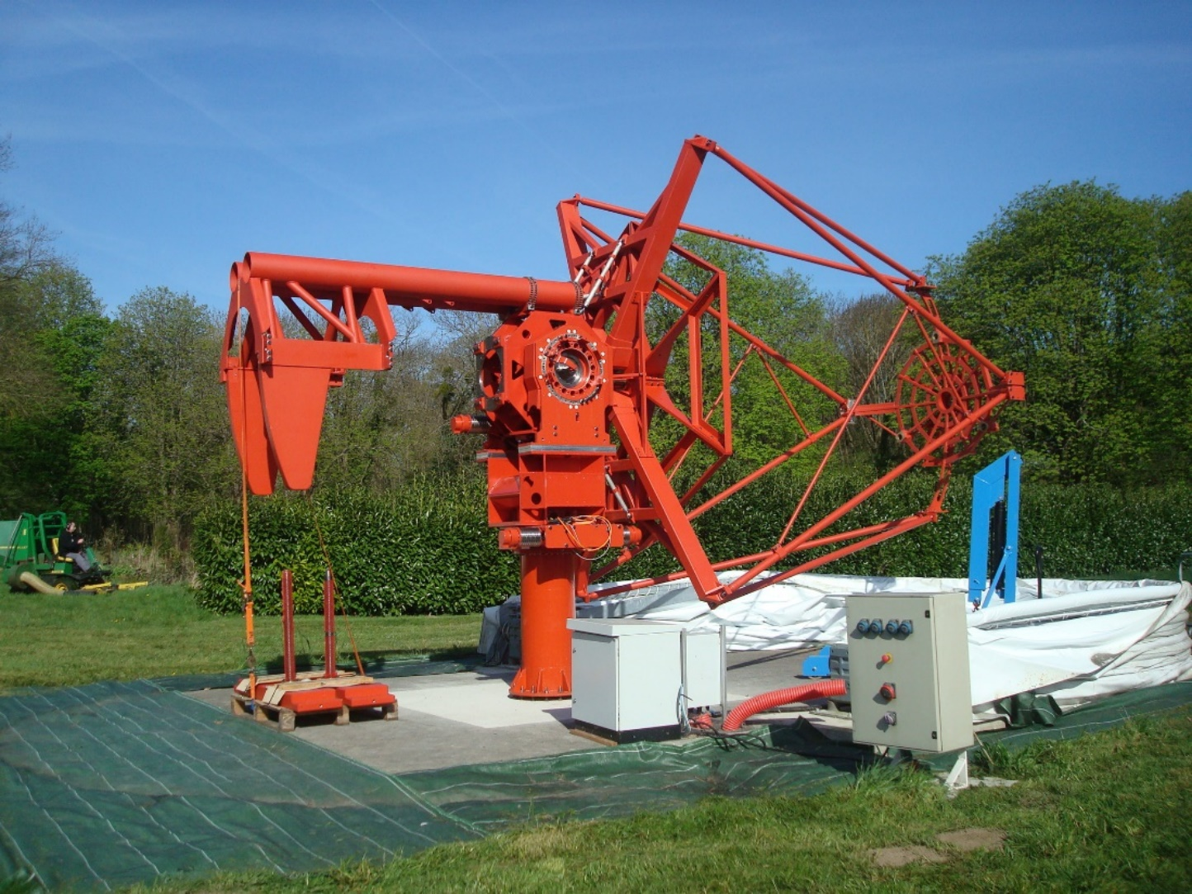
Design changes for pre-production
Telescope control:
Investigate using one motor per axis.
Reduces costs, simplifies installation and maintenance.
Emergency stop:
Replace transformer on prototype with resistor for dissipation of energy?
Smaller, lighter cheaper.
6

Slide 7

Design changes for pre-production
Tower:
Broaden base to match common SST foundation.
Lightning protection:
Add lightning rods to highest points on M1 and M2 and to counterweight.
Electrics:
Increase cooling fan capacity in cabinets.
Add preventative maintenance elements.
7

Slide 8
Status of CHEC-M
Uses multi-anode photomultipliers - first Cherenkov light seen on GCT prototype in Paris, November 2015.
Upgrade to use control electronics foreseen for CHEC-S/preproduction cameras.
Improve camera control and safety.
E.g. Power Board:
Assembly of upgraded CHEC-M for second round of tests on telescope:
Extensive testing in MPIK before CHEC-M shipped to Paris.
8

Slide 9
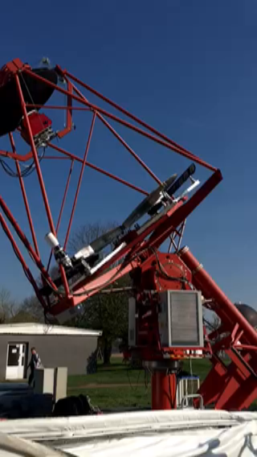
GCT tests 2017
Second round of complete telescope tests took place in last two weeks of March.
Camera mounted on telescope.
Recall prototype primary consists of two (circular) aluminium mirror segments, remaining four segments are dummies.
Mechanical actuators installed, but mirror segments not yet aligned.
Telescope motion checked.
Tracking also implemented for tests.
9

Slide 10
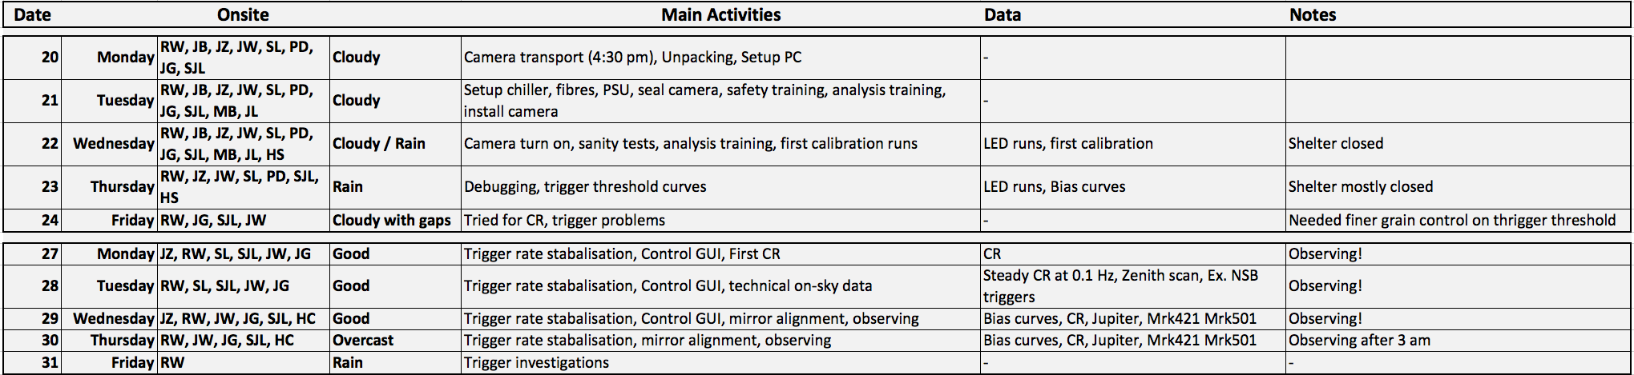
Test overview
Twelve members of the camera team involved.
Analysis training, code debugging and GUI development during the day.
Still a lot of debugging required in the evenings – typically midnight before on-sky observations running ‘smoothly’.
Only 3 nights of nice weather.
0.1 Hz steady CR rate with ~2 k events on disk.
Primary mirror segments poorly aligned.
10

Slide 11
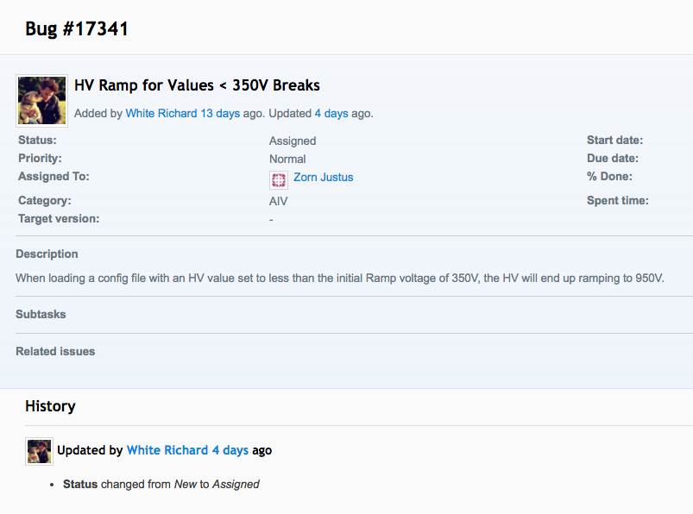
Issues
Documentation
Problems with communication with camera.
Tracked to optical fibre.
Cleaning connection to camera solved problem.
Safety board reset.
Small coding bugs found and fixed on the fly.
Lots of work required to establish acceptable trigger rate.
Issues/bugs recorded on Redmine
11

Slide 12
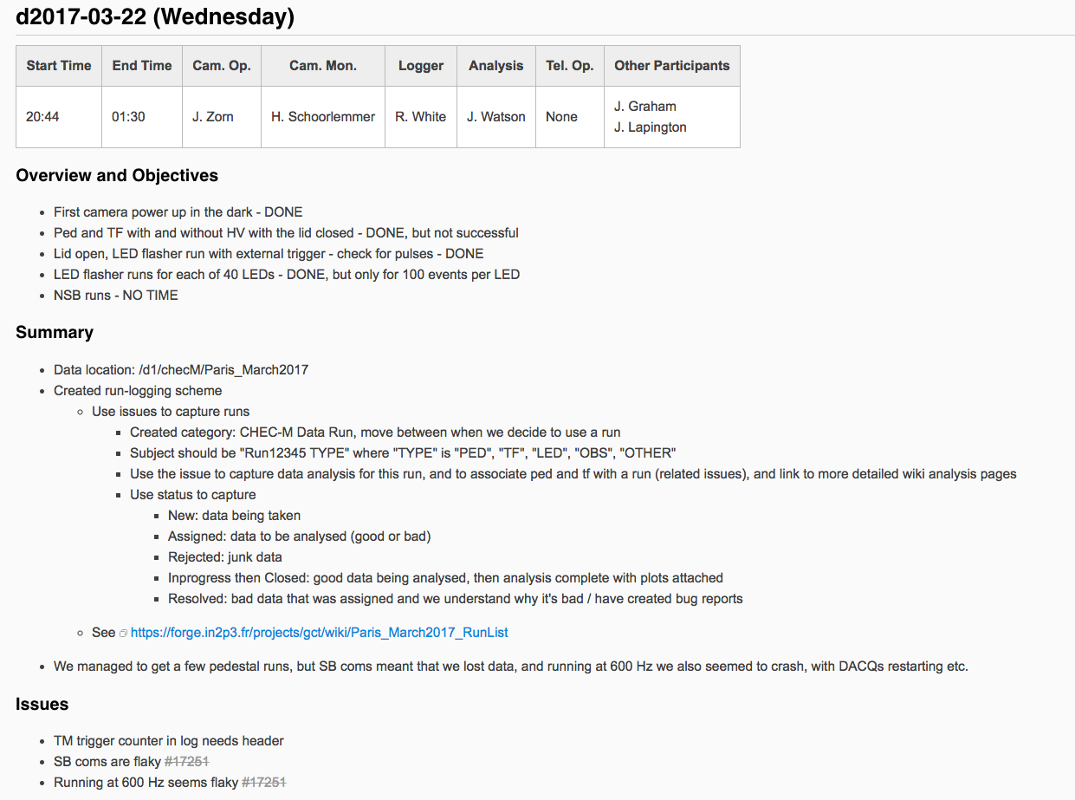
Documentation
Run Log on Redmine https://forge.in2p3.fr/projects/gct/wiki/Paris_March2017_Log.
A nightly log summarising observations and issues
Links to the run list…
12

Slide 13
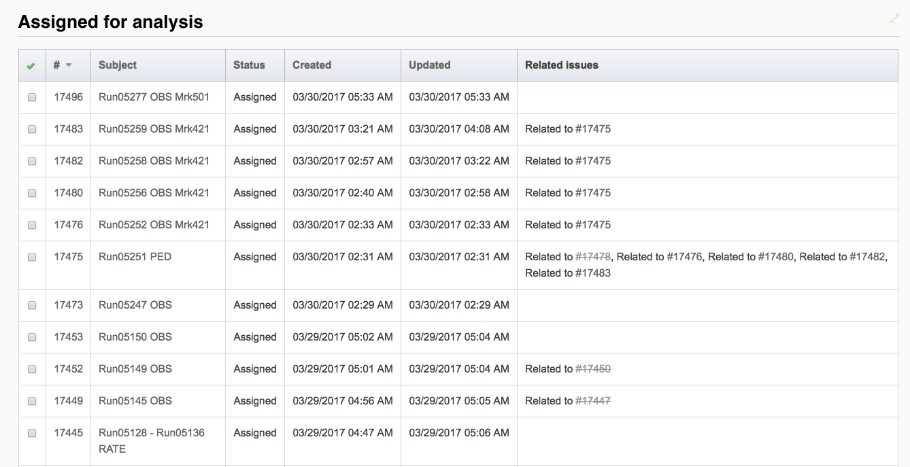
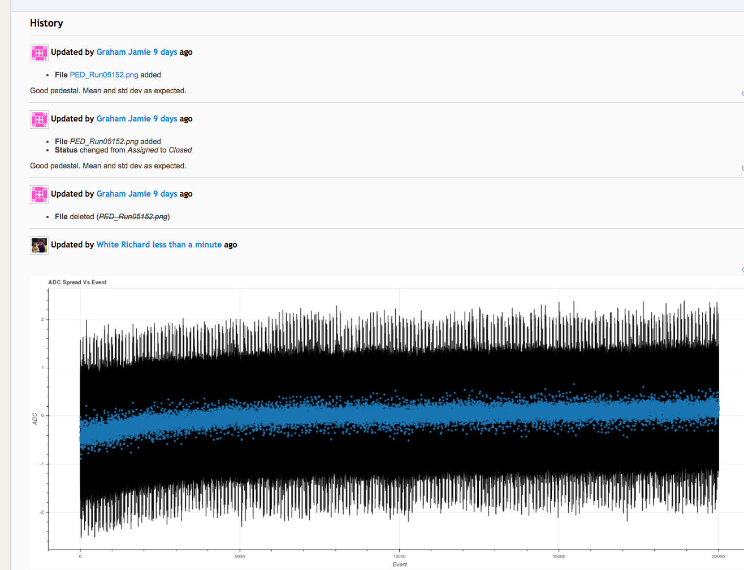
Documentation
Run list on Redmine https://forge.in2p3.fr/projects/gct/wiki/Paris_March2017_RunList.
Each run/set of runs captured as Redmine Issue.
Runs categorised as:
New.
Rejected/junk.
Assigned for analysis.
Closed (analysis complete).
Runs can be linked to calibration runs.
Run plots can be attached directly.
13

Slide 14

Compilation of events
14

Slide 15
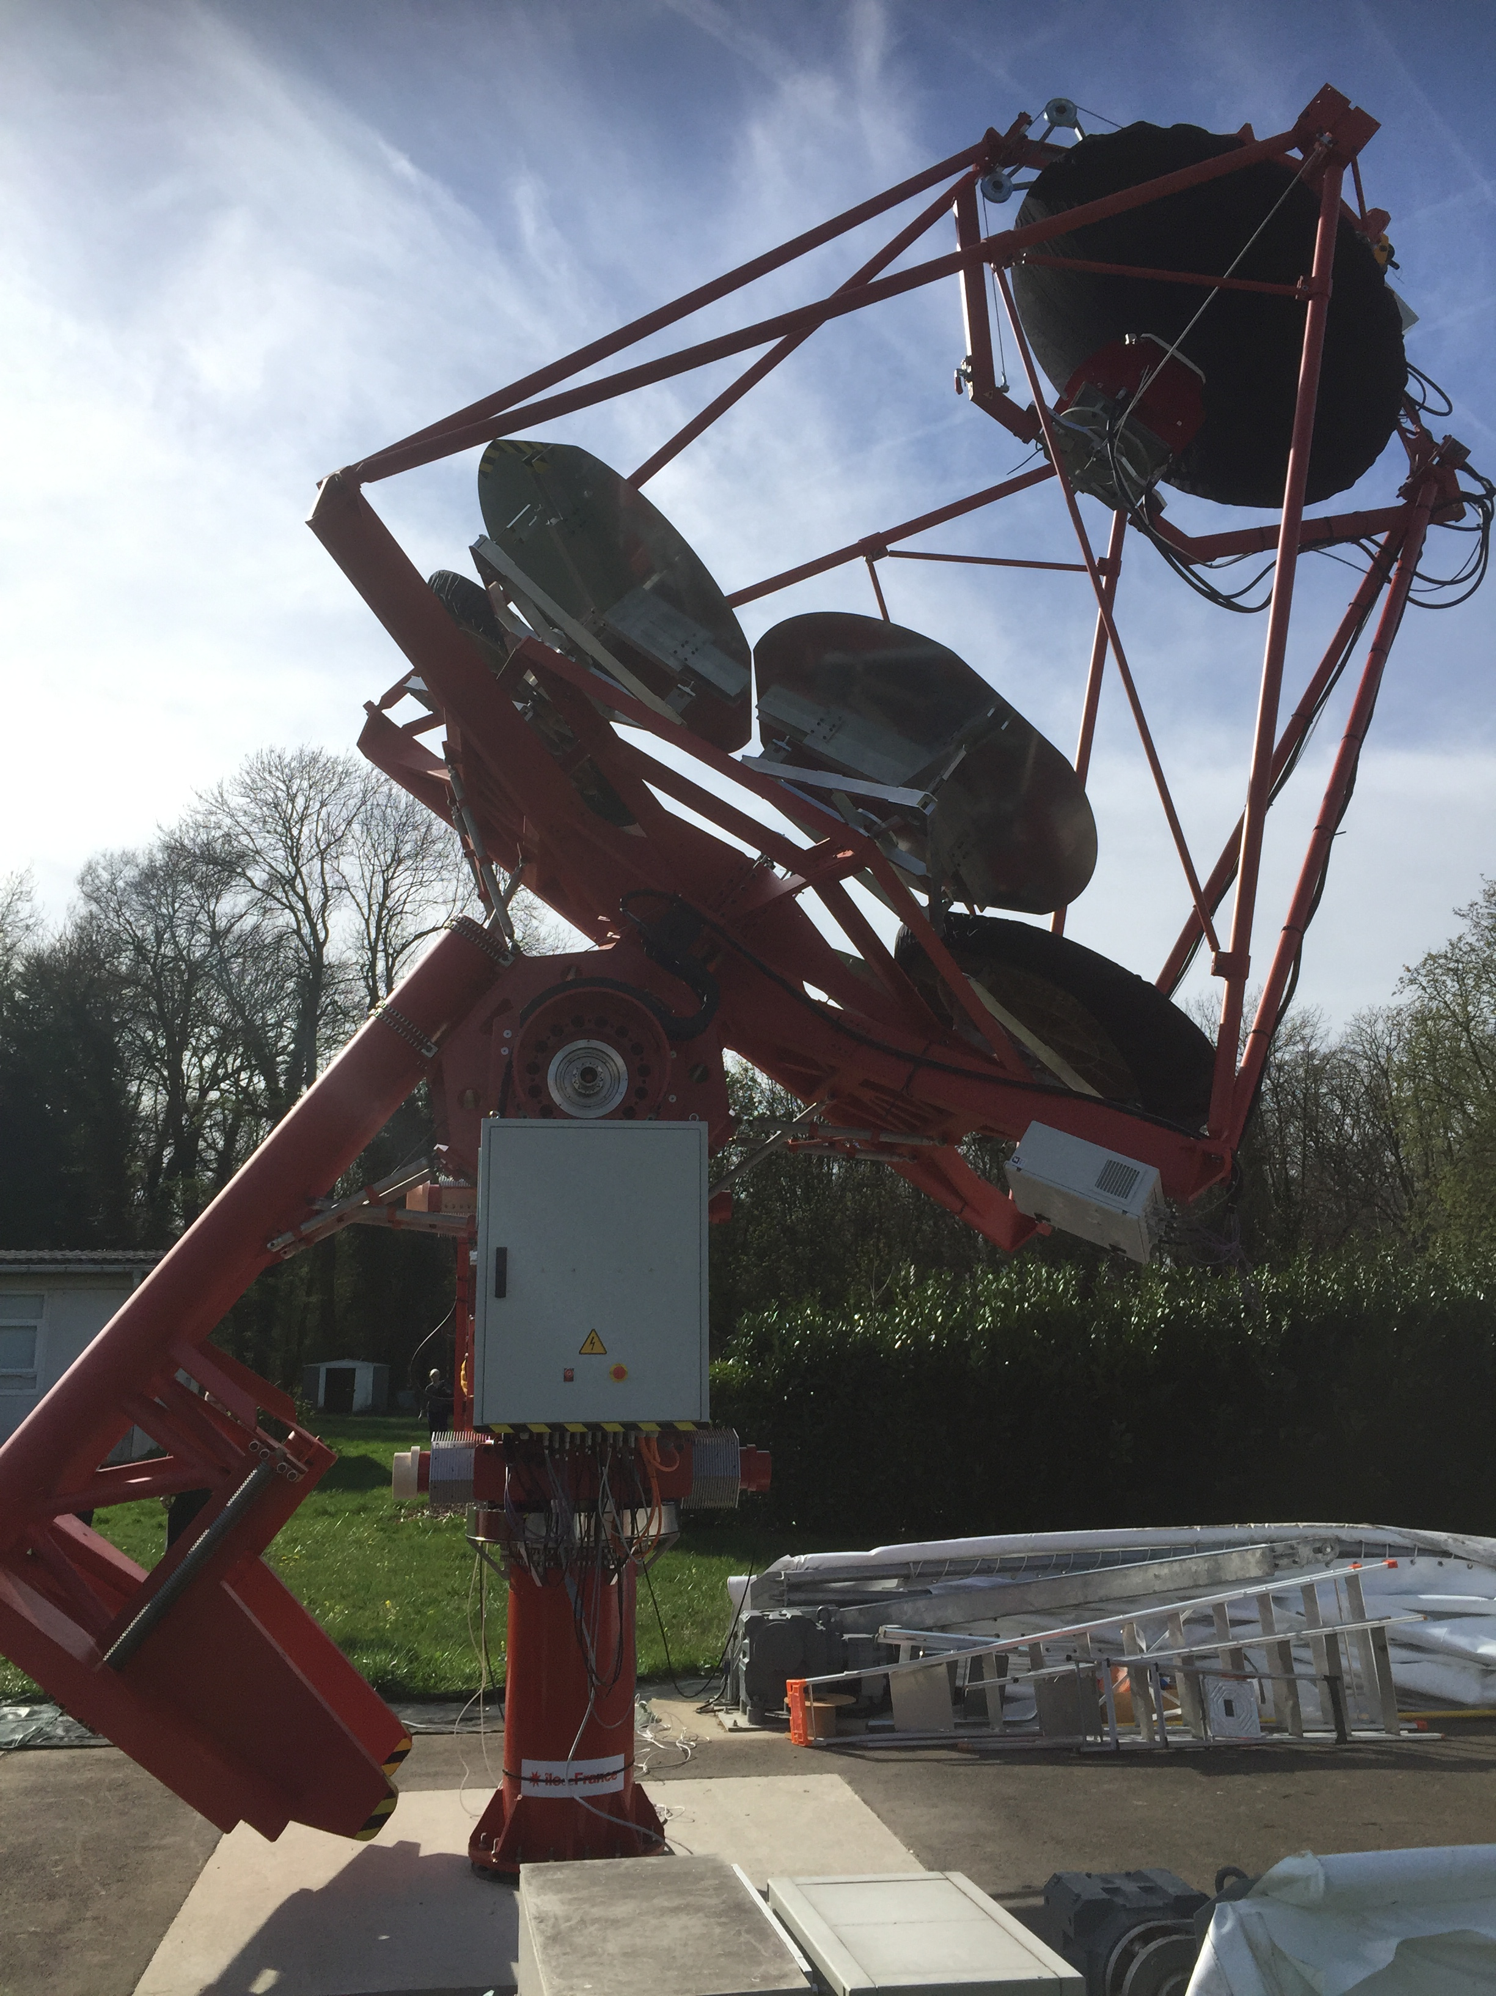
Further tests with CHEC-M
Carry out mirror alignment.
Analyse data taken in March.
Perform further short run when moon and weather permit, hopefully end of April.
Test remote control of CHEC-M (with telescope steered by team in Paris).
Aim to present results at CTA meeting in Rio de Janeiro (15th…19th May).
Then write paper on CHEC-M.
15

Slide 16
Status of CHEC-S: tests of SiPMs
Large range of silicon photomultipliers tested.
Cell sizes 35, 50 and 75 μm.
Pixel sizes 3 × 3 and 6 × 6 mm², with range of fill factors.
Technology variants such as (Hamamatsu):
Standard
LCT5.
LVR.
Silicone and epoxy protective coatings.
Measure PDE against overvoltage:
LVR operates at lower overvoltage than other SIPMs.
LVR 75 μm cell higher PDE than 50 μm cell.
Maximum PDE of LVR higher than LCT5.
16

Slide 17
Status of CHEC-S: tests of SIPMs
Measure optical cross talk as function of overvoltage:
Cross talk of 6 mm pixels is higher than that of 3 mm pixels.
Cross talk of 75 μm cells is higher than that of 50 μm cells.
Cross talk of epoxy coating is higher than that of silicone.
Cross talk of LVR devices is higher than that of LCT5 at a given overvoltage.
17

Slide 18
Status of CHEC-S: tests of SiPMS
Comparison of PDE versus cross talk:
LVR technology looks to be best.
Pick pixel size considering also its effects on field of view of CHEC.
Adding lenslets to 3 mm pixels to bridge interpixel gaps may give both best performance (PDE, cross-talk) and increased FoV.
Current recommendation:
LVR 50 μm cell, 3 mm pixel.
Verification of test results required (discussion of some apparent discrepancies ongoing).
Projected cost for 39 cameras (1250 modules) in 2019 is €1.1M.
18

Slide 19
Status of CHEC-S: TARGET ASICs
TARGET7 ASICs had improved dynamic range w.r.t. TARGET 5 but…
…suffered from trigger noise problems.
Sampling off, trigger threshold 4 mV (approx. one p.e.)
Sampling on, trigger threshold 15 mV.
Separate trigger and sampling functions onto T5TEA and TC chips, respectively.
TC maintains good sampling performance of T7.
And T5TEA performance good:
With expected buffer performance of 3…4 mV/p.e.:
Dynamic range from about 1 to above 40 p.e.
Trigger noise below 0.5 p.e.
19

Slide 20
Status of CHEC-S: front end electronics
Test complete front-end chain:
Waveform recorded through T5TEA and TARGET C.
Noise introduced by buffer/shaper small.
Full evaluation of trigger performance and charge resolution underway.
20

Slide 21
Front end electronics
New TARGET module, 7 now built.
Separate trigger output from fast clocks on dedicated planes.
Module length compatible with ASTRI.
First tests starting in Erlangen.
21

Slide 22
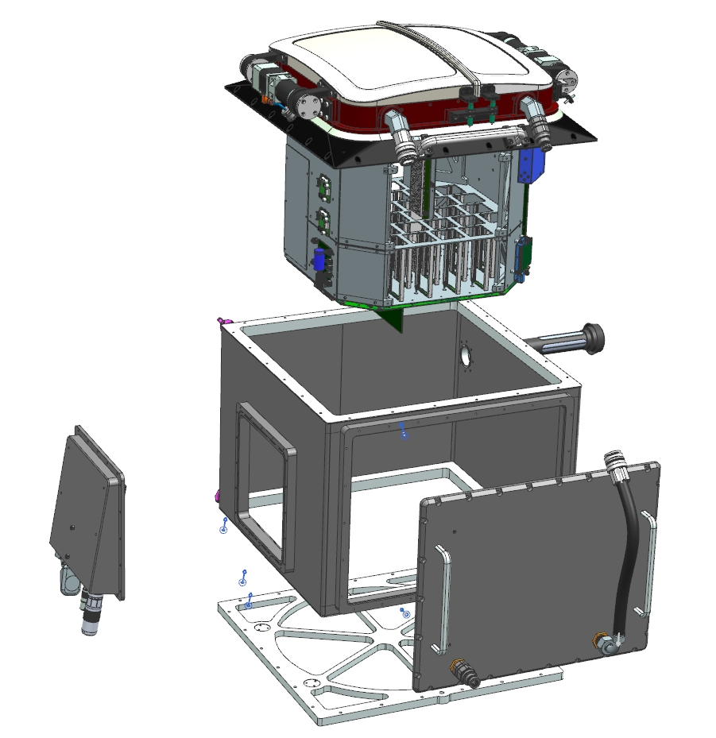
Status of CHEC-S: mechanics
Many modifications of CHEC-S design w.r.t. original CHEC-M:
Add window to protect sensors.
Water cool sensor plane as well as camera body.
Dual aluminium doors with weather-sealed stepper motors and gearboxes.
Separate 12 V (approx. 50 A) and 80 V (approx. 2 A) supplies.
Improvements to electronics layout.
Camera assembly simplified.
Size 50 × 52 × 56 cm³.
Mass 44 kg.
Focal Plane
Assembly
Rack
Assembly
Power/Comms
Assembly
Desiccator
Enclosure
Fan
Assembly
22

Slide 23
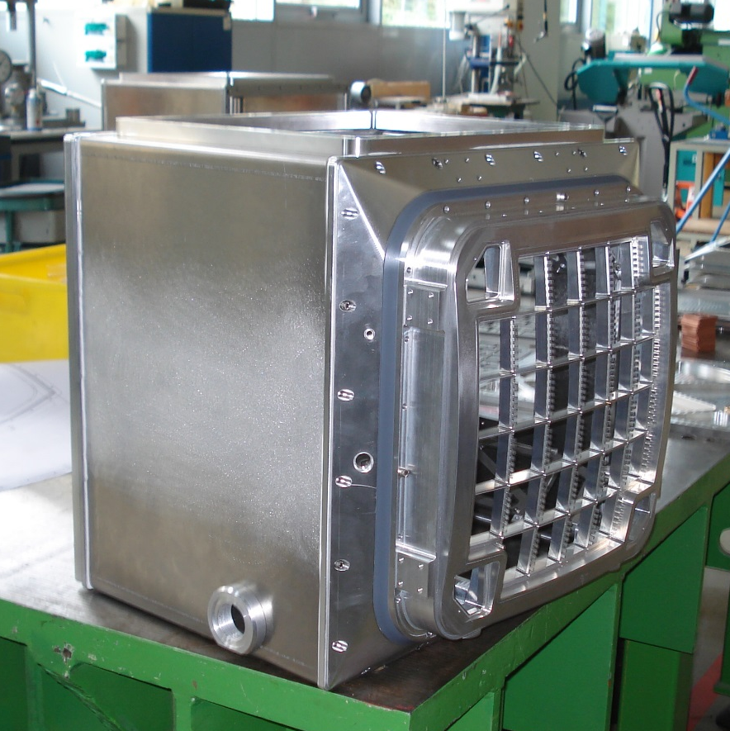
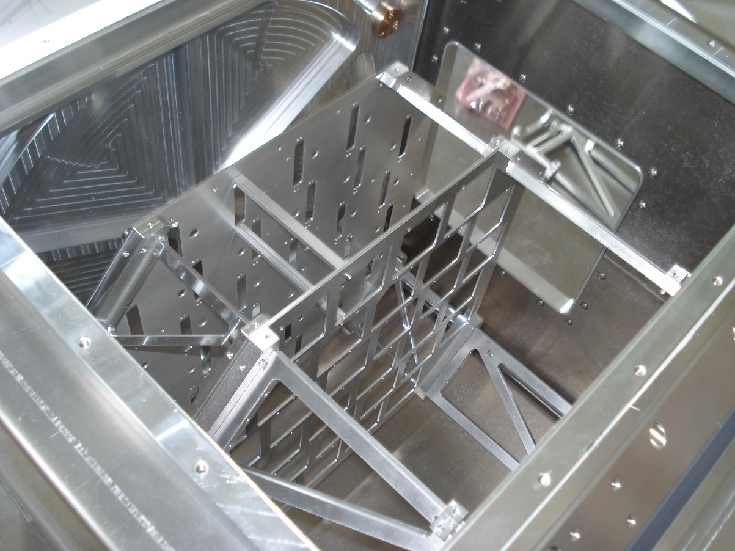
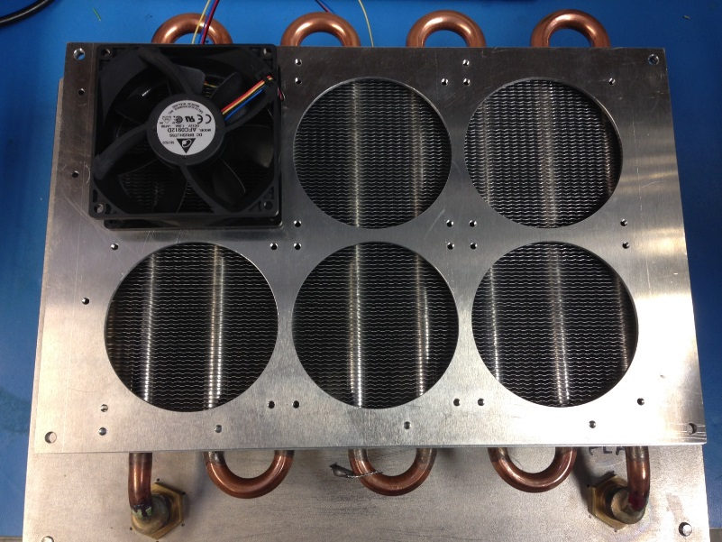
Status of CHEC-S: mechanics
Box
Rack:
Heat exchanger:
23

Slide 24
Status of CHEC: focal plane cooling
Tests of water-cooled focal plane:
Good thermal contact between focal plane ribs and SiPM/buffer planes essential.
Without thermal grease:
With thermal grease:
24

Slide 25
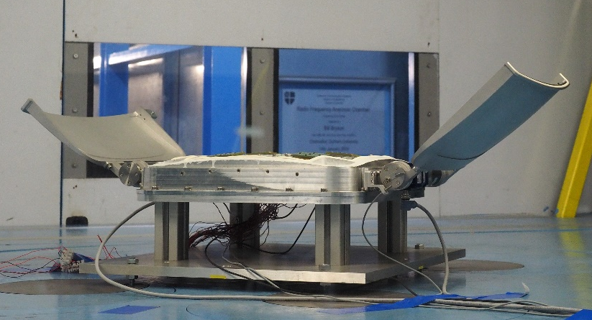
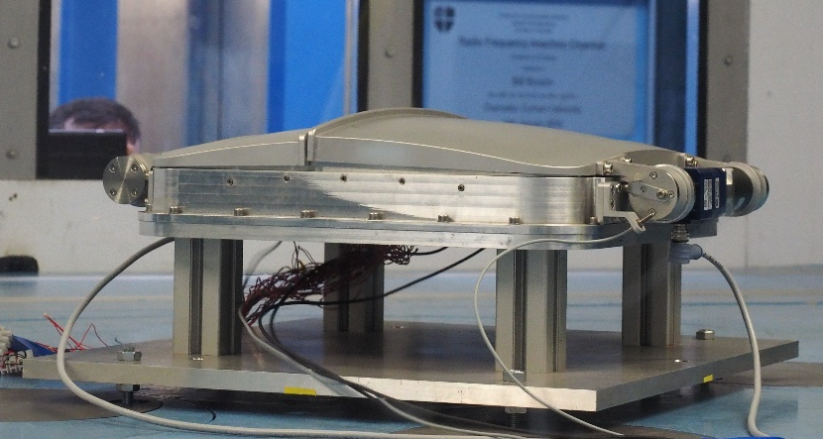
Status of CHEC-S: doors
Tested doors in Durham wind tunnel.
Wind speeds:
9 m/s (operating, CTA req.).
12.5 m/s (transition, CTA req.).
15 m/s (operating, CHEC goal).
30 m/s (closed only, survival, CTA req.).
Wind directions:
Operation to 15 m/s functioned well.
Door opened slightly at 30 m/s.
Understood and fixed implemented – retest when CHEC-S assembled.
25

Slide 26
CHEC plans
CHEC-S:
Complete component development for CHEC-S.
Field test CHEC-S on both GCT and ASTRI prototypes in 2017.
Pre-production camera:
Expect design very similar to CHEC-S.
Build 3 preproduction cameras in total, including upgrade of CHEC-S (sensors, buffers).
Funding in place.
Perhaps additional (partial) cameras for test purposes.
Advanced Deployment:
Six cameras for use on mini-array (GCT and ASTRI).
Construction possible with existing funding and internal MPIK funds.
Production camera:
Exact number of cameras required/possible depends on IKC process and funding situation.
Camera cost (following recent SiPM quotes) about €150k.
26

Slide 27

Summary
Progress with GCT good.
Comprehensive prototype telescope and camera test programme underway.
Design and review pre-production structure by mid-2017.
Test SiPM camera in 2017.
Plan to install first telescopes on southern site 2018.
27

