Slide 1
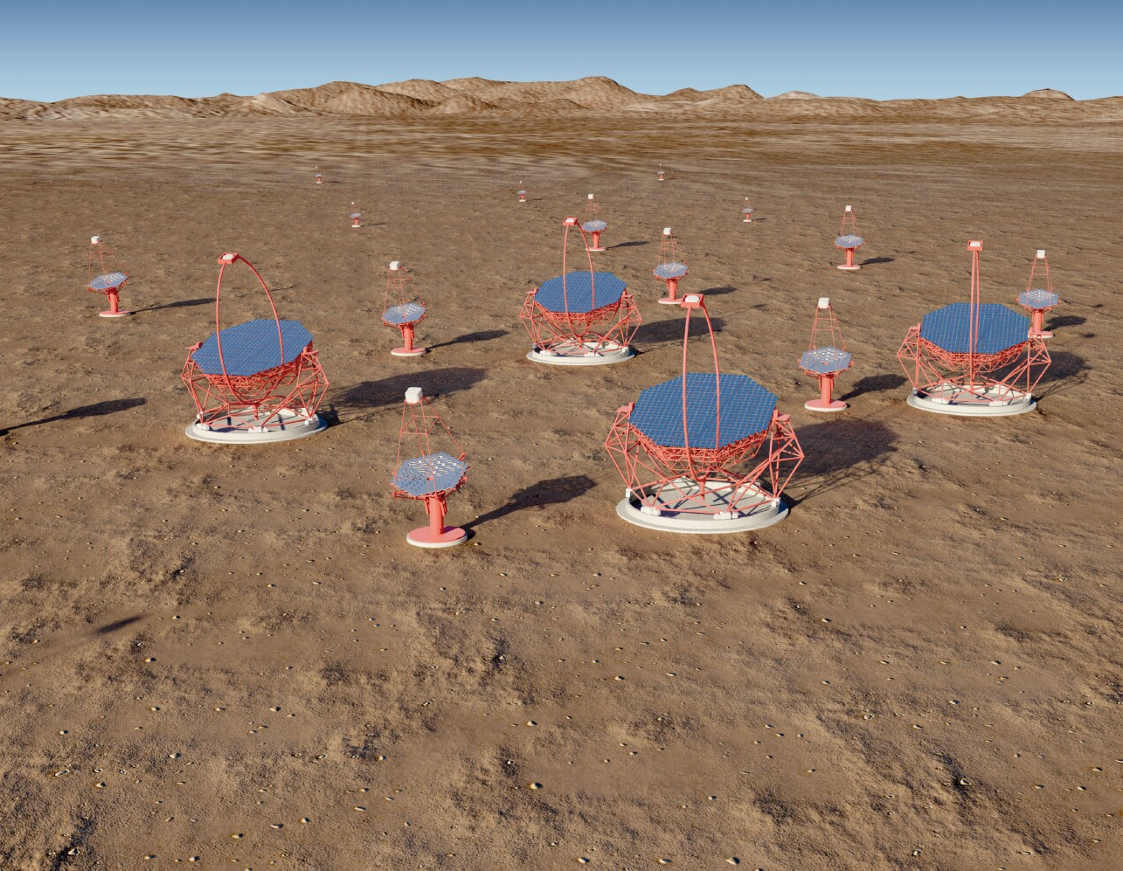
UK participation in CTA
Status of CTA
Status of GCT and CHEC
ESO visit
Installation of CHEC on telescope
First light
GCT inauguration
Next steps
CTA and SST
CTA-UK
Summary

Slide 2
Status of CTA
CTA Letter of Intent (5 pages) produced in November 2005, with 62 signatories, including Paula Chadwick (Durham) and Johannes Knapp (then Leeds).
Now CTA has nearly 1500 members from 224 institutes and 33 countries.
A total of 62 members from 12 institutes are based in the UK.
Technical Design Report produced in May 2015 (2424 pages).
2

Slide 3
Prototype CTA telescopes – MST
3

Slide 4
Prototype CTA telescopes – SST-1M
4

Slide 5
Prototype CTA telescopes – ASTRI
5

Slide 6
Prototype CTA telescopes – LST
Ground breaking in La Palma, October 2015.
6

Slide 7
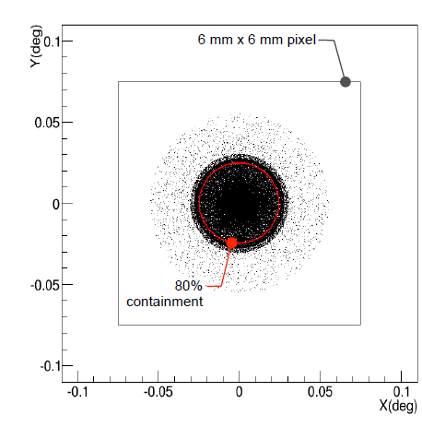
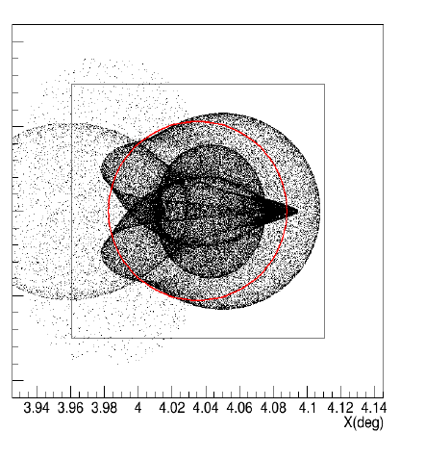
Status of GCT – optics
Durham/Liverpool, optical design:
Images of point source at infinity:
For field angles below about 5, over 80% of the light from a point source at infinity (or at 10 km with refocusing) is contained in a 6 × 6 mm² pixel.
δ = 0°
δ = 4°
7

Slide 8
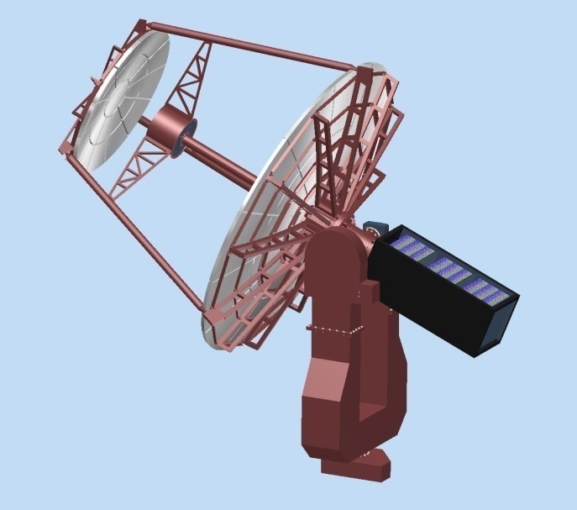
Development of GCT mechanical design
Durham 2011.
Long fork.
Central tube supports camera.
Tripod supports secondary mirror
Electronics in counterweight.
Aluminium structure.
Paris, 2012.
Short fork.
Primary dish support separated from secondary support.
Camera attached to secondary.
Shaped counterweight.
Steel structure, aluminium mirrors.
8

Slide 9
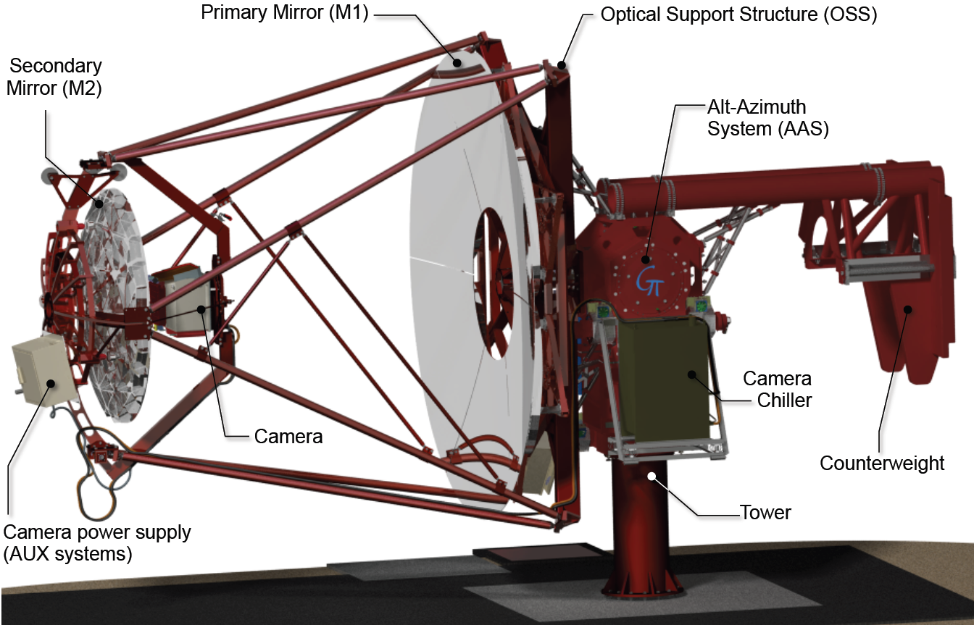
GCT prototype design
Paris 2015.
Four masts to support secondary.
Same drives on both axes.
Moveable counterweight.
Primary mirror rotation mechanism to facilitate mirror installation.
Camera removal mechanism.
9

Slide 10
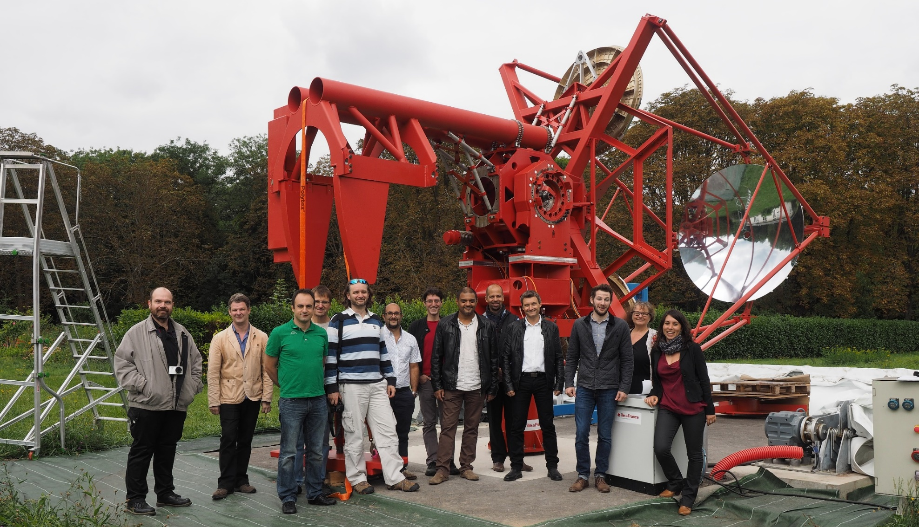
Mechanical structure and mirrors
Structure assembled in Meudon in April, visited by ESO team in September.
10

Slide 11
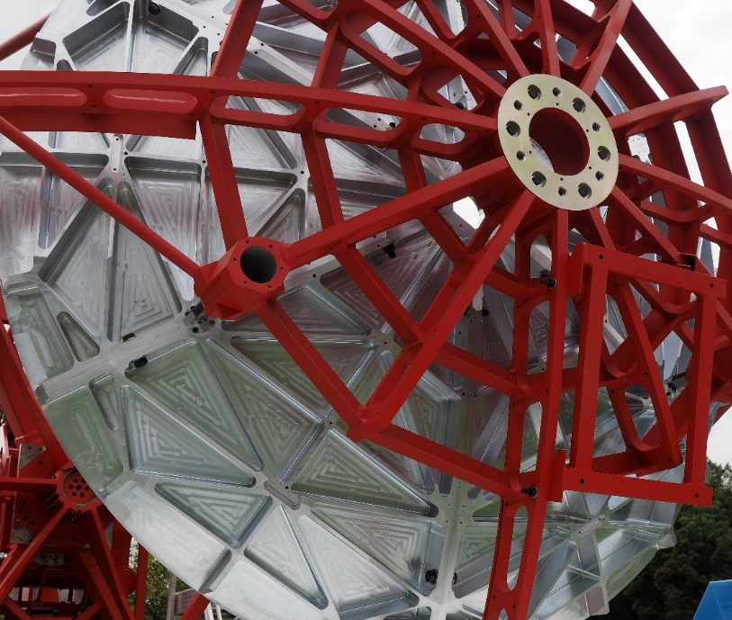
Comments from ESO team
Thanks, especially as Saturday!
Mirror maintenance concept unclear.
How recoat Al mirrors? Note that stripper attacks Al.
Enclosure is a clear plus with respect to maintenance.
Good components chosen for drives (motors, bearings, encoders).
Study vibrations generated by chiller, may affect performance of camera.
Think about maintenance when making design choices.
Schedule aggressive, need time for lessons from prototype to be applied to pre-production design.
Important for CTA to reduce number of systems as much as possible, e.g. standardise PLCs.
(C . Townsley, need value engineering exercise: does all the machining need to be so beautiful?)
11

Slide 12
Camera design – electronics
TARGET Module
16 x Preamps
Target Asic
FPGA
UDP Data
64 Pixel Module
16 x Preamps
Target Asic
16 x Preamps
Target Asic
16 x Preamp
TARGET ASIC
Trigger
Backplane Board
Buffering and Serialisation
Backplane
x 32
Amplification and shaping
Digitisation and Trigger
Camera Trigger
64 Pixel Module
Goal – produce low cost camera
with full-waveform readout
Data
DACQ Boards
Timing Board
Peripherals (calibration, lid, etc.)
Safety Board
Clock, Timestamps
12

Slide 13
Camera
TARGET Module
16 xs Preamps
Target Asic
FPGA
UDP Data
64 Pixel Module
16 x Preamps
Target Asic
16 x Preamps
Target Asic
16 x Preamp
TARGET ASIC
Trigger
Backplane Board
Backplane
x 32
Amplification and shaping
Trigger:
4 neighbouring pixels are summed, then discriminated.
64 Pixel Module
Data
6 mm
(0.17º) pixel
DACQ Boards
Timing Board
Safety Boards
Clock, Timestamps
Control
0.34º super pixel
13

Slide 14
Camera
TARGET Module
16 x Preamps
Target Asic
FPGA
UDP Data
64 Pixel Module
16 x Preamps
Target Asic
16 x Preamps
Target Asic
16 x Preamp
TARGET ASIC
Backplane Board
Backplane
x 32
Any 2 neighbouring super-pixels
64 Pixel Module
Data
DACQ Boards
Following camera trigger data read out to central location
Timing Board
Safety Boards
Clock, Timestamps
14

Slide 15
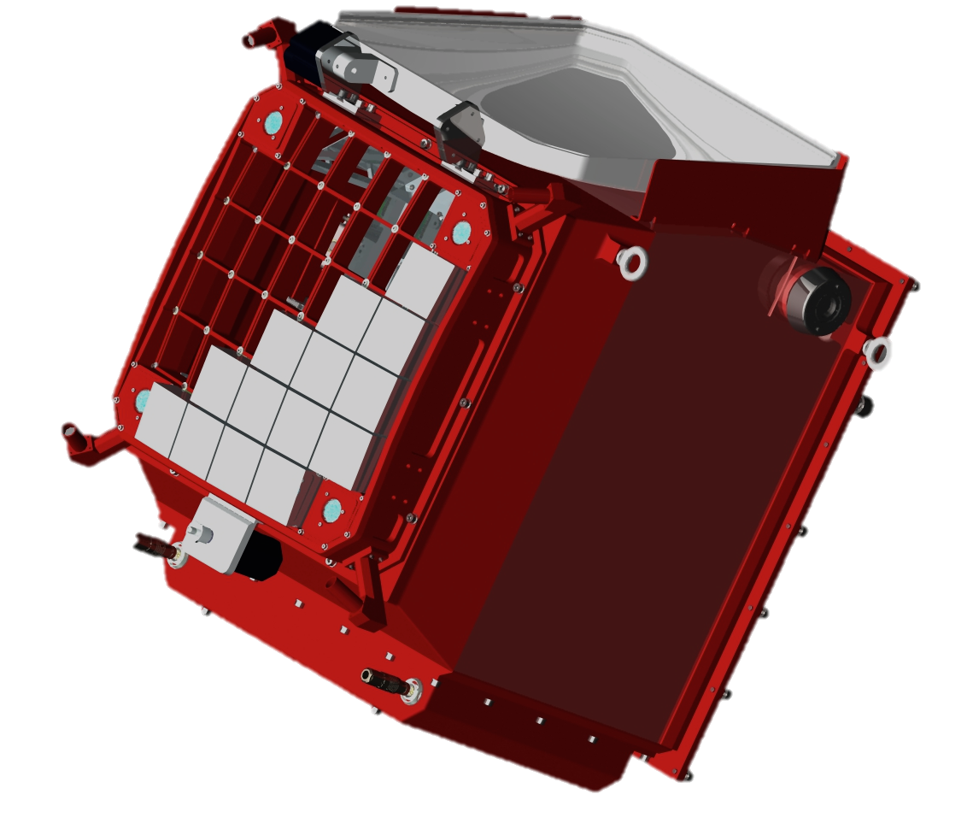
Camera
Leicester 2015, CHEC-M complete.
FEE:
Preamp/shaper.
TARGET 5 module for digitisation and FE trigger.
BEE:
2 DAQ boards, each 2 × 1 Gb/s.
Backplane for camera trigger (identical to SCT Backplane).
Pointing LEDs
Lid
Lid motor
Photodetectors and front end electronics
Mounting eyelets
LED Flasher Units
Desiccator
Focal plane plate
Lid Locking Mechanism
Motor Bulk-head Connectors
Thermal Exchange Unit
Enclosure
15

Slide 16
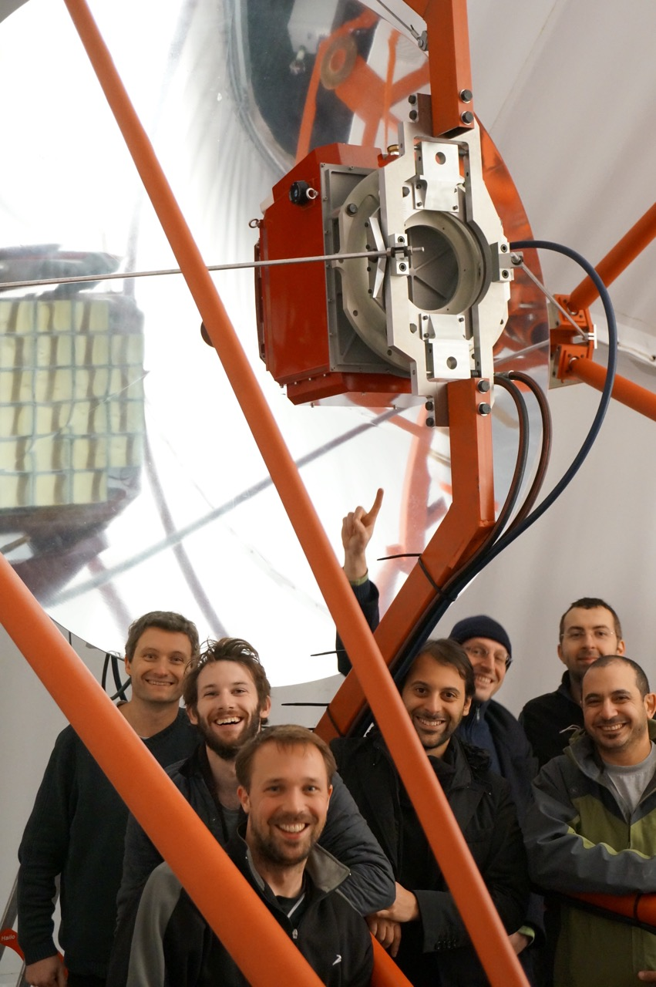
Completing the GCT prototype
Camera shipped to Paris on air-ride vehicle.
Transported in case designed for musical equipment.
Arrived 13th November.
Packing and transport procedures documented.
Max. acceleration 3.2 g along z axis, no damage caused.
Checked, then installed on telescope on Friday 20th November.

Slide 17
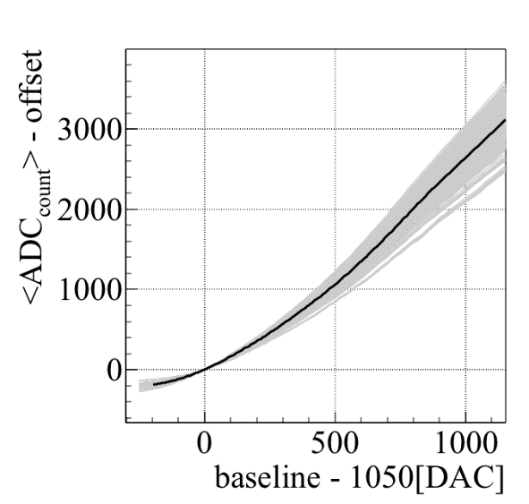
Verify camera operation on telescope
Check that operation safe, e.g. TARGET module temperatures.
Check electronics performance, e.g. transfer functions.
Check that MAPMs functioning as expected – look for single photo-electron peak:
17

Slide 18
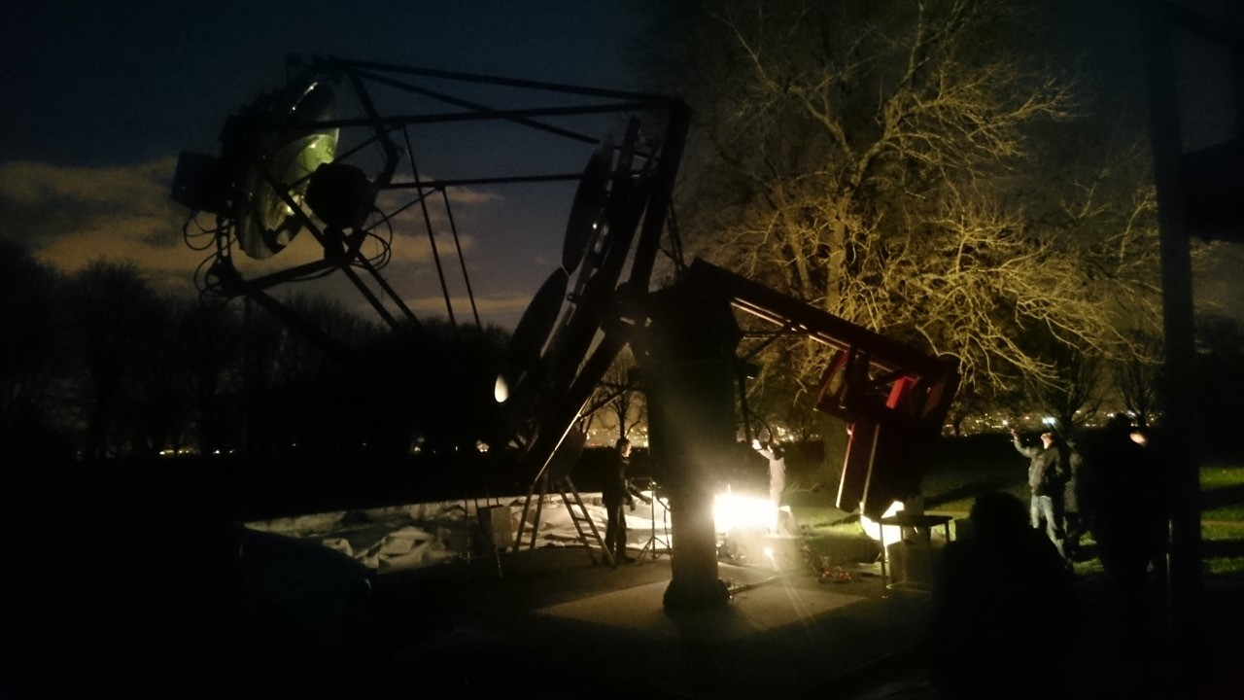
First tests of the GCT prototype on sky
Night of Thursday 26th November, NSB > 40 times that expected on CTA sites…

Slide 19
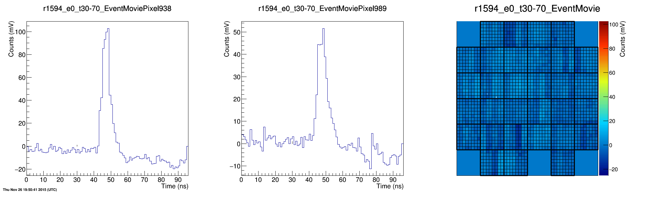
First tests of the GCT prototype on sky
…but successfully observed Cherenkov light from ~ 50 TeV showers.
19

Slide 20
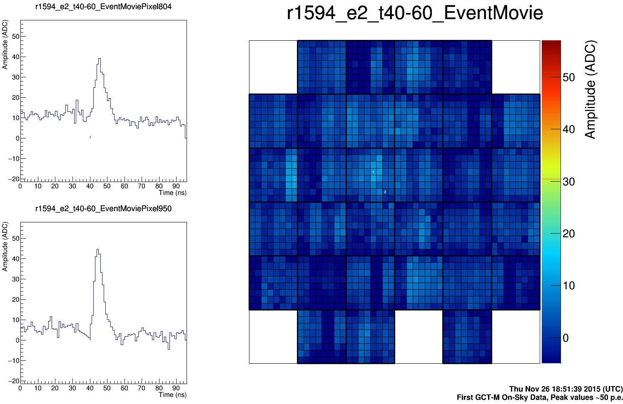
First tests of the GCT prototype on sky
Thursday 26th November.
20

Slide 21
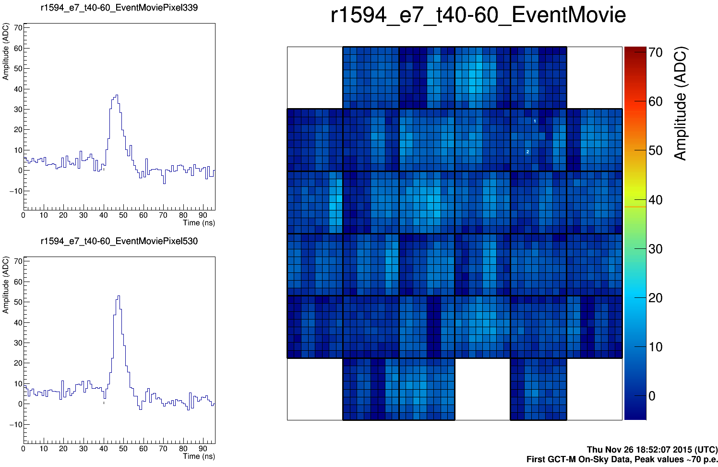
First tests of the GCT prototype on sky
Thursday 26th November.
21

Slide 22
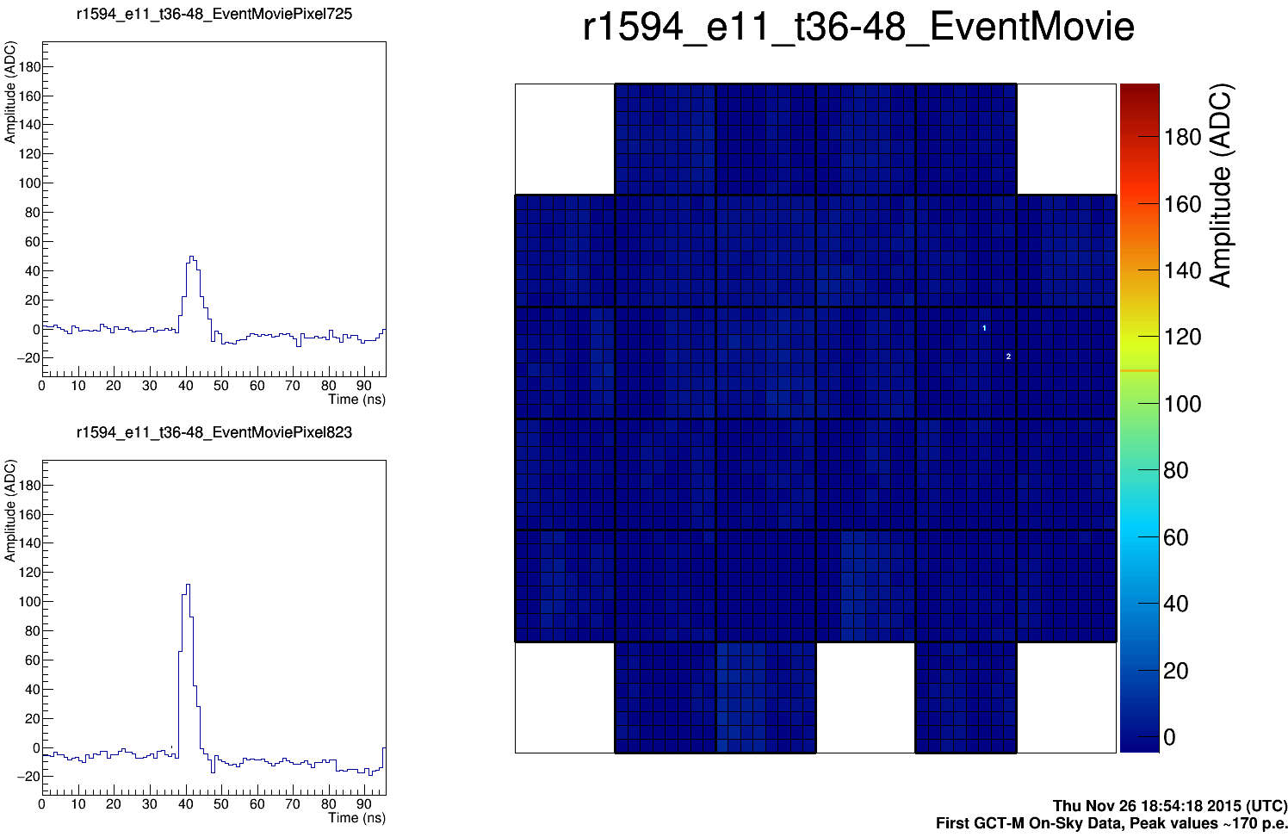
First tests of the GCT prototype on sky
Thursday 26th November.
22

Slide 23
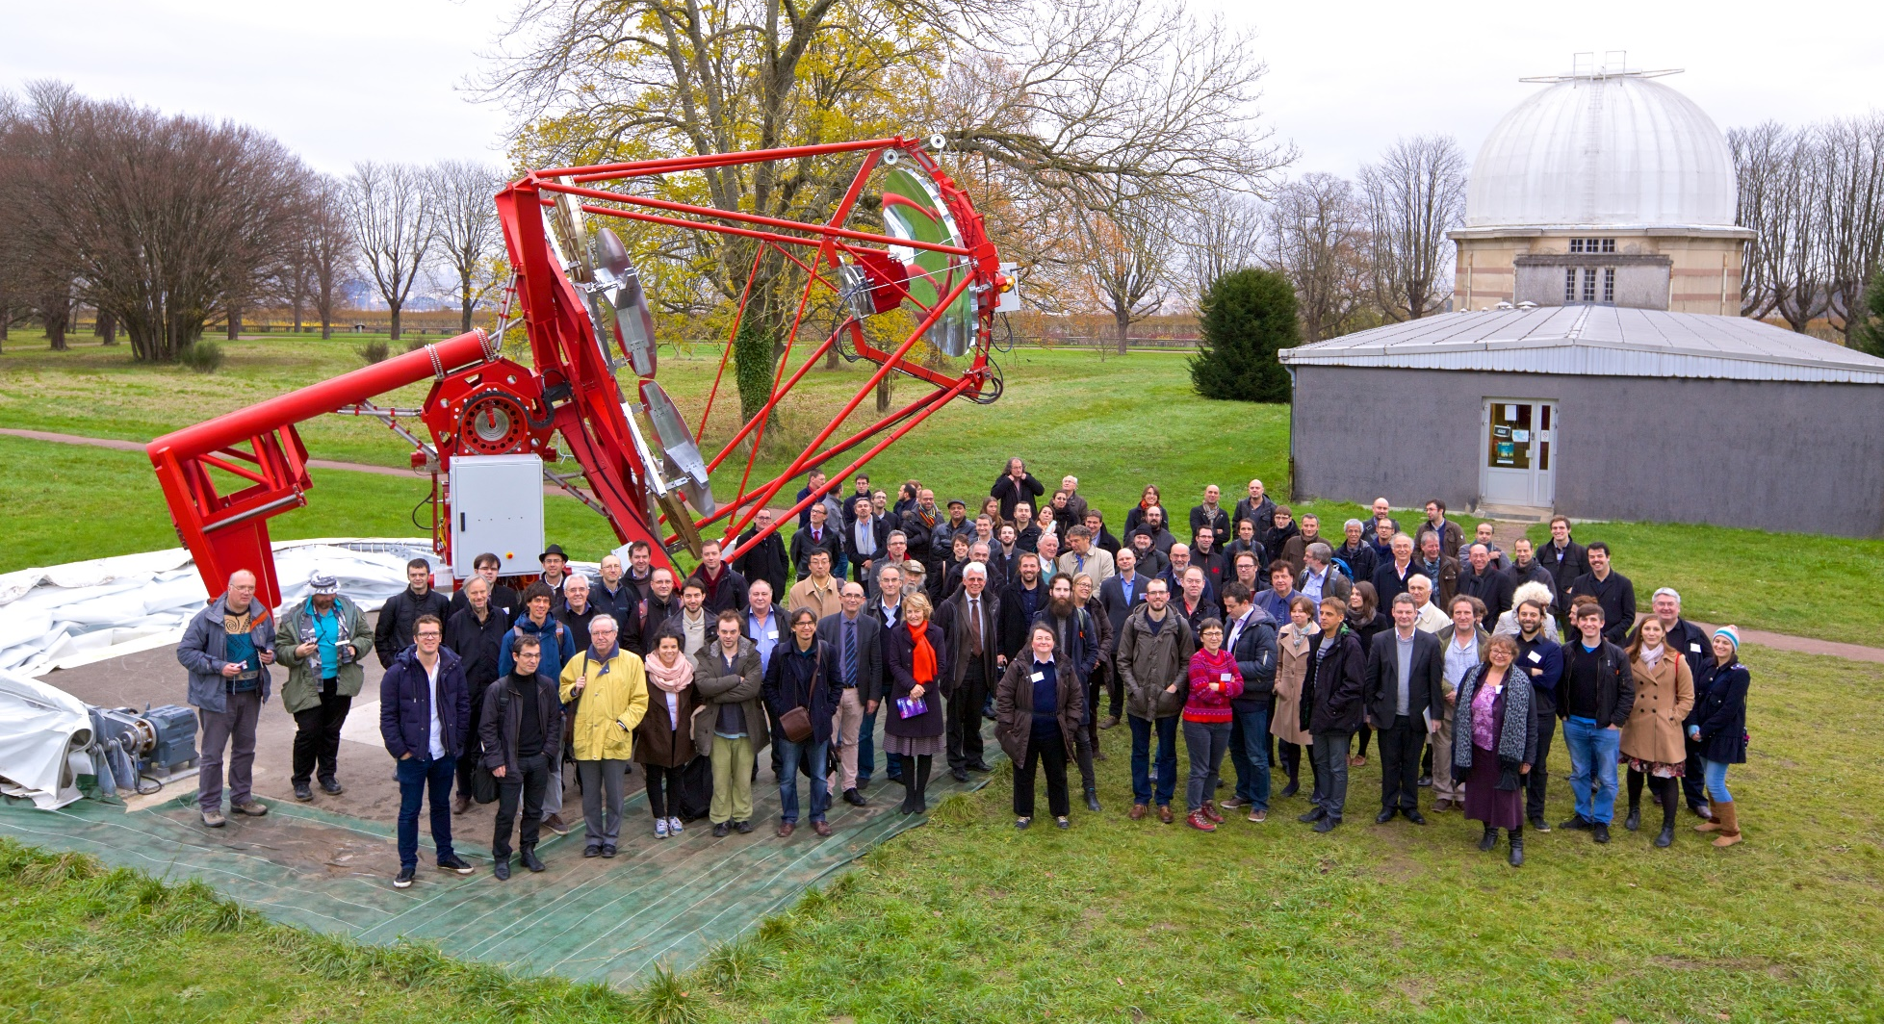
GCT Inauguration
December 1st 2015, in association with “SST science” meeting.
23

Slide 24
What have we learnt?
Identified and fixed bugs in electronics.
Time invested in simplifying installation/maintenance procedures is well spent.
Prototype helps identify problems you wouldn’t otherwise spot:
Need handles on camera.
Need “dummy connectors” for tubes and cables when camera not on telescope to prevent things flapping around and keep them clean.
Prototype aids production and checking of documentation.
24

Slide 25

What have we learnt?
We need to work on mirrors and mirror production processes.
Can see by eye that two panels of the secondary are of poor quality.
Try casting aluminium, machining, applying nickel layer, polishing, coating with aluminium and SiO₂.
Nickel layer improves surface quality, but also needed if mirror to be recoated, otherwise old Al coating cannot be stripped off.
Good quality control needed.
Casting should reduce cost (applies also to structural elements.)
Look at glass mirror construction.
Bad panel in GCT secondary.
25

Slide 26
Immediate next steps for the GCT, SST and CTA
GCT
Complete commissioning and testing of GCT camera and structure.
Put together Expressions of Interest for Project Office that cover construction of 35 GCTs.
Design pre-production camera and telescope.
Review design.
SST
Design foundation that works for all SSTs.
Find suitable common actuators.
SST cont.
Look again at ASTRI/GCT common design?
CTA
Provide information on site.
Agreement on common control systems needed (e.g. PLCs – use ESO favoured solution?) to reduce amount of effort invested in this area.
Collate Expressions of Interest.
26

Slide 27
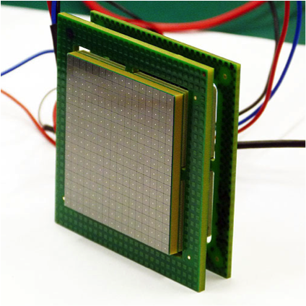
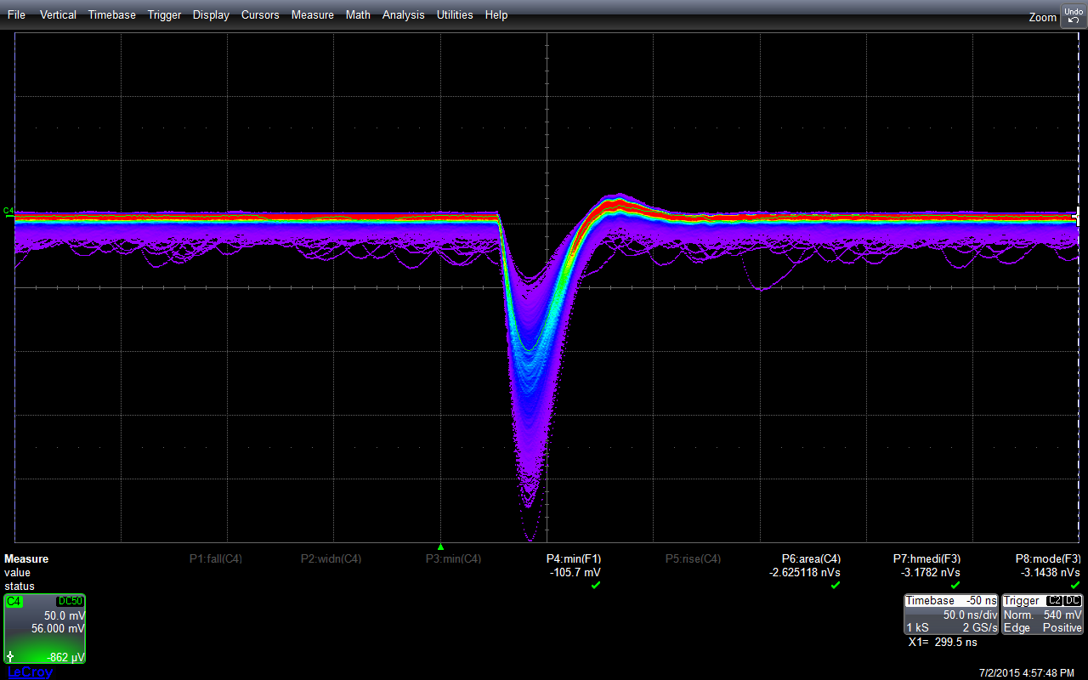
Next steps in UK, CHEC-S
Readout chain same as CHEC-M except for:
New preamp/shaper to match SiPM signals to readout chain.
TARGET 7 modules.
Upgraded DAQ so use one 10 Gb/s board?
Slightly modified Backplane (now at Washington University).
Mechanics:
Improved cooling unit.
Add cooling to faceplate to allow control of SiPM temperature.
Modifications to simplify mass production/maintenance.
Preamp/shaper:
Gang together four 3 × 3 mm² pixels to make a camera (6 × 6 mm²) pixel:
FWHM ~24 ns
27

Slide 28
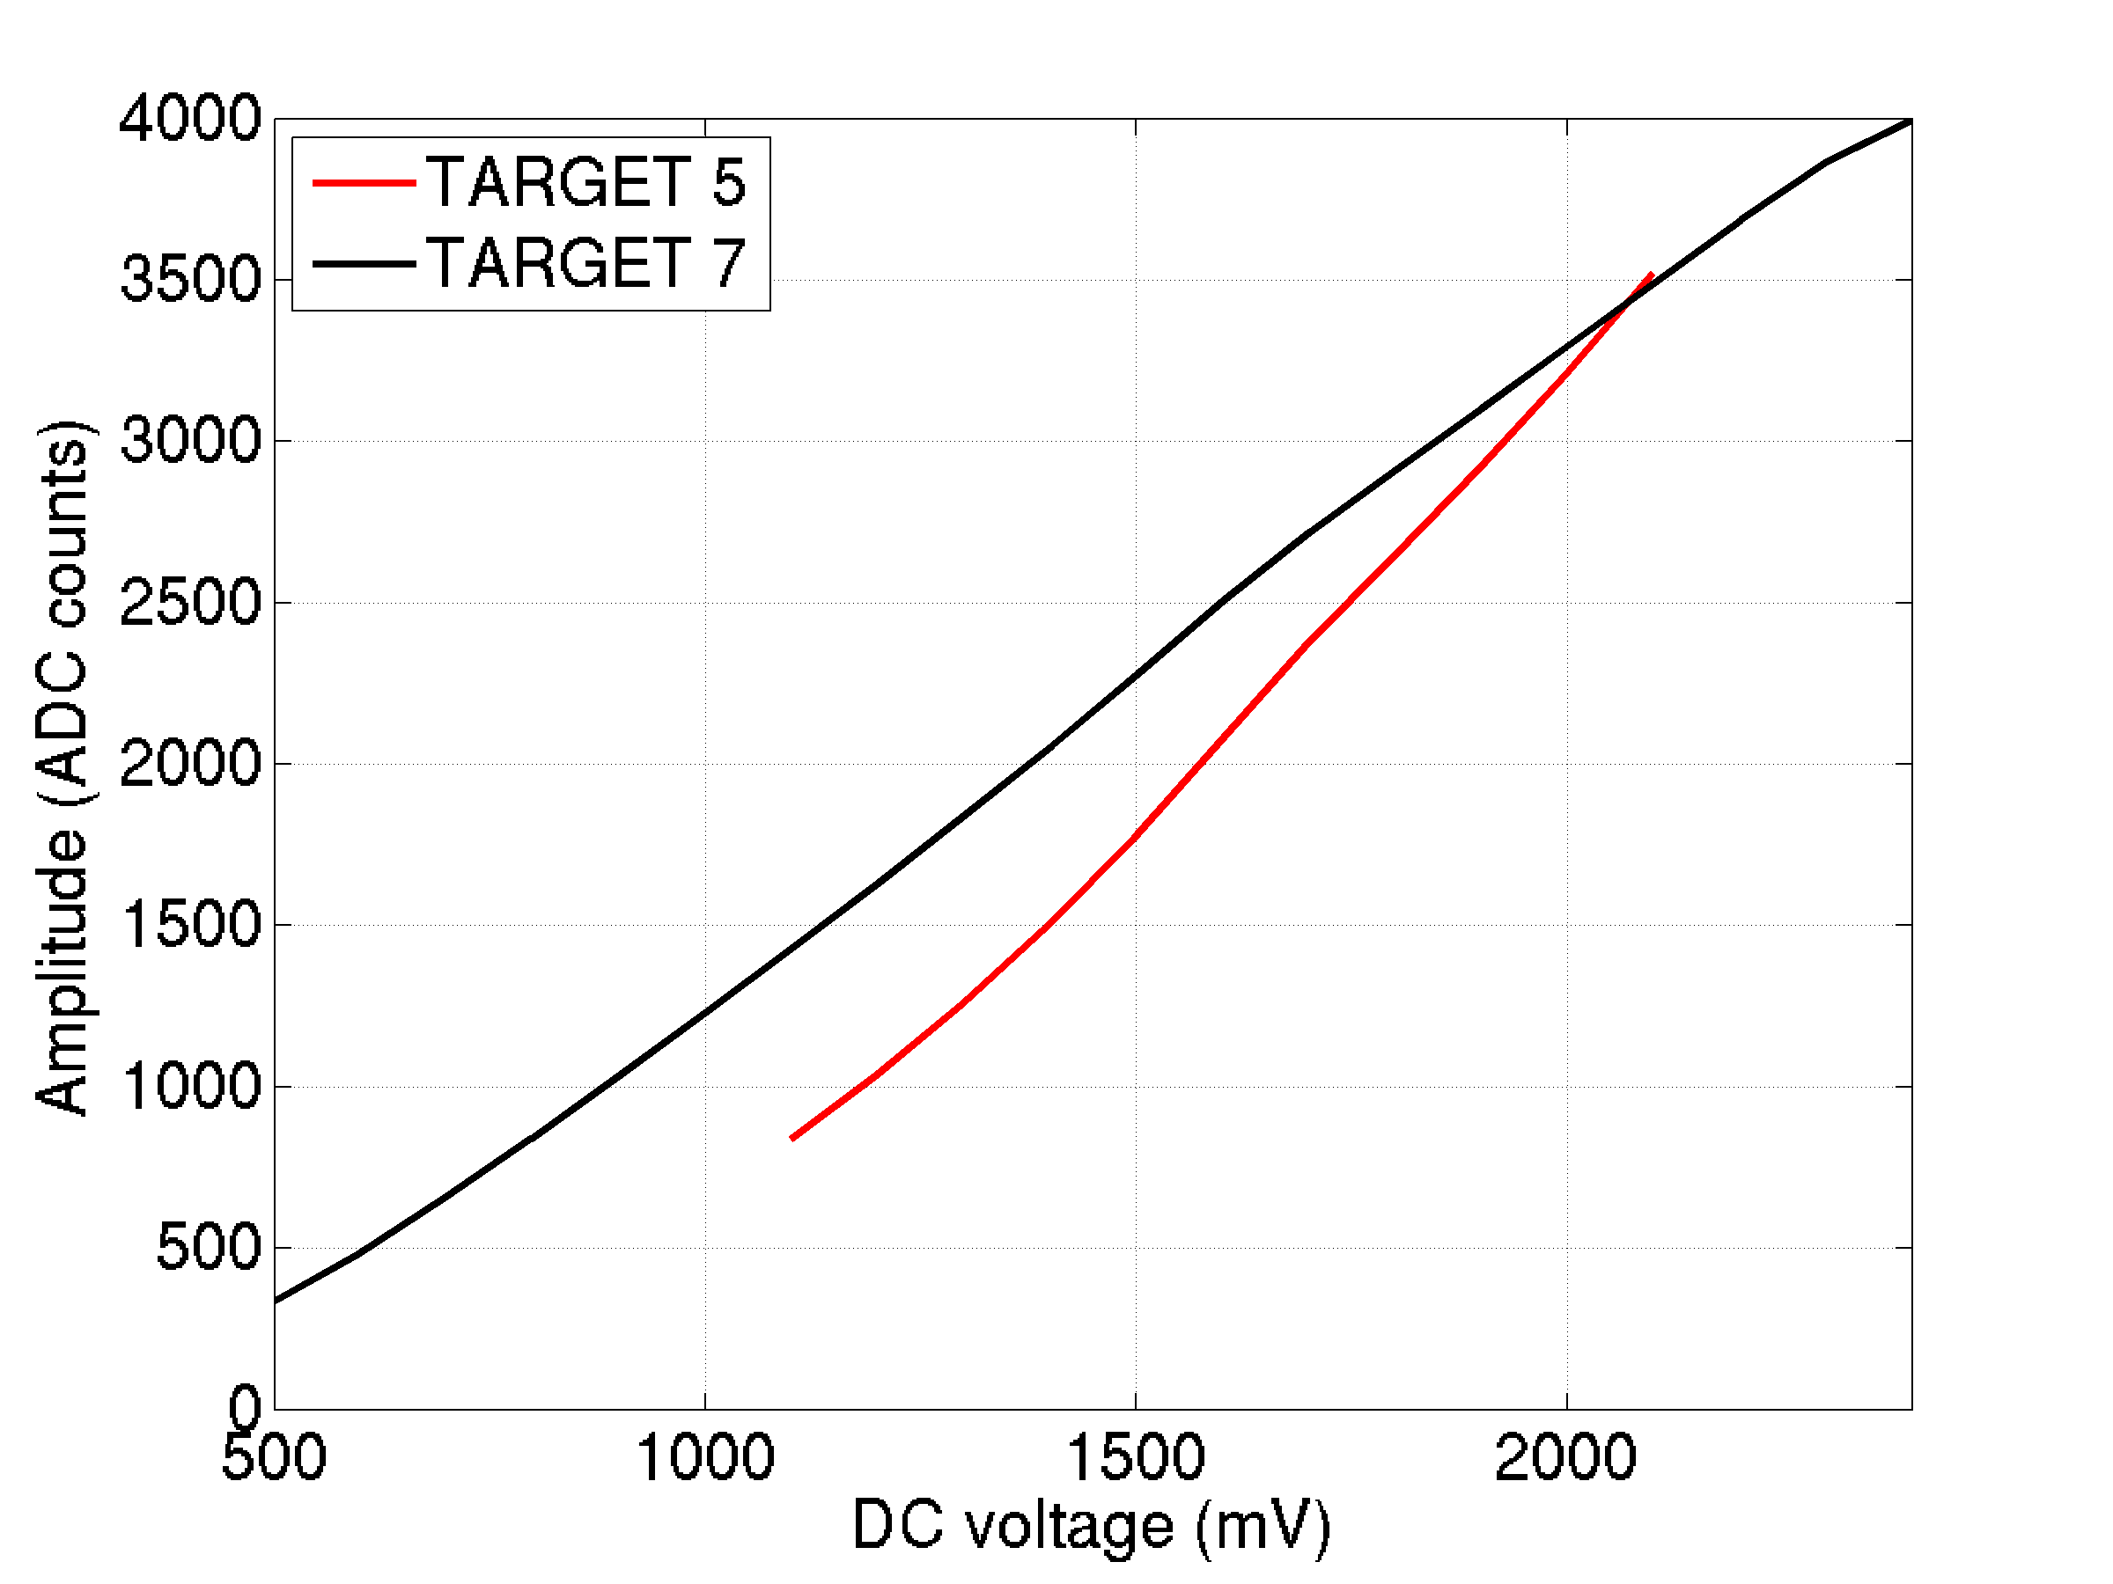
TARGET 7 modules
Sampling performance:
Range ~1.9 V (and low temperature dependence).
AC noise: ~ 5% for ~ 2 V signals, < 10% for ~ 10 mV signals.
Trigger noise:
15 mV – surprisingly high.
Noise is induced by sampling (same problem seen with TARGET 5).
With sampling off, noise is 4 mV.
Justin Vandenbroucke
TARGET 7
Operating range: 1.9 V
Integral nonlinearity: 77 counts
28

Slide 29
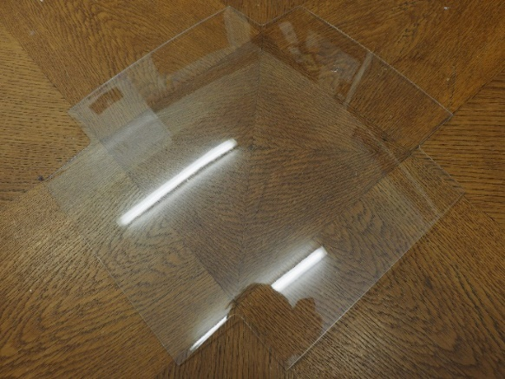
CHEC-S SiPMs and window
Hamamatsu S12642-1616PA-50 SiPMs delivered.
New coating allows water ingress.
CHEC-S needs protective window.
Use PMMA (Polycasa XT UVT)?
Thermally form to match curvature of focal plane (no shadowing).
Cut-outs for flashers.
Coat to improve UV transmittance:
First step (Siltint):
Rel. Trans.
Transmittance
Angle (°)
29

Slide 30
Software for CHEC
Concentrating on “future proof” elements.
TARGET Driver handles TARGET modules.
LibCHEC for camera operation.
Camera server, steers readout.
Camera controller, monitors and controls hardware and camera server – finite state machine.
30

Slide 31
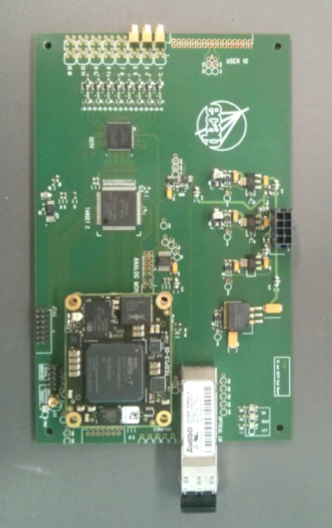
Towards pre-production cameras
Tackle noise problems on TARGET chip (cross talk from digitisation affecting trigger).
Split TARGET into:
TARGET CCTV (CTA companion trigger variant).
TARGET C (digitisation), pin compatible with TARGET 7.
Tests suggest:
Threshold < 4 mV.
Trigger noise < 1 mV.
If achieved, meets CHEC specifications.
TARGET C and CCTV test board:
31

Slide 32
CHEC data analysis
LibCHEC offline (calibration and data analysis).
Example analysis chain: read event, convert ADC to voltage, find peak in waveform.
Result:
32

Slide 33
Monte Carlo studies
Simulation of GCT with CHEC-S included in CTA Monte Carlo.
Large MC production run started to determine optimal array layout.
Various candidate arrays simulated.
Sensitivity curves compared, here hexagonal array with 4 LSTs, 24 MSTs, 73 SSTs, intermediate scaling.
Complete results expected in March.

Slide 34
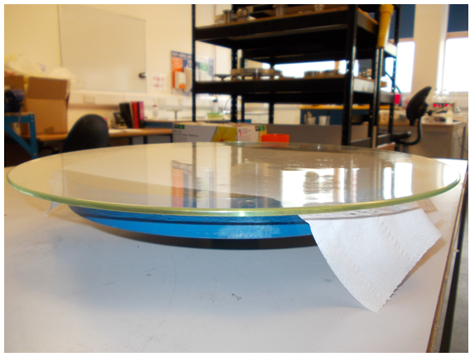
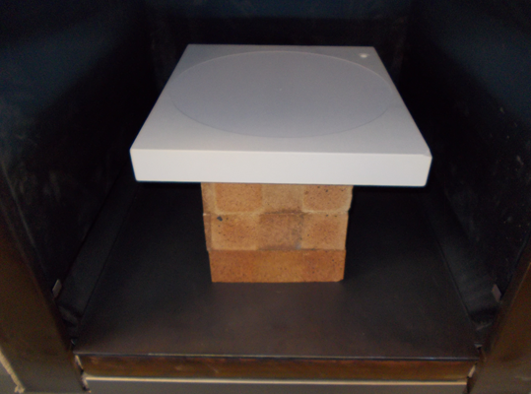
First glass mirror studies
Hot slump glass mirrors using concave mould.
Proof-of-principle studies.
Grind a ceramic mould with radius of curvature of 3 m.
Level mould in oven and slump 4 mm thick glass sheet, 35 cm diameter, using carefully controlled temperature cycle.
34

Slide 35
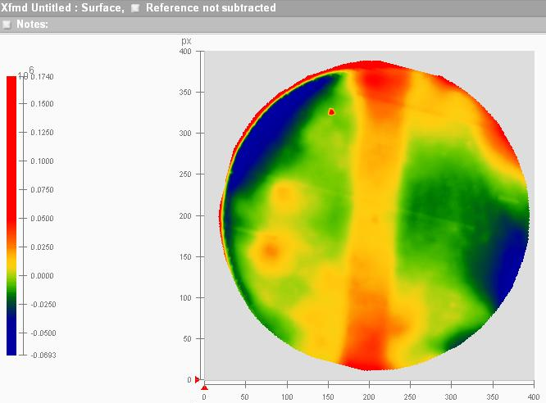
First glass mirror studies
Measure RoC of glass samples and mould.
Mould relaxes slightly after baking.
Part 1, slumped simultaneously with mould baking, during power cut.
Part 2, smaller RoC than mould.
Glass follows shape of mould.
Deviations about ± 25 nm.
Next steps, larger samples, petal shapes, smaller RoC, coating…
35

Slide 36
Summary
Progress with CTA since July 2015:
Conceptual Design Review.
Site decisions.
For the GCT:
Telescope completed.
ESO visit.
Camera installed.
First light and inauguration.
CHEC:
CHEC-M saw first air showers.
CHEC-S design progressing, incorporating lessons from CHEC-M.
Glass mirrors, tests pieces produced.
Next steps:
Expression of Interest.
Testing of GCT structure.
Further testing of CHEC-M.
Selection of SiPMs.
Completion and testing of CHEC-S.
Design of pre-production telescope and camera.
Manufacture of pre-production of telescopes/cameras.
Testing of pre-production telescope and camera.
Installation in Paranal.

