Slide 1
Phys105 – Week 5
News
This week:
News.
Directories, folders and files.
Some more on histograms.
Controlling Python programs.
Loops using for.
The if statement.
The continue and break statements.
The while statement.
From this week, everyone will have a computer class every week!
The timetable is:
I have tried to send everyone personal Teams invitations, but there is no way to do this automatically, so I might have made some mistakes…apologies if something is wrong with your email – please go to the session in the timetable!
Time | Monday | Tuesday
09:00 – 11:00 | B3 | B2 and B6
13:00 – 15:00 | B1 and B7 | B4 and B5
1

Slide 2
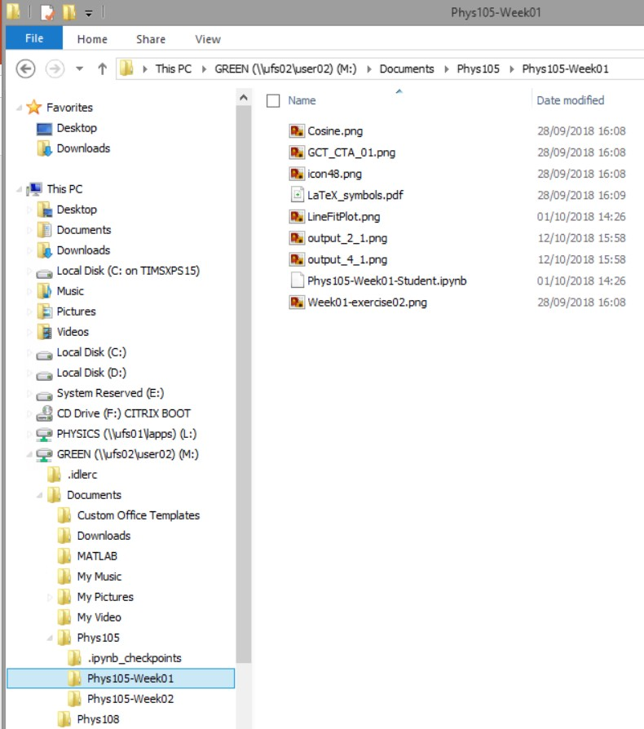
Directories on Windows
Use File Explorer.
Access via Start, Windows System, File Explorer.
In File Explorer, click View and select Navigation Pane.
Shows you all folders
in “tree” on the left and selected folder’s contents on the right.
Can move (or copy) files on the right into folders on the left…

Slide 3

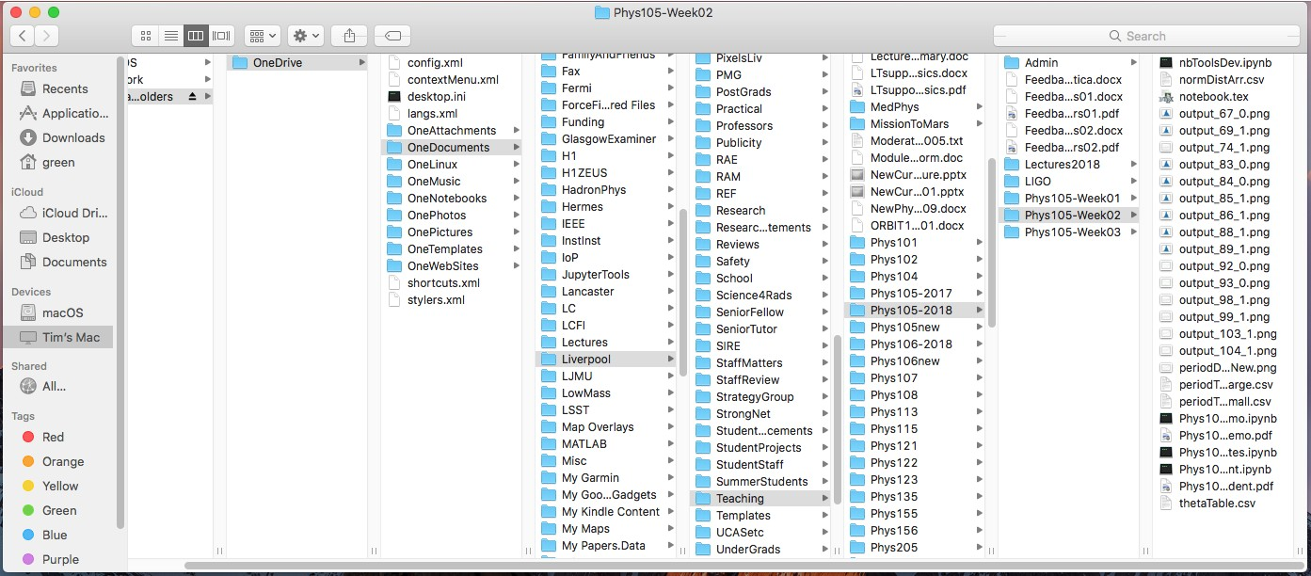
Directories on a Mac
Use Finder, can start from Dock.
Choose columns view

Slide 4
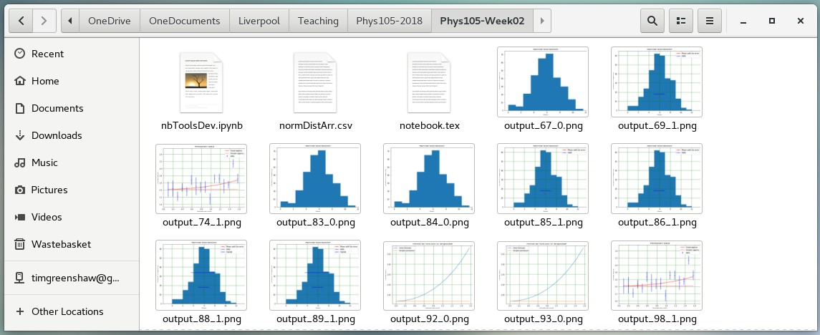
Directories on Linux
Many different flavours of Linux!
Example here is using CentOS 7.
Select Applications, Accessories, Files.
4

