Slide 1
News
Phys105 – Week 3
This week:
Comments from last week:
Uploading files to CoCalc.
Images and figures.
Switching cell types.
Directories/folders:
Windows
Mac
Linux
CoCalc
Lists, tuples and NumPy arrays.
Histograms take one.
Joe Price’s Office Hours:
Wednesdays, 10:00...11:00.
Email to book a slot!
(And if you can’t get to our Office Hours, email and we’ll find an alternative!)
1

Slide 2
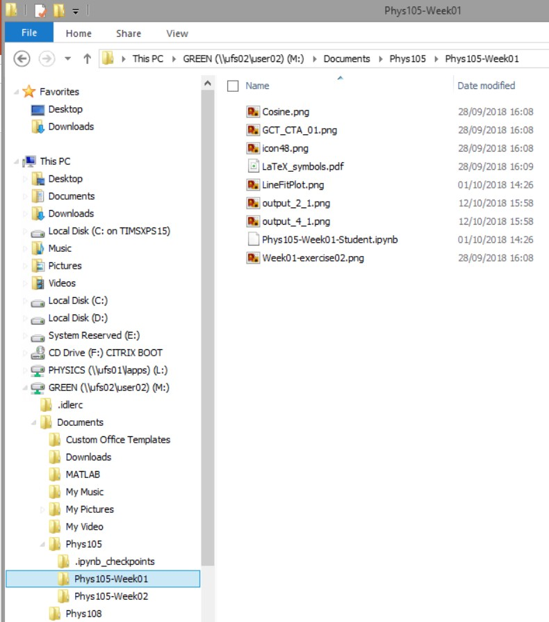
Directories on Windows
Use File Explorer.
Access via Start, Windows System, File Explorer.
In File Explorer, click View and select Navigation Pane.
Shows you all folders
in “tree” on left and selected folder’s contents on right.
Can move (or copy) files on the right into folders on the left…
2

Slide 3

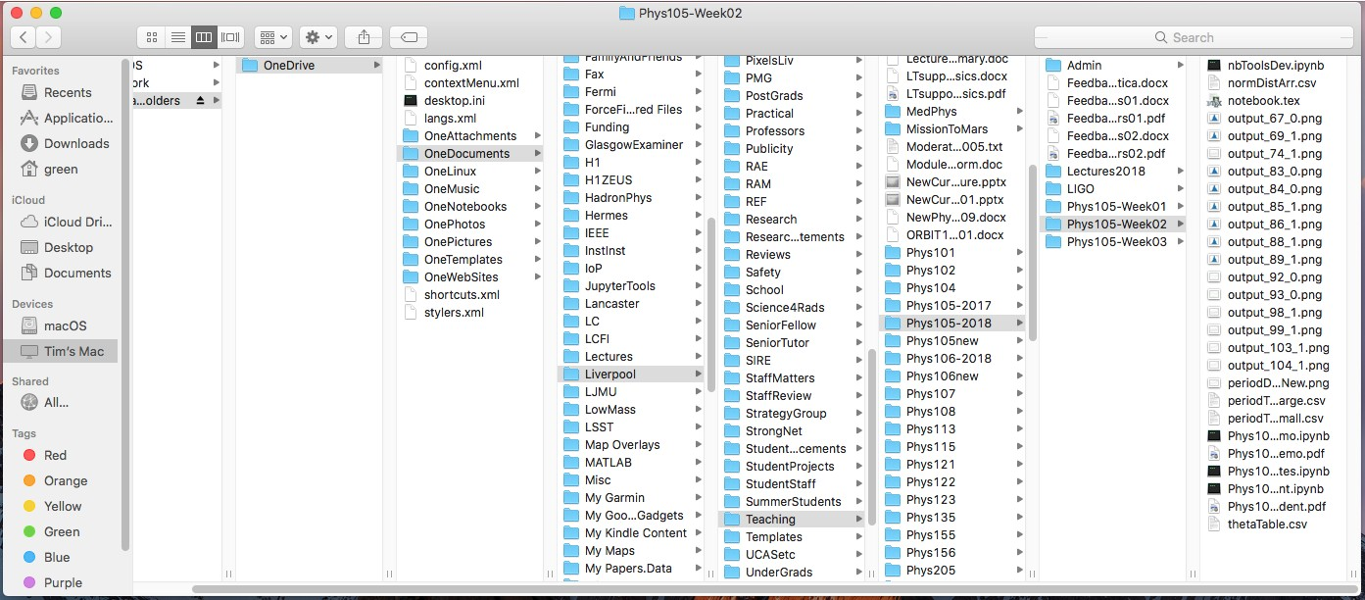
Directories on a Mac
Use Finder, can start from Dock.
Choose columns view
3

Slide 4
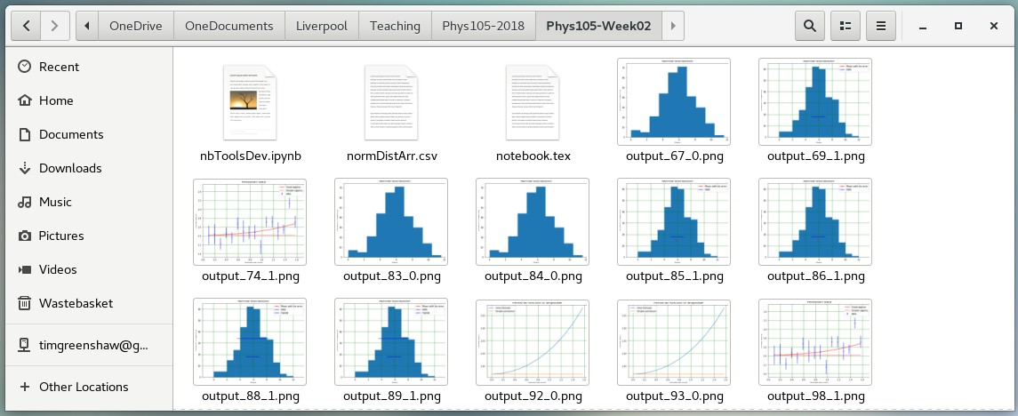
Directories on Linux
Many different flavours of Linux!
Example here is using CentOS 7.
Select Applications, Accessories, Files.
4

Slide 5
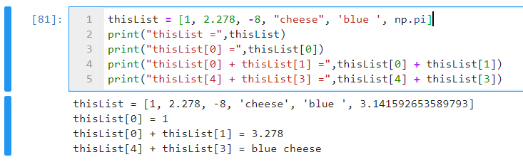
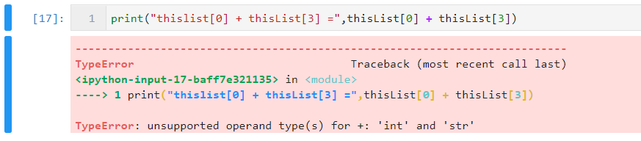
More data types – lists
In addition to the data types float and int, Python has a type called list.
You can make a list and access its elements as follows:
Effect of “+” depends on types of list elements, get error if + doesn’t make sense!
5

Slide 6
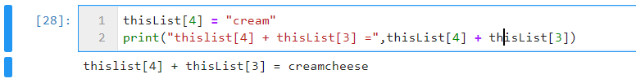
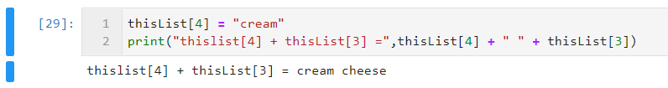

Lists
Lists can be modified, remember we had:
Change element 4 (the fifth in the list!):
If we want a space between “cream” and “cheese”, we have to either modify one of the strings (to “cream ” or “ cheese”) or put in a space explicitly:
Note that print adds spaces…
6

Slide 7
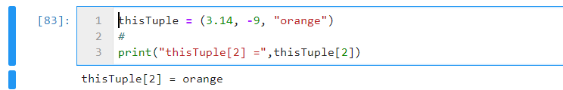
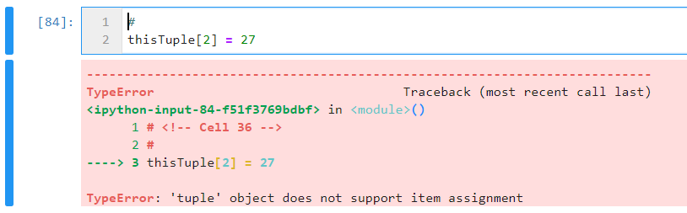
Tuples
Tuples are similar to lists.
One difference is that they are written using round brackets, not square.
The second is that while lists can be modified (are mutable), tuples cannot be changed once they have been defined (they are immutable).
7

Slide 8
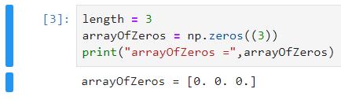
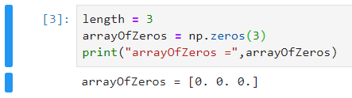
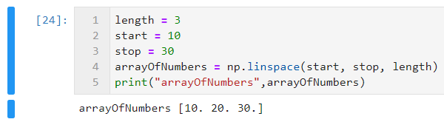

NumPy arrays
One of most useful data types for scientific computing is the numpy array.
These can be created and filled in many ways, for example: or
All elements must have same type.
Access elements in same way as for list:
8

Slide 9
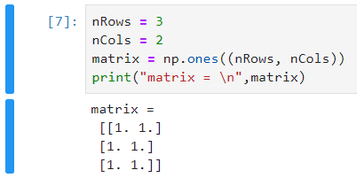

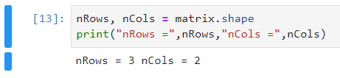
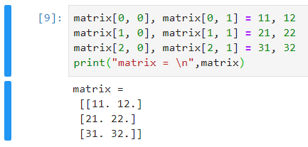
NumPy arrays
Arrays can be multi-dimensional:
More than one assignment per line is possible (but only do this when it results in understandable code!):
Check the dimensions of an array using shape:
Notice that shape returns a tuple, so we can look at its elements:
See that sometimes tuples come without the () brackets.
9

Slide 10
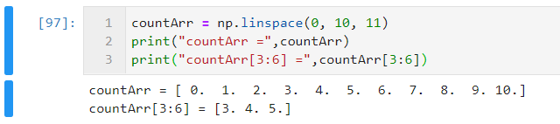
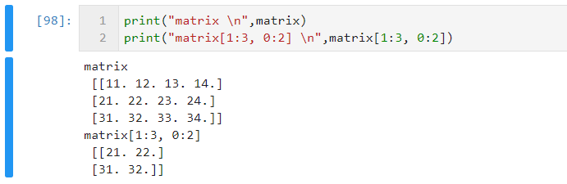
Slicing arrays
Can access range of elements using slices:
Also works in many dimensions:
10

Slide 11
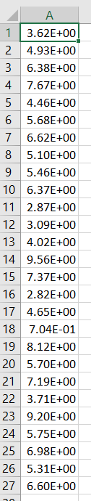
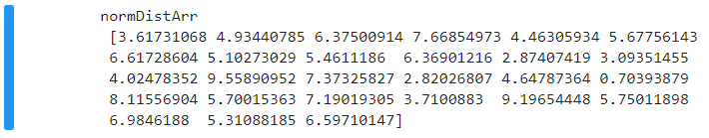
Writing out and reading in arrays
If have an array…
…can write it to a file in many ways, for example:
Can then open in Excel (see right!), Notepad etc.
Can read data from file into numpy array as follows:
11

Slide 12
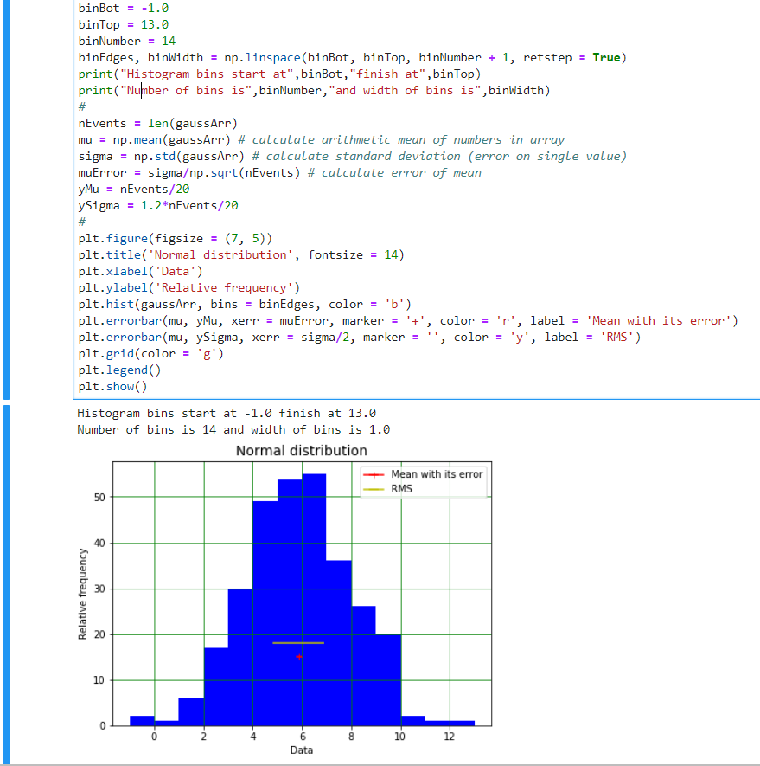
Histograms
Look at distribution of data using histogram.
Displays frequency of occurrence of values in data.
Simplest version chooses bin widths, format of plot etc. automatically…
…but you can also set your preferred bin widths and alter many aspects of the display of your histograms.
12

