Slide 1

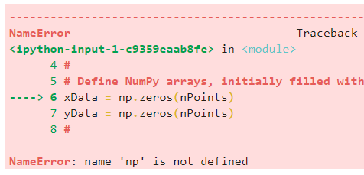
Phys105 – Week 2
Comments on Week 1
This week:
Comments on first week’s Notebook
Arithmetic with Python
Functions in Python
One common problem…
Make sure you run all the code cells in the right order.
E.g. if you haven’t run:
You will see something like the following if you try and use numpy:
1

Slide 2
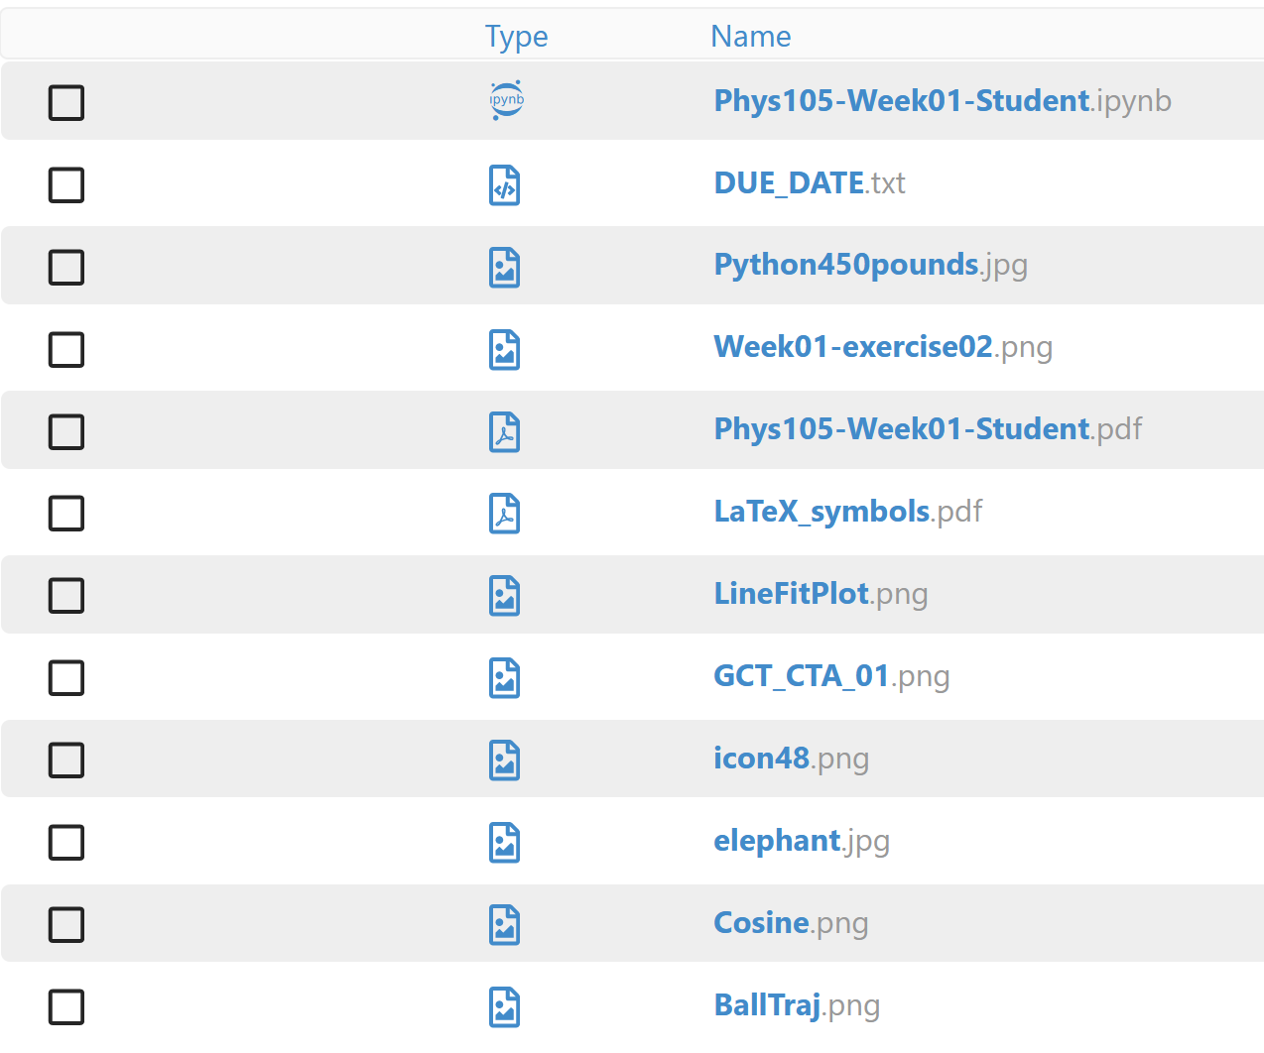
Comments on Week 1 and some hints
When adding a picture in a Markdown cell, your Notebook must be able to find the picture.
It will only look in the directory (or folder) in which it is located, unless you tell it to look elsewhere (e.g. by using a URL).
The pictures available are:
Any of the *.jpg files.
Any of the *.png files.
You can upload more pictures to your CoCalc space!
2

Slide 3
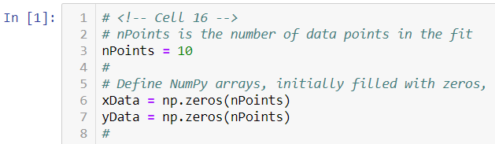
Comments on Week 1 and some hints
Can show line numbers in code cells to help with location of problems.
Either:
Click View then Toggle Line Numbers.
Or:
Make sure you haven’t selected a Markdown cell in edit mode or a Code cell and then press Shift l.
You will then see:
Python will do its best to tell you where and what the problem is.
But sometimes the descriptions are a little cryptic and the location is not quite right…
…there are just too many ways we programmers can get it wrong!
3

Slide 4

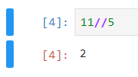
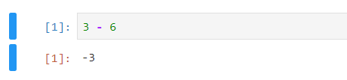
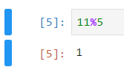

Arithmetic with Python
One of the simplest things we can do using Python is to add, subtract, multiply and divide numbers.
In a Jupyter Notebook, enter the sum you want to do in a Code cell and run the cell:
The answer appears below your code.
In addition to the operators “+”, “‒” , “*” and “/”, Python provides “**”, “//” and “%”.
Look at examples:
These examples use integers.
Can also use real numbers (“floats”):
4

Slide 5
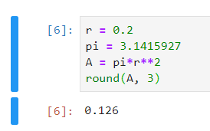
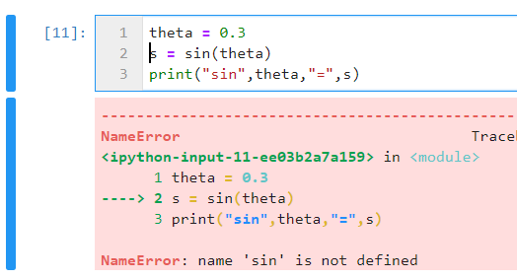
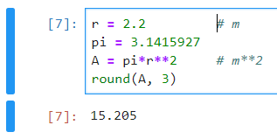
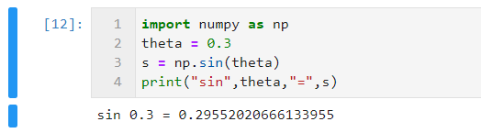

Variables and functions Python
Can define variables:
And change their values:
Use print statement to provide intelligible output:
Python provides many functions…
…but these are included in packages like numpy.
5

