Slide 1
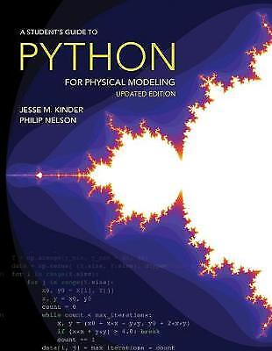

Phys105 – Introduction to Computational Physics
Prof. Tim Greenshaw.
  Office hours, Mon. 16:00-17:00.
  Email green@liv.ac.uk
Dr Carl Gwilliam.
  Office hours, Tues. 16:00-17:00.
  Email C.Gwilliam@liverpool.ac.uk
Lectures:
  Wednesday 15:00-16:00.
  Online (MS Teams).
Computer classes:
  Two hours every second week.
  Time depends on your bubble!
  Online now, may return to the MOTC (Maths, room 101).
Recommended textbooks:
  “A Student’s Guide
  to Python for
  Physical Modeling”,
  Kinder and Nelsen
  (Princeton
  University Press).
  “Learning Scientific
  Programming with
  Python”, Hill
  (Cambridge
  University Press).
Assessment:
  Computer Classes.
1
Notes:
1

Slide 2
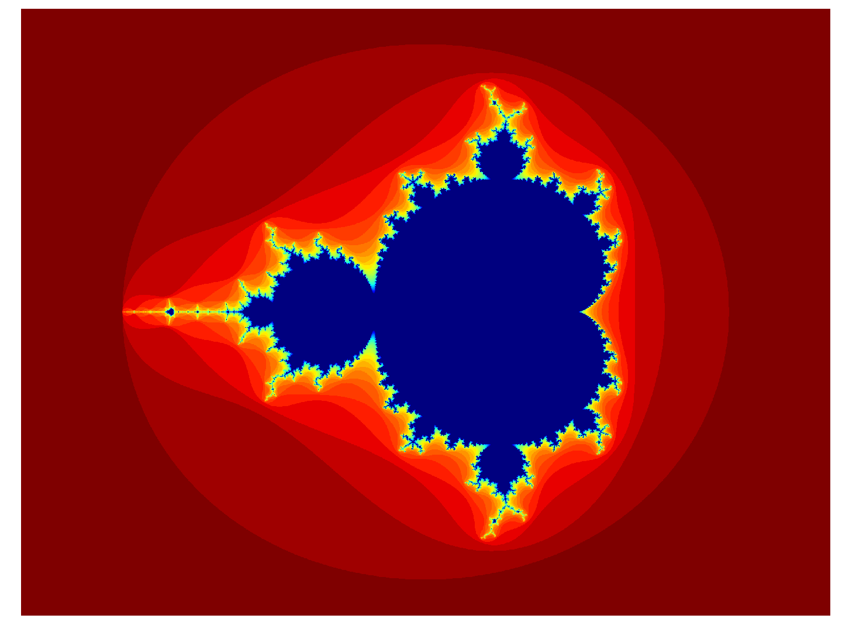
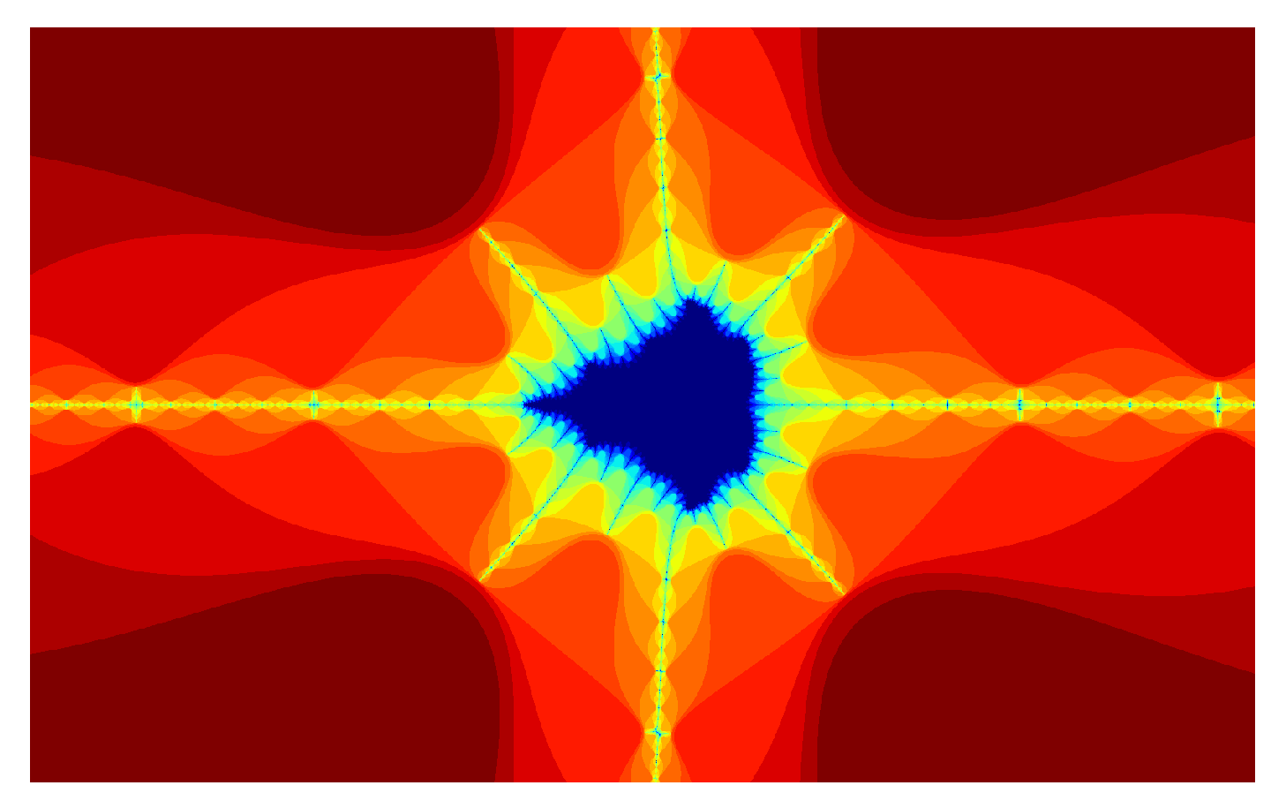
Phys105 – Introduction to Computational Physics
Outline syllabus:
  Installing Python and necessary packages/tools.
  Introduction to Python and Jupyter Notebooks.
  First steps with Python.
  Python and NumPy data structures.
  Plotting data.
  Generating random numbers and using these in Monte Carlo models.
  Numerical solution of differential equations.
  Introduction to computer algebra.
2
Notes:
2

Slide 3
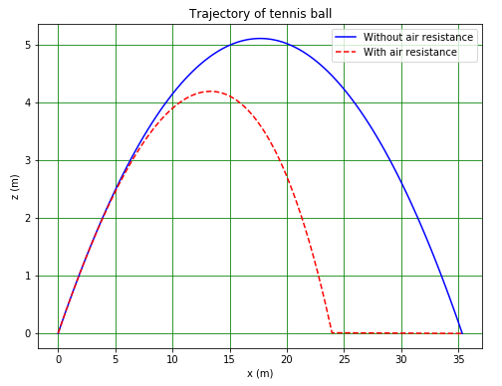
Aims and methods
Why do “Computational Physics”?
An example.
A tennis ball is thrown upwards from ground level at an angle of 30° to the horizontal and a speed of 20 m/s. Calculate how far it flies before its first bounce.
We all know how to solve this problem using…
…but the agreement of our calculation with experiment, is poor!
To provide a realistic answer, need to include air resistance.
No algebraic solution, but can be solved numerically using a computer.
3

Slide 4
Aims and methods
Aim of Phys105 is to show how problems like this can be solved, and also how computers can help with:
  Analysing and presenting data.
  Simulating the behaviour of stochastic systems.
  Differentiating and integrating functions.
Computer can also be used to do many other things we won’t look at in this course, such as control equipment or capture data.
We will use the Python programming language and work in Jupyter Notebooks.
Python is one of the most widely used programming languages…
… and Jupyter Notebooks are an excellent way of documenting scientific analysis.
See e.g. https://losc.ligo.org/tutorials/
4

Slide 5
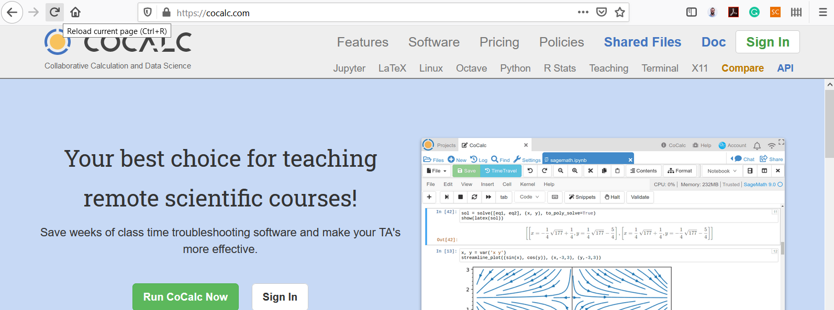





This lecture Finding the course material
In this lecture we will:
  See how to navigate to the course material on CoCalc.
  Introduce Jupyter Notebooks.
  Look at some Markdown examples.
  Have a first look at using least_squares to fit a straight line to some data points.
Start CoCalc at https://cocalc.com.
Sign in using the ID you have created.
Click
Then
And
And
And finally on
5

Slide 6
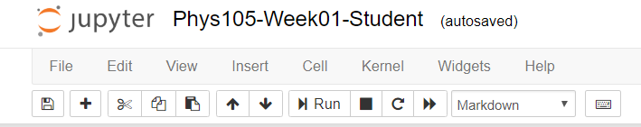
Jupyter Notebooks
Jupyter Notebooks consist of cells which can contain either computer code (Python) or text (with tables, hyperlinks, images, formulae…).
When you create a new cell, its default type is Code.
To change this to Markdown, select it (click in it) then click on Cell (menu bar), Cell Type and Markdown.
Alternatively:
  Select the cell.
  Press Esc.
  Type m.
To change the cell back to code, use the menu or select the cell, press Esc and then type y.
To delete a cell use the menu or press
Esc, d, d.
6

Slide 7
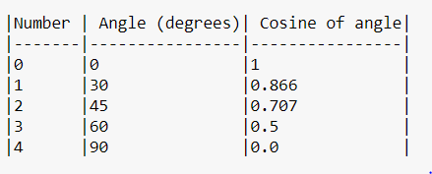
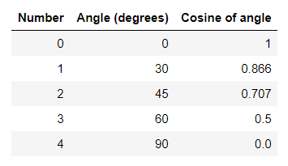
Markdown cells
Text can be entered directly into Markdown cells.
Create italics by writing _italics_ or
*italics*.
Bold text is obtained using _ _bold_ _ or **bold**.
To see the results run (or compile) the cell by selecting it and using Run in the menu bar…
…or pressing Shift + Enter.
These commands run the cell and select the next cell, or create a new cell if there is no next cell.
Using Ctrl + Enter just runs the cell.
A table as Markdown:
The same table when it is compiled:
Switch back to Markdown by double-clicking in the cell.
7

Slide 8
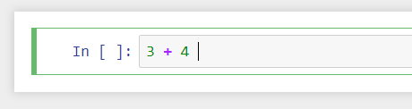
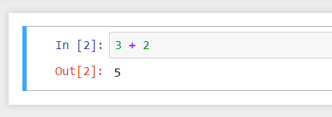
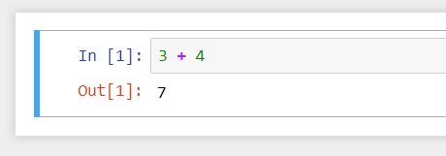
Code cells
Code cells are used to write elements of a Python program, e.g.
When this cell is run, the code is executed:
Editing the cell and re-running it gives…
We will learn to develop Python programs from scratch in this module…
…but the first thing we will look at is how to use least_squares and an existing program to fit a straight line to data, as this is needed for Practical Physics I (Phys106).
8

Slide 9
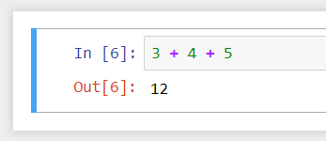
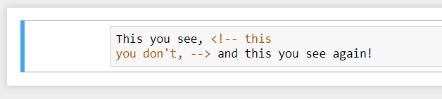
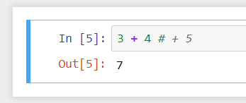
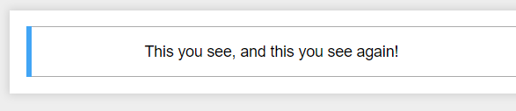
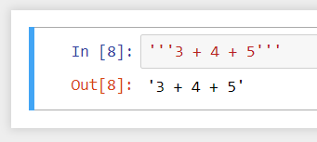
Comments
You can enter comments into both Markdown and Code cells.
These are used to explain what the Markdown or Python is doing.
For Markdown, the format is:
When this is run, the result is:
For Code cells, use #…
…or three quotes.
9

Slide 10
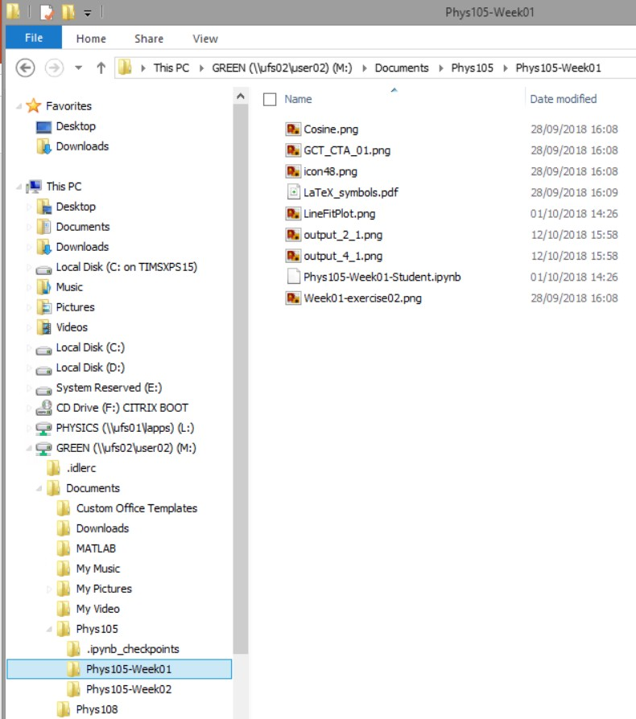
Directories on Windows
Use File Explorer.
Access via Start, Windows System, File Explorer.
In File Explorer, click View and select Navigation Pane.
Shows you all folders
in “tree” on the left and selected folder’s contents on the right.
Can move (or copy) files on the right into folders on the left…

Slide 11

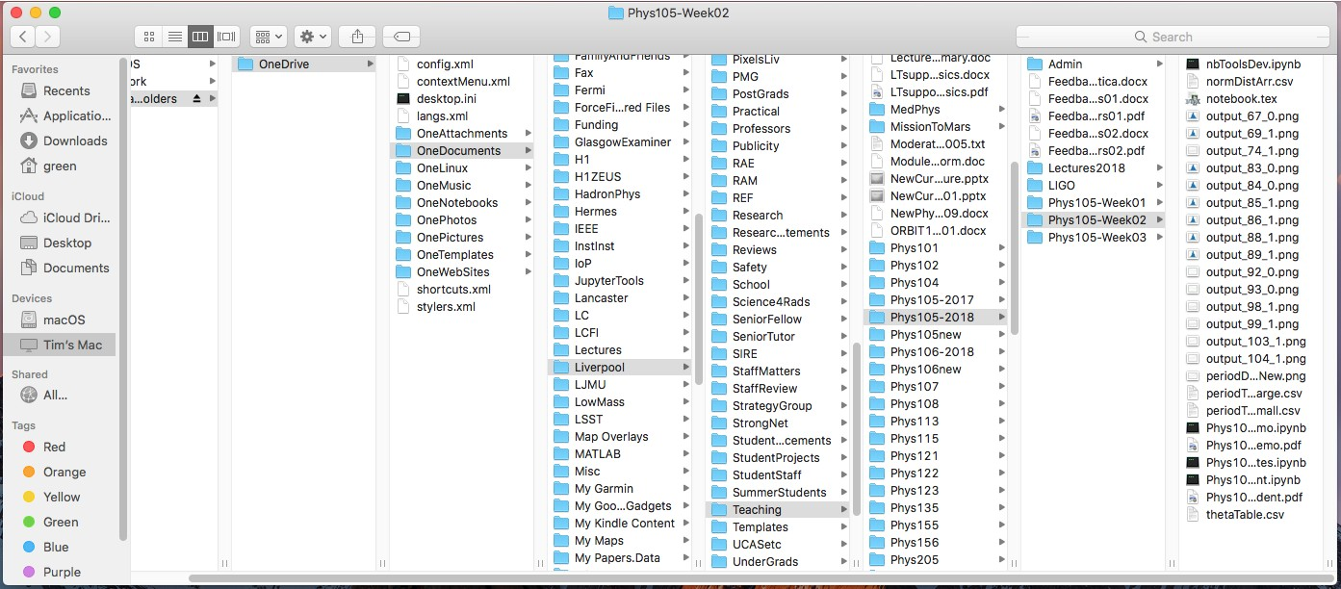
Directories on a Mac
Use Finder, can start from Dock.
Choose columns view
11

Slide 12
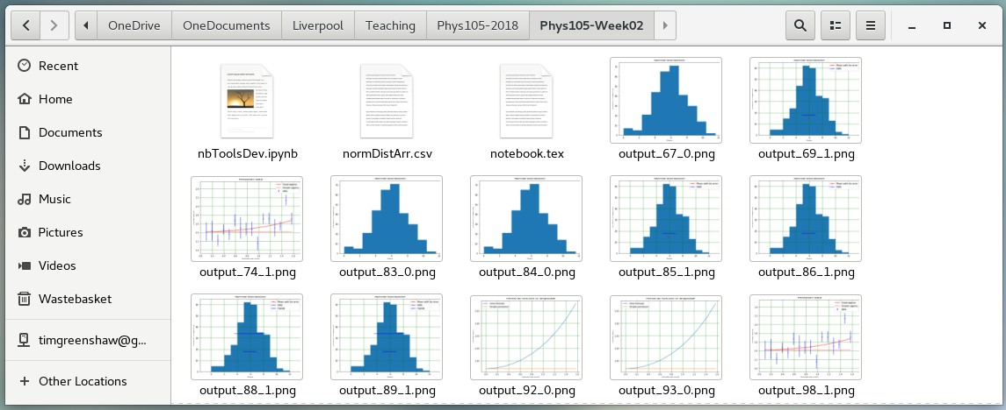
Directories on Linux
Many different flavours of Linux!
Example here is using CentOS 7.
Select Applications, Accessories, Files.
12

