Slide 1
Tim Greenshaw
Introduction to Computational Physics (Phys105)
green@liv.ac.uk

Slide 2
What will we do this year?
Using CoCalc and Jupyter Notebooks.
Installing Python on your own computer.
Fitting laboratory data.
Python data and control structures.
Matplotlib and Numpy.
Random numbers and Monte Carlo methods.
Numerical solution of equations.
Image analysis.
Introduction to computer algebra.

Slide 3
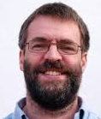
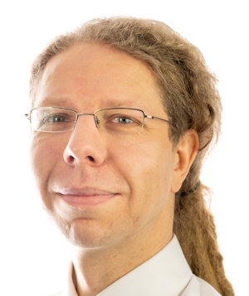

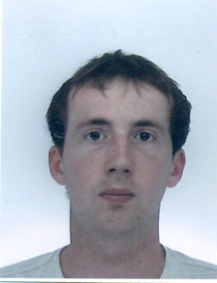
Who will we do it with?
Staff
Tim Greenshaw
Carl Gwilliam
Jan Kretzschmar
Joe Price

Slide 4
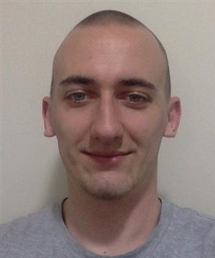
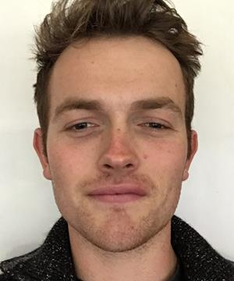
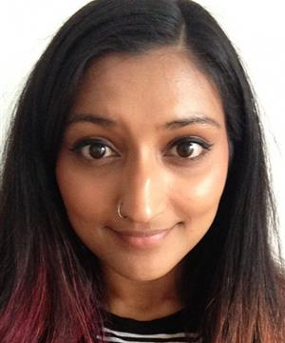
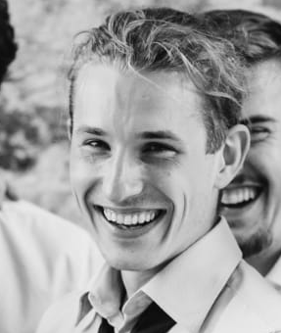
Who will we do it with?
Postgraduate demonstrators
Daniel Bromley
Selina Dhinsey
Barney Ellis
Ondrej Sedlacek

Slide 5
And how will we do it?
Online lectures.
We will use Teams – make sure you have this on your computer!
Computer classes.
These will be face-to-face, in “bubbles” of about 20.
Demonstrators will be on hand to help you with any difficulties you have working through the course’s Jupyter Notebooks.
We will use CoCalc, which means we can move completely online if necessary.

Slide 6
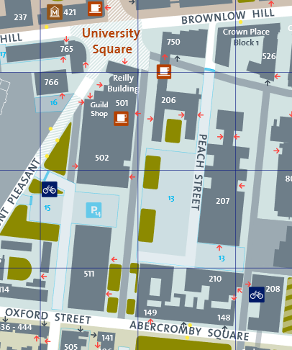
Computer classes
Will be held in the MOTC PC centre.
This is in room 101, on the first floor of Maths.
Building 206 on the Campus Map.

Slide 7
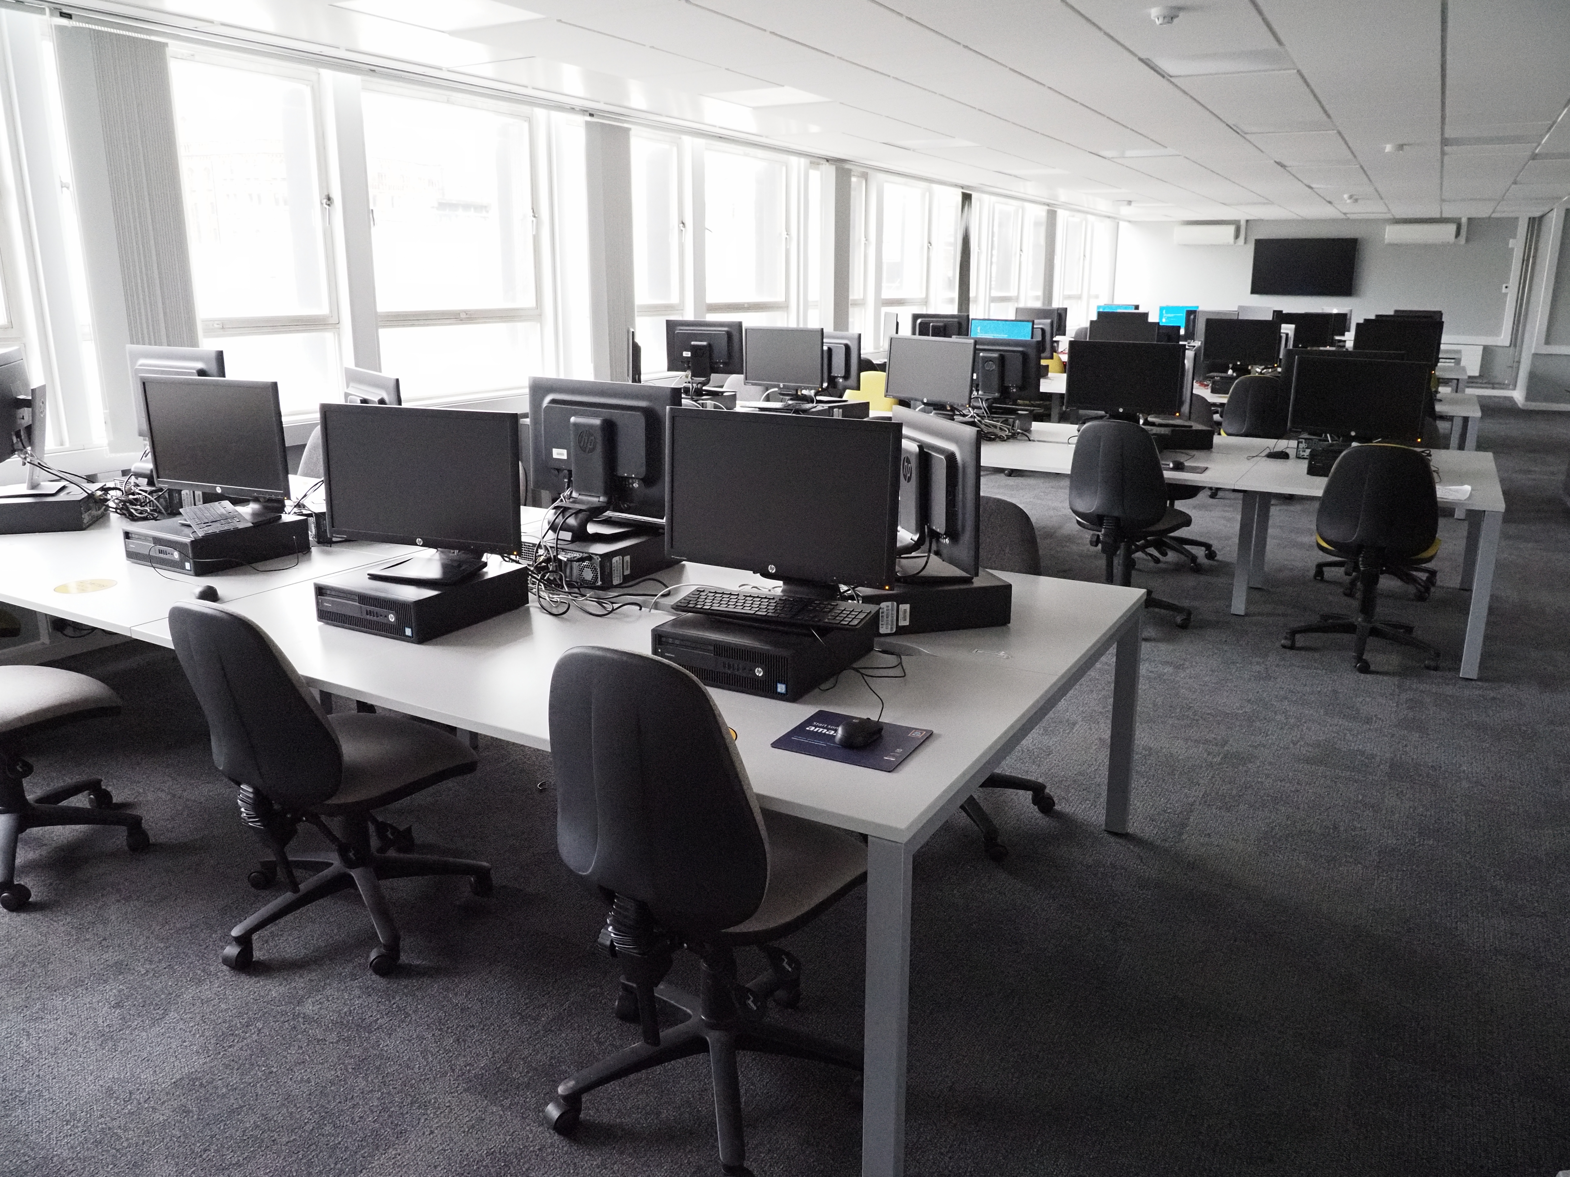
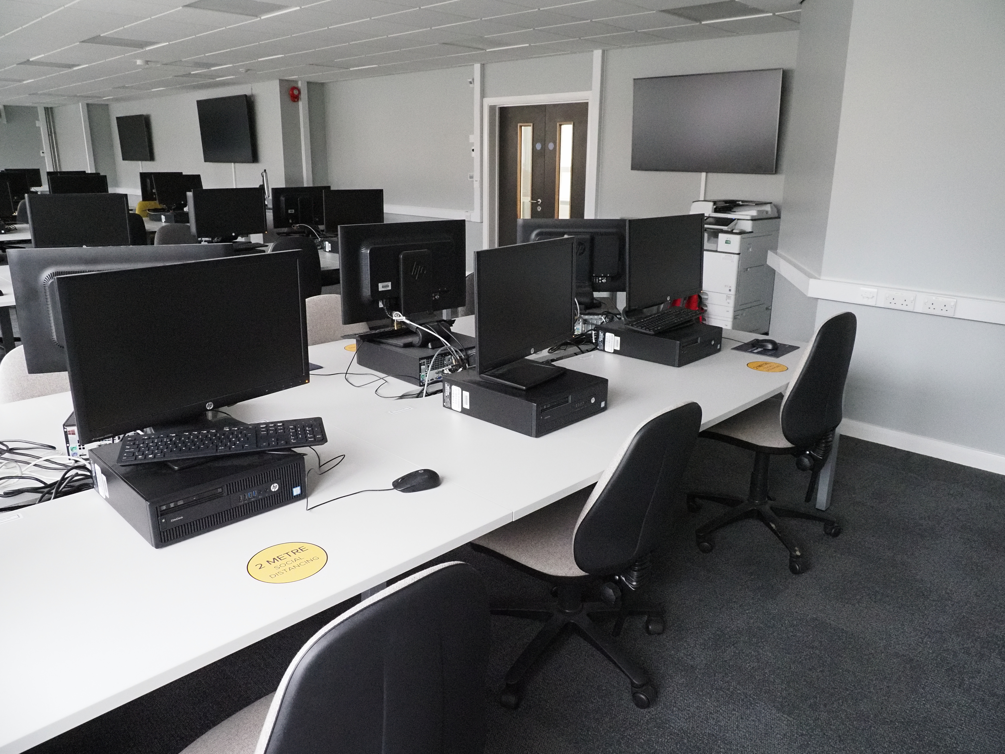
Computer classes
MOTC

Slide 8
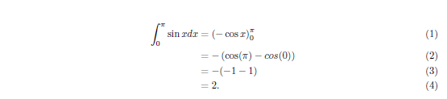
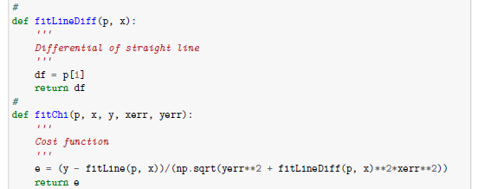
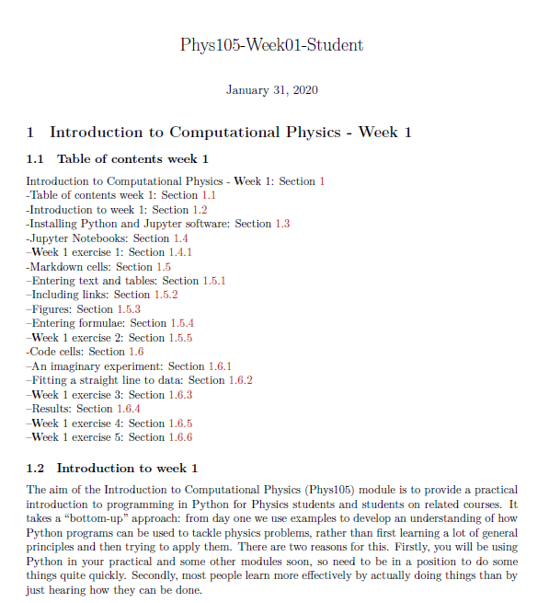
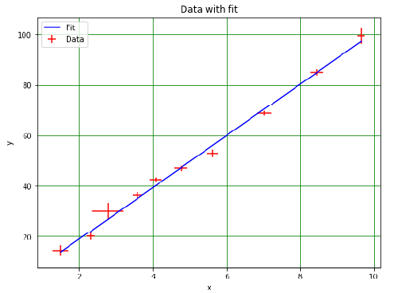
Jupyter Notebooks

Slide 9
CoCalc
The Physics Department has bought the CoCalc package to make sure teaching is as interactive as possible, whatever Covid throws at us.
Allows us to run Jupyter Notebooks online.
Demonstrators can edit and run your code with you “live”, while talking/chatting using Teams.
We will spend the first week learning how to sign in to CoCalc and use this new tool!
Looking forward to working with to make Phys105 a success!

