Slide 1
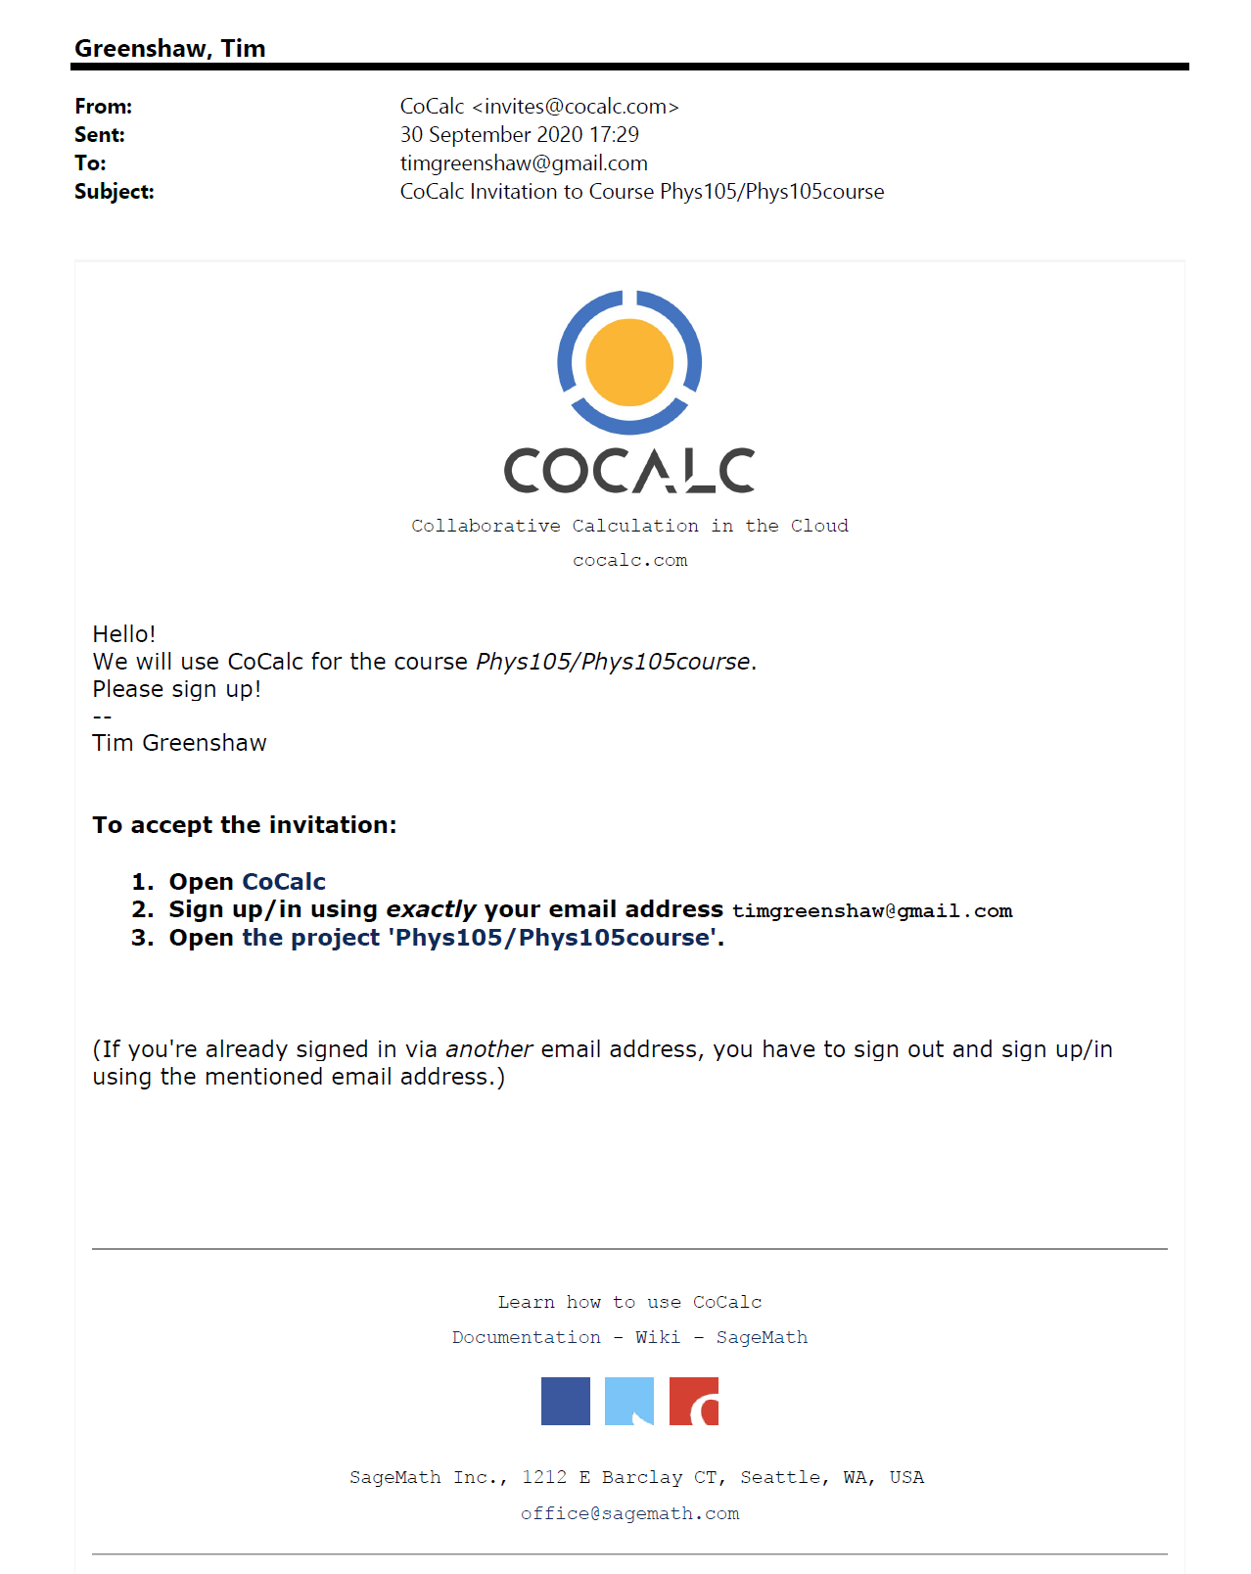
Signing in to CoCalc
If you don’t already have a CoCalc ID, you will get an email asking you to sign up.
Mail Tim Greenshaw (green@liv.ac.uk) if you have not received an invitation.
Click on the link in the email, or…
…open the CoCalc web site: https://cocalc.com/
1

Slide 2
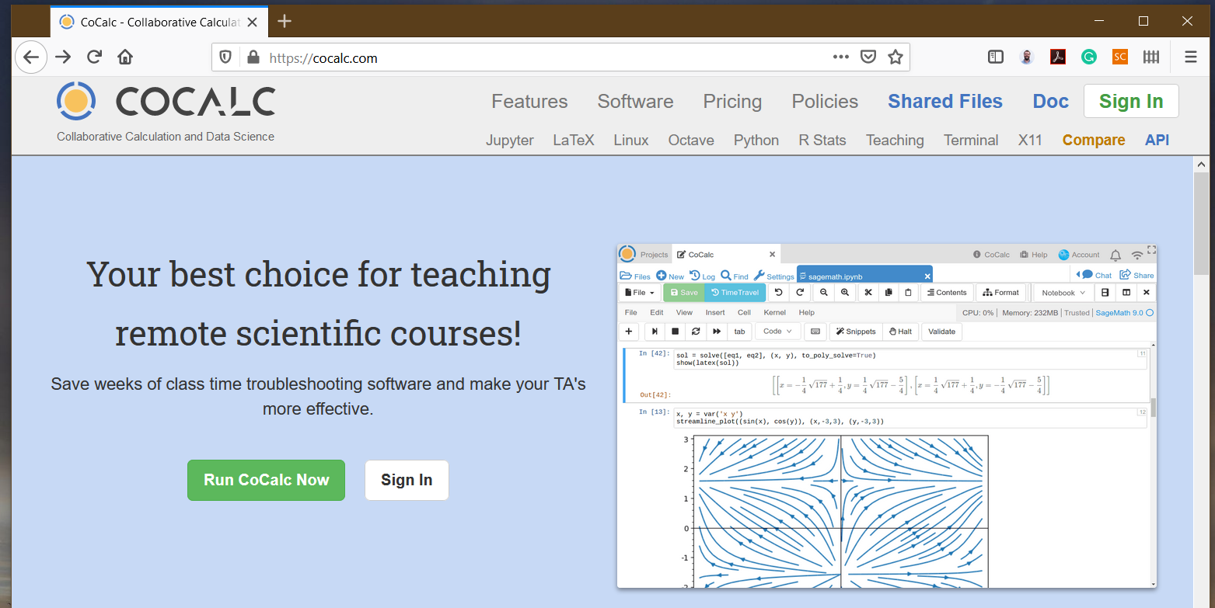
Signing in to CoCalc
Sign in, using the email address the invitation was sent to.
CoCalc help for students is at: https://doc.cocalc.com/teaching-students.html
2

Slide 3
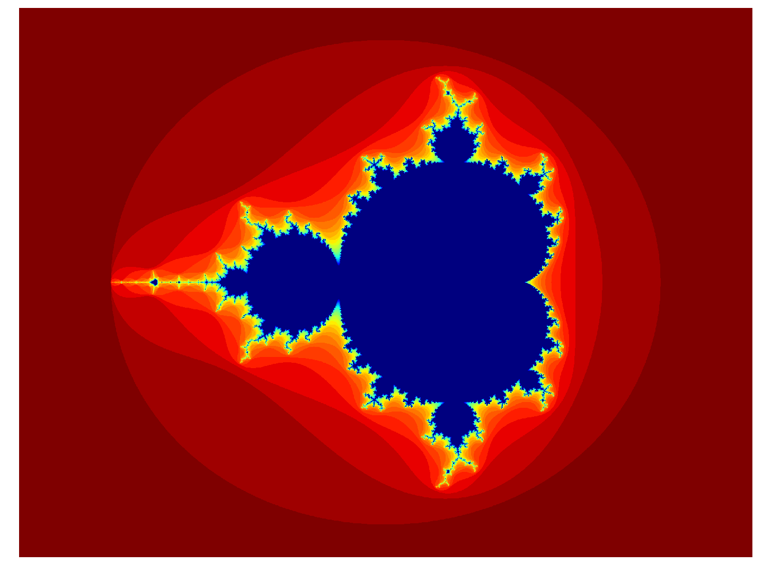



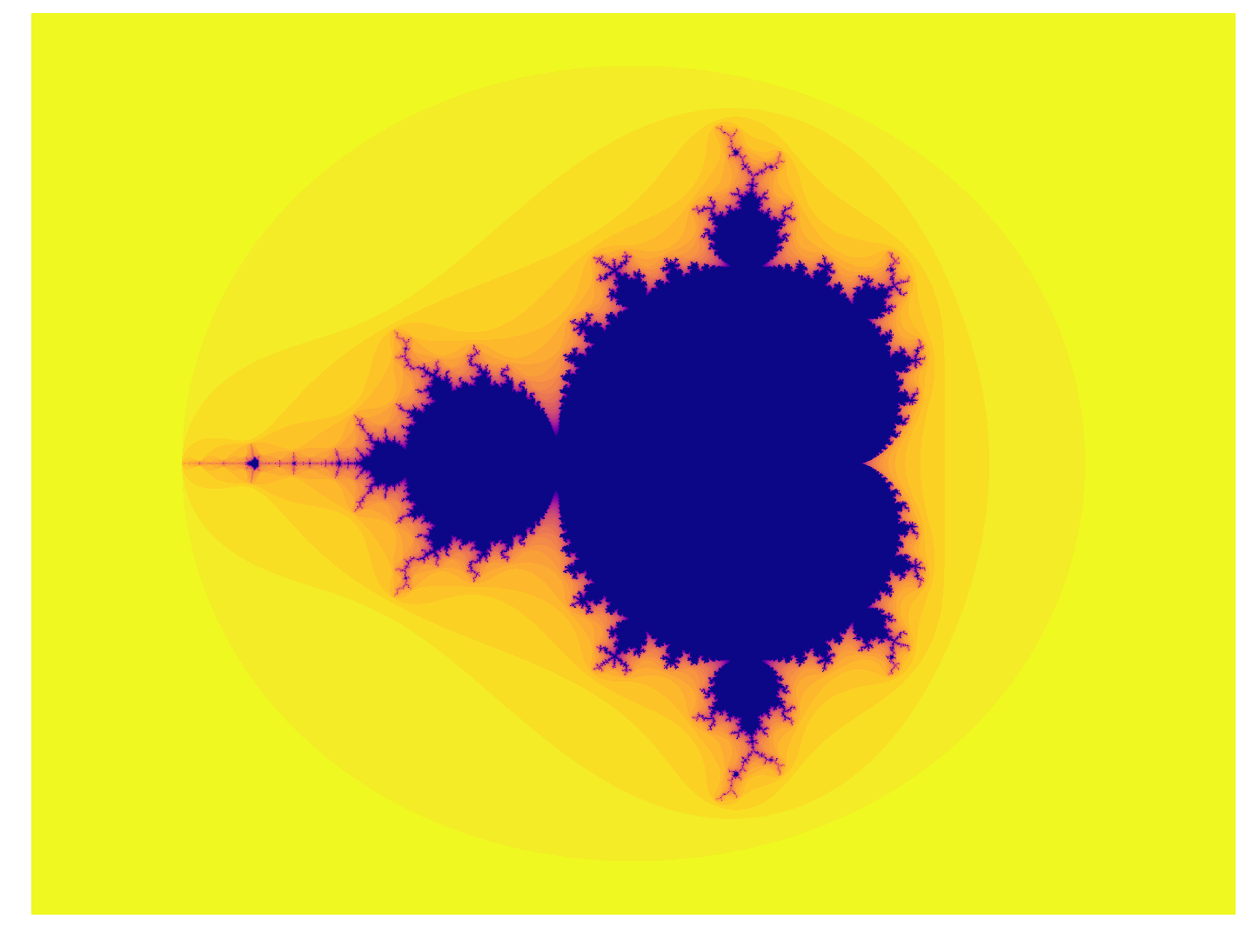


Working on a Notebook
When you sign in, you will be able to see the Phys105 project.
Click on the links until you get to the relevant folder, for example:
Click
Then
And
And
And finally on
If you want help, ask a demonstrator.
They should be able to edit your Notebook with you (we will test this today!).
3

Slide 4
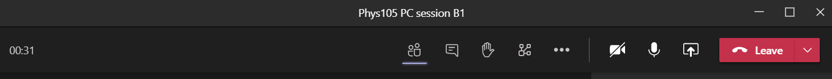
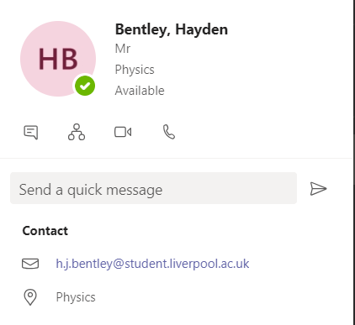
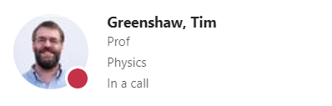

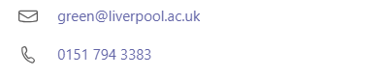
Using Teams to get help
When you want help, please raise your Teams hand.
To chat privately with a demonstrator, click the blob next to their name.
You then get various options in a dropdown menu.
You can message them, or set up an audio or video call by clicking the relevant symbols.
If you raise your hand, the demonstrators will do this when they are free to help you!

