Slide 1


Canvas at Liverpool Your virtual learning environment

Slide 2
What is Canvas?
Canvas is the University’s new virtual learning environment or VLE
It is being rolled out in stages over the next 12 months
During the 2020/21 academic year, you may have to use both Canvas and VITAL, the University’s existing VLE, for both your academic modules and to access resources developed by KnowHow, Careers and other areas
Links in both Canvas and VITAL will help ensure that you can find all your modules easily
Both Canvas and VITAL offer you access to learning and teaching content which will help you successfully complete your studies this year

Slide 3
Getting started
Accessing Canvas:
Use this URL: http://liverpool.instructure.com
This link can also be found on the student intranet homepage and in Tools & Services
Download the Canvas student app on your phone for free
Web browser:
Use Chrome or Firefox
Avoid Explorer, Edge and Safari

Slide 4

Logging on
On-campus: If you are logged on and using a computer connected to the University network, you will be automatically logged into Canvas when you open it
Off-campus: If you are using a computer that is not on the University network, you will be taken to a log-in screen
You will need to type in your email in the following format: studentusername@liverpool.ac.uk, followed by your University password

Slide 5
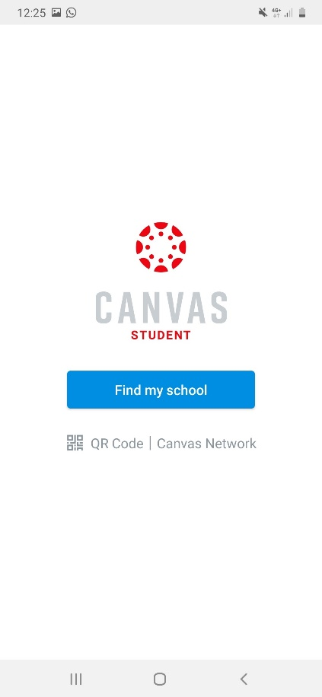
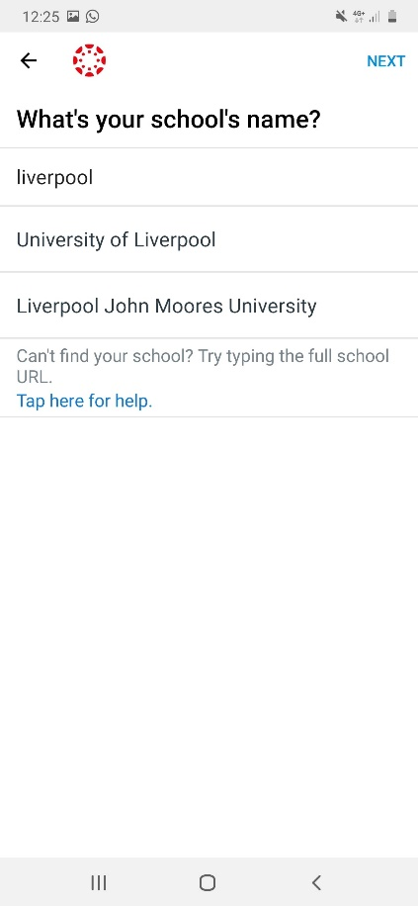
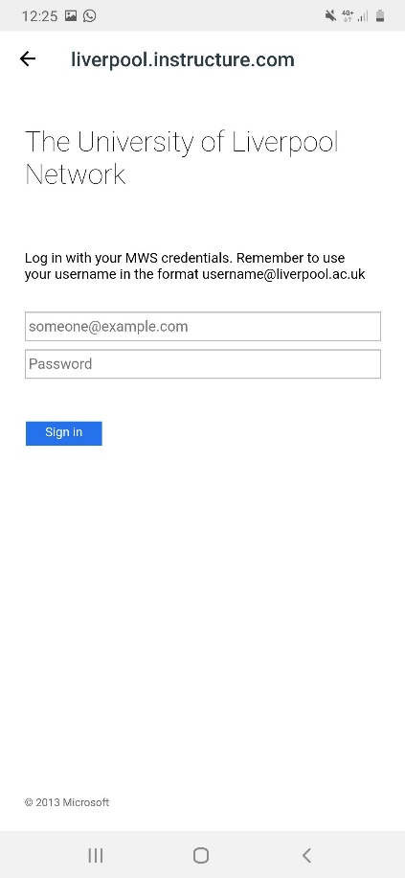
Going mobile
Using Canvas on your mobile devices
Download the Canvas Student app from the Android Play Store, or the Apple Appstore
Select University of Liverpool
Log in using you MWS details (studentusername@liverpool.ac.uk and password)
Customise your dashboard, notification settings and more

Slide 6
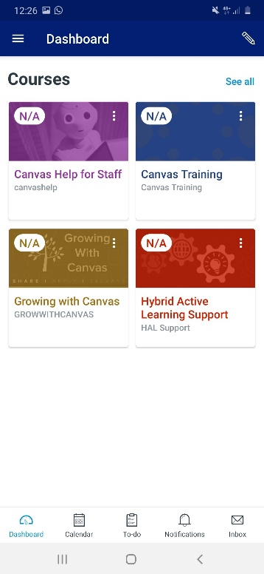
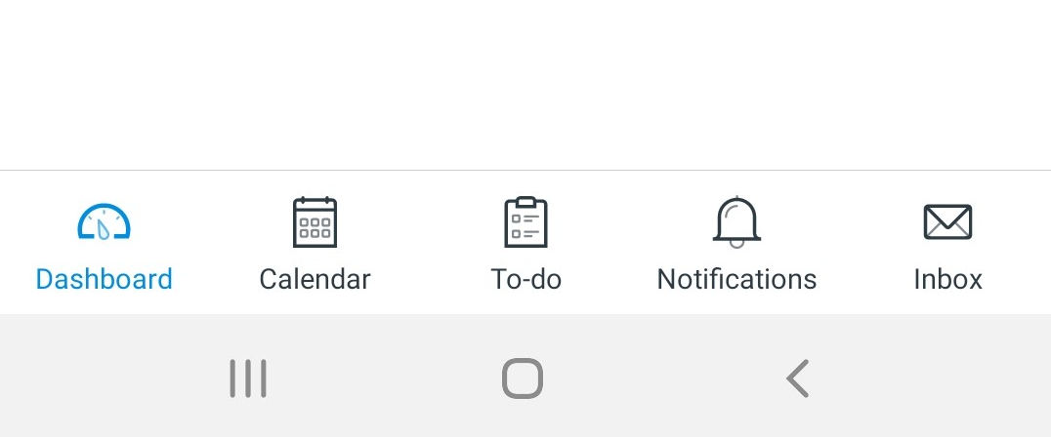
Going mobile
When using the Canvas Student app you can:
View course materials
Check 'to-do' lists
Check and submit set assignments
View grades and feedback
Record videos and upload content
Contribute to discussion boards
Access and organise your Canvas calendar
Contact your Module Leader
Access help and support
Plus much more

Slide 7
Canvas terminology
Here are the key terms you need to know:
Courses – In Canvas, University ‘modules’ are called ‘courses’, this is where you will find all your learning resources and assignments
Dashboard– This is the first thing you will see when you log into Canvas. The Dashboard helps you see what is happening in your current courses. You can return to the Dashboard at any time by clicking the Dashboard link in your Global Navigation
Modules – Canvas modules are containers or areas for sets of pages, documents and other learning and teaching content

Slide 8
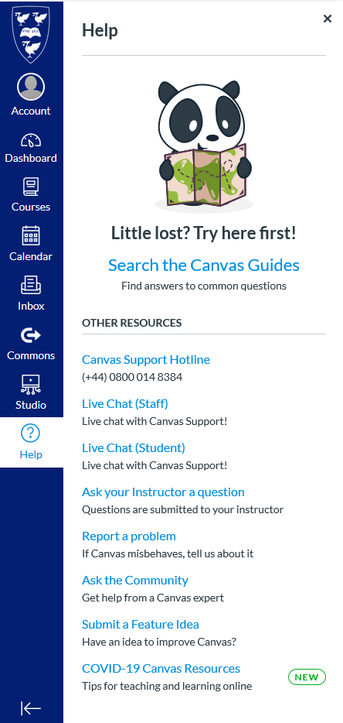
Canvas help and support
You get 24/7, 365-days-a-year help and advice on using Canvas from the Canvas Support Team (also known as Tier 1)
Accessing Canvas Support couldn’t be easier. Simply:
Log on to Canvas or open your mobile App
Click the Help button
Choose how you want to access support: via online chat, phone or email

Slide 9

Canvas help and support
Whatever your query, contacting the Canvas Support Team is always the best place to start
The Team can help with questions such as:
How do I submit an assignment?
How do I change my notification settings?
Why am I having trouble logging in to Canvas?
I can’t find a course that I should be enrolled on – what should I do?

Slide 10
When to contact your Module Leader
Not all questions can be answered by the Canvas Support Team
If you have a module-specific query – such as details on assignment deadlines or finding links to lecture recordings – you should contact your Module Co-ordinator
You will find contact their details in your Canvas course or your Module Handbook

Slide 11
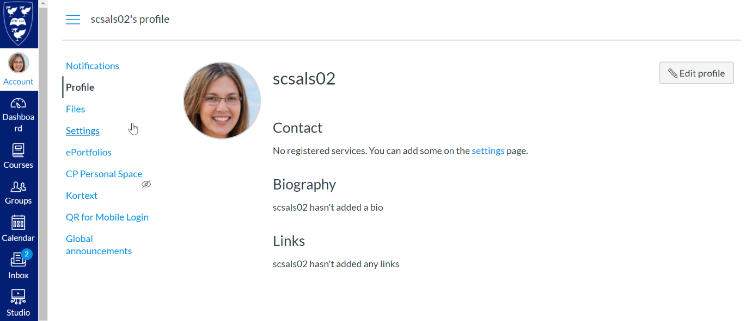
Your Account
Make your Canvas account your own with a host of customisations
Change your notification settings
We recommend you set this to ‘Notify me right away’ so you don’t miss any important announcements, conversations or updates
Change accessibility settings including the default language and screen contrast

Slide 12
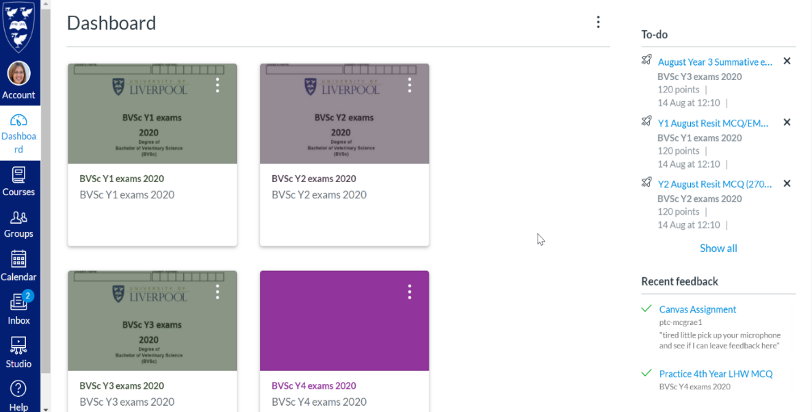
Your dashboard
Your dashboard is where you can access everything you need from Canvas
When you log on you will see a range of ‘tiles’ - one for each of your Canvas courses (University modules)
Click these tiles to see a range of content, such as your module overview, learning materials and assignments
You can customise your dashboard by reordering your favourite or most important courses
Your Dashboard will also include 'tiles' for courses offered by KnowHow, Careers plus the Canvas Help for Students
If any of your modules are missing in either Canvas or VITAL, contact your Module Leader as soon as possible

Slide 13
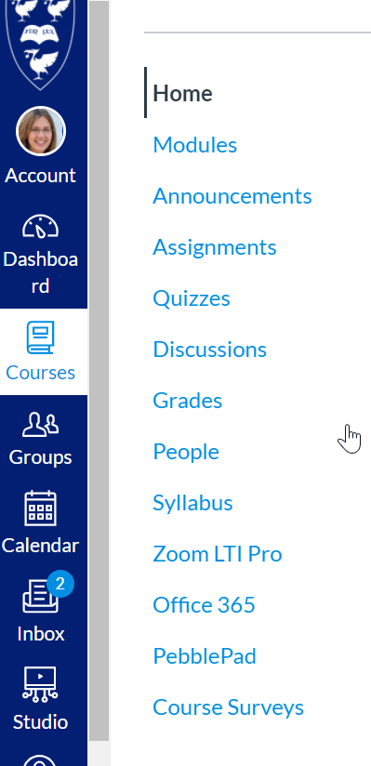
Navigation
Take the time to explore your Canvas courses and become familiar with where everything is
Course navigation - links to all the tools and content you will need for a specific module
One-click access to different course areas
Global navigation (dark blue menu) - provides shortcuts to Account settings, your Dashboard, Courses, Calendar, and Help resources
No matter where you are in Canvas, these shortcuts will always be available on the left of your screen

Slide 14
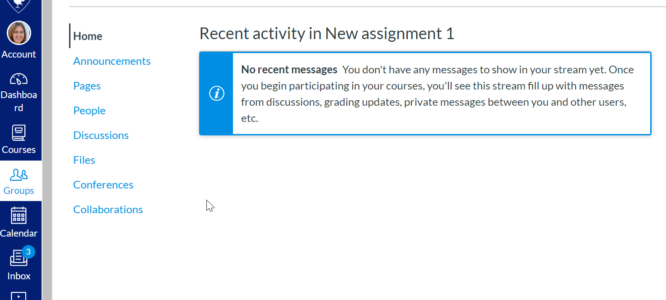
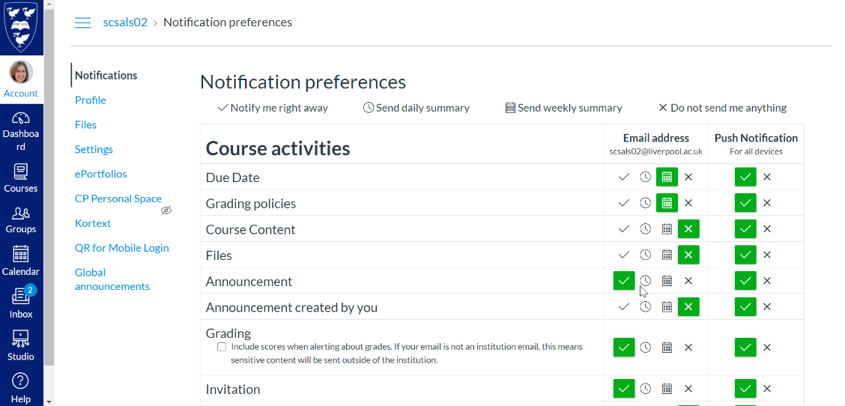
Communications
Announcements
Stay informed of news, updates and any important changes to your course
Your module leader will often use announcements for reminders and updates
Canvas Inbox
Exchange messages with other students and your module leader within Canvas
If you download the Canvas Student app you can also receive a mobile notification when you receive a message

Slide 15
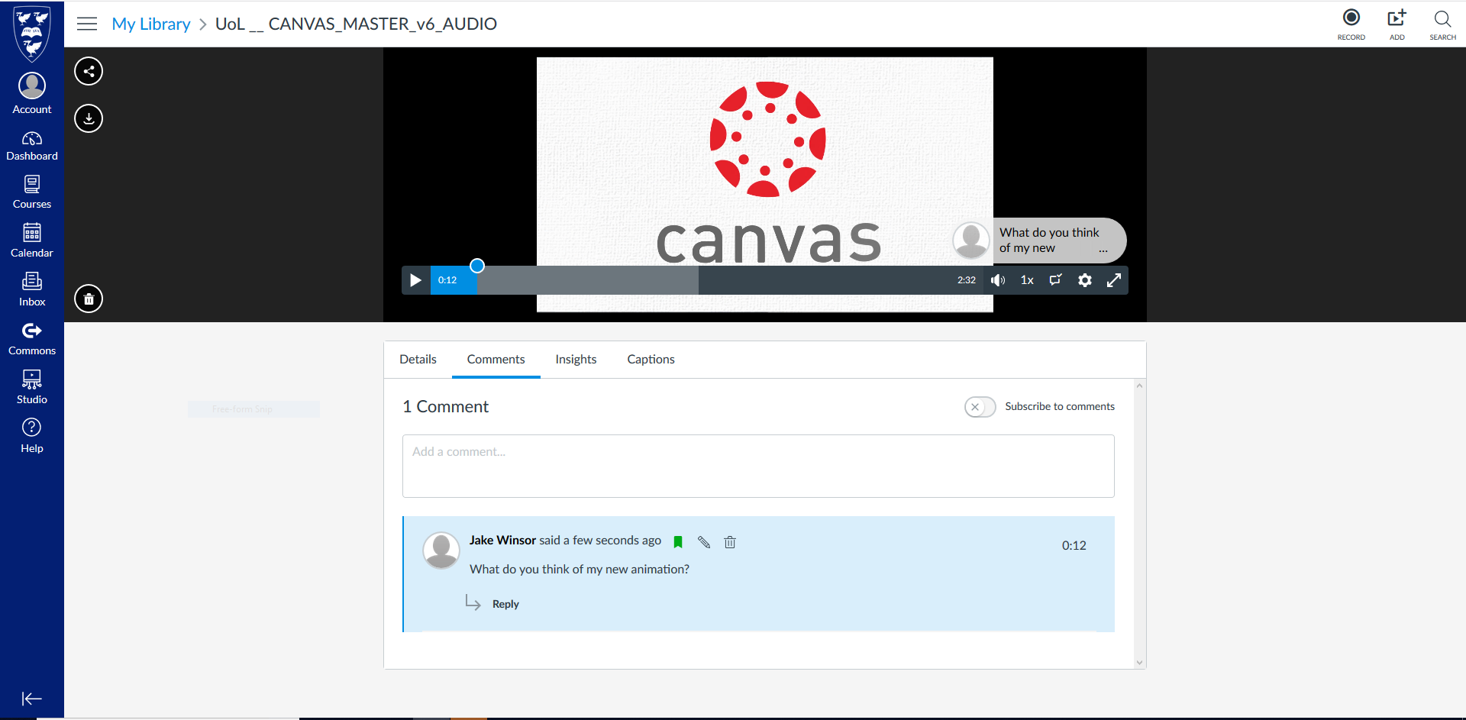
Canvas Studio
Watch, record and edit video and audio
Record from your computer or mobile
Submit video assignments and contribute to discussion boards
Interact with your lecturer and peers through video and audio
Fully accessible with auto-generated captions

Slide 16
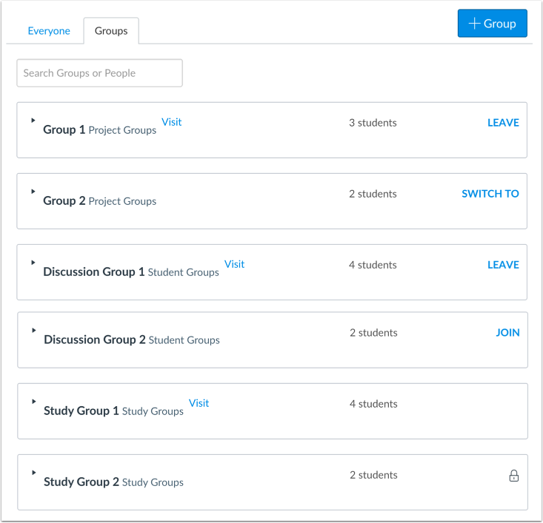
Groups
As part of your module you may do some collaborative group work and group assignments.
You can access your groups by clicking on the ‘Groups’ icon in the left navigation bar.
The Groups area gives you a space to collaborate with one another, using Canvas specific tools.

Slide 17
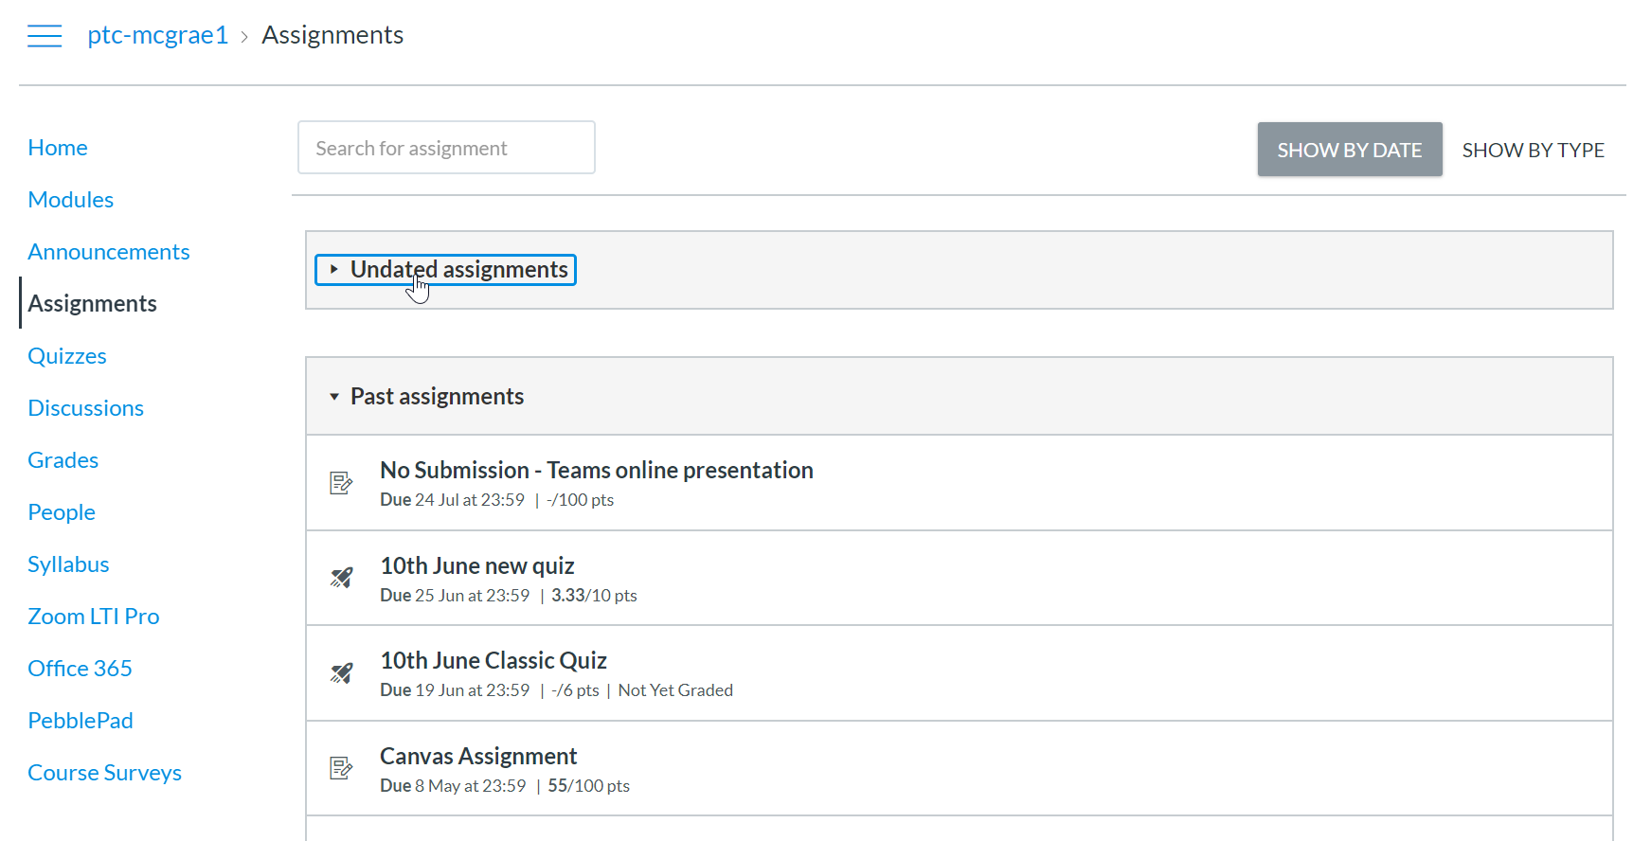
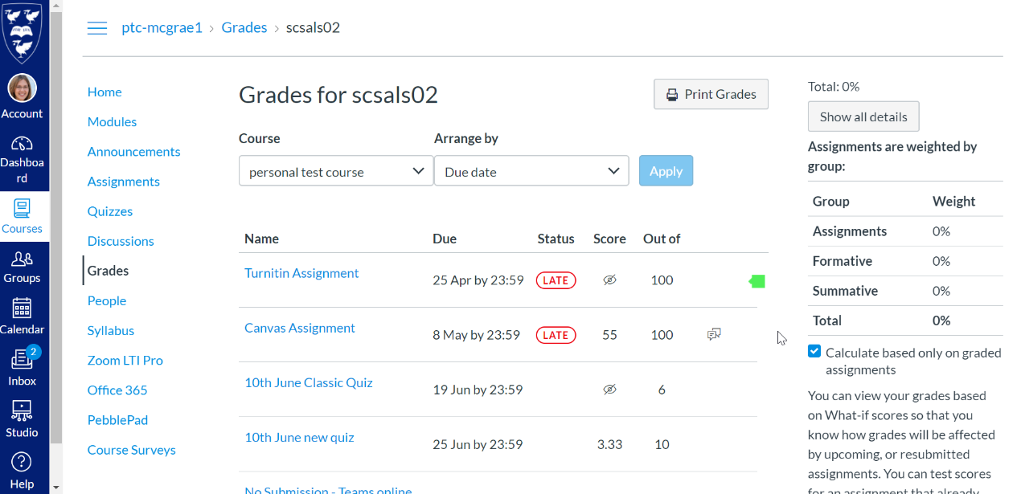
Assessments
There are three assessment types that you may come across in Canvas.
Assignment is a piece of work you submit for marking
Discussion is a group discussion where you get marked on your contribution
Quiz is a graded assessment, often multiple choice, that tests your knowledge on a certain topic

Slide 18
BLANK SLIDE FOR MODULE SPECIFIC INFO
SECTION WHERE MODULE TEAM CAN ADD COURSE SPECIFIC INFORMATION AND SCREENGRABS ETC

Slide 19
BLANK SLIDE FOR MODULE SPECIFIC INFO
SECTION WHERE MODULE TEAM CAN ADD COURSE SPECIFIC INFORMATION AND SCREENGRABS ETC

Slide 20
BLANK SLIDE FOR MODULE SPECIFIC INFO
SECTION WHERE MODULE TEAM CAN ADD COURSE SPECIFIC INFORMATION AND SCREENGRABS ETC

Slide 21
Assessments
MODULE TEAM TO ADD COURSE SPECIFIC INFORMATION – USE OF QUIZZES, DEADLINES, USE OF TURNITIN/SPEEDGRADER, ETC

Slide 22
Apps in Canvas
Academic to personalise based on planned use within their course
A range of apps have been integrated with Canvas to support your studies. We will be using the following in this module:
Zoom
Microsoft Teams
Mobius
Buddycheck
Office 365
Turnitin
LinkedIn Learning
McGraw Hill
PebblePad
Stream Lectures
Talis Aspire (Reading List)

Slide 23
Access to VITAL
Slide only relevant to returning students
You can access all the learning and teaching content associated with modules that you have already completed at the University via VITAL during the 2020/21 academic year
To log on to VITAL go to: https://vital.liv.ac.uk/
Notes:
Returning students only

Slide 24
Any questions?

