Slide 1
Lecture 15
In this lecture we will look at:
Ampere’s Law.
Magnetic fields associated with straight wires.
B fields in solenoids and toroids.
The magnetic dipole due to a current loop.
After this lecture, you should be able to answer the following questions:
State Ampere’s Law in words and as a mathematical formula.
Using Ampere’s Law, determine the strength of the magnetic field in the centre of a long, current carrying solenoid.
Explain how the direction of the magnetic field due to a current loop can be determined.

Slide 2
Ampere’s Law
Despite the name, this law was first deduced by Maxwell!
Ampere’s law:
Can be written:
Determine sign of current using yet another right hand rule.
Curl right hand round amperian loop so fingers point along direction of integration, currents in direction of thumb assigned +ive sign, in opposite direction –ive sign.
Now have
amperian loop
i₃
i₁
i₂
θ
X
direction of integration

Slide 3
Magnetic Field Outside/Inside Long Straight Wire
Outside wire:
Hence:
Inside wire:
Hence
r
i
R

Slide 4
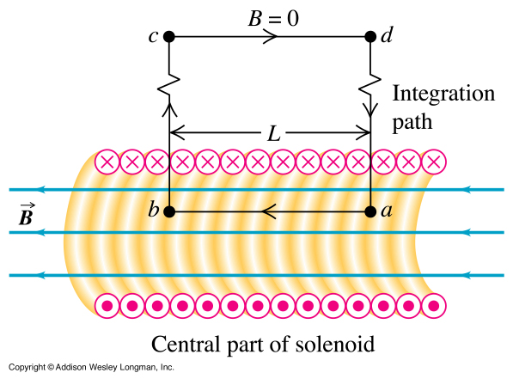
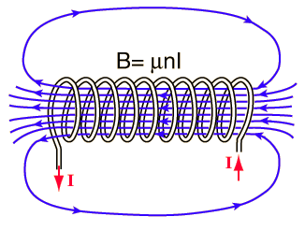
Field in a Solenoid
Magnetic field is nearly uniform in the centre of a long solenoid.
Field outside is relatively weak.
Use Ampere’s law to determine field strength.
Using this amperian loop:
h

Slide 5
Field in Solenoid
But the integral can be split up into four parts:
No of turns per unit length n.
Because the path c to d is a long way from the solenoid, the field is negligible, hence:
The result is thus:
The enclosed current is:
Hence:
h

Slide 6
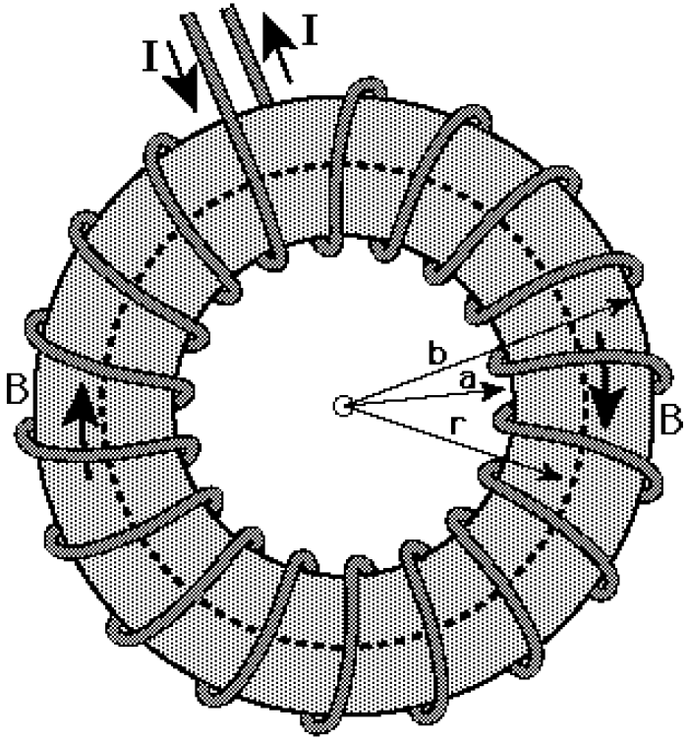
Field in Toroid
Toroid is solenoid bent into ring:
Total number of turns N.
From Ampere’s law (amperian loop at radius r traversed in clockwise direction) we get:
Note that field is not uniform as in solenoid, but decreases with increasing radius.
Field outside toroid (i.e. r < a or r > b or above or below toroid) is zero.

Slide 7
Current Loop as Magnetic Dipole
Have seen torque on current carrying loop in B field can be expressed in terms of a magnetic dipole:
As “loop” configuration is of importance (electrons in atoms!), now calculate field due to loop.
Use Biot-Savart law as opposed to Ampere’s law due to limited symmetry.
(Have already calculated the field at the centre of the loop: B = μ₀i/2R.)
Fields due to wire, current loop and solenoid:

Slide 8
Current Loop as Magnetic Dipole
Diagram shows rear half of current loop, radius R, loop perpendicular to transparency:
Angle θ between
Biot-Savart law:
Transverse field components cancel.
Use
Hence:
P
z
α
X
R

Slide 9
Current Loop as Magnetic Dipole
For points along the z axis far from the loop we have:
Using A = πR²:
If we allow the coil to have N turns this becomes:
Writing μ = NiA, we have:
Curl RH fingers round loop in direction of i, thumb gives direction of B field in loop and of dipole.
If set z = 0 we get agreement with previous calculation using Ampere’s Law:

