Slide 1
Lecture 14
In this lecture we will look at:
Magnetic fields due to currents.
Magnetic fields due to a long straight wire.
Magnetism and relativity.
Magnetic field due to an arc and a loop.
Force between two parallel currents.
The Rail Gun.
After this lecture, you should be able to answer the following questions:
What is the magnitude and direction of the magnetic field a distance R from a long straight current-carrying wire?
Determine the strength and the direction of the force between two long parallel wires, separated by a distance of 1 mm, which are each carrying a current of 6 A but which is flowing in opposite directions in each of the wires.

Slide 2
Magnetic Fields due to Currents
Consider a current carrying wire:
Magnitude of B field at point P due to current-length element
The permeability constant (or the permeability of free space) μ₀ is defined to be exactly:
Writing the expression for the field in terms of a cross product allows the direction to be determined:
This expression is known as the Biot-Savart Law.
θ
X
P
i

Slide 3
Magnetic Field due to a Long Straight Wire
Consider long straight wire:
Integrating:
Using the relationships
We get:
Using the result:
The integral becomes:
θ
s
X
R
P
i

Slide 4
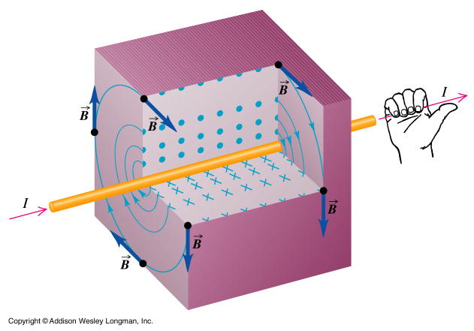
Direction of Field due to Current in Wire
From vector expression for Biot-Savart law... ...know direction of B field, e.g:
This leads to (yet another) version of the right-hand rule.
i
X
P

Slide 5
Magnetism and Relativity
Consider a stationary test charge, q₀, next to a wire with a current flowing in it:
Have total +ive charge +q and –ive charge –q in section of wire.
In this situation, the test charge experiences no force (the net charge of the wire is zero).
Now move the test charge along the wire with the same velocity as the charge carriers in the wire.
Look at the wire in the rest frame of the test charge:
Positive charges now moving w.r.t. q₀, separation Lorentz contracted.
Negative charges were moving w.r.t. q₀, no longer Lorentz contracted, so must now be “uncontracted”.
proper length, L₀
+
+
+
+
+
+
+
+
+
+
−
−
−
−
−
−
−
−
−
−
R
R
q₀
q₀

Slide 6
Magnetism and Relativity
The linear charge density in the frame of the test charge is thus:
The (electrostatic) force in this frame is and is directed away from the wire (for +ive q₀).
Now the E field due to a continuous line of charge is:
We see:
However, i = qv/L₀, so using ε₀c² = 1/μ₀, where μ₀ is the permeability of free space.
Hence,

Slide 7
Magnetic Field due to Circular Arc and Loop
Now ds = R dφ, so
Note, φ in radians!
For complete circle (loop of wire), φ = 2π, so:
Calculate field at centre of arc, radius of curvature R:
Direction always out of transparency (right hand rule).
90°
φ
i

Slide 8
Force Between Two Parallel Currents
Consider two parallel current-carrying wires, separation d:
Field due to i_{a} at position of wire b is:
Force produced on current in length L of wire b due to this field:
This gives:
The two wires attract if current parallel.
If currents anti-parallel, magnitude of force same but is repulsive.
Definition of ampere: The ampere is that constant current which, if maintained in two straight parallel conductors of infinite length and negligible cross section, placed one metre apart in vacuum, would produce on each of these conductors a force of magnitude 2 × 10⁻⁷ N.
a
b
i_{a}
i_{b}

Slide 9
Rail Gun
Device in which magnetic field can rapidly accelerate projectile.
Right hand rule shows that current in rails causes B field between them which is directed into transparency.
This B field causes a force on the current in the gas which pushes it upwards.
The gas accelerates the projectile upwards.
projectile
i
conducting gas formed
when copper “fuse” vaporises.
i
i

