Slide 1
Lecture 13
In this lecture we will look at:
The Hall Effect.
The Cathode Ray Tube.
The force on a current carrying wire and the electric motor.
Magnetic dipole moments.
The galvanometer.
After this lecture, you should be able to answer the following questions:
How can the Hall Effect be used to determine the density of charge carriers in a conductor?
Explain the functioning of a Cathode Ray Tube.
Show how the force on a wire carrying a current in a magnetic field, , is related to the force on the charge carriers in the wire,

Slide 2
Crossed Electric and Magnetic Fields: Hall Effect
The Hall Effect.
Consider a copper strip carrying a current i in a magnetic field.
Electrons forced to RHS of strip, establishing E field which opposes magnetic force; at equilibrium:
X
X
X
X
X
X
X
X
i
i
potential diff. V
X
X
X
X
X
X
X
X
X
X
−
X
X
X
X
−
X
X
d
d
X
X
i
X
X
X
X
i
X
X

Slide 3
The Hall Effect
At equilibrium, the Hall potential difference, V, across the strip gives rise to the field E = V/d.
Equating the magnetic and electric forces:
We know
Here, A is the cross-sectional area of the strip and J = i/A.
if the strip’s thickness is t, A = t d, so
Hence n, the number of charge carriers per unit volume, can be measured.
The Hall Effect can also be used to measure magnetic field strengths, rewrite expression
By moving the probe through a B field in the direction opposite to the drift of the charge carriers and adjusting the speed until the Hall potential is zero, v_{d} can be measured.
Can the Hall Effect be used to determine the sign of the charge carriers?

Slide 4
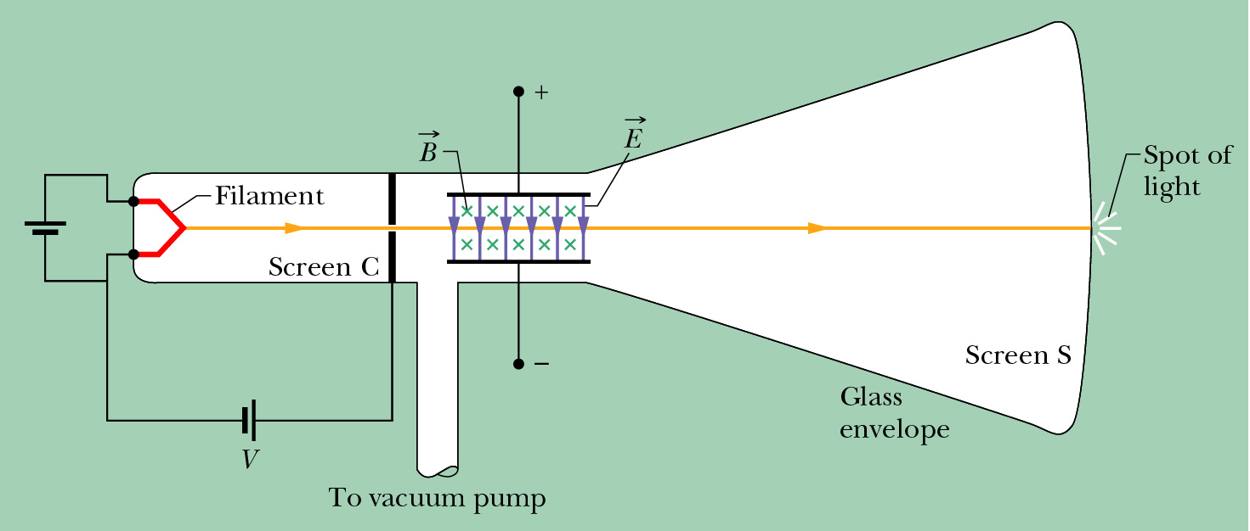
Crossed Fields: Cathode Ray Tube

Slide 5
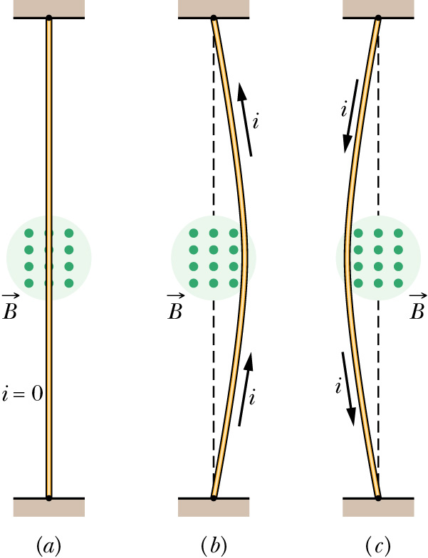
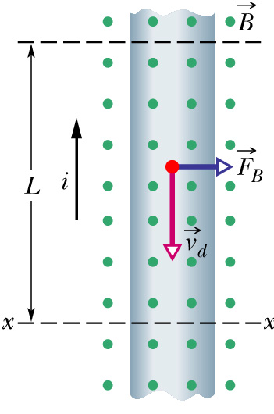
Force on a Current Carrying Wire
Consider flexible wire passing between poles of magnet:
No current, no deflection; current upwards, deflection to right; downwards deflection to left.
Close-up of section of wire:

Slide 6
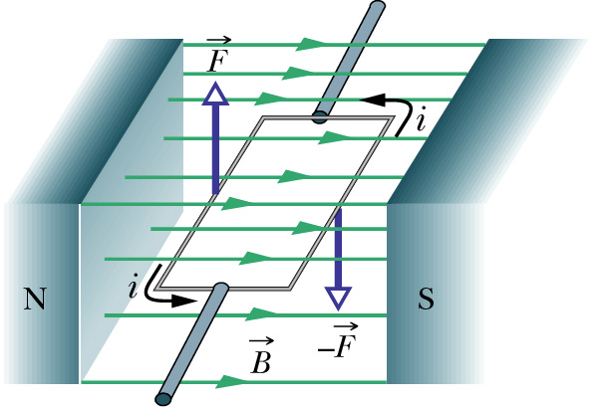
Force on a Current Carrying Wire: Electric Motor
Force on moving charge,
For wire of length L:
Hence, for wire
If orientation of wire in B field changes, must calculate force for elements of wire... ...and integrate over wire
Now calculate torque on loop:
Forces
No torque due to forces on ends of loop.
Calculate torque, τ₁, due to current in long sides of (single) loop.
Length of each long side is a.

Slide 7
Electric Motor
Replace single loop with coil of N turns.
Then have N times torque calculated for one loop.
Replace the length and width of the coil (a and b) by the area A = ab.
Note, torque will tend to align
Formula applies to all shapes of flat coil.
In a motor, the current must be reversed as to ensure the torque tends to keep the coil turning.

Slide 8
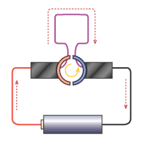
Commutator for Electric motor
Flipping of current performed by “commutator”:
Current flows in one direction through circuit containing battery.
“Brushes” at end of loop in magnetic field contact with alternate ends of loop as this rotates, flipping the direction of the current in the loop.
Direction of torque doesn’t change.

Slide 9
Magnetic Dipole Moment
The quantity (N i A), with direction is termed the magnetic dipole moment vector:
Units A m².
Can then rewrite equation for torque on loop:
C.f. expression for torque on dipole in E field:
Similarly to electric case, potential energy of magnetic dipole in B field given by:
Example:
A square loop has N = 100 turns. The area of the loop is 4 cm² and it carries a current I = 10 A. It makes an angle of 30º with a B field of strength 0.8 T. Find the magnetic moment of the loop and the torque.

Slide 10
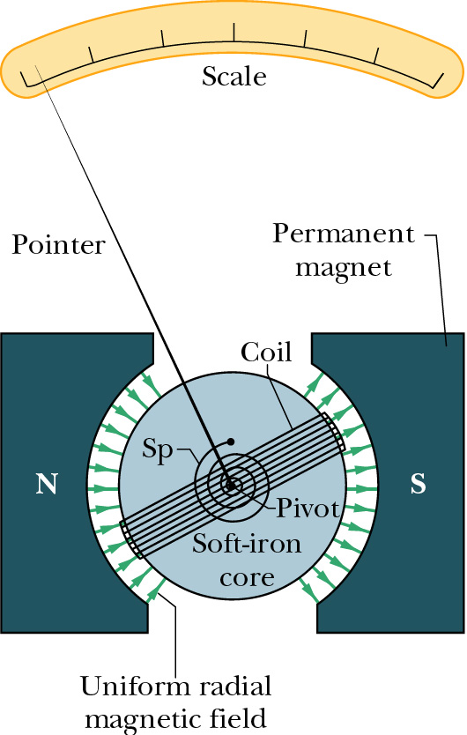
Galvanometer
Use magnetic dipole induced by current in loop in uniform B field to measure current.
Spring (“Sp”) used to provide torque opposite to that due to current.
Equilibrium position when torque due to current equal and opposite to that due to spring.
Hence ammeter: may need small resistance in parallel with galvanometer to adjust full scale deflection to appropriate range.
Voltmeter can be constructed by adding large resistance in series with galvanometer.

