Slide 1
Lecture 6
This lecture, we will look at:
Calculating the electric field from the electric potential.
The potential of a charged isolated conductor.
After this lecture, you should be able to answer the following questions:
Determine the electric field due to an isolated charge from the expression for the electric potential.
Describe the electric field and potential inside and outside a charged isolated conductor.
Explain why you could survive a lighting strike if you were inside a car.

Slide 2
Calculating
We know how to find the potential from the electric field, now look at getting the field from the potential.
Charge q₀ moves from one equipotential to next, step along s axis.
Work done by field is related to change in potential energy...
...but also to force and distance:
Equating these two expressions:
Hence
But E cos θ is the component of the s axis, so we can write:
+
s
Equipotential surface

Slide 3
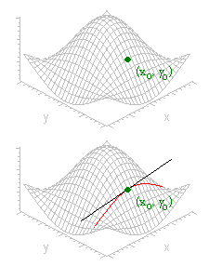
An aside – Partial Derivatives
Consider a function of two variables, f(x,y).
The partial derivatives of this function w.r.t. x and y are defined by:
Example: f(x,y) = xy².
Geometrically, consider z = f(x,y) shown opposite:
Keep y = y₀, then z = f(x,y₀) traces out the red curve shown.
The slope of this curve at (x₀,y₀) is given by

Slide 4
Calculating
Taking s to be the x, y and z axes in turn, we have:
See units of E field also V m⁻¹.
More succinctly, the electric field is given by the (negative) gradient of the potential:
Consider example of point charge again.
We have
Calculate E field using our prescription:
+q

Slide 5
Calculating
Doing the same for y and z we have:
Hence:
Now x/r = r cos θ_{xr} is the component of the radius vector in the x direction, y/r that in the y direction and z/r that in the z direction, so we see:
...the E field is directed radially away from the charge, as expected.
The gradient vector is in the direction of the maximum variation of the potential.
Can see this in 2D:
Potential (arb. units)
y (arb. units)
x (arb. units)

Slide 6
Potential of a Charged Isolated Conductor
We have shown that inside a conductor (and that the charge sits on the outer surface of the conductor).
Using we see:
Hence V = const. (Remember that
Example, E field and potential inside and outside a conducting sphere, radius 1.2 m, carrying charge 10 mC:
E (kV m⁻¹), V (Volts)
r (m)

Slide 7
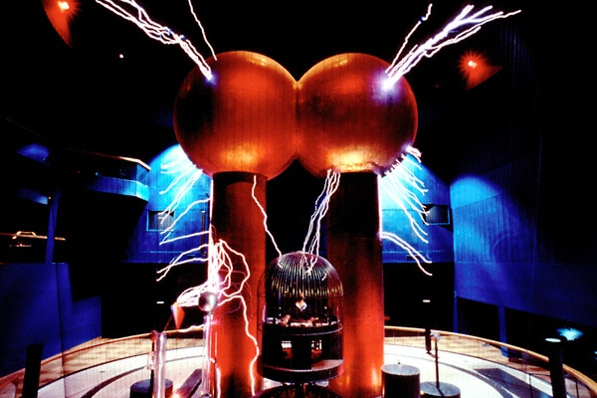
Field and Potential in Conductor: Faraday Cage

Slide 8
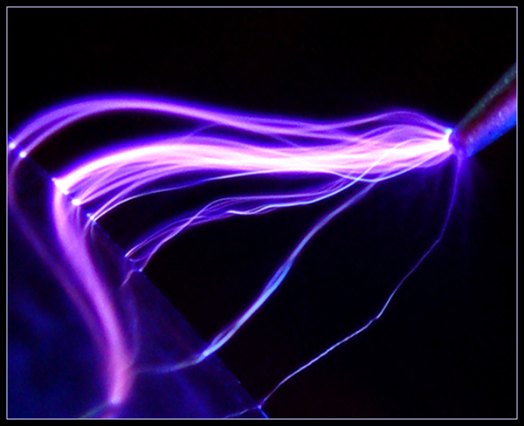
Corona Discharge

