Slide 1
Lecture 3
This lecture, we will look at:
Torque on dipole in electric field: the vector product
Potential energy of dipole in electric field: the scalar product
Electric field due to a continuous charge distribution
Flux of an electric field
After this lecture, you should be able to answer the following questions:
The dipole moment of a water molecule is 6.2 × 10⁻³⁰ Cm. What is the maximum torque on a water molecule in an electric field of strength 1000 NC⁻¹?
Derive the electric field on the symmetry axis of a circular ring of radius R carrying a uniformly distributed charge of magnitude q.
What is “electric flux” and in what units is it measured?

Slide 2
Torque on Dipole in Electric Field
Potential Energy of Dipole in Electric Field
Can represent torque using vectors.
Torque has magnitude and direction given by “right-hand screw” rule: torque is normal to with sense of screw turned from direction of
In terms of Cartesian coordinates:
Can associate potential energy with dipole in (uniform) E field.
Choose zero of potential energy to be when
Can generalise this to vector equation
In Cartesian coordinates:

Slide 3
Electric Field due to Continuous Charge Distribution
Continuous charge distribution can be line, ring, sheet, volume...
Divide distribution into elemental charges dq.
Calculate field due to dq using symmetry to simplify the problem where possible.
Integrate over charge distribution.
Consider example – field due to a ring of charge, linear charge density λ.
Element ds, charge dq = λds, produces field at P:
Horizontal components cancel (symmetry) and...
so
Total field:
P
θ
r
z
R
ds

Slide 4
Electric Field due to Continuous Charge Distribution
Hence
Now λ is charge per unit length of ring, so λ(2πR) = q, the total charge on the ring.
We can re-write the expression for the field due to a ring of charge:
Similar calculations can be done for other simple charge distributions (continuous sheet or sphere of charge, line of charge...).
Situations in which there is less symmetry may well have to be solved numerically using a computer.

Slide 5
Flux of an Electric Field
Can think of electric field lines as “flowing” through space.
The flux, Φ, of the E field is the number of lines through an area A (recall density of lines is proportional to field strength).
Must take account of fact that area may not be perpendicular to field.
Hence, define: Φ = EA cos θ [3.3] where θ is the angle between
In terms of vectors:
θ
θ

Slide 6
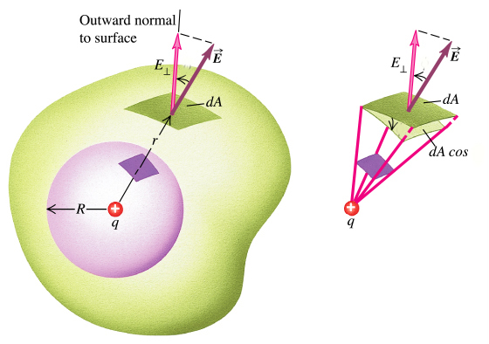
Flux of an Electric Field
If electric field varies, consider elements of area:
Then get total flux through a surface by adding up all the elements:
Becomes integral as elements taken to be infinitely small:
For a closed surface:
θ
θ
θ

