Slide 1
Lecture 2
This lecture, we will look at:
Electric fields
Electric field lines
The electric field due to a dipole
How a dipole behaves in an electric field
After this lecture, you should be able to answer the following questions:
A 0.03 C point charge is placed at the origin of a coordinate system. What is the direction and magnitude of the electric field due to this charge:
At the point (3.0 m, 4.0 m)?
At the point (-3.0 m, -4.0 m)?
At the point (6.0 m, 8.0 m)?

Slide 2
Electric Fields
How does one charge affect a second charge – “action at a distance”?
Consider that one charge produces an electric field which then influences the second charge.
Electric field strength is the force per unit charge:
Note, the electric field is a vector field which determines the magnitude and direction of the force acting on (test) charges within it:
Units of electric field, N C⁻¹.
Electric field due to point charge q:
Map of field for point charge (length of arrow proportional to E).
What is sign of charge in diagram?

Slide 3
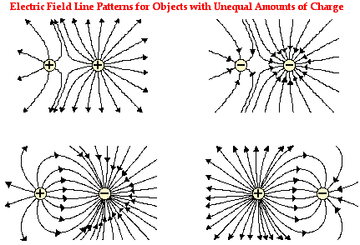
Principle of Superposition
Electric Field Lines
Force on q₀ due to charges q₁...q_{n}:
Hence E field due to charges 1...n is:
Electric field lines are way of visualising E fields.
Lines trace path followed by (slow) test charge, density of lines proportional to field strength.
Examples, charges not balanced!

Slide 4
Electric Field due to Dipole
Dipole consists of two equal but opposite charges ±q separated by a distance d.
Determine field at point P on dipole axis (z axis):
Rearrange so can use binomial theorem:
For z>>d:
P
r₊
z
+
r₋
0
−

Slide 5
Electric Field due to Dipole
Torque on Dipole in an Electric Field
At large distance, field due to dipole depends on product q x d.
Define vector quantity, the electric dipole moment,
Magnitude p = q d [2.5]
Direction from –ive to +ive.
Units of dipole moment C m.
For point charge
For dipole
Consider dipole in uniform E field:
No net translational force.
Torque:
+q
θ
−q

