Slide 1
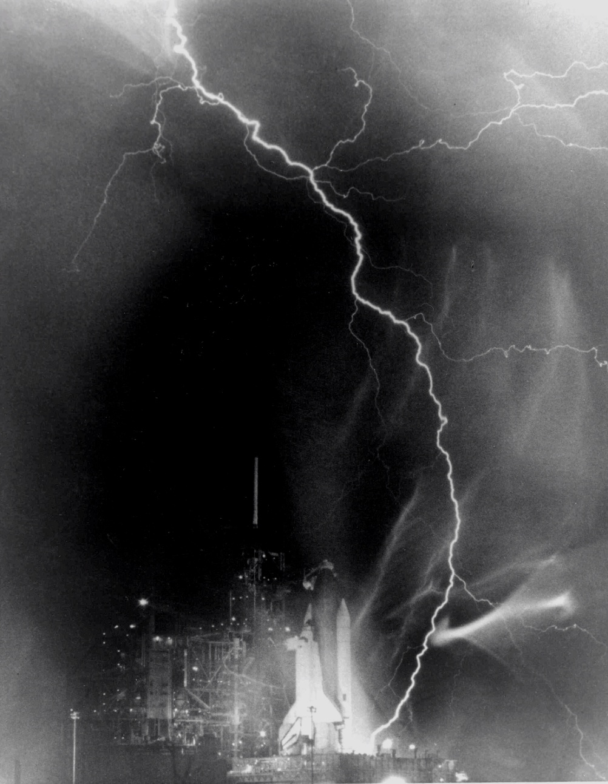
Phys123 – Electricity and Magnetism
Lecturer Prof. Tim Greenshaw, Room 313 Oliver Lodge Laboratory Email green@liv.ac.uk Tel. 0151 794 3383
Lectures:
Monday 13:00 (University Lecture Theatre C).
Thursday 09:00 (Rotblat).
Thursday 11:00 (Gossage).
Tutorials, for times and locations see first year notice board.
Recommended text book: “University Physics”, Young and Freedman, chapters 21 to 32.

Slide 2
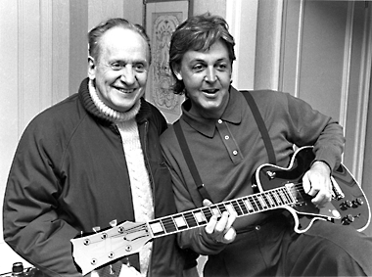
Phys123 – Electricity and Magnetism
Syllabus
Electric Charge, Coulomb’s Law
Electric Fields and Gauss’ Law
Electric Potential
Capacitance
Current, Resistance and Circuits
Magnetic Fields
Magnetic Fields and Currents
Induction and Inductance
Magnetic Materials
Maxwell’s Equations
Electromagnetic Oscillations and Alternating Current
Electromagnetic Waves

Slide 3
Lecture 1
This lecture we will cover:
Electricity and magnetism, from the Greeks to the present day
Coulomb’s Law
Principle of superposition
Shell theorem
Check your understanding: after this lecture, you should be able to answer the following questions.
The surfaces of two table tennis balls are uniformly charged up by bombarding them with electrons. A total of 6.25 × 10⁶ electrons stick to the first ball and 12.5 × 10⁶ electrons to the second. What is the force between the balls if their centres are 0.08 m apart?
What is the force on a third ball, carrying a uniformly distributed charge of + 2 pC, placed symmetrically between balls one and two. In what direction does it act?

Slide 4
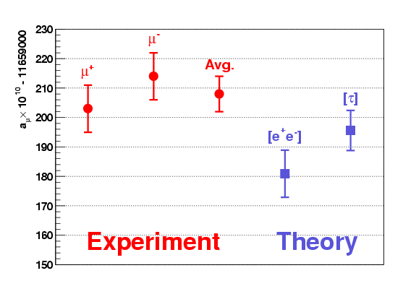
Electricity and Magnetism
The Greeks knew that:
A rubbed piece of amber would attract straw. (“Elektron” is the Greek word for amber.)
Some “stones” (magnetite) could attract iron.
Electricity and magnetism were seen to be aspects of the same force and unified in the electromagnetic theory of Maxwell.
The quantum theory of electro-magnetism, Quantum electro-dynamics (QED), has been tested experimentally to enormous precision.
Gyro-magnetic ratio of the electron: g_{e} = 2.0023193043617± 0.0000000000015
Also measured g_{μ} , shown is a_{μ} = (g_{μ} – 2)/2:
But QED cannot be the full story...
Devices relying on electromagnetic effects are all pervading.

Slide 5
Electric Charge
There are positive and negative electric charges, like charges repel, unlike charges attract.
Materials can be:
Conductors – charges move freely (superconductors, resistors).
Insulators – charges do not move.
Charge quantized, q = ne, where n is +ive or –ive integer, e is elementary charge (charge of proton).
Unit of charge is the coulomb (C), the charge transferred when current of one ampere (A) flows for one sec (s): dq = i dt [1.1]
e = 1.6 x 10⁻¹⁹ C.
Charge is conserved: in any reaction, total charge before = total charge after.
Objects are said to be “charged” when there is an imbalance of +ive and –ive charges, e.g. balloon charged by rubbing on pullover.

Slide 6
Force Between Electric Charges – Coulomb’s Law
Two point charges
Force is vector, has direction (given by arrow in diagram) and magnitude.
Permittivity constant:
Compare with gravitational force:
What are relative strengths of electric and gravitational forces?
Principle of superposition: if charge 1 interacts with charges 2...n, total force on one given by:
Where is there zero force on a proton in the cubic array of charges below?
F₁
q₁
q₂
F₂
+
r₁₂
+
+2e
+2e
+2e
+2e
+2e
+2e
+2e
+2e

Slide 7
Principle of Superposition
An example using Coulomb’s Law in vector form.
What is the net force on charge 2?
Force on 2 due to 1:
y
1
2
a
+e
−e
3
+e
x
a

Slide 8
Principle of Superposition
Shell Theorem
Sum the forces:
What is the magnitude of this force if a = 1 nm?
Compare this with an “everyday” force, e.g. the weight of an apple!
Charge distributed uniformly on a spherical shell.
For charges outside the shell (1), the force behaves as if the total charge is concentrated at the centre.
Charges inside the shell (2) experience no force: F₂ = 0.
Q
1
r
q₁
2
q₂

