Slide 1
Lecture 19
In this lecture we will look at:
Alternating current.
Resistive loads and phasors.
Capacitive loads and phasors.
Inductive loads and phasors.
After this lecture, you should be able to answer the following questions:
Write down the equations which define the capacitive and inductive reactances. In what units are these measured?
Is the reactance of a capacitor largest for high or low frequencies?
Is the reactance of an inductor largest for high or low frequencies?
Describe the phase relationships between an AC voltage applied (separately) across a resistor, a capacitor and an inductance and the resulting current in each case.

Slide 2
Alternating Current
Recall electricity generator, coil rotated in ____________ field.
Freq. f_{d}, angular freq. ω_{d} = 2πf_{d}.
Get ____________ emf:
E.g for mains, E_{m} = 325 V, f_{d} = 50 Hz
Need to understand behaviour of electrical devices when driven by emf varying _______________ with time.
This emf will induce current in electrical components.
Label _____________ of current I.
May be out of ________ with emf, so write allowing for phase shift of φ w.r.t. driving voltage.
Consider separately effects of ____________, ____________ and ____________ loads.
(V)
(s)

Slide 3
Resistive Load
Circuit consists of ______________ emf and resistance:
Using _________ loop rule, we have:
Inserting the expression for the emf we have or, using V_{R} to represent the amplitude of the _________ across R,
The current through the resistor is given by i = __/__, therefore:
We can write this as
The amplitudes of the current and voltage are related by:
The phase shift φ = 0: the voltage across the resistor and the current through it are in phase.
These relationships apply for all ____________ in AC circuits.
E
v_{R}
i_{R}
R

Slide 4
Resistive Loads and Phasors
Plotting the ___________ across the resistor and the _______ through it (using E_{m} = 325 V and R = 3 Ω):
See the voltage and the current oscillate together, i.e. are _________.
The voltage and current can also be represented as phasors.
Phasors are vectors whose length represents the ___________ of the voltage or current.
The _____________ of the phasor on the vertical axis represents the voltage or current at a particular time.
The phasors rotate in a positive direction (i.e. ____________) around the origin with angular velocity ω_{d}.
(V)
(A)
(s)

Slide 5
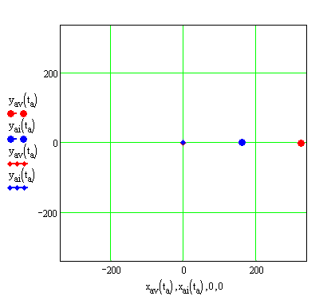
Resistive Loads and Phasors
Static picture of _______ for voltage across, and current through, resistor (parameters as before) at time t:
Allowing the phasors to rotate, we see how they describe the time variation of the __________ and __________:
v_{R} (V)
i_{R} (A)
v_{R}
i_{R}
ω_{d}t
v_{R} (V) i_{R} (A)

Slide 6
Capacitive Load
Circuit consists of alternating emf and capacitance:
Using Kirchoff’s loop rule, we have:
Inserting the expression for the _____ we have:
From the definition of ____________:
From this we can find the _________:
Introduce the capacitive ___________:
Using the substitution the expression for i_{C} becomes:
Writing this in our standard form, with φ = −π/2 and V_{C} = I_{C}X_{C} [19.6]
E
v_{C}
i_{C}

Slide 7
Phasors for Capacitive Loads
Plotting the voltage across the inductor and the current through it (using E_{m} = 325 V and C = 1 mF):
We see the current ______ the voltage by π/2, (i.e. current reaches peak before voltage).
In terms of phasors, static picture:
v_{R} (V)
i_{R} (A)
v_{C}
i_{C}
(V)
(A)
(s)

Slide 8
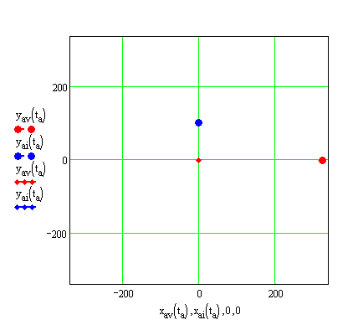
Phasors for Capacitive Loads
Animation of phasors for capacitive loads:

Slide 9
Inductive Load
Circuit consists of ___________ emf and inductance:
Using Kirchoff’s loop rule, we have:
Inserting the ____________ for the emf we have:
From the definition of ____________:
We thus have:
Introduce the ____________ reactance:
Using the substitution the expression for i_{L} becomes:
Writing this in our standard form, with φ = π/2 and V_{L} = I_{L}X_{L} [19.9]
E
v_{L}
i_{L}

Slide 10
Inductive Loads and Phasors
Plotting the voltage across the resistor and the current through it (using E = 325 V and L = 10 mH):
We see the current lags the voltage by π/2, (i.e. current reaches peak after voltage).
In terms of phasors, static picture:
v_{R} (V)
i_{R} (A)
v_{L}
(V)
(A)
i_{L}
(s)

Slide 11
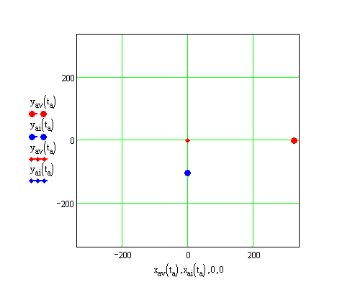
Phasors for Inductive Loads
Animation of phasors for inductive loads:
______________ for remembering phase relationships etc:
C i v i L
ELI positively is the ICE man. (i.e. E leads I for L, which has +ive phase, and I leads E for C).
X_{C} = ω_{d}C or 1/ω_{d}C? Remember that C is in Cellar, i.e. in the __________.
}
}
C, i leads v
i lags v, L

