Slide 1
Lecture 18
In this lecture we will look at:
Circuits containing capacitance and inductance.
Charge current and energy oscillations.
LCR circuits.
Damped charge, current and energy oscillations.
After this lecture, you should be able to answer the following questions:
Write down the differential equation describing the charge oscillations of a circuit containing an inductance and a capacitance.
How does this equation change if a series resistance is introduced to the circuit?
Explain the behaviour of a lightly damped series LCR circuit, starting from the point at which the capacitor is charged and there is no current flowing in the circuit.

Slide 2
Electromagnetic Oscillations
Look at circuits containing both ____________ and ____________.
Have shown that energy stored in a capacitor and inductor given by:
If start with ________ charged, have energy in E field, energy _________:
Capacitor will ___________ through inductor.
Current will cause build up of ____________ field, energy then stored in B field, energy density:
B field will then decay, inducing _______ and charging up capacitor...
Note, using small letters for varying quantities (e.g. charge q) and large letters for constants (e.g. amplitude of charge oscillations, Q).
C
L

Slide 3
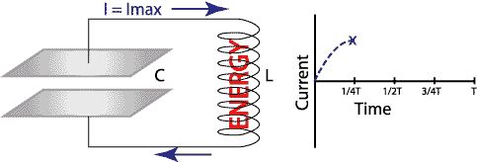
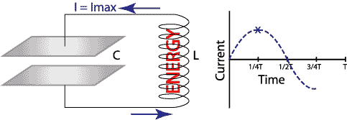
Electromagnetic Oscillations
1
2
3
4

Slide 4
Energy in LC Circuit
Total energy in L and C is:
As no resistance in circuit, no energy is _____________, that is:
Making the substitutions: we then have:
This differential equation describes the _____________ of the LC circuit.
Try solution q = Q cos (ωt +φ) [18.2]
Calculate derivatives:
Substitute into ___________ equation:

Slide 5
Charge and Current Oscillations
Hence q = Q cos (ωt +φ) is solution of
Thus the charge stored on the capacitor exhibits _____________ oscillations with frequency
Current in circuit is given by
Hence current also shows sinusoidal ____________, with _________ Qω.
Graph of charge stored on capacitor and current in circuit, with C = 10⁻⁶ F, L = 2 H (gives f = 112 Hz), charge on capacitor at t = 0 is 10⁻⁵ C (i.e. initial potential 10 V):
(C)
(A)
(s)

Slide 6
Energy Oscillations
Can now check that total energy is ______________.
Look at energy stored in E field in _____________...
...and at energy stored in B field in _____________:
Substituting for ω gives:
Plotting these quantities and their sum, U, for the values of C, L and Q used previously gives:
Notice total energy looks constant as expected: exercise, prove this!
(J)
(A)
(s)

Slide 7
RLC Circuit
Now include ________ in the circuit:
The total electromagnetic energy, U = U_{E} + U_{B}, is now no longer constant as it is converted to ______ in the resistor at a rate given by i²R.
That is:
Substituting for the current as before:
The solution to this equation is:
The ____________ of the charge oscillations decreases with time (i.e. they are damped) according to
R
C
L

Slide 8
Damped Charge and Current Oscillations
The (angular) ____________ of the oscillations is also decreased.
Consider situations in which , this is the case when the damping is not too _________.
The current is given by:
With the same L and C values as before, adding a 200 Ω resistor, the current and charge behave as below:
(C)
(A)
(s)

Slide 9
Damped Energy Oscillations
The energy stored in the electric field of the capacitor is given by:
The expression for U_{B} is a little messy, but adding this and the total _______________ energy U to the plot gives:
(J)
(J)
(s)
(s)

