Slide 1
Lecture 14
In this lecture we will look at:
Magnetic fields due to currents.
Magnetic field due to a long straight wire.
Magnetism and relativity.
Magnetic field due to an arc and a loop.
Force between two parallel currents.
The Rail Gun.
After this lecture, you should be able to answer the following questions:
What is the magnitude and direction of the magnetic field a distance R from a long straight current-carrying wire?
Determine the strength and the direction of the force between two long parallel wires, separated by a distance of 1 mm, which are each carrying a current of 6 A but which is flowing in opposite directions in each of the wires.

Slide 2
Magnetic Fields due to Currents
Consider a current carrying wire:
Magnitude of B field at point P due to ___________ element
The permeability constant (or the permeability of free space) μ₀ is defined to be exactly:
Writing the expression for the field in terms of a __________ allows the direction to be determined:
This expression is known as the __________ Law.
θ
X
P
i

Slide 3
Magnetic Field due to a Long Straight Wire
Consider long straight wire:
Integrating:
Using the relationships
We get:
Using the result:
The integral becomes:
θ
s
X
R
P
i

Slide 4
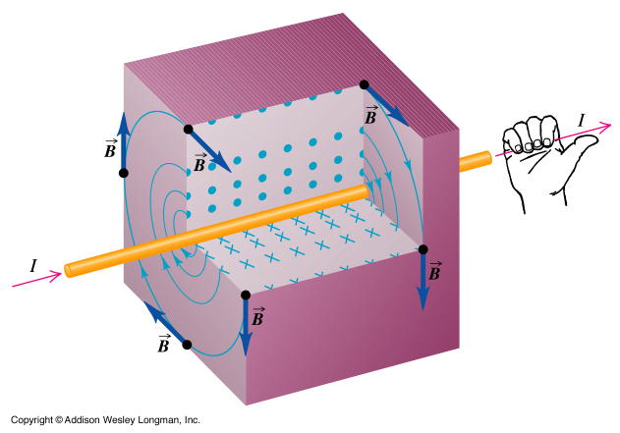
Direction of Field due to Current in Wire
From vector expression for Biot-Savart law... ...know direction of B field, e.g:
This leads to (yet another) version of the right-hand rule.
i
X
P

Slide 5
Magnetism and Relativity
Consider a _________ test charge, q₀, next to a wire with a current flowing in it:
Have total +ive charge +q and –ive charge –q in section of wire.
In this situation, the test charge experiences no ____ (the _________ of the wire is zero).
Now move the test charge along the wire with the same _______ as the charge carriers in the wire.
Look at the wire in the _________ of the test charge:
Positive charges now moving w.r.t. q₀, separation _______ contracted.
Negative charges were moving w.r.t. q₀, no longer Lorentz _________, so must now be “uncontracted”.
proper length, L₀
+
+
+
+
+
+
+
+
+
+
−
−
−
−
−
−
−
−
−
−
R
R
q₀
q₀

Slide 6
Magnetism and Relativity
The linear charge density in the frame of the test charge is thus:
The (electrostatic) force in this frame is thus and is directed _____ from the wire (for +ive q₀).
Now the E field due to a continuous line of charge is:
We see:
However, i = ___/__, so using ε₀c² = 1/μ₀, where μ₀ is the permeability of free space.
Hence,

Slide 7
Magnetic Field due to Circular Arc and Loop
Now ds = R dφ, so
Note, φ in radians!
For complete circle (loop of wire), φ = 2π, so:
Calculate field at centre of arc, radius of curvature R:
Direction always _____ transparency (right hand rule).
90°
φ
i

Slide 8
Force Between Two Parallel Currents
Consider two parallel current- carrying wires:
Field due to i_{a} at position of wire b is:
Force produced on current in length L of wire b due to this field:
This gives:
The two wires _____ if current parallel.
If currents anti-parallel, _________ of force same but is ________.
Definition of ampere: The ampere is that constant current which, if maintained in two straight ____________ of infinite ______ and negligible cross section, placed one metre apart in _______, would produce on each of these __________ a force of magnitude 2 x 10⁻⁷ N.
a
b
i_{a}
i_{b}

Slide 9
Rail Gun
Device in which ____________ can rapidly accelerate projectile.
Right _________ shows that current in rails causes B field between them which is directed _______________.
This B field causes a force on the ________ in the gas which pushes it upwards.
The gas accelerates the projectile upwards.
projectile
i
conducting gas formed
when copper “fuse” vaporises.
i
i

