Slide 1
Lecture 12
In this lecture we will look at:
  Magnetic fields.
  Force on a charged particle in a magnetic field.
  Magnetic field lines.
  Circulating charged particles.
  Magnets in particle physics.
  The Aurora Australis and the Aurora Borealis.
After this lecture, you should be able to answer the following questions:
How does a magnetic field influence a) a stationary charged particle and b) a moving charged particle?
Use field lines to illustrate the field due to a bar magnet.
Explain how the mechanism that gives rise to the Aurora Borealis.

Slide 2
Magnetic Fields
As soon as we start considering moving , we are faced with a new phenomenon: magnetism.
Two comments:
  Not really new phenomenon! (See “Relativity and Magnetism” in Lecture 14.)
  Fields due to magnets – i.e. magnetic materials – are result of
  in the materials, e.g. electrons orbiting nuclei.
The strength and direction of an electric field was defined in terms of the force it caused on a test charge:
No magnetic monopoles, so cannot quite do same for magnetic field.
Magnetic fields have no effect on
electric charges, but do cause force on charges.
Magnitude and direction of magnetic force found to depend on velocity of charge ( and !).
See is cross product:
φ

Slide 3
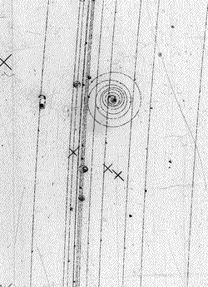
Force on a Charged Particle in a Magnetic Field
This defines and of the magnetic (“B”) field.
More descriptively, the direction of the B field is that in which the charged particle experiences no force.
The strength of the B field is
Sense (which way along direction vector) from :
  1st finger: velocity (+ive charge).
  2nd finger: B field.
  Thumb: motion (i.e. force).
Work out the direction of the B field in this bubble chamber photograph, assuming that the spiralling track is that of an electron:

Slide 4
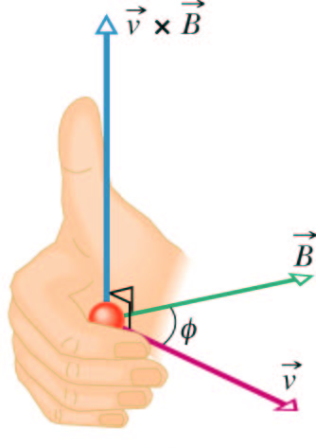
Force on a Charged Particle in a Magnetic Field
Another way of thinking of the RH rule:
  Hold your right hand so your extended fingers point along the +ive particle’s .
  Turn your hand so that when you curl your fingers they move towards the direction of the .
  Your thumb is then pointing in the direction of the .
And another...
  Rotate a RH screw from the direction of the towards that of the B field.
  The screw moves in the direction of the .

Slide 5
Force on a Charged Particle: Typical Magnetic Fields
Some comments:
  Force is to charge, force on –ive particle _______ to that on +ive particle.
  Force always ____________ to both particle’s _______ and ________ of the B field.
  The force doesn’t change the _____ (and hence ___________) of the particle.
The unit of magnetic field strength is the Tesla:
Older unit, the gauss, 1 T = 10 kG.
Some typical magnetic field values:
Surface of neutron star | 10⁸ T
Superconducting magnet | 10 T
Small bar magnet | 10⁻² T
At earth’s surface | 10⁻⁴ T = 1 G
Interstellar space | 10⁻¹⁰ T
Magnetically shielded room | 10⁻¹⁴ T

Slide 6
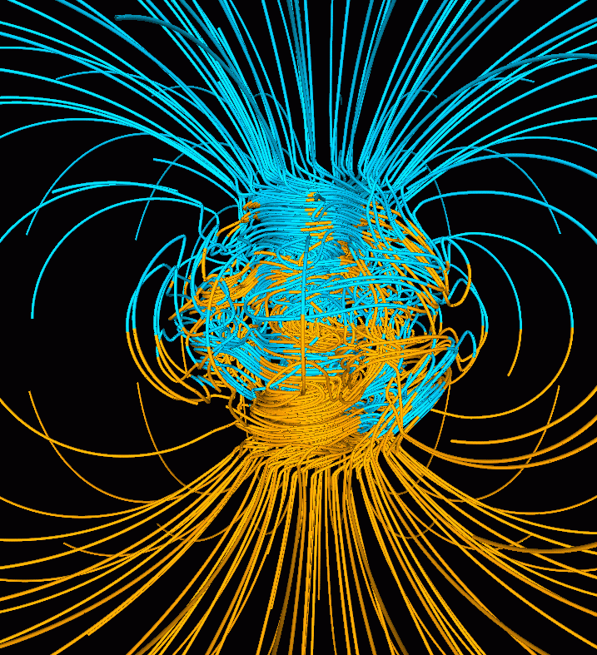
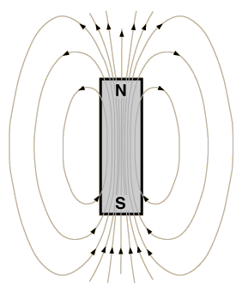
Magnetic Field Lines
Represent _______ field using field lines.
Direction of the field line gives the direction of the B field.
Density of the lines represents the __________ of the field: the closer the lines the _________ the field.
Earth’s magnetic field represented using field lines, blue = inward, yellow = outward lines.

Slide 7
Circulating Charged Particle
If project beam of particles, into magnetic field with ________ force causes particles to follow ________ path, radius r.
Lorentz force F_{B} = qvB.
__________ force:
Equating these:
B field directed into transparency.
X
X
X
X
X
X
r
X
X
X
X
X
X
X
X
X
X

Slide 8
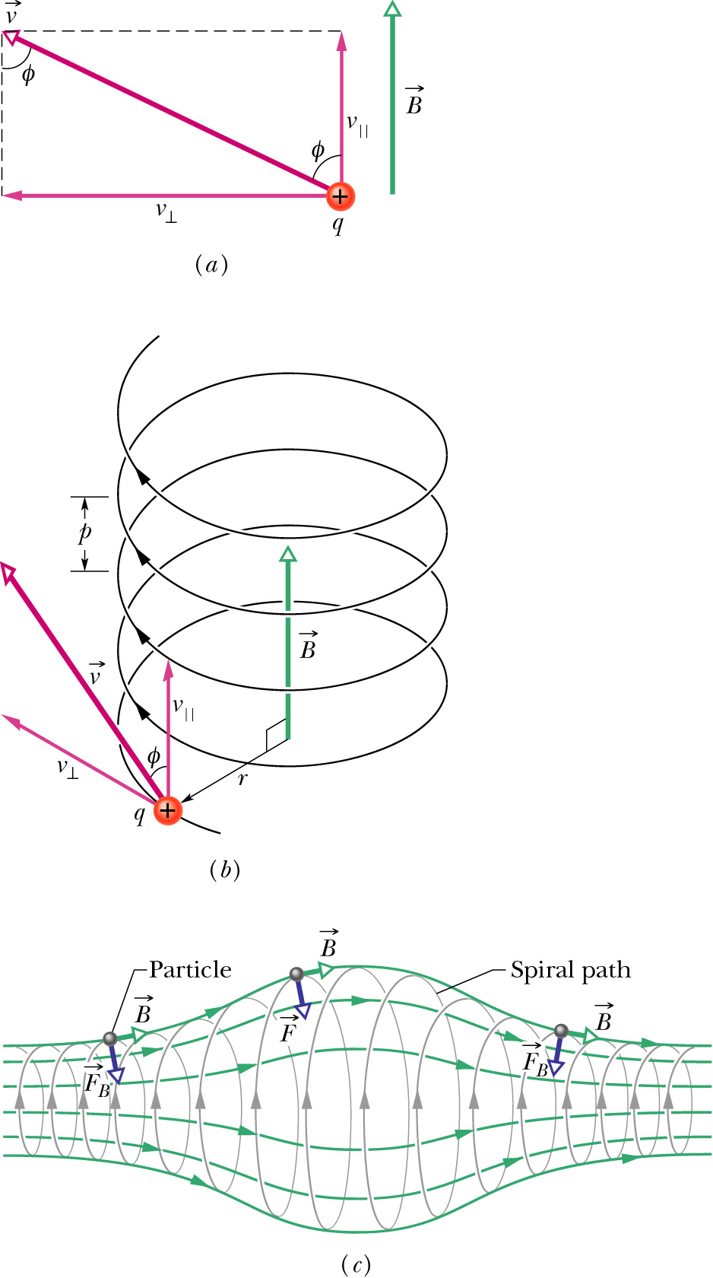
Circulating Charged Particle
The period (time for one revolution) is given by speed/distance, i.e.
Frequency given by:
Angular frequency:
If there is a component of particle’s ________, v_{L}, along direction of B field, particles follow _______ path.
Radius of helix given by v_{T}, transverse component of velocity, pitch by v_{L}.
Helical path:

Slide 9
Magnets in Particle Physics Detectors

Slide 10
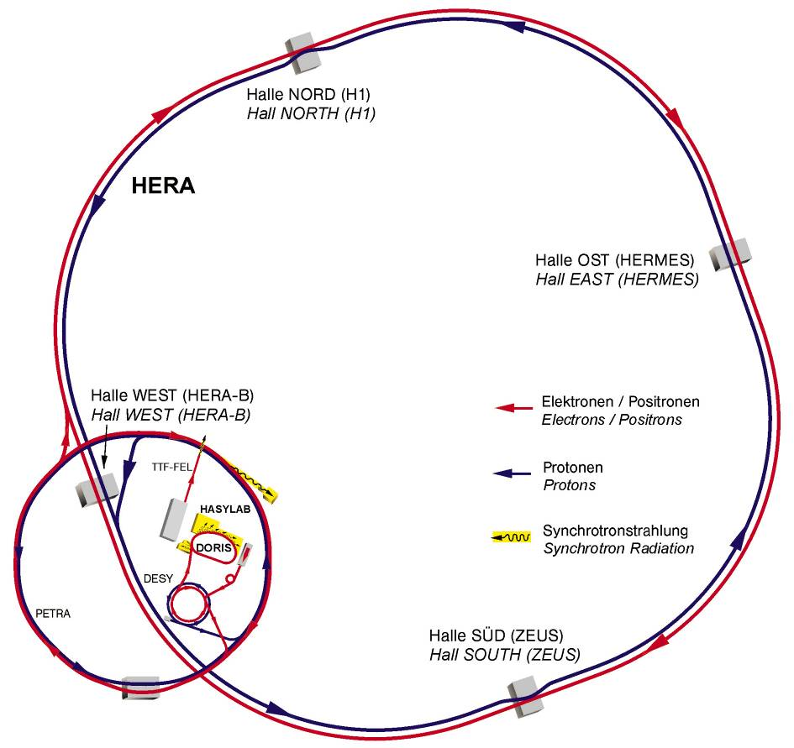
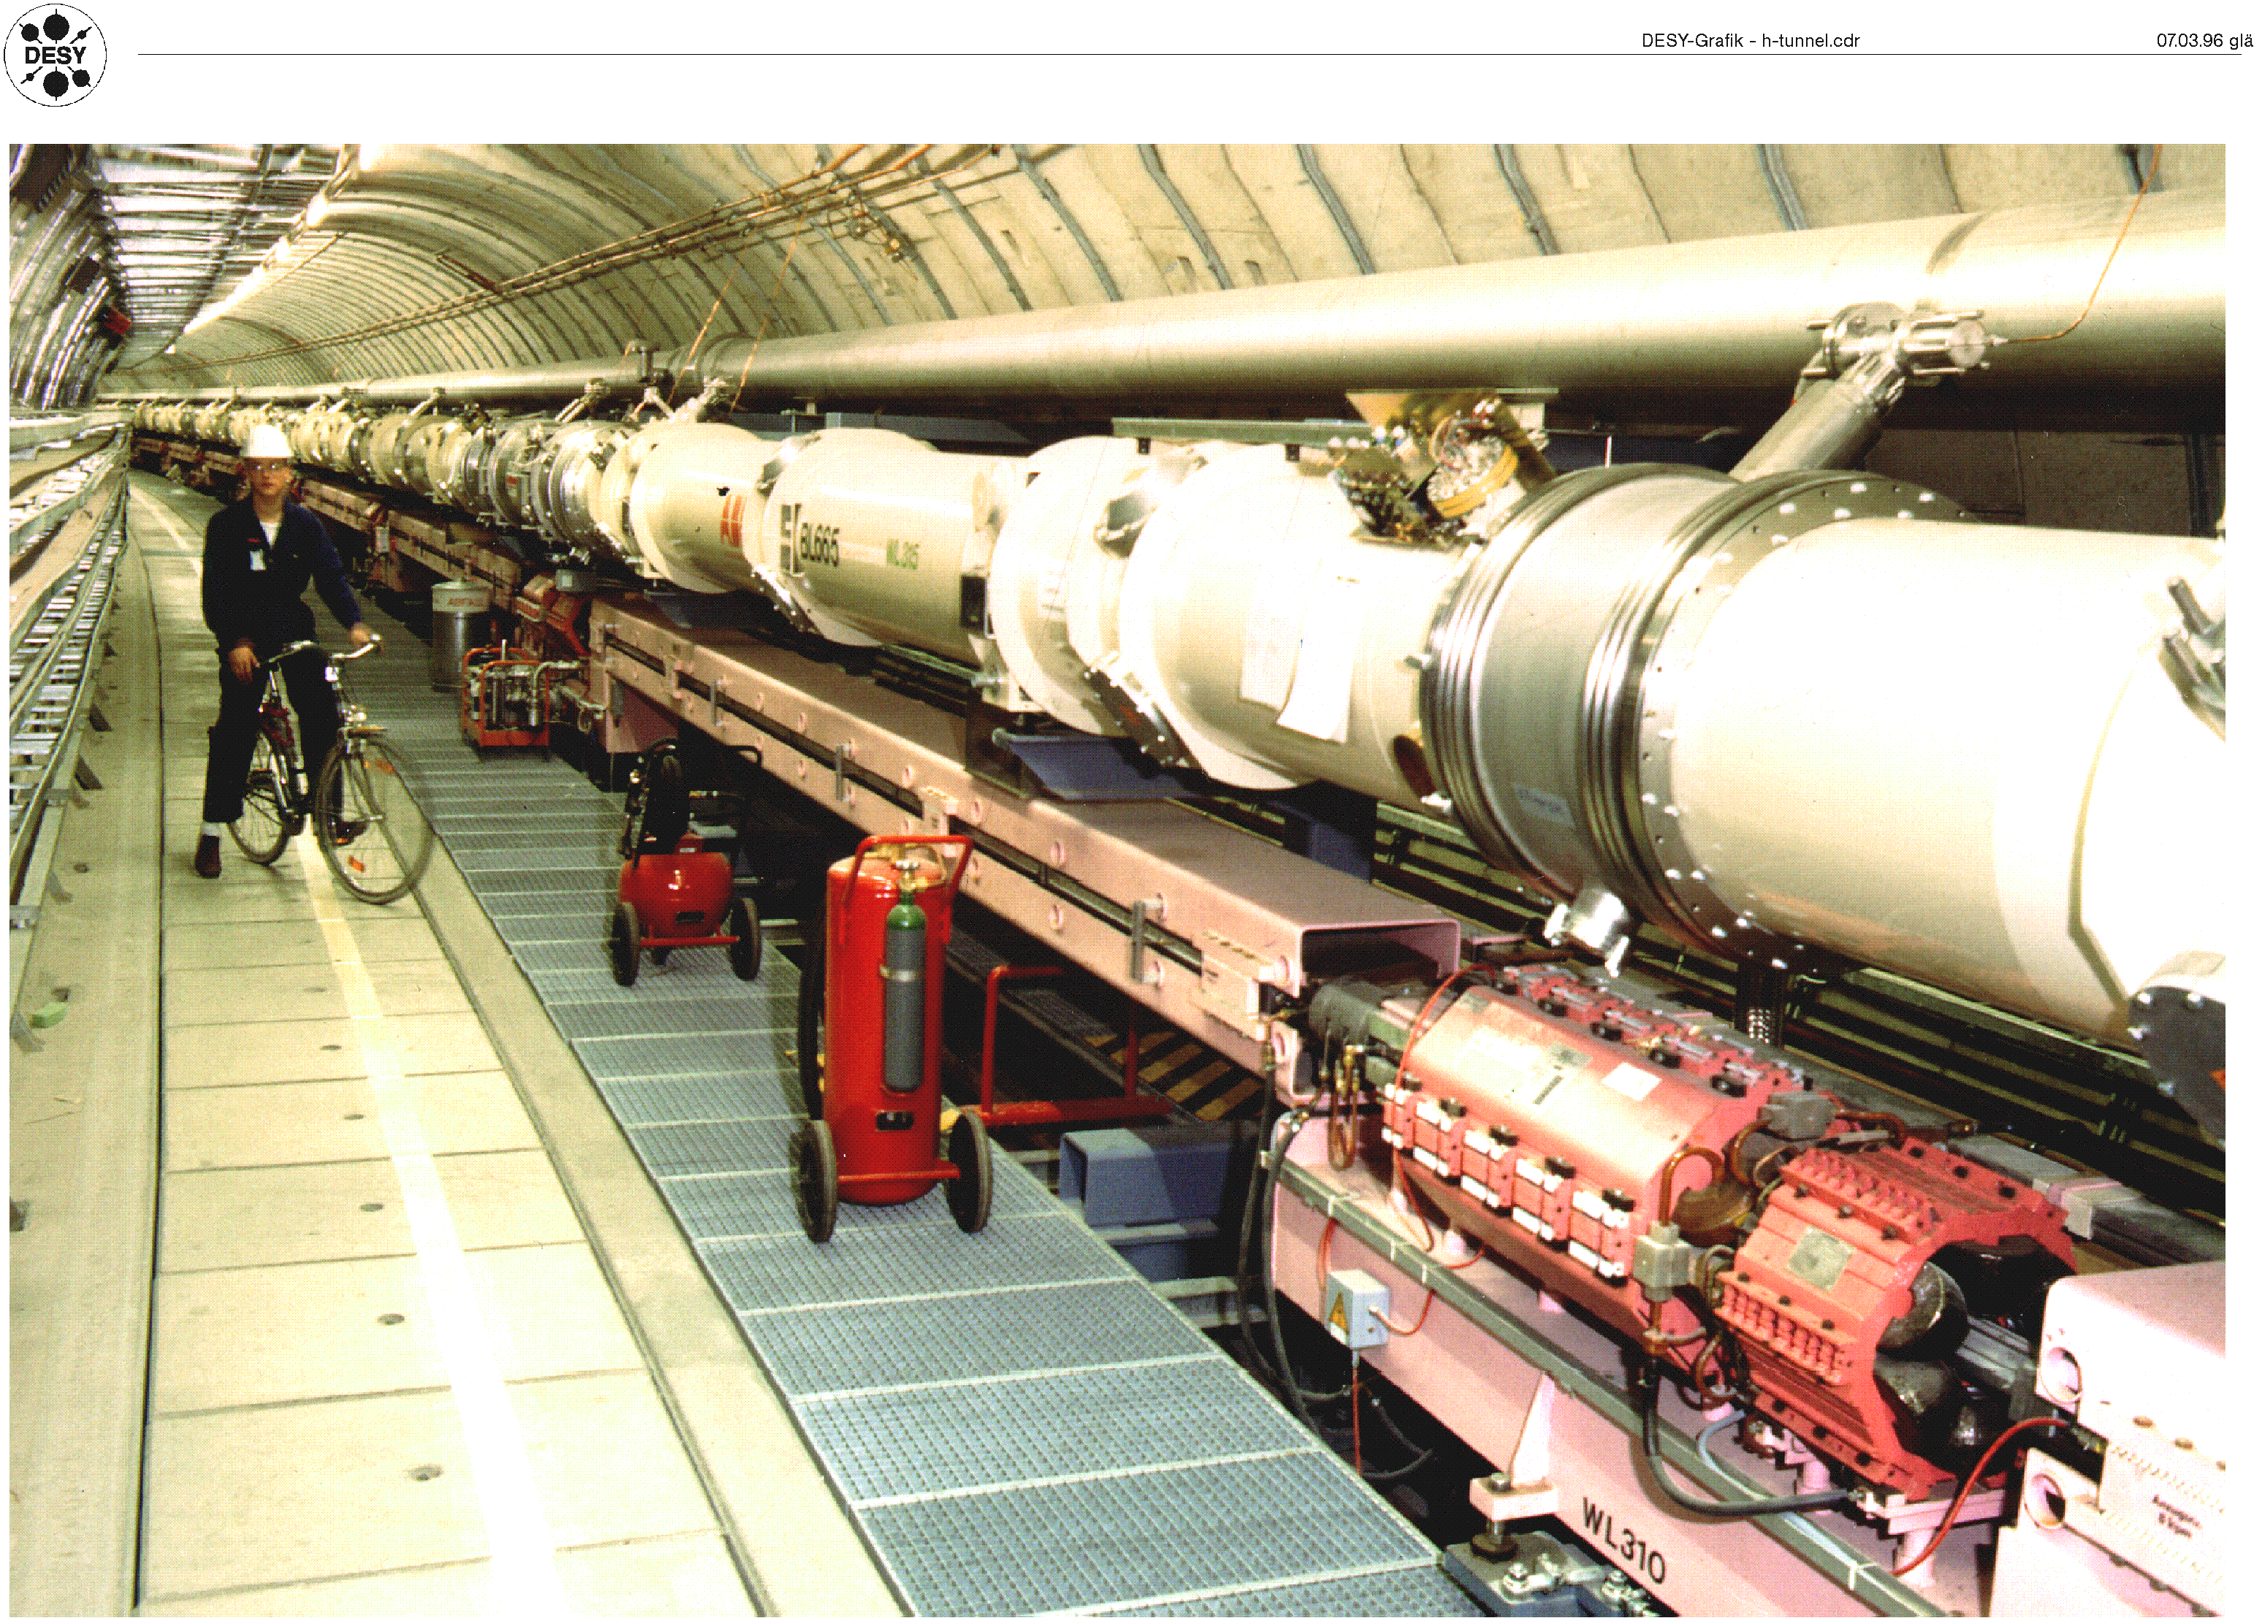
Magnets in Particle Accelerators
Dipole magnets steer particles around accelerators and quadrupole magnets provide focussing.

Slide 11
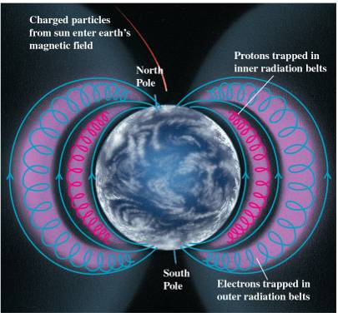
Magnetic Bottle
Charged particle can become trapped in non-uniform B field:
This happens in the magnetic field of the earth, gives rise to _________________ (right), Aurora Australis and Aurora Borealis (next slides) .

Slide 12
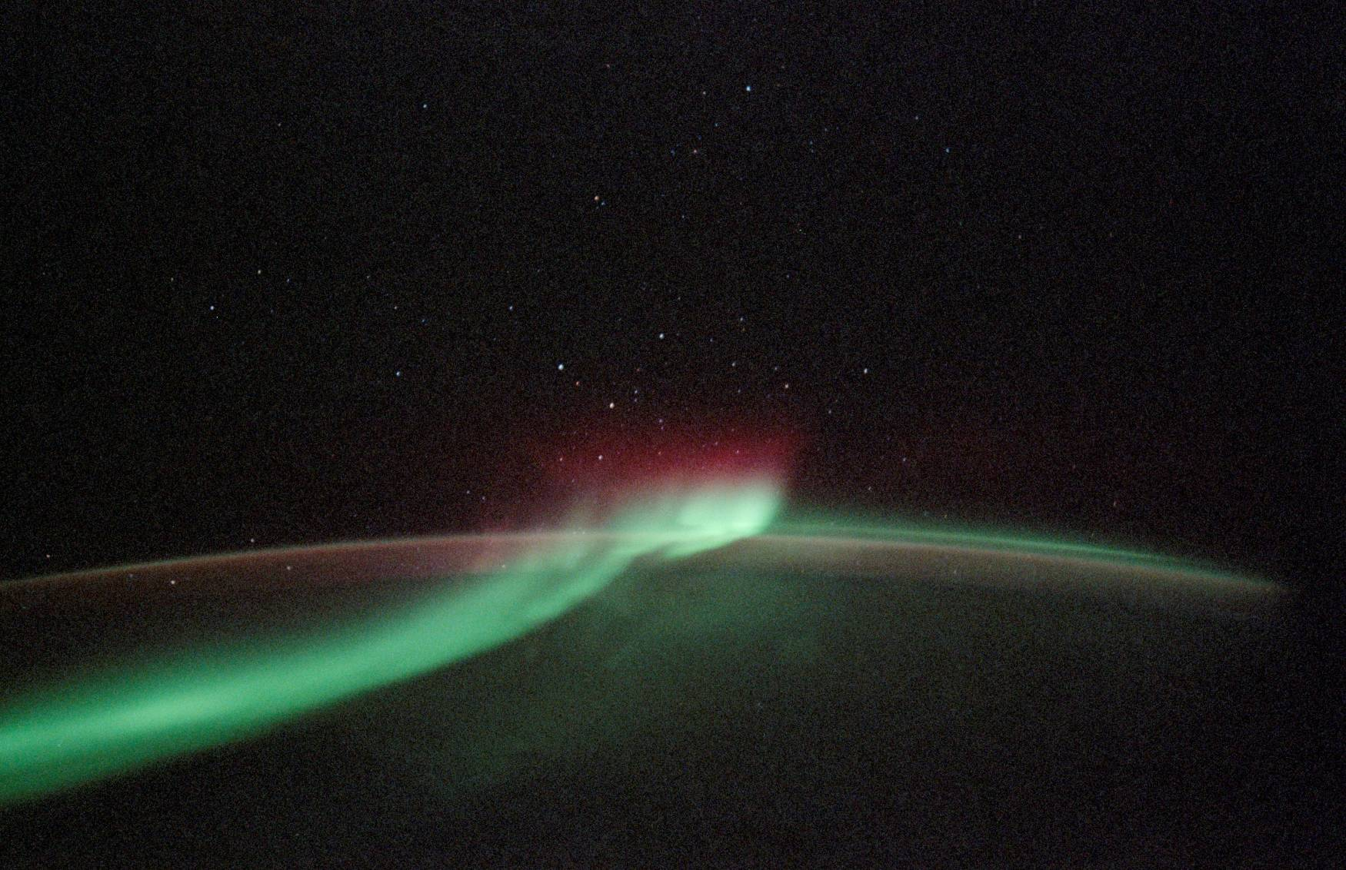
Aurora Australis, Photo from Discovery

Slide 13
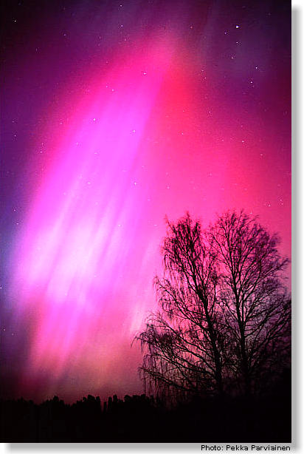
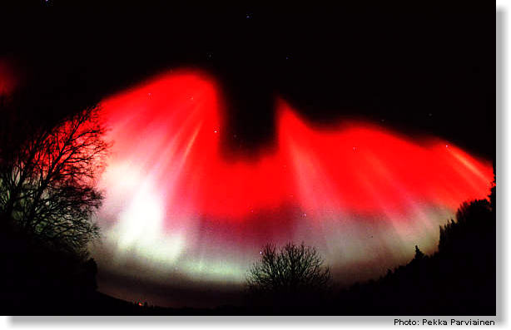
Aurora Borealis

Slide 14
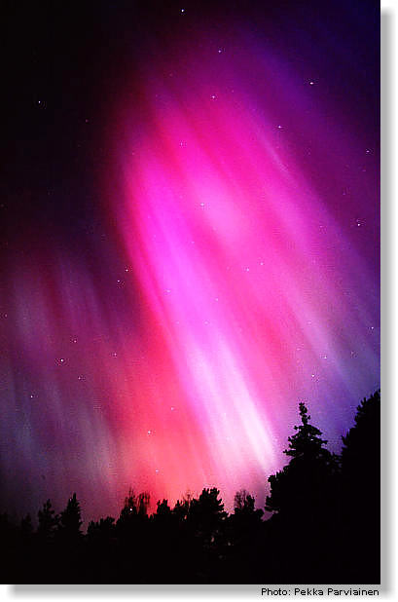
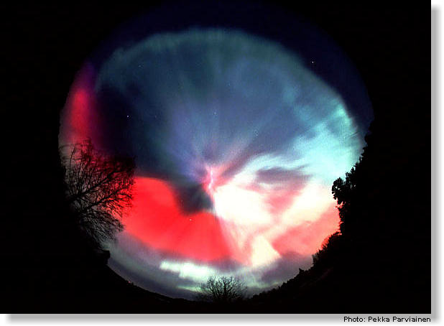
Aurora Borealis

Slide 15
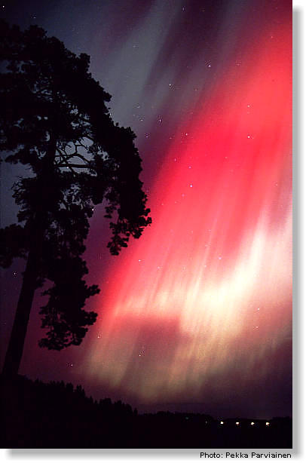
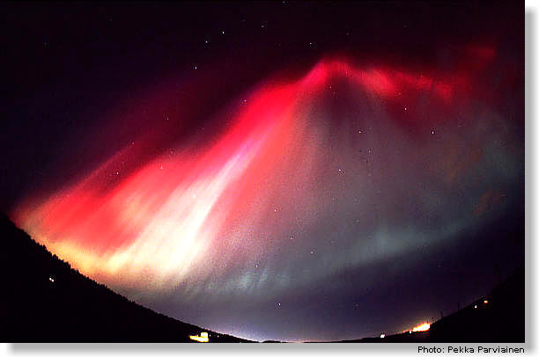
Aurora Borealis

