Slide 1
Lecture 5
This lecture, we will look at:
Electric potential.
Calculating the electric potential from the electric field.
Electric potential due to a point charge.
Illustrating the electric potential and an example from Particle Physics: the drift chamber.
The potential due to a dipole.
After this lecture, you should be able to answer the following questions:
In what units is electric potential measured and how is electric potential related to potential energy?
What are the formulae for the potential due to a point charge and a dipole?

Slide 2
Electric Potential
A charge q₀ in an electric field experiences a force
If it moves under the influence of the force, or if it is moved against the influence of the force, _____ is done.
Associate the electric ________ _______, U, with the charge in the electric field.
The change in electric PE between the initial configuration, i, and the final configuration, f, is given by:
Here, W is the ____ _____ by the electric field on the charge (−W is the work done on the ____ in moving the ______).
Define configuration with charge at infinite distance from source of field to have U∞ = 0.
Then, U = −W.
Define electric potential, the electric potential energy per unit charge:
Units J C⁻¹ = Volts (V).
The _______ _______ between points i and f is the difference in potential energy per unit charge between the two points:

Slide 3
Calculating the Electric Potential from the Field
Force on charge:
Work done in moving charge a short distance
Difference in potential energy between configurations i and f:
Hence difference in electric potential:
Defining V_{i} = 0 at infinite distance:
i
+
f
E field line

Slide 4
Electric Potential due to Point Charge
Determine potential due to point charge.
Hence:
Again, we have used
Therefore: for any point at a distance r from the charge q.
q₀
+
P
r
R
+q

Slide 5
Displaying the Electric Potential
Potential due to a point charge:
Electric potential indicated using equipotentials (c.f. contour lines on Ordnance Survey map!).
Potential (arb. units)
y (arb. units)
x (arb. units)

Slide 6
Electric Field and Associated Electric Potential
Electric field due to 3 point charges:
Principle of superposition for potentials:
Associated electric potential:

Slide 7
Electric Field and Associated Electric Potential
Electric field due to 3 point charges:
Associated electric potential:
V (arb. units)
y (arb. units)
y (arb. units)
x (arb. units)
x (arb. units)

Slide 8
Electric Potential in a Drift Chamber
Electric potential in drift chamber illustrated using equipotentials.
Electric field always normal to equipotentials.
Electrons produced in drift volume by high energy charged particle passing through gas in chamber.
Electrons drift along electric field lines to anode wires (central potential wells) where they produce electrical signals.
Drift electric field ~ 1 MV/m.
Using information on time taken for electrons to reach wires, reconstruct path of high energy charged particle.
32 mm
56 mm

Slide 9
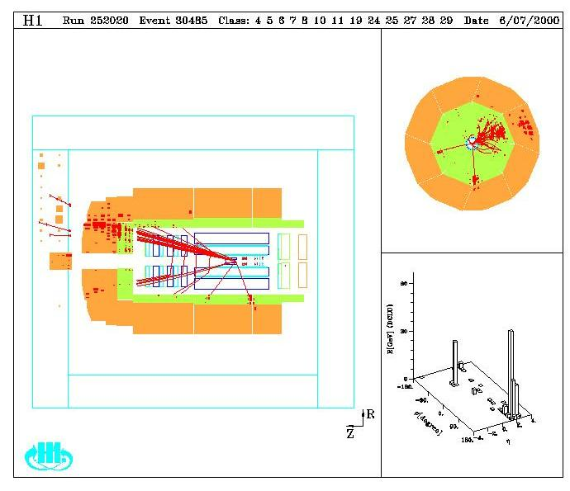
Charged Particle Paths in H1 Detector

Slide 10
Potential due to Dipole
z
Adding potentials due to positive and negative charges:
For r >> d:
Hence s
P
+
r₊
r₋
r₊
+q
θ
d
0
+
r₋
−q
d
θ
d cos θ
−

