Slide 1
Lecture 4
This lecture, we will look at:
Gauss’ Law and its equivalence to Coulomb’s Law
Some applications of Gauss’ Law
Gauss’ Law and the Shell Theorem
After this lecture, you should be able to answer the following questions:
What is the charge enclosed by a surface through which the electric flux is 24 Nm²C⁻¹?
Is this charge positive or negative?
Calculate the electric field due to an infinite line of charge with linear density corresponding to one electron every nanometre.
Use Gauss Law to prove the Shell Theorem.

Slide 2
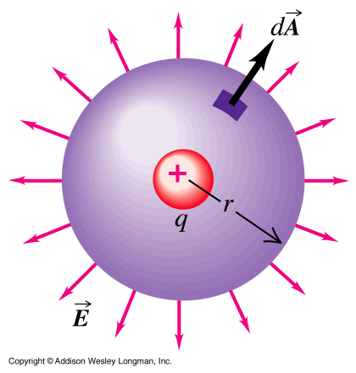
Gauss’ Law: Equivalence to Coulomb’s Law
Gauss’ Law (in a vacuum) states: The _____ of the electric field out of any closed surface equals the ______ enclosed divided by ε₀:
We now show that Gauss’ Law is equivalent to Coulomb’s Law.
Consider point charge q_{enc} at centre of spherical Gaussian surface.
Angle between is always zero, hence:
enc
E is constant over surface, so have:
Hence as required by Coulomb’s Law.

Slide 3
Field Inside Charged Isolated Conductor
The E field in a charged isolated conductor must be zero. (Why?)
Use Gauss’ Law to find out where the charge resides.
Consider lump of copper, draw ___________ just inside surface of copper.
Gauss’ Law says that for any closed surface: _________________
As E field zero, q_{enc}/ε₀ = 0, hence no charge inside the Gaussian surface: it must all be on the _________ of the copper.
Repeat argument after having scooped out a cavity in the copper.
No charge inside Gaussian surface, so no charge on ____________.

Slide 4
Field Outside Infinite Charged Conductor
Surface charge density σ (C m⁻²).
Using Gauss’ Law:
For curved surfaces:
For RH end:
For LH end,
Hence:
Field perpendicular to surface, directed out of conductor.
+
+
+
+
+
+
+
Gaussian
surface
+
+
+
+
+
+
Conductor
extends to ∞!
+
+
+

Slide 5
Field due to Infinite Charged Sheet
Surface charge density σ.
Analysis similar to that for field outside infinite charged conductor.
Difference is that there is a field present at the LH end of the Gaussian surface.
Leads to result that field strength is:
Field is directed perpendicular to sheet, towards both left and right.
+
+
+
+
+
+
+
Gaussian
surface
+
+
+
+
+
+
Sheet extends
to ∞!
+
+
+

Slide 6
Field due to Infinite Line of Charge
Linear charge density λ (C m⁻¹).
Applying Gauss’ Law:
Symmetry implies E field directed radially __________.
No contribution from cylinder ends (E field _____________ to area vectors).
E constant at given radius, so
Hence:
Gaussian
surface
r
h

Slide 7
Gauss’ Law and the Shell Theorem
What does the Shell Theorem state (Lecture 1)?
Consider charge distributed uniformly over a spherical shell:
Symmetry implies E field at each of Gaussian surfaces has _________ ___________ and is radially directed.
Consider surface outside shell:
For surface inside shell:
Total charge q
Gaussian Surfaces
R

Slide 8
Sphere of Charge
Consider uniform sphere of charge:
Total charge on sphere q.
Outside sphere, analysis as for shell:
Inside sphere:
That is, at a radius r inside the sphere, the field is the same as that due to a point charge at the centre of the sphere, with magnitude of all the charge within the radius r.
R
r

