Slide 1
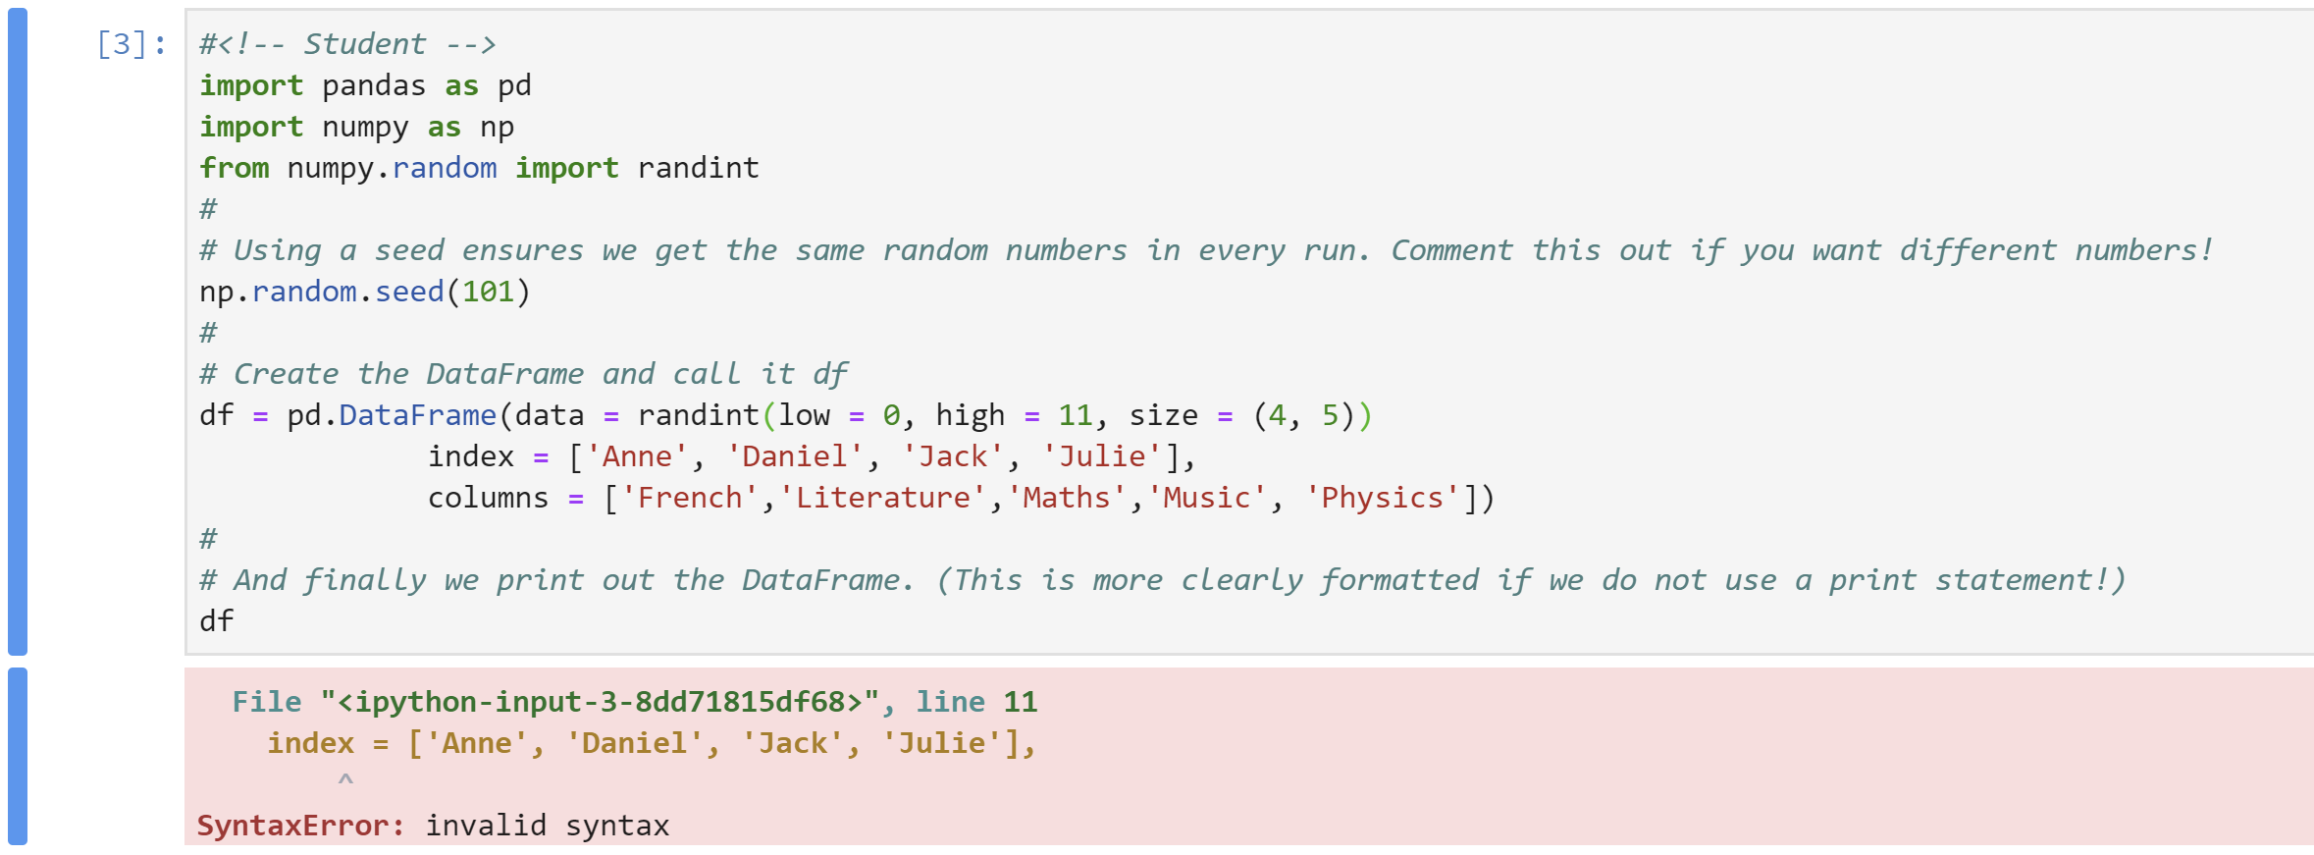
What to do when things go wrong
Sometimes, programs don’t do what you hope they will!
Python does its best to tell us what has gone wrong and where it happened.
Here, the “where” is line 11.
Switch on line numbers.
Menu: View/Toggle Line Numbers: shortcut: Shift-l (that’s a lower case L!).
1

Slide 2
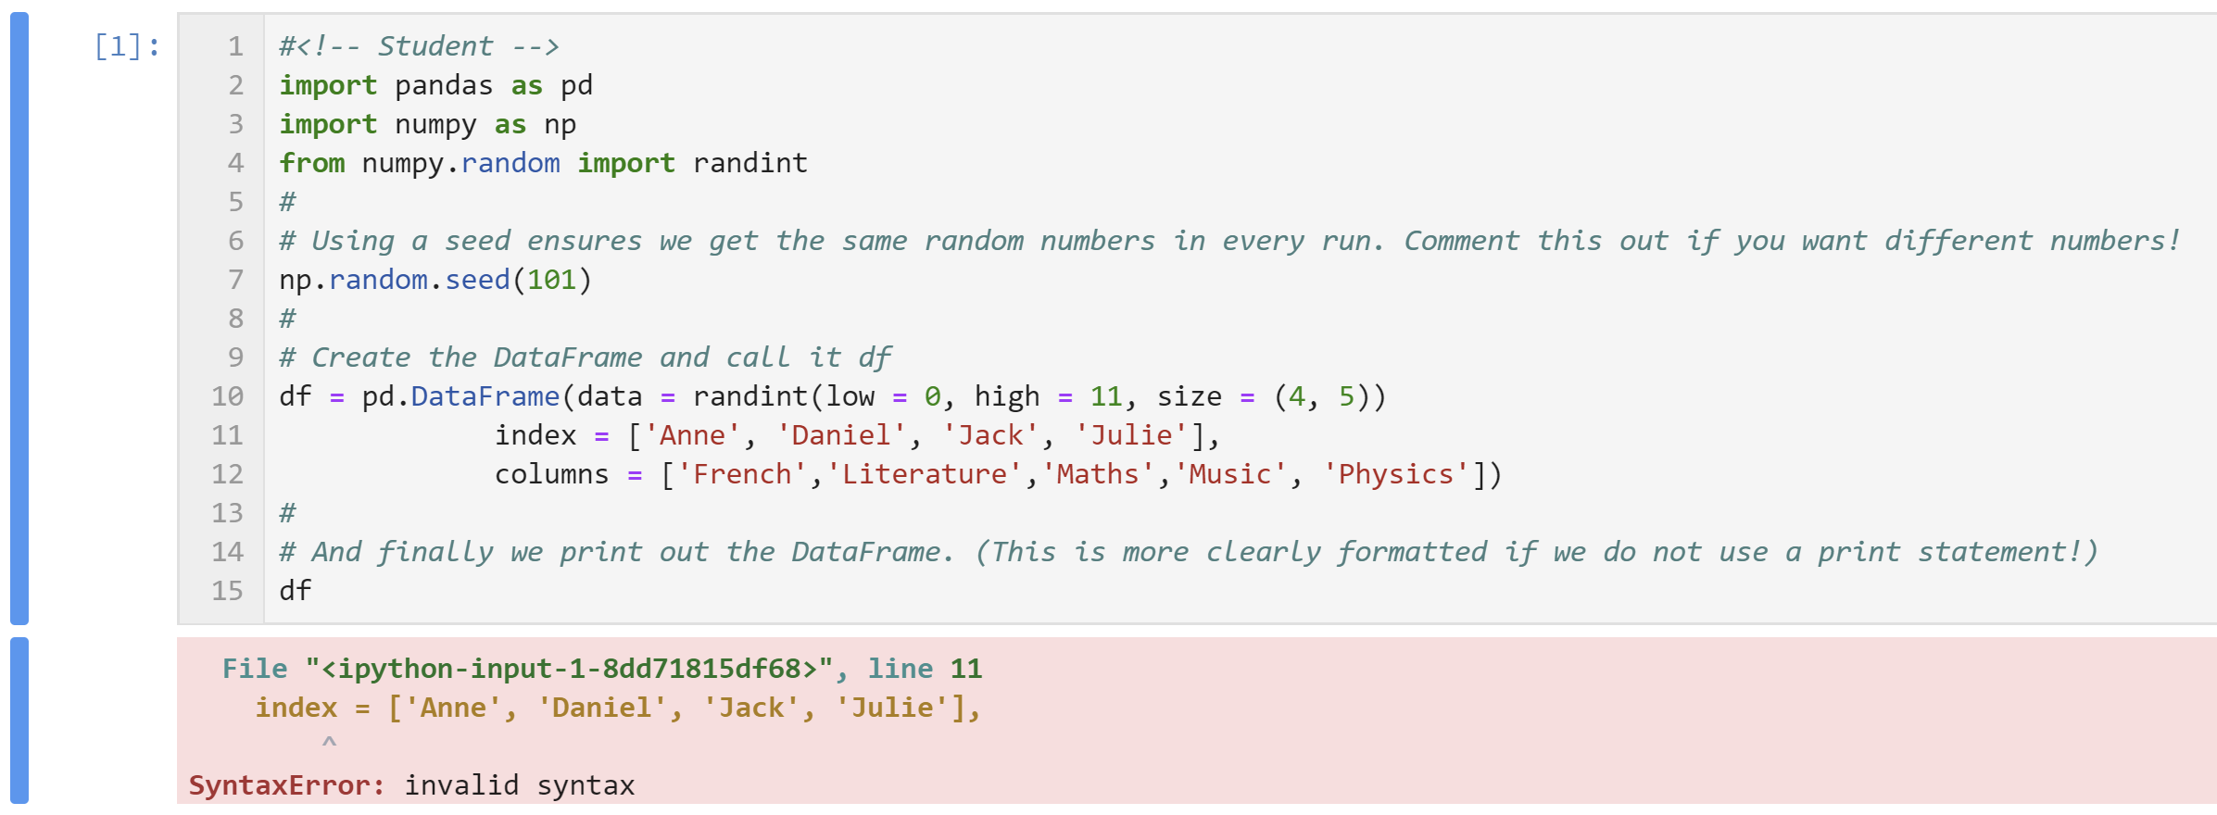
What to do when things go wrong – syntax errors
This error is of type SyntaxError.
Python is telling us we have written something that is not allowed within the rules of the language.
But there is nothing wrong with the syntax in line 11!
2

Slide 3
Syntax errors
However, there is a comma missing at the end of line 10.
Syntax errors are sometimes reported as being in the wrong line, particularly when a line of code has been split up over more than one line in the Notebook.
3

Slide 4
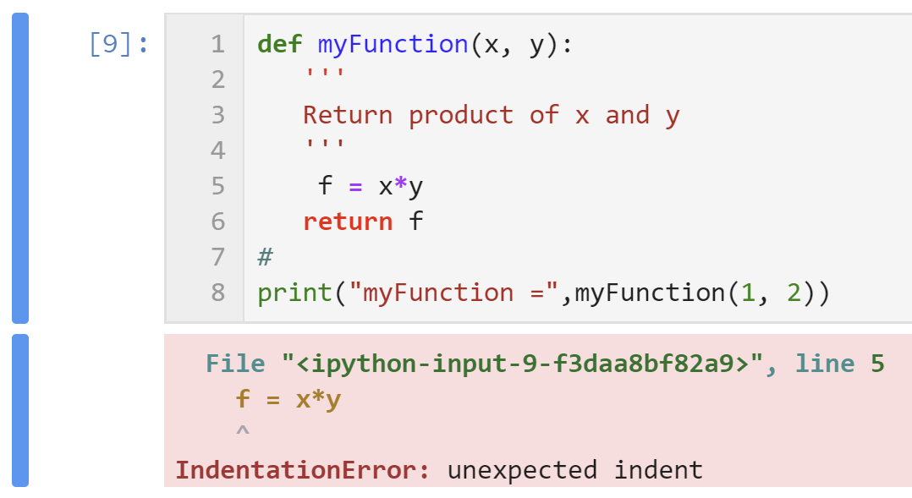
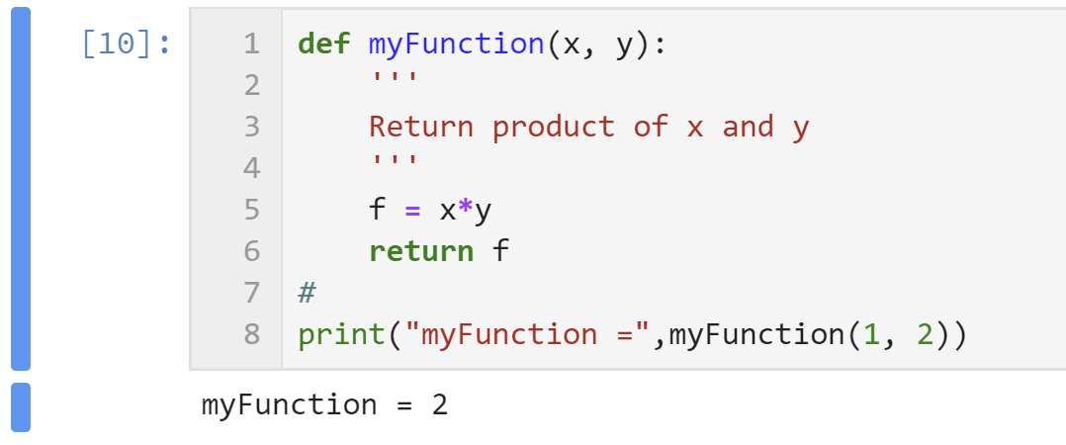
Syntax errors
Another type of syntax error that is identified is indentation errors:
Here, non-standard indentation has been used (three spaces), which is OK (though not a good idea).
But is has not been used consistently (line 5 has four spaces, not three), which is not OK!
Note that Jupyter has flagged the use of non-standard indentation by marking some things in the cell red.
Returning to the conventional four-space indentation fixes all problems and warnings:
4

Slide 5
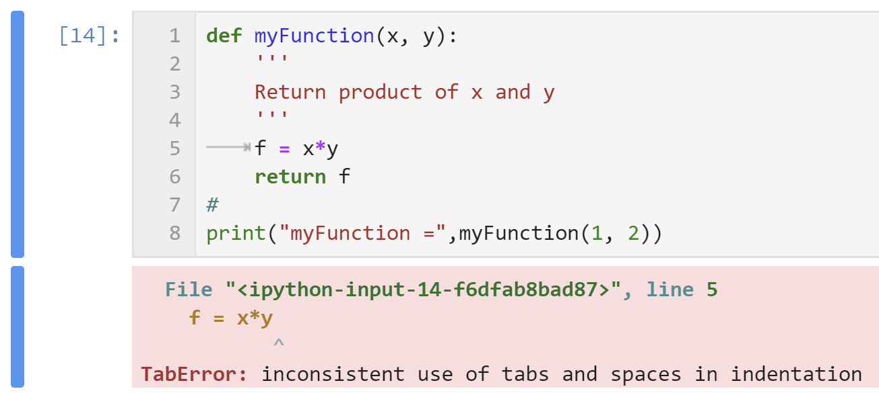
Syntax errors
A second type of syntax error that is identified is tabulation (Tab) errors:
In this case, the indentation at line 5 is a Tab, while all others are four spaces.
Jupyter replaces a Tab by four spaces to ensure you don’t get this error and also indicates where a Tab has been inserted.
Another common syntax error that may be difficult to spot is the following:
What is wrong here?
5

Slide 6
Exceptions
Even if the syntax is perfect, runtime errors may still occur.
Some of the common ones are illustrated in the following.
NameError:
As it says, the variable “elephant” is not defined
TypeError:
Can’t add integer and string (data types are incompatible).
6

Slide 7
Exceptions
ValueError:
This is not a TypeError, because the function int() can take a string as argument.
It is a ValueError, because the string “word” can’t be evaluated to give an integer.
IndexError:
Again, the error tells you exactly what’s wrong; the index is larger than is allowed!
7

Slide 8
Exceptions
ZeroDivisionError
This is another one that is exactly as it says on the tin!
KeyError:
Occurs when you try to access a value in a dictionary with an undefined key.
The error message gives you the unacceptable value of the key.
8

Slide 9
Catching exceptions
Python provides ways of coping with exceptions.
For example, here is one way of handling possible problems with undefined variables or with division by zero:
The full syntax of try includes the statements try, except, else and finally.
The Python philosophy is that its better to ask for forgiveness than permission!
9

Slide 10
Testing for possible runtime errors
You can test for an unrecoverable error using the assert statement.
Here’s as example:
Finally, you can force an error using the raise statement.
This might be useful when writing programs and trying to provide information on possible sources of error.
10

