Slide 1

Silicon detector R&D for HEP and applications
International leadership in the HEP community
Support our core activities
Provides the capabilities for the future Physics program
Base for applications (scientific, technological, commercial sectors)
Advanced design capabilities
Use of the Liverpool Semiconductor Detector Centre and mechanical workshop
Anticipation

Slide 2
International leadership in the HEP community
High visibility position:
Led research to demonstrate silicon sensors capable of operating after LHC fluences and to HL-LHC fluences (2x10¹⁶ n_{eq} cm⁻²).
Built strip sensor systems for ATLAS and LHCb-VELO.
Lead the development and specification for the ATLAS upgrade strip system.
Pixel sensor R&D: designers for the UK (sensors and flex electronics), introduced novel design concepts (both for general experiment layout and at device level), designed and produced prototypes of pixel assemblies. Taken a central role in UK and internationally for LHCb-VELO upgrade and ATLAS upgrade.
Involved in R&D for future experiments: CLIC, ILC, mu3e, G-2 upgrade, srEDM.

Slide 3
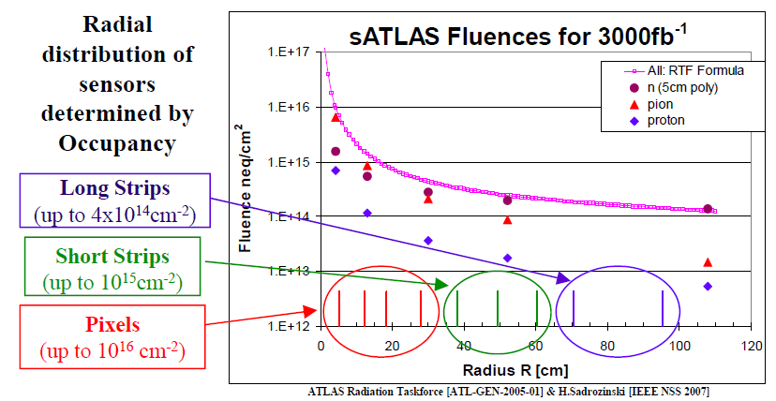
Radiation levels expected with sLHC
Established silicon sensors as the optimal choice for tracking and vertexing in LHC and its upgrades
Dominated by
pion damage
Dominated by
neutron damage
Radiation hardness requirements (including safety factor of 2)
  2 × 10¹⁶ n_{eq}/cm² for the innermost pixel layers
  1 × 10¹⁵ n_{eq}/cm² for the innermost strip layers

Slide 4
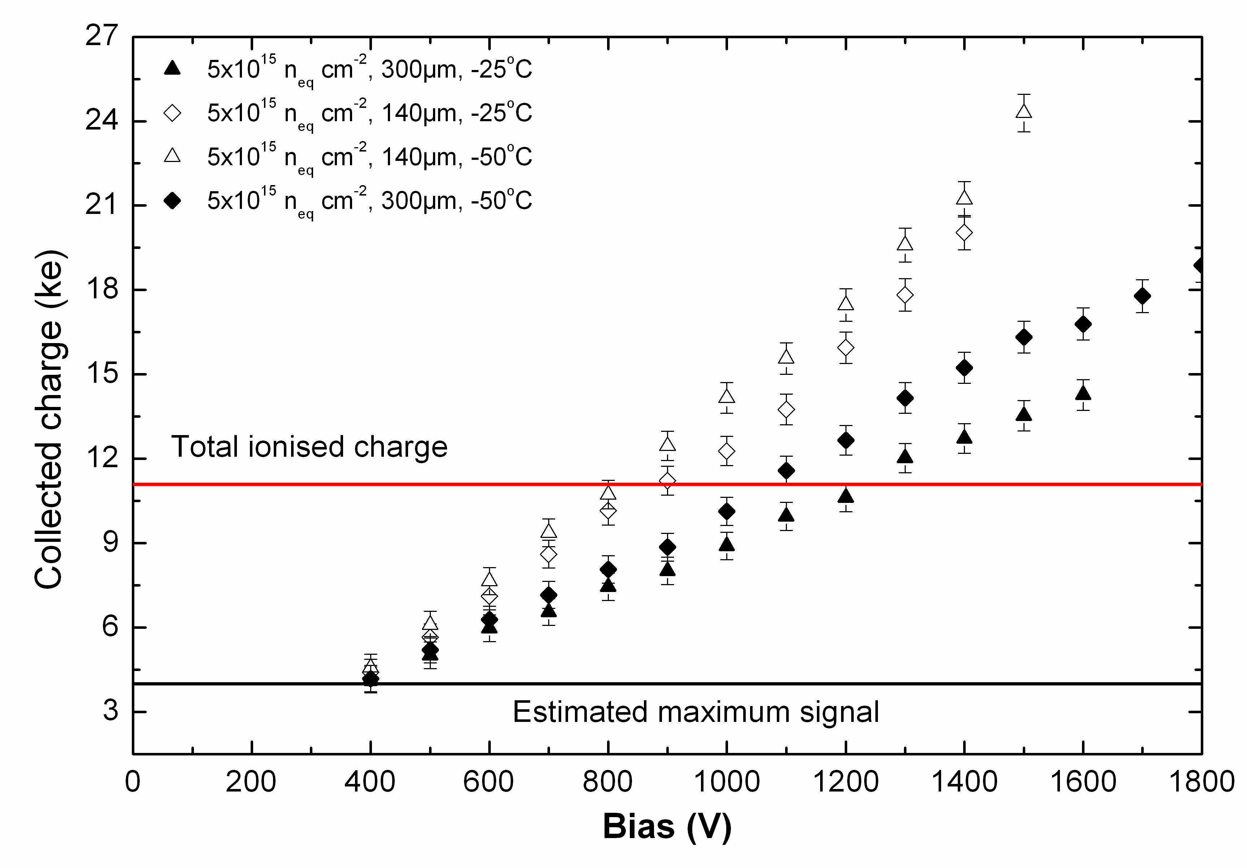
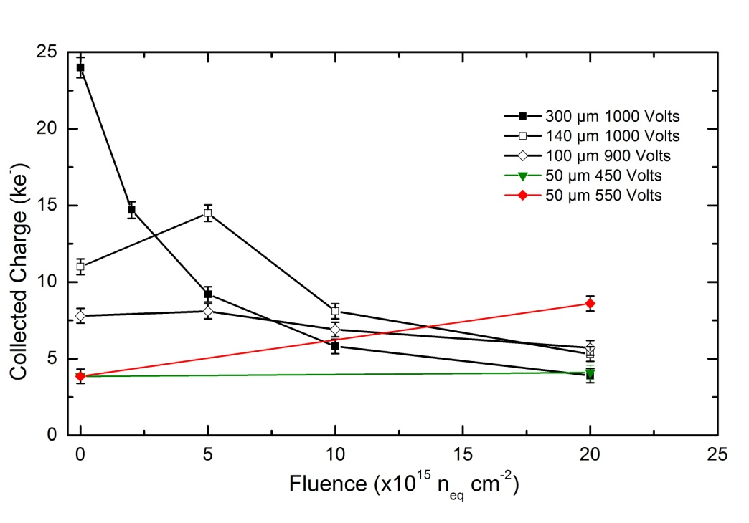
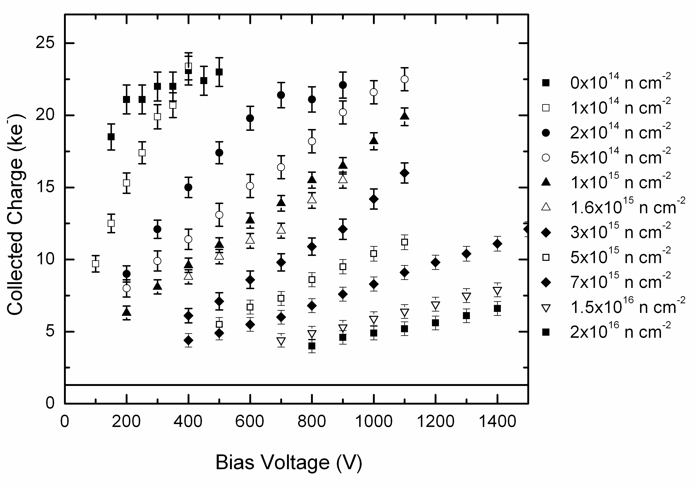
Charge multiplication: exceeds the estimated lifetime of sensors, satisfies the HL-LHC requirements
Hadron irradiation up to 2x10¹⁶ n_{eq} cm⁻²

Slide 5
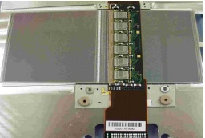
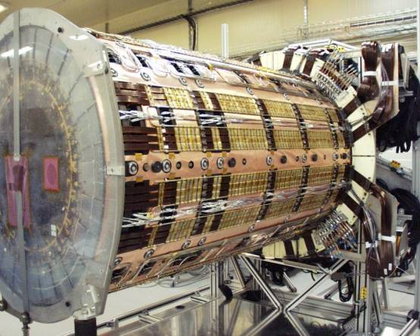
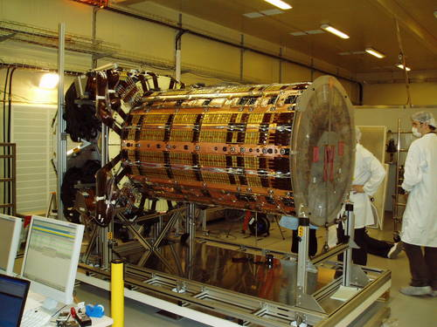
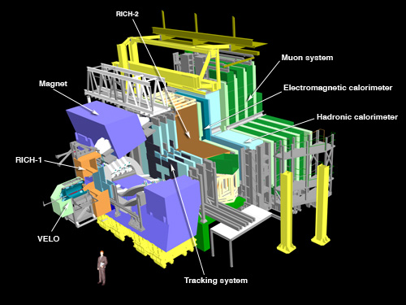
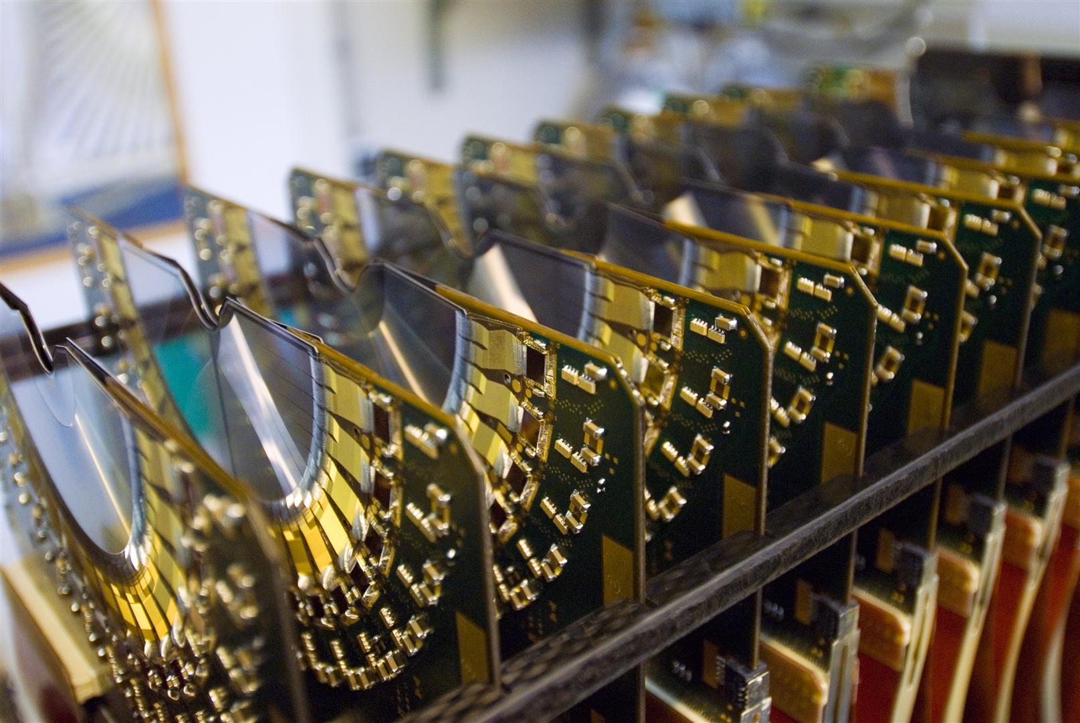
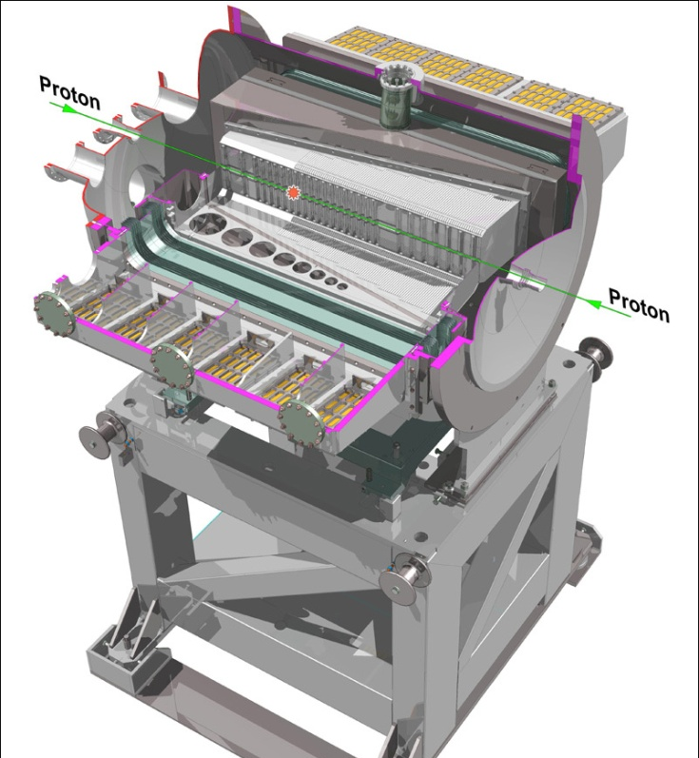
ATLAS forward disks and LHCb VELO (present LHC)

Slide 6
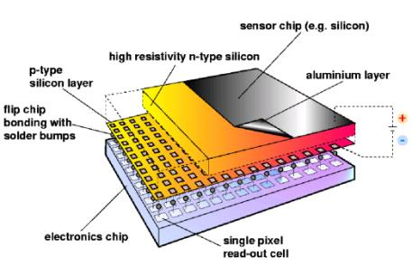
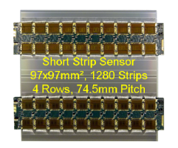
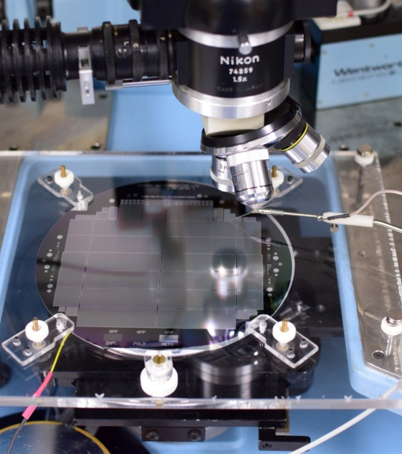
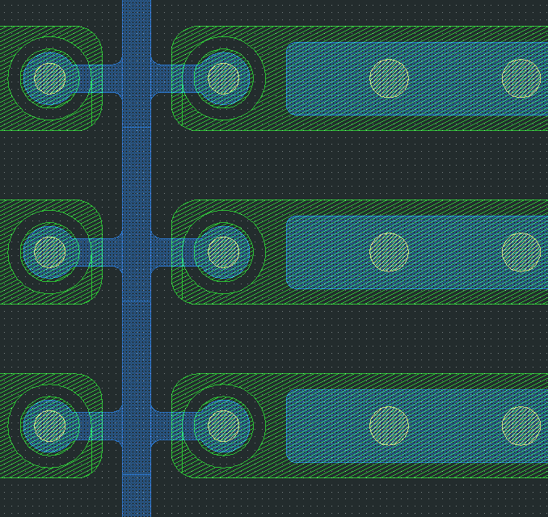


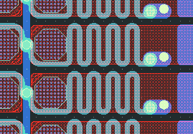
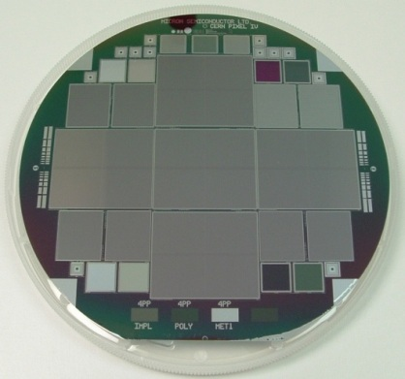
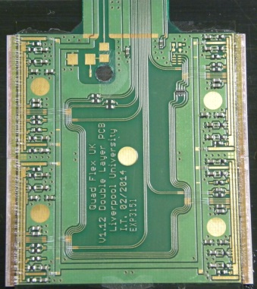
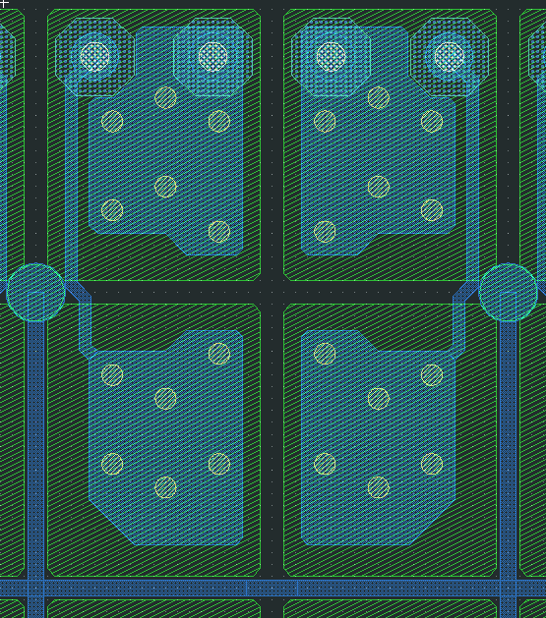


Upgrades at the LHC: Velopix and ATLAS ITK
Hybrid pixel technology
ATLAS strips (maybe the last big tracker in collider physics with this technology?).

Slide 7
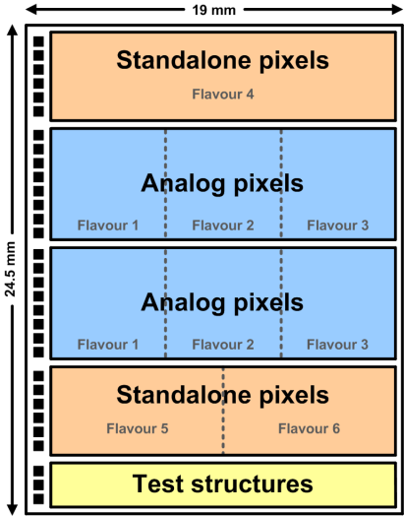
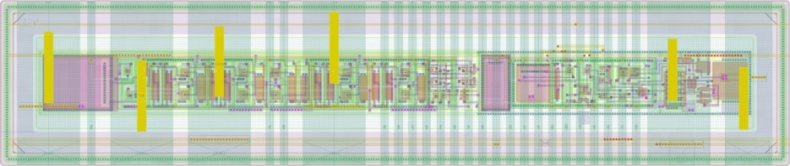
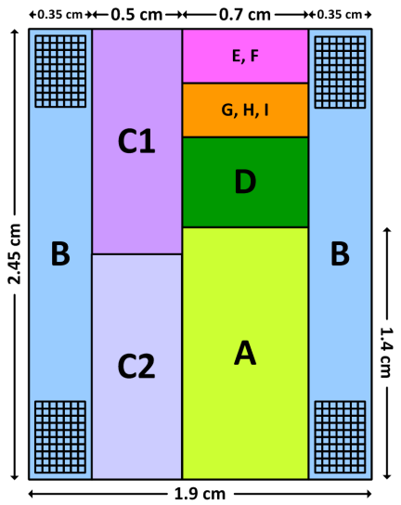
Future Physics program
Future non-LHC experiments will have different requirements with respect to the HL-LHC: higher granularity, much reduced thickness, fast time stamping. Some of the requirements have a conflictual impact of the sensor optimisation if standard approaches are followed.
We have promoted R&D with the technology that can satisfy all the requirements and be the first in the UK, collaborating with the current most advanced groups internationally. HV-CMOS or HV-MAPS sensors will replace the present devices in future trackers.
Analog pixels (2 large arrays of 24 rows x 300 columns each)
  Flavour 1 (24 rows x 100 columns) → mid-gain pre-amp. + low-speed
  Flavour 2 (24 rows x 100 columns) → high-gain pre-amp. + high-speed
  Flavour 3 (24 rows x 100 columns) → low-gain pre-amp. + very high-speed
Digital pixels (2 large arrays of 16 rows x 300 columns each)
  Flavour 4 (16 rows x 300 columns) → CMOS comparator in the periphery
  Flavour 5 (16 rows x 150 columns) → nMOS comparator without TW compensation
  Flavour 6 (16 rows x 150 columns) → nMOS comparator with TW compensation
Test structures
  Single diodes & extra pixels
Future submission for probing advanced solutions (e.g. stitching, optimal digital circuitry placement…)

Slide 8
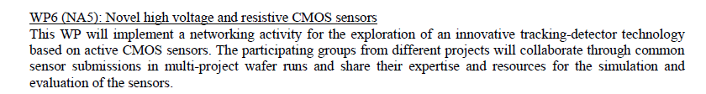
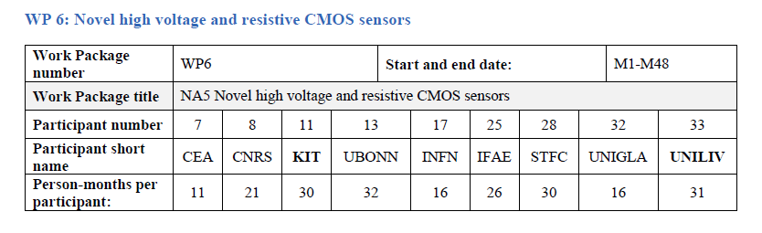
AIDA²⁰²⁰: Advanced European Infrastructures for Detectors at Accelerators
H2020-INFRAIA-2014-2015
Four tasks: 6.1 management
6.2, 6.3, 6.4 scientific.

Slide 9
Applications: healthcare
Our activities in healthcare cover the development of systems for hadron-therapy. We have investigated measurements of dose as a function of penetration in tissue, beam spot monitoring and neutron flux monitoring. These are the applications where the sensors developed for HEP can find a most direct use.
The global market for proton therapy systems is expected to triple by 2018, and reach $2.5 billion by 2030, according to a new market research report by MEDraysintell.
U.S. retains 28 percent of the world's proton therapy centers, and has 17 more currently in development or construction.
In the UK, the state-run health care system announced in August that it would invest $380 million to build two proton-beam therapy centers. Japan is home to some of the first facilities to use carbon ion radiotherapy, the newest form of particle therapy, as well as 23 percent of the world's proton therapy centers. And at least four centers opened in Europe in 2012 and 2013.

Slide 10
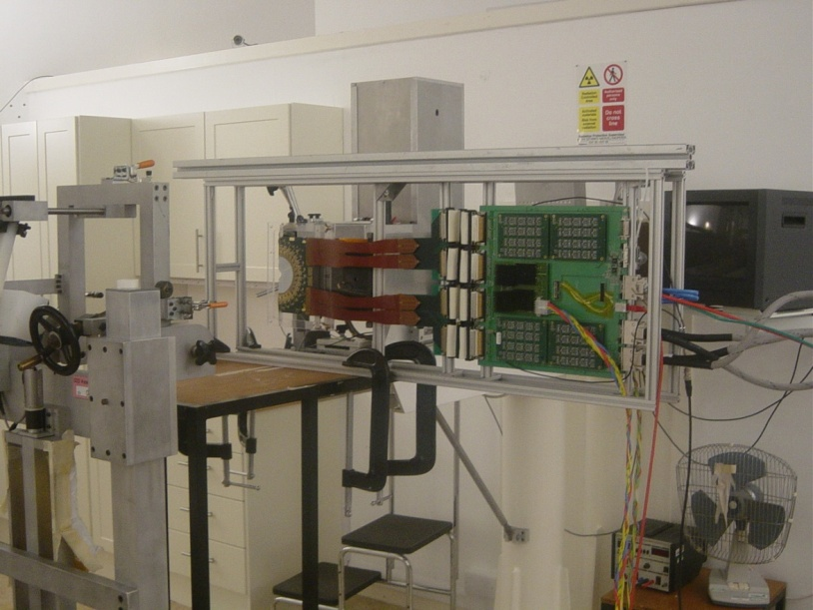
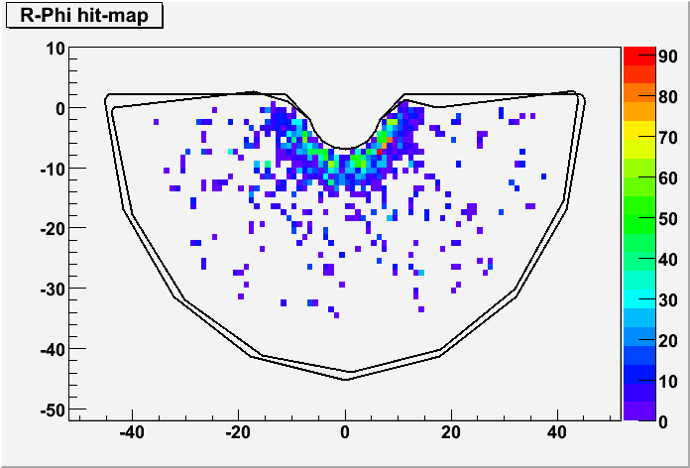
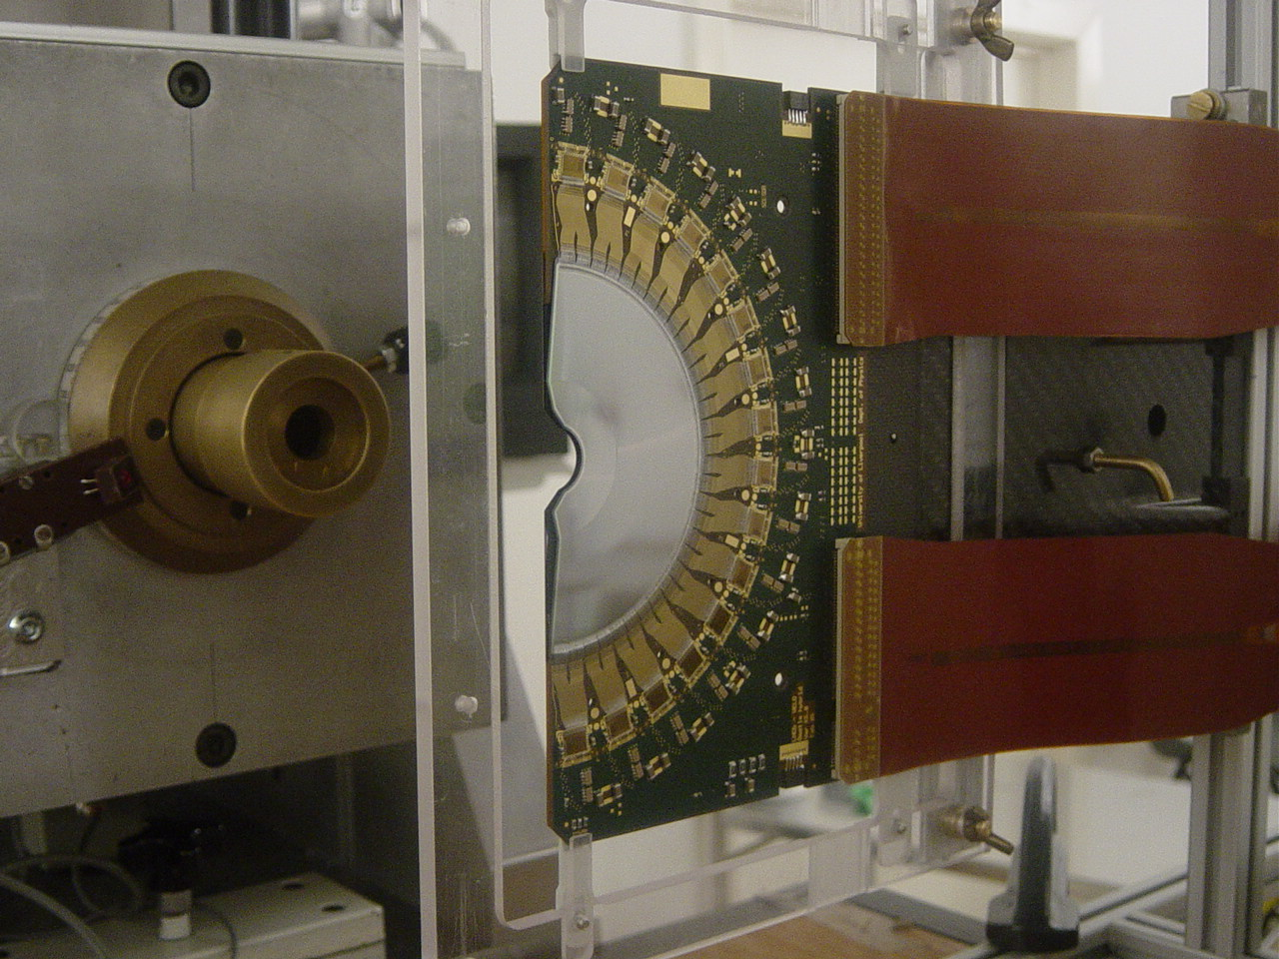
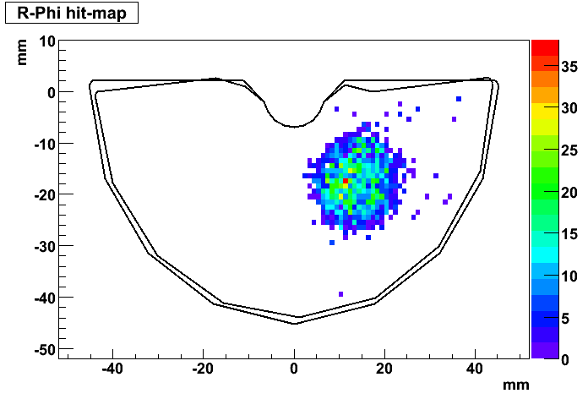
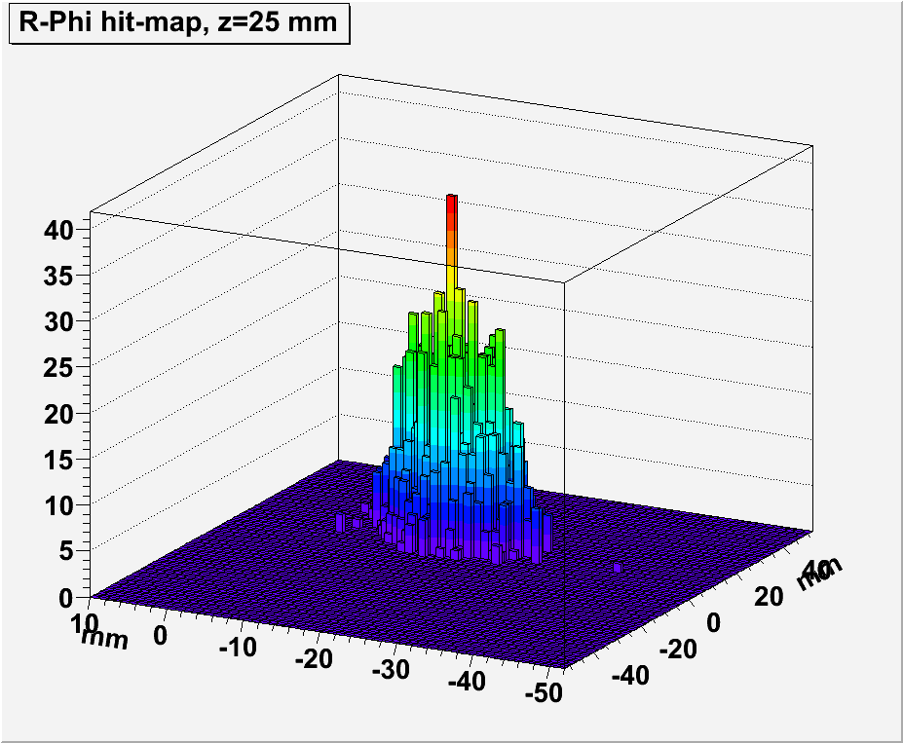
Beam monitor
The demonstration that HEP sensors can measure the beam spot, without interfering with the beam centre, raised interest in the hadron therapy community (the medical physicists). We have very good ideas about how to produce an accurate monitor for the evacuated beam transport line.
LHCb module positioned in front of the extraction collimator of the Cyclotron beam in the Clatterbridge Hospital Centre for Oncology.
The module was put at different distances and positions to measure the beam halo e the profile of the beam spot.

Slide 11
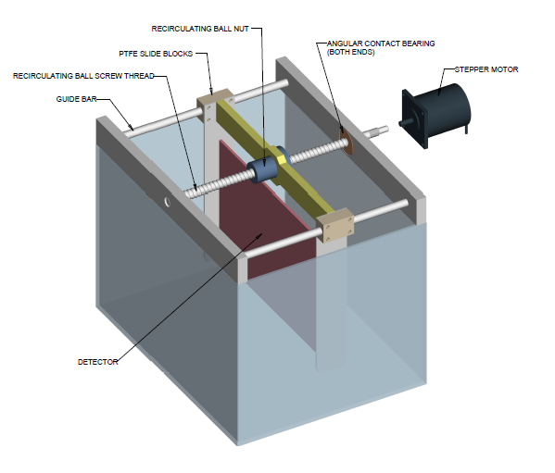
Tissue Equivalent Phantom
Instrument used for setting the therapy plan

Slide 12
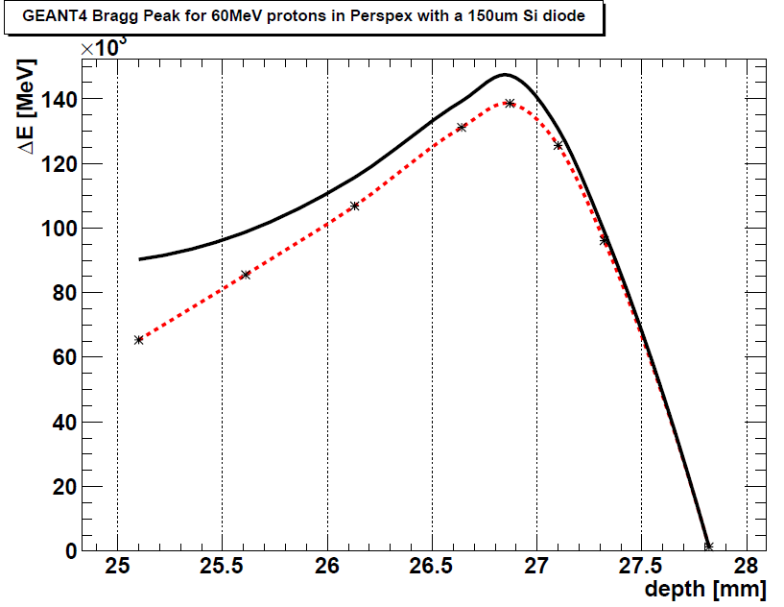
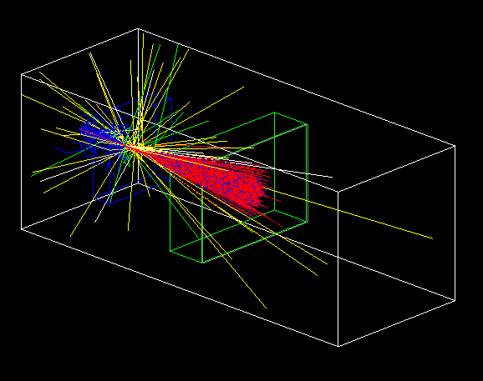
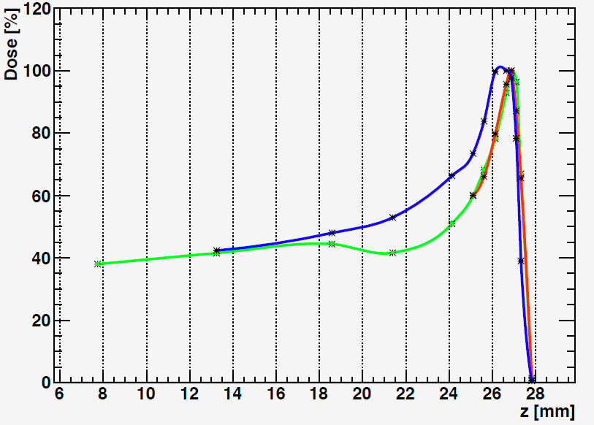
Tissue Equivalent Phantom
It is a scanning system with a silicon sensor scanning through a water container. The test have been performed with a large diode (2D image of the Bragg peak). The use of a segmented sensor will give an accurate 3D image. The use of a single device makes calibration easier and allows better energy resolution when performed. The fine segmentation and high readout speed allows for working with high intensity beams.
One PhD student starting soon to run further measurements and simulations for this instrument.

Slide 13

Proton Radiotherapy Verification and Dosimetry Applications
The first fully silicon-based proton CT scanner funded by a Wellcome Trust Translation Scheme award of £1.6 million.
The Consortium includes..
University of Lincoln, University of Birmingham, University of Liverpool, University of Surrey, University of Cape Town
University Hospital Birmingham NHS Foundation Trust, University Hospital Coventry and Warwickshire NHS Trust, iThemba Laboratories, South Africa,
Aspect Systems GmbH, ISDI Ltd.
We aim to design and make an instrument capable of..
Real-time proton therapy beam monitoring (position and profile)
Accurate beam energy (Bragg Peak) determination
Accurate dosimetry
Reducing range uncertainties in treatment planning (proton CT)

Slide 14
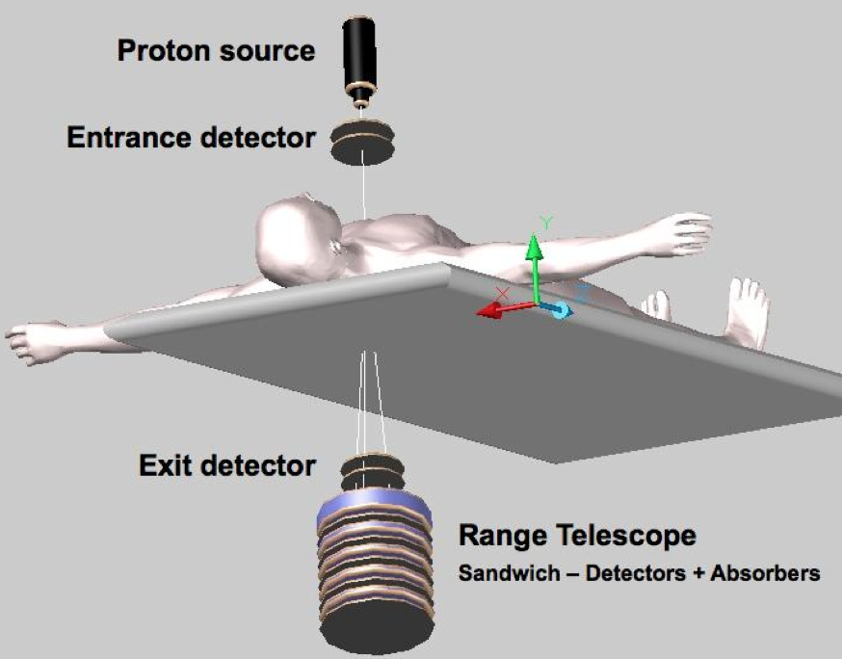
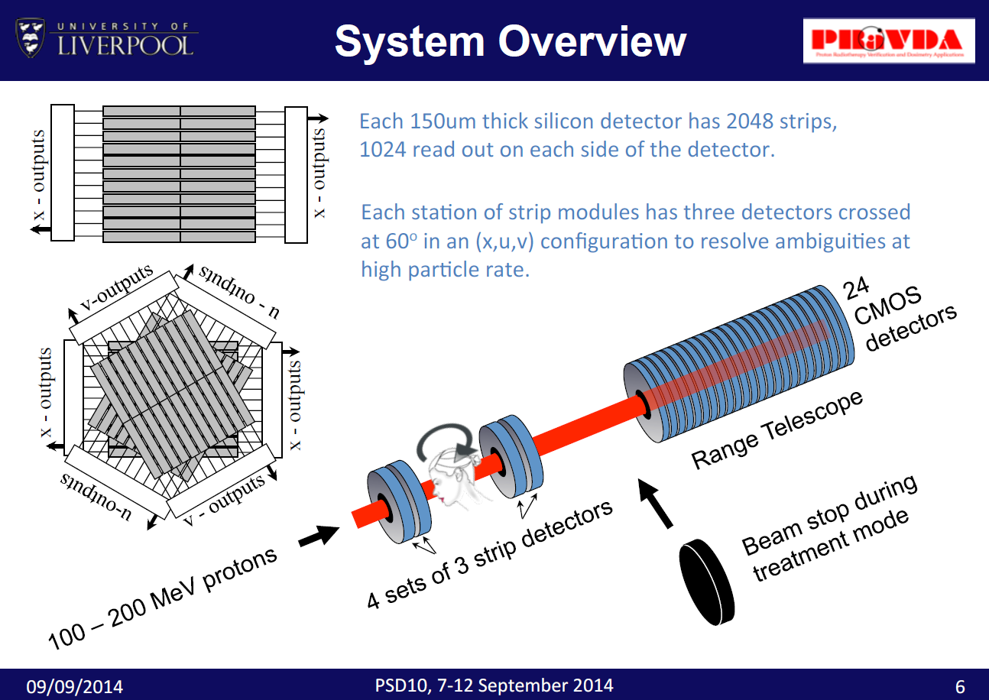
The PRaVDA System
Each plane of strips is split down the center to allow high occupancy. 8 ASICs places at each side read out a total of 2048 strips

Slide 15
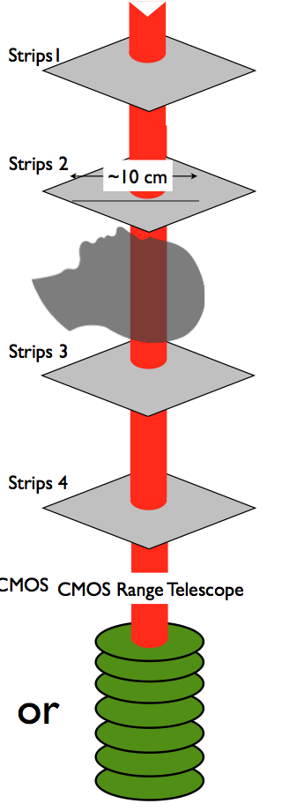
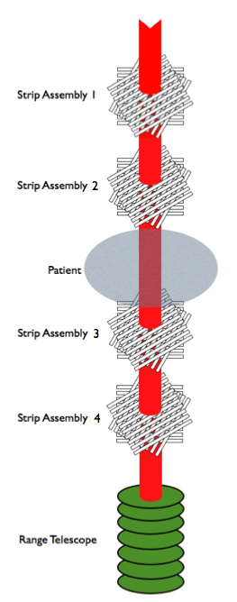
Operating Modes
Treatment Mode
(High Current)
Field size: 5cm collimated treatment beam
Energy: 60 - 191 MeV
Flux: 10⁷ protons/cm²/s
Use Strip Tracker to..
Check beam profile – reconstruct 1D & 2D histograms
Measure dose
Requirements:
- Proton counting
- 1D histograms
- 2D beam profile
CT Mode
(Low Current)
Field size: 10cm (max.)
Energy: 191 MeV
Flux: 10⁵ protons/cm²/s
Use Strip Tracker to..
Track individual protons in (x,u,v) layers
Use Range Telescope to..
Measure position and energy
Requirements:
- Accurate Tracking
- High Efficiency

Slide 16
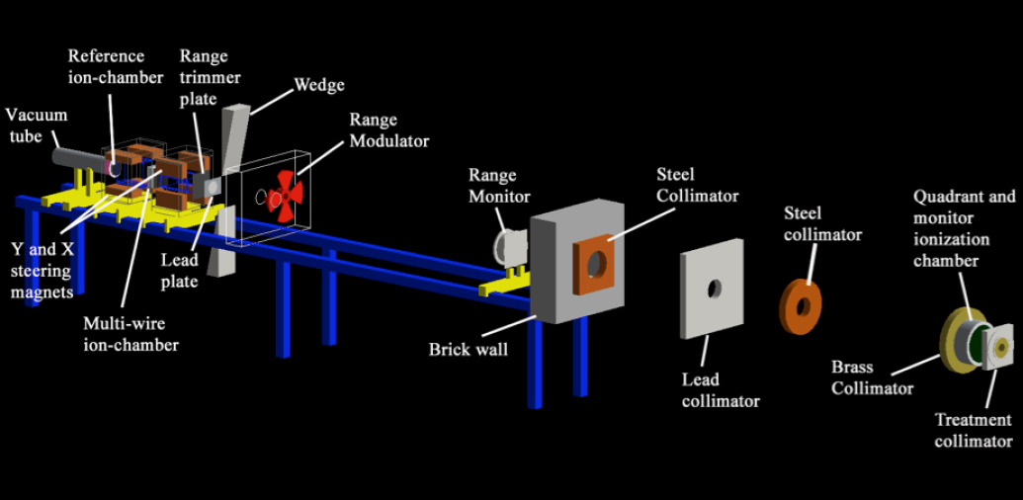
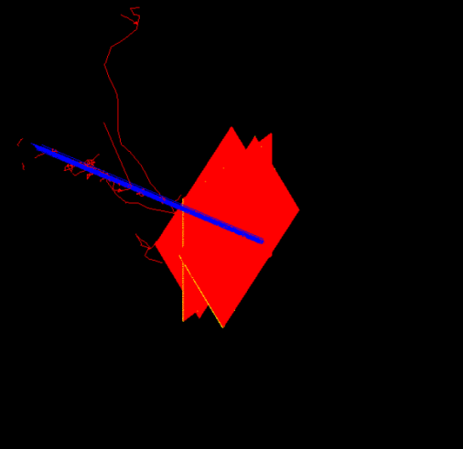
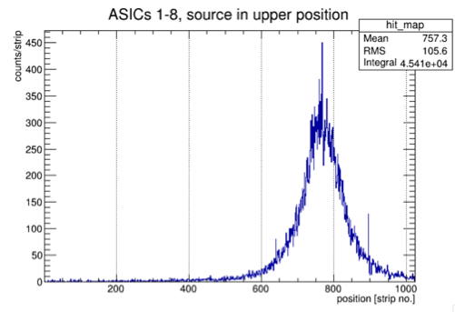
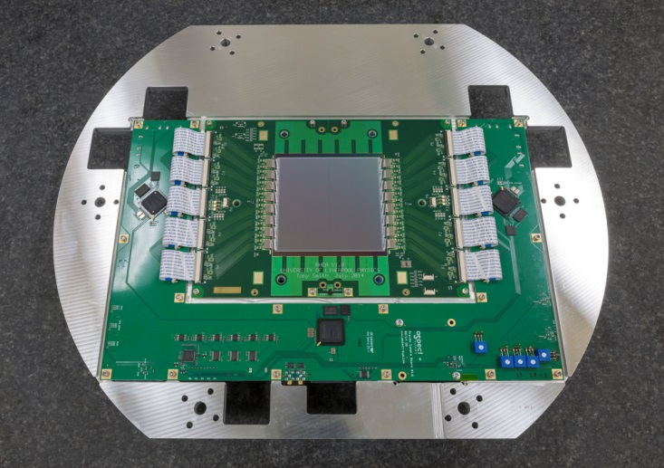
GEANT4 Simulations
iThemba beamline code used as input for GEANT4 simulations of silicon strip tracker
(x,u,v) triplets of 150um Si with 90.8um strip pitch simulated
Test with Sr90 source in the lab and with beam tests at B’ham.

Slide 17
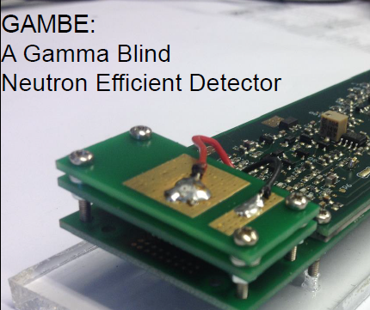
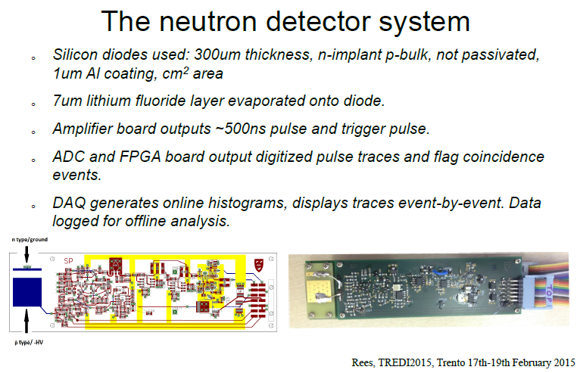
Current gamma rejection capability of neutron detectors : > 10⁻⁷. This system can improve by orders of magnitude.

Slide 18
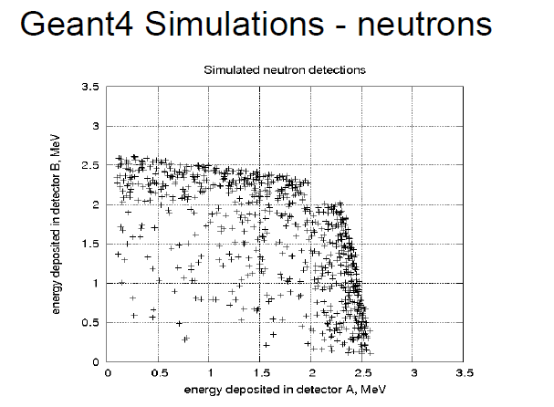
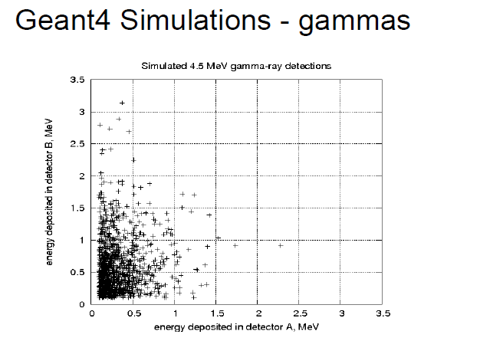
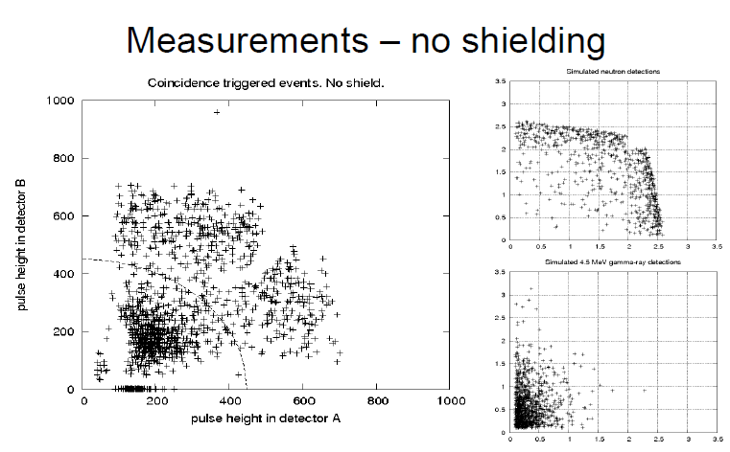
Good agreement between data and simulations. Measurements ongoing for establishing ultimate gamma rejection capability.

Slide 19
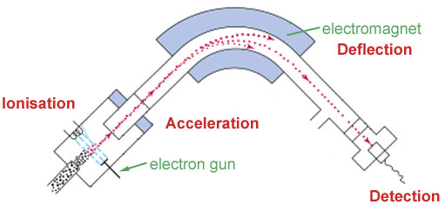
Others:
Studying application of high resolution microstrip (and pixel) sensors for portable mass spectrometers (in collaboration with an SME – Q-Technology.
Applying for funding of high risk R&D within Horizon2020.

Slide 20
SUMMARY
Silicon R&D is the larger instrumentation activity in the department. It is very successful for HEP applications and it keeps the laboratory solidly in prominent position in the UK and internationally. It attracts significant funding from Science Council and increasingly from partnerships and European sources. With new possibilities opening up (Sensor City, building-up of collaborative ventures) the group is looking for expanding on alternative funding sources.

