Slide 1
Particle Detection Techniques in HEP Two Phase Noble Gas TPCs
Post-Graduate Lecture Series
Kostas Mavrokoridis
k.mavrokoridis@liv.ac.uk
Room 207

Slide 2
Outline
Two phase ionisation/scintillation detectors
–Operation principle
Putting together the Liverpool LAr TPC from scratch
Visit to the Liverpool LAr lab
–Collection of argon scintillation and ionisation signals

Slide 3
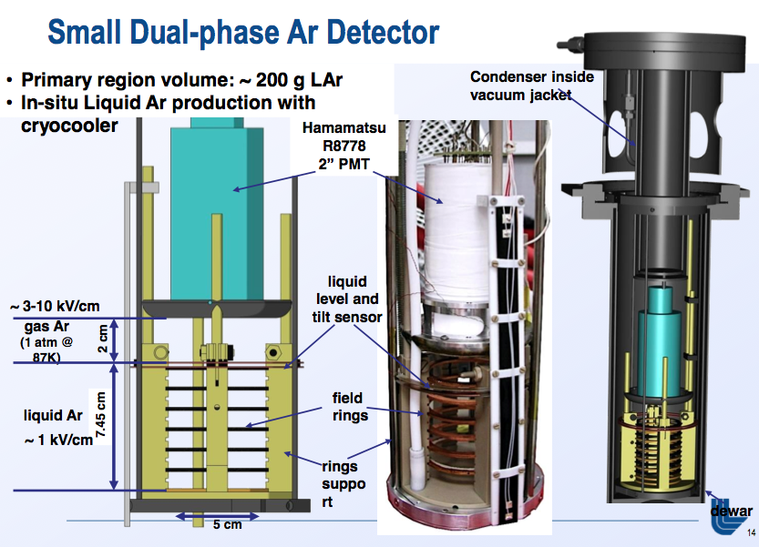
Main Applications of Two Phase Noble Gas Detectors
Direct Dark Matter Detection
Coherent Neutrino Scattering Search
Neutrino Physics
The Livermore detector
LAGUNA design study
The ArDM detector

Slide 4
Noble Gas Scintillation Production Mechanism
An interaction with a noble gas atom X (i.e. argon/xenon) causes excitation and ionization, producing electron-hole pairs (X+, e−) and excitons (X∗). Molecular ions form X+2 and attract free electrons (hot electrons can escape this attraction). In addition, the electrons can ionize and excite the medium, yielding extra electron-hole pairs and excitons. In due course the electrons thermalize and recombine with the neighbouring ions(X+2 ) forming more excitons. Self-trapping occurs producing excimers X∗2. De-excitation of these states gives rise to a luminescence emission of approximately 128 nm for argon and 175 nm for xenon.

Slide 5
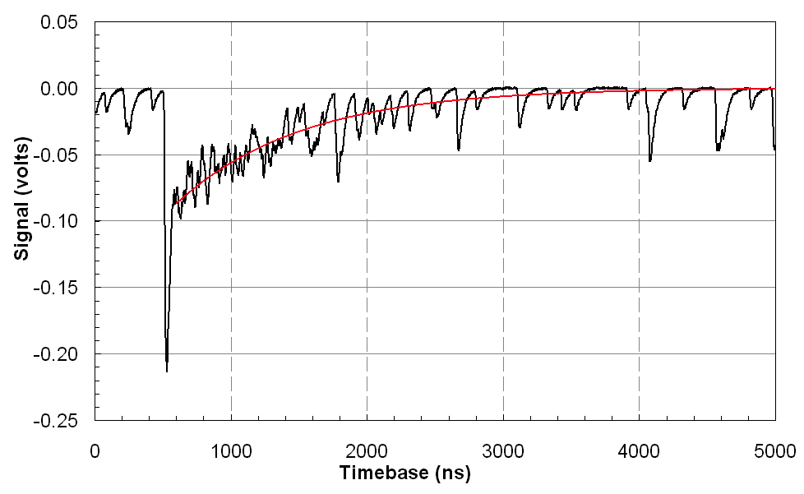
LAr Scintillation
LAr detection technology has the best performance in identifying the topology of interactions and decays of particles, thanks to excellent imaging performance.
Interactions in liquid noble gases lead to the formation of excimers in either singlet or triplet states, which decay to the ground state with characteristic fast (6 ns) and slow (1.6 μs) lifetimes in liquid argon with the photon emission spectrum peaked at 128 nm.

Slide 6
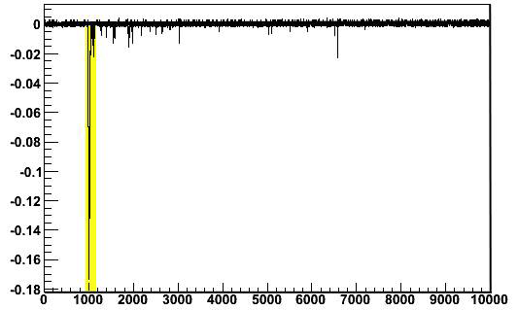
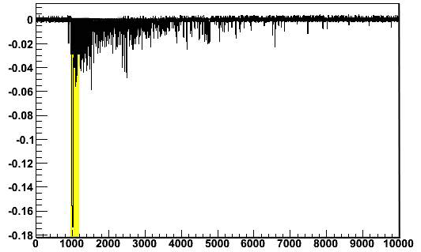
Discrimination Principle Between Particles
The fraction of dimers in singlet or triplet state depends on the incident particle type. A NR will produce more ionisation in comparison to an ER.
Yellow: Fast photon emission region due to singlet
Ratio: Fast (6 ns) light / Slow (1.6 μs) light
An event due to neutron interaction
An event due to electron interaction
Ratio is 3
Ratio is 0.3
Discrimination between nuclear and electron recoils can be achieved by pulse shape discrimination.

Slide 7
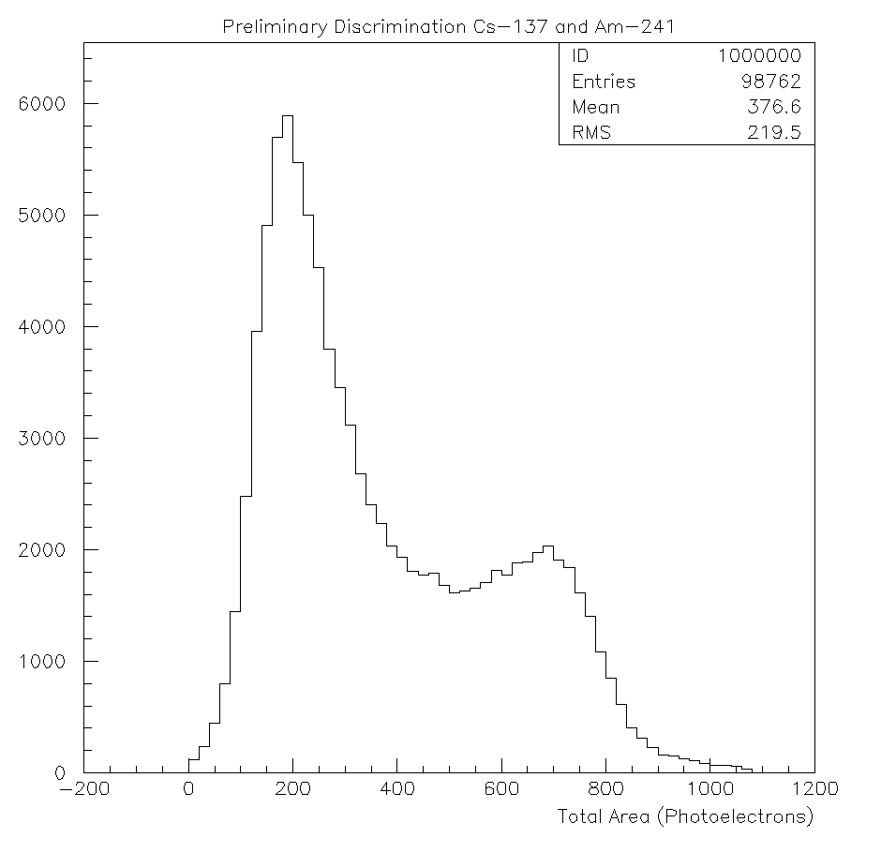
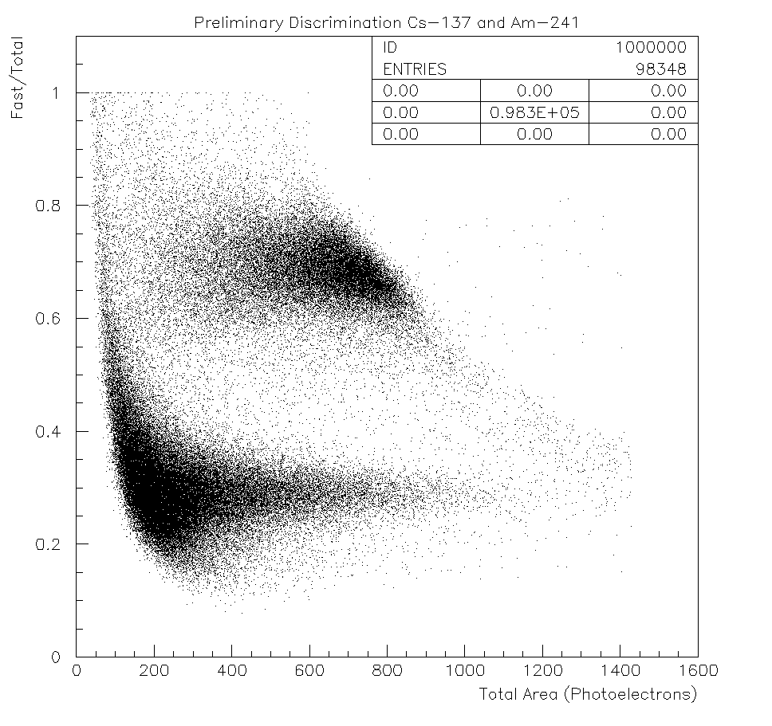
Pulse Shape Discrimination
Gammas
Alphas
Alphas
Gammas
Alphas and gammas discrimination by measuring the Fast/Total scintillation light components.

Slide 8
Detection Principle
Electrons and gammas interact with
shell electrons creating light and
charge.
Neutrons do the same but the charge
quickly recombines.
In both cases any charge produced is
drifted upwards in the field to the
charge readout where it is detected.
Light is converted to 430 nm and
detected by photomultipliers.
Background rejection possibilities:
– Different light/charge ratios
– Different shape of the scintillation light (ratio fast/slow components)
A segmented charge readout allows the XY coordinate to be determined and
the time of flight following the scintillation pulse provides the Z coordinate.

Slide 9
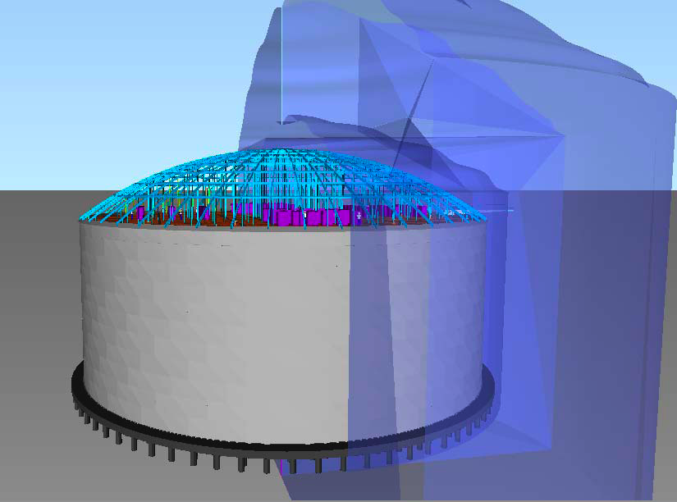
Challenges Towards a Large LAr TPC
LAr purity
<1 ppb
Drift field
2MV power supply
DAQ/trigger/electronics
2-phase charge readout and
light readout
Engineering
Event reconstruction
Liverpool activity focuses on LAr purification, light and charge readout methods
8

Slide 10
Heat Load Considerations for the Design
The formula that describes conduction is:
where Q is the energy (J), t is the time (seconds), K is the thermal conductivity (W/cm·K), A is the cross sectional area (cm2), L is the length (cm) and ∆T is the temperature difference (K).
The formula that describes convection for pressure values (P) between 10−3 torr and 10−5 torr is:
where R is the gas constant of 8.205×10−2 m3·atm/kmol·K, γ is C_{p}^{/C}_{v} of air, Γ is the temperature of the vacuum space gas (assumed to be halfway between the target and room temperature in K), m is the molecular weight in g/mole, P is the pressure of the vacuum space gas in atmospheres, and T2 ^{and T}1 are the temperatures of the hotter and colder bodies respectively (K).
The formula that describes radiation is:
where σ=5.67×10−8 W/m2·K4, A is the area of the warmer body (m2), T2 and T1 are the temperatures of the hotter and colder bodies respectively (K), ε is the emissivity coefficient (0.05 for steel), and n is the number of layers of aluminised plastic placed between the hotter and colder objects.

Slide 11
The Liverpool LAr Vessel- Conceptual Design
250 L LAr bath
40 L LAr target
Heat load loses ~115 W
Boiling rate ~12 l/min
Loosing about 20 L in 24h-assumming 10cm thick polyethylene lid

Slide 12
Major Commercial Suppliers
Kurt Lesker
MDC
Lew vac
Hamamatsu
ETL enterprises
CAEN
Agilent
LEMO
Vacuum components
Photomultiplier tubes, SiPM, CCD chips
NIM electronics, Waveform digitisers, Connectors

Slide 13
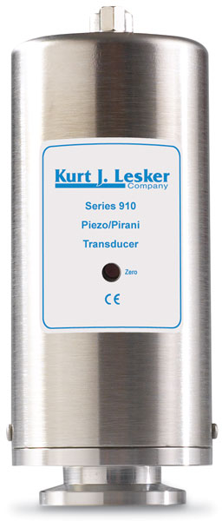
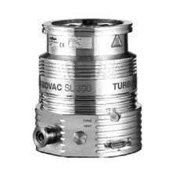
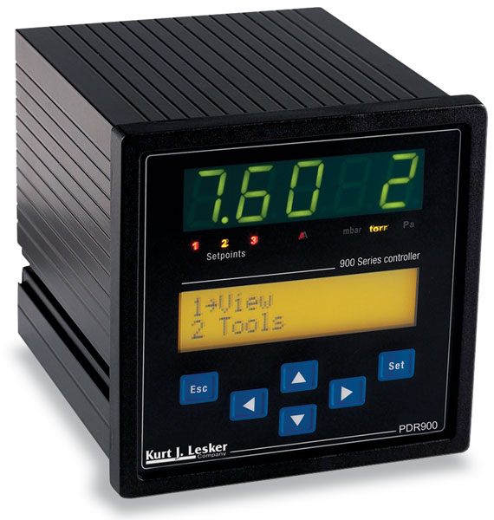
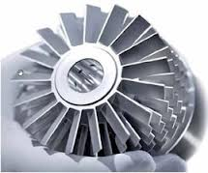
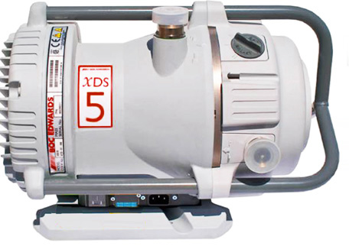
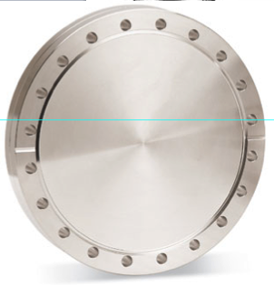
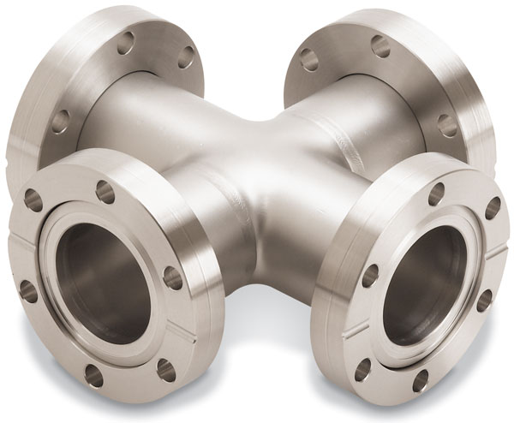
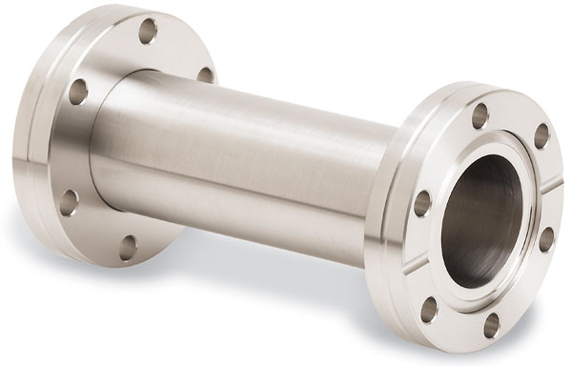
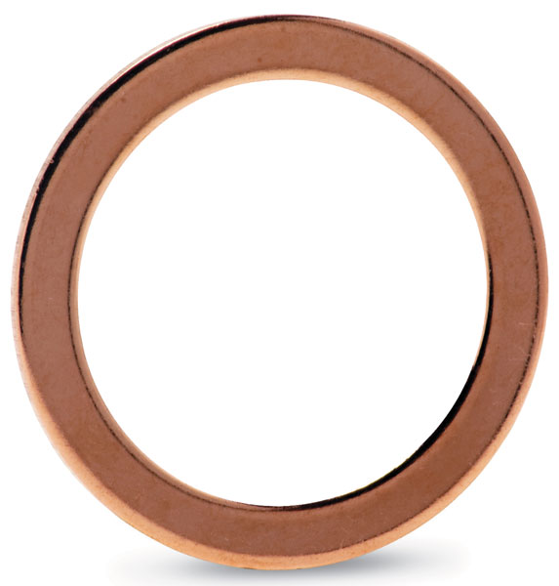
Major Vacuum Components
Scroll pump
Turbo molecular pump
Pirani/Piezo pressure gauge
Cross
Full nipple
Copper gasket
CF (ConFlat) flange

Slide 14
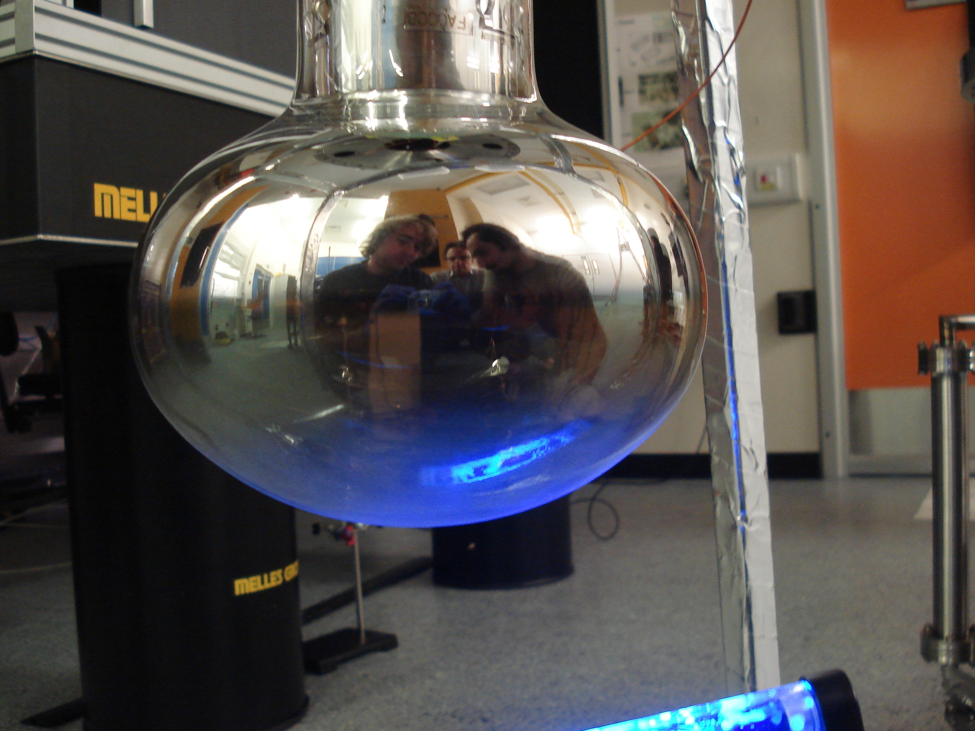
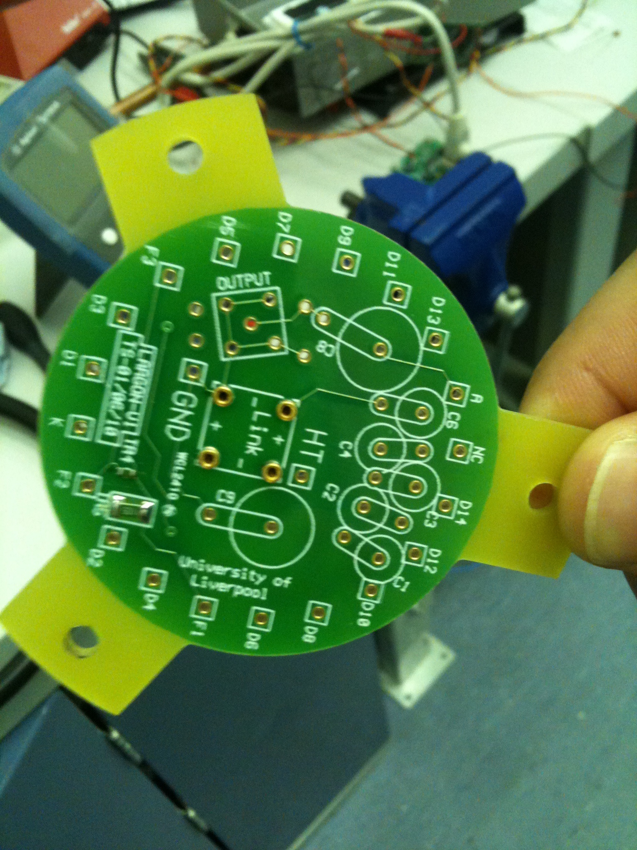
Cryogenic PMT
8-inch Hamamatsu R5912-02MOD PMT (~2500 GBP).
Bialkali photocathodes with Pt underlay (conductive material) for operation at cryogenic temperatures.
The PMT face is coated with TPB wavelength shifter. TPB absorbs 128 nm light and reemits ~430 nm which is within the high quantum efficiency region of the PMT
Spectral response
Voltage divider PCB

Slide 15
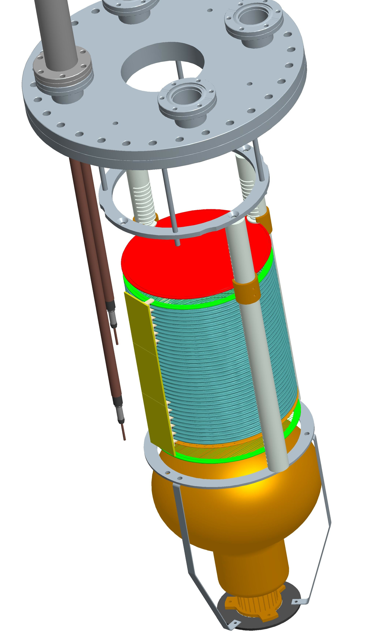
Modeling the Detector with Pro/Eng
Home made HV feedthrough
Insulating Macor rods to support the structure
Anode polished plate
Top grid
Field shaping rings
Bottom cathode grid
PMT protection grid
8-inch Hamamatsu PMT

Slide 16
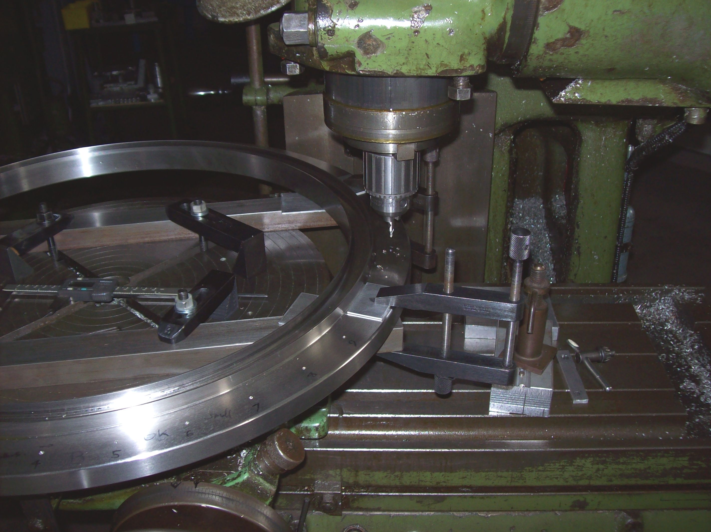
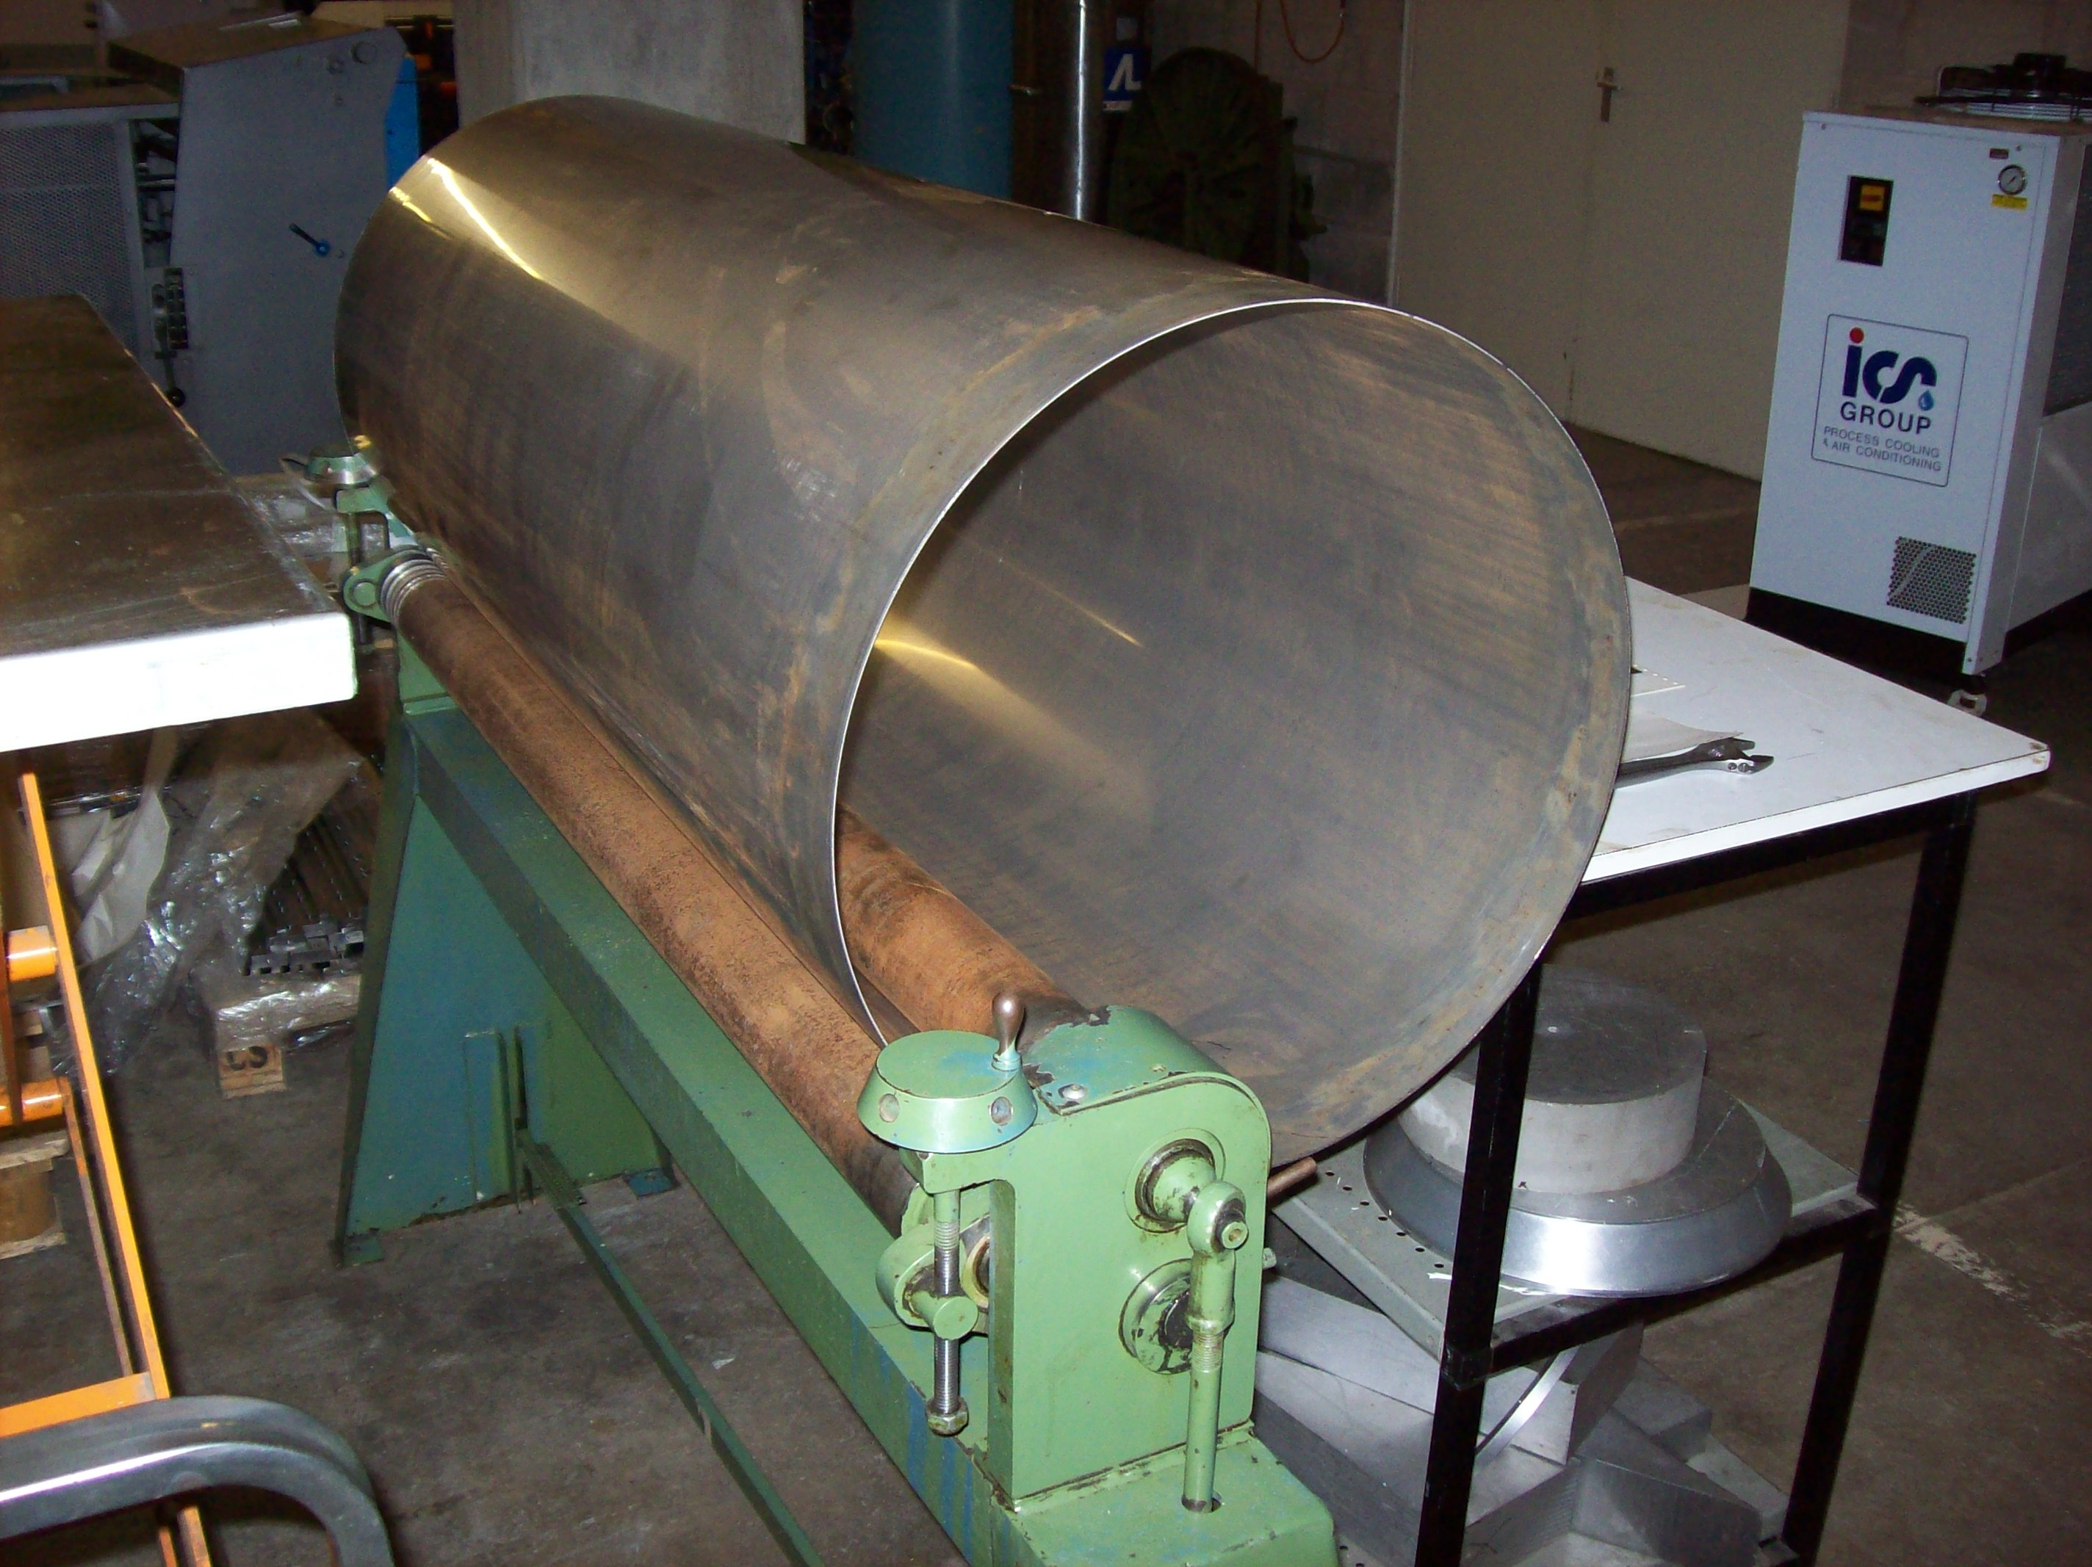
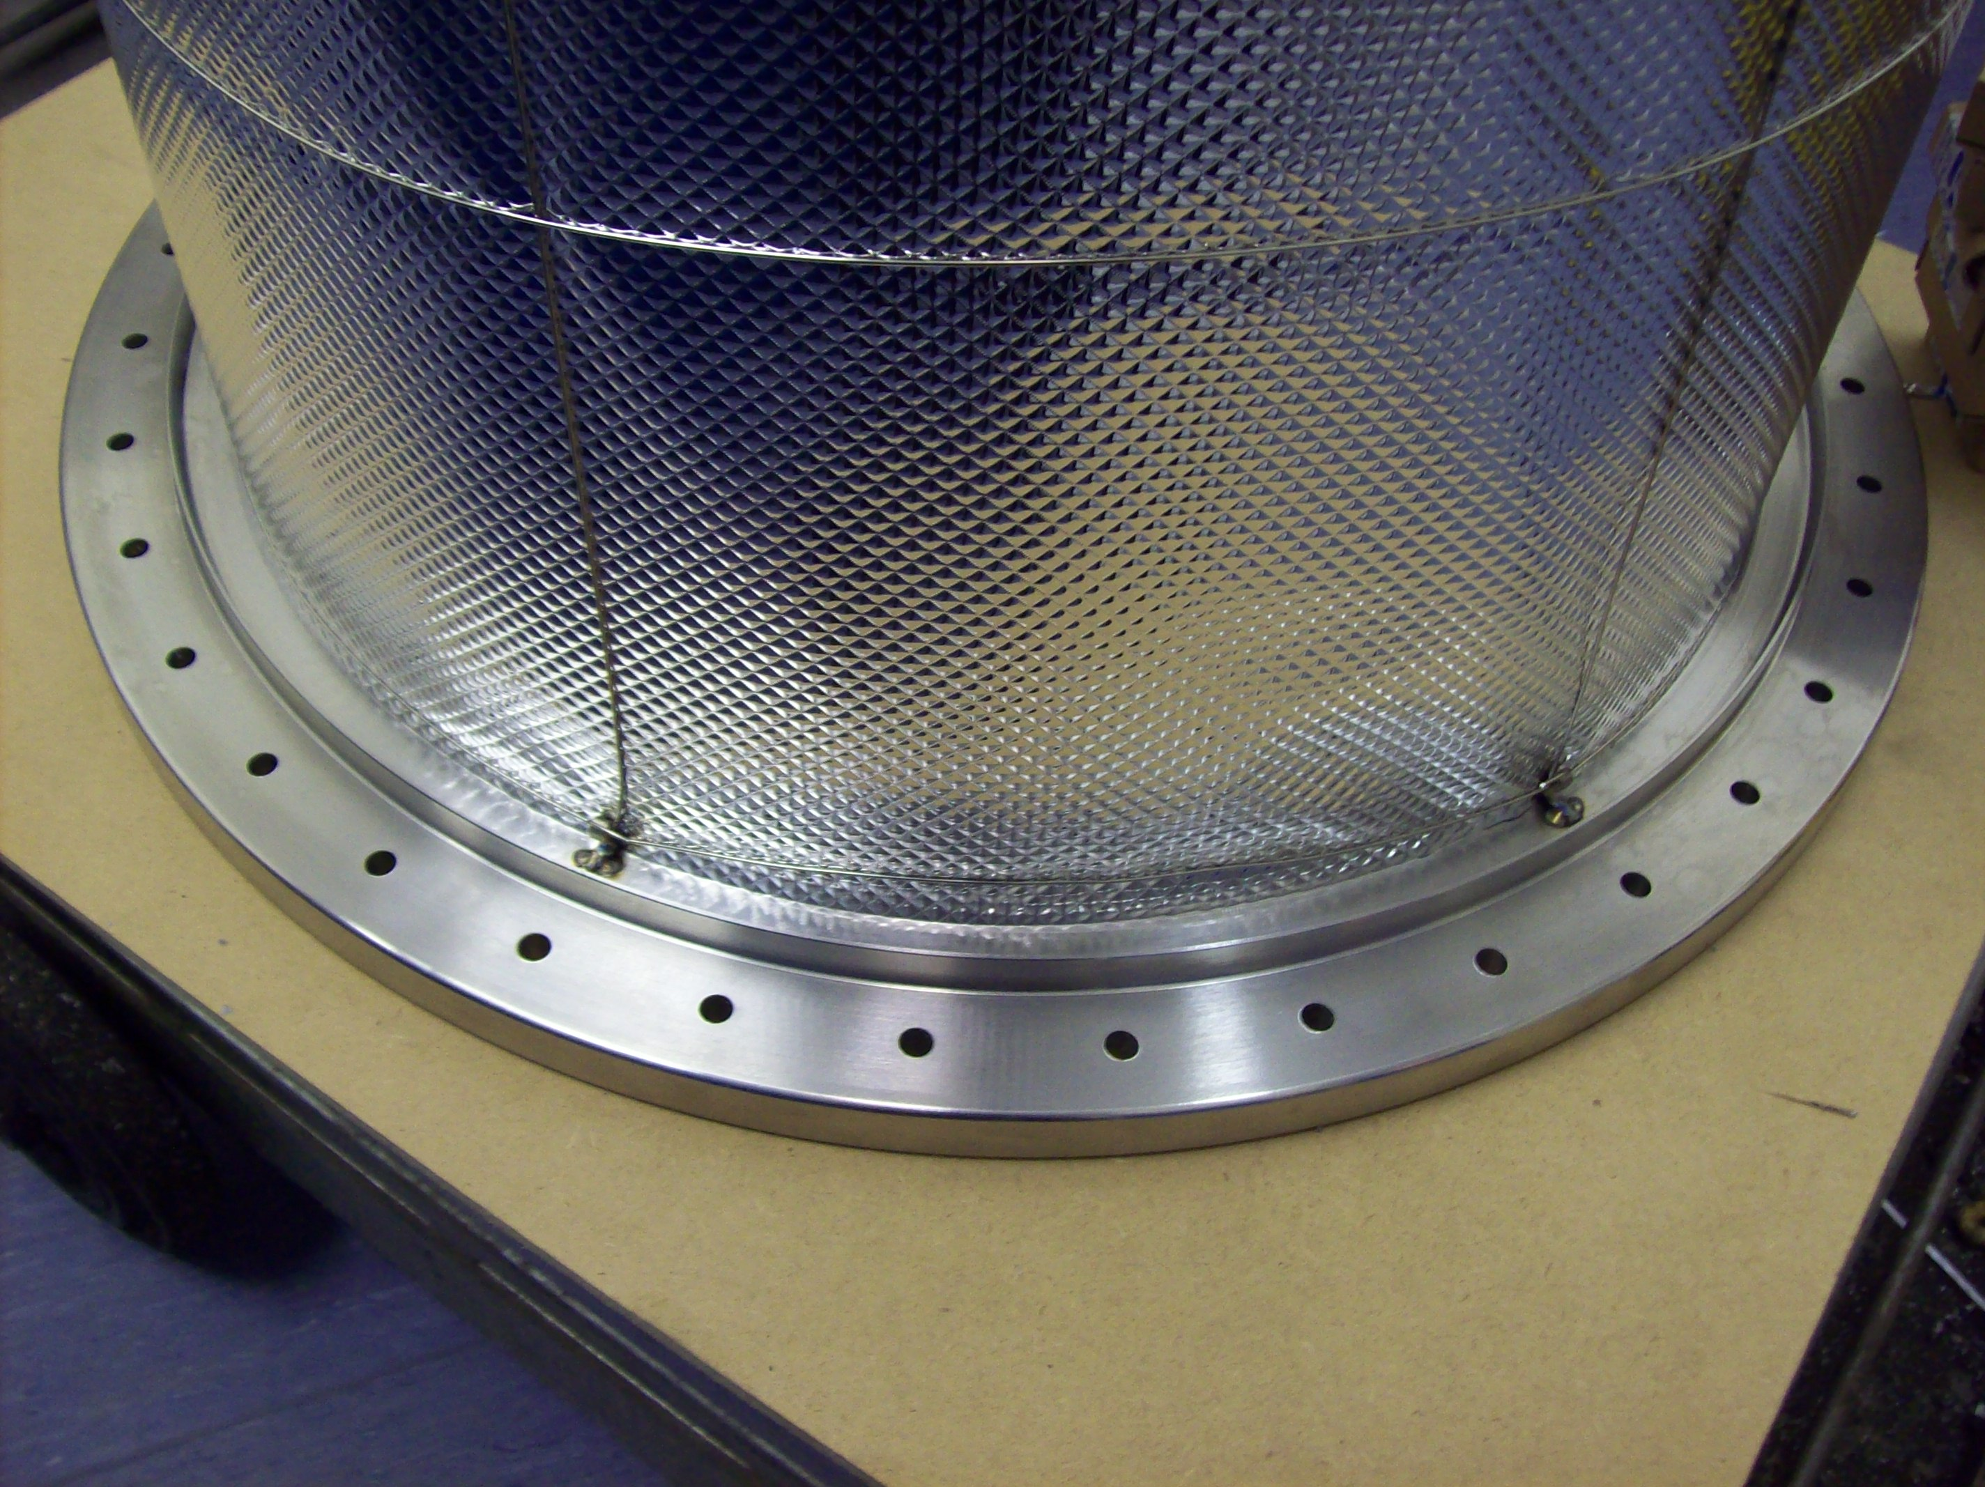
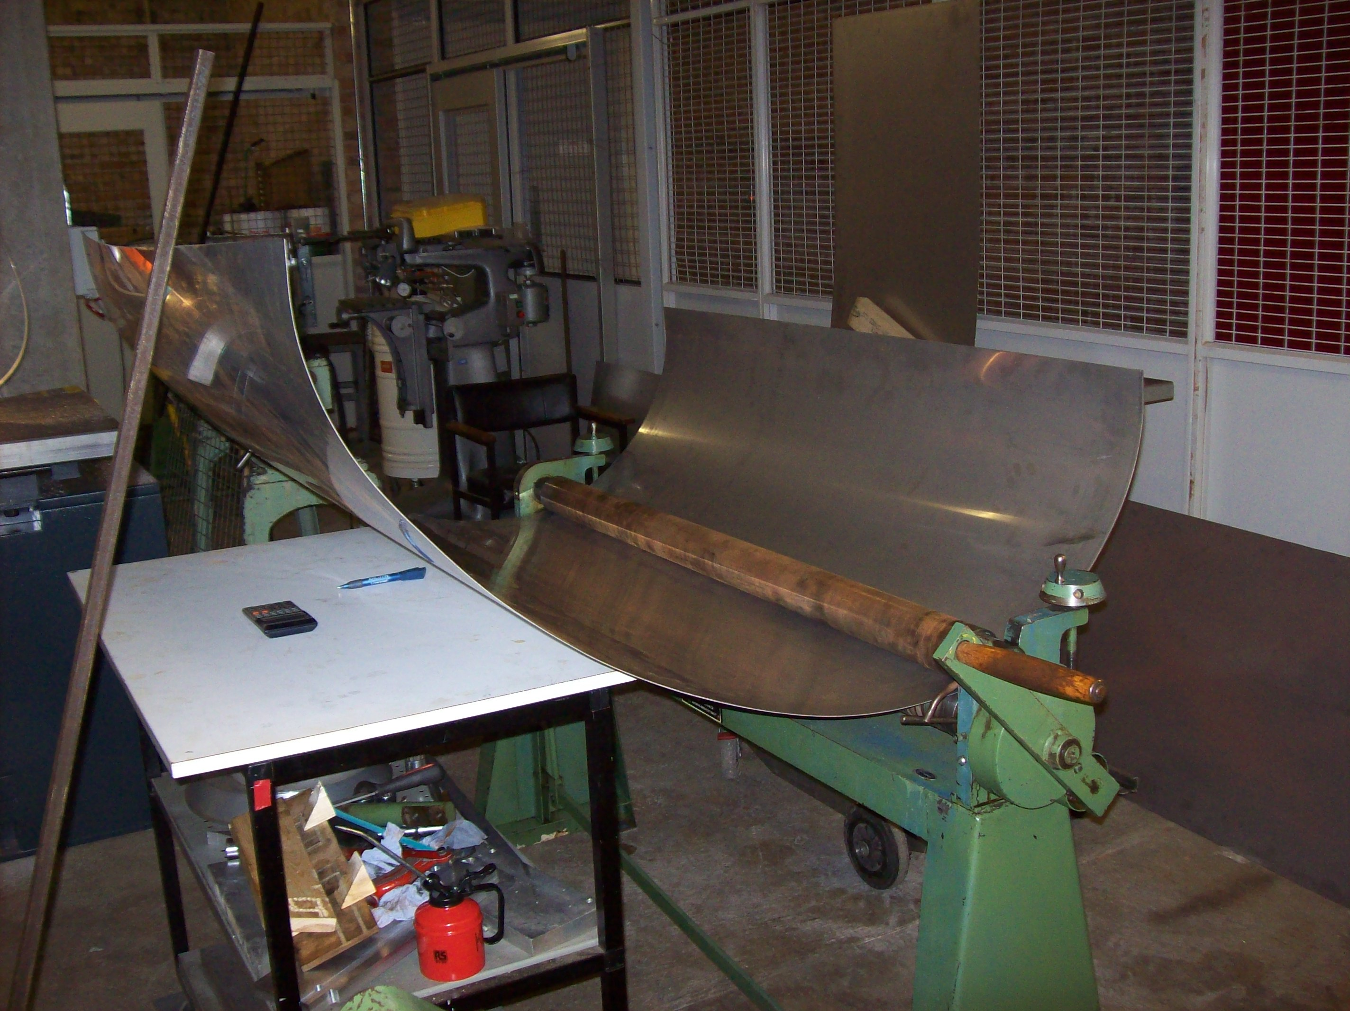
Construction of the LAr Cell in the Workshop
Left: Rolling the stainless steel sheet
Right: Machining the top flange
Construction by Kevin McCormick

Slide 17
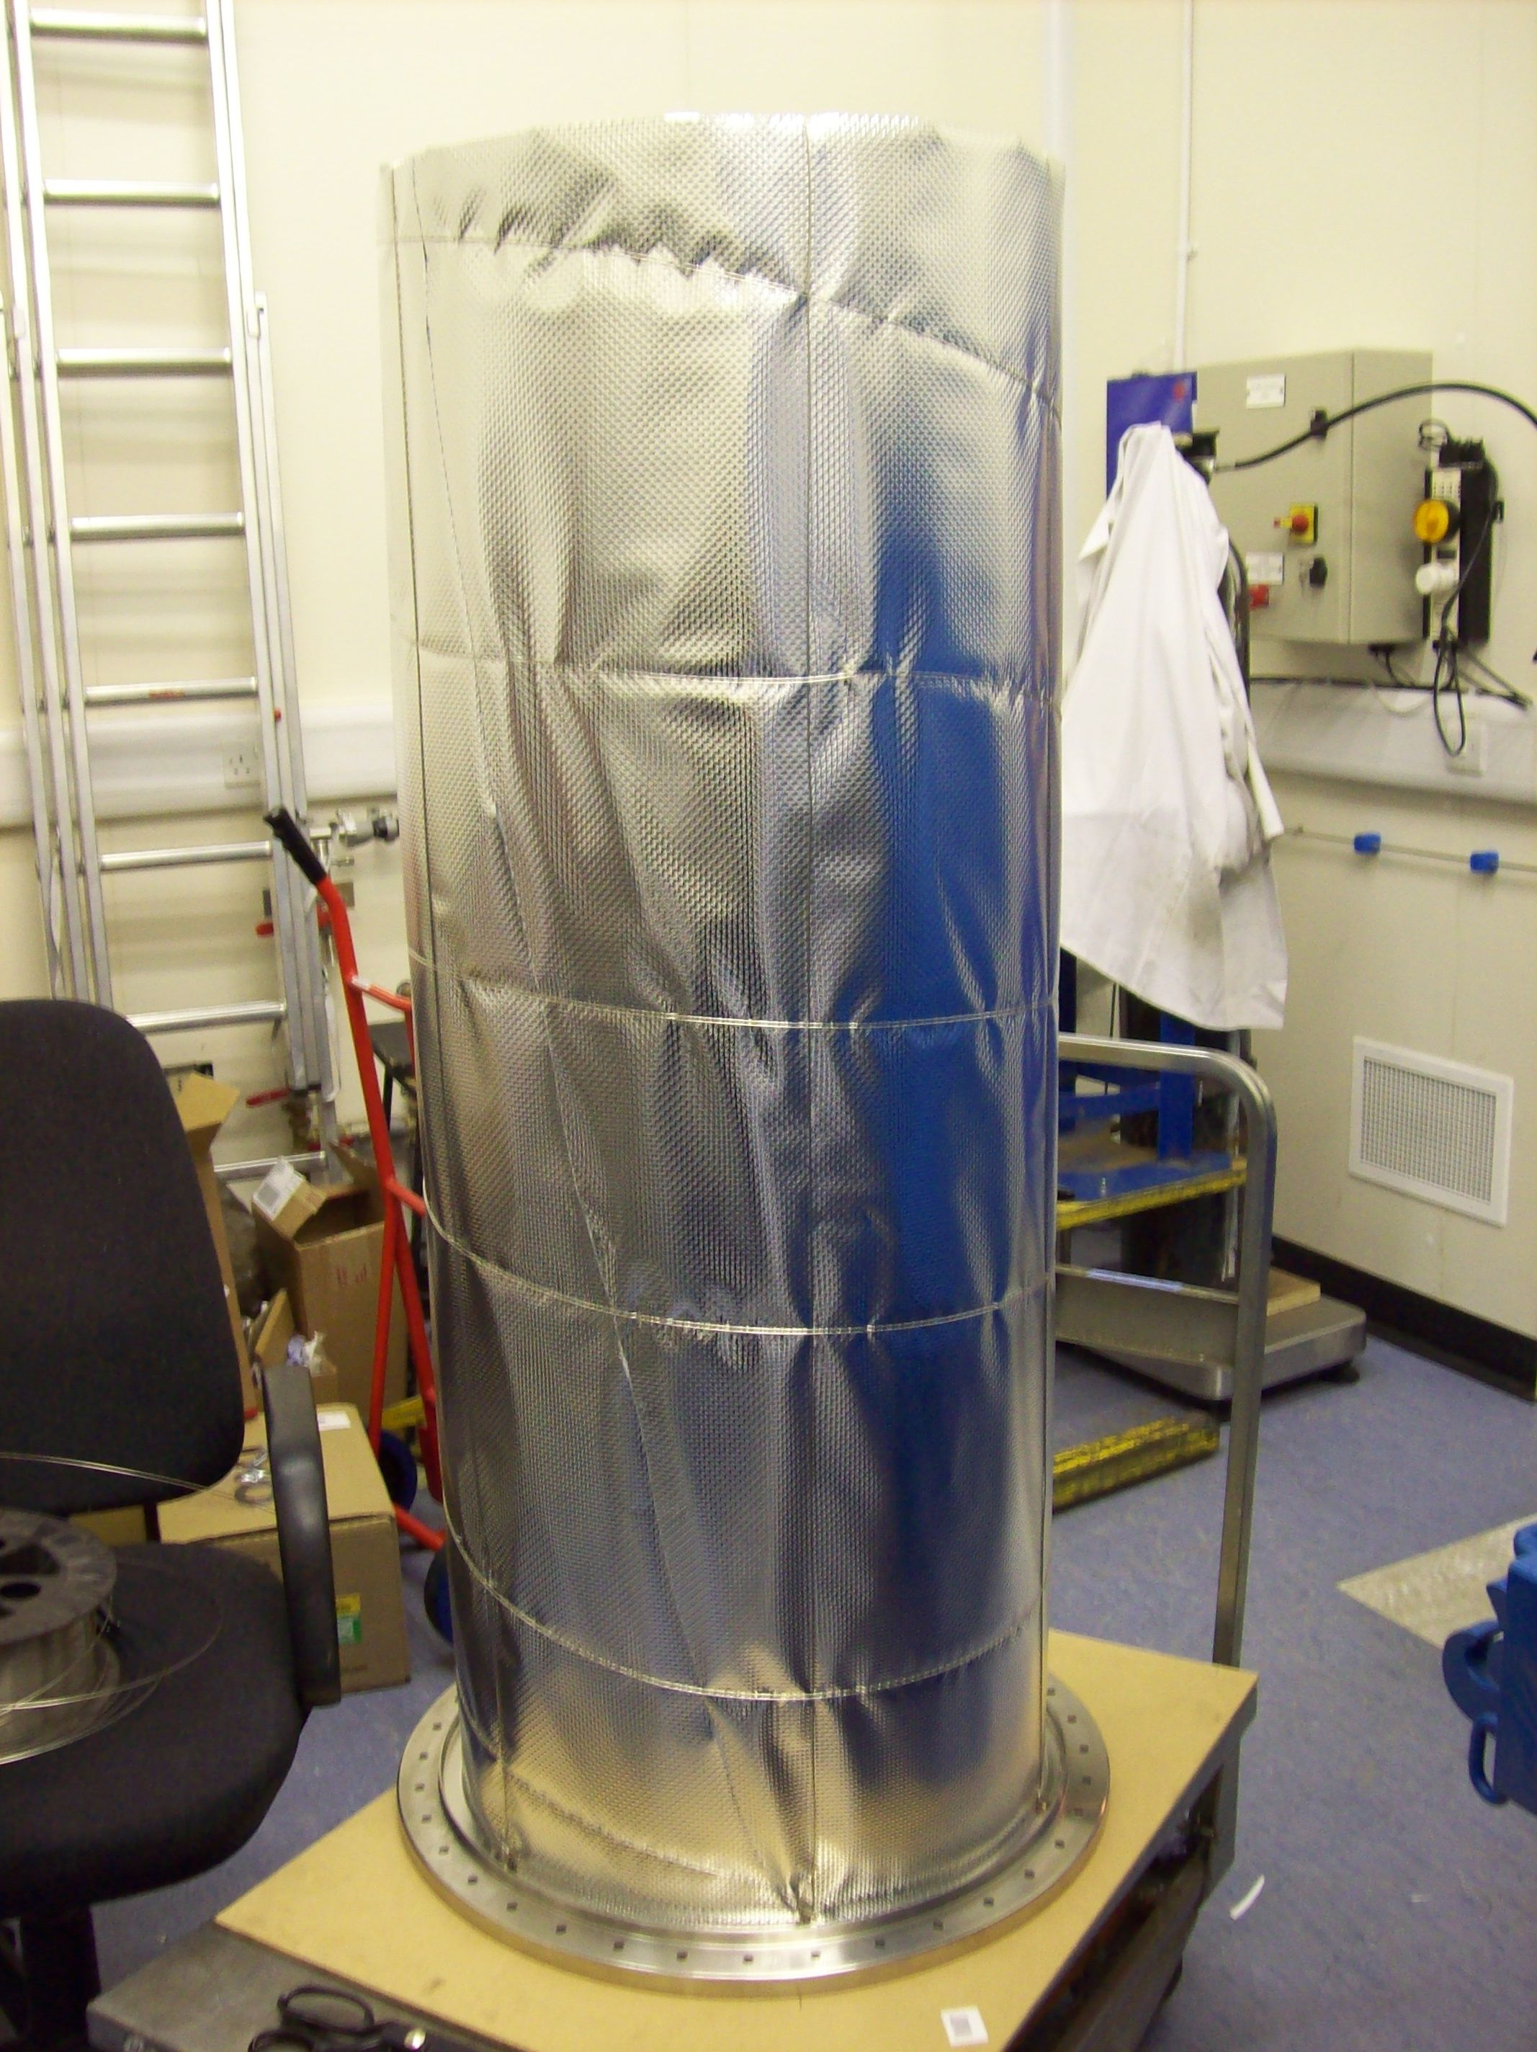
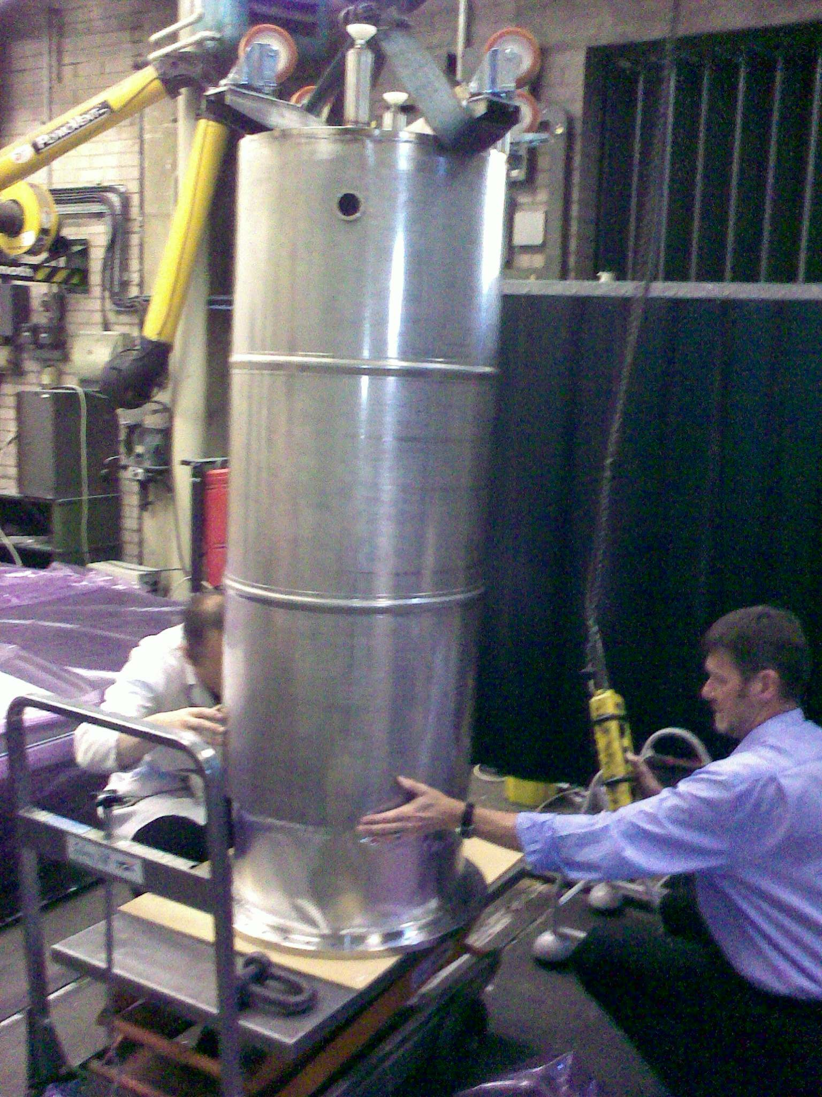
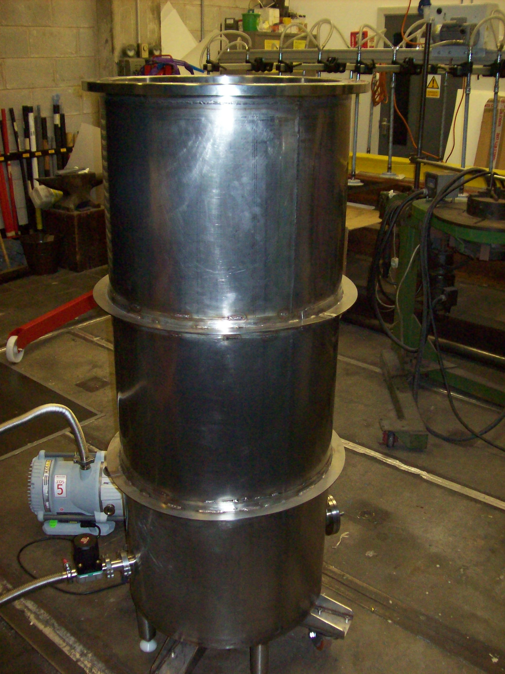
Construction of the LAr Cell in the Workshop
Wrapped with Mylar reflector to minimize radiation losses
All the welding performed using argon gas to avoid oxidation and achieve UHV

Slide 18
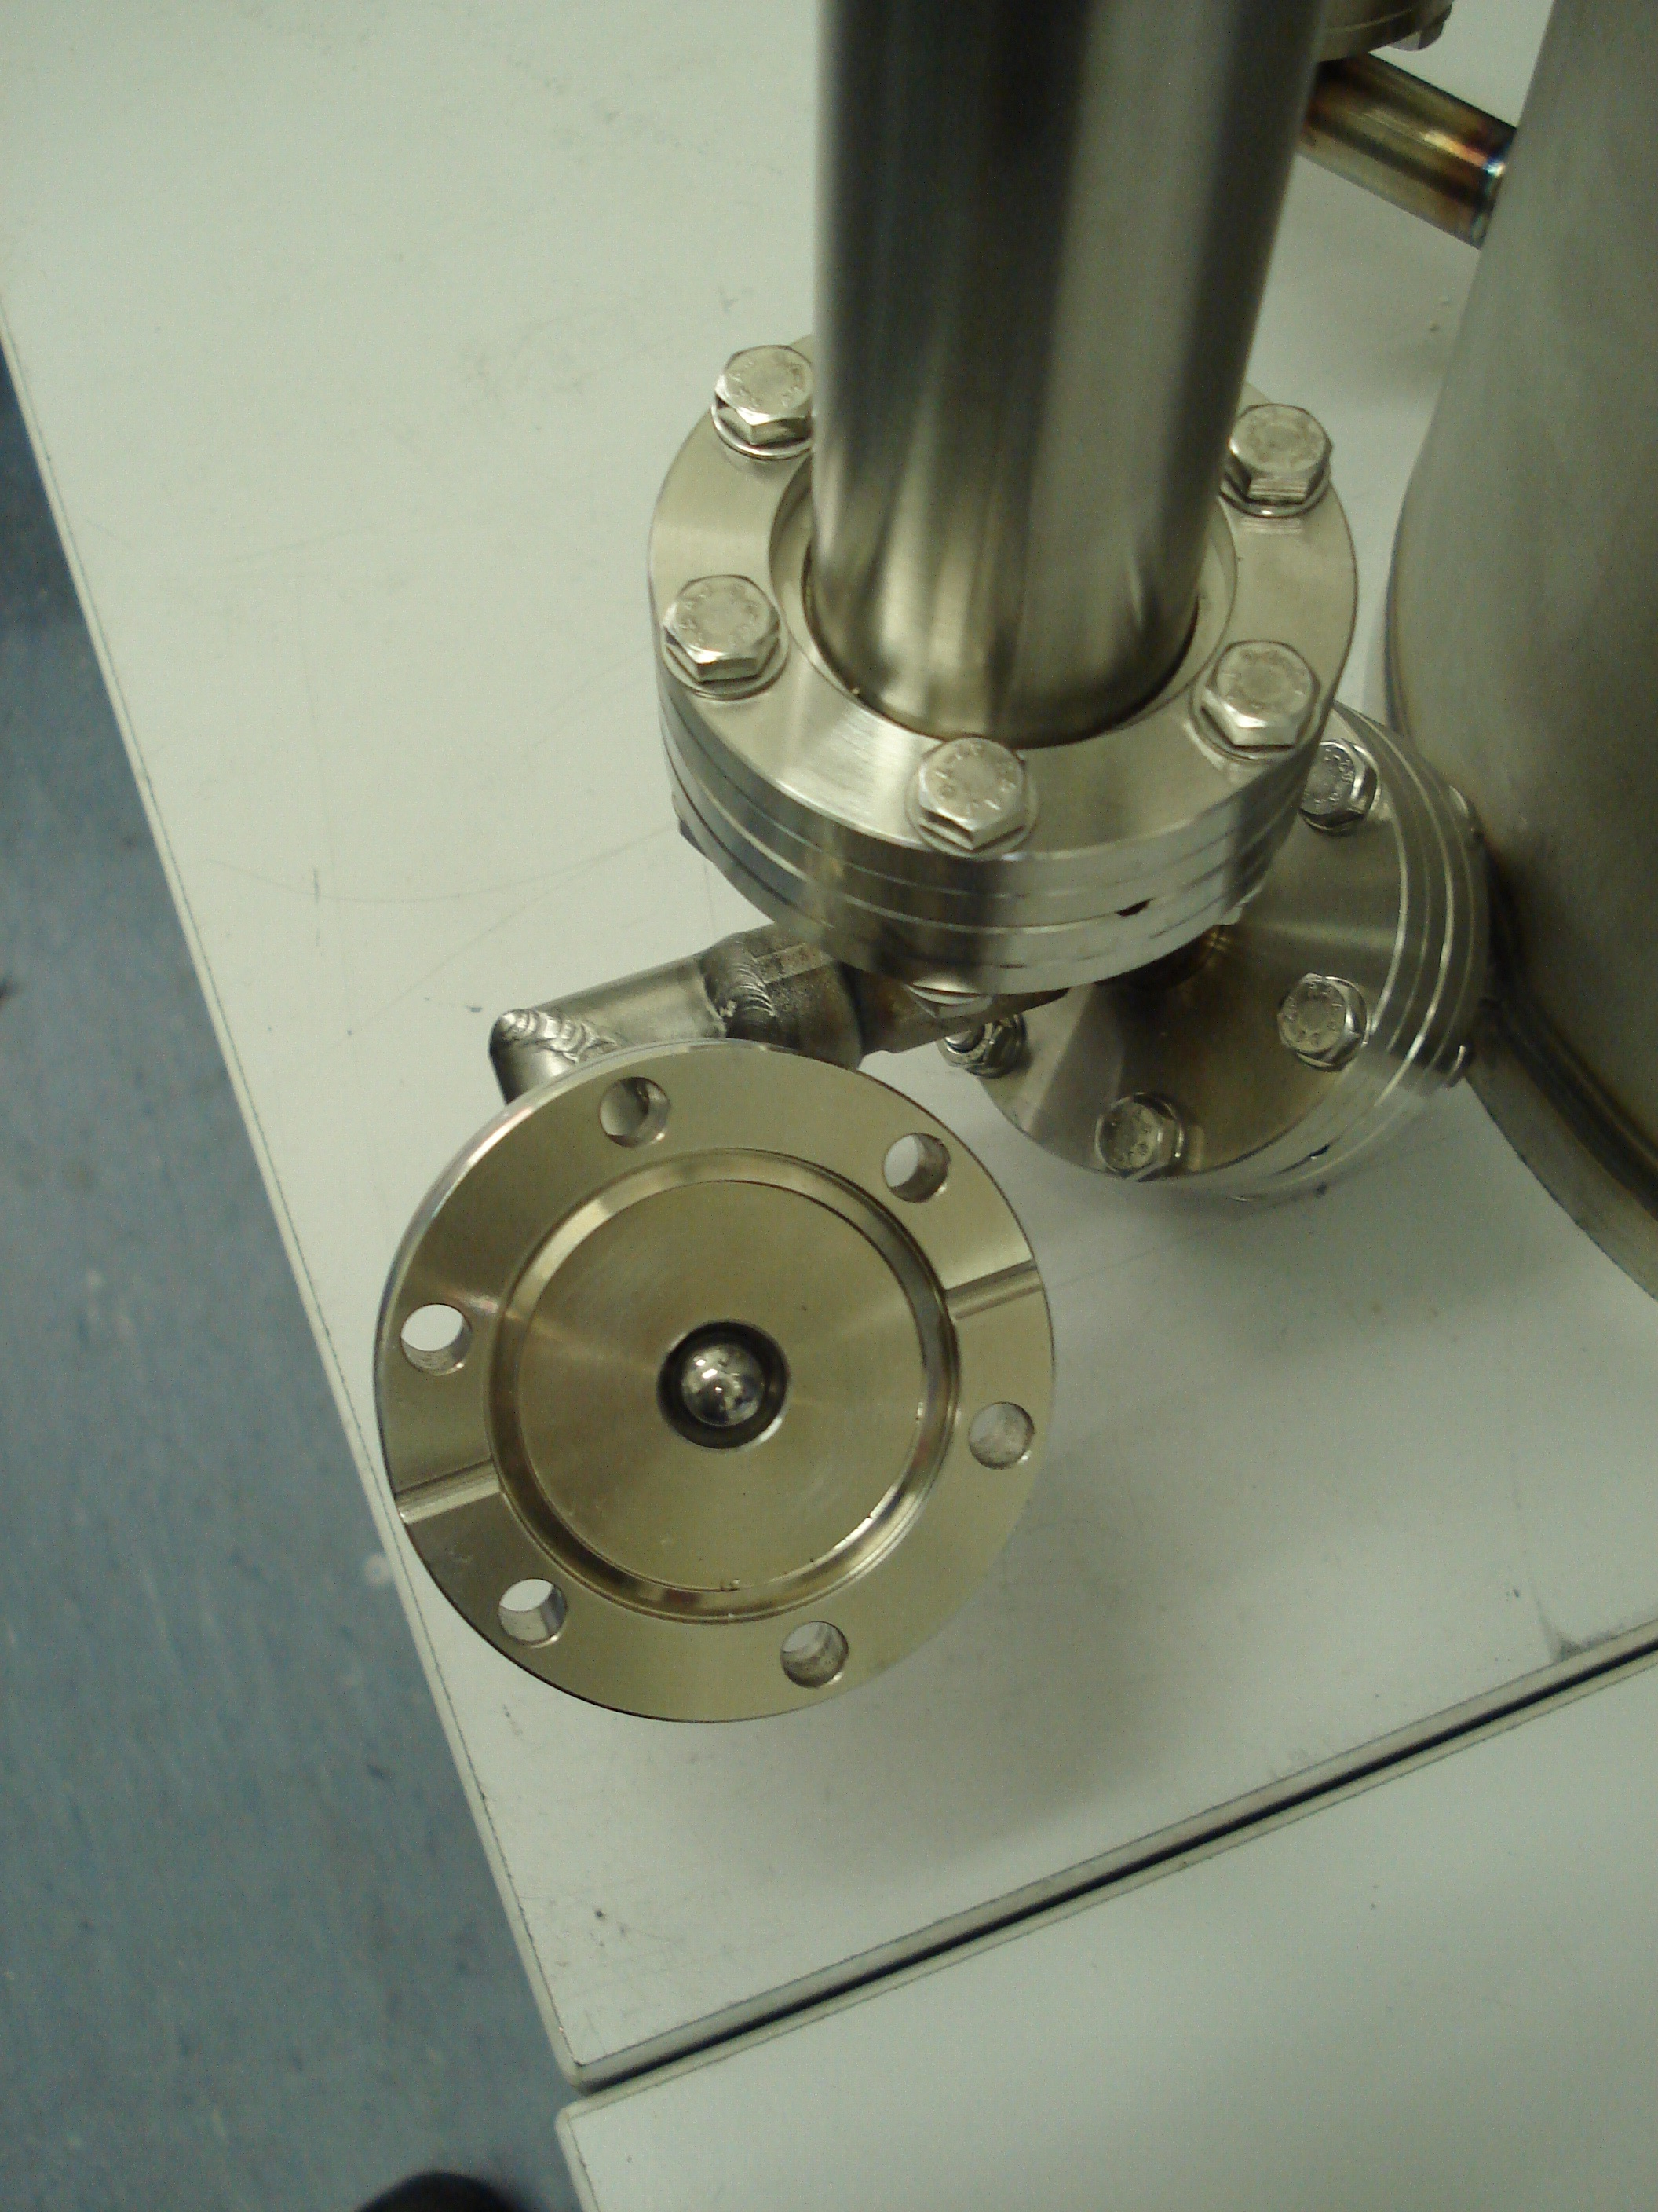
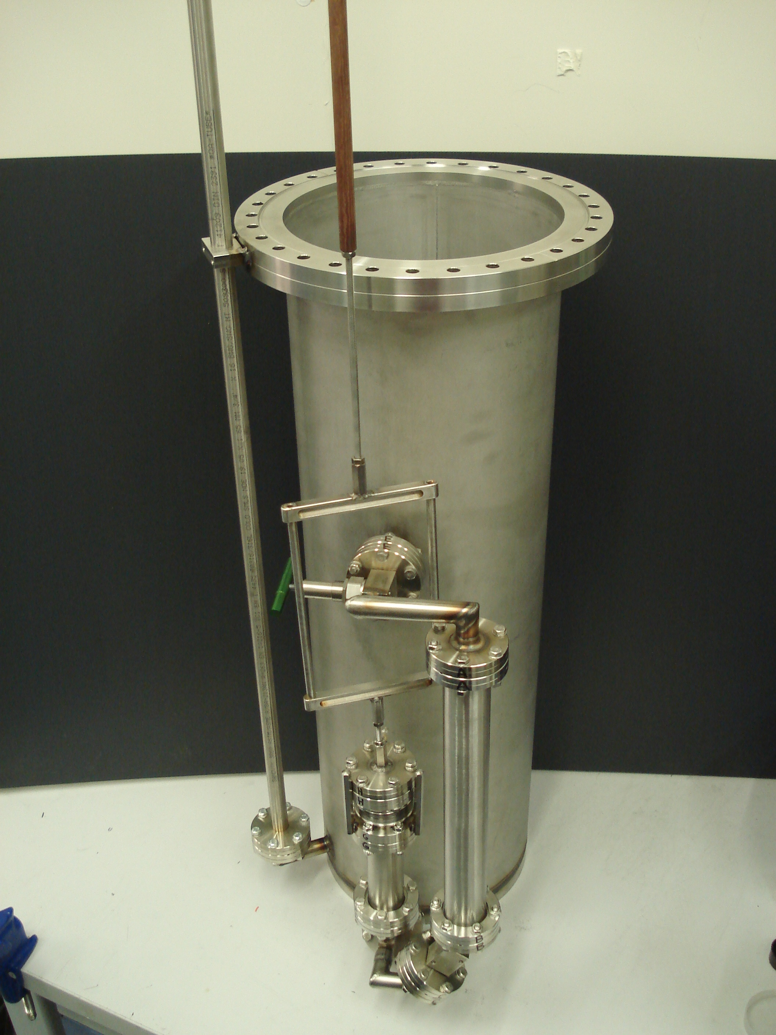
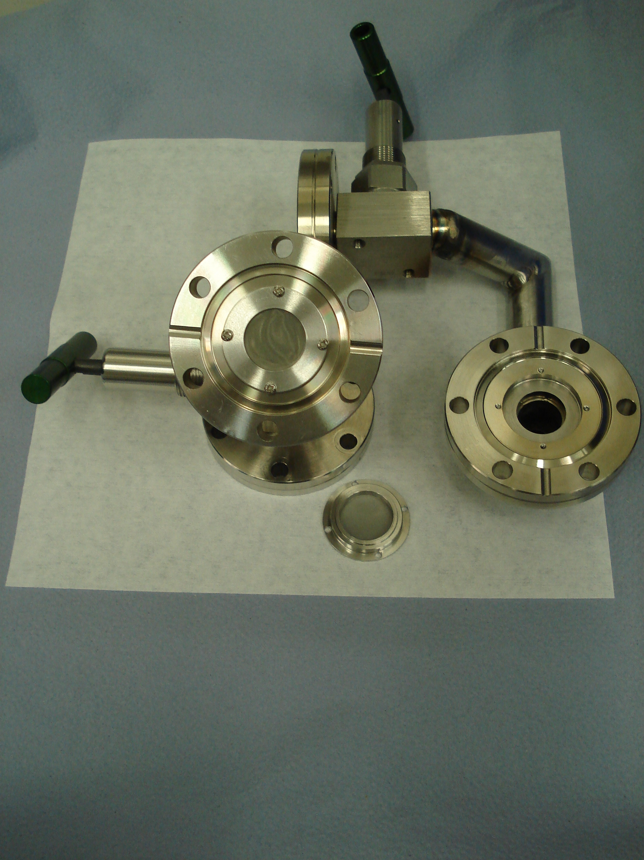
The Target Vessel and Recirculation System
Development of a novel one way recirculation system using metal balls and a bellows
Purification Cartridge
Metal bellows
LAr feedthrough

Slide 19
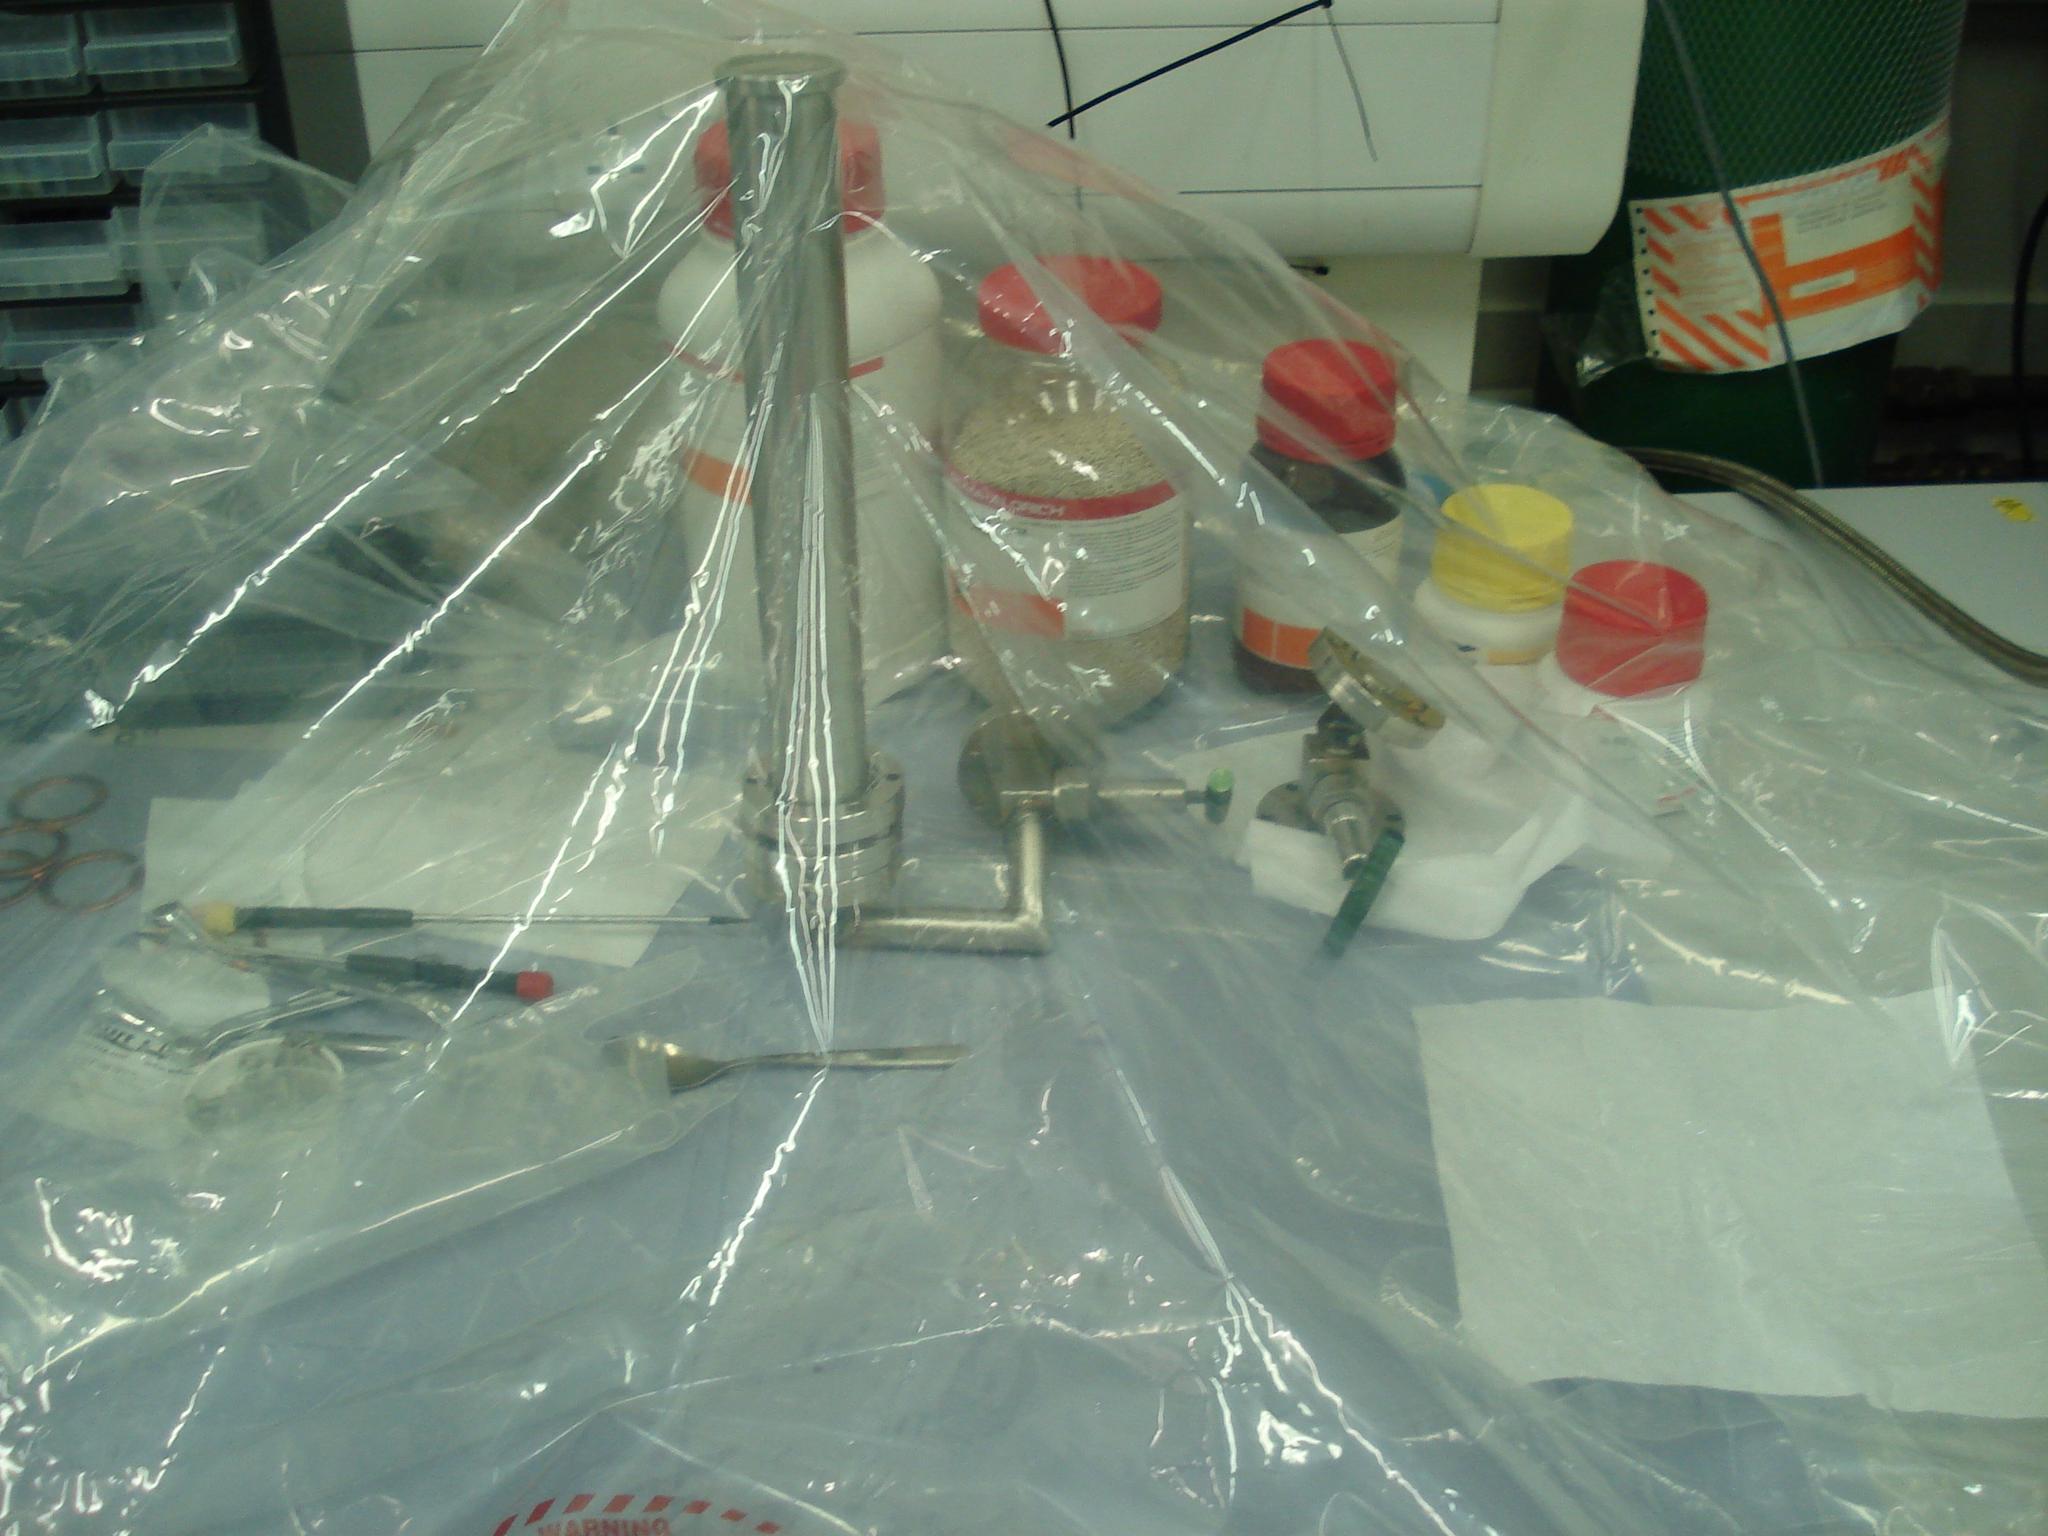
The Liverpool LAr Vessel – The Purification Cartridge
3A,4A,13X Molecular
Sieves for removing,
N₂,H₂O,CO₂
Copper for removing
O₂ (2Cu+O₂→ 2CuO)
Filling the purification cartridge within an argon bag in order to avoid reaction with air molecules

Slide 20
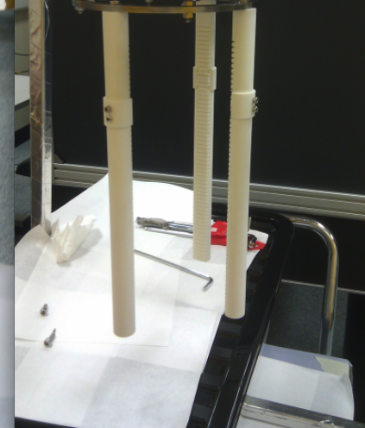
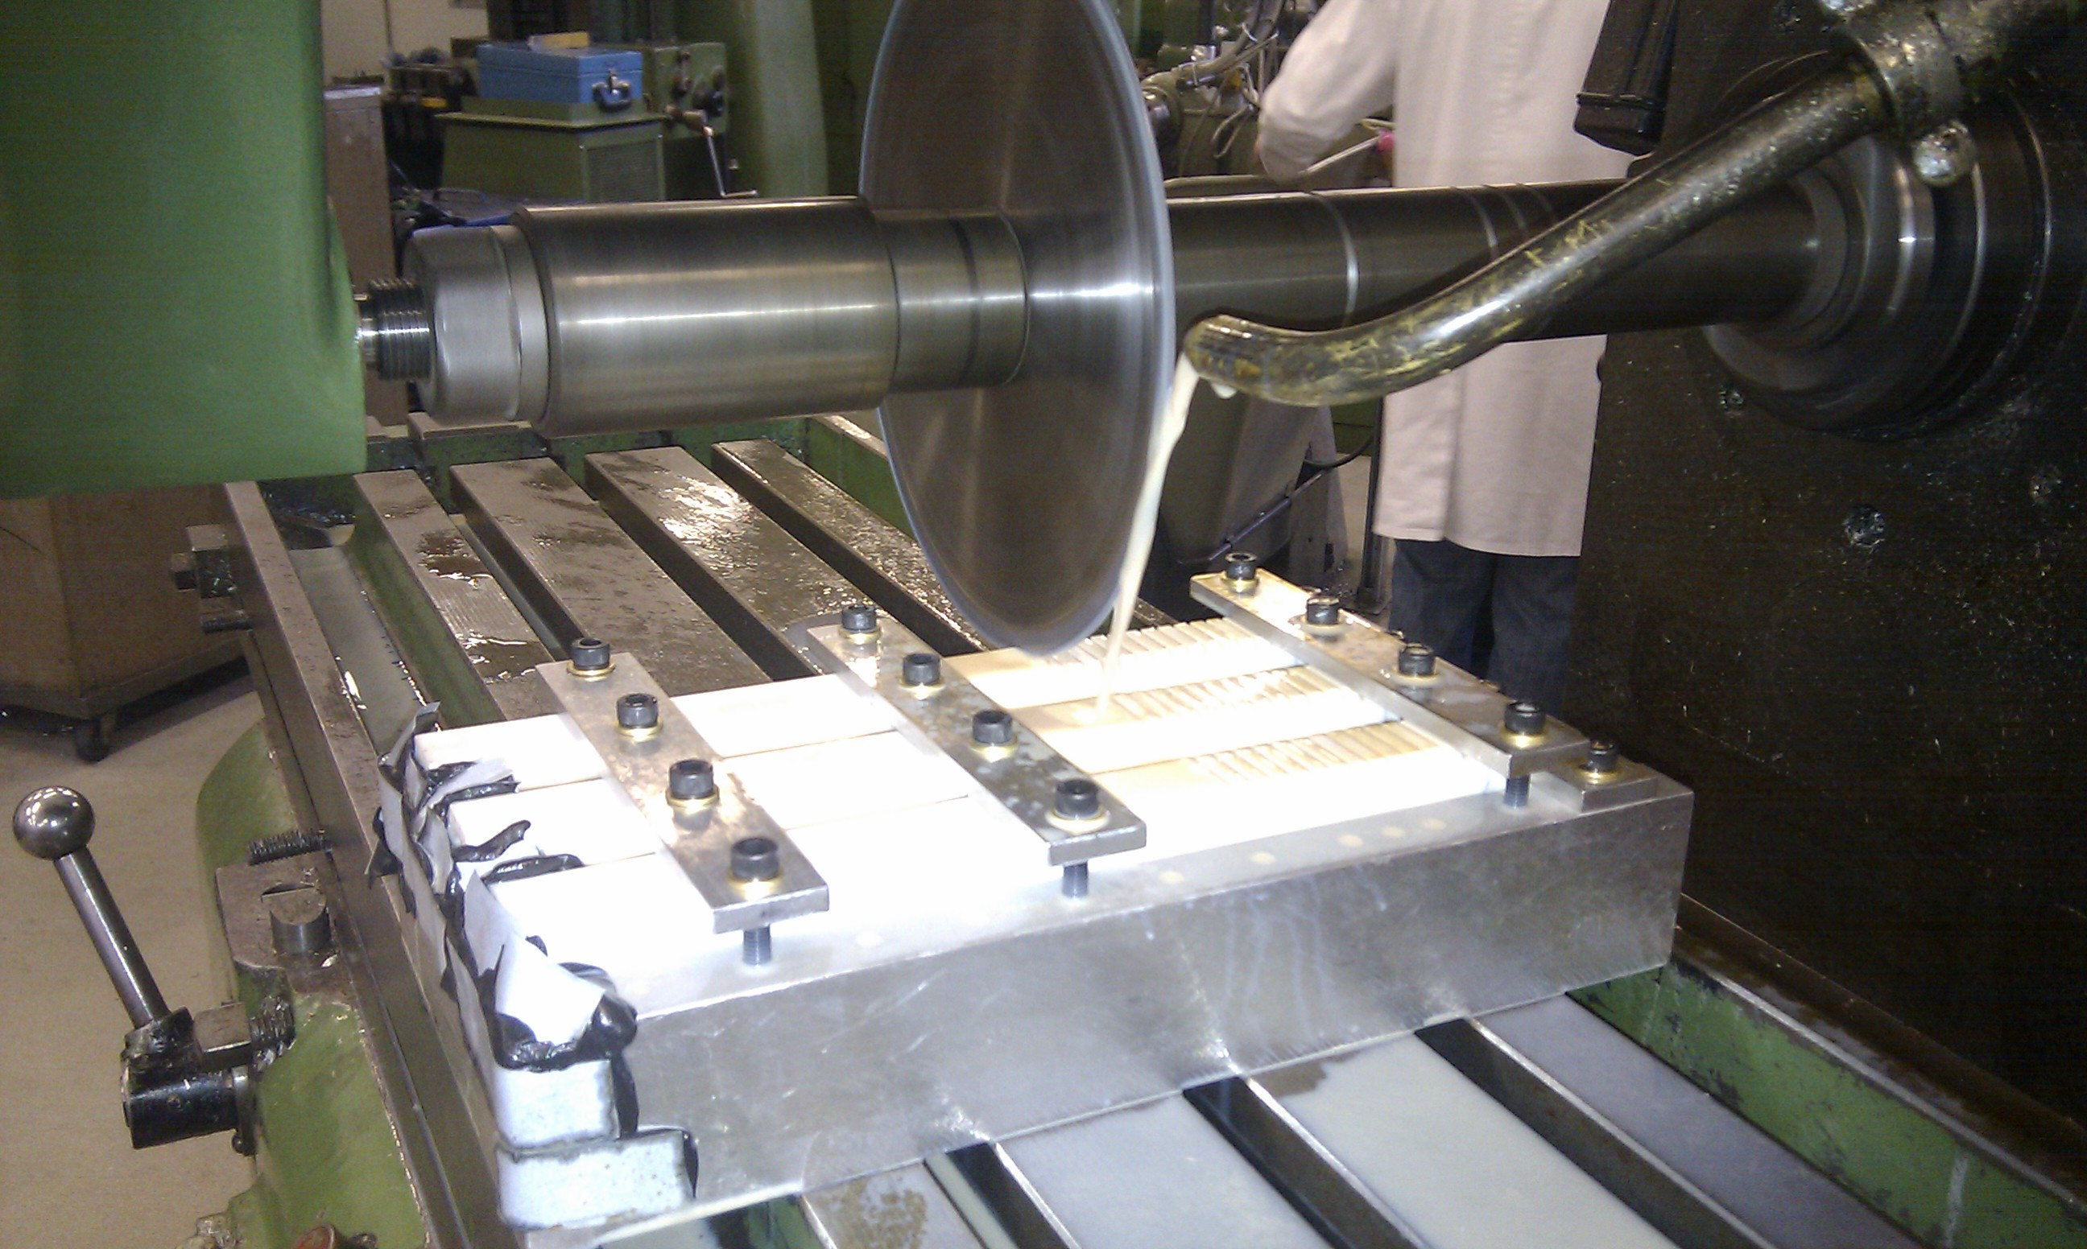
Machining the Macor rods

Slide 21
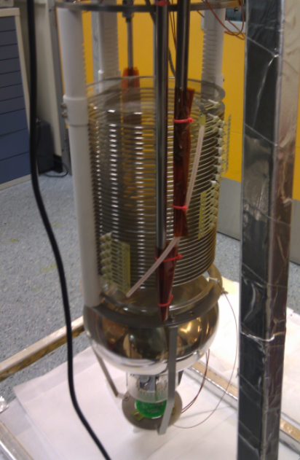
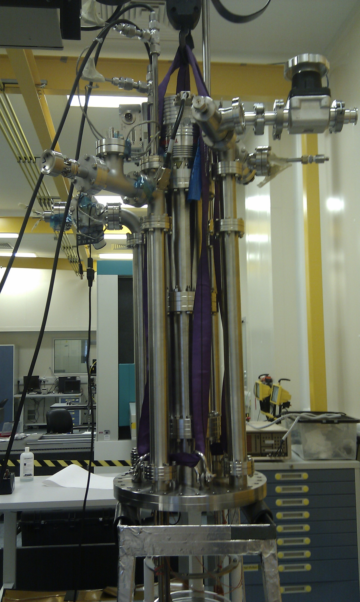
The Liverpool Field Cage Completed

Slide 22
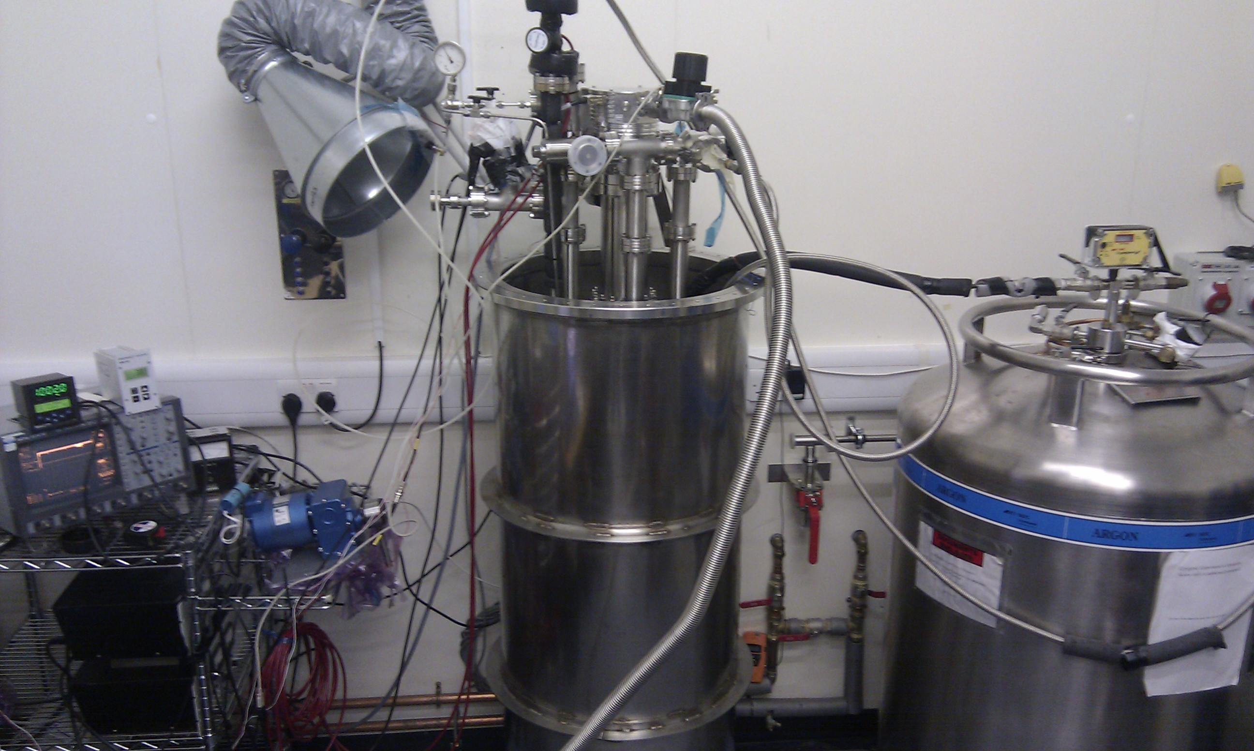
The Liverpool LAr Lab

