Slide 1
Particle Detection Techniques in HEP Lecture 2: Gaseous Tracking Detectors
Post-Graduate Lecture Series
Kostas Mavrokoridis (based on Joost Vossebeld notes)
k.mavrokoridis@liv.ac.uk
Room 207

Slide 2
Lecture 2 “Gaseous Tracking Detectors”
Charged particles in matter (ionisation)
Charge collection
Operational modes of gas amplification
Gas mixtures
Electron and ion drift in a gas
Multi wire proportional chambers
Drift chambers
MSGC, TGEMs, Micromegas
The T2K time projection chamber

Slide 3
Charged Particle Interaction with Matter (a)
When a charged particle traverses a layer of material, three processes could occur: ionisation of atoms, Cherenkov radiation or the emission of transition radiation (i.e. scintillation light).
Consider the electromagnetic interaction of a particle, of charge ze, passing a stationary charge Ze (the “target” particle) with impact parameter b and velocity v.
Assuming that the moving particle passes the target so rapidly that the latter remains stationary during the “collision”, b will remain constant. In this case, the longitudinal electrostatic force exerted on the target before and after the moment of closest approach will cancel. The effective transverse force is then:

Slide 4
Charged Particle Interaction with Matter (b)
Therefore the impulse delivered to the target is
The above calculation has been performed for a non-relativistic approach. If the projectile particle is moving relativistically, then:
^{E}x is increased by a factor γ and dy is decreased by a factor γ
^{So, ∆p remains unchanged as:}
It is useful to consider for some purposes this momentum transfer as the product of the maximum force exerted and a characteristic time.
^{Where, Fx} and the “collision time” τ are:

Slide 5
Charged Particle Interaction with Matter (c)
^{Two} ^{assumptions have been made:}
1) Impulse approximation – the target does not move (significantly) during the collision
2) The target remains non-relativistic.
If the assumptions hold, then the target gains kinetic energy given by:
The matter the particle travels through consists of nuclei, of charge Ze and an approximate mass Amp, each surrounded by Z electrons each of charge e and mass me.
^{Thus}
Given the ratio between the electron and proton masses, it is therefore reasonable to consider only the energy lost to electrons. For a single electron, we have:

Slide 6
Charged Particle Interaction with Matter (d)
^{Since E}e is determined by the impact parameter b, the probability of an energy loss between E and E+dE is given by the probability of an impact parameter between b and b+db, where b corresponds to E and b+db corresponds to E+dE.
^{So, P(E}e )dE = −Pʹ(b)db -the minus sign arising as an increase in b results in a decrease in E.
The energy loss is not due to an interaction with a single target electron.
However, consider a thin slice of material, of density ρ and thickness Δx.

Slide 7
Charged Particle Interaction with Matter (e)
So the most probable energy loss in traversing this slice is:
This can be simplified by grouping together a number of physical constants, which depend on the properties of neither the projectile particle nor the target material. Lets define:
^{Hence}

Slide 8
Charged Particle Interaction with Matter (f)
Obviously there must be some limits on Emin ^{and E}max ^{(or b}min ^{and b}max) to prevent the value of the integral being infinite, which is of course unphysical. For Emin , this is where the collision becomes very “soft”, and the electric field of the passing particle simply perturbs the atomic electron adiabatically, with no energy being absorbed. This occurs when the collision time is long compared with the period of the electron in its atomic orbit.
^{Now, hf}rot ^{≈ I}0,
^{where I}0 is the mean ionisation potential of the atom, thus:
^{For E}max, there are a number of possible limits. The above calculation becomes invalid when the electron receives enough energy for it to become relativistic. There are also absolute limits on the maximum transferable energy. For example, it clearly cannot be greater than the energy of the incoming particle. A proper quantum mechanical, relativistic calculation is needed for the full result. However, it can be determined approximately by relatively simple quantum mechanical arguments. It can be shown that for any incoming particle significantly heavier than an electron (i.e. muon, pion, proton or nuclear fragment), then the most important limit comes from the fact that the uncertainty principle does not allow b to be specified too precisely, and so limits bmin.

Slide 9
Charged Particle Interaction with Matter (g)
For a projectile particle which is not extremely relativistic (γ < 100), then the limit on bmin ^{is:}
Substituting these limits in to eq. 6 gives the following approximate expression for the mean energy loss:
The full quantum mechanical treatment (by Bethe and Bloch) for “heavy” particles (not electrons) gives the result:
^{The two additional terms are:}
ε, a small correction due to screening of the inner atomic electrons (the “shell correction”). It is often ignored.
δ, a function of β and the dielectric constant of the medium, and is known as the “density effect”. Polarisation of the material at large values of b (which are only important for large γ) screens the effect of the traversing charge. It is much more important for dense media, such as solids, than it is for gases.

Slide 10
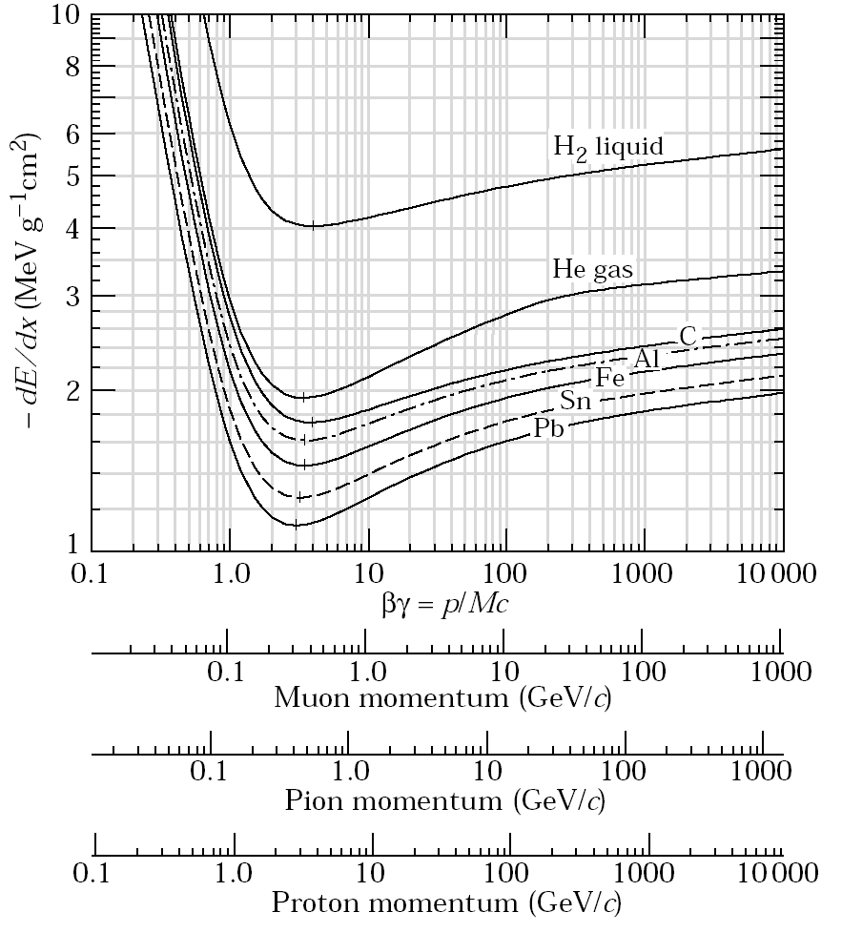
Charged Particle Interaction with Matter (h)
Schematically, the variation of mean energy loss per unit thickness, dE/dx , has the following behaviour as a function of β or γ:
PDG 2001

Slide 11
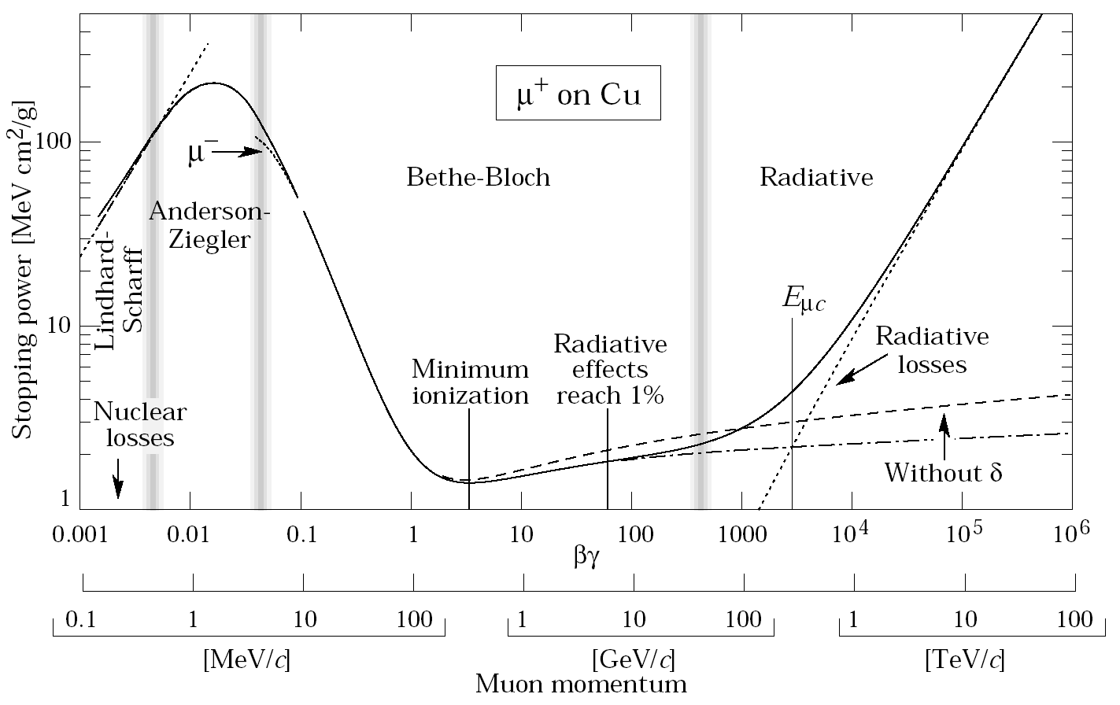
Other Mechanisms
I
II
III
PDG 2001
I At very low energy ionisation is impossible. Only have interactions with nucleus.
II For most particles ionisation dominates from a few MeV up to TeV-scale.
III Above that Bremsstrahlung due to nuclear electric field dominates.
Electrons (low mass) are an exception! Bremsstrahlung dominates from 5-20 MeV!

Slide 12
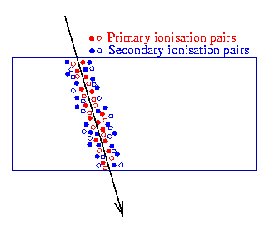
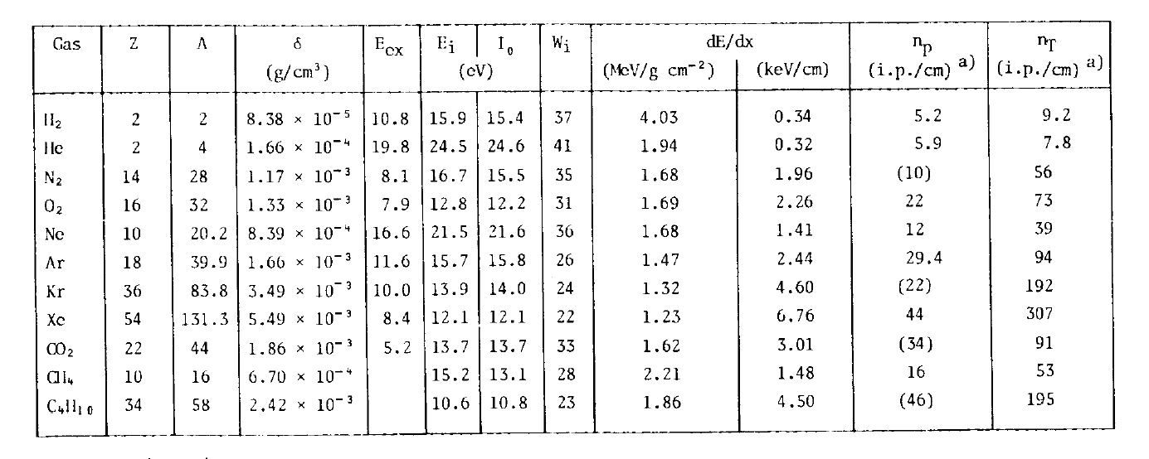
Where does the lost energy go?
Ionisation produces electron/ion pairs (in general ~100 pairs/cm)
Primary electrons have enough energy to cause secondary ionisation.
F. Sauli,
CERN 77-09

Slide 13
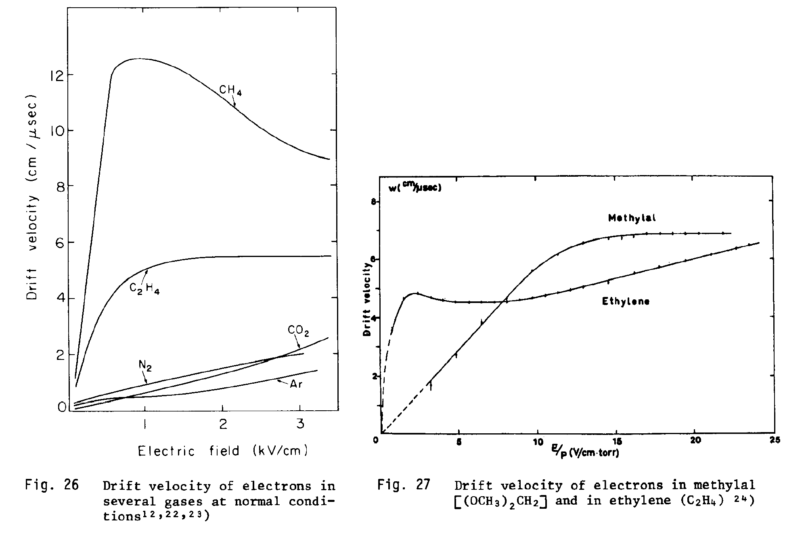
Electron Drift:
The drift velocity for electrons in an E-field, w, has a more complex dependence on E.
Electrons (very light) accelerate quickly between interactions and have a longer mean free path length.
τ: average time between collisions (∝1/σ)
Strong dependence on gas-mixture, E and p.
If your detector should measure drift times, choose voltage/gas where drift velocity is (almost) constant!
F. Sauli,
CERN 77-09

Slide 14
Drift and Diffussion in a Magnetic Field
Often detectors have magnetic fields as well. How does this affect the drift?
Two common cases:
Added component to the drift in direction of the Lorentz angle:
⇒ Curved trajectory towards anode
Charge collection becomes a bit slower
Drift towards anode unaffected
Diffusion transverse to drift direction is forced in circles! Transverse diffusion remains small over large drift distance!
Exploited in time-projection-chambers (TPC) (discussed later)

Slide 15
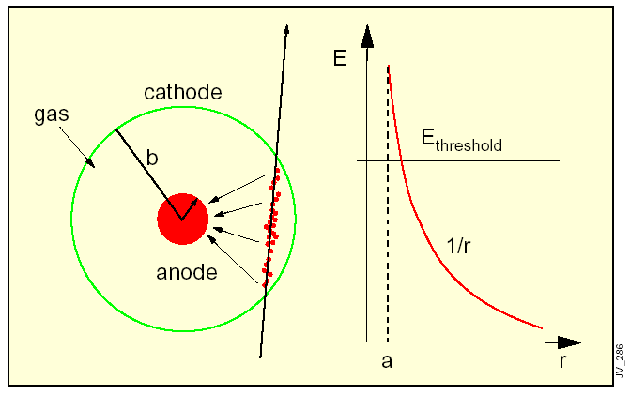
Detecting e/ion Pairs Produced by a Charged Particle
In E-field electrons (ions) drift to anode (cathode)
But, 100 e/ion pairs do not constitute a measurable signal
(noise from electronic amplifier typically ~1000 electrons or more).
In a strong E- field (E > E_{threshold}) electrons can obtain enough energy to cause further ionisation, thus producing an avalanche of e/ion pairs (gas amplification).
Simple particle detector: Gas filled tube with anode wire in the centre. (Using a very thin anode wire is an easy way to achieve a high field.)
T.S. Virdee: European School of High Energy Physics CERN 99-04

Slide 16
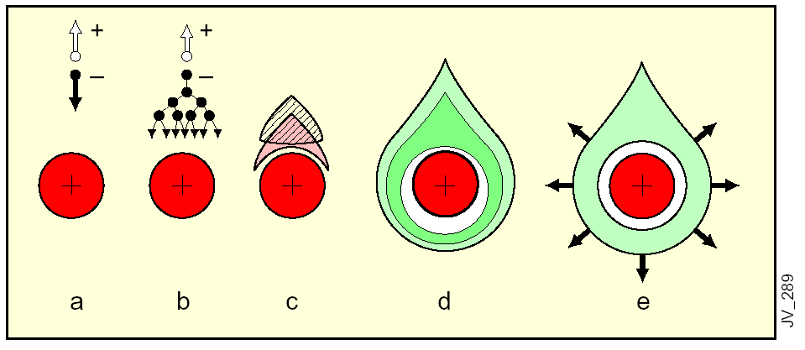
Gas Amplification
T.S. Virdee: European School of High Energy Physics CERN 99-04
Electrons (ions) drift towards anode (cathode)
Gas avalanche produces more e/ion pairs
Ion cloud reduces field and stops avalanche
d,e) Electrons collected on anode, ions drift to cathode
Notes:
Because of lateral diffusion and small wire size charge surrounds the wire

Slide 17
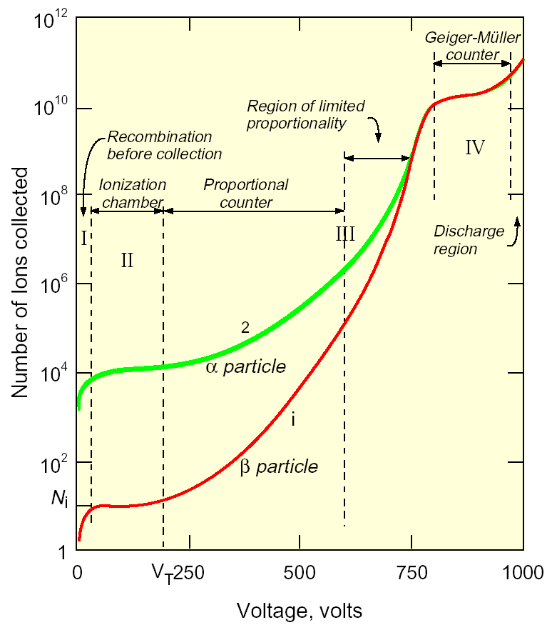
Operational Modes of Gas Amplification
Behaviour of gaseous detectors depends strongly on the field strength.
I) very low field: partial (or no) charge collection
II) Ionisation mode: charge collection but no amplification
III) Proportional mode:
proportional charge amplification.
Gain highly dependent on V!
Streamer mode: proportionality lost by distortion of E-field by space-charge
IV) Geiger or saturated mode: full ionisation of the gas volume (photo-emission). Only stopped by interruption of HV
T.S. Virdee: European School of High Energy Physics CERN 99-04
In HEP: chambers mostly in proportional mode, sometimes streamer or saturated mode (can be read out without an electronic amplifier!)

Slide 18
The Choice of Gas(-Mixture)
The requirements:
• High specific ionisation
• Gas amplification at low working voltage and good proportionality
• High voltage before saturation (high gain achievable)
• High rate capability (fast charge drift & fast recovery) and long lifetime (of detector)
Noble gases:
• Few non-ionising energy loss modes ⇒ avalanche multiplication at low V
• Heavy gases (Ar, Xe, Kr) ⇒ high specific ionisation
• Excited Ar emits 11.6eV photons ⇒ free electrons at cathode ⇒ new showers ⇒ permanent discharge
Poly-atomic gases:
• Many non-ionising states ⇒ effective absorption of γ’s. (photon-quenching)
e.g. Methane effectively absorbs γ’s 7.9-14.5 eV
Organic gases: Methane, CO², BF³, freons, isobutane (C⁴H¹⁰)
• Small admixture of photon-quencher prevents permanent discharge in eg. Ar!
• Absorbed energy is released in break-up/inelastic collisions ⇒ formation of radicals ⇒ damage detector materials or leave solid or liquid organic deposits on anode or cathode
• In a high rate environment gas may get fully quenched ⇒ Gas must be circulated!
Needed anyway to control gas mixture and because most detectors leak!

Slide 19
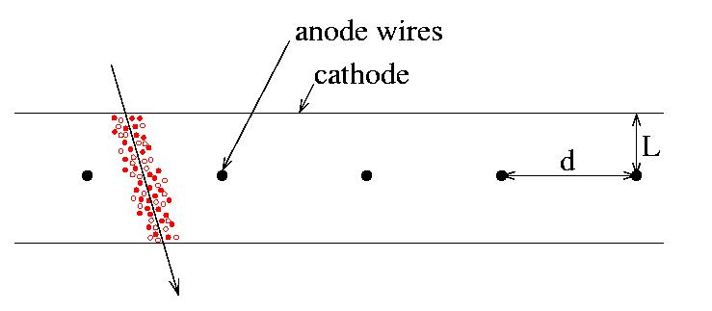
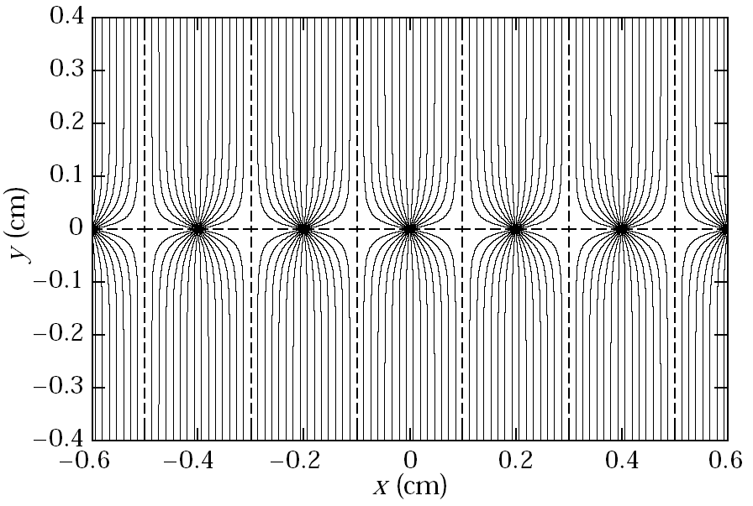
Multi Wire Proportional Chamber (MWPC)
Charpak et al. (1968) ⇒ Nobel prize 1992
Electrons/ions drift along field lines
Ions ⇒ cathode
Electrons ⇒ nearest anode wire!
If all charge collected on 1 wire,
resolution along x determined by
wire spacing (pitch):
(Gaussian width: )
Charge sharing ⇒ better resolution
Original worry: Capacitive coupling
between wires is largely compensated
for by positive charge in avalanches
Typically: L=5mm & d=1mm
Electric field lines
d
PDG 2001
Only sensitive to x-coordinate.

Slide 20
The y-Coordinate
hits
Crossed wire planes:
Perpendicular (ghost hits when more than 1 particle!)
Stereo-angle (few degrees) only ghosts from hits near to each other
ghost hits
Two-sided readout
Charge division (resistive wire)
Time difference
Note: velocity along wire 30 cm/ns so at best σ(x) ~ several cm
Segmented cathode planes
Strips/wires/pads
(Slow!)

Slide 21
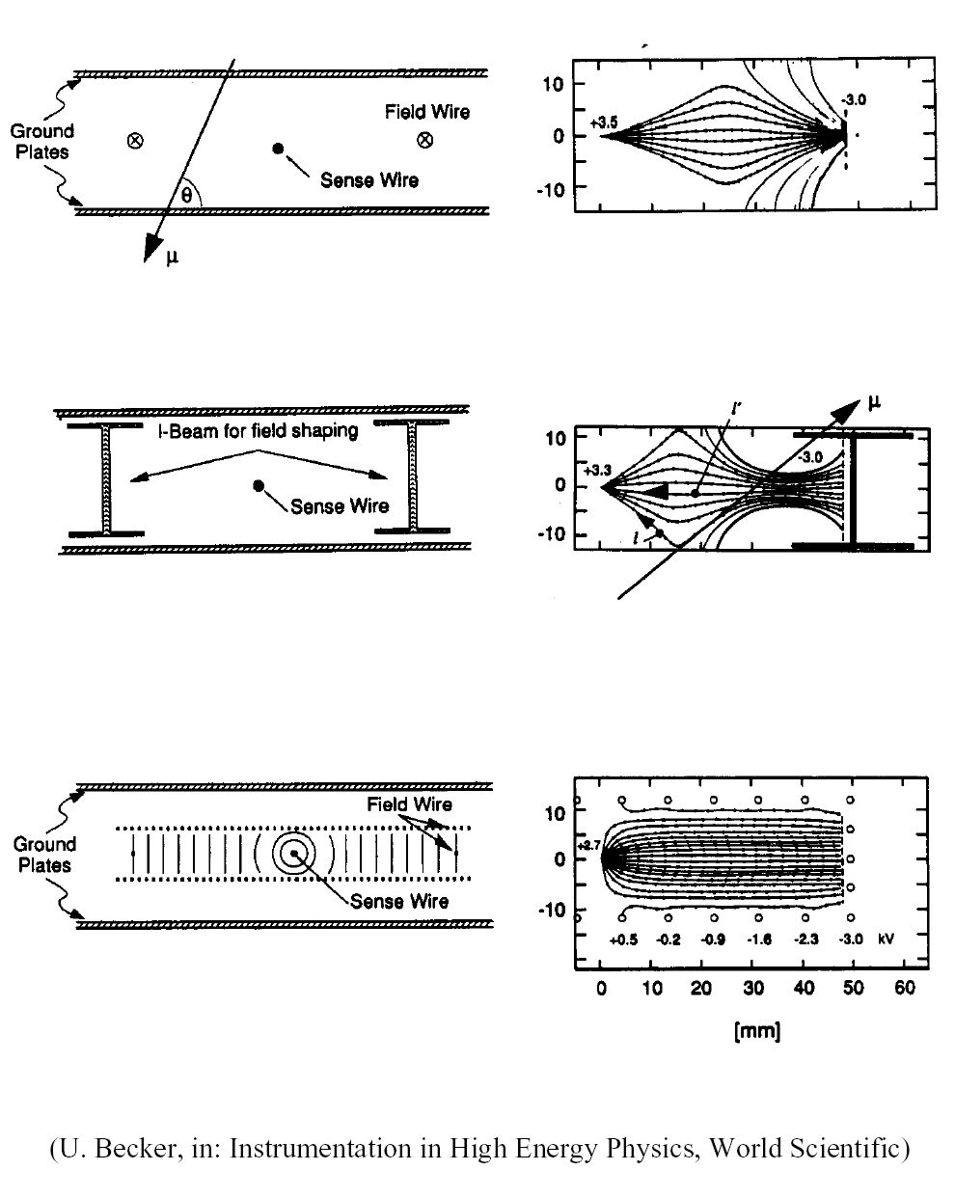
Drift Chambers
(examples of planar drift chambers)
Field lines aligned with x-direction
via use of field and sense wires
(cathode and anode wires)
Then x can be measured from the
arrival time
Better x-resolution while using larger
wire pitch than in MWPC’s
Fewer wires g less electronics, less
mechanical support
As field is generated between wires various geometries possible:
Planar
Cylindrical
…
Aim to get linear relation between position and arrival time!
U. Becker, in: Instrumentation in High Energy Physics, World Scientific

Slide 22
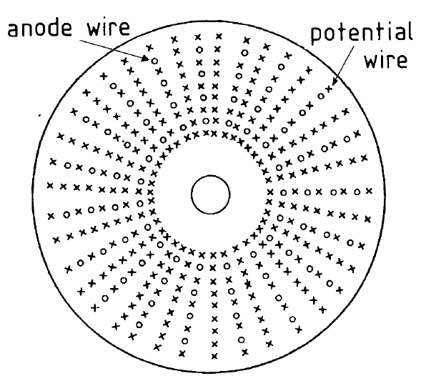
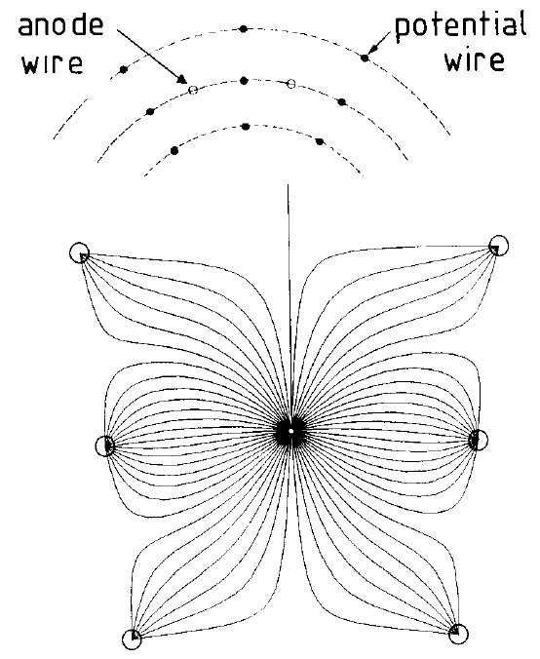
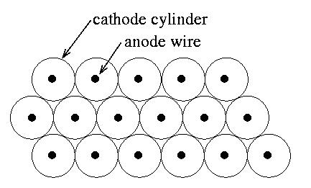
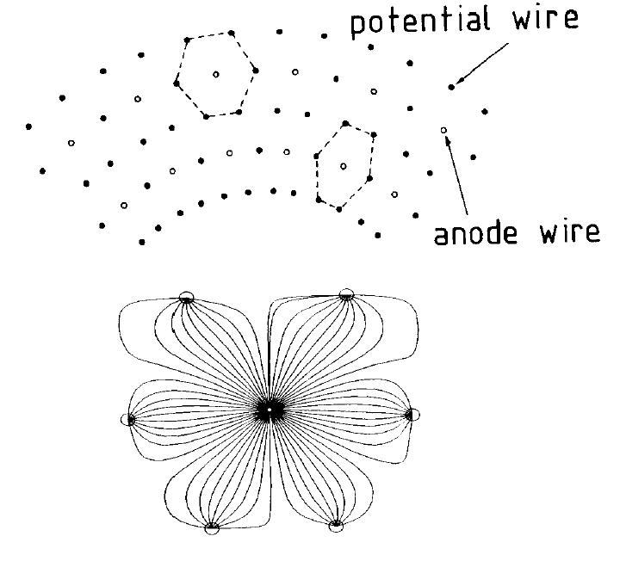
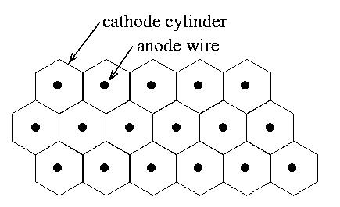
Other Drift Chamber Geometries
Tubes or cells:
self supporting
less material at end-support
“easier” to build
C. Joram, CERN summer student lectures 2001
Cylindrical:
barrel shape
wires supported from end plates
very little material (centrally)
Straw tubes
Honeycomb cells
One broken wire can destroy large section!

Slide 23
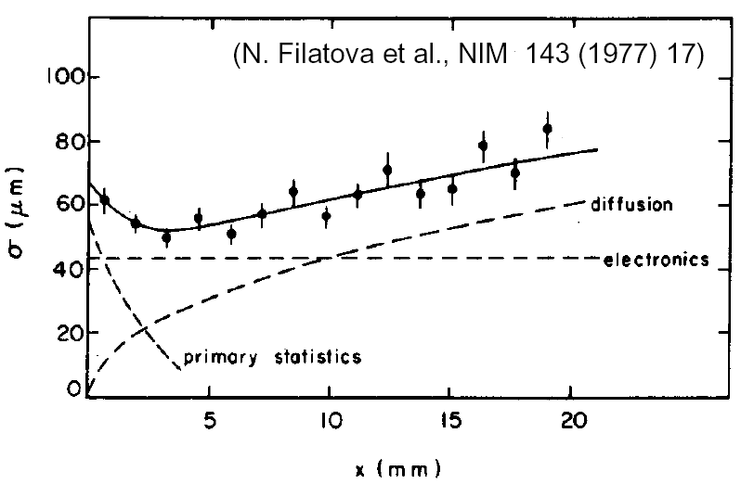
Position Resolution in Drift Chambers
Remember electron drift velocity ~ few cm/μs:
With timing precision of a few ns ⇒ σ(x) ~100 μm
Measurement precision:
Statistics primary ionisation (for small “cell”-sizes)
Electronics
Spread in arrival time:
Diffusion (especially for long drift paths)
Path length fluctuation complex in E-fields
cell size

Slide 24
Moving Towards Small Gaseous Tracking Detectors
Future (high rate) experiments need small scale detectors to prevent having too
many hit wires/strips per event.
(occupancy = fractional hit rate per channel per event)
Challenges for small & fast gaseous detectors:
small structures (detection elements)
high voltage to get enough charge
prevent (slow) ions from drifting back to cathode
There are several technologies for small scale gaseous tracking detectors:
Micro-strip gas chambers (MSGC)
Gas electron multipliers (GEM)
Micromegas
Micro-gap chambers
Micro-gap wire chambers
GEMs combined with pixel detectors

Slide 25
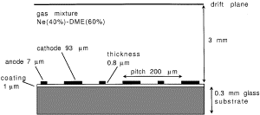
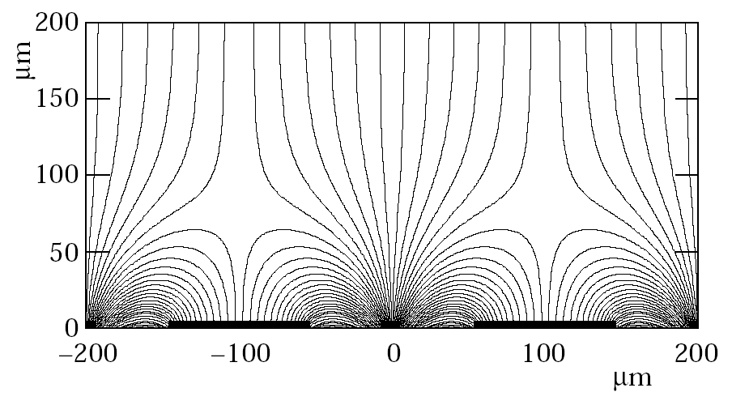
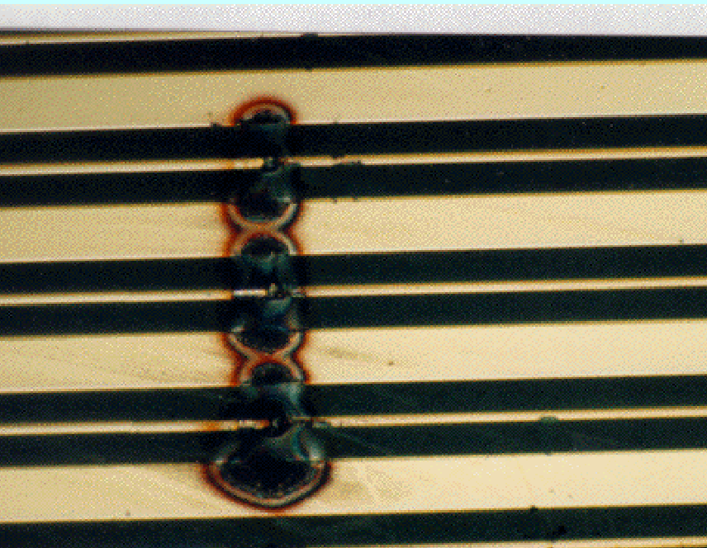
Micro-Strip Gas Chambers (MSGC)
PDG 2001
Example: CMS MCGC’s (abandoned)
MSGC’s:
anode and cathode strips etched on glass substrate
cathode strips provide fast “drain” for ions from avalanche
High sensitivity to discharges, damaging strips

Slide 26
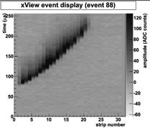
Thick Gas Electron Multipliers (TGEMs)
The TGEM is a double sided metallised PCB plate with holes drilled in a regular pattern.
By applying a potential difference to the TGEM electrodes, an electric field is attained in the holes.
Charge amplification (Townsend avalanche):
^{Gain: G = exp(αx) where,} x is effective multiplication length; α~ Ap exp(-Bp/E): first Townsend coefficient.
^{500 μm diameter holes}
Read the segmented charge and reconstruct tracks
Notes:
Typical amplification GEM ~100
Considered for TESLA TPC

Slide 27
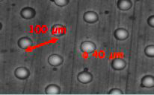
Micromegas
Thin (~100μm) amplification gap between a micromesh and the anode (strips, pads)
Notes:
Typical amplification GEM ~100
Considered for TESLA TPC

Slide 28
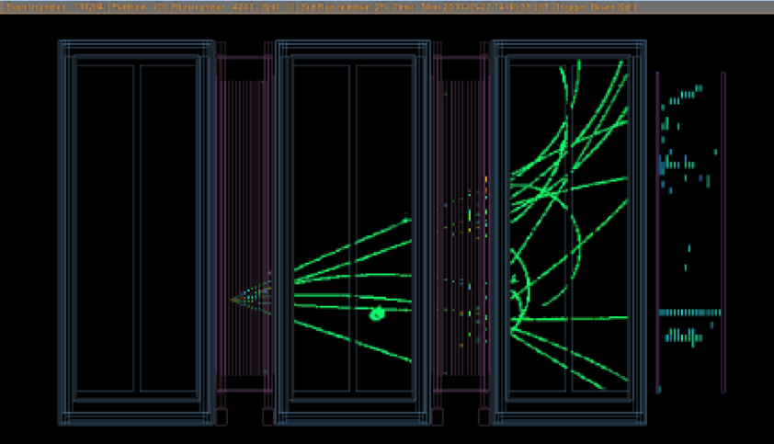
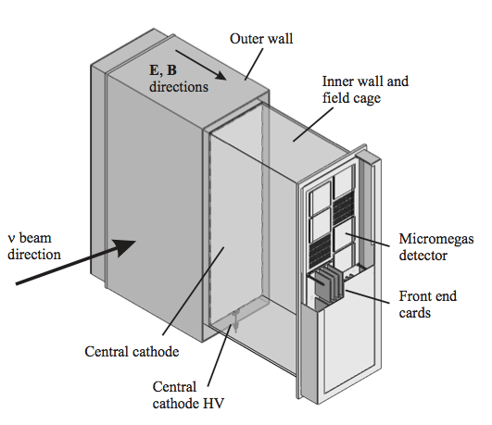
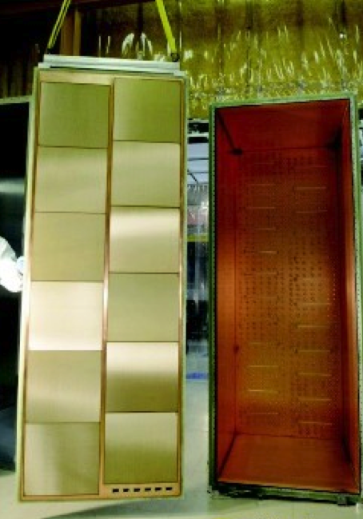
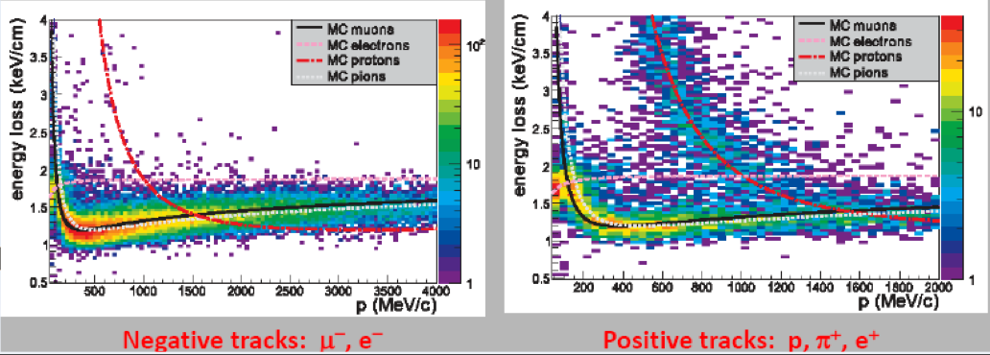
The T2K Time Projection Chamber (TPC)
T2K event display
T2K TPC drift gas: 95% Ar, 3% CF4, 2% iC4H10
Particle identification based on energy loss(dE/dx) of charged particles in the gas.
The 12 Micromegas modules

Slide 29
Difficulties With Gaseous Tracking Detectors
Difficult to build (and transport):
very thin wires need to be strung under tension (fragile) (one broken wire can destroy large section of chamber)
larger drift chambers need bulky end plates
Complicated to operate:
gain highly sensitive to voltage/field strength
in some layouts small mechanical distortions can change detector behaviour (discharges)
behaviour is sensitive to (complex) gas mixture
combination of (often) organic gases with high voltage gives complicated ageing effects due to the effects of radicals/organic deposits
Nevertheless, gaseous tracking detectors are widely used very successfully

