Slide 1
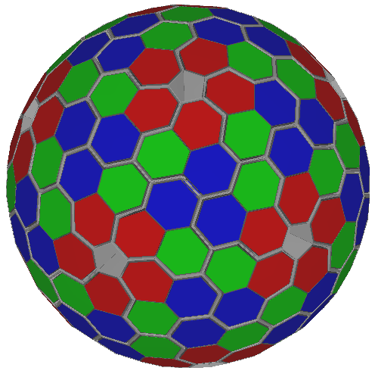
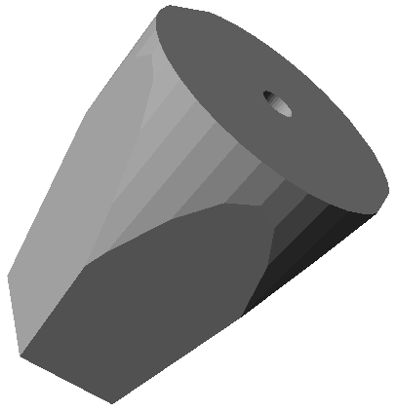
Digital Gamma-ray Spectroscopy
Frontiers of gamma-ray spectroscopy
AGATA
GRETA

Slide 2

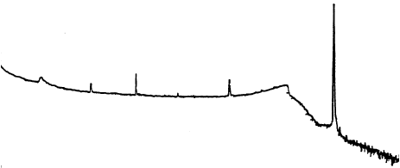
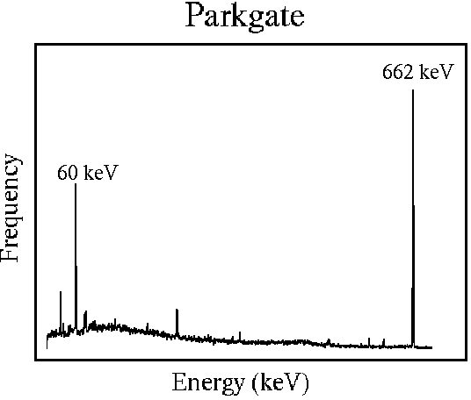
The AGATA Concept
Without Compton suppression shields
Compton continuum.
=> Large peak to total ratio
Less solid angle coverage
=> Big drop in efficiency
With BGO shielding
Path of γ-ray reconstructed to form full energy event
=> Compton continuum reduced
=> Excellent efficiency ~50% @1MeV
=> Greatly improved angular resolution (~1⁰) to reduce Doppler effects
With highly segmented detectors

Slide 3
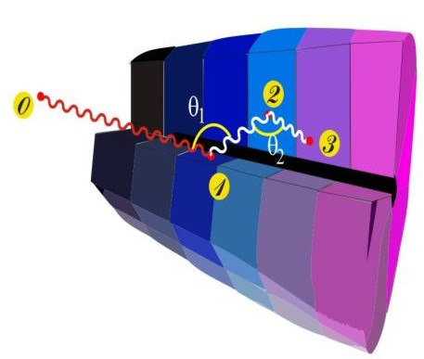
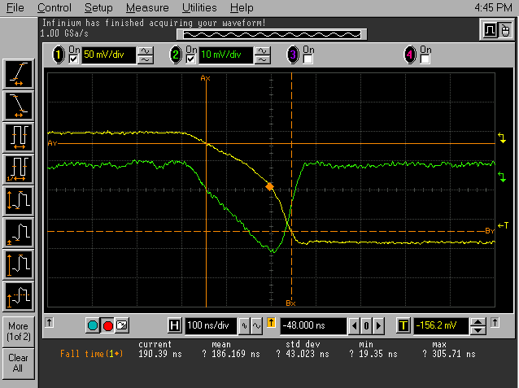
Ingredients of Gamma-Tracking
4
1
Identified
interaction points
Reconstruction of tracks
e.g. by evaluation of permutations
of interaction points
Highly segmented
HPGe detectors
(x,y,z,E,t)_{i}
γ
·
·
·
Pulse Shape Analysis
to decompose
recorded waves
·
2
3
Digital electronics
to record and
process segment signals
reconstructed γ-rays
Notes:
What has to be done to perform tracking
What are the ingredients
Detectors highly segmented, encapsulated, cryostats
Electronics Digital
PSA to extract Energy Time and Position
Algorithm development particularly for position
Area where effort is required Thorsten Kroell. See him.
Tracking algorithms, reconstruction of the events for full array
Obtain full energy
Many technical development in all areas.

Slide 4
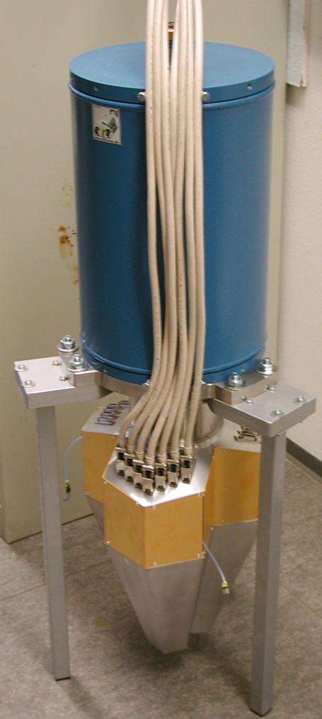
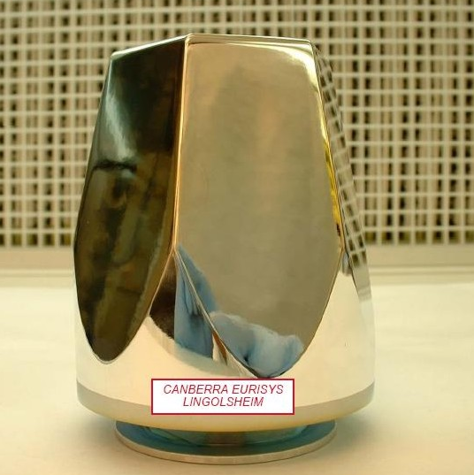
AGATA : The configuration
Ge crystals size:
length 90 mm
diameter 80 mm
180 hexagonal crystals 3 shapes
60 triple-clusters all equal
Inner radius (Ge) 22 cm
Amount of germanium 310 kg
Solid angle coverage 80 %
Singles rate ~50 kHz
6480 segments
Efficiency: 40% (M_{γ}=1) 25% (M_{γ}=30)
Peak/Total: 65% (M_{γ}=1) 50% (M_{γ}=30)

Slide 5
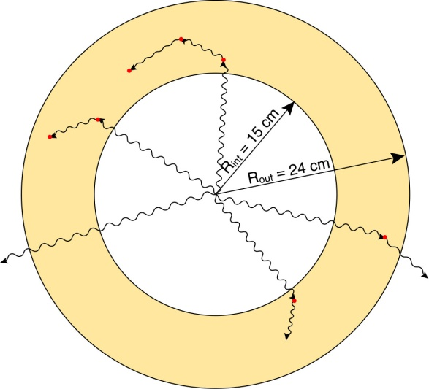
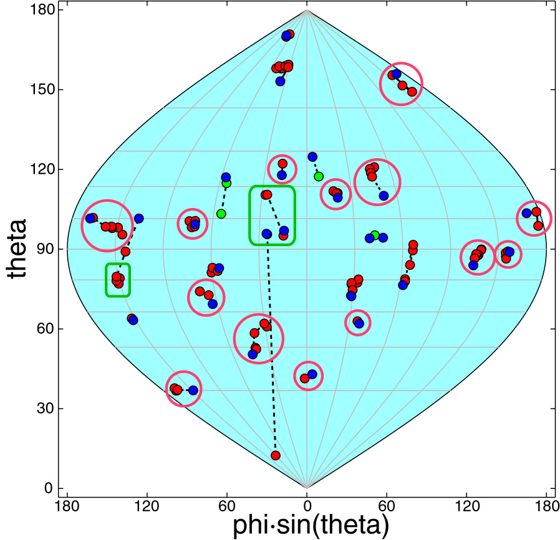
The “Standard” Germanium Shell
Idealized configuration to determine
maximum attainable performance
A high multiplicity event
R_{i} = 15 cm
R_{o} = 24 cm
230 kg of Ge
E_{γ} = 1.33 MeV
M_{γ} = 30
M_{γ}= 1 → ε_{ph} = 65%
P/T = 85%
M_{γ}= 30 → ε_{ph} = 36%
P/T = 60%
27 gammas detected -- 23 in photopeak
16 reconstructed -- 14 in photopeak
Assuming 5 mm Position Resolution

Slide 6

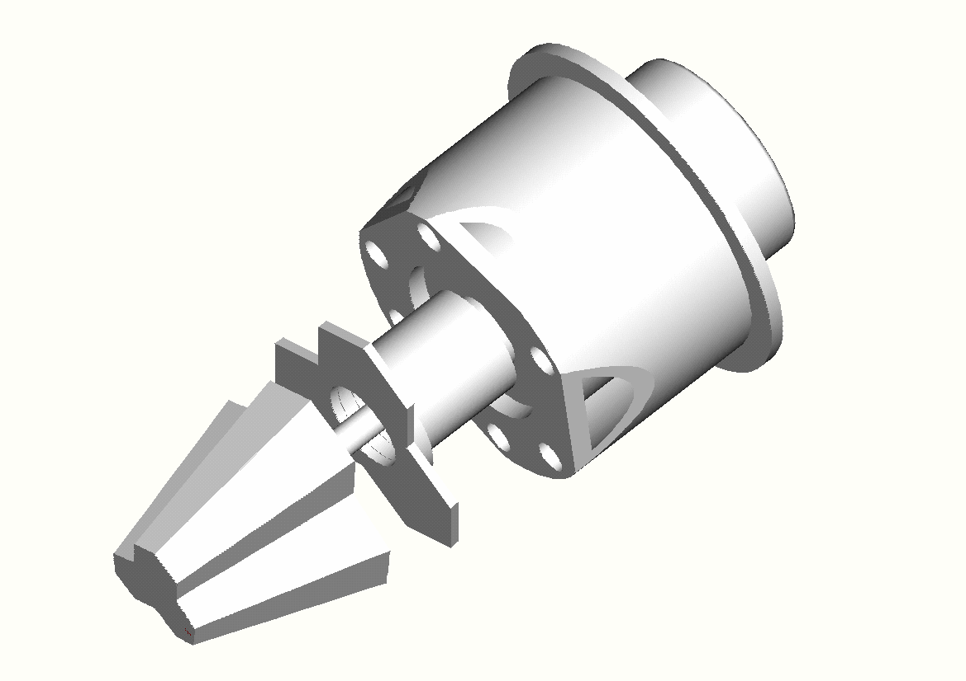
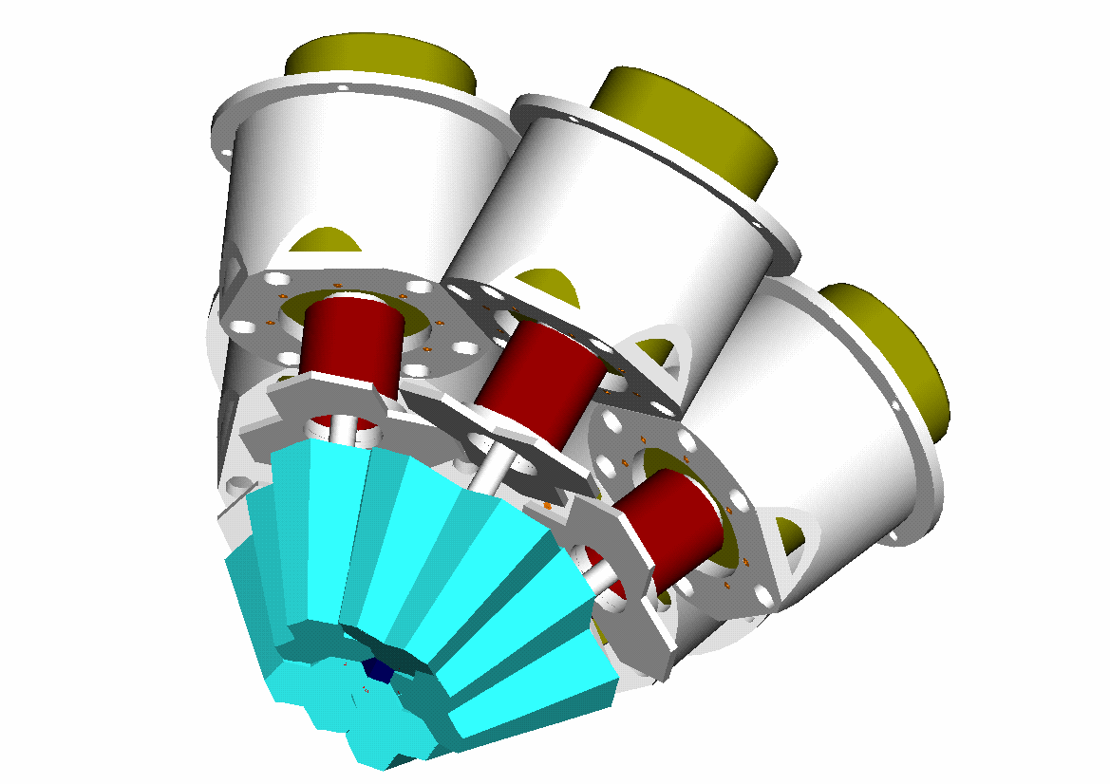
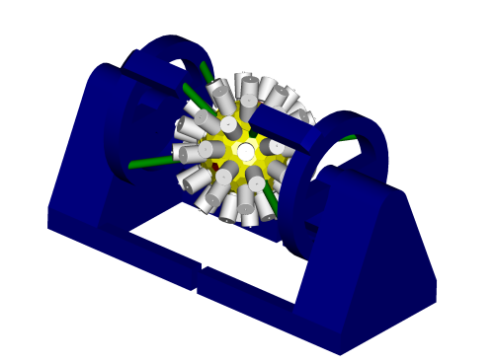
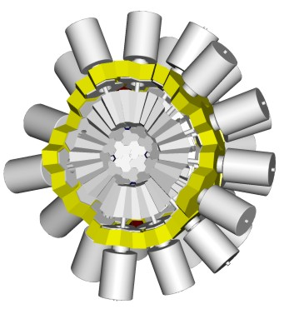
AGATA Design
3 different asymmetric hexagonal shapes are used
Triple cluster modular units in a single cryostat
The AGATA demonstrator: 5 triple clusters, 540 segments. Scheduled for completion 2008
2π of completed array
Completed array (6480 segments) with support structure

Slide 7
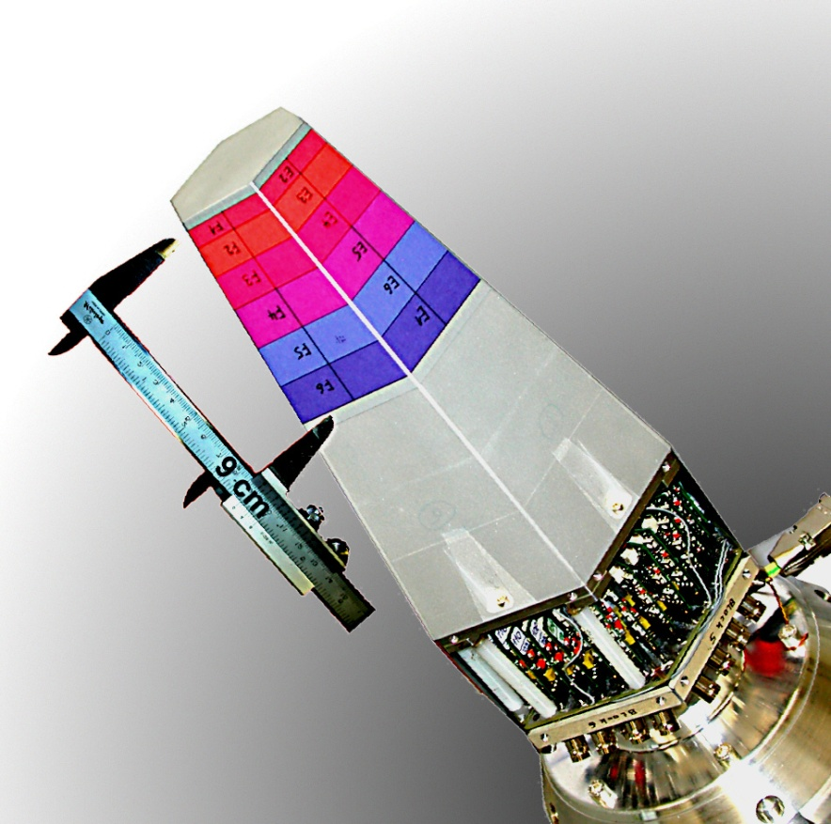
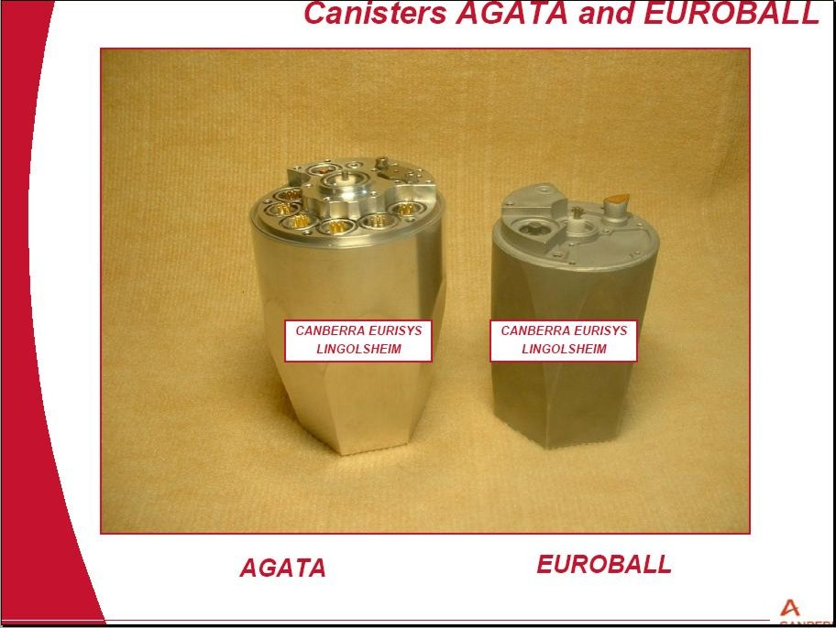
AGATA 1st symmetric cluster

Slide 8
Cs-137 Singles Fine scan
920MBq Cs-137 source
60 sec per position
1mm steps
1mm diameter collimator
Max count rate = 720 cps
Background = 40 cps
600keV CFD threshold
Accepted triggers = 120 cps
180GB pre-sorted data

Slide 9
Core 662keV – Ring gated

Slide 10
Core 662keV & Fold 1, Core T30

Slide 11
Core 662keV & Fold 1, Core T90

Slide 12
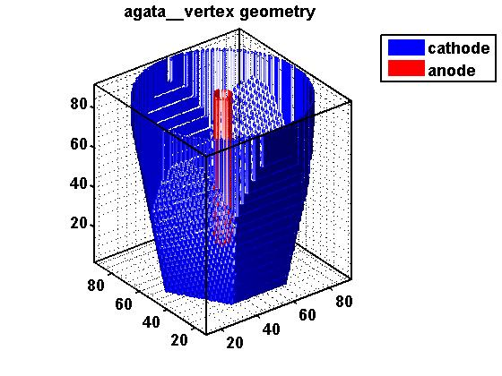
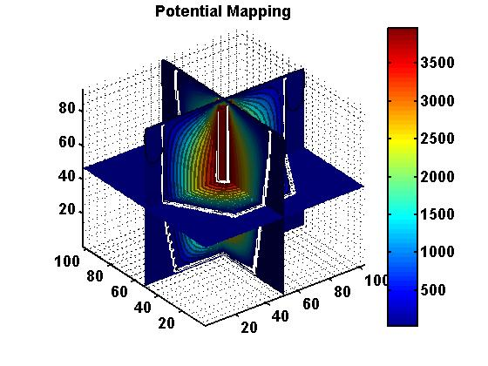
Electric Field Simulations : MGS
Electric field simulations have been performed and details comparisons have been made with experimental pulse shape data.
I
Geometry
II
Potential
Elec field
III
Drift velocities
IV
Weighting fields
AGATA symmetric crystal simulation

Slide 13
Calculation of pulse shapes
•
•
•
•
•
•
•
•
•
•
•
•
•
•
•
•
•
∗
•
net charge signals
transient signals
•
•
•
•
•
•
•
•

Slide 14
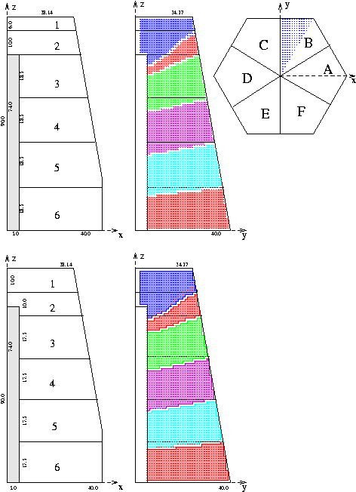
Pulse shape database
A 1mm grid was used to evaluate the pulse shapes.
Following cylindrical symmetry arguments interactions only in seg. B → 25,000 grid points were used.
Net and image charge considered.
662 keV photons from ¹³⁷Cs considered.

Slide 15
Sensitivity
Total average sensitivity:
χ < 1 : Difference in signal is less than noise
χ = 1 : Difference in signal is noise
χ > 1 : Difference in signal is well above noise
Charge collected at time t in segment i for interaction (x,y,z)
Noise factor 1% of total charge
Integration over time in steps of 1ns
Segment that collects net charge and eight direct neighbours

Slide 16
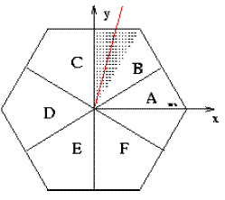
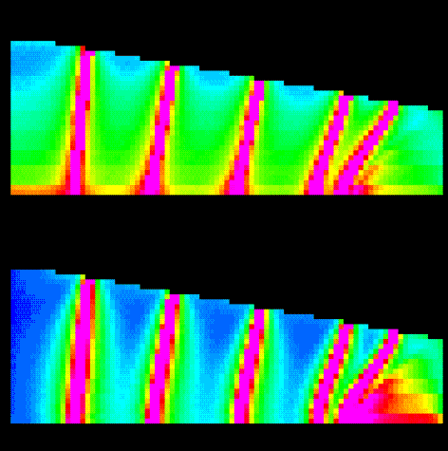
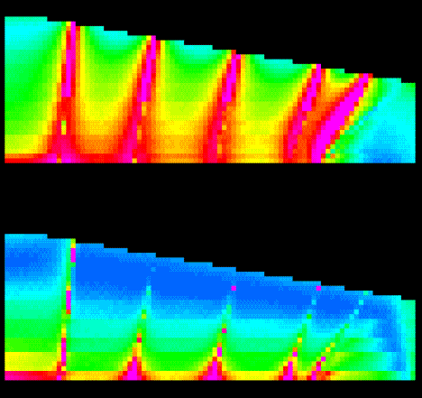

Sensitivity
Demonstration of sensitivity: the position sensitivity peaks at the (effective) segment borders
Regions near the outer surface between segment borders have the poorest sensitivity
total
dy
high
dz
dx
low

Slide 17
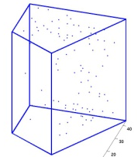
Which grid to choose ?
 |  | advantages | drawbacks
 | r,θ | cst. values of t₁₀₋₉₀… cylindrical | not homogenous
 | √r,θ | cst. values of t₁₀₋₉₀… homogen., cylindr. | not the same x/y accuracy
 | x,y,z | homogenous simple | not cylindrical large distances to grid
 | hexagon, z | cylindrical compact | not compact in z not homogenous
 | hexagonal compact | cylindrical maximum compacity | less “standard”
 | Adaptive grid | optimum conditioning of the problem | not homogenous

Slide 18
Cartesian Grid
Different colors show active regions for the different segments

Slide 19
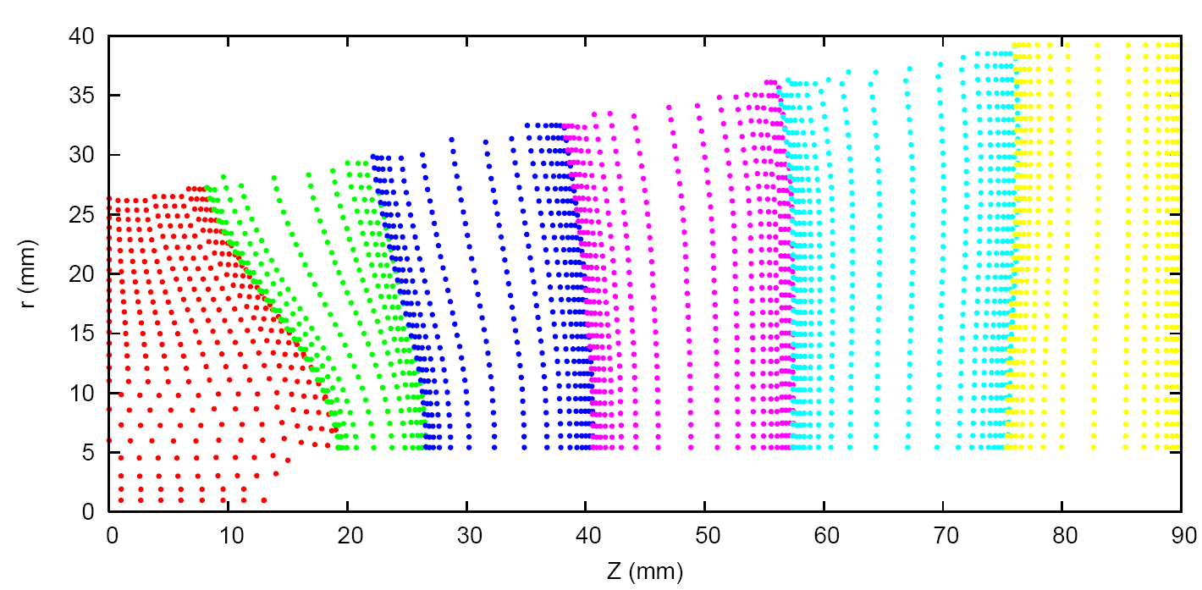
New Quasi-cylindrical Grid
Different colors show active regions for the different segments
Spacing is equidistant in sensitivity

Slide 20
New Quasi-cylindrical Grid
Different colors show active regions for the different segments
Spacing is equidistant in sensitivity

Slide 21
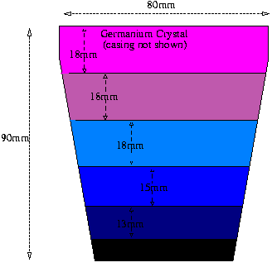
Coincidence scan: set up
Physical segmentation depth:
Collimation gap centred on (w.r.t. crystal base):
90mm
83.7mm
72mm
Div = 2.1mm
65mm
54mm
48mm
36mm
29mm
21mm
13.5mm
8mm
Div = 1.5mm
0mm
2mm

Slide 22
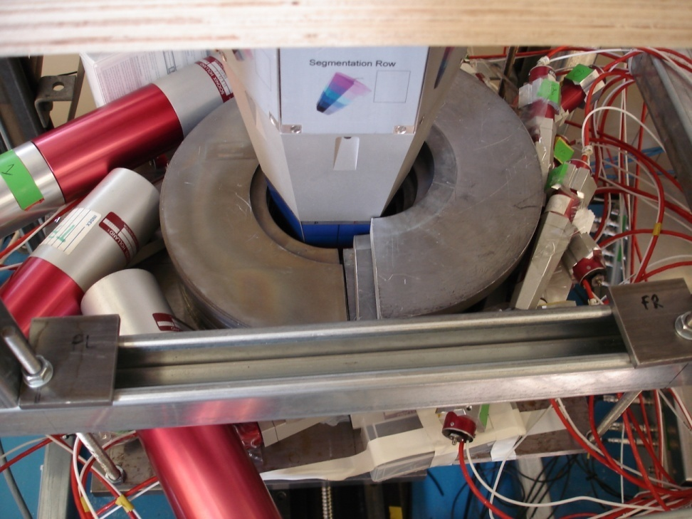
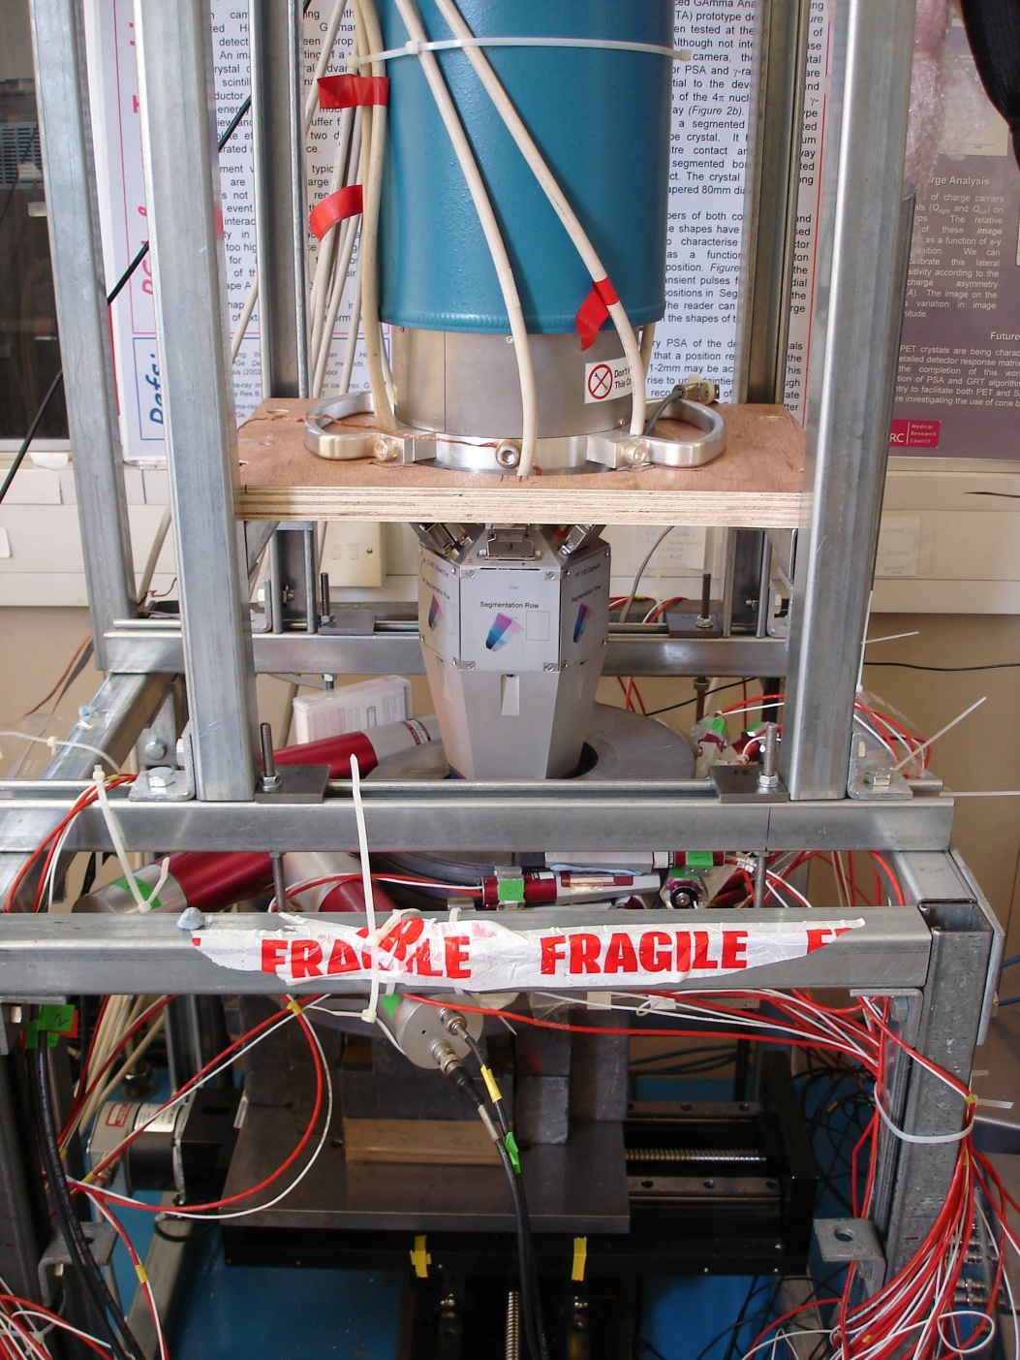
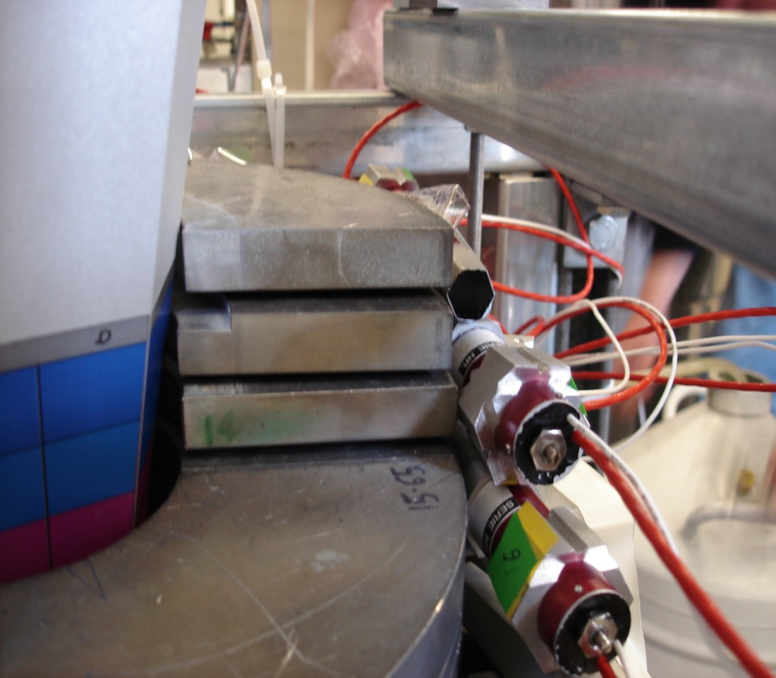
Coincidence scan: set up

Slide 23
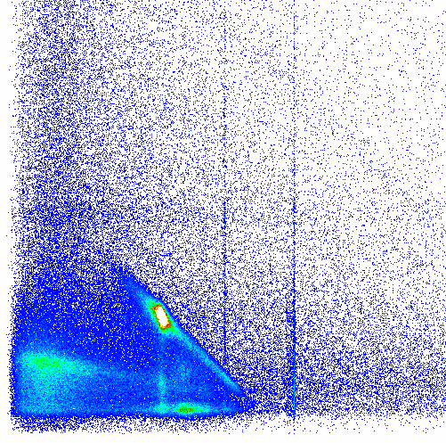
Coincidence results
Matrix of Ge energy vs Total NaI derived from Silena ADCs
The region of interest for “true” coincidences is highlighted in red.
The data was presorted to keep only the data in this region.
  This leaves ~ 1.5Gb of data per line.
  Gzip compressed into three 400Mb files.
Available for download now.
NaI Energy
Region of Interest
288 keV
374 keV
Ge Energy

Slide 24
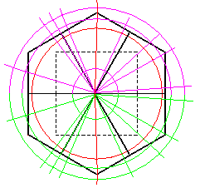
Coincidence scan: plan
2
1
3
6
Azimuth 1
4
7
Azimuth 2
Azimuth 4
F
8
5
Azimuth 3
A
E
9
17
13
B
D
Azimuth 5
Azimuth 7
C
16
Azimuth 6
15
12
11
14
10

Slide 25
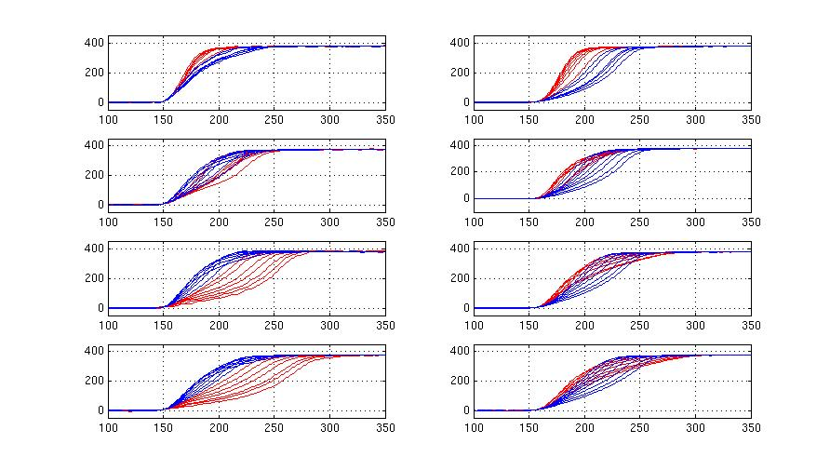
Segment pulses
Centre contact pulses
6.0 mm
15.5 mm
28.5 mm
45.5 mm

Slide 26
Digital Gamma-ray Spectroscopy
Frontiers of gamma-ray spectroscopy
AGATA
GRETA

