Slide 1
Lecture 13: Radiation detectors II
Germanium detectors
  Planar
  Coaxial
  Energy resolution
  Efficiency

Slide 2
Interaction of gamma-rays with matter
Gamma radiation is a very penetrating form of radiation that does not directly ionise the material through with it travels.
The three main interaction processes responsible for gamma-rays interacting with matter are:
  Photoelectric absorption
  Compton Scattering
  Pair Production
Following such an interaction an electron with a finite amount of energy will be left in the semiconductor material.

Slide 3
Germanium : Advantages
Germanium semiconductor detectors are the configuration of choice for gamma-ray spectroscopy:
  Can be made hyperpure and therefore large crystals can be fully depleted.
  High Z (32) compared to Silicon (14) (Cross-section for photoelectric absorption ∝Z⁴).
  Excellent energy resolution due to low (3eV) ionisation energy – much better than scintillator technology

Slide 4
Germanium detectors
Germanium semiconductor detectors are the detector of choice for applications in gamma-ray spectroscopy.
The major limitation is the maximum depletion depth or active volume that can be created ~3mm for normal semiconductor purity.
Much thicker detectors are required for gamma-ray spectroscopy.

Slide 5
Germanium detectors
To accomplish this goal there are two general approaches:
  Further refine the semiconductor reducing the impurity concentration to ~10¹⁰atoms/cm³. Such an impurity concentration would give a 1cm depletion depth at 1000V reverse bias. Techniques have been developed to achieve this goal in Germanium, but not in Silicon. Detectors based on this technique are called High-Purity Germanium detectors (HPGe).
  Create a compensated material where residual impurities are balanced by equal concentration of dopant atoms. Such lithium ion drifting is added to the semiconductor following crystal growth. Such detectors are called Ge(Li) detectors.
HPGe detectors have superseded Ge(Li) detectors because HPGes offer much better operational convenience.
Exercise: Calculate d for a planar HPGe detector with a net impurity
concentration of N=10¹⁰ atoms/cm³ and a reverse bias of 2000 V

Slide 6
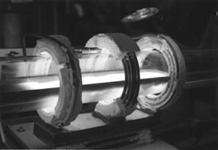

HPGe detector fabrication
Starting material is bulk Ge for semiconductor industry, already of high purity
Processed by zone refining: impurity levels are progressively reduced by locally heating and slowly passing a melted zone through the material many times
Impurities are more soluble than Ge: they are transferred to the molted zone and swept away
Large single crystals of Ge are slowly grown from this material of extremely high purity

Slide 7
HPGe detector manufacturing
Good?
Poly Crystalline
Zone
Refiner
Crystal
Puller
Ge Single
Crystal
Boron
Implant
Wet
Lab
Lithium
Diffusion
Mechanical
Preparation
Good?
Good?
Load in
Cryostat
IV
Test
Spectroscopy Test
Good?
Mechanical
& electronic
Ship
Thermal
Cycle
Courtesy Ortec, Oak Ridge, USA

Slide 8
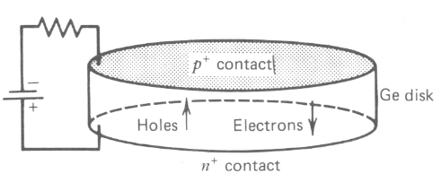
HPGe detector configurations
Planar detectors:
  The n⁺ contact can be formed by lithium evaporation and diffusion or ion implantation.
  The detector depletion region is formed by reverse biasing the n⁺-p junction.
  The other contact must be non-injecting for a majority carrier. It may consist of a p⁺ contact formed by ion implantation of acceptors (thin) or a metal-semiconductor surface barrier (Shottky barrier).
Fully depleted detector
Operated at 77K

Slide 9
Planar Germanium detectors
Are operated as fully depleted detectors.
  Reverse bias requires that a positive voltage be applied to the n⁺ contact with respect to the p⁺ surface.
  The depletion region begins at the n⁺ contact and extends further into the detector as the voltage is raised.
  Further increases in voltage increase the E-field everywhere by a uniform amount.
The detector voltage is increased in order to saturate the drift velocity of the charge carriers minimising collection time and detrimental effects due to carrier recombination and trapping.
Saturation velocity for electrons in germanium at 77K is reached with a minimum field of 10⁵V/m

Slide 10
Closed-end coaxial Germanium
In the closed end coaxial configuration the electric field lines are no longer radial, as they would be in the true coaxial case.
The bulletized closed end geometry rounds the corners of the crystal which helps prevent localised weak E-fields.
n-type crystal

Slide 11
Types of contacts on coaxial detectors
Li diffusion is used to form the n+ contact
Boron is ion implanted to produce the p+ contact.
In Coaxial crystals:
Outer Contact Inner Contact
p-type n(Li) p(B)
n-type p(B) n(Li)
The n ~ 600 μm - 1 mm, p contact is very thin ~ 0.3 μm.
Advantages of n-type material:
1. usable to lower energy
2. about 20 times more resilient to neutron damage.
Disadvantages:
1. Expensive
2. coincidence summing between γs and low energy x-rays.

Slide 12
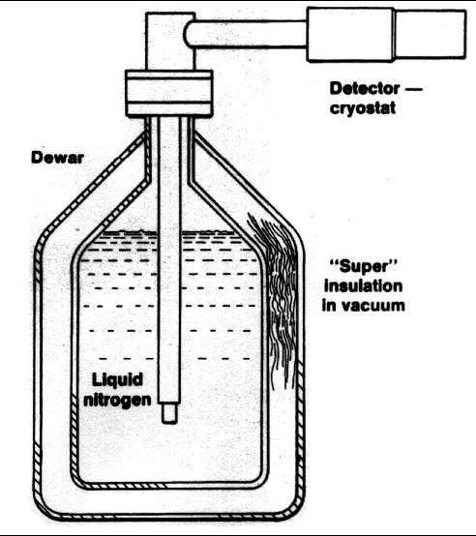
HPGe detectors
Typical cryostat assembly for a HPGe detector

Slide 13
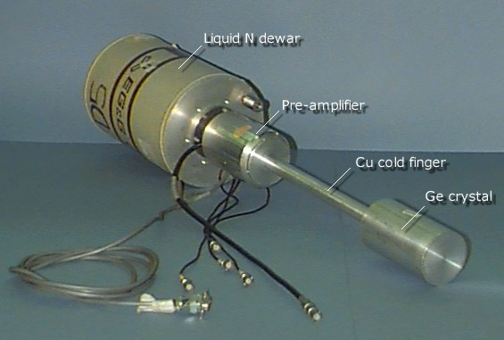
Coaxial Germanium detector

Slide 14
Coaxial Germanium detector
In order to determine the drift velocity of the charge carriers within the detector volume Poisson’s equation is solved.
Poisson’s equation in cylindrical coordinates becomes:
Treating the case of a true coaxial detector the voltage needed to fully deplete the detector can be written:
Notice the depletion voltage decreases linearly with dopant level.

Slide 15
Germanium: Energy resolution
The overall energy resolution is normally determined by a combination of three factors:
W_{D} is the inherent statistical fluctuation in the number of charge carriers created.
  This is given by:
  Where F is the Fano factor, ε is the ionisation energy and E is the gamma-ray energy
W_{X} is due to incomplete charge collection (important in large volume detectors).
W_{E} is from the broadening effects of all electronic components following the detector.
W_{Doppler} is the Doppler component from a moving source

Slide 16
Germanium: Energy resolution
Typical values for a standard coaxial HPGe:
● WT = 1.0 keV at dE = 122 keV
● WT = 2.0 keV at dE = 1332 keV (WT/dE=0.15%)

Slide 17
Detector Efficiency
Absolute full-energy efficiency = (counts in peak) / (number of emitted gamma rays)
Intrinsic full-energy efficiency = (counts in peak) / (number of gamma rays incident on the detector)
Relative full-energy efficiency = efficiency at 1332 keV (⁶⁰Co source) relative to a 3 x 3 in. cylindrical NaI(Tl) crystal with a source-detector distance of 25 cm
100
Intrinsic
full-energy peak
efficiency(%)
both
n- & p-type
n-type
10
p-type
1
10
10²
10³
10⁴
1
Photon energy (keV)

Slide 18
Germanium detector spectrum
⁸⁸Y collected on a High Purity Germanium Detector

Slide 19
Lecture 13: Radiation detectors II
Germanium detectors
  Planar
  Coaxial
  Energy resolution
  Efficiency

