Slide 1
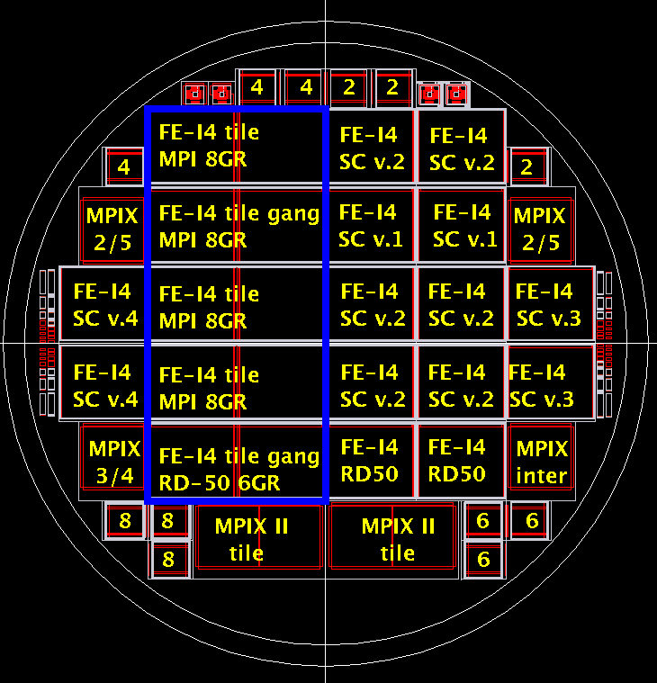
FE-I4 SC v.4 = Live FEI4 MPI Guard IBL Slim Edge
FE-I4 SC v.3 = Live FEI4 MPI Guard IBL Slim Edge ganged pixels
FE-I4 SC v.2 = Live FEI4 MPI Guard IBL ganged pixels
FE-I4 SC v.1 = Live FEI4 MPI Guard IBL
FE-I4 RD50 = Live FEI4 RD50 Guard IBL ganged pixels
SEE M* FOR MEDIPIX POSITION ON WAFER
M1
M2
M3
M4

