Slide 1



Characterization of Silicon Photomultipliers for beam loss monitors
Lee
Liverpool University weekly meeting

Slide 2
What I will talk about
Short introduction about me
What are SiPMs and their uses
Experiments performed
Results and implications

Slide 3
Beam Loss monitoring
Due to the size of proposed linear colliders, what is required is a beam loss monitor that can span long lengths for beam alignment and machine protection.
One proposed method is optical fibers along the beam line
Charged particles may cross these fibers inducing Cherenkov radiation which may be trapped within the critical angle of the fiber and travel down the fiber.
A detector is placed at the end of the fiber.
A detector with large dynamic range is required .
One option is to use a Silicon Photomultiplier (SiPM)

Slide 4
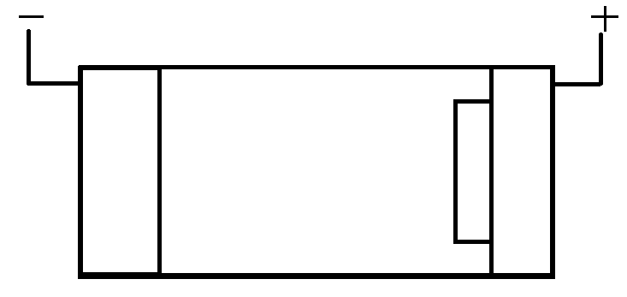
Principles of SiPM operation
P⁺
π
n⁺
P
hole

Slide 5
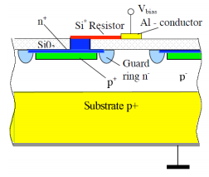
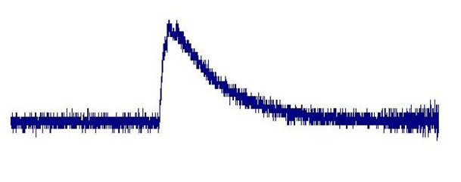
Principles of SiPM operation
Output is quenched passively by a resistor
Quenching reduces output to original state and the process can start again
An SiPM is covered in these cells.
The general shape of the SiPM output is given by the rise time of a signal and the quenching time of the output falling back to zero

Slide 6
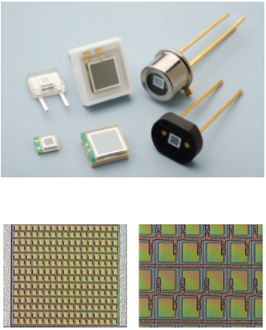
SiPMs
Compact
  From 1 to 3.5 mm²
Insensitive to magnetic fields
Low operational voltage
  Tens of volts
Versatile
  Widely used
Cheap
  $100’s per detector
A collection of mounted SiPMs
Array of cells and quenching resistors

Slide 7

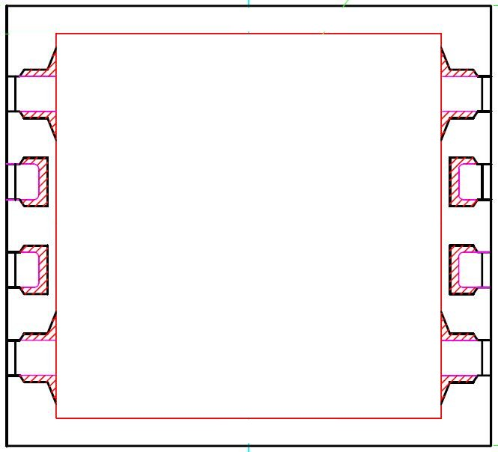
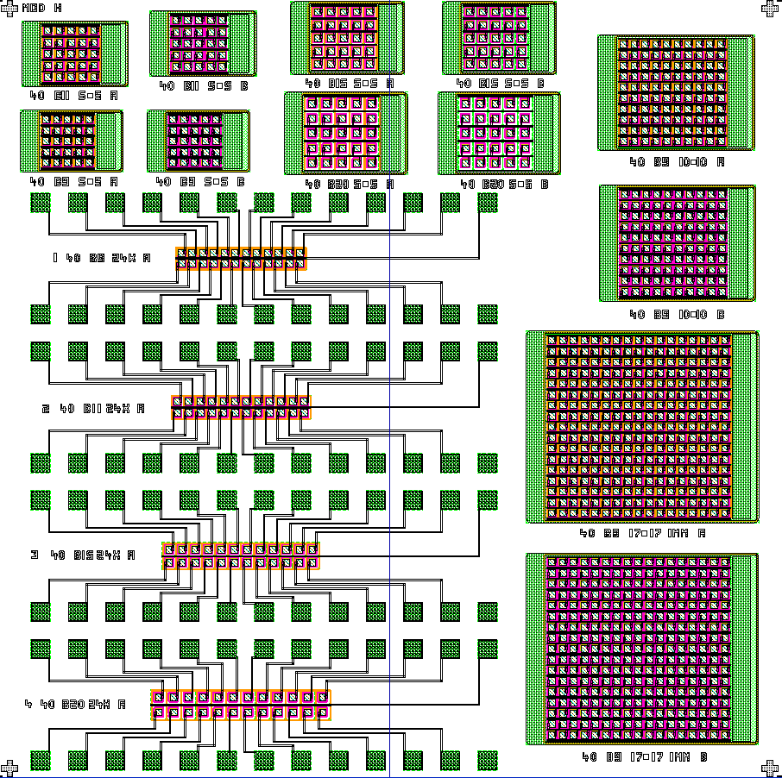
SiPMs under consideration
Two prototype SiPMs were considered
1.STMircoelectronics – Module H
2.Hamatsu – S10362- 11-100C
Both SiPMs have different architecture and very different bias voltages

Slide 8
Experiments undertaken
Total noise
- To define count rate plateaus
After pulsing
- Not essential for characterisation but interesting to observe after pulsing
phenomenon
Time and Spatial resolution
- To benchmark detector limits for triggering a signal
Photon resolving power
  - To find the maximum/minimum detectable photons

Slide 9
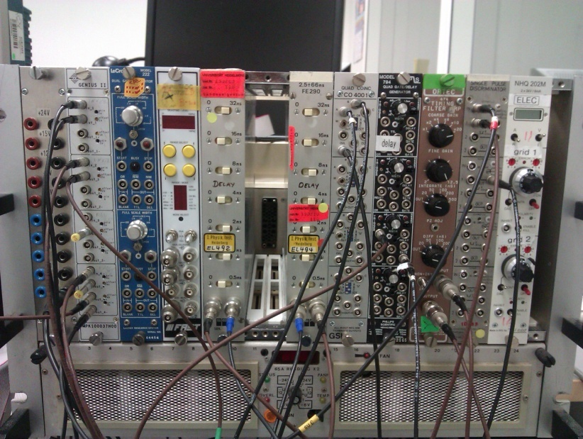
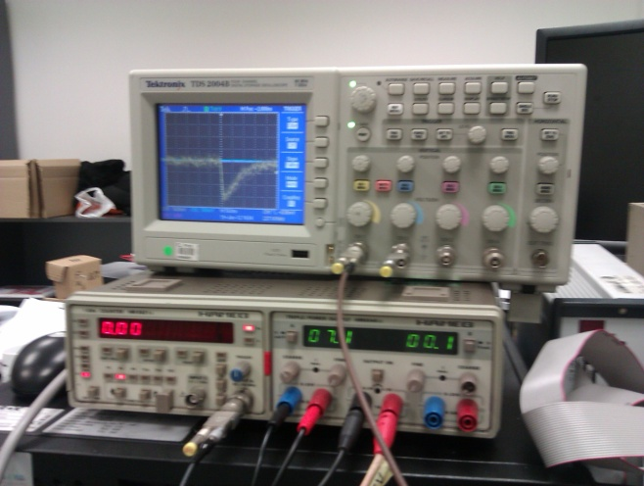
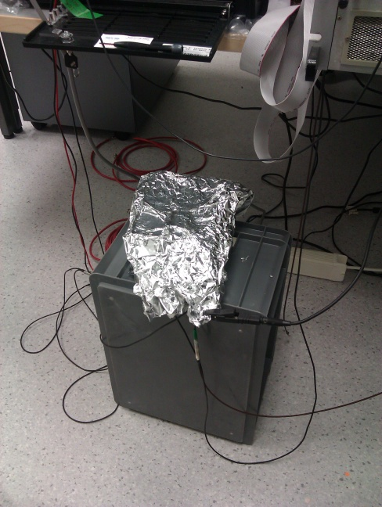
Equipment and layout
NIM modules
Counter / power generator
Fan to cool modules
LED
SiPM

Slide 10

Experiment 1 – Total noise
First experiment was designed to measure the dark count from the SiPM.
Dark counts come from various sources but high proportion are from thermally induced electrons which cause an avalanche
This was done by activating the SiPM without firing

Slide 11
Total noise results (ST module H)
ST module H
9/18

Slide 12
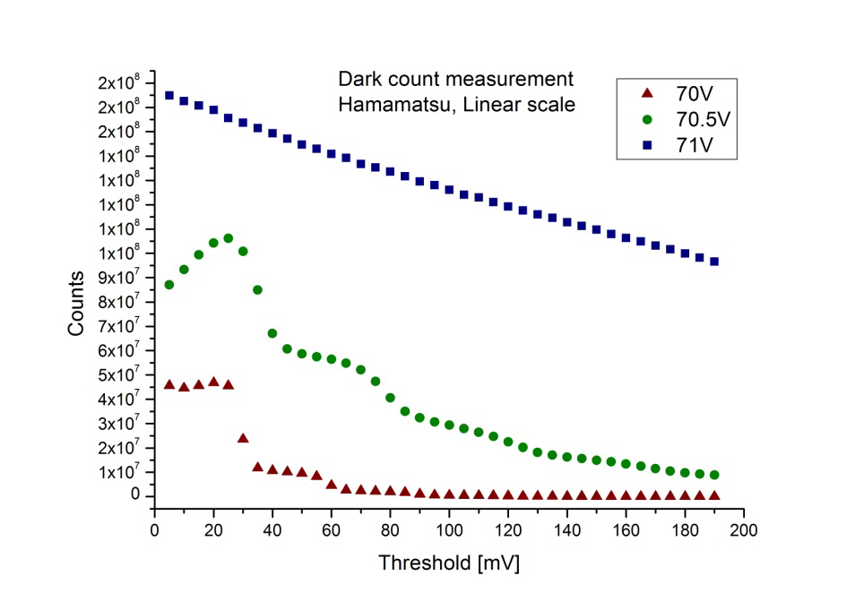
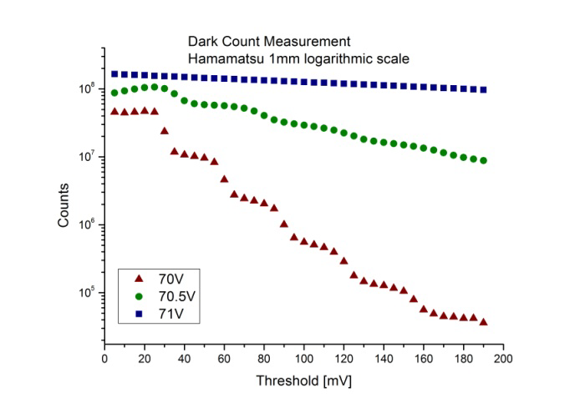
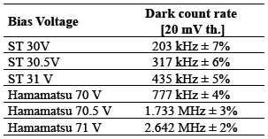
Total noise results (Hamamatsu)
Overall results

Slide 13

Experiment 2 – After pulsing
After pulsing is an effect caused by impurities in the SiPM
Electrons become trapped in the device
Released about 100ns later causing an avalanche and a signal after the main signal
To characterise the SiPM for after pulses, the number of pulses within a 100 micro seconds window and moving the start of this window along
Time delay between window and main pulse
We want to count the number of pulses in this region
Main pulse
Window width 100 micro s
10/18

Slide 14
Experiment 2 – After pulsing
SiPM
Amplifier
Inverting i/o
Linear fan out
Discriminator
Discriminator
Gate generator / delay module
AND gate
Counter
11/18

Slide 15
Experiment 2 – After pulsing results
12/18

Slide 16
Experiment 3 – Time resolution
An important quantity is the resolution of the SiPM as this links to spatial resolution to BLM
What affects the resolution of the SiPM
Charge collection time ~ 10ps
Avalanche propagation time ~ 10’s ps
Electron drift time ~1ps
Read out electronics ~10’s ns(major)
The sigma of the distributions indicates the temporal uncertainty

Slide 17
Experiment 3 – Time resolution
Pulse generator
LED
SiPM
Amplifier
Linear fan out
Discriminator
oscilloscope
Gate generator
Stop signal
Start signal
TDC

Slide 18
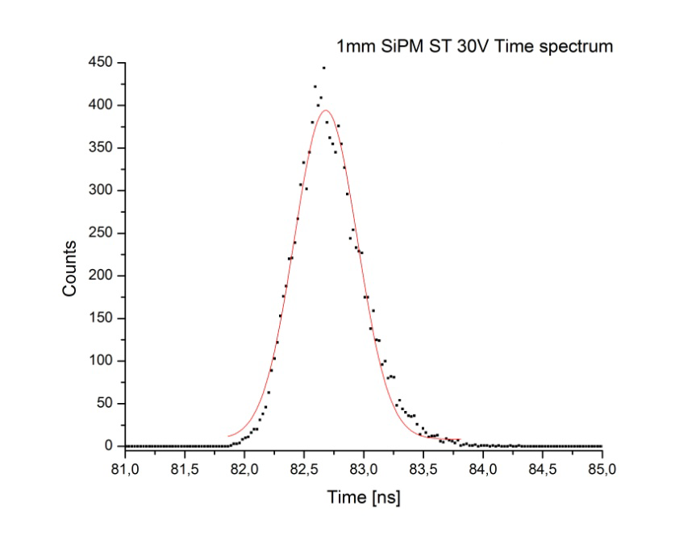
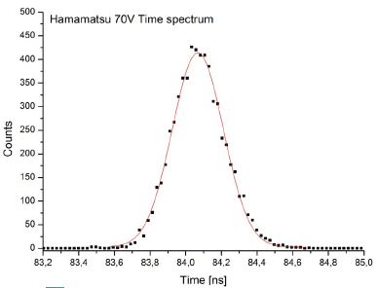

Experiment 3 – Time resolution

Slide 19
Experiment 4 – Spectrum
The final and longest experiment was the spectrum measurement
The SiPM was left to fire pulses for a long period of time
The signal is converted to digital such that the entire spectrum of SiPM output pulses is recorded.
The output of a charge spectrum should (in theory) result in multiple peaks representing multiple cell activation. However due to noise etc the distribution is more a convolution of a Poisson distribution from cells firing and a Gaussian distribution due to noise etc
Charge spectra greatly influenced by :
1) Bias voltage
2) Light source intensity

Slide 20
Experiment 4 – Spectrum
Pulse generator
LED
Gate generator
SiPM
Delay module 45 ns
Amplifier
ADC

Slide 21
Experiment 4 – Spectrum
ST
Hamatsu

Slide 22
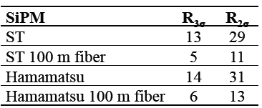
Experiment 4 – Spectrum
The resolving power is the number of measured photons , where the separation between two consecutive peaks is three times the variance.
The peak resolution is two times the variance
Resolution power of both SiPMs with and without fiber

Slide 23
Thanks for listening
Special thanks to Marco Panniello

