Slide 1
Standard Model Diphoton Background
DIPHOX and RESBOS

Slide 2
Motivation
Standard model diphoton spectrum not very well understood.
Has been studied mostly at ‘low’ diphoton masses for Higgs background estimation.
Aim: extend studies into higher mass region where relevant for BSM diphoton signatures
(e.g. GMSB SUSY, graviton searches etc.)
Need (at least) NLO estimates of diphoton production. Two cross section calculators with different ingredients studied by H→γγ people:
RESBOS
DIPHOX

Slide 3
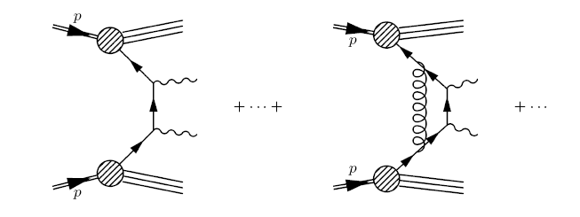
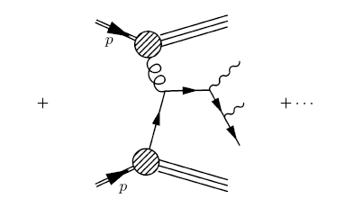
DiPhox Ingredients…
“Direct” Photon production
i.e. not from π⁰, η, ω
LO Born:
NLO O(α_{S})
…and

Slide 4
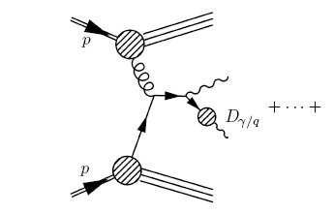
Soft and collinear singularities: Single fragmentation or “Bremmstrahlung”
+
+ ∙ ∙ ∙
Fragmentation functions:
asymptotically of same order as Born term!
May dominate because high gluon density
need higher order terms for consistency.

Slide 5
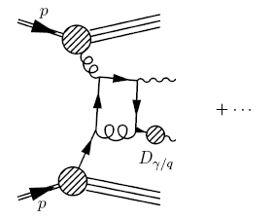
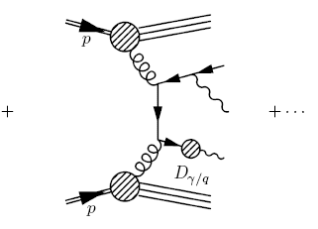
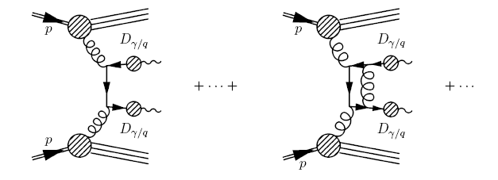
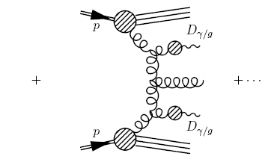
So include these “NLO” terms:
And “double fragmentation” terms:
“LO”
“NLO”

Slide 6
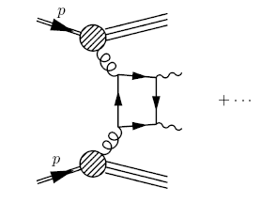
Include “Box” contribution gg→γγ
NNLO (LO for gg→γγ) but high gluon density nearly cancels extra α_{S}.
Other gg initiated NNLO terms probably important as well but not included yet. e.g.
Higher order corrections to Box may be large (hints that ~50%!) – and will have their own scale dependencies cancelled only at still higher order.
Fragmentation scale, , dependence only cancels when direct, one and two fragmentation contributions summed.

Slide 7
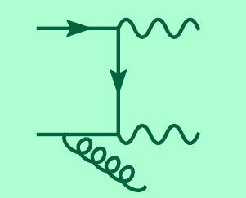
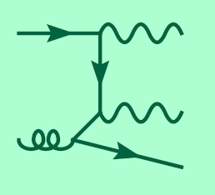
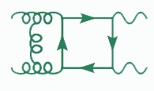
RESBOS?
Factorisation of hard cross-section and PDF based on longitudinal momentum fractions . But:
Colour neutral
Divergencies when Q_{tγγ}→0
Multiple soft gluon emission
RESBOS resums large ln(M_{γγ} /Q_{t}) terms
Q_{tγγ}
Has HO box
But only LO, single fragmentation

Slide 8
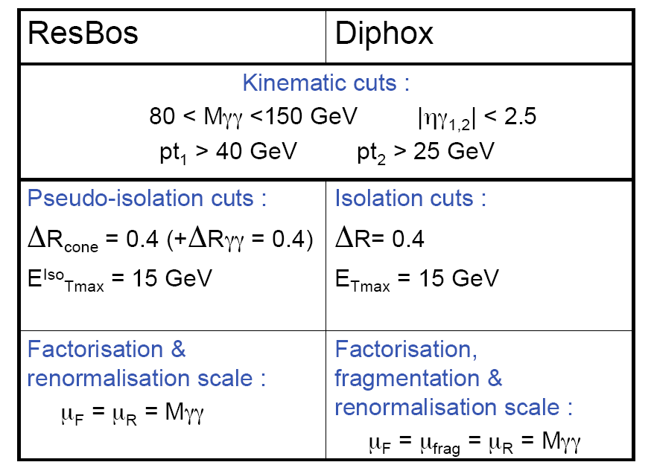
Existing study:

Slide 9
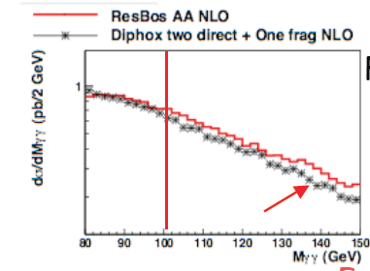
What happens when M_{γγ} ∼ 1TeV?
Status:
RESBOS and DIPHOX packages obtained (FORTRAN+perl scripts!)
DIPHOX running and trying to reproduce existing results.

Slide 10
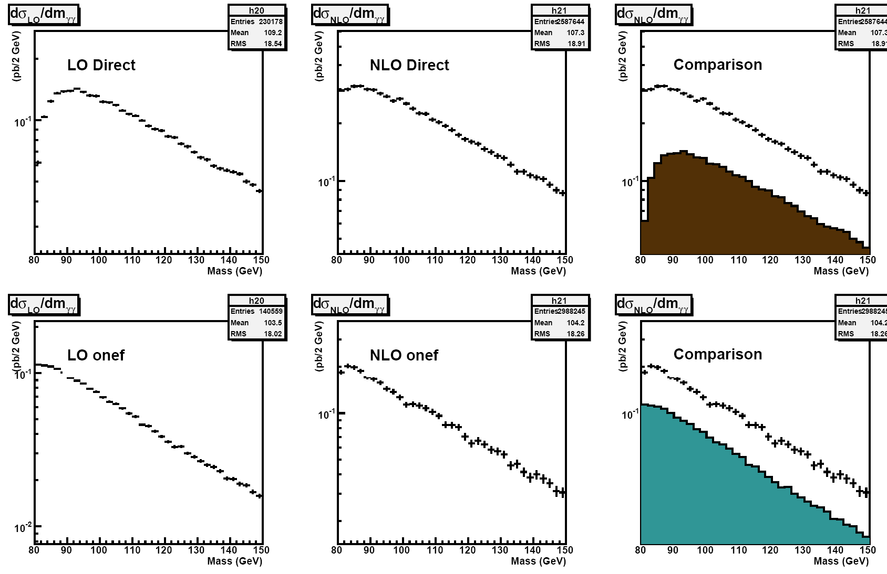

Slide 11
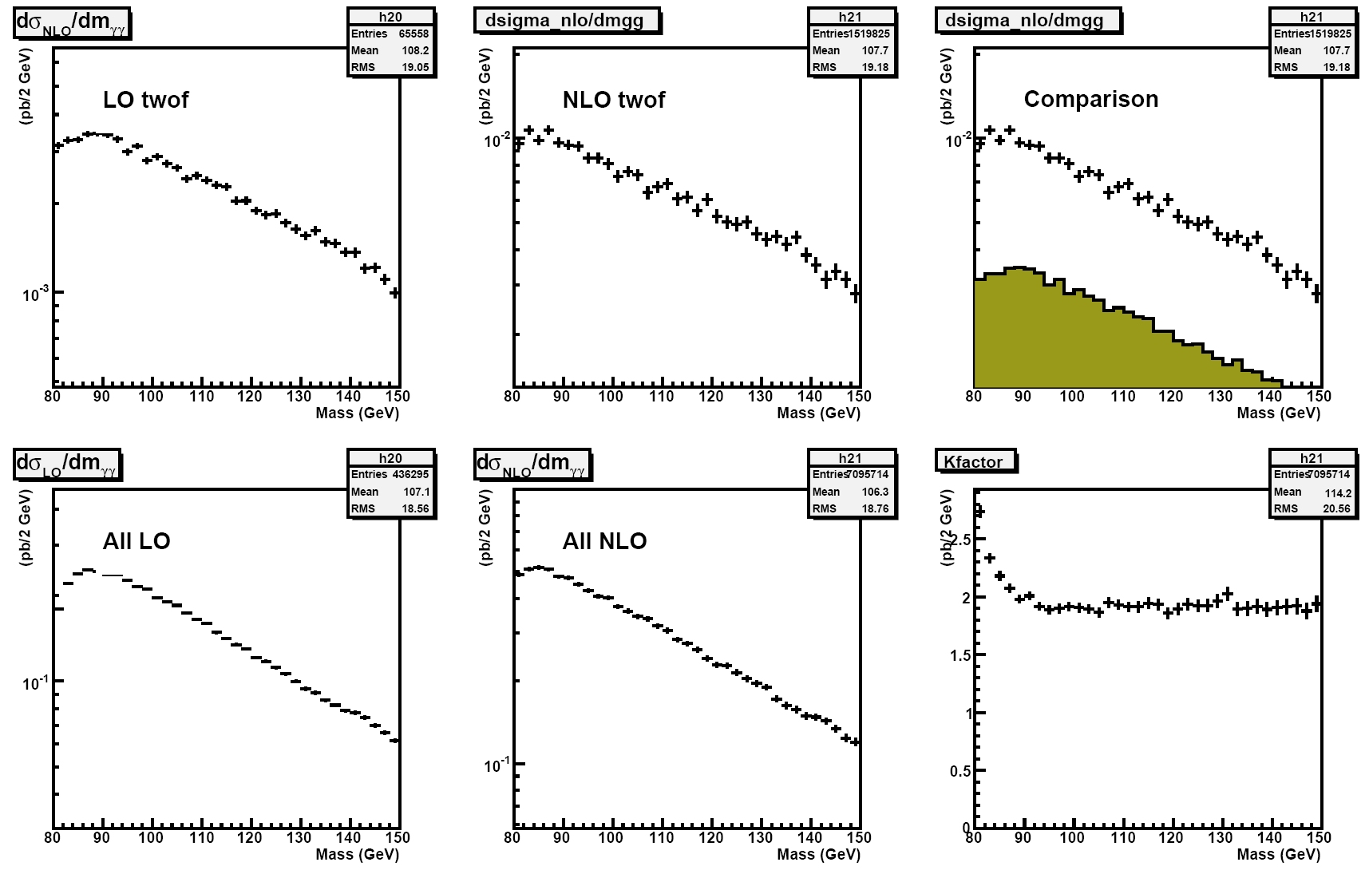

Slide 13
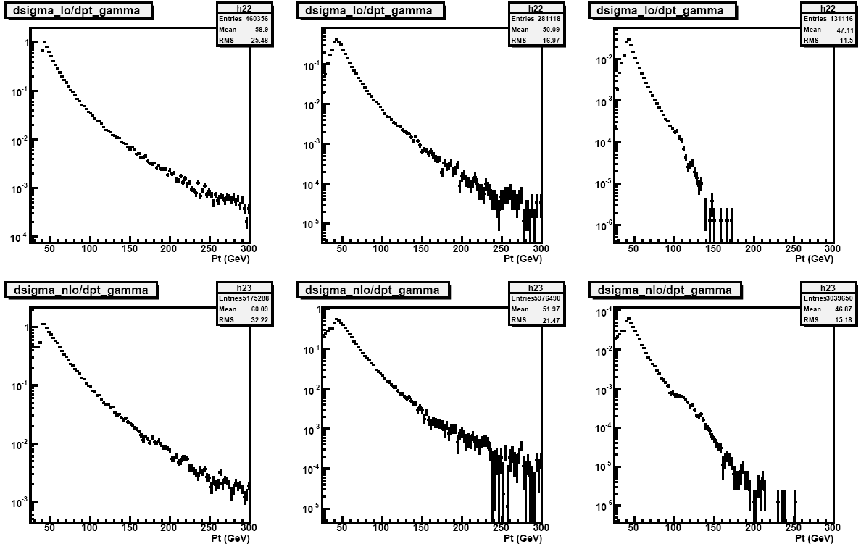

Slide 14
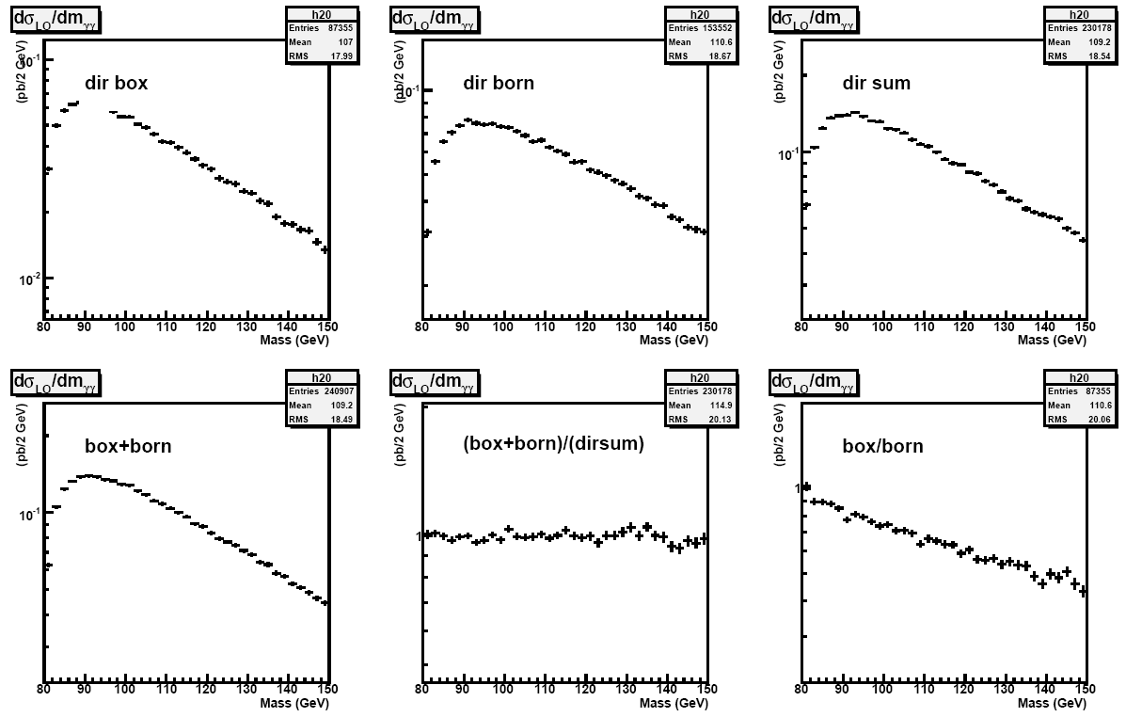

Slide 15
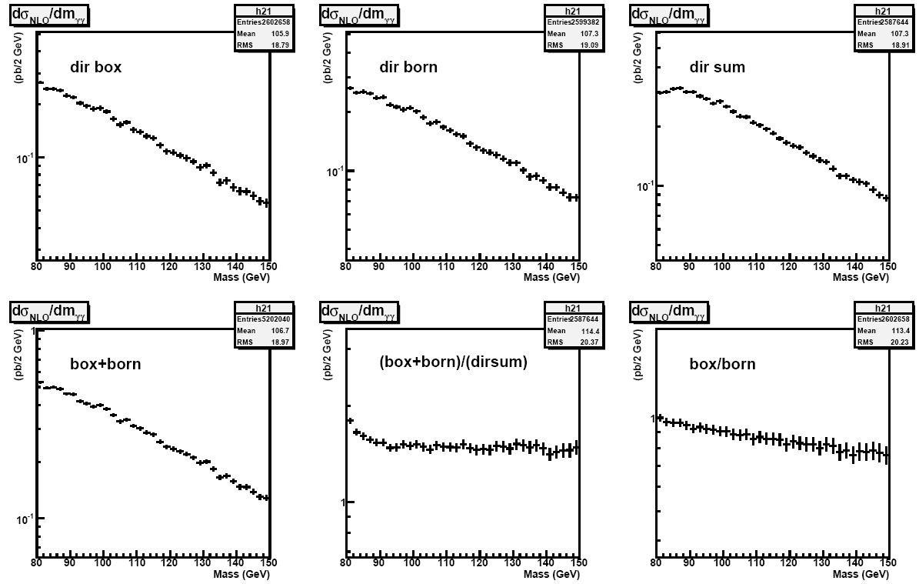

Slide 17
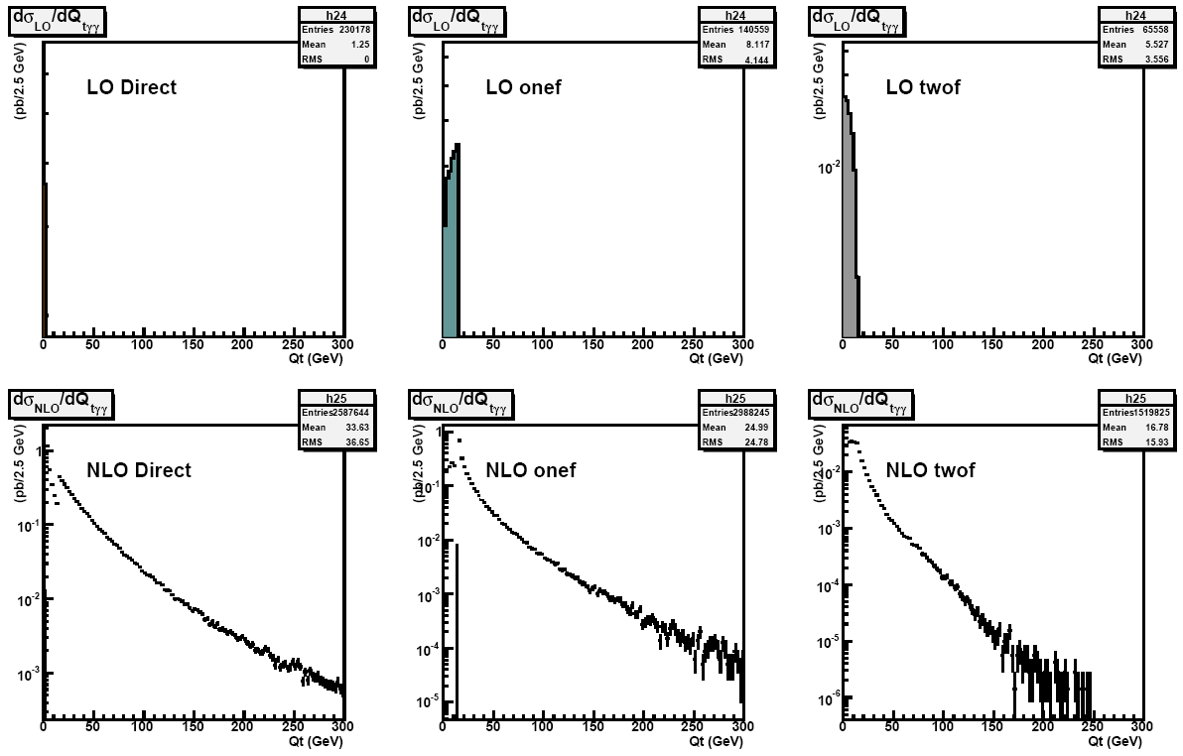

Slide 18
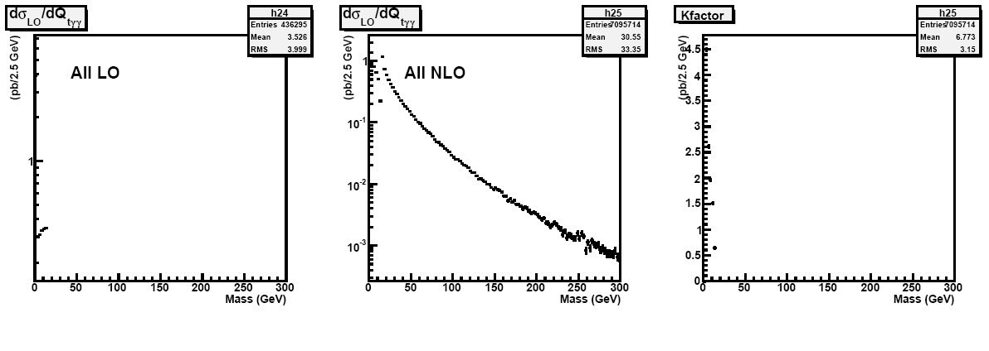

Slide 19
Next steps
Try and understand peculiarities and complete cross-checks for DIPHOX
Extend to high M_{γγ}
Get RESBOS running
Event generator?

