Slide 1
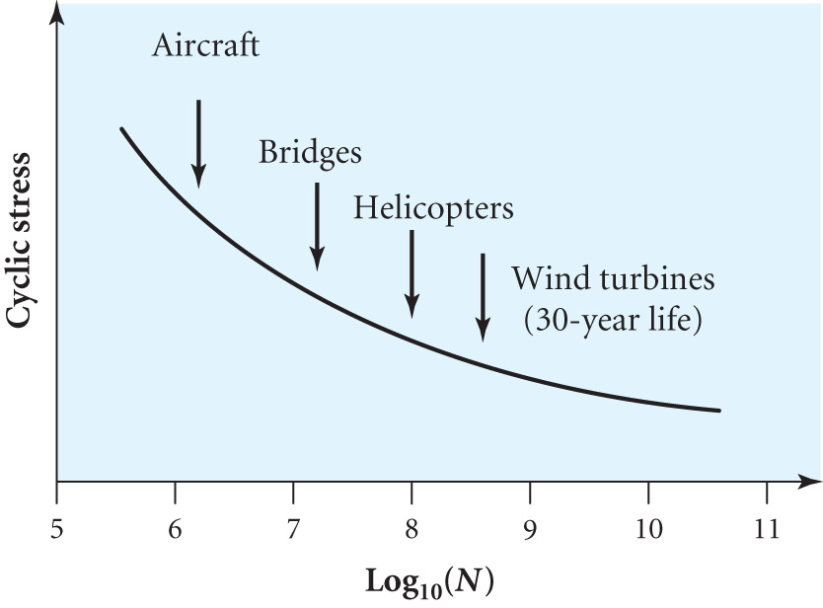
FATIGUE IN WIND TURBINES
A severe problem as in a 30 year life span a turbine will make typically ~ 10⁸ rotations
Fatigue failure is the fracture of material subjected to repeated cycles with changing loads
In the plot N is the number of
cycles to failure
Need low value for the
maximum stress
Composites such as carbon fibre
and carbon/glass hybrids are being developed
In the 1980s wind turbines in California suffered blade failures due to the fatigue not being fully understood

Slide 2
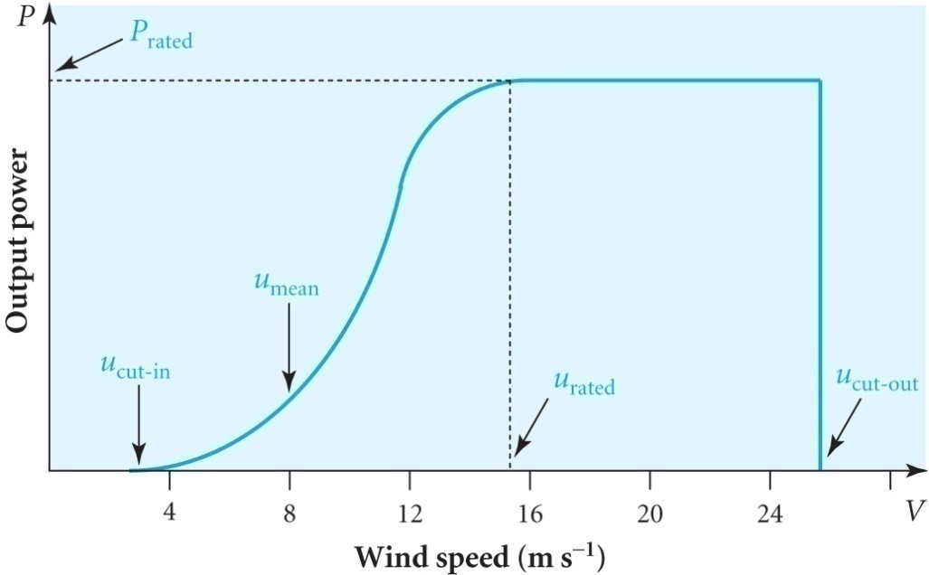
TURBINE CONTROL AND OPERATION
Orientation to the wind direction is by the yaw control mechanism
Ignoring friction the wind torque = opposing generator torque in steady operation
If the rated design speed is chosen to match the grid frequency then although control is simple with fixed blade pitch the aerodynamic efficiency cannot be optimised with changing wind speed
As the wind speed increases the angle of attack α gets larger and lift drops as the blade stalls
For a constant speed and fixed pitch turbine
the blades are optimised for u_{mean}
u_{rated} is speed to produce maximum
power P_{max}
λ and C_{P} vary with wind speed so
P_{max} (14 m/s) is ~ 2.5 x P(8 m/s)
rather than(14/8)³ = 5.4 times

Slide 3
Modern turbines are variable speed and variable pitch and use
AC-DC-AC converters to match the grid frequency
Allows C_{P} to be optimised when wind speed > minimum u_{cut-in}
Generally only the speed is altered by varying the generator load and hence torque, for wind speeds up to u_{rated} after which the speed is kept constant and the pitch of the blade is adjusted to reduce the wind torque and keep loads on turbine within safe limits
There is a balance between the maximum power output and the capital cost as large expensive generators would be needed to take advantage of periods of high wind speeds
This results in rating generator powers typically at 3 x average power output leading to a capacity factor of 1/3
Turbines typically operate for 65 – 80% of the time between u_{cut-in} and u_{cut-out}
Specific energy output is the output per unit of swept area and is useful in comparing different designs

Slide 4
Example:-Calculate the average power output of a wind turbine with blades 85 m diameter operating in a mean wind speed of 7 ms⁻¹ at which C_{P} = 0.45. If the rated power output is 1.5 MW at wind speeds > 13ms⁻¹ calculate the value of C_{P} at 13ms⁻¹.
From P =½ ρ u₀³ A₁ C_{p} (7.9) we get
0.45 = P / [ ½ x 1.2 x (π 85²/4) x 7³] so
∴ P = 526 kW at 7 ms⁻¹
At 13 ms⁻¹ C_{P} = 1.5 x 10⁶ / [ ½ x 1.2 x (π 85²/4) x13³] = 0.20

Slide 5
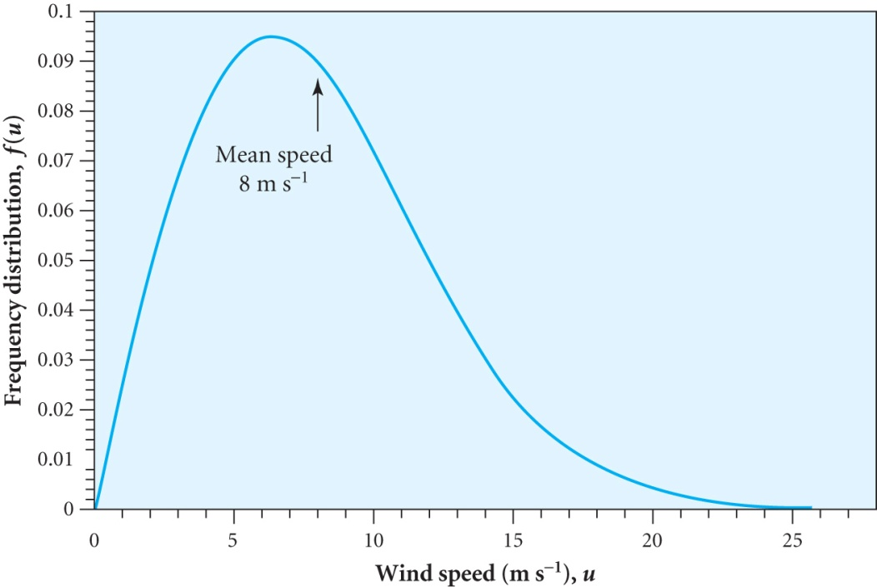
WIND CHARACTERISTICS
Wind speed fluctuates over periods of minutes, hours and days
Averages are taken over a 10 minute period
Shorter fluctuations quantified by
I_{T} = σ_{T}(u) / u depends on terrain
height approximately as [ln(z/z₀)]⁻¹
where z is the height of the turbine
and z₀ characterises the terrain
For annual mean wind speeds greater
than 4.5 ms⁻¹a steady wind has a
Rayleigh frequency distribution f(u)
given by f(u) = (2u/c²) exp [-(u/c)²]
where c = 2<u>/π^{1/2} and <u> is the
average wind speed (9.1)
Terrain | z₀(m)
Urban area | 3 – 0.4
Farmland | 0.3 – 0.002
Open sea | 0.001 – 0.0001

Slide 6
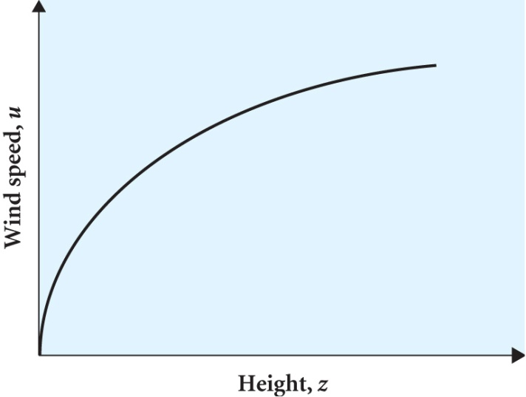
A parameterisation of the variation of u with height is u(z)=u_{S}(z/z_{S})^{αS} (9.2) where z_{S} is the height (10m usually) where u_{S} is the speed and α_{S} is the
wind shear coefficient which generally
shows a diurnal variation changing
from > 0.15 in the night to > 0.5 by day
α_{S} also depends on the terrain
For u_{S}=8 ms⁻¹and z = 10m α_{S} can vary between 0.32 and 0.05 depending on the terrain , α_{S} ≈ ½ (z₀/10)^{0.2} (9.3)
For a 1 MW turbine at a height of 80 m this translates into a variation of speed from 15.6 to 8.9 ms⁻¹depending on the terrain
For the same speed at10m more power is produced if the turbine is mounted higher, particularly if there is large wind shear
However large wind shears produce more turbulence and hence fatigue
The magnitude of the turbulence intensity, I_{T}, is important here

Slide 7
POWER OUTPUT OF A WIND TURBINE
From P =½ ρ u₀³ A₁ C_{p} from (7.9) the average power output P₀ is given by
P₀ = ½ ρ A ∫ C_{P}(λ){u(z)}³ f(u) du where λ = v_{tip} /u
For a turbine with variable pitch and/or speed, C_{P} can be kept close to its maximum value over a range of wind speeds
As we have seen if the pitch and speed are fixed then C_{P} varies with wind speed
e.g. For the Cuillagh Mountain wind farm (described later) the integral is roughly ½ <u(z)>³ where <u(z)> is the mean wind speed at the height of the turbine hub
The resulting power is
P₀≈ 0.2 D² <u(z)>³ (9.4) where D is the diameter of the turbine

Slide 8
EXAMPLE:- Estimate the power output of a wind farm of 25 fixed pitch and constant speed 1 MW turbines. The hub height is 85m and the diameter is 55m. The average wind speed at a height of 10m is u = 7 ms⁻¹. The land is characterised by a surface roughness parameter z₀ = 0.001.
First we calculate α_{S} ≈ ½ (z₀/10)^{0.2} (9.3)
α_{S} ≈ ½ (0.001/10)^{0.2} = 0.08
So using u(z)=u_{S}(z/z_{S})^{αS} (9.2) u_{hub} = 7 (85/10)^{0.08} = 8.3 ms⁻¹
Putting u_{hub} in equation (9.4) P₀≈ 0.2 D² <u(z)>³ gives an estimate of the power of each turbine
P₀ = 0.2 (55)² (8.3)³ = 346 kW
The wind farm output is estimated as
25 x 346 kW = 8.65 MW

Slide 9
WIND FARMS
Good sites require an average wind speed > 6m s⁻¹
Mountain passes, exposed ridges, high altitude plains and coast
A spacing of 5 – 10 rotor diameters is needed to maintain good wind conditions at each turbine
Low wind shear minimises fatigue so offshore wind sites are good
Turbines offshore can be tall and higher speed as noise is less of a concern
Undersea cables, maintenance and installation costs are higher than onshore wind farms
The power density from a wind farm with 5 MW rated turbines, each with a capacity factor of 0.35 and a diameter of 115m would be ~ 5 MW km⁻² if spaced at 7D (downwind) x 4D (cross wind).
N.B. The power density is roughly independent of turbine size as the output and area both depend on D², but larger turbines generally have a higher hub height and hence wind speed

Slide 10
CUILLAGH MOUNTAIN WIND FARM
18 Vestas V47 wind turbines ~ 320 m above sea level where the wind speed at 30 m is 7.2 ms⁻¹.
3 blades with diameter 47m and hub height of 45m
Fixed rotor speed of 28.5 rpm and a rated power of 660 kW
At 45m height the mean wind speed is 8.1 ms⁻¹.
Average annual output is 2.05 GWh (≡235 kW continuous output)
Area covered ~ 10⁶ m² and the array loss is calculated to be 7.3%
Monthly outputs can vary 74% - 140% of predicted values but overall the output was only 1.6% lower than expected
Power output of V47 as a function of wind speed
Speed ms⁻¹ | 5 | 7 | 9 | 11 | 13 | 15 | 17 | 19
Power kW | 44 | 166 | 350 | 538 | 635 | 657 | 660 | 660

Slide 11
ENVIRONMENTAL IMPACT
No global warming or pollution
Primarily fuel savers rather than energy suppliers
Concerns about
the visual impact and noise (although this is relatively low)
bird deaths although very many more are killed by cars, cats and flying into plate glass windows
Estimate the area of land required to provide 10% of UK demand
In 2004 the UK electricity demand was ~350 TWh per year
There are 8760 hours / year so this would need a continuous power P of
P = 350 x 10¹²/8760 = 40 x 10⁹ = 40 GW
To provide 10%, 4 GW, wind farms with a capacity of 12 GW needed
Provided by 12000/5 = 2400 5 MW turbines with typical diameter 115m
Assuming a 4D x 7D array area = 2400 x 460 x 805 = 8.9 10⁸ m²
This is ~ 900 km² cf area of UK of 200,000 km²

Slide 12
ECONOMICS OF WIND POWER
Depends on capital costs and M&O costs (~ 2% of capital p.a.) together with the revenue from electricity sales over 30 years
Electricity costs in pence / kWh are 3.4p for onshore farms compared to 2.4 – 4.5p for new coal plants and 4.7p for new nuclear plants. Offshore costs are 30 – 100% higher.
The external costs (mainly environmental) are estimated as 2 -15p /kWh for coal compared to 0.2p for wind
Wind power requires back-up but this is not too difficult if it only supplies < 20% of power required as spare capacity is already needed to cope with peak demands
The costs are expected to reduce with future developments making wind power competitive with gas at ~ 2.5p / kWh when production reaches150 GW capacity which could be achieved in 2010 with the current growth in wind power

Slide 13
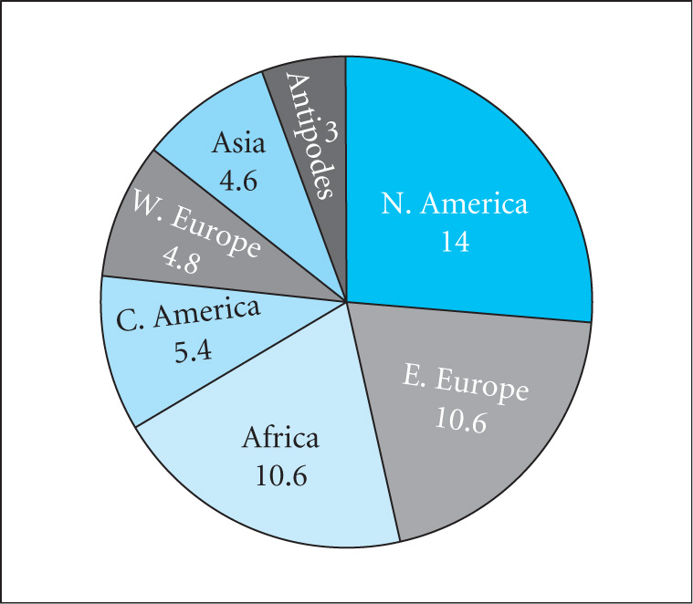
OUTLOOK
Global estimates are that between
20,000 -53,000 TWh
of wind power can be exploited
Offshore there is a huge technical
problem. Estimates in Europe are
3030 TWh per year
The many factors which need to be taken into account have lead to 3 different definitions of the potential of wind power
Technical – practical, environmental and social constraints
Economic – amount of technical that is economically competitive
Practicable – amount of technical potential that can be realised in a particular time (planning permission etc)

Slide 14
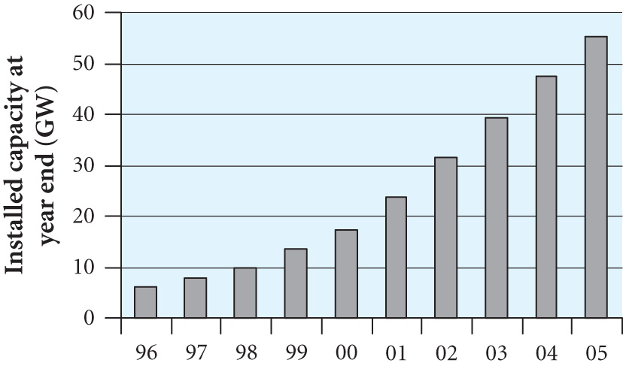
Estimates made by DTI for 2025
Annual growth of wind power was 27% in 2002 when
31 GWh was produced
compared to the global demand
of 125000 TWh / year
Wind power has the potential to
provide ‘clean’ power and
reduce consumption of coal, gas
Wind variability and the need for back-up is not a large problem if the contribution is ~ 20% of total need
Potential energy supply (TWh / year)
Wind region | Cost p / kWh | Economic | Technical | Practicable
Offshore | 2.5 – 3.0 | 100 | ~3500 | 100
Onshore | < 3.5 | 58 | 317 | 8

