Slide 1
SOURCE OF WIND ENERGY
Sun heats the Earth causing temperature and pressure gradients
A simple example is the offshore night time winds found on the coast due to the sea retaining heat better than the land
On the global scale high intensity radiation at the equator causes warm air to rise and cooler air to flow in from the north and south
1 – 2% of the incident solar power (1.37 kW m⁻²) is converted to wind power
Taking the radius of the Earth as 6000 km the area is ~ 10¹⁴ m² and the power in the wind is ~ 10¹⁵ W
This is 100 times global power usage but wind is a diffuse and variable source and it is only practical to harness a very small fraction of this amount

Slide 2
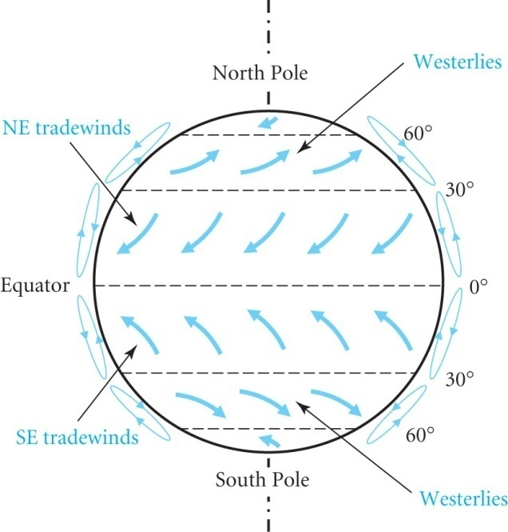
GLOBAL WIND POWER
The simple model of north-south convection
is modified by the rotation of the earth
An observer at the equator sees
the north-south wind gain an
easterly component due to
rotation.
The easterly component accelerates
as its distance from the earth’s axis decreases (Coriolis Force)
Wind speed becomes unstable at 30⁰ latitude and the north-south motion ceases.
In the northern hemisphere the sinking air near 30⁰ latitude produces the north-east trade winds
3 regions from the equator are defined as the Hadley Cell, Ferrel Cell and Polar Cell of which only the first is clearly seen, the other two being progressively much weaker
There are many other effects : surface friction, large scale eddies and seasonal variations

Slide 3
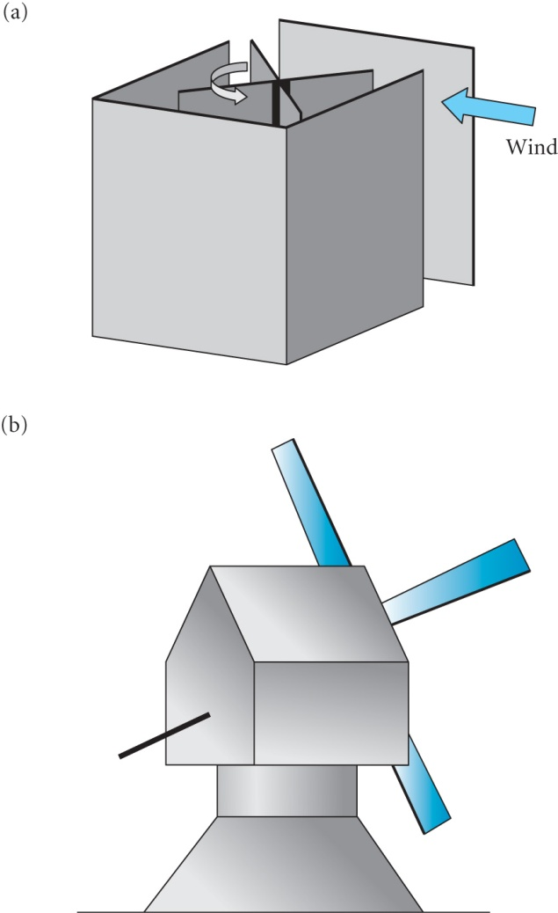
HISTORY OF WIND POWER
In 10th century Persia windmills used a vertical axis
Used for pumping and grinding.
Wind pushes sails around with
the drag force dependent on the
relative speeds of wind and sail.
Horizontal axis windmills are
driven by the lift force and are
more efficient.
The figure shows a tower-mill
where the top with the windshaft
swivelled to face the wind
It was discovered that twisting the sails gave more power

Slide 4
Development of modern wind turbines began at the end of the 19th century to generate electricity
Poul La Cour used a 4 bladed design producing ~ 25kW
Palmer Putman proposed a 1.25MW 2 bladed turbine in late 1930s
Built in Vermont and ran successfully until a blade failed in 1945
Use of wind power in Denmark during the 1939-45 war was a temporary measure due to lack of fuel oil
After the 1973 oil crisis there was large scale investment in California but the technology was not well developed and development declined in 1980s due to economic factors
Lack of tax incentives and the fall in oil prices
In Europe, and particularly in Denmark, support was maintained and investment is growing

Slide 5
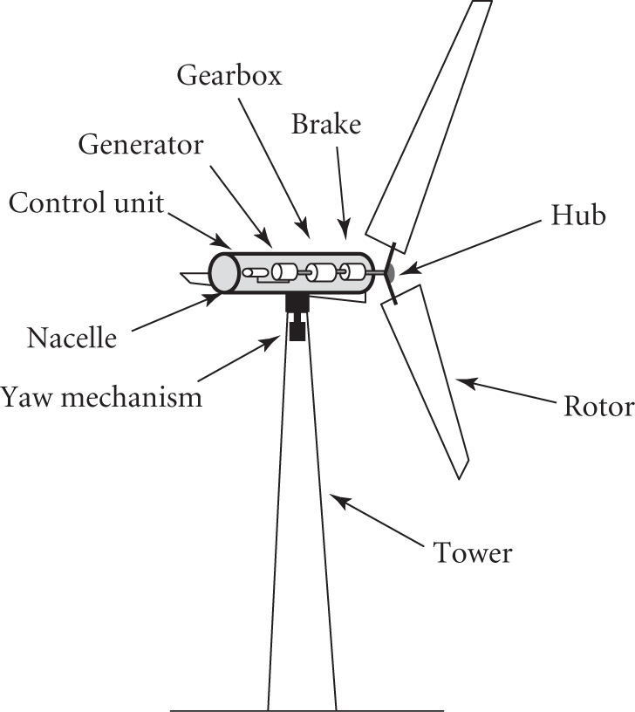
MODERN WIND TURBINES
Horizontal-axis wind turbines (HAWTs) are the most common
The turbine blades are aerofoils
providing lift forces to drive the
turbine.
The bearings, gearbox and
generator are enclosed in the
nacelle mounted on a tower.
There are generally 2 or 3
turbine blades.
Modern 5MW HAWT
The nacelle is orientated into the wind by a drive mechanism, the yaw control

Slide 6
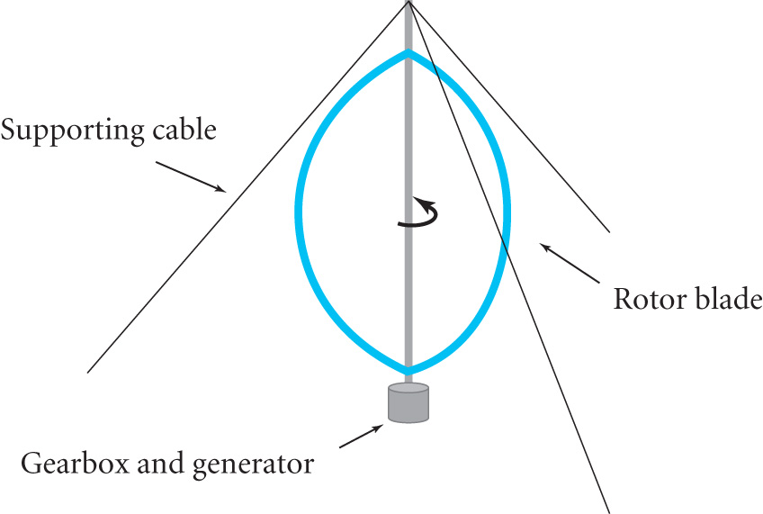
There has also been some R&D into vertical axis turbines (VAWTs)
In the Darrieus design the turbine
is driven by lift forces generated
by aerofoil shaped blades.
Torque is maximum when the
blades are moving across the
wind direction and zero when
moving parallel to the wind.
No yaw mechanism is needed and it sits at ground level
Cables limit height of rotors (and stronger winds higher up)
Greater torques mean more robust construction needed
Found to be less cost effective than HAWTs

Slide 7
Kinetic energy of wind
For wind speed u and air density ρ the energy density is given by
E = ½ ρ u² per unit volume (7.1)
Volume of air flowing through an area A (normal to the wind direction) is uA per second so the power P = EuA or
P = ½ Aρ u³ (7.2)
So the power varies as the cube of the wind speed so fluctuations in wind speed can have a large effect on power output
Example: Compare the power in a wind incident on turbine blades of 100m diameter as u changes from 5 ms⁻¹ to 10 ms⁻¹
= 1.2 kg m⁻³.
At 5 ms⁻¹ P = ½ (π x 50²) x 1.2 x 5³ = 0.6 MW
At 10 ms⁻¹ P increases by a factor (10/5)³ = 8 so P = 4.8 MW

Slide 8
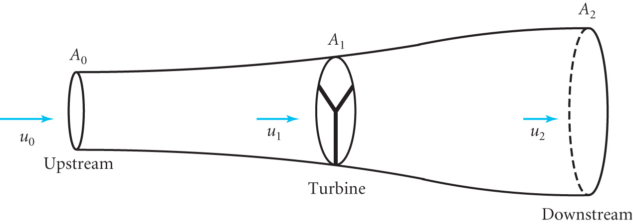
PRINCIPLES OF A HORIZONTAL WIND TURBINE
Not all of the kinetic energy of the wind can be extracted as some is carried downstream to maintain the airflow
The airflow is shown below through a stream tube of area A_{o} at entrance increasing to A₁, the area swept by the turbine blades, and increasing to A₂ downstream with corresponding speeds u₀, u₁ and u₂ respectively with u₀ > u₁ > u₂.
The drop in wind speed before and after the turbine gives rise to a pressure drop (Bernoulli) giving thrust on the blades

Slide 9
MAXIMUM EXTRACTION EFFICIENCY
The thrust T on the turbine is equal to the rate of change of momentum so that
T = dm/dt (u₀ – u₂) (7.3)
where dm/dt is the mass flowing down the stream tube per second
Power extracted = thrust x airspeed at the turbine
P = Tu₁ = dm/dt (u₀ – u₂) u₁ (7.4)
We can also calculate P in terms of the rate of loss of kinetic energy of the wind
P = ½ dm/dt (u₀² – u₂²) (7.5)
Equating these expressions
(u₀ – u₂) u₁ = ½ (u₀² – u₂²) = ½ (u₀ – u₂)(u₀ + u₂)
u₁ = ½ (u₀ + u₂) or u₂ = 2u₁ – u₀ (7.6)
Mass Continuity
dm/dt = ρ u₀ A₀ = ρ u₁ A₁ = ρ u₂ A₂ (7.7)
N.B. ρ is essentially constant as pressure changes are small

Slide 10
Substituting for u₂ (7.6) and dm/dt (7.7) in (7.4) we find
P = 2ρ u₁² A₁(u₀ – u₁) (7.8)
Let u₁ = (1 – a) u₀ where a is the induction factor then
P = 2ρ u₁² A₁(u₀ – u₁)= 2ρ u₀³ A₁a(1 - a)²
P = ½ ρ u₀³ A₁{4a(1 - a)²} =½ ρ u₀³ A₁ C_{p} (7.9)
where C_{p} = 4a(1 - a)² is the Power Coefficient (7.10)
C_{p} represents the fraction of the power in the wind that is extracted by the turbine since P = ½ ρ u₀³ A₁ represents the power in the wind for area A₁ with no turbine present so u₁= u₀
The maximum power available is when d C_{p} / da = 0
d C_{p} / da = 4(1-a)² – 8a(1-a) = 4 – 8a + 4a² -8a +8a²
= 12 a² -16a + 4 = 0 = (4a-4)(3a – 1)
so a = 1/3 or 1
a = 1 ➔ P = 0 so the maximum value of P occurs when a = 1/3

Slide 11
oi
a = 1/3 gives the following relations for maximum power:-
u₁ = 2u₀/3 and u₂ = u₀/3
C_{p} = 16/27
P_{max} = ½ ρ u₀³ A₁ C_{p} = ½ ρ(16/27) u₀³ A₁ (7.11)
This corresponds to ~ 59% of the power of the incident wind passing freely through an area equal to that of the turbine, A₁.
This limit for the power coefficient C_{p} is known as
the Betz or Lanchester-Betz limit
The design of the turbine blades determines how close we can get to the Betz limit in practice

Slide 12
Example. A wind turbine has blades of 40 m radius. The wind speed is 8 m s⁻¹ in the absence of the turbine. Calculate the maximum power produced by the turbine and the corresponding thrust on the turbine.
For maximum power we need the Betz limit
P_{max} = ½ ρ u₀³ A₁ C_{p} = ½ ρ(16/27) u₀³ A₁
= ½ x 1.2 x (16/27) x 8³ x π x 40² = 0.92 MW
Thrust T = dm/dt (u₀ – u₂) = u₁ ρ A₁ (u₀ – u₂)
In the Betz limit u₂ = 1/3 u₀ and u₁ = 2/3 u₀ so
the maximum thrust = 2/3 u₀ ρ A₁ (u₀ – 1/3 u₀) = 4/9 ρ A₁ u₀²
T_{max} = 4/9 x 1.2 x π x 40² x 8² = 1.7 x 10⁵ N.

