Slide 1
TIDES
There are two high tides and two low tides around the earth at any instant
High tides on longitude closest and farthest from the Moon and low tides at 90º to this
Interval between high tides is ~ 12 hrs 25 mins
Tidal range is 0.5 – 1m in mid ocean but much larger on continental shelves
Some examples of large tidal sites
Country | Site | Range m | Basin area km² | Capacity GW
Argentina | Golfo Nuevo | 3.7 | 2376 | 6.6
Canada | Cobequid | 12.4 | 240 | 5.3
India | Gulf of Khambat | 7.0 | 1970 | 7.0
Russia | Mezen | 6.7 | 2640 | 15.0
Russia | Penzhinsk | 11.4 | 20530 | 87.4
UK | Severn | 7 | 520 | 8.6

Slide 2
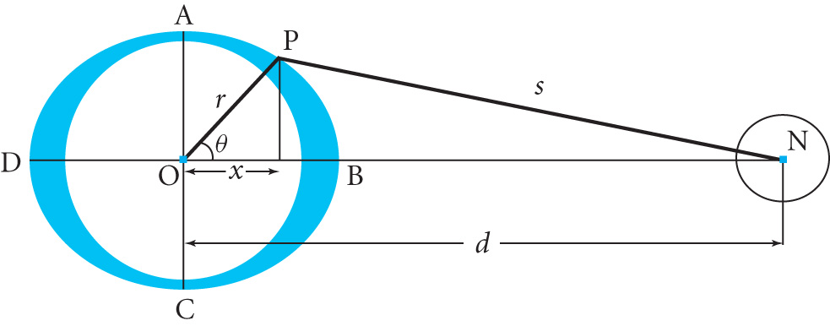
PHYSICAL CAUSE OF TIDES
The Moon is the main cause. The Sun has ~ ½ the effect but this either increases or decreases the lunar tide depending on the relative positions of Earth, Moon and Sun.
The Earth’s rotation simply affects the location of the tides
To explain ignore the effect of the Sun for now
Assume the Earth is covered
with water
Gravitational potential at P is
φ= -Gm / s
and m is the lunar mass. d >> r
1/s = [d² + r² - 2d r cosθ] ^{-1/2} = (1/d)[1 + {(-2r/d)cosθ + r²/d²}] ^{-1/2}
= (1/d)[1 + (r/d)cosθ + (r²/d²){(3/2) cos²θ -1/2 }+…]
1st term is constant (no force) and 2nd gives a constant GM/d² providing centripetal acceleration for the Moon-Earth rotation
3rd describes the variation of the potential around the Earth

Slide 3
Note that the reason for two tides is the combination of the variation of gravity across the Earth and the dynamics of the Moon-Earth system
The surface profile of the water is an equipotential surface due to the combined effects of the Earth and Moon
Potential of unit mass due to Earth’s gravitation is gh where h is the height above equilibrium level and g = GM_{Earth}/r²
Hence the height of the tide h(θ) is given by
g h(θ) - (Gmr²/d³){(3/2) cos²θ -1/2 }= 0
(N.B. The equipotential constant is set to 0 because h is relative to the equilibrium level)
h(θ) = (Gmr²/gd³){(3/2) cos²θ -1/2 }= h_{max} {(3/2) cos²θ -1/2 } (5.1)
where h_{max} = Gmr²/gd³ = mr⁴ / Md³ since g = GM/r²
The maximum occurs when θ = 0 or π
Putting m/M = 0.0123, d = 384400 km and r = 6378 km gives
h_{max} ≈ 0.36m which is roughly in line with observations

Slide 4
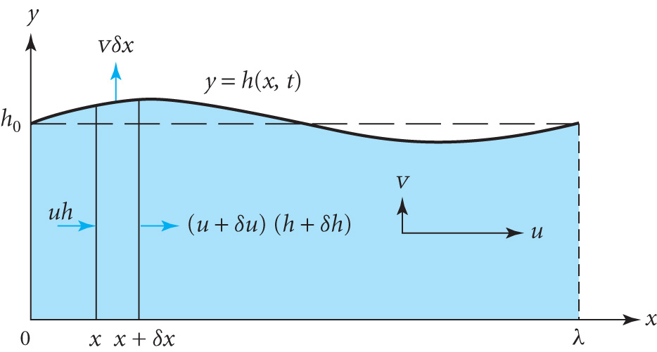
TIDAL WAVES
Consider a wave of small amplitude with λ >> mean depth h₀.
Shallow water theory in which the vertical accelerations << g
Pressure below surface is roughly hydrostatic and at a height y above the sea bed it is given by
p = p₀ +ρg( h(x,t) – y)
where y=h(x,t) is the wave profile and
p₀ is the atmospheric pressure
1st consider the force on the vertical
slice shown, of unit width, due to the change in pressure going from x to x+δx, i.e. p(x) ➔ p(x + δx) = p(x) + ∂p/∂x δx
Force in x direction = mass x acceleration = pressure difference x area
so (1hρ δx) ∂u/∂t = - (1h δx)∂p/∂x =- h δx ρg ∂h/∂x independent of y
∴ ∂u/∂t = -g ∂h/∂x for all y (5.2)

Slide 5
Next consider the continuity equation which says that the difference in volume flowing across the slice is equal to the volume displaced per second, vertically where v = ∂h/∂t
i.e. uh = (u+δu)(h+δh) + v δx
= uh + hδu+uδh + δh² + v δx
Neglecting δh² and uδh (<< hδu) and writing δu= ∂u/∂x δx we get
v δx = ∂h/∂t δx = -hδu = -h ∂u/∂x δx
Taking h ≈ h₀ we obtain ∂u /∂x= - (1/ h₀) ∂h/∂t (5.3)
Eliminating u between (5.2 )and (5.3) we obtain the wave eqn.
∂²h /∂x²= (1/ c²) ∂²h/∂t² (5.4)
where c = (g h₀)^{1/2} (5.5)
(5.4) is the equation for the height profile h(x,t)
In fact the tidal bulges cannot keep up with the Earth’s rotation so the tides lag behind the position of the moon, e.g.
At the equator h₀ = 4000m so c = (9.81 x 4000)^{1/2} = 198 ms⁻¹
Speed of sea bed = 2π x 6370 x10³/(24 x 60 x 60) = 463 ms⁻¹

Slide 6
TIDAL POWER
A barrage across a river estuary allows water to accumulate in a tidal basin. This is then released through low-head turbines
Operates for a good fraction of the day
Choice of using conventional turbines (uni-directional) or less efficient turbines that can operate in either direction
Historically such schemes were used with water wheels to grind corn
1st large scale plant at La Rance, France in 1966
240 MW generated with 24 low head Kaplan turbines
A number of small plants have been built to investigate the ecological and environmental effects
Various proposals to build a barrage across the River Severn in UK have been turned down due to the large cost, public opposition and the availability of cheaper alternatives

Slide 7
POWER FROM A TIDAL BARRAGE
Let A be the area of the tidal basin and let h be the tidal range so that at full tide the level is h above the low water mark.
Mass of water above
Low level is m = ρAh
C of G is at ½ h
Energy required to raise m by ½ h = 1/2mgh= ½ ρgAh²
Average Power P = (ρgAh² )/2T where T is the tidal period (5.6)
e.g. The Severn Barrage would have A = 520 km² and tidal range h=7m. Tidal period T ≈ 12.5 h or 4.5 10⁴ s
Check that (5.6) estimates the power P to be ≈ 2.8 GW

Slide 8
TIDAL RESONANCE
The tidal range varies in different oceans due to tidal resonance
Average depth of Atlantic is 4000m so c ≈ 200 ms⁻¹
Tidal frequency ≈ 2 10⁻⁵ Hz so λ ≈ 200 / 2 10⁻⁵ ≈ 10⁴ km
This is ~ 2 x width of Atlantic and so resonance occurs; the time taken for a shallow wave to make the round trip ~5 10⁴ s which is close to the tidal period ~ 4.5 10⁴ s
so the amplitude builds up
River estuaries can also exhibit large tidal resonance if the length and depth are favourable
Time for a wave to propagate down a channel of length L and back to the inlet is t = 2L /(gh₀)^{1/2}
If this is equal to half the time between successive tides the tidal range is doubled

Slide 9
TIDAL RESONANCE IN A UNIFORM CHANNEL
Consider a channel of length L with a vertical wall at x=L and open to the sea at x=0
Let the height of the incident tidal wave be h_{i}(t)=a cos(ωt)
Consider a travelling wave of form h_{i}(x,t)=a cos(kx - ωt)
Mass Continuity ∂u /∂x= - (1/ h₀) ∂h/∂t (5.3) gives
- ∂u_{i} /∂x= (1/ h₀) ∂hi/∂t = (ωa/ h₀) sin(kx - ωt)
Integrating with respect to x gives u_{i} = (ωa/ kh₀) cos(kx - ωt)
In order to satisfy boundary conditions at x = 0 or L since there can be no flow across the barrier we superpose a reflected wave u_{r} = (ωa/ kh₀) cos(kx + ωt)
Total velocity at x = L is u(L,t) = u_{i}(L,t) + u_{r}(L,t) =0
u(L,t) = (ωa/ kh₀)[cos(kL - ωt) + cos(kL + ωt)]
= (2ωa/ kh₀) cos kL cosωt = 0
∴ kL = π/2 so L= λ/4

Slide 10
The total height of the incident and reflected waves is
h(x,t) = h_{i}(x,t) + h_{r}(x,t) = a cos(kx – ωt) + a cos(kx – ωt)
h(x,t) = 2a sin(kx) sin(ωt)
At the end of the channel h(L,t) = 2a sin(ωt), i.e. double the amplitude .
This effect allows the amplitude to build up giving a tidal range of 10 – 14m in the River Severn
Example: Estimate the length of estuary required for tidal resonance if the average depth is 20m
Equating the time taken for a wave to travel the length of the channel and back again to half the tidal period we have
2L / (9.81 x 20)^{1/2} = ½ x 4.5 10⁴ so that L≈ 160 km

Slide 11
Tidal Currents
In some locations strong tidal currents exist (e.g. between islands)
Turbines with horizontal axes can be mounted on the sea bed or suspended from a floating platform to tap into the kinetic energy of the current
1st generation devices are underwater versions of wind turbines operating in shallow water (i.e. 20-30m)
Impact on the ecology and environment
Barrages block navigation so systems of locks are required
Fish are killed in the turbines and impeded from migrating to spawning areas
Intertidal wet/dry habitat is altered affecting animals and plants
Natural flushing of silt / pollution is impeded affecting water quality
Tidal regime downstream may be affected. Proposed barrier in Bay of Fundy (Canada)could increase tidal range at Boston (1300 km away) by 0.25m

