Slide 1
ENERGY AND SOCIETY
The amount of energy consumed per capita is closely related to the standard of living – expected to increase
Increasing populations also increases the amount of energy needed
Fossil fuels provide most of this energy today
Known reserves are > 40 years for oil, 70 years for gas and 250 years for coal
All produce CO₂ and hence promote global warming
Alternative sources are more expensive at present
In this section we will review the environmental impact, economic issues, possible policies and strategies to deal with this situation

Slide 2
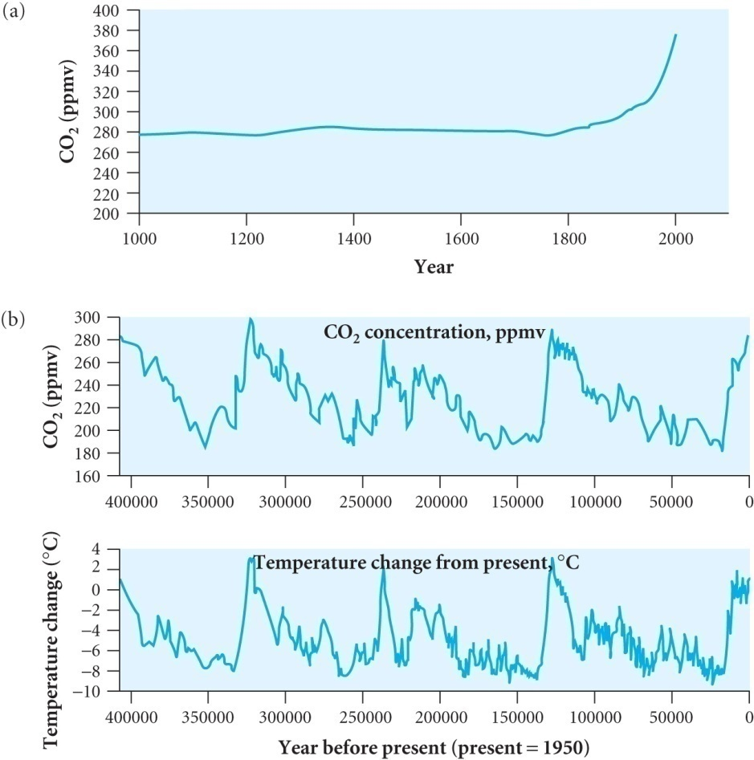
GLOBAL WARMING
CO₂ concentration has risen sharply over the last 50 years
Ice cores show that over time there has
been fluctuations in the CO₂ level
These are related to the slight periodic
changes in the Earth’s orbit and are
linked to the ice ages
However over the last 30 years the
0.5ºC increase in temperature is closely
related to the increase in CO₂ over that
period
Ice sheets are disappearing and
salinity near the poles is decreasing but is increasing near the equator due to increased evaporation
Marine life is being affected

Slide 3
IMPACT OF MORE CO₂ IN ATMOSPHERE
Current level ~ 800 Gt. Approximately ½ of emissions, 7 Gt per year in 2005, are absorbed by the Earth, mainly in the oceans
If no action is taken we will have ~ 14 Gt / year in 2055
Causing ~ 1.2ºC rise in temperature (assuming ∝ CO₂ increase)
Other factors affecting this are the increased areas of open sea and increased water vapour due to evaporation
Water vapour is the main greenhouse gas and more solar radiation absorbed by sea rather than being reflected by ice
Temperature rise could release methane frozen under permafrost
These are examples of positive feedback effects that could lead to a ‘tipping point’ triggering dangerous climate change
Negative feedback can come from reflection from clouds but the positive feedback is thought to dominate
Oceans absorb heat from atmosphere - negative feedback

Slide 4
Oceans get warmer absorbing less heat and less CO₂
The Intergovernmental Panel on Climate Change (IPCC) in 2001 predicted a global temperature rise between 1990 and 2100 of between 1.4ºC and 5.8ºC depending on assumptions in the models
A smaller variation of 1.0 – 1.8ºC up to 2050
Technologies exist to provide low carbon energy but economics has hampered the widespread application
Economics of energy production
Consider 3 factors: capital cost, M&O and revenue
A measure of competitiveness is the time needed to pay back the capital cost + annual M&O taking account of the effect of inflation on future revenues
£100 invested may make £105 in one year but £105 revenue in that year would only be worth £100 at today’s prices

Slide 5
Discounted cash flow analysis
£Q invested at an interest (discount) rate R will be worth £Q(1+R)^{n} after n years
So £A received in n years time has a present day value of £A/(1+R)^{n}
The present value of a series of annual payments £A over N years is
V_{P} = A/(1+R) + A/(1+R)² + A/(1+R)² + …. A/(1+R)^{N}
∴ V_{P} = A [ 1 - (1 + R)^{-N} ] / R
Define the net present value V_{NP} = V_{P} – C_{capital}
Calculate the cost of energy, C_{cost} by finding the annual revenue A_{cost} at the given discount rate would make V_{NP} = 0
i.e. C_{capital} = A_{cost} [ 1 - (1 + R)^{-N} ] / R
Then the cost of energy is C_{energy} = A_{cost} / E
where E is the energy produced per year

Slide 6
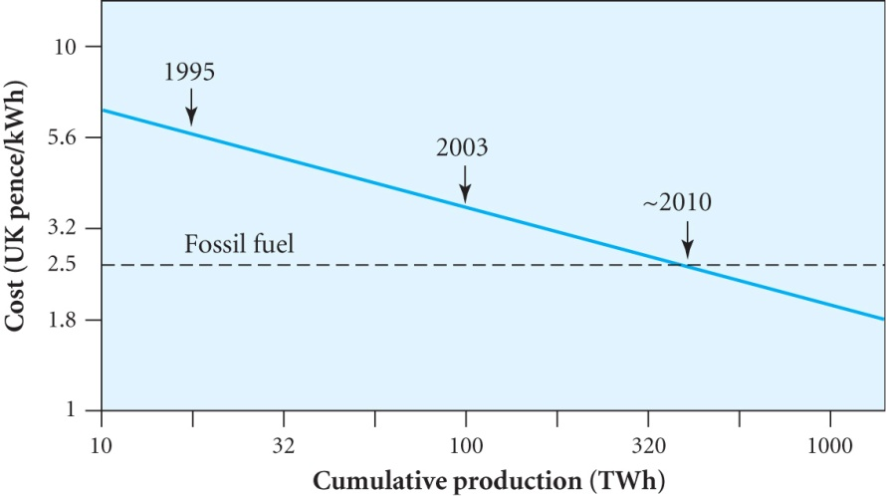
If the capital costs are spread over the N years needed for construction then for equal payments of C_{capital} /N per year we need to increase the capital sum C_{capital} (since repayment only starts at the end of construction)
by F_{discount} =(1+R)[(1+R)^{N}-1] / NR
Increases C_{capital} in all previous equations including C_{energy}
Need a pricing regime guaranteeing a rate of return and maintaining competition between the utilities
Prediction of future costs uses Learning curve estimation.
Based on experiences that technology
costs decrease linearly with cumulative
production on a log-log plot
Example shown is for on-shore wind
Learning rate is % reduction in costs
for a doubling of cumulative production
For graph shown this is 15% (typically 10 – 30% in general)

Slide 7
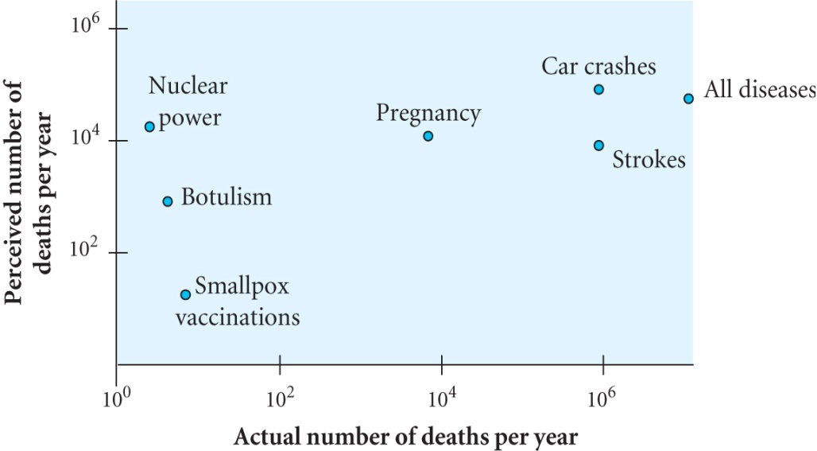
Life cycle and cost benefit analyses and risk
Life cycle analysis is the analysis of emissions such as the amount of CO₂ per kWh of energy produced
Extra costs e.g. carbon tax or cost of carbon capture
Cost benefit analysis identifies the benefits of a project and assigns a monetary value to be compared with the costs
Risk analysis first identifies the risks and assigns a probability to each and a factor describing the severity of the consequences with the product of the two numbers indicating the seriousness of the risk
The public perception is often
different from the expert view leading
to a dread factor
The plot shows that although nuclear
power has a high dread factor the
actual data is significantly different

Slide 8
CARBON ABATEMENT POLICIES
The 160 signatories of the Kyoto Protocol agreed to reduce emissions of greenhouse gases by 5.2 % compared to 1990 and Emissions Trading is part of the agreement
Some countries have limits above their current production and this surplus may be purchased by other countries if they so wish
Credit is given for the creation of CO₂ sinks (eg new forests)
Setting up a Carbon Tax (collected by government) is a simpler scheme to set up
A Renewables obligation promotes renewables in the UK by requiring electricity suppliers to obtain a fraction of their energy from renewable sources rising to 10% by 2010
A market in Renewable Obligation Certificates (ROC) has been set up and suppliers have to buy a certain number from the renewable energy generator or on the open market or pay a buy out price to show that they have met the target
Renewable generators earn revenue from selling electricity and ROCs providing extra income (1 ROC per 1 MWh)
Idea is that as the price of ROCs rises developers will be encouraged to build more renewable generators
Market forces will generate competition favouring the most economic

Slide 9
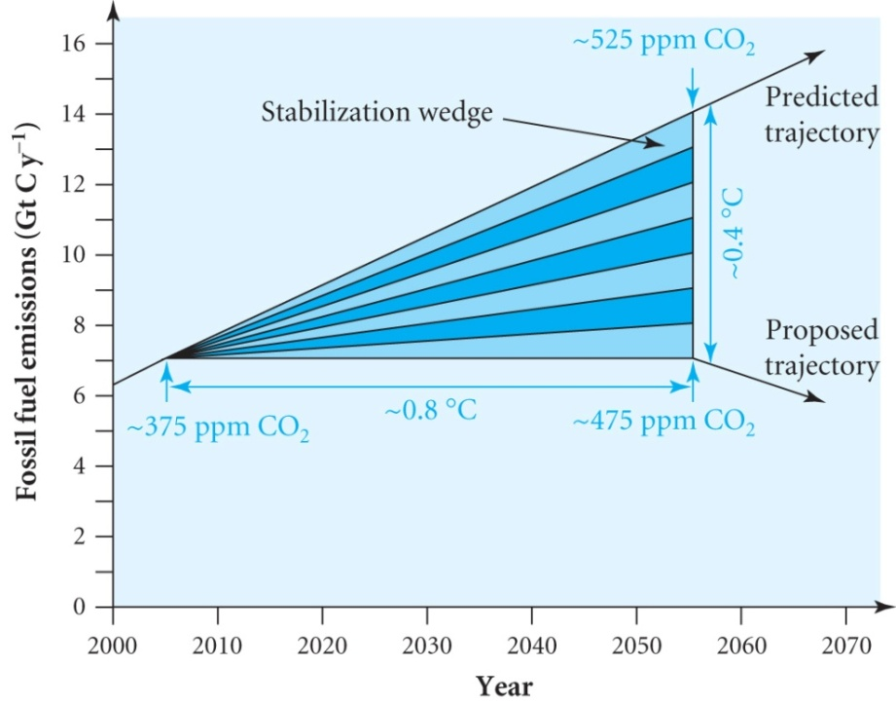
STABILIZATION WEDGES
Stabilization at ~ 500 ppm requires holding emissions at the current level of 7 Gt C y⁻¹ for the next 50 years assuming that the Earth continues to absorb close to half
A fall in the amount emitted each year would be possible by 2055 if nuclear + renewables + carbon capture and sequestration were developed
Pacala and Socolov propose achieving this by means of the 7
different methods listed on the
next slide
The effect of each is shown as a wedge
on the plot
The plot shows how each method
contributes to reducing the predicted
increase to the target level
In 2002 CO₂ emissions were 22% transport,
36% industry and buildings, 42% power generation

Slide 10
The wedges are:-
1. Energy efficiency
e.g. More efficient engines, install compact flourescent lights etc
2. Energy conservation
e.g. Improve thermal insulation of buildings
3. Reduction of carbon emissions
e.g. switch from coal-fired to natural-gas-fired plants
4. Capture of carbon emissions
e.g. Store CO₂ underground
5. Increase of carbon-free energy
e.g. nuclear power, wind power etc
6. Increase of carbon-neutral energy
e.g. biomass producing ethanol & biodiesel
7. Enhancement of natural carbon sinks
e.g. ending de-forestation and replanting tropical forest

Slide 11
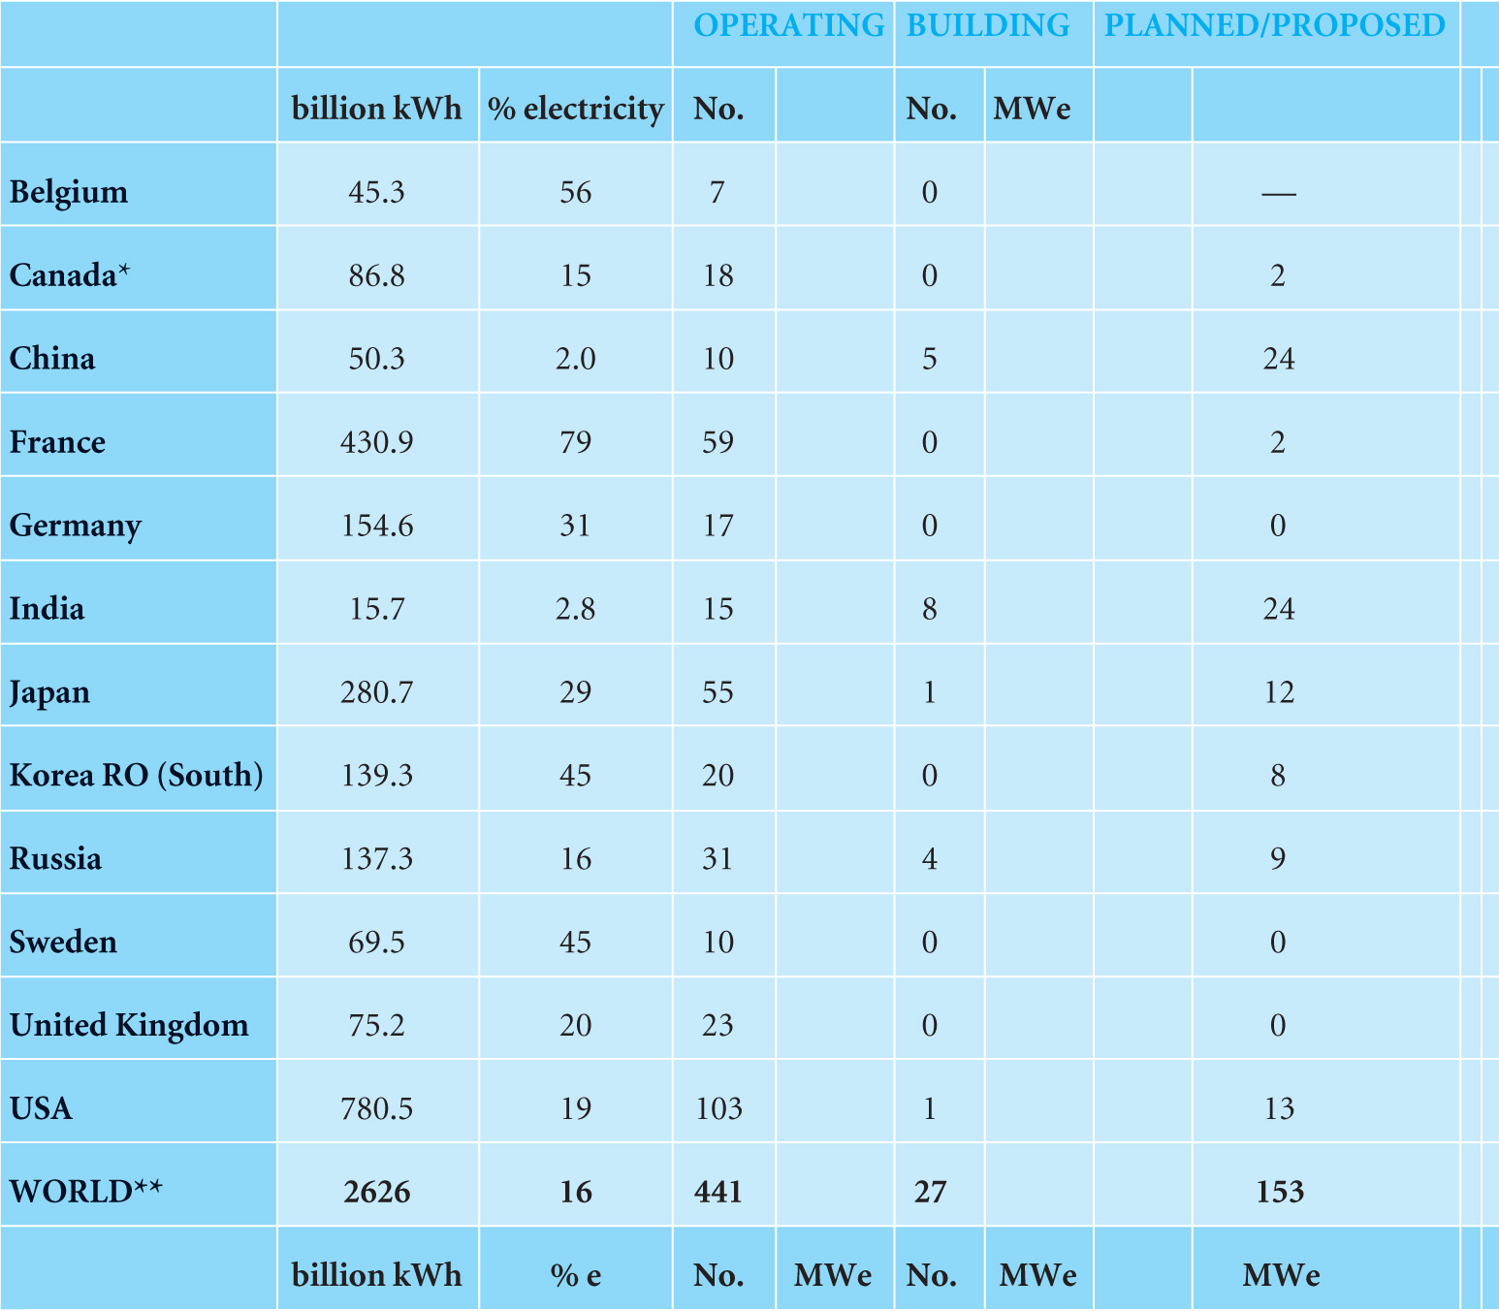
Nuclear power plants operating in 2005

Slide 12
ENERGY STORAGE
Energy storage is an area receiving a lot of attention
Current methods include
Pumped storage using a high level reservoir
Compressed air storage for smoothing out power fluctuations
Flywheels for niche markets – significant capital costs
Superconductor magnet storage can provide very high power for short periods but needs cryogenics and large capital costs
Batteries .. New technologies
Fuel cells – currently too expensive
Of these only the pumped storage system has the capacity to store large amounts of energy to be used at peak demand or when output from wind farms ceases for example
Not many sites where this is possible

Slide 13
SUMMARY
New power sources offer a reduction in greenhouse gases
Each source has its limitations in terms of economics, environmental issues and its potential capacity
It is clear that a mix of all the new sources needs to be developed in the next 10 to 20 years to provide the increased demand for power and the necessity of avoiding climate change
As well as developing renewable sources it is clear that nuclear technologies will form a major part of future energy generation
This has to be combined with efforts on energy efficiency and conservation carbon abatement policies
The technologies exist and we need the political will to make it happen, particularly in USA and China

