Slide 1
REACTOR ACCIDENTS
1. CHERNOBYL
RMBK design has several weaknesses including
No secondary shutdown system
Ability to over ride safety trips easily!
Less stable than western reactors
Graphite runs at > 700ºC (burns in air!)
Reactivity worth of control rods inadequate

Slide 2
Attempted a test to check whether the emergency cooling system was OK!!
To be carried out in a shutdown
Delayed to night shift due to order to provide power on day shift
Started with staged power reduction from 3200MW
Reduced in error below 30 MW
Badly poisoned with ¹³⁵Xe
Should have abandoned test here
Control rods withdrawn to raise power to 200MW
Standby coolant pumps started
Power at 7% and cooling at 120%!!
Very sensitive δk~10⁻¹ and T~1s
Problem with steam drum level (low)
Reactor trip signal disabled!!
Manual top up with cold water
Fall in core temperature ➔control rods out to furthest limit
Reactor uncontrollable
Crew decide to start the test!!!

Slide 3
Cut off steam supply to the turbine ( no heat sink) after disabling the safety reactor trip
Steam fraction increases
k and φ increase too rapidly for automatic control rods
Panic button pressed when P > 320MW but control rods are too few and too slow
1St surge of power boils
Cooling water cannot take away heat
Fuel disintegrates and coolant boils
Final surge of power > 3000MW
Steam explosion
Hydrogen (from zirconium-water and water-graphite reactions) explodes
Graphite ignites
World’s worst nuclear accident

Slide 4
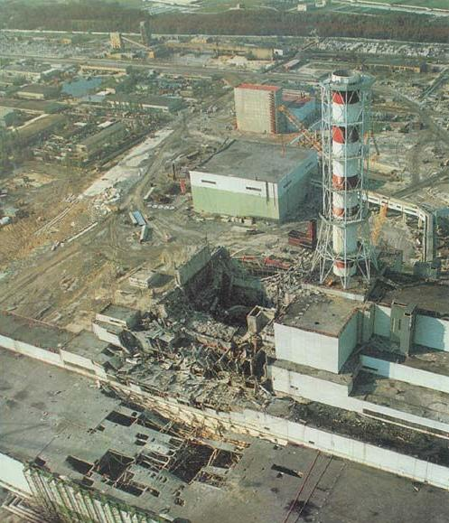

Slide 5
2. THREE MILE ISLAND (1979)
The accident involved the loss of coolant to a PWR due to a failure in the feed--water system
Reactor and turbine tripped off
Problem handling residual heat led to temperature rise in the core and a 20% core meltdown
Volatile fission fragments contaminated the primary coolant which, due to pressure, vented a quantity of material into the atmosphere
Many lessons were learned about reactor design, human misjudgement and the malfunction of pumps and valves.
3. WINDSCALE (1952)
An air cooled reactor built solely to manufacture plutonium
Some release of radiation into the atmosphere due to limited instrumentation and the not well understood Wigner effect (radiation damage to graphite)
Not really relevant as a safety issue today

Slide 6
HEALTH HAZARDS ASSOCIATED WITH RADIONUCLIDES
All radiation is dangerous but some radionuclides are especially so as their chemistry allows them to get into the food chain
Strontium–90 (and ⁸⁹Sr)
is absorbed in plants from soil or by foliar deposition, and then passed to diary products. Absorbed into bone because chemically is calcium-like.
Cesium-137
tightly bound by soil but contaminates food by foliar absorption. Chemically potassium-like.
Carbon-14
readily passes into biological systems
Radioiodine (¹³¹I) (F-, Cl-like)
ingested through drinking milk and concentrates in thyroid gland.

Slide 7
Natural Radioactivity
Some radionuclides occur naturally as single isotopes (of cosmic and terrestrial origin). Others are components of three distinct chains of radioactive elements:
(1) The uranium series which originates with ²³⁸U
(T_{1/2} =4.5 x 10⁹ years)
(2) The thorium series which originates with ²³²Th (T_{1/2} =1.4 x 10¹⁰ years)
(3) The actinium series which originates with ²³⁵U (T_{1/2}= 7.0 x 10⁸ years)
These 3 families of radioactive heavy nuclei are found in the earth’s crust and account for much of the radioactivity to which man is exposed.
A fourth family, the neptunium series – parent ²⁴¹Pu (T_{1/2} = 14 years) once existed but the parent and subsequent daughters have short half lives; only ²⁰⁹Bi (T_{1/2} = 2 x 10¹⁷ years) remains.

Slide 8
SECULAR EQUILIBRIUM
Uranium series has
²³⁸U ➔ ²³⁴Th * ➔ ²³⁴Pa * etc.
(T_{1/2} =4.5 x 10⁹ years) (T_{1/2}=6.7 hours) (T_{1/2}=24 days)
(1) (2) (3)
Rate of decay of (1) ⇒ dN₁/dt = - λ₁ N₁ ----- (A)
Rate of decay of (2) ⇒ dN₂/dt = λ₁ N₁ - λ₂ N₂ ----(B)
(1st term is rate of formation from (1); 2nd term is decay of (2))
Rate of decay of (3) ⇒ dN₃/dt = λ₂ N₂ - λ₃ N₃ -----(C) etc.
N₁ N₂ N₃ are the number of radioactive atoms (1) (2) (3) at time t
Solve (A) ⇒ N₁ = N₁⁰ exp(-λ₁t)
where N₁⁰ = number of (1) atoms at t=0

Slide 9
Solve (B) ⇒ dN₂/dt = λ₁ N₁⁰ exp(-λ₁t) - λ₂ N₂
Multiply both sides by exp(λ₂t) and note that
d (N₂ exp(λ₂t) )/dt = dN₂/dt . exp(λ₂t) + λ₂N₂ exp(λ₂t)
Substituting for λ₂N₂ exp(λ₂t) we have
d (N₂ exp(λ₂t)) /dt = λ₁N₁⁰ exp{(λ₂ - λ₁) t}
or d (N₂ exp(λ₂t) )= λ₁N₁⁰ exp{(λ₂ - λ₁) t]}dt
Integrating between 0 and t, we have
{[ N₂ exp(λ₂t) ]_{t} - [ N₂ exp(λ₂t) ]₀ =
{[λ₁N₁⁰ exp{(λ₂ - λ₁) t}]_{t} – [λ₁N₁⁰ exp{(λ₂ - λ₁) t} ]₀}/ (λ₂ - λ₁)
So N₂ exp(λ₂t) – N₂⁰ = λ₁ N₁⁰ . (exp{(λ₂ - λ₁) t} – 1) ) /(λ₂ - λ₁)
Multiply through by exp(-λ₂t), and noting that N₂⁰ = 0 :
N₂ = λ₁ N₁⁰ . (exp(-λ₁t) - exp(-λ₂t)) /(λ₂ - λ₁) +

Slide 10
Assumption that is true for actinide series T_{1/2} (1) >> T_{1/2} (2)
∴ λ₁ << λ₂ since λ₁ = ln2 / T_{1/2} (1) and λ₂ = ln2 / T_{1/2} (2)
∴ at large enough t we can neglect exp(-λ₂t) compared with exp(-λ₁t)
∴ N₂ ≈ (λ₁/λ₂) N₁⁰ exp(-λ₁t) = (λ₁/λ₂) N₁
∴ λ₁ N₁ = λ₂ N₂
and using (B) dN₂/dt = λ₁ N₁ - λ₂ N₂ = 0
Using (C) dN₃/dt = λ₂ N₂ - λ₃ N₃ = λ₁ N₁ - λ₃ N₃
Using same arguments as before
λ₁ N₁ = λ₃ N₃ and dN₃/dt = 0
∴ λ₁ N₁ = λ₂ N₂ = λ₃ N₃ = … etc. called secular equilibrium
i.e. dN/dt = 0 for all members of series except first
Note that activity of any of the daughters is given by λ_{i} N_{i} = λ₁ N₁
i.e. is the same for each nuclide in the chain.

Slide 11
Example
Uranium series has
²³⁸U (T_{1/2} =4.5 x 10⁹ years) decaying to
²³⁴Th * (T_{1/2}=6.7 hours) decaying to ²³⁴Pa* (T_{1/2}=24 days)
A sample of rock contains 1kg of ²³⁸U. What numbers of ²³⁴Th * and ²³⁴Pa atoms would you expect to find?
Assume secular equilibrium and λ = ln(2)/T_{1/2}
So N_{U}/(4.5x10⁹ x 365 x 24) =
N_{Th}/(6.7) =
N_{Pa}/(24 x 24)
N_{U} = 1 / (238 x 1.66 x 10⁻²⁷) = 2.5 x 10²⁴
So N_{Th} = 4.2 x 10¹¹
and N_{Pa} = 3.7 x 10¹³

