Slide 1
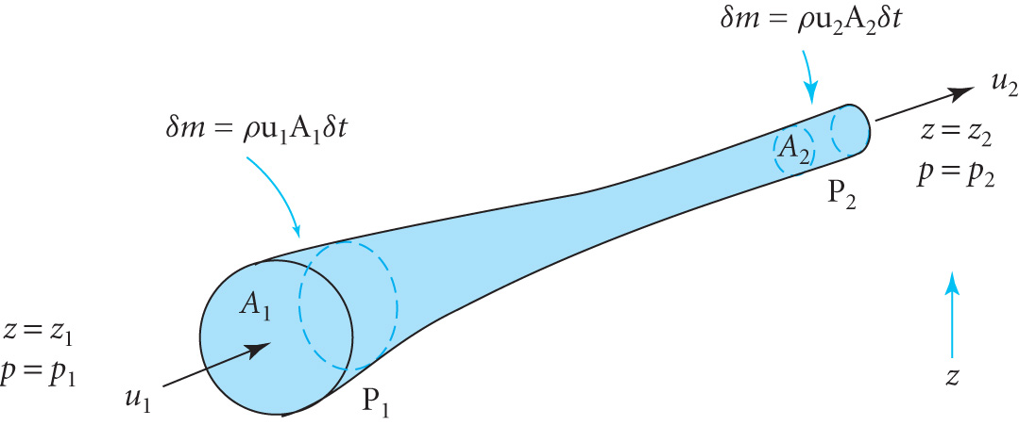
ESSENTIAL FLUID MECHANICS
Assume streamlined flow
Mass Continuity Equation
Bernoulli’s Equation for an ideal fluid
Consider the flow along the stream tube shown for an
incompressible fluid
Increase in PE for mass δm is
δm g(z₂-z₁)
In time δt Mass Continuity gives
δm = ρ u₁A₁δt = ρ u₂A₂δt
Work done against pressure p₁ inwards at P₁ in δt is δW₁= p₁u₁A₁δt
Work done against pressure p₂ outwards at P₂ in δt is δW₂= - p₂u₂A₂δt
Net work is δW₁ + δW₂ = p₁u₁A₁δt - p₂u₂A₂δt
Energy conservation says that this = change in PE + change in KE
i.e. p₁u₁A₁δt - p₂u₂A₂δt = δm g(z₂-z₁) + ½ δm(u₂²- u₁²)

Slide 2
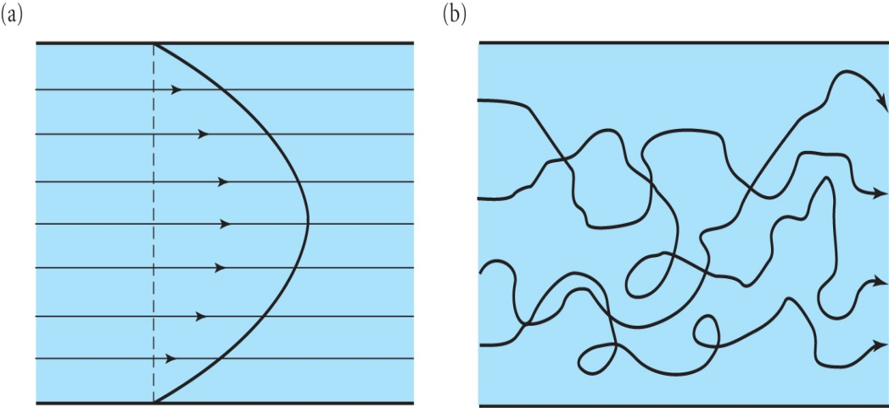
Substituting for δm and tidying up we obtain
p₁/ρ +gz₁ + ½ u₁² = p₂/ρ +gz₂ + ½ u₂²
i.e p/ρ +gz + ½ u² = constant BERNOULLI’S EQUATION (3.1)
The Pitot Tube and Venturi Meter are practical applications
DYNAMICS OF A VISCOUS FLUID
Real fluids have viscous properties. In laminar flow there are strong attractive forces between adjacent layers and between the layer next to a solid.
eg (a) shows the velocity profile
in a pipe if the flow is laminar
The viscous shear stress is given by
F /A = - μ du/dy (3.2) where μ is the
Coefficient of Viscosity and du/dy
is the velocity gradient
(b) Represents turbulent flow which occurs at high flow rates

Slide 3
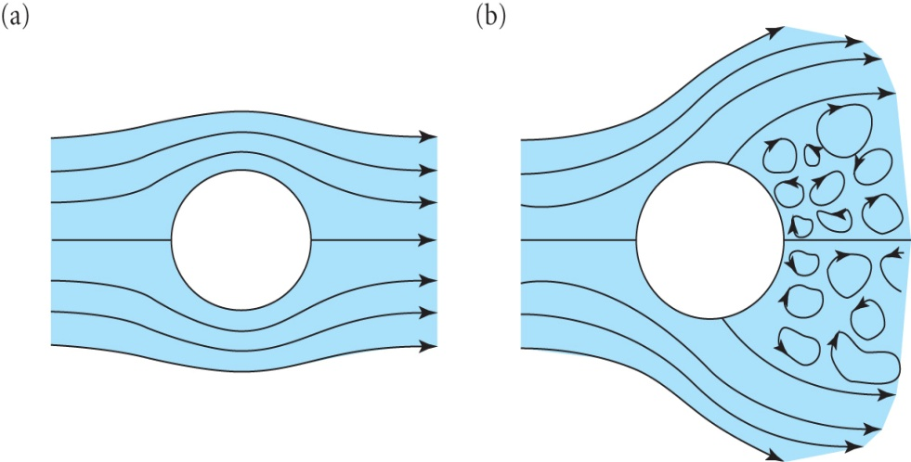
The particular flow regime depends on the ratio of the inertial force to the viscous force as defined by
REYNOLDS NUMBER R_{e} = ρ U L / μ = U L/ ν (3.3) where U, L and ν are the characteristic velocity, length and kinematic viscosity
Reynolds discovered that small values indicated laminar flow while large values involved turbulence and that two different flows with the same R_{e} value exhibit similar geometric behaviour
Represents the flow of an inviscid
fluid about a cylinder while (b) shows
The flow of a viscous fluid
D’Alembert’s Paradox is that in (a) the flow and hence pressures are symmetric whereas common experience shows that a net force exists on the cylinder

Slide 4
The component of velocity tangential to the surface is zero at all points
For R_{e}>>1 the viscous force is negligible in the bulk but is very significant in the viscous boundary layer
Rotational components of flow, vortices, are generated within the boundary layer and at the separation point the boundary layer detaches from the surface and vorticity is discharged into the fluid
A net force known as the drag force acts on the cylinder in the flow direction and there is no component normal to the flow (but see the spinning cylinder and aerofoils for Lift Force L )
Expect Drag D to be a function of density ρ, area A and velocity U
Assume D = ½ C_{D} ρª U^{b} A^{c} where C_{D} is the dimensionless Drag Coefficient and use dimensional analysis (C_{L} is the Lift Coefficient)
MLT⁻² = (ML⁻³)ª(LT⁻¹)^{b}(L²)^{c} = MªL^{-3a+b+2c}T^{-b} so a=1, b=2,c=1
∴ Drag Force D = ½ C_{D} ρ U² A ( Lift Force L= ½ C_{L} ρ U² A) (3.4)

Slide 5
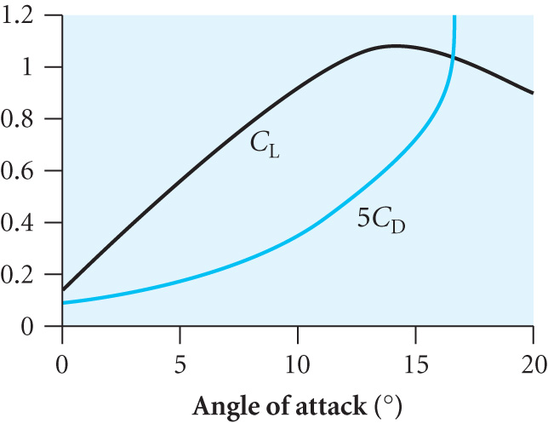
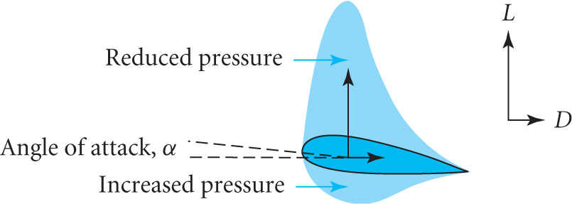
Birds control lift and drag forces by changing the shapes of their wings and angle of attack
With an aerofoil as used in aircraft and turbines, for small angles of attack the pressure on the upper surface is significantly lower than on the lower surface resulting in a lift force
The diagram shows the dependence of C_{L} andC_{D} (magnified by 5) as a function of the angle of attack

Slide 6
LIFT AND CIRCULATION
It is possible to explain lift using inviscid fluid dynamics by introducing the concept of circulation
This leads to the Magnus Effect where a spinning ball experiences a sideways force
It is simpler to think of a fixed cylinder with a circumferential velocity u_{θ} superimposed on a uniform stream velocity U.
u_{θ} = Γ / 2πr where Γ is a constant called the circulation
In (a) the flow is symmetric so there is no net force but in (c) the superposition leads to different velocities and hence pressures with a resultant force called the Lift L= ρUΓ (3.5)

Slide 7
KUTTA-JOUKOWSKI THEOREM
An incompressible fluid has ρ = constant and if it is irrotational also (i.e. no vortices) then ∇ x U = 0
Hence U = - ∇ ψ where ψ is the scalar Velocity Potential
The Continuity Equation ∇.(ρ U) + ∂ ρ / ∂ t = 0 ➔ ∇.(U) = 0
Hence ∇² ψ = 0 Laplace’s Equation
MAGNUS EFFECT
Consider the two components of flow around a cylinder of radius a as shown on the last slide
In 2D cylindrical coordinates Laplace ➔
Velocity components are u_{r} = - ∂ ψ / ∂ r and u_{θ} = - (1/r) ∂ ψ / ∂ θ
Check that u_{r}≡ 0 and u_{θ} = Γ / 2πr are valid solutions of Laplace
Check that the potential ψ = -U r cosθ(1+a²/r²) satisfies Laplace leading to components
2. u_{r} = U (1-a²/r²) cosθ and u_{θ} = -U(1+a²/r²) sinθ

Slide 8
Note that solutions 2. yield u_{r} = U cosθ and u_{θ} = -U sinθ as r ➔∞ satisfying the boundary conditions for a uniform stream a
Superimposed velocity components 1. + 2. are
u_{r} = U (1-a²/r²) cosθ and u_{θ} = -U(1+a²/r²) sinθ +Γ/2πr
At r ≅ a u_{θ} = -2U sinθ − Γ/2πa = -U(2sinθ + Β) with B= Γ/2Uπa
and u_{r} = 0 (boundary condition satisfied)
Putting u_{θ} = 0 we get two stagnation points when sinθ = - Γ/4Uπa on the lower side (π ≤ θ ≤ 2π) if B < 2. i.e. Γ= -4Uπa sinθ
Bernoulli’s theorem states the pressure on surface p = k – ½ ρ u_{θ}²
p = k – ½ ρ U²(4sin²θ + 4Bsinθ+B²)
=k – ½ ρ U²(4sin²θ + B²) – 2 ρ U²Bsinθ
Last term is –ve for 0 ≤ θ ≤ π on upper side and +ve on lower side, the other terms being symmetric
Force/unit length
So Lift L= ρUΓ

Slide 9
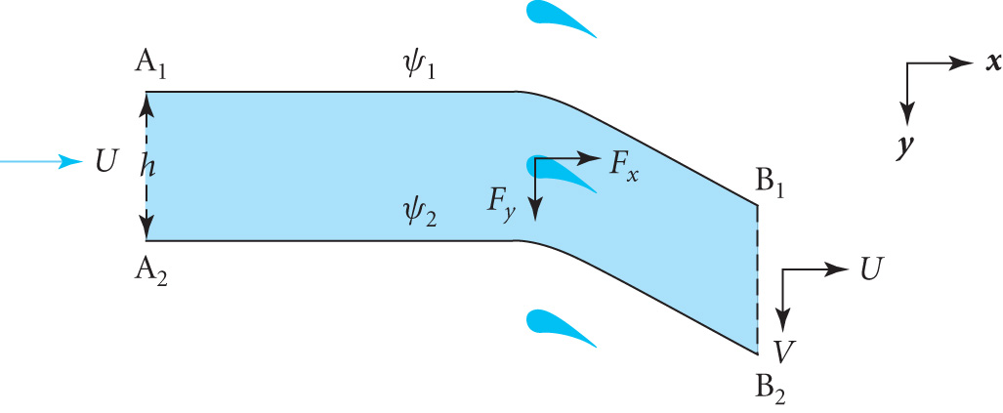
LIFT ON A TURBINE BLADE
It is easier to treat a cascade of
turbine blades as shown
Stream lined flow is bent through
an angle α creating a vertical
component of velocity v = U sin α
Force /unit length F_{y} = mass / sec x vertical velocity = (ρUh)v
Circulation where C is the contour A₁B₁B₂A₂A₁
N.B. Contributions from A₁B₁and B₂A₂ cancel, A₂A₁is zero so the contribution from B₁B₂ gives Γ = hv and hence
F_{y} = (ρUh)v = ρU Γ as before
Theory shows that for the velocity to be finite at all points on the aerofoil surface Γ = πU w sinα (3.6) is the required circulation where w is the width of the aerofoil. For a length l
Lift L = ρU Γl = πρU²lw sinα so C_{L}= 2πlw sinα / A = 2π sinα (3.7)

Slide 10
The formula derived for C_{L} predicts that C_{L} = unity when
α = 9 degrees, close to what is observed in practice
The circulation concept is justified by the way that vorticity is generated when an aerofoil begins to move
Vorticity is generated at the leading edge which is swept back to the trailing edge and then shed in the wake leaving an equal and opposite flow around the aerofoil
Reason why aircraft wait on a runway to allow time for vortices from previous aircraft to disperse
The effect of viscosity is therefore to produce circulation and then the lift force follows from inviscid fluid theory.

Slide 11
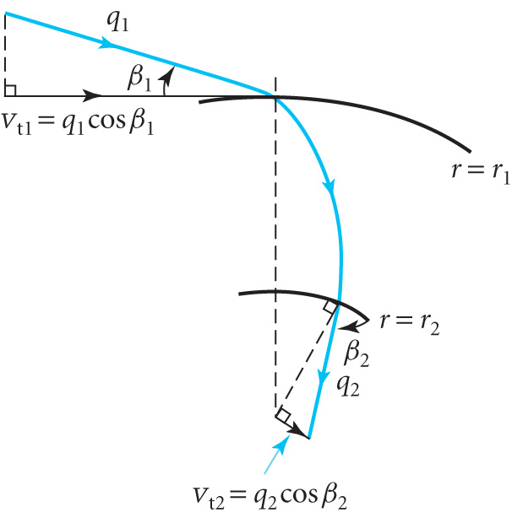
EULER’S TURBINE EQUATION
In most types of power generation the kinetic energy of a fluid is converted into rotational motion of a shaft
Rate of change of angular momentum of
the fluid = torque on shaft
Fluid enters with circumferential velocity
v_{t1} at r=r₁ and leaves at r = r₂ with v_{t2}
Mass flow rate = Qρ where Q is the
volume flow rate
Torque T = Qρ (r₁v_{t1}-r₂v_{t2})
N.B. internal details of flow are irrelevant
Power delivered to a turbine rotating with angular velocity ω is P=ω T
Substituting we obtain EULERS TURBINE EQUATION
P = ω Qρ (r₁q₁ cosβ₁ -r₂q₂ cosβ₂) (3.8)
N.B. Maximum power when cosβ₂ =0, i.e. fluid flows out radially

