Slide 1
SYSTEMS FOR MAGNETIC CONFINEMENT
The problem is that while it is easy to predict the behaviour of
a single ion in a magnetic field the same is not true for a
plasma containing ~ 10²¹ ions m⁻³
Each ion moves and creates its own electric and magnetic field which interact with other ions and the confining field
  Very difficult to analyse all but the simplest instabilities
MAGNETIC MIRROR
Simplest configuration

Slide 2
Consider an ion (or electron) moving at an angle θ to the z axis at the centre of the magnetic mirror
Total energy E = ½ mv² is conserved
  v² = v_{x}² + v_{y}² + v_{z}² = v₀² + v_{z}²
Angular momentum L = mv₀a is conserved
a = v₀ / ω = m v₀ / e B_{z}
  ∴ L = m² v₀² / e B_{z}
At the ends of the mirror v_{z}² = v² - v₀²
  ∴v_{z}² = v² – (L e / m² ) B_{z}^{MAX}
At the centre L = m² v₀² / e B_{z}^{MIN}
∴ At the end
  v_{z}² = v² – v₀² B_{z}^{MAX} / B_{z}^{MIN}
Now v₀ = v sinθ (v_{z} = v cosθ )
∴ v_{z} at the end of the mirror = 0 when sinθ = (B_{z}^{MIN} / B_{z}^{MAX} )^{1/2}
i.e. REFLECTION OCCURS IF
θ ≥ sin⁻¹(B_{z}^{MIN} / B_{z}^{MAX} )^{1/2}

Slide 3
The problem is that ions near the centre experience a small B (plasma is diamagnetic) so that end losses occur
Currently the ‘Mirror’ is not considered a practical proposition for a reactor
TOROIDAL MAGNETIC FIELD
To eliminate end effects the field lines are bent to close on themselves in a torus
Recall for a solenoid B = μ₀ n I where n = No. turns / unit length
For a toroid n = N / 2πR (N = total no. of turns)

Slide 4
For a TOROID B = μ₀ N I / 2πR ∝1/R
A major problem is that the field gradient leads to a drift of the ions and electrons in opposite directions (i.e. plasma separates)
B is perpendicular to the diagram into the plane.
If B were constant the red and blue lines would simply be circles.
Let B changes abruptly from B₁ to B₂ at the central black line
(B₁ > B₂ )

Slide 5
Now the circles are distorted and as +ve and –ve particles experience different forces this distortion leads to a separation
  +ve and –ve ions drift apart in opposite directions and perpendicular to both B and R.
Drift distance in one rotation [ a=v ₀/ω]
  is d = 2 (a₂ – a₁)
  Time required t_{d} = ( τ₁ + τ₂ ) / 2
    τ = rotational period = 2π/ω
Drift velocity v_{d} = d / t_{d}
As charges separate, then the force ev_{d} ∧ B causes the plasma to drift out along R
Analysis shows that the v_{d} = - mv₀²/eπBR ~ -kT/eBR so the drift velocity increases with temperature

Slide 6
Proof of the last relation for completeness:-

Slide 7
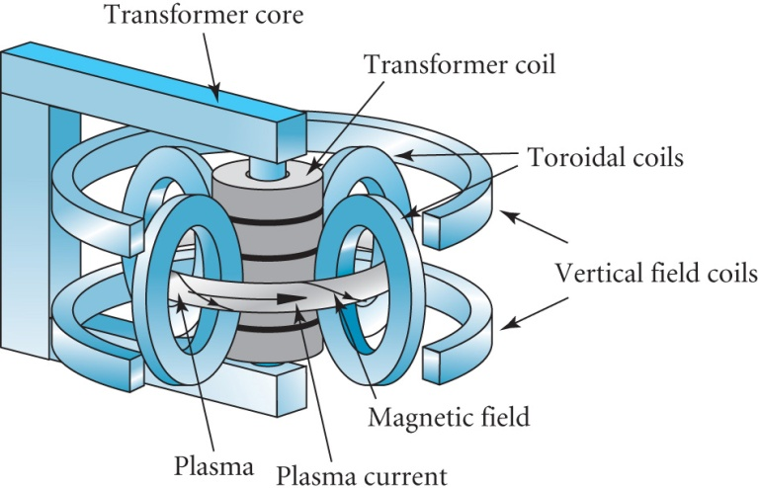
TOKOMAK
INTRODUCTION
Russian in origin – name is an acronym for
  TO (roidal)
  KA (MERA) = chamber
  MAK (netic)
Presently the most successful system of magnetic confinement. Used in JET (Joint European Torus) at Culham
PRINCIPLE OF OPERATION

Slide 8
Consider a plasma confined in a torus
  Let R = major radius of torus
  Let a be minor radius of torus
In a TOKOMAK the plasma forms the secondary winding of a set of transformers whose primaries are driven by a pulse of current
  Thus an AXIAL current I_{T} (density j_{T}) is induced in the plasma
  Induces ohmic heating, power density η j_{T}² (η ➔ plasma resistivity)
  Induces the POLOIDAL FIELD B_{P}
B_{P} opposes the drift of the plasma outwards because of q (v_{d} ∧ B_{P}) causes looping about the poloidal field lines

Slide 9
A second effect of the Poloidal field is the PINCH EFFECT
Each ion (e- and D+, T+ move in opposite directions) feels a force directed inwards because of q (v_{I} ∧ B_{P})
  where v_{I} = velocity in direction of I_{T}
This results in a plasma pressure given by
There are many complex stability issues to be overcome

Slide 10
SIZE OF TOKAMAK
Assuming parameters
  Power density 40 MW m⁻³
  n ~ 3 x 10²⁰ m⁻³ at T = 13 keV
For a total power ~ 1GW then
  2πR . πa² = 1000/40 ∴Ra² =1.3 m³
The ratio R / a is determined by detailed considerations of the stability conditions
  Typically R / a ~ 2.4 i.e. a ~ 1m
  For ‘JET’ a = 1.25m, R = 2.96m
MAGNITUDE OF I_{T}
Must satisfy P = 2nkT and
For n = 3 x 10²⁰ m⁻³ , T = 5 x 10⁷ K, a = 1m I_{T} ~ 10⁷ (β_{P})^{-1/2}
‘JET’ started with 2.6MA then 4.8MA later

Slide 11
HEATING THE PLASMA
OHMIC HEATING
Ohmic heating power density = η j_{T}²
Crudely η arises from Rutherford scattering of electrons from +ve ions
As T rises➔ relative energies rise ➔ cross section decreases
Maximum temperature reached by ohmic heating is 3-4 keV so extra heating is required
RF HEATING
Energy can be absorbed from radio waves beamed into plasma
  In JET 25 – 55 MHz is used to provide 15 MW of heating
NEUTRAL BEAM INJECTION
H+ or D+ ions can be accelerated, converted into atoms in a neutraliser, and injected into the plasma
  Neutral atoms can cross field lines
  Provides 10 MW of heating in JET

Slide 12
ADIABATIC COMPRESSION
The plasma is initiated in the outer part of the torus and heated by ohmic, RF and/or neutral beam.
I_{T} (so B_{P}) and B_{T} are then raised rapidly moving the plasma to the centre of the torus
  Compression heats the plasma
PRESENT STATUS AND FUTURE OF TOKOMAKS
4 large Tokomak projects were started between 1982 and 1986 in Culham UK (JET), Princeton USA (TFTR), Japan (JT-60) and Russia (T-15)
JET was set up by EURATOM in 1983 and has achieved
  plasma temperatures of 25 keV,
  density 0.5 x 10²⁰ m⁻³,
  confinement time 1.0s.
The construction of the new International Tokomak ITER is underway at Cadarache, France

Slide 13
LAWSON PLOT

Slide 14
FUTURE → INTERNATIONAL THERMONUCLEAR EXPERIMENTAL REACTOR
JET ITER(2002)
R (m) 2.96 6.2
a (m) 1.25 2.0
B_{T} (T) 3.5 5.3
I_{T} (MA) 4.8 15(17)
Burn time (s) 1 100
Duty Cycle 1/600 0.7
Fusion Power (MW) 2 700
(90%D/10%T)
The building for ITER is ready and assembly of Tokomak begins ~ 2013
ITER commissioning starts ~ 2017 and opens ~2018
Other developments include the SPHERICAL TOKOMAK
See http://www.fusion.org.uk/index.html

