Slide 1
EFFECT OF DELAYED NEUTRONS
As we have seen the prompt lifetime of neutrons, 10⁻³ seconds, in a MAGNOX reactor leads to a very unstable situation as k changes
For FAST reactors T = 10⁻⁷ seconds and the situation is worse
Computers and electronics can respond in 10⁻⁶ seconds BUT CONTROL RODS CANNOT
The key to the control of reactors is the presence of DELAYED NEUTRONS
EFFECT OF DELAYED NEUTRONS
In ²³⁵U fission 0.65% of all neutrons arise from delayed emission.
The average mean life of the delayed neutron precursors is
= 12.5 seconds

Slide 2
The mean lifetime is
(i.e. a weighted average)
This is much more easily controllable
This is a critical number and is studied with much more detailed calculations
REACTIVITY CHANGES IN OPERATION
1. FUEL BURN UP (for thermal reactors)
For a hypothetical pure ²³⁵U reactor the fuel concentration and hence δk will reduce as the reactor burns fuel
The fuel burn up is greatest at the centre where the neutron flux is highest
Hence composition of the reactor varies non-uniformly and non-linearly with time
For normal thermal reactors using natural or slightly enriched U NEW fissile material ²³⁹Pu is constantly produced by breeding reactions

Slide 3
The new ²³⁹Pu offsets the loss of ²³⁵U
Extends useful life of fuel
Produces more energy than is produced by ²³⁵U alone
Important reactions in fuel burn up are
n + ²³⁵U ➔ FISSION or ²³⁶U
n + ²³⁸U ➔ ²³⁹U ➔ ²³⁹Np ➔ ²³⁹Pu
n + ²³⁹Pu ➔ FISSION or ²⁴⁰Pu
n + ²⁴⁰Pu ➔ ²⁴¹Pu
n + ²⁴¹Pu ➔ FISSION or ²⁴²Pu
²⁴¹Pu fission is only important at the end of the fuel cycle at high burn up
The concentrations of ²³⁵U and ²³⁹Pu can be calculated i.e.

Slide 4
Integrating these equations we obtain
where N₀ is the initial concentration
The following graphs are examples for Φ_{thermal} ~ 10¹⁷ m⁻² s⁻¹
Some refuelling is required before ~ 2 years
235

Slide 5
REACTOR POISONS
Many fission products (i.e. different neutron rich isotopes) are produced in reactors
Two products have huge capture cross sections for thermal neutrons and can effect reactor operations
¹³⁵₅₄Xe₈₁ σ_{A}=2.65 10⁶ barns (cf σ_{A}= 190barns for ¹³³ Xe)
Yield = 0.064 atoms per fission
¹⁴⁹₆₂Sm₈₇ σ_{A}=5.8 10⁴ barns (cf σ_{A}= 5.5barns for ¹⁵⁴ Sm)
Yield = 0.0113 atoms per fission
They are formed primarily from β decay
¹³⁵Te→ ¹³⁵I →¹³⁵Xe →¹³⁵Ce →¹³⁵Ba
¹⁴⁹Nd→ ¹⁴⁹Pm →¹⁴⁹Sm
The τ_{1/2} values increase along the chains -- τ_{1/2} = 9.2 hrs for ¹³⁵Xe and ¹⁴⁹Sm is stable

Slide 6
¹³⁵Xe is the main reactor poison and reaches a steady concentration after ~ 30 hours
Causes δk to decrease by 0.03 for Φ~10¹⁸ m⁻² s⁻¹
Need to build this amount of excess reactivity into the reactor
During normal operation (> 30 hrs) ¹³⁵Xe is being produced as above. Equilibrium comes through losses via
β decay
The reaction ¹³⁵Xe(n,γ) ¹³⁶Xe
However after shutdown the (n,γ) reaction ceases so ¹³⁵Xe starts to build up from ¹³⁵I decay until the ¹³⁵Xe β decay dominates
This poisoning implies that it is not possible to re-start a reactor until 40-60 hrs after shutdown
Need to build in excess δk of 0.15 to cope with shutdown problems

Slide 7
EFFECT OF ¹³⁵Xe ON REACTIVITY
Consider a flux F ~ 10¹⁸ m⁻² s⁻¹
Excess reactivity of ~ 3% needed to overcome ¹³⁵Xe during
steady operation
About 12% needed to enable the reactor to restart at any time
In practice 15% is built in to allow for other poisons such
as ¹⁴⁹Sm
¹⁴⁹Sm has a build up time τ_{½} ~ 53 hrs

Slide 8
EFFECT OF ¹⁴⁹Sm ON REACTIVITY
Consider a flux Φ ~ 10¹⁸ m⁻² s⁻¹
In an operating reactor the quantity of ¹⁴⁹Sm grows until
production = destruction by neutron capture
If the reactor is shut down more ¹⁴⁹Sm is created since
destruction stops i.e. no neutrons so no capture
An excess reactivity of δk~ 1.5% is needed to overcome this
when starting the reactor

Slide 9
SHUTDOWN CHARACTERISITICS (Other than poisoning)
1. FISSION PRODUCT DECAY HEATING
There is a large energy release from the fuel after shutdown due to radioactive decay of accumulated fission products
Let F = fraction of power produced after shutdown
It is an important safety feature of power reactors that
coolant circulates after shutdown to remove heat

Slide 10
2. DELAYED NEUTRONS
The reduction of neutron flux to near zero at shutdown will be significantly delayed by this source of neutrons
The neutron flux decays with a period equal to the mean life of the longest lived precursor (~ 80s)

Slide 11
ACCELERATOR DRIVEN SYSTEMS
There are many advantages to be gained from accelerator driven systems
A 1 GeV proton beam ~ 10mA current generates neutrons (spallation) in a heavy target e.g.Pb or U. inside a fast breeder assembly
The coolant is metallic e.g. molten lead
The fast fission unit uses ²³²Th as fuel running at k ~ 0.95 !!
Each proton produces 13 fissions in the first generation, 13k in the 2nd, 13k² in the 3rd etc giving a total of 13 / (1-k) fissions per proton.
At 200 MeV per fission and k=0.95 this gives an energy gain of 50!!
About 10-20% of this would be needed to power the accelerator

Slide 12
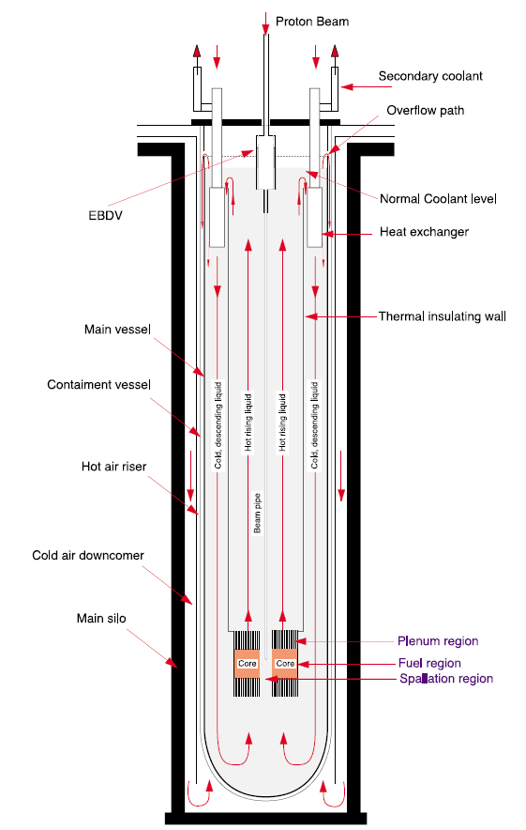
Example of an accelerator
driven design
The schematic shown is a conceptual design
By C. Rubbia et al
CERN/AT/95-44 (ET)

Slide 13
ADVANTAGES
Operates far from the critical condition
No conditions in which self
sustaining reactions are possible
Reactor stops when accelerator stops
Breeds fuel and incinerates long lived wastes
E.g. n + ²³²Th ➔ ²³³U chain
May remove the need for geological storage of waste
REQUIREMENTS
Advance in cyclotron technology to deliver tens of milliamps at 1 GeV
~ 10 times current values but CERN are very confident it can be achieved
An efficiency of 40 – 50% for converting electrical energy into beam energy

Slide 14
Outlook for Fission Reactors
Economically nuclear power is compatible with fossil fuels in Europe but less so in the US due to differences in fuel costs
Environmentally nuclear power is good for low CO₂ emission but the main concerns are:
Risk of an accident – then the siting of the reactor, population distribution, prevailing winds etc. etc.
Radioactive waste: high, intermediate and low level
Stored on-site for several years in storage pools to remove heat and allow for the most intense activity to decay
Then stored or reprocessed to recover U and Pu
Remainder immobilised by vitrification into borosilicate glass, or incorporated in stable mineral lattices and stored in corrosion resistant cans in an underground depository

Slide 15
Country | (2005) Nuclear Generation | Number of Reactors
 | % Total Electricity | Operating | Being Built | Planned / Proposed
France | 79 | 59 | 0 | 2
Germany | 31 | 17 | 0 | 0
Japan | 29 | 55 | 1 | 12
Russia | 16 | 31 | 4 | 9
UK | 20 | 23 | 0 | 0
USA | 19 | 103 | 1 | 13
World | 16 | 441 | 27 | 153
Public opinion has a major effect on government decisions
In a poll in europe in 2001 50% agreed to the nuclear power option if waste could be managed with 25% against
The desire for a secure energy supply and a reduction of CO₂ emissions is causing nations to re-evaluate the nuclear power option

