Slide 1
SOME THERMODYNAMIC RELATIONS
HEAT TRANSFER
Conduction Q = kA dt/dx k is the thermal conductivity
Convection
Radiation P = εσT⁴ per unit area. ε is the emissivity, σ is the Stefan-Boltzmann constant
= 5.67 10⁻⁸ W m⁻² K⁻⁴
1st Law ΔU = dQ – dW For fluids dW = pdV
Entropy Δs = ΔQ_{REV} / T
Efficiency of a Carnot Engine η_{C} = 1 – T₂ / T₁
Enthalpy h = u + pv Useful for describing
1. Heat transfer at constant pressure in a boiler or
condenser. Heat input Q = h₂ - h₁ (2.1)
2. Adiabatic changes in compressors and turbines where
net work on the shaft W = h₁ - h₂ (2.2)
(See derivation 2.2 in the text book for proof of these last two relations)

Slide 2
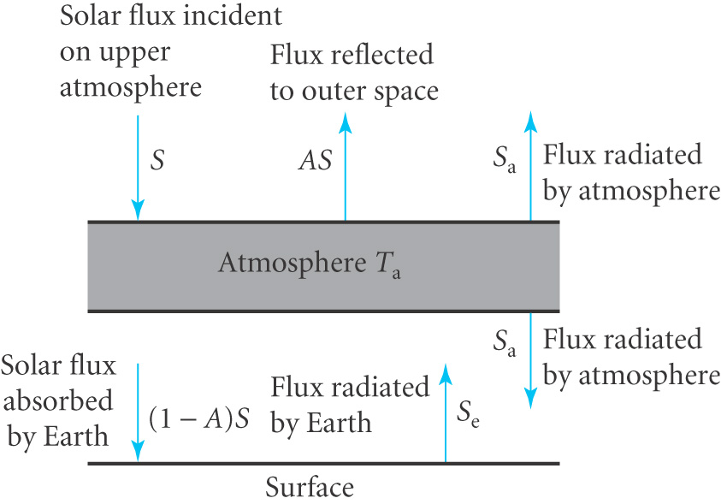
THE GREENHOUSE EFFECT
Solar radiation incident on Earth has an intensity S = 1.37 kW m⁻²
Energy spectrum from IR to UV. Assume the atmosphere is almost transparent to solar radiation but absorbs radiation from Earth (IR)
A fraction of solar radiation, the albedo, A, is reflected by clouds and the Earth’s surface back into space (this is close to 30%)
(1-A)S heats up the earth
to a temperature T_{e} which
radiates S_{e} (IR) outwards
Water vapour + CO₂ + …
absorb IR
The temperature of the
atmosphere is T_{a} which
then radiates a flux S_{a}
both upwards and out
into space

Slide 3
If there was no atmosphere the total heat absorbed by the Earth would be (1-A).Sπ R² (R is the radius of the Earth)
Equilibrium would be reached at a temperature T where
(1-A).Sπ R² = 4π R² σT⁴ (assuming ε = 1) (2.3)
Putting A = 0.3 gives T = 255 K
Taking ε = 1 for the atmosphere with temperature T_{a} we have the net heat absorbed being radiated out into space by the atmosphere
(1-A).Sπ R² = 4π R² σT_{a}⁴ (2.4)
But the surface now receives extra heat from the atmosphere and so reaches a temperature T_{e} where
(1-A).Sπ R² + 4π R² σT_{a}⁴ = 4π R² σT_{e}⁴ (2.5)
From these equations we obtain T_{e}⁴ = 2T⁴
So T_{e} = 303K
More realistically we should account for the small fraction f of solar radiation absorbed by the atmosphere adding a factor (1-f) to the first term in (2.5)

Slide 4
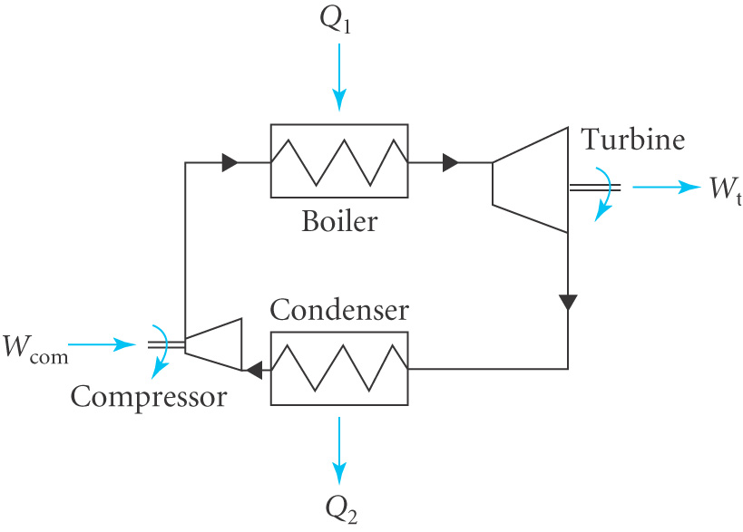
CLOSED CYCLE FOR STEAM POWER PLANT
The working fluid undergoes changes of phase in a closed cycle
Compressor
Work W_{com} done on system to compress cold water from sub-atmospheric pressure to high pressure
Boiler
Heat Q₁ added to convert cold water to steam
Turbine
Work W_{t} done by system
(i.e. by steam) on
turbine blades
Condenser
Heat Q₂ lost from system
to environment
( steam➔cold water)

Slide 5
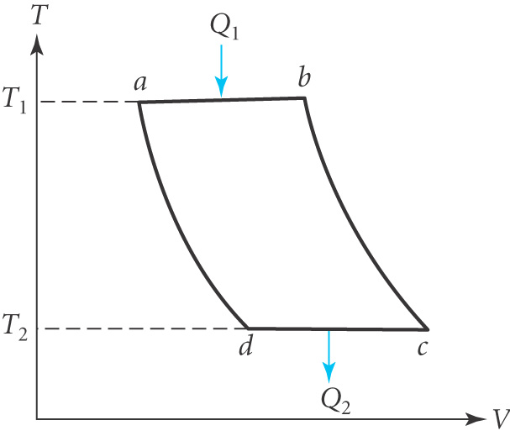
-
1st Law
After each complete cycle ΔU = 0 = (Q₁-Q₂)-(W_{t}-W_{com})=0 1st Law
Efficiency η = net work out / heat in = (W_{t}-W_{com})/Q₁ = (Q₁-Q₂)/Q₁
∴ η = 1 - Q₂ / Q₁ (2.6)
The maximum efficiency is limited by the 2nd Law of Thermodynamics.
The Carnot cycle for a perfect gas
involves reversible isothermal and
adiabatic changes leading to
η_{C} = 1 - T₂ / T₁ (2.7)

Slide 6
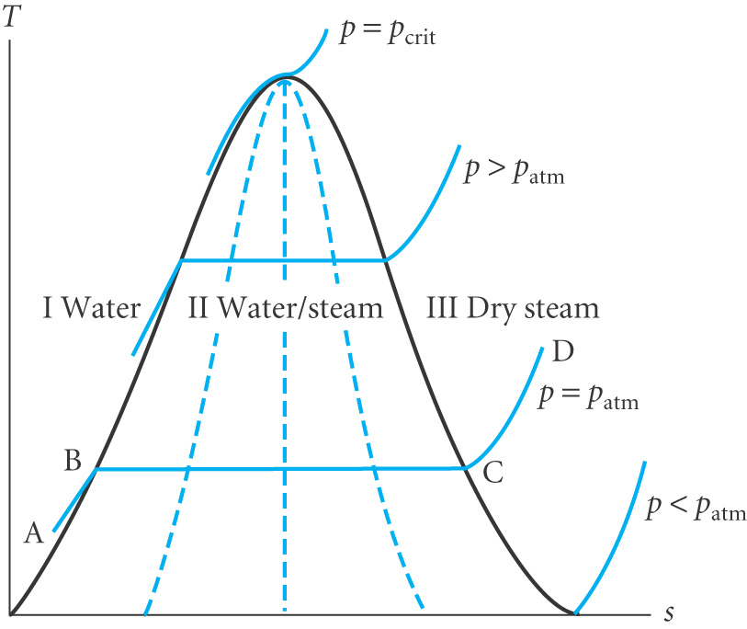
THERMAL PROPERTIES OF WATER AND STEAM
3 regions of interest
Water
Mixture of water + steam
Dry steam
T – s diagram
Solid blue lines are isobars
Dotted lines have constant x
For a mixture Steam Quality x = m_{gas} / m where m = m_{gas} + m_{fluid}
Steam tables give specific values of s, u and h for fluid and gas
from which the value for a mixture can be determined
eg . mh = m_{gas} h_{gas} + m_{fluid} h_{fluid}
h= (1-x) h_{fluid} + x h_{gas} per unit mass (2.80)
The path ABCD corresponds to water boiling and becoming dry steam

Slide 7
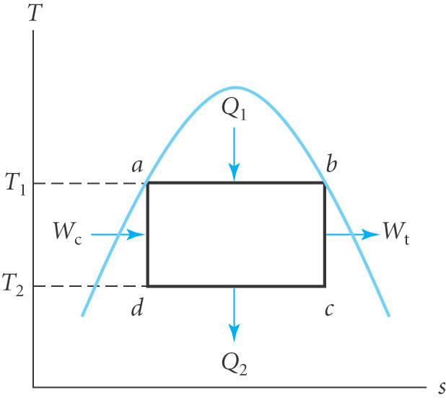
Example:- A steam power plant operates on a Carnot cycle. The boiler is at T₁=352ºC, p=170 bar and the condenser is at T₂ = 30ºC, p = 0.04 bar
 |  | h (kJ kg⁻¹) |  | s (kJ kg⁻¹ K⁻¹)
T(ºC) | P (bar) | h_{fluid} | h_{gas} | s_{fluid} | s_{gas}
30 | 0.04 | 126 | 2556 | 0.436 | 8.452
352 | 170 | 1690 | 2548 | 3.808 | 5.181
η_{C} = 1 - T₂ / T₁ = 1-303/625 ~ 0.52
Since the boiler is at constant pressure
Q₁ = h_{b}-h_{a} = 2548-1690 = 858 kJ kg⁻¹
Since bc is adiabatic in the Carnot cycle W_{t} = h_{b} – h_{c}=2548 – h_{c}
To find h_{c} we use h_{c} = (1-x_{c}) h_{fluid} + x_{c} h_{gas} where x_{c} is value of x at c
To find x_{c} note that s_{b}=s_{c} = 5.181 (adiabatic expansion in the turbine)
But s_{c} = (1-x_{c}) s_{fluid} + x_{c}s_{gas} = (1-x_{c}) 0.436 + 8.452x_{c} = 5.181
Hence x_{c} = 0.59 and so h_{c} = (1-0.59)x126 + 0.59 x 2556 = 1560 kJ kg⁻¹
So work done by the turbine W_{t} = h_{b} – h_{c}=2548 – 1560 = 988 kJ kg⁻¹
A similar analysis to find x_{d} gives x_{d} = 0.42 and Q₂ = h_{c}-h_{d} = 413kJ kg⁻¹

Slide 8
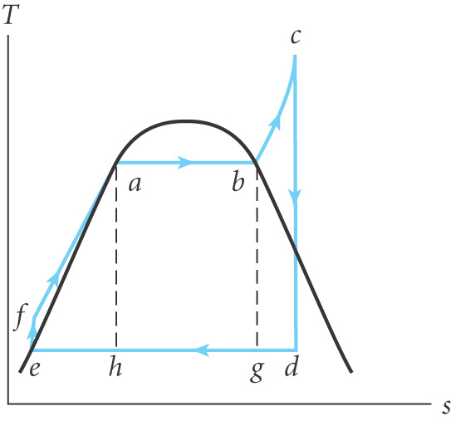
RANKINE CYCLE
The Carnot cycle is impractical using water as the working fluid
Need T₁ constant. Only possible in region II
Region II is 2 phase. Fast water droplets damage turbine blades
and compressor blades
Volume of steam is very large – expensive compressor
In the Rankine cycle all the steam is converted
to water (de) before entering the compressor
which raises the pressure adiabatically (ef)
Modern plants have 3 sections
Economiser heats water until boiling (fa)
Evaporator converts water to dry steam (ab)
Superheater heats dry steam at constant p (bc).
Work on turbine blades (cd) then wet steam enters the condenser.
Typical efficiencies with reheat are in the range 40 – 45%
T_{c} is limited to 650 ºC to avoid corrosion
The Carnot cycle is impractical using water as the working fluid
Need T₁ constant. Only possible in region II
Region II is 2 phase. Fast water droplets damage turbine blades
and compressor blades
Volume of steam is very large – expensive compressor
In the Rankine cycle all the steam is converted
to water (de) before entering the compressor
which raises the pressure adiabatically (ef)
Modern plants have 3 sections
Economiser heats water until boiling (fa)
Evaporator converts water to dry steam (ab)
Superheater heats dry steam at constant p (bc).
Work on turbine blades (cd) then wet steam enters the condenser.
Typical efficiencies with reheat are in the range 40 – 45%
T_{c} is limited to 650 ºC to avoid corrosion
The Carnot cycle is impractical using water as the working fluid
Need T₁ constant. Only possible in region II
Region II is 2 phase. Fast water droplets damage turbine blades
and compressor blades
Volume of steam is very large – expensive compressor
In the Rankine cycle all the steam is converted
to water (de) before entering the compressor
which raises the pressure adiabatically (ef)
Modern plants have 3 sections
Economiser heats water until boiling (fa)
Evaporator converts water to dry steam (ab)
Superheater heats dry steam at constant p (bc).
Work on turbine blades (cd) then wet steam enters the condenser.
Typical efficiencies with reheat are in the range 40 – 45%
T_{c} is limited to 650 ºC to avoid corrosion

Slide 9
GAS TURBINES AND THE BRAYTON CYCLE
In a gas turbine the products of combustion are typically ~ 1300ºC
Gas turbines operate in the Brayton (or Joule) cycle
Air at 1 bar (a) is compressed to 10 – 20 bar (b)
It is then mixed with fuel and the exhaust gases enter the turbine (c)
And vented at (d) to the atmosphere
Adiabatic process in the compressor so W_{com}= h_{b} – h_{a}
Similarly in the turbine W_{t}= h_{c} - h_{d}
Heat supplied Q₁ = h_{c}- h_{b}= c_{p}(T_{c} - T_{b}) and
Heat rejected Q₂ = h_{d}- h_{a}= c_{p}(T_{d} - T_{a})
where c_{p} is the specific heat capacity at constant pressure

Slide 10
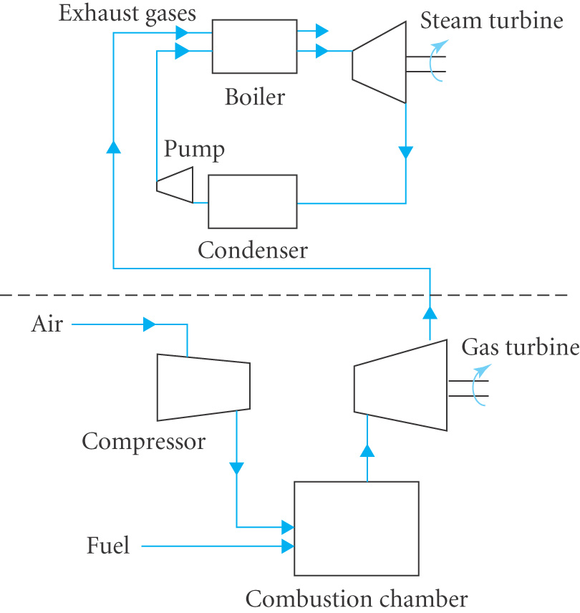
Efficiency η = (Q₁ – Q₂) / Q₁ = [(T_{c}-T_{b}) - (T_{d}-T_{a})] / (T_{c}-T_{b})
Since PV^{γ} = constant and PV=RT we have P^{(1-γ)} T^{γ} = constant so
Efficiencies for simple gas turbines ~ 40%
This can be improved by combining the
Brayton and Rankine cycles to make a
Combined Cycle Gas Turbine (CCGT)
Efficiencies ~ 60%
Combined Heat and Power cycle (CHP)
uses waste heat for district heating
Efficiencies ~80% but expensive

Slide 11
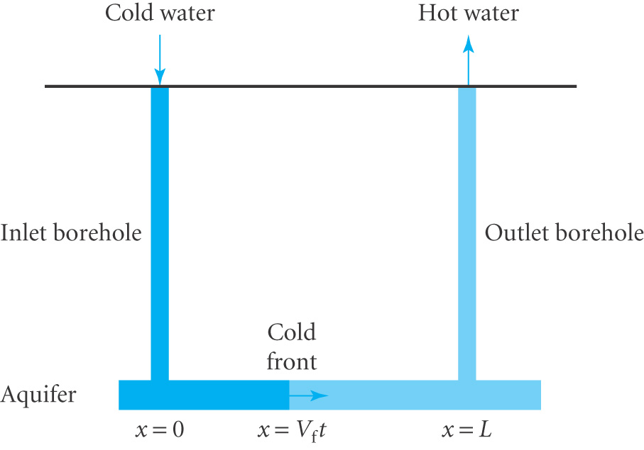
GEOTHERMAL ENERGY
An Aquifer is a layer of porous rock trapped between layers of impermeable rock
Heat is extracted by pumping water at
temperature T₀ down a borehole and
extracting water at T₁ at a 2nd borehole
Heat available per unit volume of rock is
ρ_{r}c_{r}(T₁-T₀)
Assume the aquifer has cross- sectional area
A & porosity φ (fraction of volume occupied by pores)
Power output for a volume flow Q= A v_{w} is P=ρ_{w}c_{w}(T₁-T₀)Q (2.9)
A ‘cold front’ moves through with speed v_{f}. In time δt volume of rock exposed = (1-φ)A v_{f} δt and heat removed = heat gained by water
∴ ρ_{r}c_{r}(T₁-T₀) (1-φ)A v_{f} δt = ρ_{w}c_{w}(T₁-T₀) A v_{w} δt
So v_{f} =λ v_{w} where λ = ρ_{w}c_{w} / ρ_{r}c_{r}(1-φ) (2.10)
The lifetime = time for cold front to reach outlet t_{life}= L / v_{f} (2.11)
Total energy available is fixed E= ρ_{r}c_{r}(T₁-T₀) AL (2.12)
so the choice of Q (v_{w}) and t_{life} are determined by economics

Slide 12
Flow rate is determined by Darcy’s Law Q = kA Δp / L (2.13) where k is the permeability of the rock and Δp the pressure difference
Other techniques can be used:-
Heat can be extracted from hot dry rocks at higher temperatures
Heat pumps are also used for heating and cooling
In US over 40% energy and nearly 40% CO₂ emissions are from water heating, space heating and cooling
100,000 geothermal heat pumps are estimated to save 1.1 10⁶ tonnes of carbon over a 20 year period
Drilling for geothermal power is speculative but it is a largely untapped source
Currently ~ 1TW is extracted world wide
Potential to provide 5% of global electricity by 2020

