Slide 1
PRINCIPLES OF NUCLEAR FISSION REACTORS
SUMMARY OF UNDERLYING PHYSICS
Neutrons can induce fission in heavy nuclei
~ 200 MeV is released per fission
~ 2.5 neutrons per fission are released
σ_{F} is large at certain energies
CHAIN REACTIONS
If no absorption or loss of
neutrons occurred then an
initial neutron in a block
of uranium can start a
chain reaction
For simplicity assume 2 neutrons per fission

Slide 2
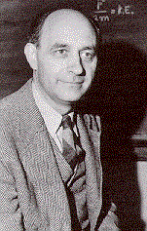
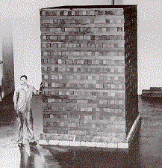
Fermi’s Chicago pile number 1 with alternating layers of uranium and graphite. On December 2nd 1942 Fermi slipped the control rods out of the pile generating heat.

Slide 3
Define
REPRODUCTION CONSTANT ( MULTIPLICATION FACTOR) k
k > 1 ‘Super-critical’ – explosion (bomb)
k < 1 ‘Sub-critical’ – reaction dies out
k = 1 ‘Critical’ – stable chain reaction
Excess reactivity ➔ δk = k - 1
k depends on many factors including the cross sections.
Natural Uranium (Infinite system) - No chain reaction possible
As neutrons slow from 2 MeV to 1 keV σ_{c} becomes dominant over σ_{f}
Enriched Uranium (with ²³⁵U) Chain reaction possible
For all values of T_{n}, σ_{f} (²³⁵U) > σ_{c}
Shows basis for FAST REACTORS in which mostly high energy neutrons cause fission

Slide 4
Conceptual diagram of
a basic thermal reactor
A simple matrix of natural (or slightly enriched U surrounded by a moderator
FUEL: U (or less frequently Pu)
MODERATOR: C, H₂O or D₂O to slow neutrons from ~2Mev to < 1 eV
CLADDING: Contains fuel and prevents release of radioactive fission products + provides thermal contact with coolant
COOLANT Gas or liquid, separated from fuel and moderator-.takes heat away from fuel for electricity generation
CONTROL RODS Usually B (or Cd )with large σ_{C} for thermal neutrons to maintain k=1
SHIELD Usually steel to contain pressure and concrete to give radiation protection

Slide 5
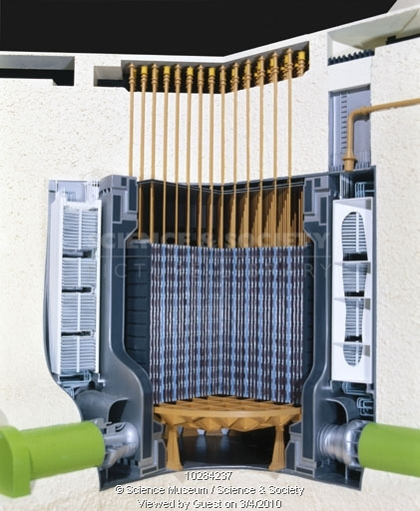
Oldbury Magnox reactor 1968

Slide 6
For n + U σ_{R} is negligible and the other cross sections (barns) as a function of energy are
T_{n} MeV | Isotope | σ_{S} | σ_{f} | σ_{i} | σ_{C}
2 | ²³⁸U | 4 | 0.6 | 2.9 | 0.2
2 | ^{NAT}U | 4 | 0.6 | 2.9 | 0.2
2 | ²³⁵U | 3.5 | 1.3 | 2.3 | 0
0.3 | ²³⁸U | 9 | 0 | 0.5 | 0.2
0.3 | ^{NAT}U | 9 | 0.009 | 0.5 | 0.2
0.3 | ²³⁵U | 7 | 1.3 | 0.7 | 0
0.001 | ²³⁸U | 11 | 0 | 0 | 4
0.001 | ^{NAT}U | 11 | 0.6 | 0 | 4
0.001 | ²³⁵U | 10 | 8 | 0 | 3
Thermal | ²³⁸U | 8 | 0 | 0 | 3
Thermal | ^{NAT}U | 8 | 4.1 | 0 | 3.7
Thermal | ²³⁵U | 10 | 580 | 0 | 100
Remember that there are large resonances below 1keV

Slide 7
ROLE OF THE MODERATOR
The moderator slows neutrons by elastic scattering
E.g. General case :-
Let the masses of n and X be m and M respectively
In the Laboratory Frame X recoils in this process and so n loses energy in this frame
If we consider the process in the Centre of Mass System where n and X have equal and opposite momenta before and after scattering
➔ No loss of energy in this frame
Consider the transformation to the centre of Mass system travelling with speed V_{C}

Slide 8
In CMS mu¹ + Mu_{X}¹= 0 by definition
Also u¹ = u - V_{C} and u_{X}¹ = - V_{C}
Substituting for u¹ and u_{X}¹ gives
V_{C} = u m / (m + M) and
u¹ = u M / (m +M)
Now consider the final velocities of
the neutron, v and v₁ in lab. and CMS, and v_{X} and v_{X1} the corresponding velocities for X.
In CMS mv₁ + Mv_{X1}=0= mu¹ + Mu_{X}¹ ∴ |v₁ | = |u¹ | and |v_{X1} | = |u_{X}¹ |
The velocity v may be found from the following triangle of velocities using the cosine rule

Slide 9
Substituting for V_{C} and v₁ we obtain
Let T₀ and T₁ represent the neutron K.E. before and after collision so T₀ = ½ m u² and T₁ = ½ m v²
If A is the mass number of X then M=A u and m= 1 u
The maximum energy loss occurs when cos(θ) = -1 with T₁ a minimum
i.e. θ =180⁰ (head-on collision)
Experiment shows that the angular distribution of the neutrons is
isotropic in the C.M.S.

Slide 10
N.B. φ is the azimuthal
angle and the –ve sign
occurs because T₁
decreases as θ increases
Integrating over φ gives :-

Slide 11
For rapid moderation we need A as small as possible
e.g. to reduce T_{n} from 2 MeV to 0.025 eV takes ~ 20 collisions for hydrogen but ~ 100 for carbon
Practical considerations for choice of moderator are
1) small A,
2) large σ_{S}, and
3) small σ_{A} ( = σ_{C} + σ_{R})
CHOICES | H₂O | D₂O | GRAPHITE
σ_{S} (b) | 50 | 11 | 4.7
σ_{A} (b) | 0.66 | 0.001 | 0.0045
N.B. If H₂O is used then U must be enriched with ²³⁵U because the absorption σ_{A} is large for H₂O

Slide 12
EXAMPLE: Compare the probabilities of traversing 1m of a) H₂O, b) D₂0 and 3) Graphite without being absorbed. [Densities are:- a)1000 kg m⁻³, b)1100 kg m⁻³ and c) 1600 kg m⁻³]
P(x) = exp (-N σ x)
H₂O; N_{H2O} = 1000 / ( 18 * 1.66 10⁻²⁷) = 4.78 10²⁸ m⁻³
P_{H2O} = exp (- 4.78 10²⁸ x 0.66 10⁻²⁸) = 0.043
b) D₂O; N_{D2O} = 1100 / ( 20 * 1.66 10⁻²⁷) = 3.31 10²⁸ m⁻³
P_{D2O} = exp (- 3.31 10²⁸ x 0.001 10⁻²⁸) = 0.997
c) Graphite; N_{C} = 1600 / ( 12 * 1.66 10⁻²⁷) = 8.03 10²⁸ m⁻³
P_{C} = exp (- 8.03 10²⁸ x 0.0045 10⁻²⁸) = 0.965

