Slide 1
NUCLEAR REACTION RATES AND CROSS SECTIONS
The probability for a particular reaction to occur is expressed in terms of ‘cross section’
Consider a beam of nuclei a bombarding a target consisting of nuclei B
Let N = No. of nuclei B per m³ in the target and
n = No. of nuclei a per m³
= density of particles in the beam

Slide 2
The CROSS SECTION σ is the ‘effective area’ of a target nucleon to the incident beam
E.g. For ‘billiard ball scattering’ of a point particle by spherical targets of radius r σ = πr²
Other scattering processes are more complex but the idea is the same
In an area A of target material of thickness dx there will be N A dx nucleons
Total area ‘offered’ to one beam particle ‘to generate’ an event
= N A σ dx
Interaction Probability P = N A σ dx / A = N σ dx (15.1)
The beam flux density φ is the number of particles crossing a unit area per second
φ = v n (15.2)
Total number of interactions per second = reaction rate R

Slide 3
R = (Number of beam particles /
second) x (interaction probability)
= (φ A) x P
∴ R = φ A N σ dx = φ N σ dV
or R = φ N σ per unit volume (15.3)
In this formula A is the area of interaction between beam and target.
It may be defined by either target dimensions or beam dimensions
Note that the assumption is that the same flux traverses the whole target, i.e. very few beam particles interact
This is the ‘thin target approximation.’
Cross sections are measured in BARNS
1 b = 10⁻²⁸ m²
For nuclear power typical values :-
10⁻² b < σ <10⁺³ b

Slide 4
EXAMPLE: The total cross section for a 2 MeV neutron in ²³⁵U is 7.7 b. What is the probability of an interaction if the target is 1 mm thick ? [²³⁵U has a density ρ = 19000 kg m⁻³]
Number density for ²³⁵U is
N = 19000/(235 x 1.66 10⁻²⁷) = 4.84 10²⁸ m⁻³
P = N σ dx = 4.84 10²⁸ x 7.7 10⁻²⁸ x 10⁻³ = 0.037
i.e. There is about 4 % chance of an interaction.
However the cross section for thermal neutrons is ~ 690 b !
So what happens then??

Slide 5
ATTENUATION
Consider the loss of flux in a beam traversing a distance x of material
The loss of flux dΦ in a beam traversing a thickness dx is given by the interaction rate
dΦ = dφ x A = - R = - φ A N σ dx so dφ / φ = - N σ dx & integrating
➔ φ = φ_{ο} exp( - N σ x) (15.4)
where φ_{ο} is the flux density at x = 0
MEAN FREE PATH
The Mean Free Path λ is the average distance between interactions
Probability of a beam particle interacting between x and x + dx is
P(x) = (Probability of traversing x) x (Probability of interacting in dx)

Slide 6
P(x) = exp( - N σ x) . N σ dx
λ = 1 / σN = 1 / Σ (15.5)
where Σ = σ N is the MACROSCOPIC CROSS-SECTION
We can rewrite the flux attenuation as
φ = φ_{ο} exp( - x / λ ) or φ = φ_{ο} exp( - Σ x ) or φ = φ_{ο} exp( - μ x ) where μ is the ABSORPTION COEFFICIENT
For a mixture Σ = σ₁N₁+ σ₂N₂+ σ₃N₃+... (15.6)

Slide 7
The intensity of a beam of thermal neutrons is attenuated by a factor 10⁻⁶ by means of the (n,α) reaction in a plate of natural boron of thickness 1.4mm. Calculate the macroscopic cross section for natural boron. The composition by mass of natural boron is 20% of ¹⁰B and 80% of ¹¹B. The interaction of thermal neutrons with ¹¹B is negligibly small. Calculate the microscopic (n,α) cross section σ for thermal neutrons incident on ¹⁰B. (The density of natural boron is 2.3 x 10³ kg m⁻³)
I = I₀ exp(-Σx) so 10⁻⁶ = exp(-1.4 10⁻³ x Σ) Then Σ = 9868 m⁻¹
Average mass No. of Boron = 0.2*10+0.8*11 = 10.8
No. atoms per cubic metre is
N = 2.3 10³ / (10.8 x 1.66 10⁻²⁷) = 1.28 10²⁹ m⁻³
σ(natural boron) = 0.2 x σ(¹⁰B) + 0.8 x σ(¹¹B) = 0.2 x σ(¹⁰B)
Σ = 9868 = 1.28 x10²⁹ x 0.2 x σ(¹⁰B)
Hence σ(¹⁰B) = 3.855 x 10⁻²⁵ m² = 3855 b

Slide 8
RADIOACTIVE DECAY
Basic assumption is that nuclear decay is a RANDOM process
The probability for ONE nucleus to decay per unit time, Γ, is a constant
i.e. p₁(t) = (1/N) dN/dt = - Γ = constant so dN/dt = -Γ N (15.7)
(-ve sign because N decreases due to decay)
N = N(t) is the number of radioactive nuclei at time t
N₀ = N(0) = initial number at t=0
(15.8)
For N nuclei the probability of decay
P(t) = N p₁(t) = -Γ N (15.9)

Slide 9
MEAN LIFETIME τ
Define the mean lifetime in terms of the probability function P(t) as follows:-
Define HALF LIFE T_{1/2} as time
taken for ½ radioactive nuclei
to decay
N.B. ACTIVITY = dN/dt = -ΓN =-N/τ is easier to measure
(15.10)
(15.11)
(15.12)

Slide 10
FORMS OF DECAY
α-DECAY
Occurs in heaviest nuclei with Z > 83
e.g. ²³⁸U ➔ ²³⁴Th + α T_{1/2} ~ 4x10⁹ yrs
²¹⁶Rn ➔ ²¹²Po + α T_{1/2} ~ 4.5 μs
β-DECAY AND e_{K} CAPTURE
T_{1/2} ~ 11 min
T_{1/2} ~ 9 min
e.g. β⁻
N.B. The * indicates an excited state and
the bar indicates an antiparticle (anti-neutrino)
and β⁺ e.g
T_{1/2} ~ 4 sec
K-capture is when an electron is captured from the K-shell of an atom.
Similar to positron emission, Z ➔ Z-1, N➔N+1 and energetically
more favourable
e.g.
T_{1/2} ~ 53 days

Slide 11
γ-DECAY
Nuclei left in excited states e.g. ²⁷Al*, decay to their ground states by emitting γ-rays with τ < 10⁻¹² s
FISSION
Some nuclei heavier than uranium can fission spontaneously e.g.
T_{1/2} ~ 53 days

Slide 12
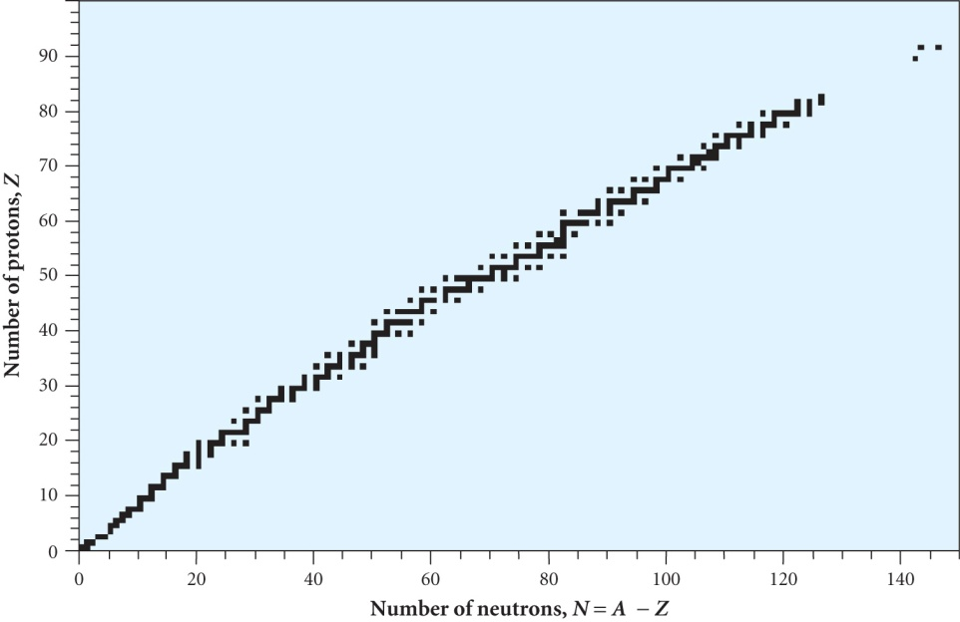
NUCLEAR STABILITY CURVE
Heavy nuclei contain more neutrons than protons
Nuclear forces are the same
Coulomb forces reduce the binding energy of protons
Radioactive nuclei lie outside the region of stability. A ‘parent’ decays to a ‘daughter’
Multiple decays may occur to reach the stable region

Slide 13
Example of the decay chain for ²³⁸U
This sequence concludes with the stable isotope ²⁰⁶Pb
Fission produces neutron rich products
e.g. ²³⁸U₁₄₆ / 2 ➔ ¹¹⁹Pd₇₃ (Asymmetry likely)
The only stable nucleus with A=119 is ¹¹⁹Sn₆₉
So several β⁻ decays are needed to reach stability

