Slide 1
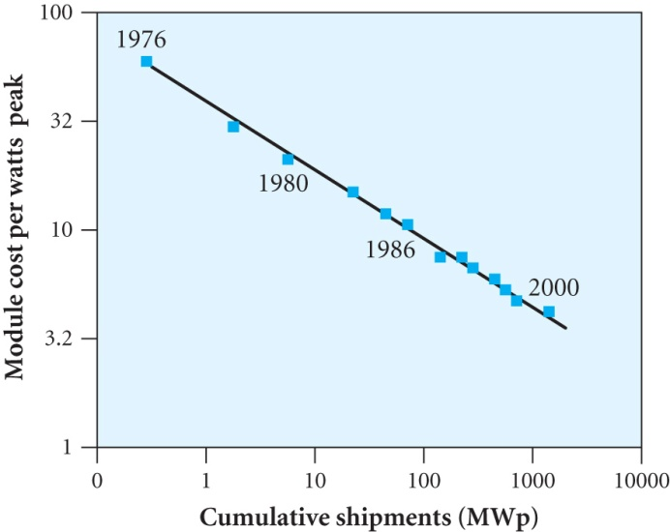
SOLAR PANELS
Example: 40 thin multicrystalline wafers, each of area 125cm² with V_{OC} = 0.6 V connected in series gives 24 V.
The 0.5 m² panel under 1000 Wm⁻² solar radiation gives ~ 75 W assuming 15% conversion efficiency
Under this illumination the output is termed the watts peak (Wp)
The cost of panels in terms of $ / Wp has
dropped since 1976 as the volume of
production has increased
The yearly output of a 1 kWp array is
numerically equal to the annual amount of
solar energy per sq m. ( produces 1 kW for intensity of 1 kWm⁻²)
Typically produces ~1800 kWh/y in southern California and 850 kWh/y in northern Germany so about 10 – 20% of peak output
Average British household uses ~ 3000 kWh /y and has a roof area of ~10 m² which could provide ~ 750 kWh / y from a ~1kWp array

Slide 2
Example: A solar panel consists of 40 silicon cells (each of area 0.01 m², V_{OC} = 0.6 V and FF = 0.7) in series. Under AM1.5 illumination J_{SC} for the panel is 400 A m⁻². Estimate the energy per year for a house in UK with 8 m² available assuming 750 kWh m⁻² y⁻¹ of solar radiation
AM 1.5 illumination gives 1 kW m⁻² wheras E_{s} = 750 kWh m⁻² y⁻¹
corresponds to a continuous illumination P_{inc} given by P_{inc} t = E_{s}
t= 8760 hours (1 y) so P_{inc} = 85.6 W m⁻²
J_{SC} ∝ to radiation so J_{SC} = 400 x (85.6 / 1000)= 34.2 A m⁻²
One panel has area 0.4 m² and V_{OC} = 40 x 0.6 = 24 V and the
short circuit current I_{SC} = J_{SC} x 0.01 = 0.342 A
With 8 m² of panels I_{SC} = 0.342 x 8 / 0.4 = 6.84A
Average power output P = FF (I_{SC} V_{OC}) = 0.7 x 6.84 x 24 = 115W
Energy per year = 8760 x 0.115 = 1007 kWh ~ 1 MWh
Solar panels are often used for battery storage. The voltage remains ~ constant during charging➔ close to max. power point over a good range of currents and hence solar intensities

Slide 3
ECONOMICS OF PHOTOVOLTAICS (PV)
Price per Wp has dropped to ~4$ / Wp in 2005
Factors depend on amount of sun and availability of the grid.
~$5000 per km to connect to the grid
Makes PV competitive for a house if > 2 km from the grid
Need either battery storage or a grid connection to which power can be inputted or extracted at night
The high cost of electricity in Japan has favoured solar power
Japan and Germany had 69% of PV market in 2004
 | Euro cents / kWh | Capital costs (euro/kWh
Coal | 4-9 | 1200
Gas | 3-5 | 550
Wind | 3-10 | 750-1000
Hydro | 3-14 | 900
Biomass | 7-20 | 1100
Solar PV | 25-30 | 5000-9000

Slide 4
ENVIRONMENTAL IMPACT AND OUTLOOK
Operation produces no pollutants, greenhouse gases.
There are no moving parts so no noise and visually unobtrusive
Cd and As are hazardous and used in production but quantities are small and there are safeguards
Production of panels requires energy. Energy payback times (EPBT) are estimated ~ 7 years ( cf 30 y lifetime) so if fossil fuels produce this energy the CO₂ emission is reduced by 7 / 30
Production of panels is estimated to rise to 3.26 GWp by 2010
Growth will eventually be limited by silicon production leading to increased prices and shortages
Thin film technologies will help
Shell have a scenario for future energy supplies in which solar power accounts for 15-20% by 2060

Slide 5
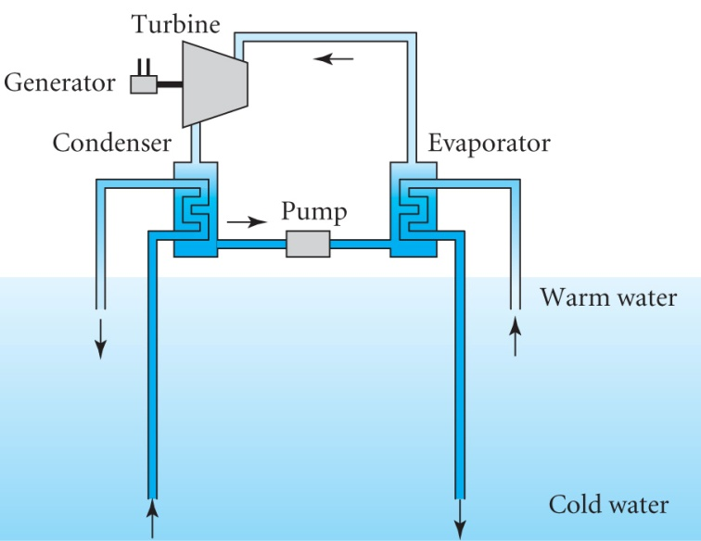
SOLAR THERMAL POWER PLANTS
Many methods have been devised. Here are three examples.
Ocean Thermal Energy Conversion (OTEC)
Oceans collect a huge amount of solar radiation in the top hundred metres where T ~ 20-25ºC higher than in the depths
~ 1 GW / km² falls on the sea but the
temperature difference is small so
η_{Carnot} = ΔT/T_{hot} is < 1%
If Q is the volume of water drawn up /s
heat flow P_{flow}= Q ρ C ΔT where ρ is the
density and C the specific heat capacity
Output P_{out} < η_{Carnot} P_{flow}= Q ρ C ΔT² / T_{hot}
For ΔT=20 C and P_{out} =1 MW we would need Q > 0.18m³ s⁻¹ (180 litres s⁻¹)
Needs large expensive equipment. Problems with bio-fouling.

Slide 6
Solar Driven Stirling Engines
The Stirling engine is a heat engine containing a gas sealed in a system of two cylinders connected together ( alpha type)
One cylinder is heated and the other is cooled so that the gas is alternatively heated and cooled and drives pistons in the cylinders
In 2005 a scheme to generate 500MW in California is based on setting up dishes each with 82 mirrors and an area of 90 m² to focus sunlight onto an area ~20 cm diameter on the hot side of a 25 kW Stirling engine.
The maximum temperature of the hydrogen gas was 720ºC and the conversion efficiency is close to 30%
The scheme will cover an area of ~ 11km x 11km
It is hoped that mass produced units would cost ~$50000 corresponding to ~ $2 per Watt
competitive with current solar panels

Slide 7
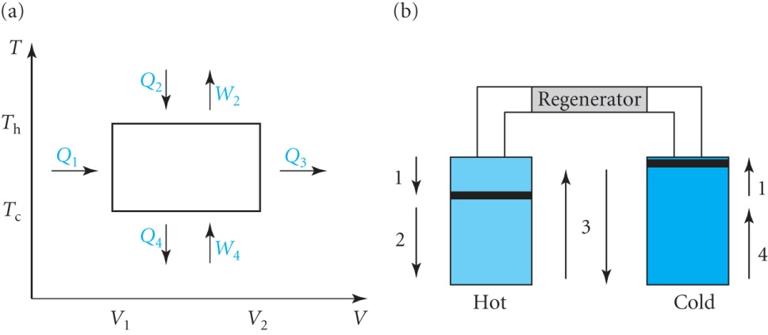
The Stirling Engine (alpha configuration)
Consider an ideal Stirling Engine containing an ideal gas
The two pistons are connected to
a crank with a 90º phase difference
The regenerator is a porous matrix that
acts as a temporary heat store or supply
Start position: LH piston at top and RH piston ~ 1/3 up
RH piston moves to top and LH piston moves down. Gas is pushed into hot cylinder at constant volume absorbing heat Q₁ from regenerator
Heat Q₂ absorbed from hot cylinder producing expansion of gas. Piston moves fully down doing work W₂ in isothermal process. Expansion also pushes the RH piston part way down. Gas attains its maximum volume.
Flywheel continues motion bringing RH piston to bottom and LH piston part way up. Gas moves into cold cylinder at constant volume giving up heat Q₃ to the regenerator
RH piston moves up compressing the gas doing work W₄ and heat Q₄ is given up to the cold cylinder isothermally

Slide 8
Analysis
The regenerator improves efficiency by recycling heat internally
For now assume Q₁ is provided externally and Q₃ is ‘lost’
For an ideal gas U≡(T) so ΔU = Q – W = 0 for isothermal changes
Define α = C_{V}/R (1.5 for monotomic gas and ~ 2.5 for diatomic) and assume 1 mole of gas
Q₁ = αNk(T_{h}-T_{c}) (isovolumetric change) assumed supplied
Q₂ = W₂ = NkT_{h} ln(V₂/V₁) isothermal expansion
Q₃ = = αNk(T_{h}-T_{c}) but assumed ‘lost’ for now
Q₄ = W₄=NkT_{c} ln(V₂/V₁) isothermal compression
Efficiency ε = (W₂ – W₄) / (Q₁ + Q₂)
= Nk(T_{h}-T_{c}) ln(V₂/V₁) /[αNk(T_{h}-T_{c}) + NkT_{h} ln(V₂/V₁)]
The efficiency of a Carnot engine would be ε_{C} = (T_{h} – T_{c}) / T_{h}
∴ ε = ε_{C} / [α ε_{C} / ln(V₂/V₁) + 1]

Slide 9
A perfect regenerator will have Q₁ = Q₃ and so recycling this heat with 100% efficiency means that the external heat supplied would be just Q₂
Hence the first term in denominator vanishes and the efficiency ε approaches the Carnot efficiency ε_{C}
In practice high efficiency requires a monotomic gas such as helium or hydrogen and a large volume ratio (V₂ / V₁)
Actual Stirling engines are more complicated thermodynamically but high efficiencies can be achieved
Solar Chimneys
Suitable for areas with strong solar radiation and where land is readily available
Warm air is produced under a large area of glass and is drawn up a high chimney driving a wind turbine
A prototype in Spain produced 50 kW using a collector 240m in diameter and a chimney 195m high and 10m in diameter

Slide 10
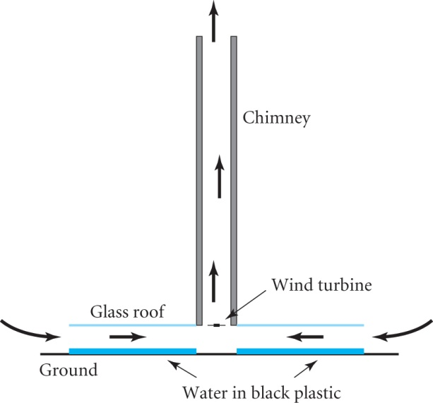
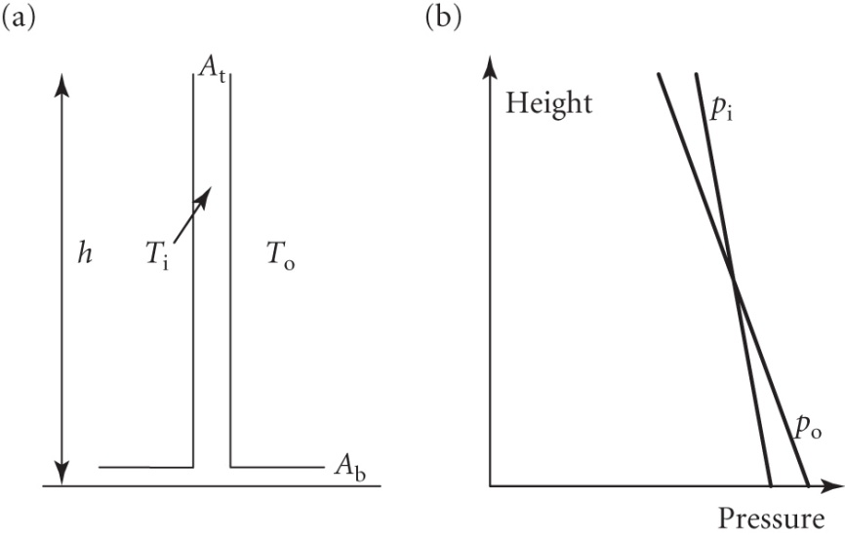
A large Australian project uses a tower 1000m high and 150m diameter with a collector of 5000m diameter
Black plastic pipes full of water
under the glass heat up during the
day so that the system continues to
produce power at night.
The design is for a power of 200 MW
The updraught depends on the height of the chimney
Assume the temperature in the
chimney is T_{i} and outside is T₀
Rate of change of pressure with
height is dp / dz = - ρ g
Inside the chimney Δp_{i} = h ρ_{i} g
Outside the chimney Δp₀ = h ρ₀ g

Slide 11
Since ρ ∝1/T we can write ρ_{i} = A/T_{i} and ρ₀ = A/T₀ . The difference is small compared to the average density ρ.
Hence the difference in pressure driving the air up the chimney is Δp = (ρ_{i} - ρ₀) g h = ρ(ΔT / T) g h (ρ and T are averages with ρ = A / T)
As shown p_{i} < p_{o} at the bottom of the chimney sucking air in and p_{i} < p_{o} at the top expelling the air (p_{i} = p_{o} half way up)
Conservation of mass gives u₂ = u₁ A₁ / A₂ (A₁ >> A₂)
Estimate the flow using the Bernoulli theorem
Δp = ½ ρ (u₂²-u₁²) ≈ ½ ρ u₂²
Some energy will be lost by turbulence so write
u₂ =C_{T}{2Δp/ ρ} ^{½} = C_{T} {2(ΔT / T)gh } ^{½} where the constant C_{T} < 1
The power of a wind turbine is given by P = ½ ε A ρ u³ (7.9) where C_{P} has been replaced by an overall efficiency ε
Taking ρ = 1.25 kgm⁻³, C_{T}=0.8, ε =0.4 for the Spanish prototype with D=10m and h = 195m, ΔT =20K and T=300K gives
A = 78.5 m², u = 12.8 m s⁻¹ and ➔ P ~ 40kW

