Slide 1
COMMERCIAL SOLAR CELLS
Currently most cells today are crystalline but thin film cells are being developed to reduce cost
Crystalline Silicon Cells
Can be single or polycrystalline cells
Single cells are formed by sawing 200-400μm wafers from a silicon crystal ingot --- expensive
Can use ingots of polycrystalline silicon which are cheaper but less efficient, or to avoid losses due to sawing make polycrystalline silicon in the form of a ribbon
The 200-400μm thickness is determined by the need to capture most of the sunlight.
To use thinner (50 μm) layers requires light trapping techniques but reduces the amount of material and so reduces the cost

Slide 2
Thin Film Cells
Materials with good light absorption include GaAs, CdTe, CuInGaSe₂ (CIGS) and amorphous hydrogenated silicon (a-Si:H)
All these films only need to be ~ 1μm thick
Materials are only part of the cost and the challenge is to develop techniques for fast deposition while maintaining the film quality
Cells with areas ~ 1 m² generally have more imperfections and less efficiency than ~1 cm² devices
GaAs
E_{gap} = 1.4 eV, close to optimal, and it can withstand high temperatures as E_{gap} is sufficiently large to keep thermal excitations small
The active region is grown epitaxially on a very thin GaAs single crystal layer -- Expensive so only small area cells have been made
Concentrators can focus radiation onto an active cell increasing the flux by ~100 times
The other materials can be made into large area cells

Slide 3
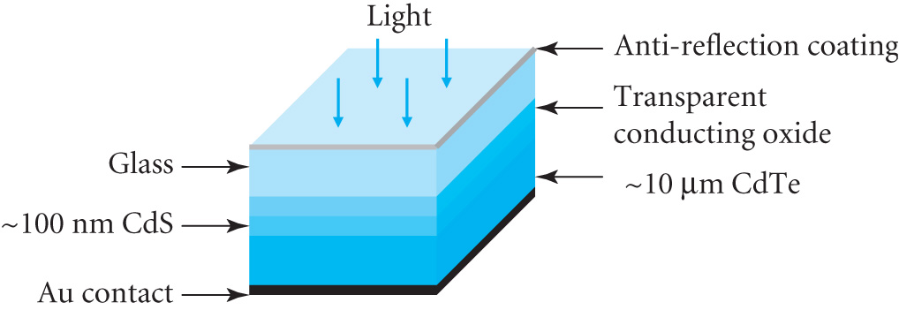
CdTe solar cell
Fabricated on a thin (2 – 4 mm)
sheet of glass (normally coated)
A transparent conducting oxide
(tin or indium tin) provides good electrical contact to the thin
polycrystalline CdS layer which is n-doped
CdS has E_{gap} ~ 2.4 eV and it is transparent down to λ ~ 500nm
CdTe is polycrystalline and is p-doped with E_{gap} ~ 1.5 eV
CdTe is less doped than the CdS so most of the depletion layer lies in the CdTe and is ~ 10 μm thick
An aluminium or gold contact makes contact with the CdTe layer
This is a heterojunction as the n and p layers are in different semiconductors
Has shown good performance but also instabilities due to difficulty making a good contact to the CdTe layer

Slide 4
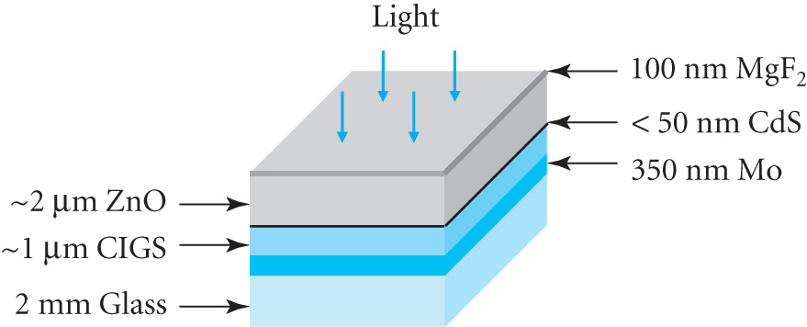
CIGS Solar Cells
A molybdenum contact layer is
sputtered on to a glass substrate
followed by the CIGS p-type
layer (1.2 μm)
A compound (InGa)₂Se₃ is first deposited. This layer is then reacted with Cu and Se, followed by In and Ga evaporation in the presence of Se.
Can give a material in which E_{gap} varies with depth (later)
Thin layers with uniform E_{gap} can be made by simultaneous deposition of all elements
The n-type CdS layer is added to form the heterojunction and the ZnO layer provides the transparent contact with the 100 nm MgF₂ layer providing the anti-reflection coating

Slide 5
The band gap E_{gap} can be varied between 1.1 and 1.2 eV by altering the ratio of In to Ga
For a small area device with E_{gap} =1.2 eV illuminated under AM1.5 (1 kW m⁻²) the following values are obtained
J_{SC} = 34.6 mA cm⁻²
J_{S} = 5 10⁻⁸ mA cm⁻²
FF = 79.7%
Conversion efficiency = 19.3%
Large area modules have been made with efficiencies ~ 12%
The technology is less developed than for a-Si cells but it has great potential

Slide 6
Amorphous silicon solar cells
The first amorphous silicon cell was made in 1976
Amorphous silicon, a-Si, is produced by electrically decomposing silane, SiH₄, with a small amount of boron dopant
The hydrogen provides additional electrons that combine with dangling bonds in a-Si producing an intrinsic semiconductor a-Si:H
This silicon – hydrogen alloy has 5-20 (atomic)% of hydrogen and a resulting band gap E_{gap} ~ 1.7 eV
The disordered arrangement of atoms together with the hydrogen gives high optical absorption
So only a 1 μm thick layer is required

Slide 7
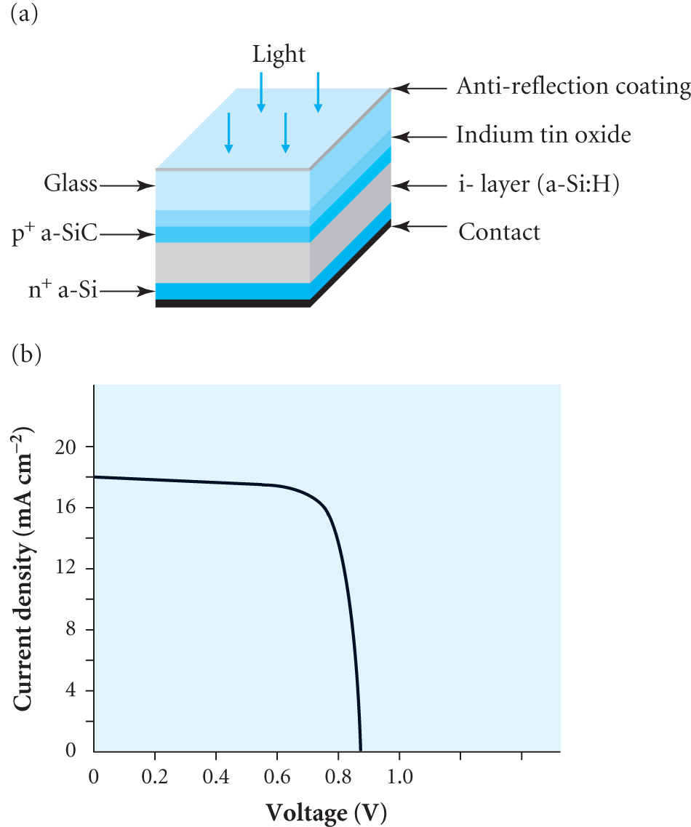
The cell is built on a glass substrate
with transparent indium tin oxide
providing the electrical contact to the
p-doped hydrogenate amorphous SiC
layer
The SiC has a larger E_{gap} than a-Si
allowing a larger fraction of solar
radiation through to the a-Si:H layer
Below the a-Si:H layer there is an
n-doped region with contact layer
Most of the e-h pairs are produced in
the a-Si:H region and holes flow to the p-region and electrons to the
n-region
The layers form a p-i-n junction with i being the a-Si:H

Slide 8
A problem is that the efficiency decreases under illumination due to the creation of metastable states
Diluting silane with hydrogen and optimising growth conditions can limit this decrease to 20%
Large area devices have been produced with long term efficiencies ~ 7%
By changing the deposition conditions good quality multicrystalline (mc) films can also be produced
It is necessary to improve the light absorption in the thin mc-Si layers
‘Light trapping’ for the thin mc-Si layer is useful in increasing the light path by ~ 4n² ~50 since n = 3.5 for silicon
Enables even a thin (~ 10μm) layer of mc-Si to be used
The efficiency can also be increased by making multi layer devices consisting of several p-i-n junctions

Slide 9
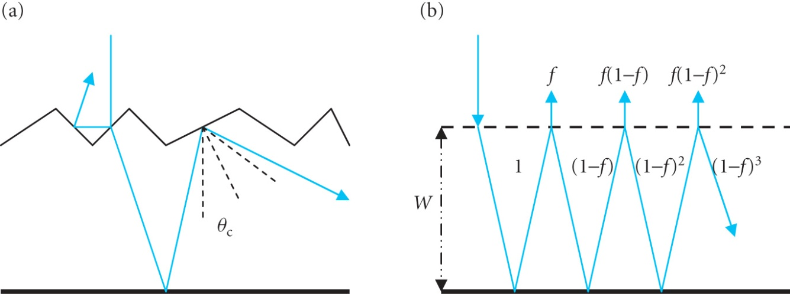
LIGHT TRAPPING IN THIN FILMS
The front surface of the
silicon is textured and the
rear is reflective
Light can make two
reflections at the top
surface which will reduce the overall amount reflected
Once inside only light within the critical angle θ_{c} = sin⁻¹(1 / n) will escape {n = 3.5 so θ_{c} = 16.6º}
The top surface acts as a diffuser and the intensity per unit solid angle is given by Lambert’s Law B(θ) = (I₀ / π) cosθ where I₀ is the incident intensity
After each reflection a fraction f of the light escapes

Slide 10
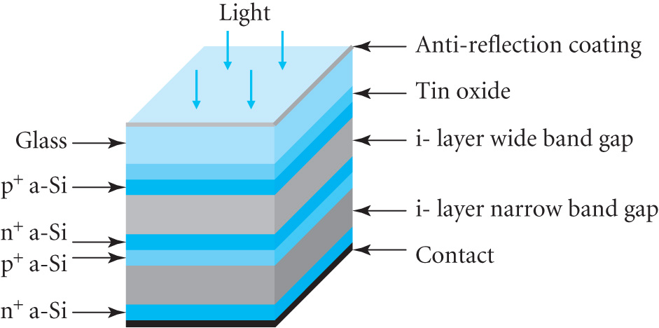
The mean light path between reflections off the back surface is
where W is the thickness of the layer. The range of angles allows for the diffusion from the front surface
The mean path P = 4W[ 1 + (1-f) + (1-f)² + (1-f)³ +…] = 4W / f
∴ P = 4n²W
Multilayer thin film cells
Example shown is a 2 layer cell
layers have different E_{gap} to
access different parts of the
solar spectrum

Slide 11
A wide gap material absorbs higher energy photons while the lower energy photons are absorbed in the second layer
e.g. a-Si:H and a-SiGe:H (E_{gap} = 1.7 &1.1 eV) layers in series so the current is limited to the layer producing the smallest current
4 layer devices have a theoretical efficiency > 50%
Example: Consider a 2 layer cell with band gaps = 1.7 eV & 1.1 eV
j_{L} = 19 mA cm⁻² for photons between 1.1 and 1.7 eV and 21.3 mA cm⁻²
for photons > 1.7 eV. Compare power output to that of a simple Si cell
(E_{gap}=1.1 eV). Assume V_{OC} = V_{g} – 0.4V for each layer and FF = 0.8
The cells are in series so I_{SC} = 19 mA cm⁻² as this is the smaller value
and V_{OC} =(1.1-0.4) + (1.7-0.4) = 2.0 V
Power P_{m} = FF I_{SC} V_{OC} = 0.8 x 19 x 2 = 30.4 mW cm⁻²
The single cell has I_{SC} = 19 + 21.3 = 40.3 mA cm⁻² (i.e. The total for energies >1.1 eV)
and V_{OC}=1.1-0.4=0.7V giving power P_{m}= 0.8x40.3x0.7 = 22.6 mWcm⁻²

Slide 12
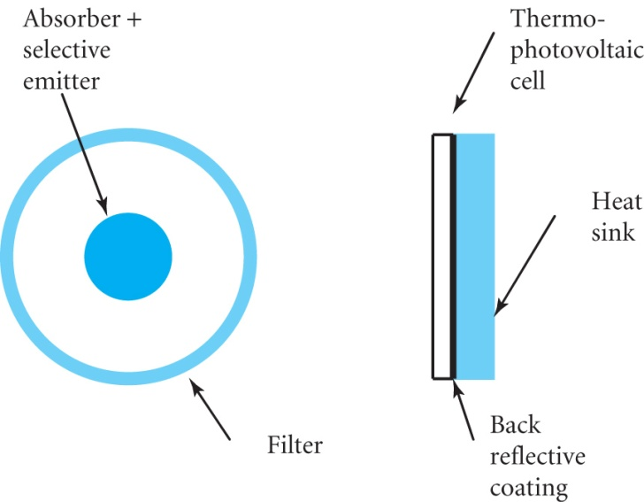
DEVELOPING TECHNOLOGIES
Electrochemical cells
TiO₂ nanoparticles (~20 nm diameter) are coated with dye in an electrolyte.
Dye absorbs light producing e-h pairs. Electrons go into the conduction
band of the TiO₂ and diffuse to a transparent conductive substrate.
Holes are filled from –ve ions in the electrolyte.
~11% efficiencies in the lab.
Thermo-voltaic cells
An intermediate absorber re-emits the
solar energy as thermal radiation
reducing the mean photon energy
from ~ 1.8 eV to 0.45 eV
GaSb & Ge have E_{gap} = 0.72 and 0.66 eV
Predicted efficiency for GaSb is ~25%
Also concentrators and organic semiconductor cells developments

